Slide 1
Section 5.R.3
Solving One-Step Linear Equations

Slide 2
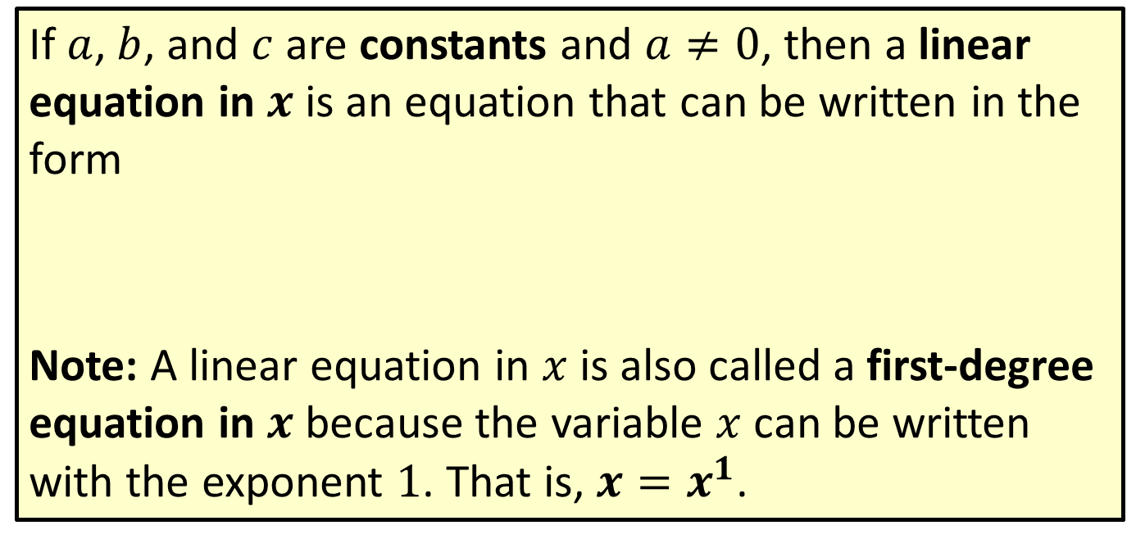

Definition: Linear Equation in $x$
If $a$, $b$, and $c$ are constants and $a≠0$, then a linear equation in $x$ is an equation that can be written in the form
Note: A linear equation in $x$ is also called a first-degree equation in $x$ because the variable $x$ can be written with the exponent 1. That is, $x=x^{1}$.

Slide 3
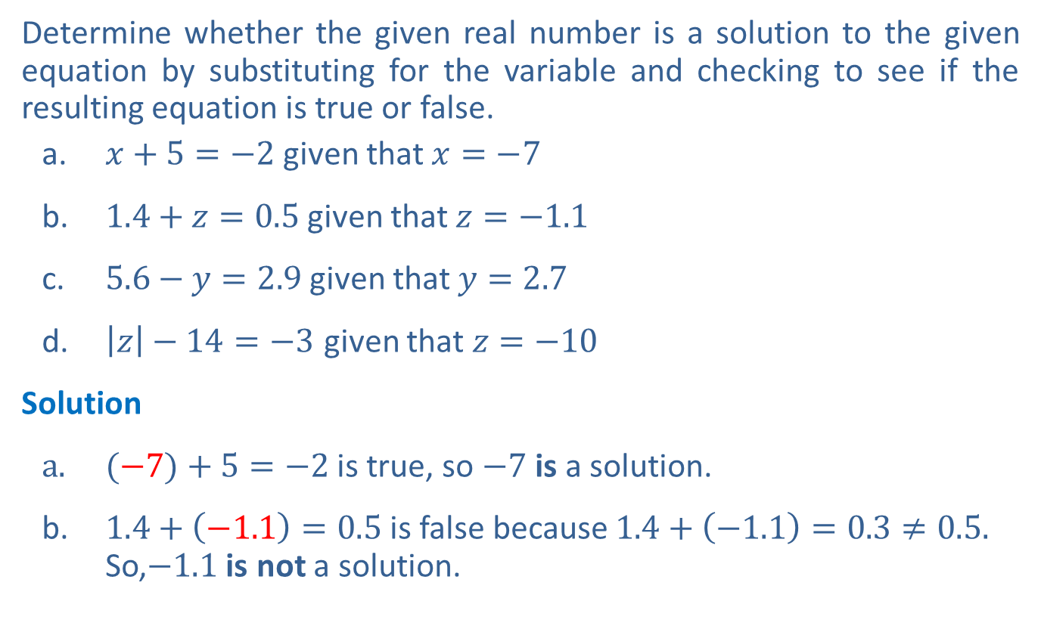
Example 1: Checking Given Solutions in Equations
Determine whether the given real number is a solution to the given equation by substituting for the variable and checking to see if the resulting equation is true or false.
  ​$x+5=−2$ given that $x=−7$
​$1.4+z=0.5$ given that $z=−1.1$
​$5.6−y=2.9$ given that $y=2.7$
​$\left|z\right|−14=−3$ given that $z=−10$
Solution
$(−7)+5=−2$ is true, so $−7$is a solution.
​$1.4+\left(−1.1\right)=0.5$is false because $1.4+\left(−1.1\right)=0.3≠0.5.$ So,$−1.1$is not a solution.

Slide 4

Example 1: Checking Given Solutions in Equations (cont.)
​$5.6−(2.7)=2.9$ is true, so $2.7$is a solution.
​$\left|−10\right|−14=−3$ is false because $\left|−10\right| −14=−4≠−3.$
So, $−10$ is not a solution.

Slide 5
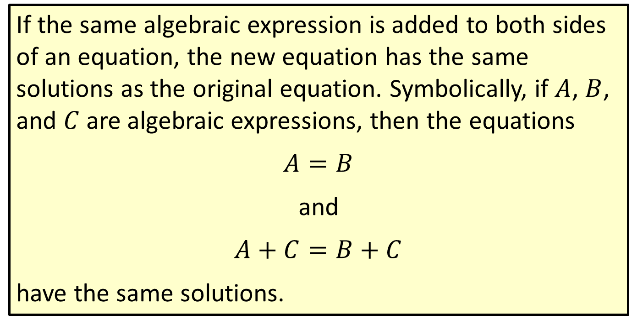
Properties: Addition Principle of Equality
If the same algebraic expression is added to both sides of an equation, the new equation has the same solutions as the original equation. Symbolically, if $A$, $B$, and $C$ are algebraic expressions, then the equations
$$A=B$$
and
$$A+C=B+C$$
have the same solutions.

Slide 6
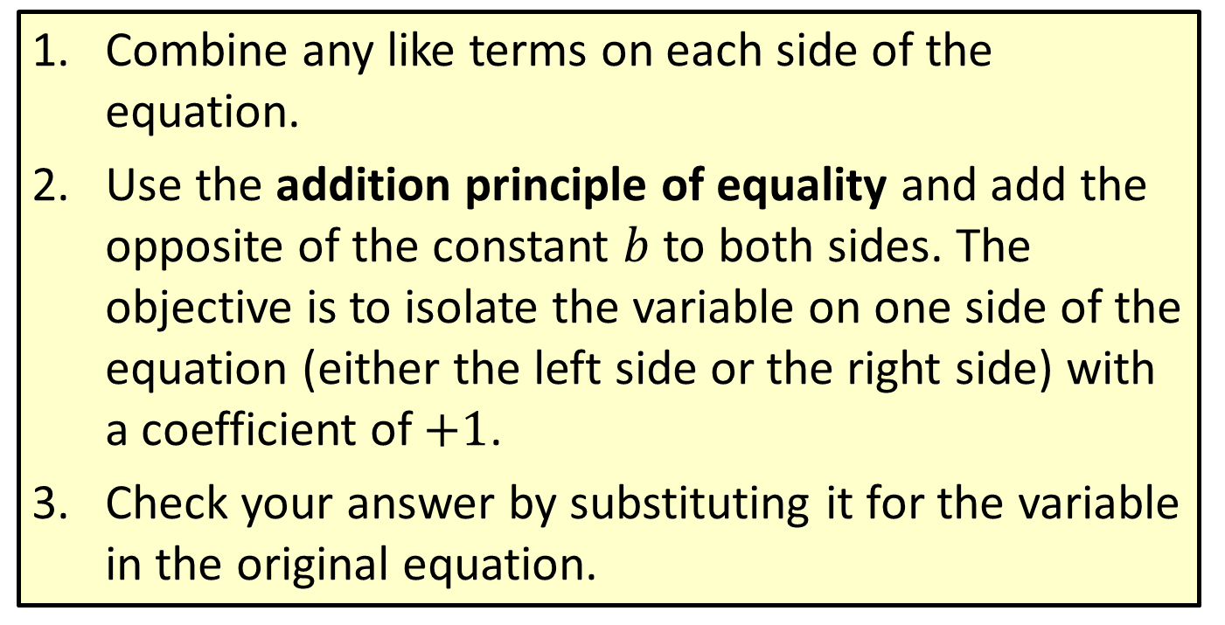

Procedure: Solving Linear Equations that Simplify to the Form $x+b=c$
​Combine any like terms on each side of the equation.
​Use the addition principle of equality and add the opposite of the constant $b$ to both sides. The objective is to isolate the variable on one side of the equation (either the left side or the right side) with a coefficient of $+1$.
​Check your answer by substituting it for the variable in the original equation.

Slide 7


Example 2: Solving Linear Equations of the Form
$$x+b=c$$
Solve the equation: $x−3=7$
Solution
Check

Slide 8


Example 3: Solving Linear Equations of the Form
$x+b=c$
Solve the equation: $−11=y+5$
Solution

Slide 9


Example 4: Solving Linear Equations of the Form
$$x+b=c$$
Solve the equation: $−4.1+x=0$
Solution

Slide 10


Example 5: Solving Linear Equations of the Form
$$x+b=c$$
Solve the equation: $x−\frac{2}{5}=\frac{3}{10}$
Solution

Slide 11

Example 5: Solving Linear Equations of the Form
$x+b=c$ (cont.)
Check

Slide 12

Example 6: Simplifying and Solving Linear Equations
Simplify and solve: $3z−2z+2=3+8$
Solution

Slide 13
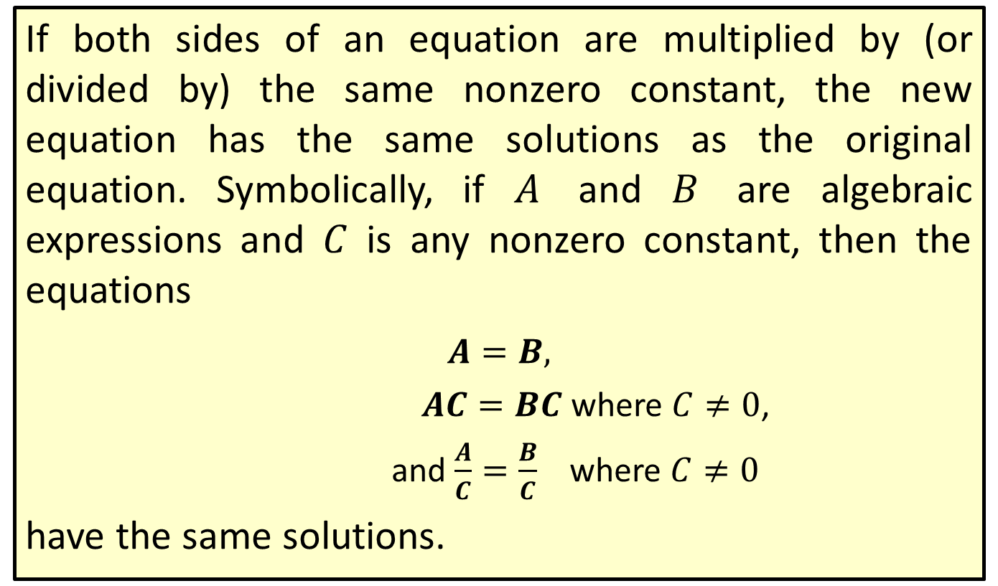
Properties: Multiplication (or Division) Principle of Equality
If both sides of an equation are multiplied by (or divided by) the same nonzero constant, the new equation has the same solutions as the original equation. Symbolically, if $A$ and $B$ are algebraic expressions and $C$ is any nonzero constant, then the equations
​$A=B,$
$AC=BC$ where $C≠0$,
and $\frac{A}{C}=\frac{B}{C}$ where $C≠0$
have the same solutions.

Slide 14
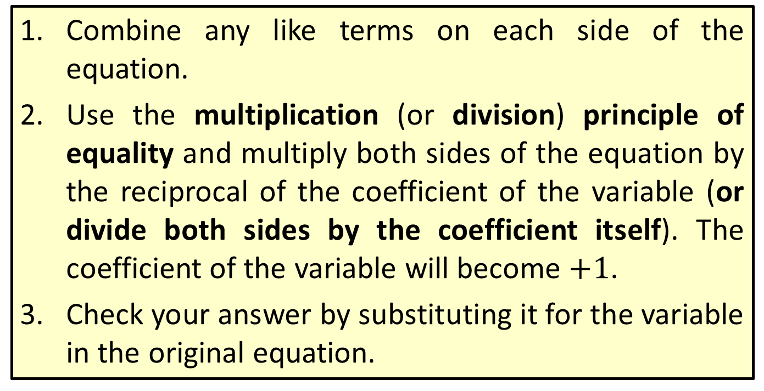

Procedure: Solving Linear Equations that Simplify to the Form $ax=c$
​Combine any like terms on each side of the equation.
​Use the multiplication (or division) principle of equality and multiply both sides of the equation by the reciprocal of the coefficient of the variable (or divide both sides by the coefficient itself). The coefficient of the variable will become $+1$.
​Check your answer by substituting it for the variable in the original equation.

Slide 15
Example 7: Simplifying and Solving Linear Equations
Supply the reasons for each step in solving the equation.
Solution

Slide 16
Example 7: Simplifying and Solving Linear Equations (cont.)
Supply the reasons for each step in solving the equation.
Solution

Slide 17


Example 8: Solving Linear Equations of the Form
$$ax=c$$
Solve the linear equation: $5x=20$
Solution
Check
?

Slide 18


Example 8: Solving Linear Equations of the Form
$ax=c$ (cont.)
Multiplying by the reciprocal of the coefficient is the same as dividing by the coefficient itself. So, we can multiply both sides by as we did, or we can
divide both sides by 5. In either case, the coefficient of becomes +1.
$$x$$

Slide 19


Example 9: Solving Linear Equations of the Form
$$ax=c$$
Solve the linear equation: $1.1x+0.2x=12.2−3.1$
Solution
When decimal coefficients or constants are involved, you might want to use a calculator to perform some of the arithmetic.
Check
?
?

Slide 20


Example 10: Solving Linear Equations of the Form
$$ax=c$$
Solve the linear equation: $−x=4$
Solution
Check

Slide 21

Example 11: Solving Linear Equations of the Form $ax=c$
Supply the reasons for each step in solving the following equation.
Solution

Slide 22

Example 11: Solving Linear Equations of the Form $ax=c$(cont.)
Supply the reasons for each step in solving the following equation.
Solution

Slide 23
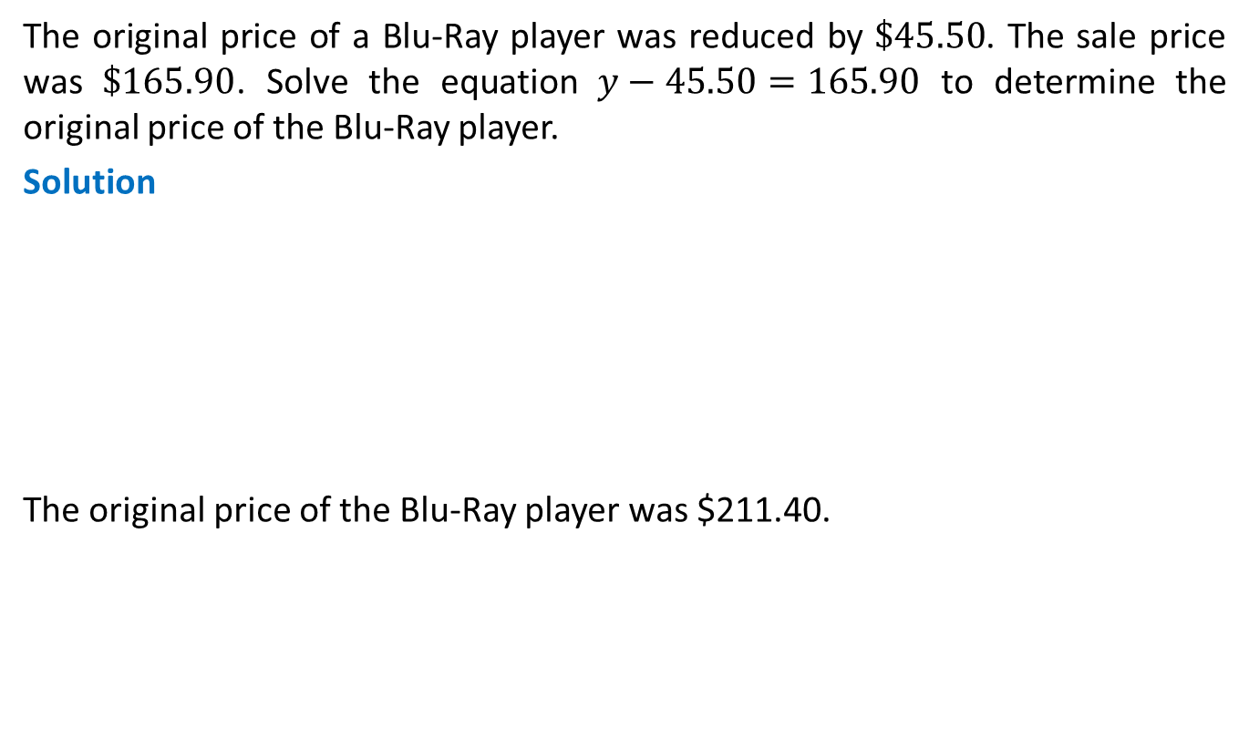
Example 12: Application: Solving Linear Equations
The original price of a Blu-Ray player was reduced by $\$45.50$. The sale price was $\$165.90$. Solve the equation $y−45.50=165.90$ to determine the original price of the Blu-Ray player.
Solution
The original price of the Blu-Ray player was $211.40.

