Slide 1
Section 5.R.4
Solving Multi-Step Linear Equations

Slide 2
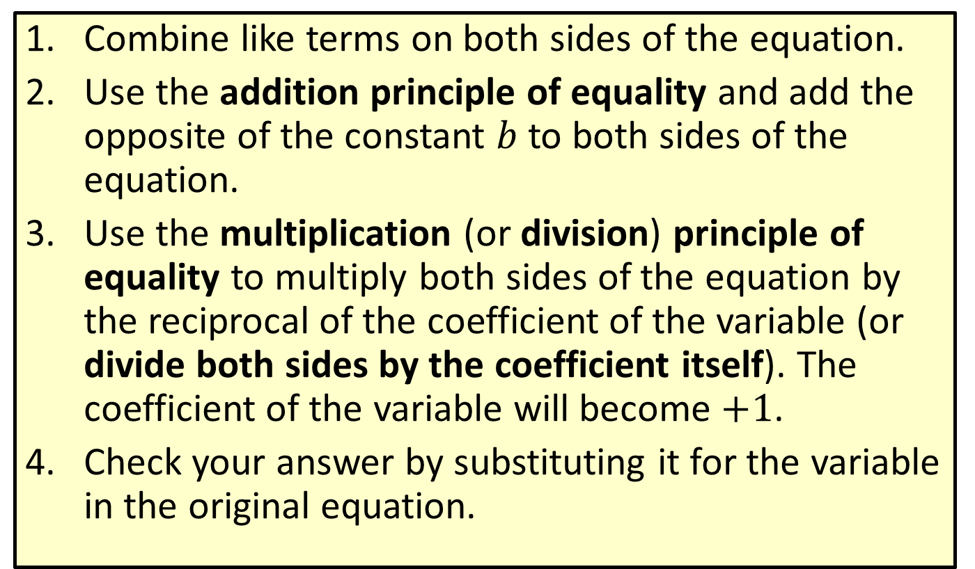

Procedure: Solving Linear Equations that Simplify to the Form $ax+b=c$
​Combine like terms on both sides of the equation.
​Use the addition principle of equality and add the opposite of the constant $b$ to both sides of the equation.
​Use the multiplication (or division) principle of equality to multiply both sides of the equation by the reciprocal of the coefficient of the variable (or divide both sides by the coefficient itself). The coefficient of the variable will become $+1$.
​Check your answer by substituting it for the variable in the original equation.

Slide 3


Example 1: Solving Linear Equations of the Form $$ax+b=c$$
Solve the equation: $3x+3=−18$
Solution
Check
?
?

Slide 4


Example 2: Solving Linear Equations of the Form $ax+b=c$
Solve the equation: $−26=2y−14−4y$
Solution
Check
?
?

Slide 5

Example 3: Solving Linear Equations Involving Decimals
Solve the equation: $16.53−18.2z−6.23=1.2$
Solution

Slide 6
Example 3: Solving Linear Equations Involving Decimals (cont.)
Check
?
?

Slide 7

Example 4: Solving Linear Equations Involving Fractions
Solve the equation: $\frac{5}{6}x−\frac{5}{2}=−\frac{10}{9}$
Solution

Slide 8
Example 4: Solving Linear Equations Involving Fractions (cont.)

Slide 9
Example 4: Solving Linear Equations Involving Fractions (cont.)
Check
?
?

Slide 10
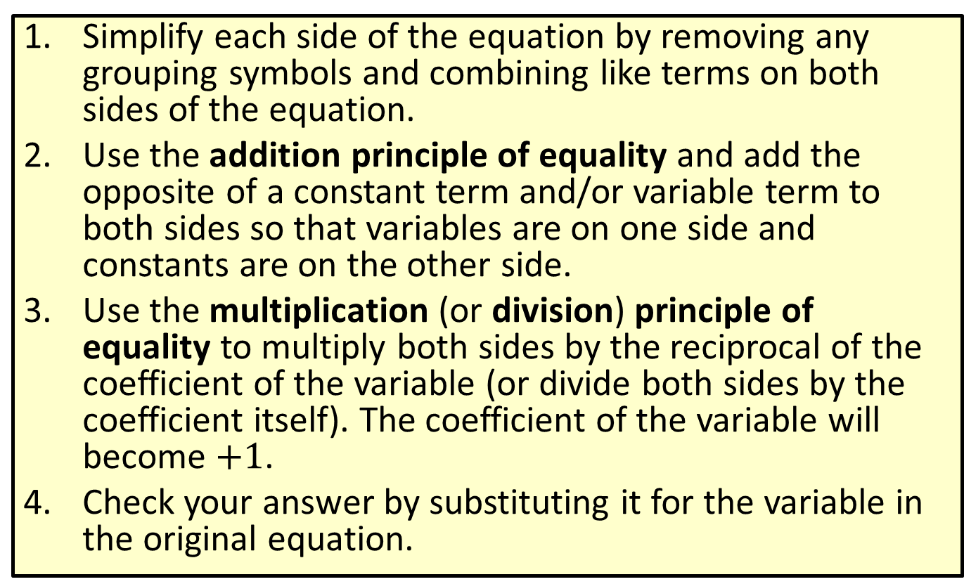

Procedure: Solving Linear Equations that Simplify to the Form $ax+b=cx+d$
​Simplify each side of the equation by removing any grouping symbols and combining like terms on both sides of the equation.
​Use the addition principle of equality and add the opposite of a constant term and/or variable term to both sides so that variables are on one side and constants are on the other side.
​Use the multiplication (or division) principle of equality to multiply both sides by the reciprocal of the coefficient of the variable (or divide both sides by the coefficient itself). The coefficient of the variable will become $+1$.
​Check your answer by substituting it for the variable in the original equation.

Slide 11


Example 5: Solving Equations of the Form $$ax+b=cx+d$$
Solve the equation: $5x+3=2x−18$
Solution

Slide 12

Example 5: Solving Equations of the Form $ax+b=cx+d$ (cont.)
Check
?
?

Slide 13


Example 6: Solving Equations of the Form $ax+b=cx+d$
Solve the equation: $4x+1−x=2x−13+5$
Solution

Slide 14

Example 6: Solving Equations of the Form $ax+b=cx+d$ (cont.)
Check
?
?

Slide 15

Example 7: Solving Linear Equations Involving Decimals
Solve the equation: $6y+2.5=7y−3.6$
Solution

Slide 16
Example 7: Solving Linear Equations Involving Decimals (cont.)
Check
?
?

Slide 17

Example 8: Solving Linear Equations Involving Fractions
Solve the equation: $\frac{1}{3}x+\frac{13}{15}=\frac{3}{5}x−1$
Solution

Slide 18
Example 8: Solving Linear Equations Involving Fractions (cont.)

Slide 19

Example 9: Solving Equations Involving Parentheses
Solve the equation: $−2\left(5x+13\right)−2=−6\left(3x−2\right)−41$
Solution

Slide 20
Three Types of Equations
Type of Equation | Number of Solutions
Conditional | Finite number of solutions
Identity | Infinite number of solutions
Contradiction | No solution

Slide 21
Example 10: Solving Equations Involving Parentheses
Solve the equation:
Solution

Slide 22
Example 10: Solving Equations Involving Parentheses (cont.)
Solve the equation:
Solution

Slide 23

Example 11: Determining Types of Equations
Determine whether the equation $3\left(x+5\right)+1=−11$ is a conditional equation, an identity, or a contradiction.
Solution
The equation has one solution. Therefore, it is a conditional equation.

Slide 24

Example 12: Determining Types of Equations
Determine whether the equation $3\left(x−25\right)+3x=6\left(x+10\right)$ is a conditional equation, an identity, or a contradiction.
Solution
The last equation is never true. Therefore, the original equation is a contradiction and has no solution.

Slide 25

Example 13: Determining Types of Equations
Determine whether the following equation is a conditional equation, an identity, or a contradiction.$−2\left(x−7\right)+x=14−x$
Solution
The last equation is always true. Therefore, the original equation is an identity and had an infinite number of solutions. Every real number is a solution.

