Slide 1
Section 5.R.5
Solving Linear Inequalities

Slide 2
Note
The symbol for infinity, (or ) is not a number. It is used to indicate that the interval is to include all real numbers from some point on (either in the positive direction or the negative direction) without end.

Slide 3
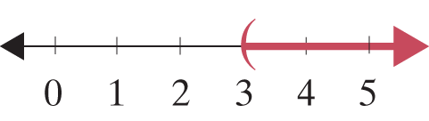
Example 1: Graphing Intervals
Graph the open interval
Solution

Slide 4
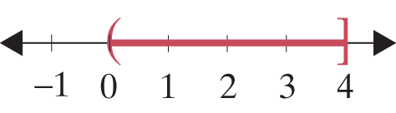
Example 2: Graphing Intervals
Graph the half-open interval 0 < x ≤ 4.
Solution

Slide 5
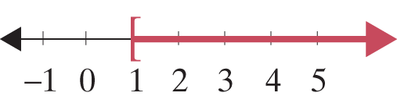
Example 3: Graphing Intervals
Represent the following graph using algebraic notation, and state what kind of interval it is.
Solution
x ≥ 1 is a half-open interval.

Slide 6
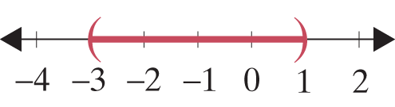
Example 4: Graphing Intervals
Represent the following graph using interval notation, and state what kind of interval it is.
Solution
(−3, 1) is an open interval.

Slide 7
Attention!
Any principle or rule stated for inequalities with the < symbol holds true for ≤, >, and ≥ as well.

Slide 8
Properties: Addition Principle for Solving Linear Inequalities
If A and B are algebraic expressions and C is a real number, then the inequalities
A < B
and
A + C < B + C
are equivalent.
(If a real number is added to both sides of an inequality, the new inequality is equivalent to the original.)

Slide 9

Example 5: Solving an Inequality and Graphing the Solution Set
Solve the inequality y − 3.2 ≥ 5.6 and graph the solution set. Write the solution set using interval notation.
Solution
y − 3.2 ≥ 5.6
y − 3.2 + 3.2 ≥ 5.6 + 3.2
y ≥ 8.8
y is in [8.8, ∞).

Slide 10
Example 6: Solving an Inequality and Graphing the Solution Set
Solve the inequality and graph the solution set. Write the solution set using interval notation.
Solution

Slide 11

Example 6: Solving an Inequality and Graphing the Solution Set (cont.)

Slide 12
Properties: Multiplication Principle for Solving Linear Inequalities
If A and B are algebraic expressions and C is a positive real number, then the inequalities
A < B
and
AC < BC
are equivalent.
If A and B are algebraic expressions and C is a negative real number, then the inequalities

Slide 13
Properties: Multiplication Principle for Solving Linear Inequalities (cont.)
A < B
and
AC > BC
are equivalent.
(In other words, if both sides are multiplied by a negative number, then the sense of the inequality is reversed.)

Slide 14

Example 7: Solving an Inequality and Graphing the Solution Set
Solve the inequality 5x > 15 and graph the solution set. Write the solution set using interval notation.
Solution
x is in (3, ∞).

Slide 15

Example 8: Solving an Inequality and Graphing the Solution Set
Solve the inequality −3x ≤ 12.3 and graph the solution set. Write the solution set using interval notation.
Solution
x is in [−4.1, ∞).

Slide 16
Procedure: Steps for Solving Linear Inequalities
Combine like terms on each side of the inequality symbol.
Use the addition principle of inequality to add the opposites of constants or variable expressions to both sides so that constants are on one side and variables on the other.

Slide 17
Procedure: Steps for Solving Linear Inequalities (cont.)
Use the multiplication (or division) principle of inequality to multiply (or divide) both sides by the coefficient of the variable so that the new coefficient is +1. If this coefficient is negative, be sure to reverse the sense of the inequality.

Slide 18
Procedure: Steps for Solving Linear Inequalities (cont.)
A quick (and generally satisfactory) check is to select any one number in your solution set and substitute it into the original inequality. If the statement is false, you need to look for an error in your solution.

Slide 19
Example 9: Solving Linear Inequalities
Solve the inequality and graph the solution set. Write the solution set using interval notation. Solution

Slide 20
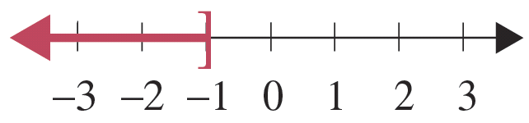
Example 9: Solving Linear Inequalities (cont.)
x is in (−∞, −1].
Check
As a check, pick a number in the solution interval and substitute it into the original inequality. For example, choose −3 and substitute it for x.

Slide 21
Example 9: Solving Linear Inequalities (cont.)
Note that not every number in the interval can be checked, but a true result, as shown here, does give some confidence in the solution interval.

Slide 22
Example 10: Solving Linear Inequalities
Solve the linear inequality and graph the solution set. Write the solution set using interval notation.
Solution

Slide 23
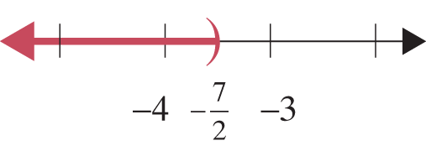
Example 10: Solving Linear Inequalities (cont.)

Slide 24
Example 11: Solving Linear Inequalities
Solve the linear inequality and graph the solution set. Write the solution set using interval notation.
Solution

Slide 25
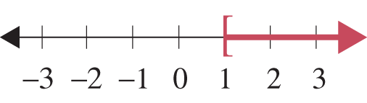
Example 11: Solving Linear Inequalities (cont.)

Slide 26
Completion Example 12: Solving Linear Inequalities
Supply the reasons for each step in solving the linear inequality and graph the solution set. Write the solution set using interval notation.
Solution

Slide 27
Completion Example 12: Solving Linear Inequalities (cont.)
Add −2x to both sides.
Simplify.
Add 7 to both sides.
Simplify.
Divide both sides by 2.
Simplify.

Slide 28
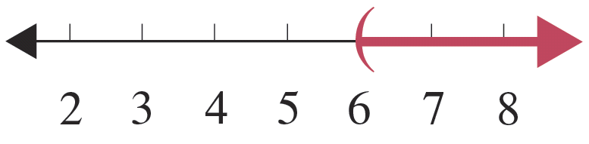
Completion Example 12: Solving Linear Inequalities (cont.)
Graph the interval on a number line.
x is in _______

Slide 29
Example 13: Application: Using Inequalities
A math student has grades of 85, 98, 93, and 90 on four examinations. If he must average 90 or better to receive an A for the course, what scores can he receive on the final exam and earn an A? (Assume that the final exam counts the same as the other exams.)
Solution
Let x = score on final exam.
The average is found by adding the scores and dividing by 5.

Slide 30
Example 13: Application: Using Inequalities (cont.)
If the student scores 84 or more on the final exam, he will average 90 or more and receive an A in math.

Slide 31
Example 14: Application: Using Inequalities
Ellen is going to buy 30 stamps, some 34-cent and some 49-cent. If she has $11.40, what is the maximum number of 49-cent stamps she can buy?
Solution
Let x = number of 49-cent stamps,
then 30 − x = number of 34-cent stamps.
Ellen cannot spend more than $11.40.

Slide 32

Example 14: Application: Using Inequalities (cont.)
Ellen can buy at most eight 49-cent stamps if she buys a total of 30 stamps.

