Slide 1
Section 5.R.8
Graphing Linear Equations in
Two Variables

Slide 2
Definition: Standard Form of a Linear Equation
Any equation of the form
Ax + By = C,
where A, B, and C are real numbers and A and B are
not both equal to 0, is called the standard form of a
linear equation.

Slide 3
Note
Note that in the standard form Ax + By = C, A and B
may be positive, negative, or 0, but A and B cannot
both equal 0.

Slide 4
Procedure: To Graph a Linear Equation in Two Variables
Locate any two points that satisfy the equation. (Choose values for x and y that lead to values that are easily calculated for the other variable. Remember that there are an infinite number of choices for either x or y. Once a value for x or y is chosen, the corresponding value for the other variable is found by substituting into the equation.)
Plot these two points on a Cartesian coordinate system.

Slide 5
Procedure: To Graph a Linear Equation in Two Variables (cont.)
Draw a line through these two points. (Note: Every point on that line will satisfy the equation.)
To check: Locate a third point that satisfies the equation and check to see that it does indeed lie on the line.

Slide 6
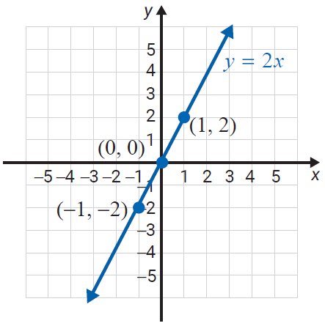
Example 1: Graphing a Linear Equation in
Two Variables
Graph:
Solution
Substitute −1, 0, and 1 for x.
x y = 2x y
−1
y = 2(−1)
−2
0
y = 2(0)
0
1
y = 2(1)
2

Slide 7
Example 2: Graphing a Linear Equation in
Two Variables
Graph:
Solution
Make a table with headings x and y and, whenever possible, choose values for x or y that lead to values that are easily calculated for the other variable. (Values chosen for x and y are colored and bolded.)

Slide 8
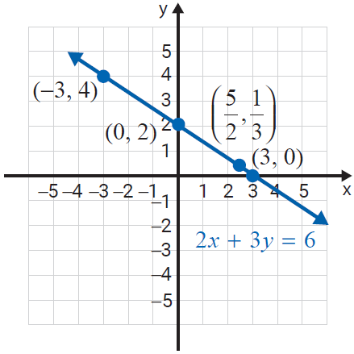
Example 2: Graphing a Linear Equation in
Two Variables (cont.)
x | 2x + 3y = 6 | y
0
2(0) + 3y = 6
2
−3
2(−3) + 3y = 6
4
3
2x + 3(0) = 6
0

Slide 9
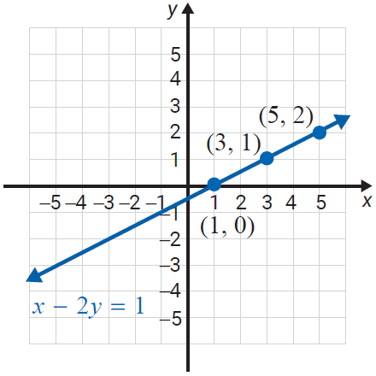
Example 3: Graphing a Linear Equation in
Two Variables
Graph:
Solution
Solve the equation for x and substitute 0, 1, and 2 for y.
x x = 2y + 1 y
1
x = 2(0) + 1
0
3
x = 2(1) + 1
1
5
x = 2(2) + 1
2

Slide 10
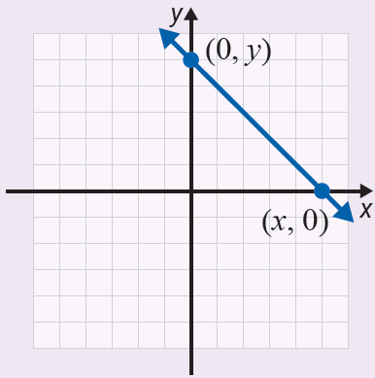
Procedure: Intercepts
To find the y-intercept
(where the line crosses the
y-axis), substitute x = 0
and solve for y.
To find the x-intercept
(where the line crosses
the x-axis), substitute
y = 0 and solve for x.

Slide 11
Note
In general, the intercepts are easy to find because substituting 0 for x or y leads to an easy solution for the other variable. However, when the intercepts result in a point with fractional (or decimal) coordinates and estimation is involved, then a third point that satisfies the equation should be found to verify that the line is graphed correctly.

Slide 12
Example 4: Using Intercepts to Graph Linear Equations
Graph by locating the y-intercept and the
x-intercept.
Solution
Find the y‑intercept:
Find the x‑intercept:
(0, 3) is the y-intercept.
(9, 0) is the x-intercept.

Slide 13
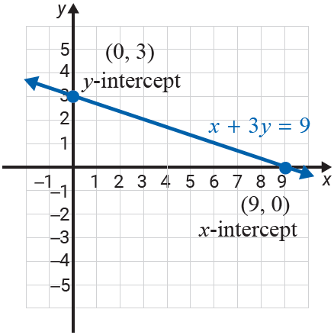
Example 4: Using Intercepts to Graph Linear Equations (cont.)
Plot the two intercepts and draw the line that contains them.

Slide 14
Example 5: Using Intercepts to Graph Linear Equations
Graph by locating the y-intercept and the x-intercept.
Solution
Find the y‑intercept:
Find the x‑intercept:
(0, −6) is the y-intercept.
(4, 0) is the x-intercept.

Slide 15
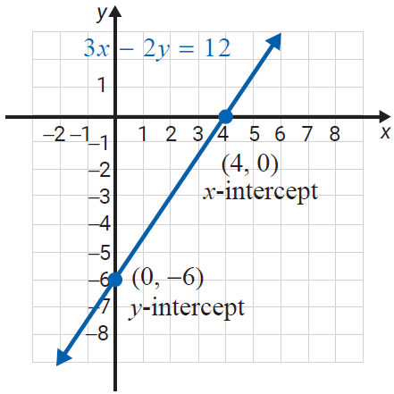
Example 5: Using Intercepts to Graph Linear Equations (cont.)
Plot the two intercepts and draw the line that contains them.

Slide 16
Completion Example 6: Using Intercepts to Graph Equations
Graph by locating the y-intercept and the
x-intercept.
Solution
Find the y-intercept:
0
−
−5y = 5
y = −1
(0, −1)

Slide 17
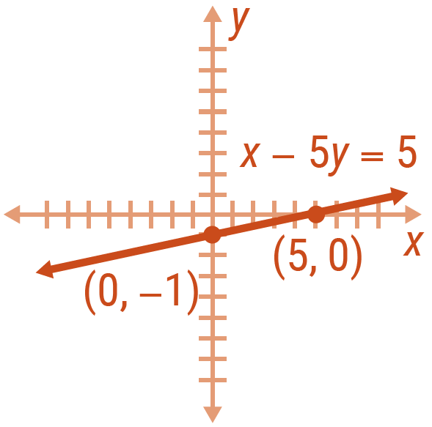
Completion Example 6: Using Intercepts to Graph Equations (cont.)
Find the x-intercept:
−
0
x − 0 = 5
x = 5
(5, 0)
Plot the two intercepts and draw the line that
contains them.

Slide 18
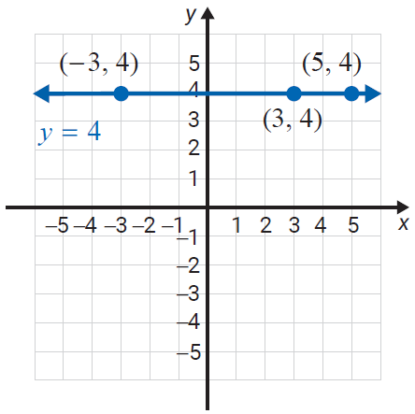
Example 7: Graphing Horizontal Lines
Graph the line y = 4 (or 0x + y = 4)
Solution
Choose three values for x; for example, –3, 3, and 5. As
indicated in the following table,
y = 4 in each case. The graph is a
horizontal line.
x 0x + y = 4 y
−3
0(−3) + y = 4
4
3
0(3) + y = 4
4
5
0(5) + y = 4
4

Slide 19
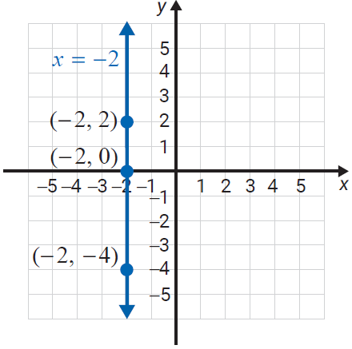
Example 8: Graphing Vertical Lines
Graph the line x = −2 (or x + 0y = −2)
Solution
Choose three values for y; for example, –4, 0, and 2. As
indicated in the following table,
x = −2 in each case. The graph is a
vertical line.
x x + 0y = −2 y
−2
x + 0(−4) = −2
−4
−2
x + 0(0) = −2
0
−2
x + 0(2) = −2
2

Slide 20
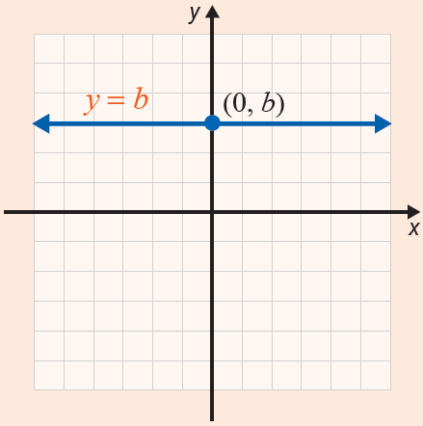
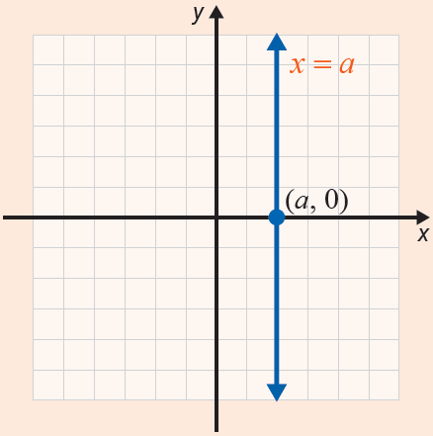
Definition: Horizontal and Vertical Lines
For real numbers a and b, the graph of
y = b is a horizontal line and x = a is a vertical line.

