Slide 1
Section 6.R.2
Percentages

Slide 2
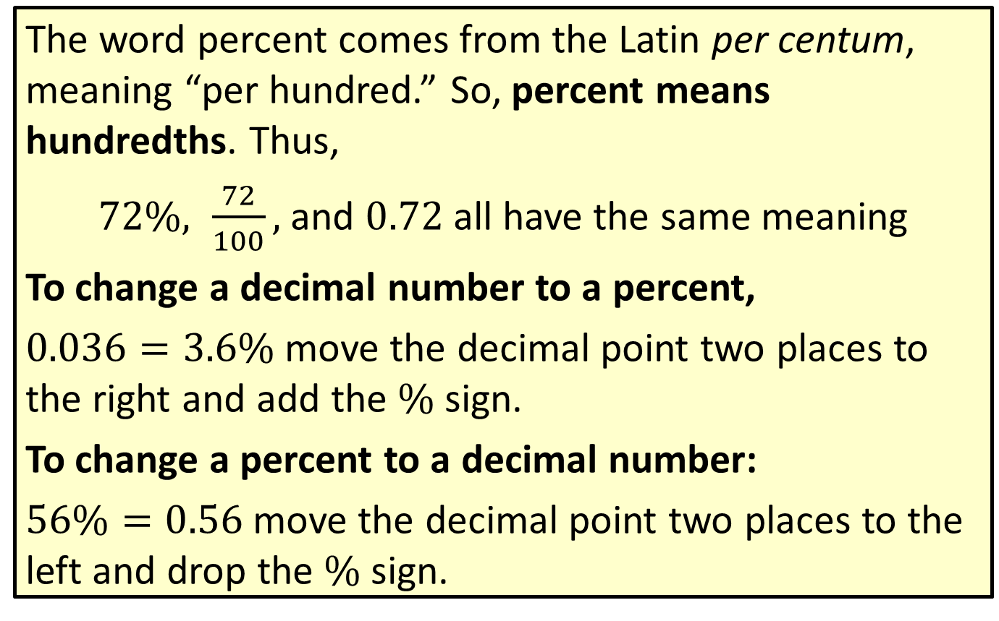
A Brief Review of Converting Percent
The word percent comes from the Latin per centum, meaning “per hundred.” So, percent means hundredths. Thus,
$72\%, \frac{72}{100},$ and $0.72$ all have the same meaning
To change a decimal number to a percent,
$0.036=3.6\%$ move the decimal point two places to the right and add the $\%$ sign.
To change a percent to a decimal number:
$56\%=0.56$ move the decimal point two places to the left and drop the $\%$ sign.

Slide 3
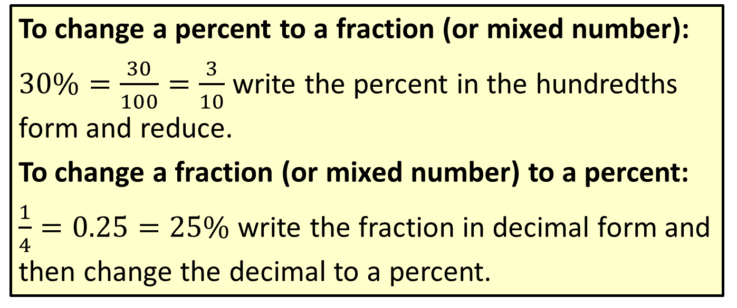
A Brief Review of Converting Percent (cont.)
To change a percent to a fraction (or mixed number):
$30\%=\frac{30}{100}=\frac{3}{10}$ write the percent in the hundredths form and reduce.
To change a fraction (or mixed number) to a percent:
$\frac{1}{4}=0.25=25\%$ write the fraction in decimal form and then change the decimal to a percent.

Slide 4
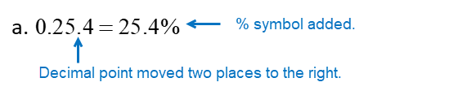
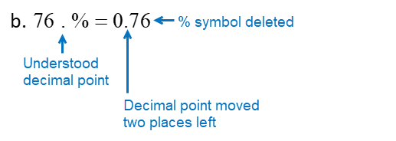

Example 1: Changing between Percents and Decimal Numbers
​ Change 0.254 to a percent.
​ Change $76\%$ to a decimal number.
Solution

Slide 5

Example 2: Changing between Percents and Fractions
​ Change $12\frac{1}{2}\%$ to a fraction.
​ Change $\frac{3}{8}$ to a percent.
Solution

Slide 6
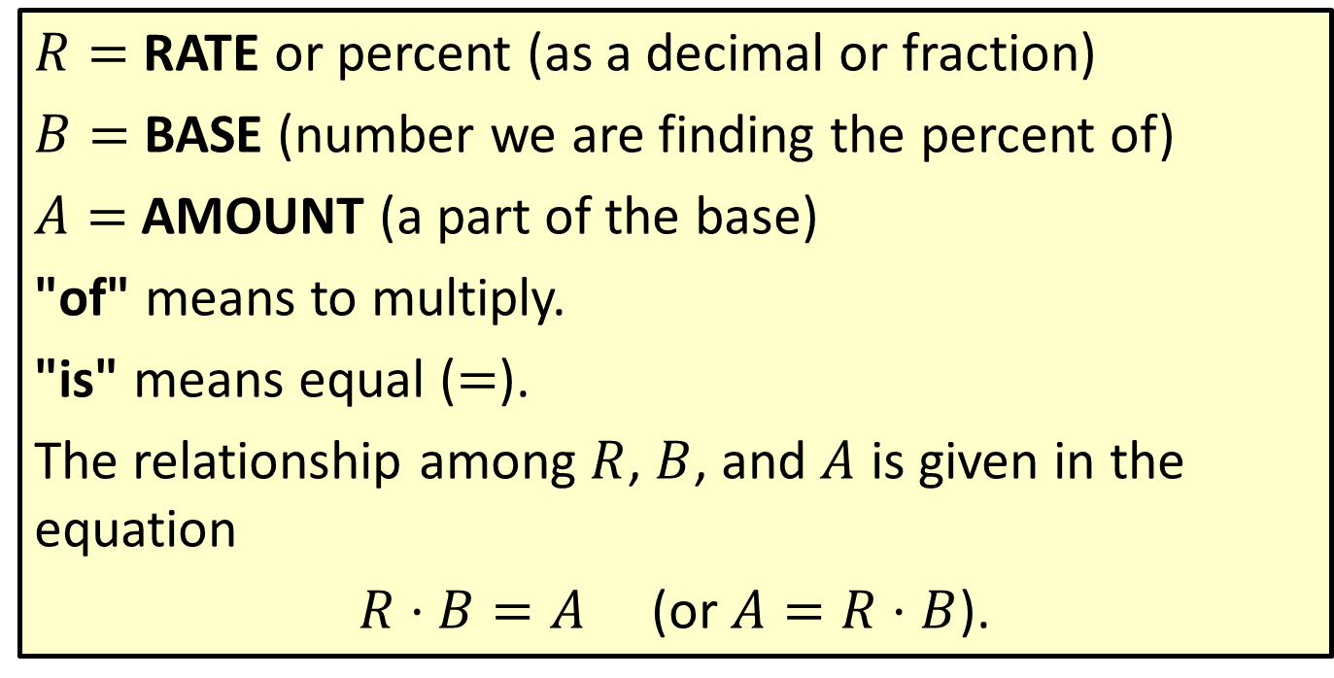

Definition: The Basic Formula $R$ ⋅ $B$ = $A$
$R=$ RATE or percent (as a decimal or fraction)
$B=$ BASE (number we are finding the percent of)
$A=$ AMOUNT (a part of the base)
"of" means to multiply.
"is" means equal ($=$).
The relationship among $R$, $B$, and $A$ is given in the equation
$R⋅B=A$ (or $A=R⋅B$).

Slide 7

Example 3: Finding the Amount
What is $72\%$ of 800?
Solution

Slide 8

Example 4: Finding the Base
$57\%$ of what number is 163.191?
Solution
So $57\%$ of 286.3 is 163.191.

Slide 9
Example 5: Finding the Percent
What percent of 180 is 45?
Solution
So 25% of 180 is 45.

Slide 10
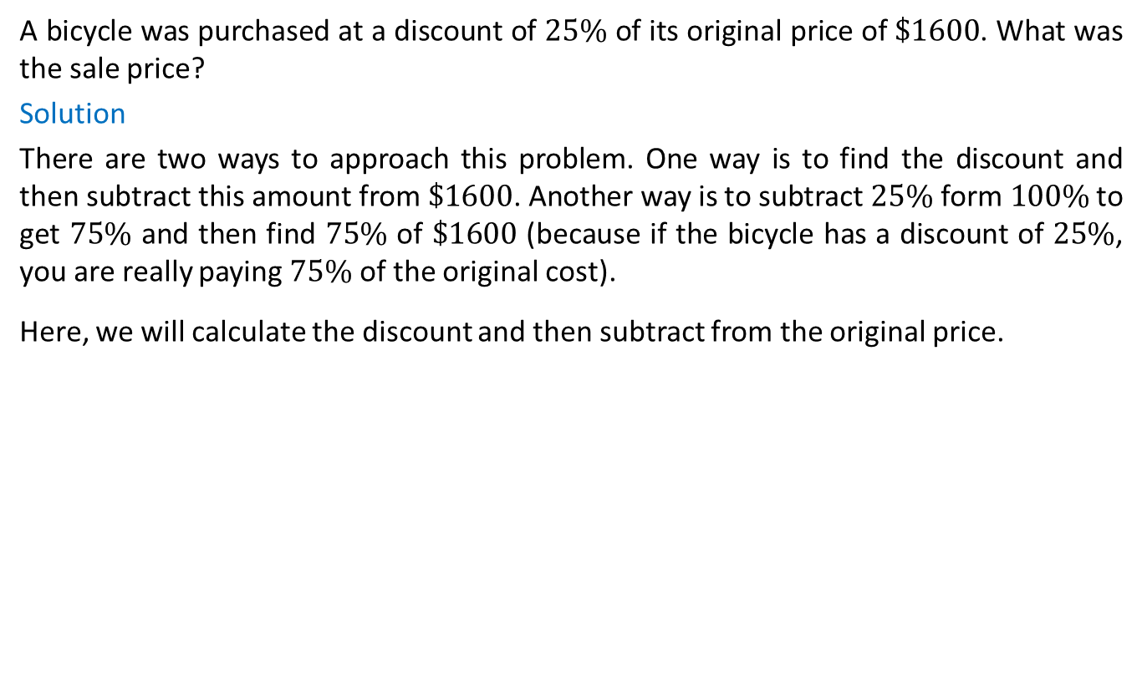
Example 6: Application: Finding a Discount
A bicycle was purchased at a discount of $25\%$ of its original price of $\$1600$. What was the sale price?
Solution
There are two ways to approach this problem. One way is to find the discount and then subtract this amount from $1600. Another way is to subtract 25% form 100% to get 75% and then find 75% of $1600 (because if the bicycle has a discount of 25%, you are really paying 75% of the original cost).
Here, we will calculate the discount and then subtract from the original price.

Slide 11

Example 7: Application: Calculating Sales Tax
Suppose a $6\%$ sales tax was added to the sale price of a $\$1200$ bicycle. What was the total paid for the bicycle?
Solution
The sales tax must be calculated on the sale price and then added to the sale price.

Slide 12
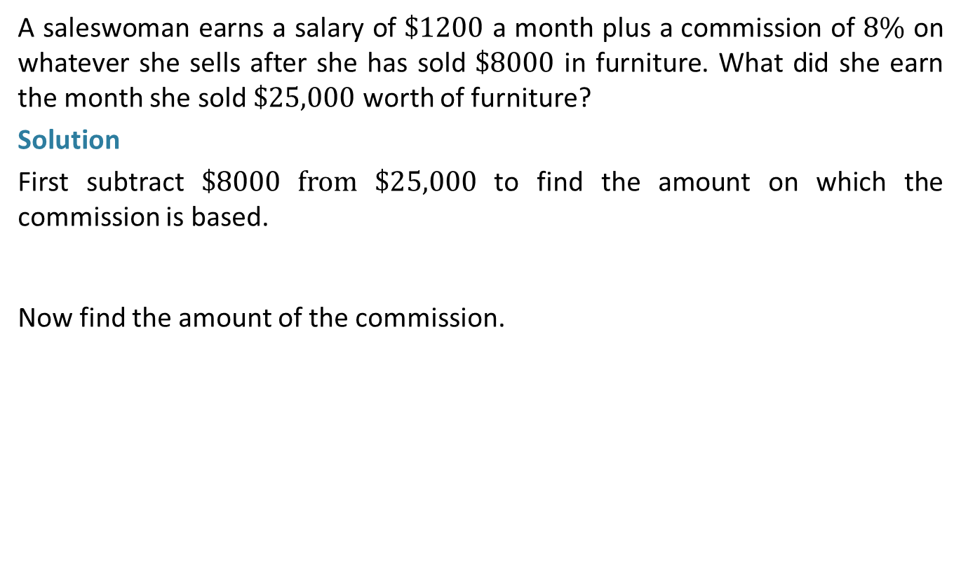
Example 8: Application: Determining Commission
A saleswoman earns a salary of $\$1200$ a month plus a commission of $8\%$ on whatever she sells after she has sold $\$8000$ in furniture. What did she earn the month she sold $\$25,000$ worth of furniture?
Solution
First subtract $8000 from $25,000 to find the amount on which the commission is based.
Now find the amount of the commission.

Slide 13
Example 9: Application: Finding the Percent Increase
Akshi sells homemade greeting cards on the internet. Last year she sold 160 cards. This year she sold 176 cards. What was her percent increase in sales from last year to this year?
Solution
First, find the increase in sales from last year to this year.
Now determine the percent increase by finding what percent 16 is of 160. Use 160 as the base because we want to find the percent increase from last year’s sales.
Akshi’s percent increase in sales was 10%.

Slide 14
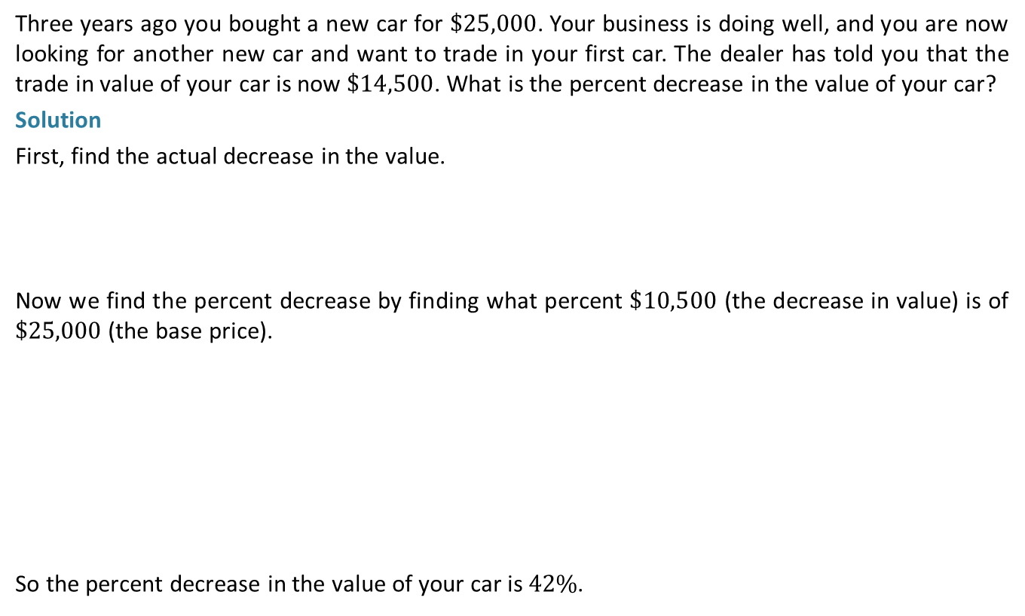
Example 10: Application: Finding the Percent Decrease
Three years ago you bought a new car for $\$25,000$. Your business is doing well, and you are now looking for another new car and want to trade in your first car. The dealer has told you that the trade in value of your car is now $\$14,500$. What is the percent decrease in the value of your car?
Solution
First, find the actual decrease in the value.
Now we find the percent decrease by finding what percent $10,500 (the decrease in value) is of $25,000 (the base price).
So the percent decrease in the value of your car is 42%.

Slide 15
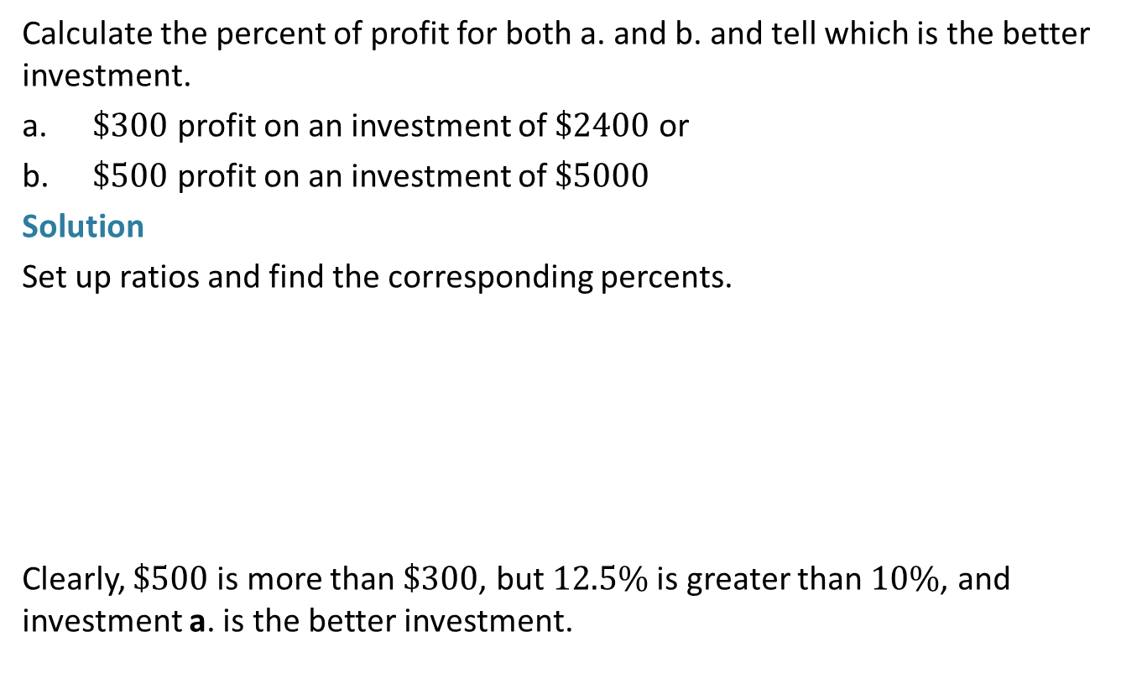
Example 11: Application: Calculating Percent of Profit
Calculate the percent of profit for both a. and b. and tell which is the better investment.
​$\$300$ profit on an investment of $\$2400$ or
​$\$500$ profit on an investment of $\$5000$
Solution
Set up ratios and find the corresponding percents.
Clearly, $500 is more than $300, but 12.5% is greater than 10%, and investment a. is the better investment.

