Slide 1
Section 9.R.1
Angles and Triangles

Slide 2
Definition: Point, Line, Plane
Term | Representation | Discussion
Point | Point A A | A point is represented by a dot. Points are labeled with capital letters.
·

Slide 3
Definition: Point, Line, Plane (cont.)
Term | Representation | Discussion
Line |  | A line has no beginning or end. Lines are labeled with lowercase letters or by two points on the line.
Line l or line AB
l
A
B

Slide 4
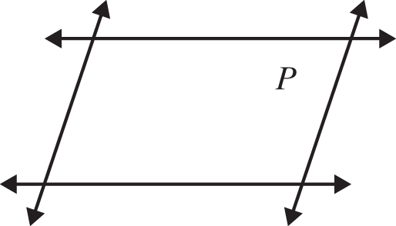
Definition: Point, Line, Plane (cont.)
Term | Representation | Discussion
Plane | Plane P | Flat surfaces, such as a table top or wall, represent portions of planes. Planes are labeled with capital letters.

Slide 5
Definition: Ray and Angle
Term | Definition | Illustrations with Notation
Ray | A ray consists of a point (called the endpoint) and all the points on a line on one side of that point.
Q
P
Ray PQ with endpoint P

Slide 6
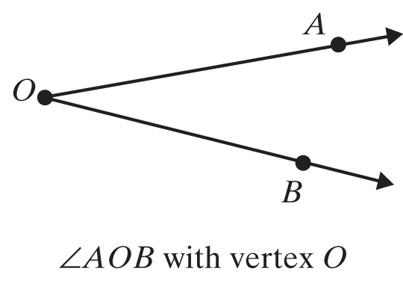
Definition: Ray and Angle (cont.)
Term | Definition | Illustrations with Notation
Angle | An angle consists of two rays with a common endpoint (called a vertex).

Slide 7
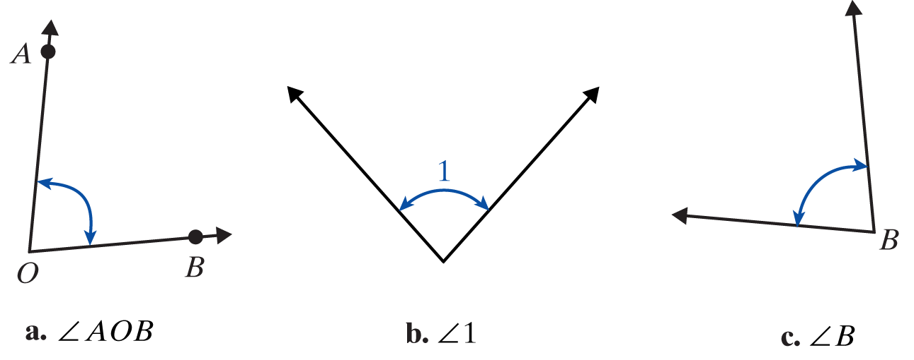
Procedure: Labeling Angles
Three common ways of labeling angles:
Using three capital letters with the vertex as the middle letter.
Using single numbers such as 1, 2, 3.
Using the single capital letter at the vertex when the meaning is clear.

Slide 8
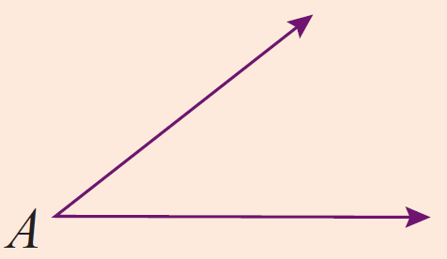
Definition: Angles Classified by Measure
Name | Measure | Illustrations with Notation
Acute |  | is an acute angle.

Slide 9
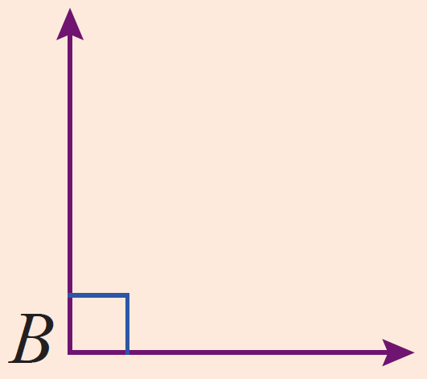
Definition: Angles Classified by Measure (cont.)
Name | Measure | Illustrations with Notation
Right |  | is a right angle.

Slide 10
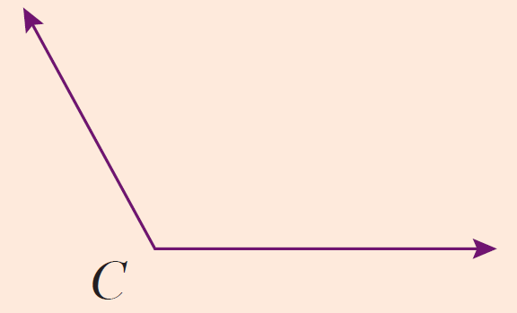
Definition: Angles Classified by Measure (cont.)
Name | Measure | Illustrations with Notation
Obtuse |  | is an obtuse angle.

Slide 11
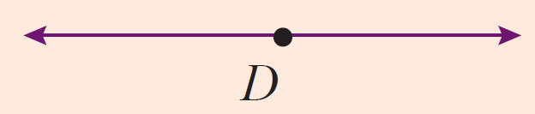
Definition: Angles Classified by Measure (cont.)
Name | Measure | Illustrations with Notation
Straight |  | The rays are in opposite directions. is a straight angle.

Slide 12
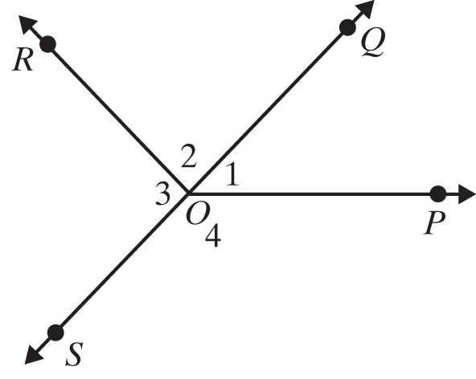
Example 1: Measuring Angles
Use a protractor to check the measures of the given angles.
Solutions

Slide 13
Example 2: Identifying Angles
Classify each angle as acute, right, obtuse, or straight.
a. ∠1 b. ∠2 c. ∠POR
Solutions
∠1
∠2
∠POR

Slide 14
Definition: Complementary and Supplementary Angles
Two angles are complementary if the sum of their measures is 90°.
Two angles are supplementary if the sum of their measures is 180°.

Slide 15
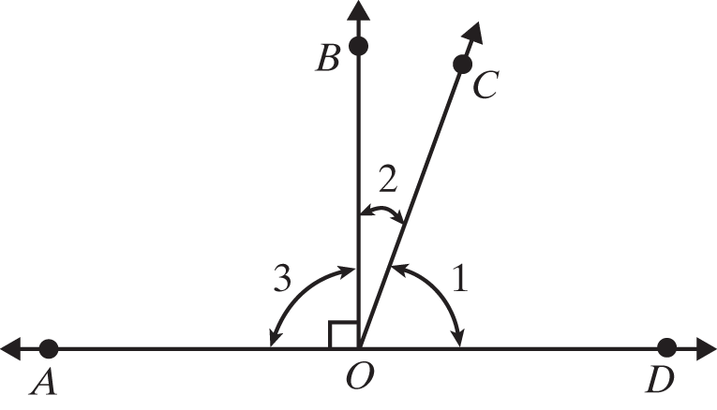
Example 3: Identifying Complementary and Supplementary Angles
In the figure shown, is a straight line. Identify all pairs of complementary, supplementary, and straight angles.

Slide 16
Example 3: Identifying Complementary and Supplementary Angles (cont.)
∠1 and ∠2 are complementary since
∠COD and ∠COA are supplementary.
∠AOD is a straight angle since
∠BOA and ∠BOD are supplementary; and in this case

Slide 17
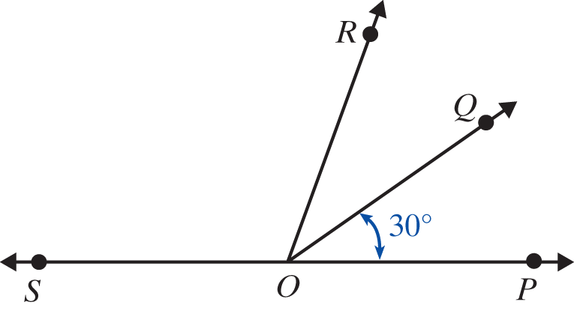
Example 4: Calculating Measures of Angles
In the figure below, is a straight line and
Find the measure of ∠QOS.
Find the measure of ∠SOP.
c. Are any pairs supplementary?

Slide 18
Example 4: Calculating Measures of Angles (cont.)
Solution
Yes, ∠QOP and ∠QOS are supplementary and ∠ROP and ∠ROS are supplementary.

Slide 19
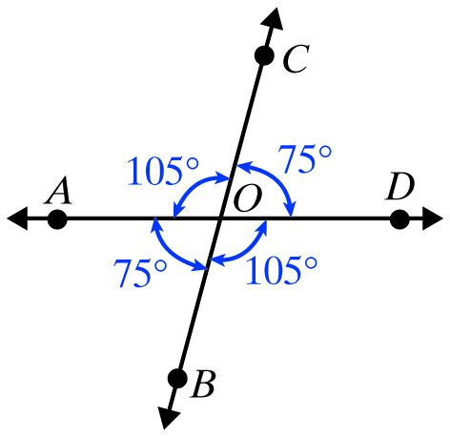
Example 5: Identifying Congruent Angles
In the figure shown below, identify the congruent angles.
Solution

Slide 20
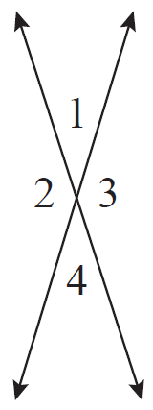
Definition: Vertical Angles
Vertical angles are congruent. That is, vertical angles have the same measure.

Slide 21
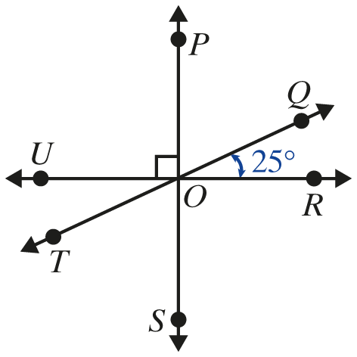
Example 6: Calculating Measures of Angles
In the figure shown, three lines intersect at the point O.
Find the measures of the following angles:
a. ∠TOU b. ∠ROS c. ∠POQ d. ∠SOT

Slide 22
Example 6: Measures of Vertical Angles (cont.)
Solution
are vertical angles and are congruent. They have the same measure,
are vertical angles and are congruent. They have the same measure,

Slide 23
Example 6: Measures of Vertical Angles (cont.)
Because is a straight line, we have
are vertical angles and have the same measure. This means

Slide 24
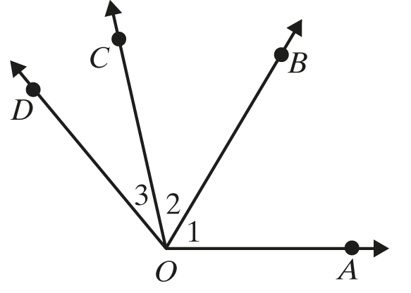
Definition: Adjacent Angles
Two angles are adjacent if they have a common side.
∠1 and ∠2 are adjacent angles.
They have the common side
∠2 and ∠3 are adjacent angles.
They have the common side

Slide 25
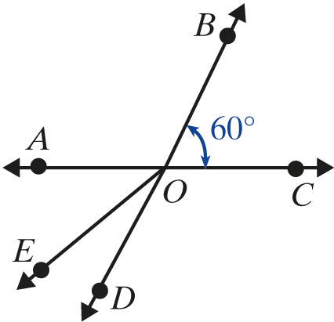
Example 7: Finding Adjacent Angles
In the figure below, are straight lines.
Name an angle adjacent to

Slide 26
Example 7: Finding Adjacent Angles (cont.)
Solution
One angle adjacent to is Two other angles adjacent to are and

Slide 27
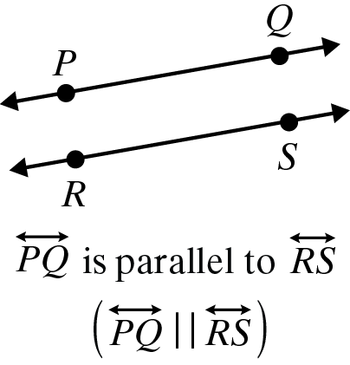
Definition: Parallel Lines and Perpendicular Lines
Term | Definition | Illustrations with Notation
Parallel Lines | Two lines are parallel (symbolized ) if they are in the same plane and do not intersect.

Slide 28
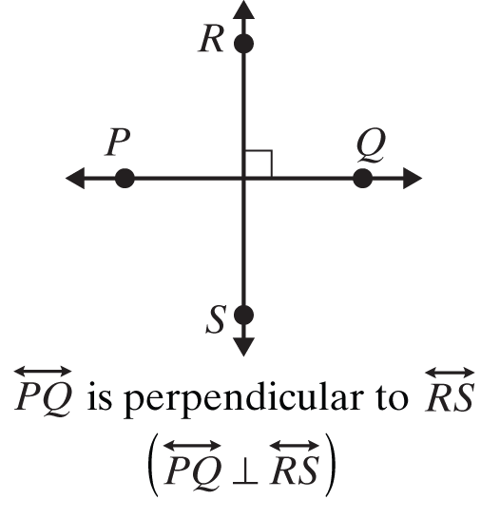
Definition: Parallel Lines and Perpendicular Lines (cont.)
Term | Definition | Illustrations with Notation
Perpendicular Lines | Two lines are perpendicular (symbolized ⊥ ) if they intersect to form right angles.

Slide 29
Procedure: Parallel Lines and a Transversal
If two parallel lines are cut by a transversal, then the following two statements are true.
1. Corresponding angles are congruent.
2. Alternate interior angles are congruent.

Slide 30
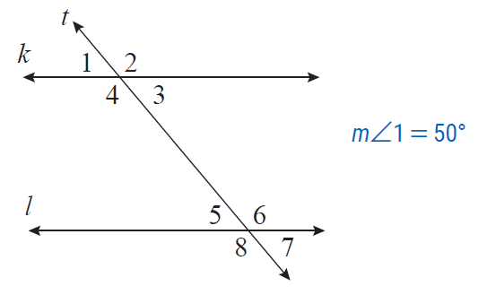
Example 8: Calculating Measures of Angles
In the figure below, lines k and l are parallel, t is a transversal, and Find the measures of the other 7 angles.

Slide 31
Example 8: Calculating Measures of Angles (cont.)
Solution
One way of reasoning (among several) is as follows:
∠1 and ∠3 are vertical angles so
∠1 and ∠2 are supplementary angles so
∠2 and ∠4 are vertical angles so

Slide 32
Example 8: Calculating Measures of Angles (cont.)
Now, because ∠1 and ∠5 are corresponding angles, they have the same measures and
Because ∠4 and ∠6 are alternate interior angles, they have the same measures and
Again, with vertical angles and

Slide 33
Note
The line segment with endpoints A and B is indicated by placing a bar over the letters, as in The length of the segment is indicated by writing only the letters, as in AB.

Slide 34
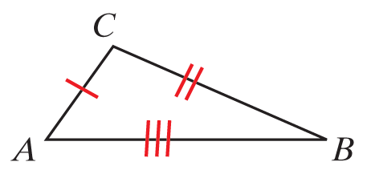
Definition: Triangles Classified by Sides
(Note: In the figures, sides with equal length are indicated by the same number of slash marks.)
Name | Property | Example
Scalene | No two sides have equal lengths. | ∆ABC is scalene since no two sides have equal lengths.

Slide 35
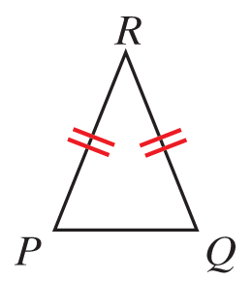
Definition: Triangles Classified by Sides (cont.)
Isosceles | At least two sides have equal lengths. | ∆PQR is isosceles since PR = QR.

Slide 36
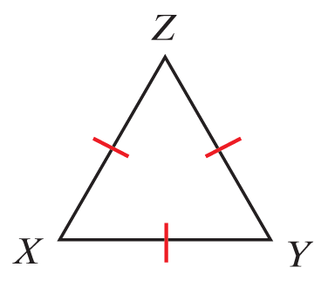
Definition: Triangles Classified by Sides (cont.)
Equilateral | All three sides have equal lengths. | ∆XYZ is equilateral since XY = XZ = YZ

Slide 37
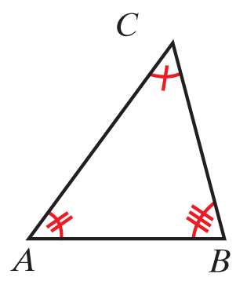
Definition: Triangles Classified by Angles
Name | Property | Example
Acute | All three angles are acute. | are all acute so ∆ABC is acute.

Slide 38
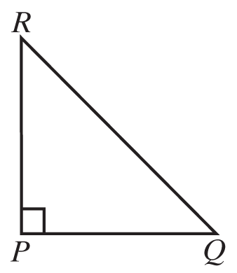
Definition: Triangles Classified by Angles (cont.)
Right | One angle is a right angle. | so ∆PRQ is a right triangle.

Slide 39
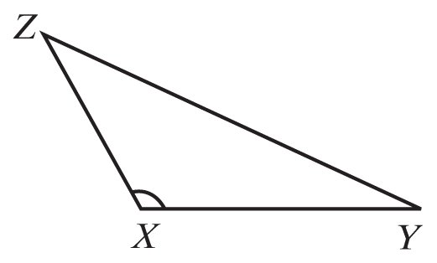
Definition: Triangles Classified by Angles (cont.)
Obtuse | One angle is obtuse. | is obtuse so ∆XYZ is an obtuse triangle.

Slide 40
Properties: Three Properties of Triangles
In a triangle:
The sum of the measures of the angles is 180°.
The sum of the lengths of any two sides must be greater than the length of the third side.
Longer sides are opposite angles with larger measures.

Slide 41
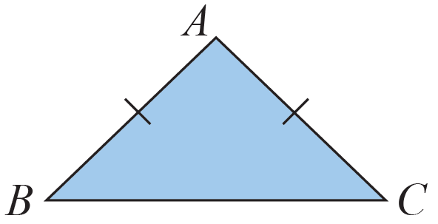
Example 9: Classifying a Triangle by Its Sides
InΔ∆ABC below, AB = AC. What kind of triangle is ∆ABC?
Solution
∆ABC is isosceles because two sides have equal lengths.

Slide 42
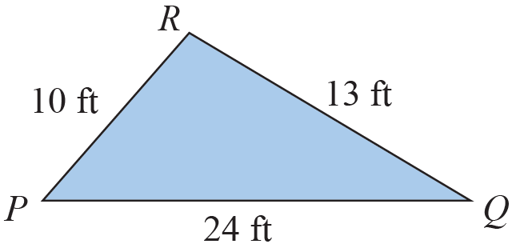
Example 10: Determining Whether a Triangle Exists
ΔPQR was drawn and then the lengths of the sides were labeled as shown in the figure. Explain why the labels cannot be correct.

Slide 43
Example 10: Determining Whether a Triangle Exists (cont.)
The labels cannot be correct because PR + QR = 10 ft + 13 ft = 23 ft and PQ = 24 ft, which is greater than the sum of the other two sides. In a triangle, the sum of the lengths of any two sides must be greater than the length of the third side.

Slide 44
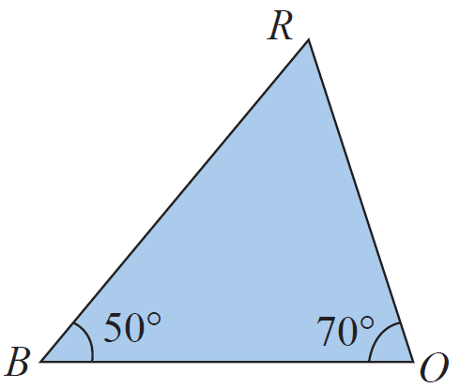
Example 11: Analyzing Triangles
In ∆BOR below, and
What is
Which side is opposite
Which sides include
Is ∆BOR a right triangle? Why or why not?

Slide 45
Example 11: Analyzing Triangles (cont.)
Solutions
The sum of the measures of the angles must be 180˚.
Since
is opposite
and include
∆BOR is not a right triangle because none of the angles is a right angle.

