Slide 1
Section 1.1
Thinking Mathematically

Slide 2
Fun Fact 1
Ian Ayres, author of Super Crunchers, is an American lawyer and economist. He is a professor at the Yale Law School and at the Yale School of Management.

Slide 3
Definition: Inductive and Deductive Reasoning
Inductive reasoning is a line of argument that takes specific examples as its premise and then draws a general conclusion from these examples.
Deductive reasoning uses statements that are commonly accepted as facts to make a case for a specific conclusion.

Slide 4
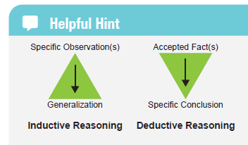
Helpful Hint 1
Figure 1

Slide 5
Example 1: Identifying Inductive and Deductive Reasoning—Slide 1
Determine whether the following arguments use inductive or deductive reasoning.
a. ​In Boulder, Colorado, it snowed 16.2 inches during January 2019 and 16.3 inches during January 2020. Therefore, Boulder will receive at least 16 inches of snow every January.
​b. All even numbers are divisible by two. The number 2,045,890 is even. Therefore, 2,045,890 is divisible by two.

Slide 6
Example 1: Identifying Inductive and Deductive Reasoning—Slide 2
c. ​To get a bachelor's degree at Georgia Southern University, a student must have 120 credit hours. James is about to graduate from Georgia Southern University with a bachelor's degree in engineering. Therefore, James has at least 120 credit hours on his transcript.
​d. Colleagues in the office have determined that the optimal time to leave work is 4:42 p.m. based on traffic patterns they experienced over the past two weeks.

Slide 7
Example 1: Identifying Inductive and Deductive Reasoning—Slide 3
Solution
​a. Notice that in this argument, the examples are specific to January 2019 and January 2020, and then a very general conclusion is made. The likelihood of it snowing about 16 inches each January is not very likely; nevertheless, the argument is inductive.
​b. Here two mathematical facts are used: all even numbers are divisible by two and the number 2,045,890 is even. A specific conclusion is then drawn from these facts. Thus, this is an example of deductive reasoning.

Slide 8
Example 1: Identifying Inductive and Deductive Reasoning—Slide 4
c. The fact about the number of hours required to get a bachelor's degree is used to draw a specific conclusion. This is deductive reasoning.
​d. Because the office workers are basing their conclusion on specific examples over the past two weeks, they are using inductive reasoning to draw a general conclusion.

Slide 9
Example 2: Using Inductive Reasoning—Slide 1
Use inductive reasoning to identify a pattern in each of the following sequences of numbers in order to establish the next term in the sequence.

Slide 10
Example 2: Using Inductive Reasoning—Slide 2
Solution
When identifying a pattern in a sequence of numbers, there is not a set method to follow. Instead, we use trial-and-error techniques such as looking for common differences, common multiples, or other computational operations. ​
let's begin by determining whether the difference between the consecutive terms is constant; that is, whether the difference is the same for each consecutive pairs of terms or if the difference between the consecutive pairs of terms varies.

Slide 11
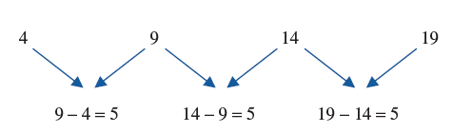
Example 2: Using Inductive Reasoning—Slide 3
We can see here that there is a common difference between each number in the sequence, making it an arithmetic sequence. The common difference is 5 and the sequence is increasing. Thus, the next term in the sequence will be 19 + 5 = 24. ​

Slide 12
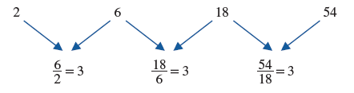
Example 2: Using Inductive Reasoning—Slide 4
does not have a
common difference between terms like we had in part a. (Check this for yourself.) Since there is no common difference, we need another approach. Perhaps there is a common multiple between the consecutive pairs of terms. We can check this by finding the quotient of consecutive pairs of terms.

Slide 13
Example 2: Using Inductive Reasoning—Slide 5
​We can see that each successive number is the product of the previous number and 3. So 2 ⋅ 3 = 6, 6 ⋅ 3 = 18, 18 ⋅ 3 = 54, and so on. This means that the next term would be 54 ⋅ 3 = 162. Because the gap between each term is a constant multiple, this is a geometric sequence.

Slide 14
Example 2: Using Inductive Reasoning—Slide 6
c. ​For the sequence,
there is no common
difference or common ratio between the numbers. (Check this for yourself.) Thus, we need to ask ourselves, "What do we have to do to the first term in order to obtain the second?" In this case, we have to add 1 to 5 in order to get 6. For the next term, we see that the sum is 2 + 6 = 8. We can now see a pattern developing that we need to investigate further. We added 1 to the first term and 2 to the second term. If we continue in this manner by adding 3 to the third term, 4 to the fourth term, and so on, does the pattern continue? For the next term, 8 + 3 = 11, so indeed it does.

Slide 15
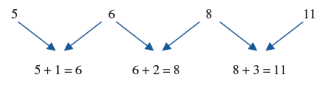
Example 2: Using Inductive Reasoning—Slide 7
Thus, to find the next term in the sequence, we add 4 to 11 to get 15.

Slide 16
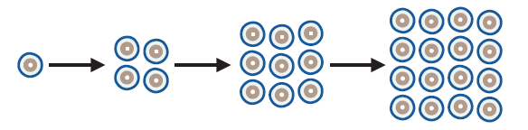
Example 3: Using Inductive Reasoning—Slide 1
A certain type of human cell reproduces in the following manner: 1 cell, 4 cells, 9 cells, 16 cells.
​a. Determine the number of cells present on the next production of cells.
​b. How many cells would be present on the n^{th} production cycle?
Figure 2

Slide 17
Example 3: Using Inductive Reasoning—Slide 2
Solution
​a. The first iteration contains 1 cell and the second iteration contains 4 cells, or 2². The third and fourth iterations contain 3² = 9 cells and 4² = 16 cells, respectively. These numbers should look familiar to you. They are the squares of the natural numbers. So, the next iteration in the sequence will contain 5² = 25 cells. (Notice that 1² = 1, so the pattern holds.)
​b. We've already established that at each production (1st, 2nd, 3rd, etc.) we square the production number. So on the n ^{th} production cycle, we will square n; that is, there will be n² cells.

Slide 18
Think Back
The set of natural numbers is often called the counting numbers and are defined as the set of numbers {1, 2, 3, …}.

Slide 19
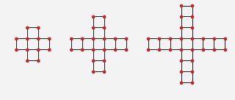
Skill Check 1
Consider the patterns in Figure 3. The first requires 16 line segments to join all of the dots, the second requires 28 line segments, and the third requires 40 line segments. How many line segments would be needed for the 8th pattern? The n^{th} pattern?
Figure 3
Answer: 100; 4 + 12 n

Slide 20
Definition: Counterexample
A counterexample is an example that shows that a generalization or rule is false by satisfying the conditions of the generalization or rule, but not satisfying the conclusion.

Slide 21
Fun Fact 2
Between 1894 and 1900, scientists discovered six new elements, all of which they believed had the property that they could not combine with any other element. These became known as "noble gasses." The conclusion that "noble gases cannot form compounds" became generally accepted by chemists as fact until 1962 when a compound was made for the first time from one of the gasses. The creation of this compound proved that the inductive reasoning behind noble gasses and their ability to form compounds was false.

Slide 22
Example 4: Finding Counterexamples—Slide 1
Consider each conclusion that was drawn using inductive reasoning. Show each conclusion is false by finding a counterexample.
a. ​You must have a degree in computer science to become wealthy in the computer tech industry.
​b. If a sport uses a ball, then the ball is spherical.
​c. If a number is a perfect square, then it has exactly three factors.

Slide 23
Example 4: Finding Counterexamples—Slide 2
Solution
​a. For this example, we need to look no further than two of the most famous people in the computer tech industry—Steve Jobs (cofounder of Apple Computers) and Bill Gates (cofounder of Microsoft). Neither Jobs nor Gates has a degree in computer science, yet both became quite wealthy in the computer tech industry. Hence, we have found a counterexample to our conclusion, and the argument is false.

Slide 24
Example 4: Finding Counterexamples—Slide 3
​b. Football is a sport that uses a ball, but the ball is not a sphere; it is oblong. Thus, the argument is false.
​c. The number 100 is a perfect square (10² = 100), yet it has more than three factors, making the argument false. The factors of 100 are 1, 2, 4, 5, 10, 20, 25, 50, and 100.

Slide 25
Skill Check 2
Which of the following is a counterexample to the following argument?
If the product of two numbers is positive, then their sum is positive.
​a. 5 and 5
​​b. −2 and 5
c. −8 and −8
Answer: c.−8 and −8

Slide 26
Helpful Hint 2
Mathematical statements proved by deductive reasoning are called theorems.

Slide 27
Example 5: Using Deductive Reasoning—Slide 1
Use deductive reasoning to choose the correct conclusion for each argument.
a. ​My state requires all lawyers pass the bar exam to practice legally. If I do not pass the bar, then I _(blank)___.
1. ​will not be able to represent someone legally in my state.
​2. will have to take the exam again.
b. ​The tutoring center at my college is offering free exam reviews to students. I am a student and I plan on reviewing for my sports management exam, so I _(blank)___.
​1. will pass my exam.
​2. will not have to pay anything for this service.

Slide 28
Example 5: Using Deductive Reasoning—Slide 2
c. ​My boss said the person with the highest sales would get a promotion at the end of the year. I generated the highest sales, so I _____________
1. ​am anticipating my promotion.
​2. am the highest earner in my workplace.
Solution
​a. Since the state requires all practicing lawyers to pass the bar, it is impossible to practice law legally without first passing the bar exam. Although one might consider taking the exam again, it is not a definite conclusion. Consequently, the correct answer is conclusion 1.

Slide 29
Example 5: Using Deductive Reasoning—Slide 3
​b. The tutoring center is offering free reviews to students. I satisfy all of the criteria to be eligible for that free tutoring. Neither of the premises ensure that I pass the exam. So the correct answer is conclusion 2.
​c. Since my boss promised a promotion to the best salesman, my having the highest sales would lead me to conclusion 1, if my boss keeps their word. However, neither premise guarantees that I earn the most, ruling out conclusion 2. Thus, the correct answer is conclusion 1.

Slide 30
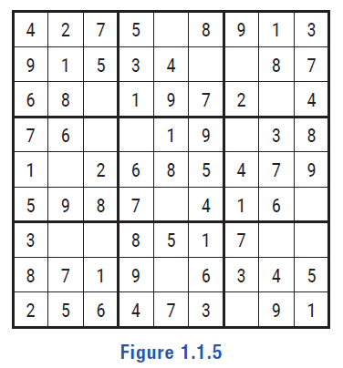
Example 6: Using Deductive Reasoning—Slide 1
Use deductive reasoning to complete the first three rows of the Sudoku puzzle.
Figure 5

Slide 31
Example 6: Using Deductive Reasoning—Slide 2
Solution
When completing a Sudoku puzzle, there are often many options of where to begin. We'll start in the top left-hand
section. Notice that in that section,
there is only one number missing: the number 3. So this means that 3 must go in the intersection of the third row and third column, as shown in Figure 6.

Slide 32
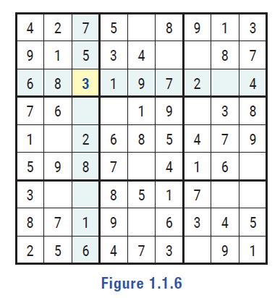
Example 6: Using Deductive Reasoning—Slide 3
Figure 6

Slide 33
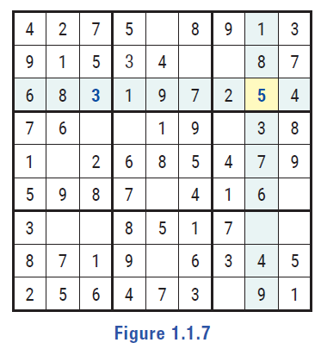
Example 6: Using Deductive Reasoning—Slide 4
Notice that this leaves only one number missing in the 3rd row: the number 5. So we can fill in that square with a 5, as shown in Figure 7.
Figure 7

Slide 34
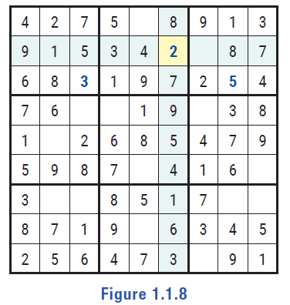
Example 6: Using Deductive Reasoning—Slide 5
Next, notice that the 6th column is only missing one number: the number 2.
Figure 8

Slide 35
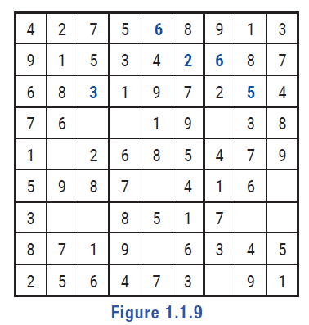
Example 6: Using Deductive Reasoning—Slide 6
When we place that number, as shown in Figure 8, we know the 1st and 2nd rows have every value except 6, thus the last two missing squares must both be 6s. The first three rows are now complete in Figure 9.
Figure 9

Slide 36
Example 6: Using Deductive Reasoning—Slide 7
Verify for yourself that each of the top three rows and the top three
boxes have the values 1 through 9. We leave the
remainder for you to complete now that you have the idea of how to solve a Sudoku puzzle.

Slide 37
Example 7: Using Inductive versus Deductive Reasoning—Slide 1
Consider the following process and its conclusion.
Choosing a positive integer, multiply it by 2, then add 1 to the product.
The result will be an odd number.
​a. Evaluate this conclusion as an inductive argument.
​b. Evaluate this conclusion as a deductive argument.

Slide 38
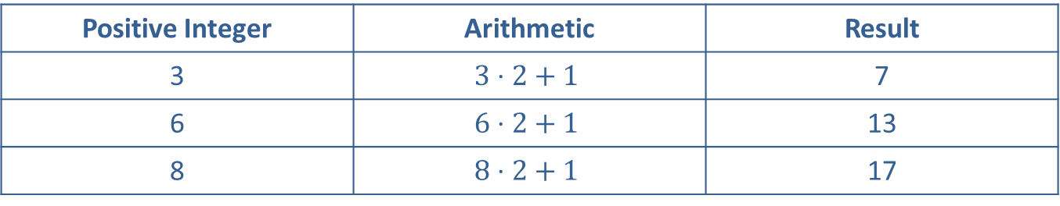
Example 7: Using Inductive versus Deductive Reasoning—Slide 2
Solution
a. ​To evaluate the conclusion with an inductive perspective, we will begin by looking at some specific examples using the numbers 3, 6, and 8. Table 1 shows the results for each number.
​
Table 1
Positive Integer | Arithmetic | Result
3 | $$3⋅2+1$$ | 7
6 | $$6⋅2+1$$ | 13
8 | $$8⋅2+1$$ | 17

Slide 39
Example 7: Using Inductive versus Deductive Reasoning—Slide 3
​We can see that choosing a positive integer, multiplying it by 2, and adding 1 to the product does result in an odd number in each of these three examples, regardless of whether we choose an even or and odd positive integer. Since the conclusion (getting an odd number as the result) is a generalization based on three specific examples, we have used inductive reasoning to show that the conclusion is likely correct.

Slide 40
Example 7: Using Inductive versus Deductive Reasoning—Slide 4
​b. To evaluate the conclusion using deductive reasoning, we will introduce the variable x to represent any positive integer we might use for the process. The first step is to multiply the integer by 2, so we now have 2x. Then we are to add 1, so our number can now be expressed as 2x + 1.
​Using deductive reasoning, we can apply two mathematical facts:
​1. Any number multiplied by 2 is always an even number.
2. ​When you add 1 to an even number, you will always get an odd number.
​Therefore, we can assert that given any positive integer x, when x is multiplied by 2 and then added to 1, the result will be an odd number. We can now use this general statement (which we have just proven to be true) and apply it to specific numbers.

