Slide 1
Section 1.2
Estimating and Evaluating

Slide 2
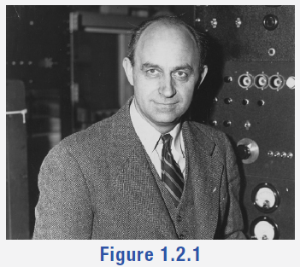
Math Milestone
Enrico Fermi was an Italian American Nobel winning physicist who created the world's first nuclear reactor. Born in Rome, he later moved to New York and then on to Chicago. Fermi was known as an inspiring teacher and his method of getting quick approximations became informally known as the Fermi method.
Figure 1

Slide 3
Tips for Estimating
​1. Start with something you know about the topic or the closest thing you know to the topic.
​2. Have a rough order of magnitude. For example, will it take 5 days, 5 weeks, 5 months, or 5 years?
3. Use past experiences to find context.
4. Break the original question into simpler, more manageable questions.
​5. Round numbers to make calculations easier.
6. Sample a small area and scale it up by multiplying.

Slide 4
Example 1: Estimating Order of Magnitude—Slide 1
Determine which piece of information would be most helpful for you to know in order to make each estimation. Then estimate an appropriate order of magnitude.
a. ​Estimate the depth of the deepest known point of the ocean.
​1. The height of the tallest mountain.
​2. The radius of Earth.
​3. The distance a boat has to travel to cross each ocean.
4. ​The distance of the longest river.
b. ​Estimate the weight of an empty commercial passenger jet.
1. The length of a commercial passenger jet.
2. ​The weight of an empty school bus.
3. ​The density of steel.
4. ​The weight of an empty passenger train car.

Slide 5
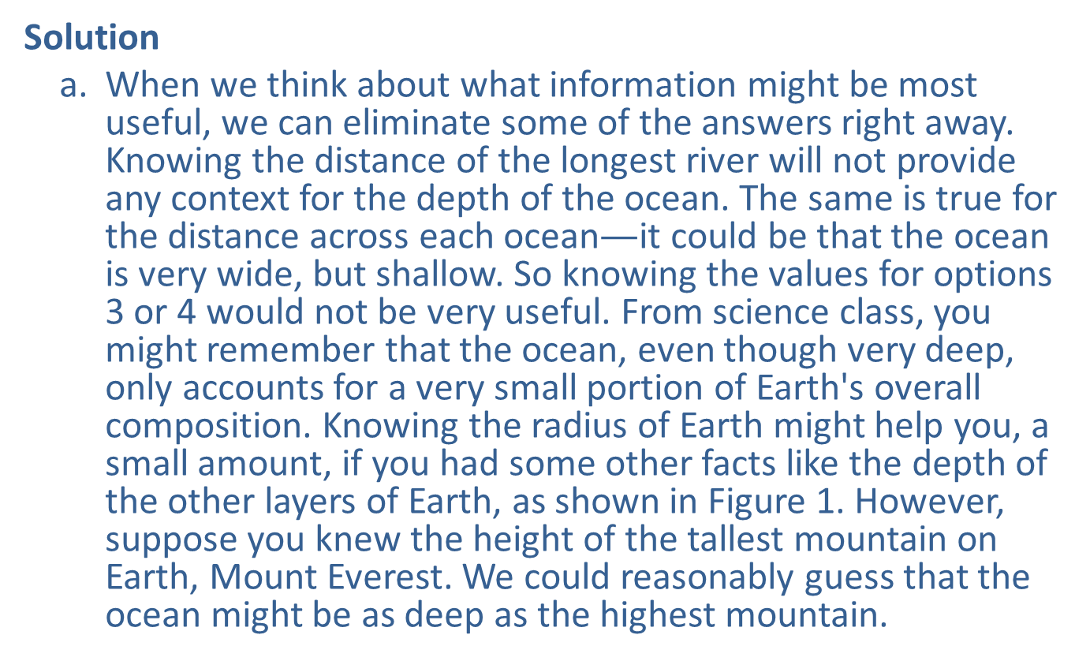
Example 1: Estimating Order of Magnitude—Slide 2
Solution
​a. When we think about what information might be most useful, we can eliminate some of the answers right away. Knowing the distance of the longest river will not provide any context for the depth of the ocean. The same is true for the distance across each ocean$—$it could be that the ocean is very wide, but shallow. So knowing the values for options 3 or 4 would not be very useful. From science class, you might remember that the ocean, even though very deep, only accounts for a very small portion of Earth's overall composition. Knowing the radius of Earth might help you, a small amount, if you had some other facts like the depth of the other layers of Earth, as shown in Figure 1. However, suppose you knew the height of the tallest mountain on Earth, Mount Everest. We could reasonably guess that the ocean might be as deep as the highest mountain.

Slide 6
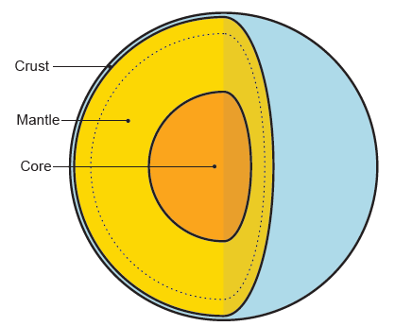
Example 1: Estimating Order of Magnitude—Slide 3
Figure 2
So knowing that Mt. Everest is about 29,000 feet high gives us a good magnitude of scale. We could guess that the deepest part of the ocean is somewhere in the tens of thousands of feet deep. The actual deepest part of the ocean is 36,161 feet. So we indeed have chosen the right magnitude of scale.

Slide 7
Example 1: Estimating Order of Magnitude —Slide 4
b. Again, we are looking for the most helpful piece of information for an estimate of scale. Even though we may not be familiar with all of the given choices, we might need to just make an educated guess. Looking through the list of facts, the least useful seems to be length of the commercial jet. Although that gives us a sense of scale, without other facts, it doesn't help us with the weight of the jet. Thinking about the construction of the jet compared to that of a train, we can determine that a passenger train car is the wrong type of comparison. (A train is built with much heavier materials than a jet.) That leaves us with the empty school bus and the density of steel. You might find the density of steel to be useful, but with that fact alone we have no sense of the dimensions of the aircraft. If we think about an empty school bus, one might guess that its construction makeup is the closest to the jet’s.

Slide 8
Example 1: Estimating Order of Magnitude —Slide 5
c. We can guess that one passenger jet can hold approximately the same number of people as four school buses. If we knew the weight of the bus, we could multiply that by four to have the magnitude of scale. An empty school bus weighs about 25,000 pounds. So our guess would be that an empty passenger jet weighs in the hundred-thousand-pound range. In actuality, an empty passenger jet weighs 90,000 pounds on average. Again, we had a very good estimate!

Slide 9
Skill Check 1
Choose the best order of magnitude.
How many countries belong to OPEC (Organization of the Petroleum Exporting Countries)?
​1. Single Digits,
​2. Tens,
​3. Hundreds,
​4. Thousands.
Answer: Tens (In 2021, there were 13 member countries)

Slide 10
Example 2: Using Past Experience in Estimation—Slide 1
A public university is expanding its campus by building a new Mathematics and Computer Science Center. Estimate the cost of the new center by using the cost specifications of the most recently constructed building on campus, the library. The library had 20,000 square feet of assigned space, with a construction cost of $6,000,000. The new center needs to contain 40,000 square feet of assigned space.

Slide 11
Example 2: Using Past Experience in Estimation—Slide 2
Solution
The problem asks for an estimate of the building cost for the new center based on previous figures. State-funded universities build all academic buildings at roughly the same level of quality. Since we are given the construction cost of the first building, using deductive reasoning we can reasonably conclude that the new center will cost approximately the same amount per square foot. Because we are doubling the square footage of assigned space in the new center, we will need to double the construction cost. Using the information we are given, a good estimate for the cost of the new Mathematics and Computer Science Center is $12,000,000.

Slide 12
Example 3: Breaking Down the Question—Slide 1
Suppose you are planning a wedding reception for 100 people. This is your first time planning such an event. Estimate the cost of the reception.
Solution
If we are estimating the cost of the reception, then we need to account for all of the possible expenses we might encounter and add the approximate expenses to find an estimate for the total. There are several factors that go into the cost of the reception. Breaking the overall cost into smaller segments by listing as many of these as possible is a great place to start.
How many cost factors can you name? If you're not in the reception business, you might seek the help of an online planner or other resource so that you don't leave anything out. Suppose an internet search for "planning a reception checklist" produced the following factors.

Slide 13
Example 3: Breaking Down the Question—Slide 2
​• Venue cost
​• Food
​• Décor
​• Entertainment
First of all, you need a venue big enough to comfortably hold 100 people. Since this cost varies based on location, it is best to get a few rough estimates—again, these estimates can be obtained online. According to one online report, couples spend between $3000 and $11,000 on average for their wedding reception venue. Since all we need is an estimate, we can take the middle of these two numbers as our average:
However, keep in mind that some venues include the cost of food in the total cost of the venue, while other venues do not include the cost of food and may still cost tens of thousands of dollars.

Slide 14
Example 3: Breaking Down the Question—Slide 3
Food for a reception is usually based on a per person amount. As a result, changing the number of guests could drastically change the total cost of the food. Wedding-cost estimator sites give an average cost for 100 people in the range of $45 per person, which is $4500 in total for 100 people. Again, keeping in mind that we’re looking for an estimate and not an exact figure, this will help keep us moving forward on finding the estimate and keep us from being bogged down in finding the least expensive price per head.
Decorations can be anything from very simple to spectacular! However, the average reported cost is in the $600 to $800 range for reception decorations and flower arrangements. So we’ll take the average again and use $700 for our estimate.

Slide 15
Example 3: Breaking Down the Question—Slide 4
Finally, assuming entertainment is a desired feature of the reception, we’ll need to make an initial decision based on some quick research. Having a DJ or single musician ranges from $300 to $700 for the reception, while having a live band ranges from $900 to $1600. It might seem like averaging the two of these would give a good general idea, but stop and think for a minute. An average of the lowest and highest amounts would give us an amount of $950. This amount is either far too much for the first category, or just barely enough for the higher category. So instead of being off in either direction, we will simply choose one of the categories and mention it in our estimation. For now, choosing the less expensive option of having a DJ means that the average entertainment cost is $500.
Now we’re prepared to combine all of the individual estimates in order to arrive at a total estimate for a wedding reception.

Slide 16
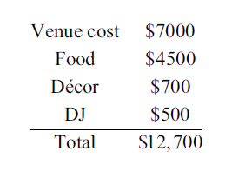
Example 3: Breaking Down the Question—Slide 5
So a reasonable estimate for the cost of a wedding reception could be $12,700.

Slide 17
Fun Fact 1
During the pandemic of 2020, the national average cost of a wedding ceremony and reception in America was $19,000, a drop from 2019's average cost of $28,000. Utah had the smallest average cost at $19,700 while New Jersey had the most expensive cost, averaging a whopping $53,400.

Slide 18
Skill Check 2
Using the estimation prices given in Example 1.2.3, what is the estimated cost for the same reception if the number of guests is only 50? Or 200 (assuming that all venues in our previous calculations could accommodate 200 people)? Think carefully about how you might arrive at the estimates.
Answer: Only the estimation for food will change; $10,450 for 50 guests and $17,200 for 200 guests.

Slide 19
Example 4: Estimating by Rounding—Slide 1
The average adult has between 4500 mL to 5700 mL of blood in their body. When you donate blood, approximately 473 mL is taken. On average, the local blood bank center collects 43 blood donations per day.
​a. Estimate the amount of donated blood the center collects in one week.
​b. Estimate the amount of donated blood the center collects in a year.

Slide 20
Example 4: Estimating by Rounding—Slide 2
Solution
First, notice that there is information in the question that we don't need to use. Although interesting, the amount of blood the average adult has in their body does not help us estimate the amount of blood donated at a blood center. What we are concerned with is the amount of blood that is taken (473 mL) and how many donors there are (43).
​

Slide 21
Example 4: Estimating by Rounding—Slide 3
​a. We'll round each of these numbers so that the multiplication is easier. Remember that when we round, we are making a trade-off for accuracy. The more we round, the less accurate our answer will be. We could round the blood amount to 480 mL for greater precision or round to 500 mL for an easier calculation. The same is true for the 43 donors. We can round down to 40 for a minimum estimate or up to 50, which is likely an overestimate. As a compromise to increase accuracy of the estimate, let's round the blood amount up to 500 mL and the donor count down to 40. We will also assume that the center collects blood all 7 days of the week. We estimate the amount the center will collect per week as follows.
​

Slide 22
Example 4: Estimating by Rounding—Slide 4
b. We can scale up the estimate we found in part a. to guess the amount of blood the center collects in a year. Since there are 52 weeks in a year, we can multiply by 140,000 mL to estimate that the center collects.
Notice that both estimates assume the blood center collects blood every day of the year—even on holidays—and has roughly the same intake of donors per day. It is unlikely for that to be the case, so we could say that both estimates are upper estimates for the amount of blood the center collects. However, both answers are certainly in the right magnitude of scale.

Slide 23
Think Back
Only consider the digit directly to the right of the place you are rounding to. Round down for digits less than 5. Round up for all other digits.

Slide 24
Skill Check 3
Estimate how many people ride New York City subway system every year if approximately 4.3 million people ride it every day.
Answer: Approximately 1.6 billion people

Slide 25
Example 5: Estimating by Scaling—Slide 1
At most concerts, the floor area immediately in front of the arena stage is designated as standing room only. Using an aerial camera view, a local news crew counted 27 people in an area that was approximately
of this portion of the floor. How could the news station estimate the number of people in the standing-room-only section?

Slide 26
Example 5: Estimating by Scaling—Slide 2
Solution
A common technique to estimate crowd size is to divide the area of people into equal sections and then determine the number of people in one of those sections. Once this value is known, the amount of people in one section is multiplied by the total number of sections. In this case, the news crew counted 27 people in one section and estimated that there were 11 sections. We can multiply the two numbers together to get an estimate for the size of the crowd in front of the stage.
27 ⋅ 11 = 297
Thus, the news could reasonably report there were approximately 300 people in the standing-room-only section.

Slide 27
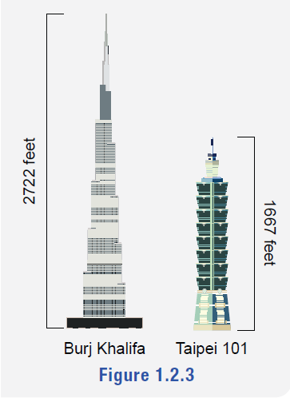
Fun Fact 2
The Burj Khalifa, in Dubai, stands as the tallest skyscraper in the world with a height of 2722 feet, just over half a mile! It took the crown in 2010, beating out Taipei 101, the previous title holder from 2004–2009, which stands 1677 feet tall.
Figure 3

Slide 28
Example 6: Using the Wisdom of the Crowd—Slide 1
Thirty people were asked to estimate the attendance at an outdoor community concert to the nearest 10. Their estimates are shown in Table 1. Use the crowd-sourced data to make an estimate of the community concert attendance.
Table 1: Community Concert Attendance Estimates
370 | 210 | 310 | 270 | 300 | 260
270 | 220 | 270 | 320 | 220 | 330
240 | 280 | 230 | 300 | 310 | 200
210 | 260 | 240 | 250 | 260 | 300
200 | 260 | 310 | 340 | 350 | 290

Slide 29
Example 6: Using the Wisdom of the Crowd—Slide 2
Solution
One method of making an estimate could be to look for the number that was most commonly guessed. However, the wisdom of the crowds says that the average of many estimates is better than a single estimate. So instead of using a single number, we can add all of the estimates together and divide by the number of estimates (30).
The sum of all of the estimates is 8180. Dividing by 30, we have the following.
Thus, we should estimate that there were approximately 273 people at the community concert.

