Slide 1
Section 1.3
Problem Solving: Processes and Techniques

Slide 2
Think Back
Recall that a variable is a representation of an unknown quantity or amount in a mathematical equation. We often solve equations for a given variable to determine its value.

Slide 3
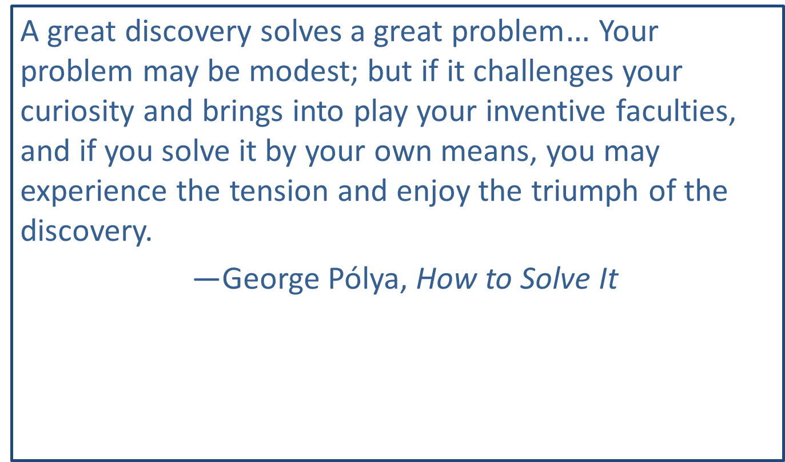
Pólya’s Problem-Solving Technique—Slide 1
A great discovery solves a great problem$…$ Your problem may be modest; but if it challenges your curiosity and brings into play your inventive faculties, and if you solve it by your own means, you may experience the tension and enjoy the triumph of the discovery.
—George Pólya, How to Solve It

Slide 4
Pólya’s Problem-Solving Technique—Slide 2
Step 1: Understand the Problem
To understand the problem means reading and rereading the problem to identifying pertinent information, discerning what is being asked, writing down important facts, and assigning names or variables to unknown quantities.

Slide 5
Pólya’s Problem-Solving Technique—Slide 3
Step 2: Devise a Plan
Pólya offers many strategies to devising a plan. You can look to problems that you have solved before (or related problems that could be useful) and use similar methods. You should look for any patterns in the data and consider different points of view. You should also ask questions to help propel you onward.
The strategy or plan will vary since some problems may require multiple strategies and multiple attempts to find a solution. Here are some standard strategies to consider.

Slide 6
Pólya’s Problem-Solving Technique—Slide 4
Step 3: Carry Out the Plan
Carry out the plan set out in Step 2. Be persistent and carefully check each step. If the plan does not work, understanding why the plan fails may allow you to discover something new about the problem that you didn’t understand before. This enables you to use that new information to devise a new plan. And take heart—this is the nature of mathematics. Failure is only a step toward success.

Slide 7
Pólya’s Problem-Solving Technique—Slide 5
Step 4: Look Back
An essential part of problem solving is having the ability to be reflective in thought. Examine the solution you obtained. Ask yourself the following questions.
Is my answer feasible and correct?
What worked?
What didn’t work?
Will the solution to this problem assist me the next time I see a similar problem?
Looking back with a critical eye on what you have done what worked and what didn’t work—helps you predict what strategy to use to solve future problems.

Slide 8
Procedure: Pólya's Problem-Solving Technique
​1. Understand the problem.
​2. Devise a plan.
3. ​Carry out the plan.
4. ​Look back.

Slide 9
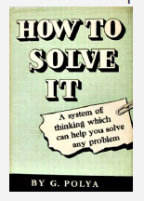
Math Milestone 1
Hungarian mathematician George Pólya is best known for his book titled How to Solve It. Since its publication in 1945 it has been continuously in print and sold over one million copies.
Figure 1

Slide 10
Example 1: Working Backward—Slide 1
While three watchmen were guarding an orchard, a thief slipped in and stole some apples. On his way out, the thief met the three watchmen, one after another, and to each in turn he gave one-half of the apples he had, plus two more in addition to that. In this way, he managed to escape with one apple. How many apples had the thief stolen originally?

Slide 11
Example 1: Working Backward—Slide 2
Solution
Step 1: Understand the Problem
After reading the problem, identify the pertinent information needed to solve the problem. We are told three important points: the thief had only one apple when he escaped the orchard, he met three watchmen, and he gave each of the three watchmen one-half of the apples in his possession, plus two more. We are asked to determine how many apples he stole originally.

Slide 12
Example 1: Working Backward—Slide 3
Step 2: Devise a Plan
In this problem, let's try working backward from the ending value of one apple. If the thief gave away one-half of the apples plus two more per watchman, we need to add them back in for each watchman he met. Remember that when using a method of working backward, all of the arithmetic operations are done in reverse. We can use a table to help us keep track of the process.

Slide 13
Example 1: Working Backward—Slide 4
Step 3: Carry Out the Plan
We have decided to work backward. Recall from the initial problem that the thief is dividing his apples in half and then subtracting two more from the number of apples in his possession each time he meets a watchman. To work backward, we must reverse the operations. So instead of subtracting 2 apples, we add 2. Instead of dividing the number of apples in half (that is, instead of dividing by 2), we multiply by 2. Knowing that the thief escaped with only 1 apple, we start with this value. The thief must have had 1 + 2 = 3 apples, and then twice that amount, or 6 apples, when he met the final watchman. Using the same logic, we can continue to work backward to calculate the number of apples he had as he met each watchman in turn.

Slide 14
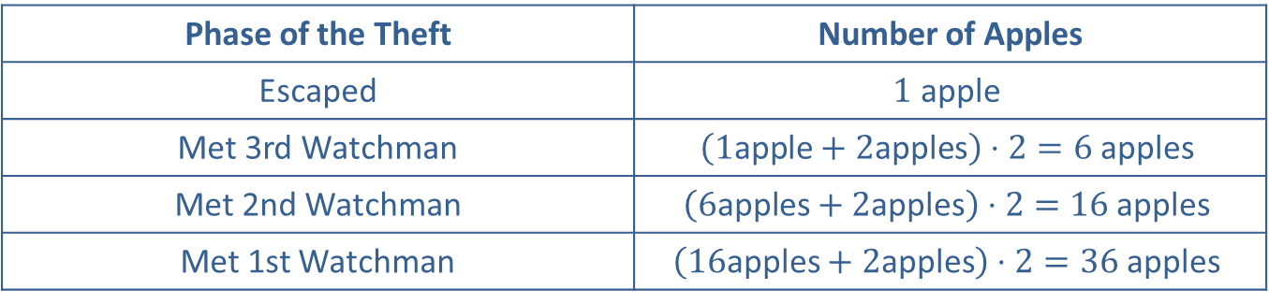
Example 1: Working Backward—Slide 5
Thus, the thief originally stole 36 apples.
Table 1: Number of Apples
Phase of the Theft | Number of Apples
Escaped | $$1 \text{apple}$$
Met 3rd Watchman | $$\left(1\text{apple}+2\text{apples}\right)⋅2=6 \text{apples}$$
Met 2nd Watchman | $$\left(6\text{apples}+2\text{apples}\right)⋅2=16 \text{apples}$$
Met 1st Watchman | $$\left(16\text{apples}+2\text{apples}\right)⋅2=36 \text{apples}$$

Slide 15
Example 1: Working Backward—Slide 6
Step 4: Look Back
The last step in the process requires that we consider the answer to determine if it is feasible. We can use our solution of 36 apples to see if the thief actually ends up with 1 apple on escape after meeting each of the three watchmen.
​• He meets the 1st watchman and gives him one-half of his apples and 2 more.
​​​• ​He meets the 2nd watchman and gives him one-half of his remaining apples and 2 more.
​​• He meets the 3rd watchman and gives him one-half of his remaining apples and 2 more.
When looking at our process, we should ask ourselves if what we have done makes sense and is feasible. Notice that we have done more than show our answer is feasible, we have shown that it works. So the answer to both of these is yes. We can have confidence in our answer that the thief originally stole 36 apples.

Slide 16
Helpful Hint
Language we use casually every day may have precise meanings in mathematics—perhaps different from its everyday meanings. Here, for example, the following all have the same meaning in mathematics.
Dividing in half
Dividing in 2
Dividing by 2
Be careful: dividing by one-half is not the same thing.

Slide 17
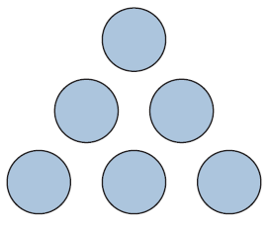
Example 2: Using the Trial-and-Error Method—Slide 1
Arrange the numbers 1, 2, 3, 4, 5, and 6 in the circles of the given triangle so that the sum along each side is 12.
Figure 2

Slide 18
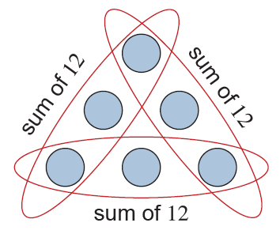
Example 2: Using the Trial-and-Error Method—Slide 2
Solution
Step 1: Understand the Problem
Since we are given a figure to consider, understanding the problem must include understanding the figure. In this case, we are being asked to place each of the numbers 1 through 6 in the circles such that each side of the triangle has a sum of 12.
Figure 3

Slide 19
Example 2: Using the Trial-and-Error Method—Slide 3
Step 2: Devise a Plan
Unless the answer is obvious to you, we most likely need to use the strategy of trial and error. Trial and error is an effective strategy for solving problems where you are given enough information to test your results immediately and the data is a manageable size. Trial and error is sometimes the best strategy for helping to determine where to begin in solving a problem, and it makes it possible to quickly eliminate erroneous solutions.

Slide 20
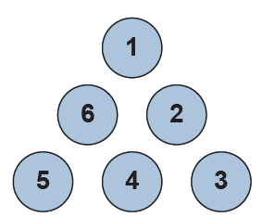
Example 2: Using the Trial-and-Error Method—Slide 4
Step 3: Carry Out the Plan
Our first guess will be to place the numbers 1 through 6 in any order on the circles and add the numbers along each side to see what happens. We'll start by placing 1 at the top and then ordering the numbers clockwise around the triangle.
Figure 4
From our initial guess, we can see that the sum along two of the sides is 12, but not along all three sides.
1 + 2 + 3 = 6 3 + 4 + 5 = 12 5 + 6 + 1 = 12

Slide 21
Example 2: Using the Trial-and-Error Method—Slide 5
We can use this information to formulate a better second guess. Consider the possibilities of acquiring a sum of 12 when using the numbers 1 through 6. The only possible sums of 12 using the numbers 1 through 6 are the following.
1 + 5 + 6 = 12
2 + 4 + 6 = 12
3 + 4 + 5 = 12

Slide 22
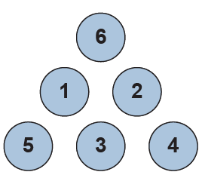
Example 2: Using the Trial-and-Error Method—Slide 6
Looking at our three sums, we can see that the numbers 4, 5, and 6 are each used in two of the three sums, while the numbers 1, 2, and 3 are used only once. This indicates that the numbers 4, 5, and 6 should be placed in the corner circles of our triangle so that the numbers are used in two sums each.
Figure 5

Slide 23
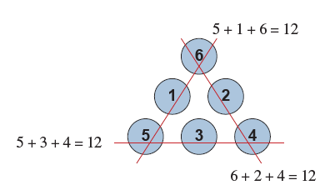
Example 2: Using the Trial-and-Error Method—Slide 7
Step 4: Look Back
Now, we need to check to see that the sums of all of the sides are indeed 12. Now we can check our answer.
Figure 6
So the sum of each side of the triangle is 12. Therefore, we have a solution. Notice that although we failed the first time we tried to arrange the numbers, we gained new information that led to our eventual success.

Slide 24
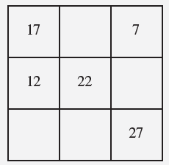
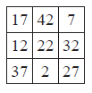
Skill Check 1
A magic square is a square arrangement of numbers in which the sums of all the rows, columns, and diagonals are equal. This magic square uses the numbers 2, 7, 12, 17, 22, 27, 32, 37, and 42 only once each. Determine the placement of the missing numbers in the given magic square.
Figure 7
Answer:

Slide 25
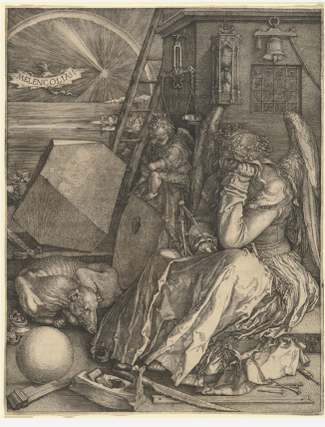
Math Milestone 2
Magic squares are very ancient, dating back more than 400 years according to Chinese legend. They have been associated with mythical significance, have been the center of perfect harmony and balance, and have appeared in works of art.
Figure 8: Melancholia I by Albrecht Durer

Slide 26
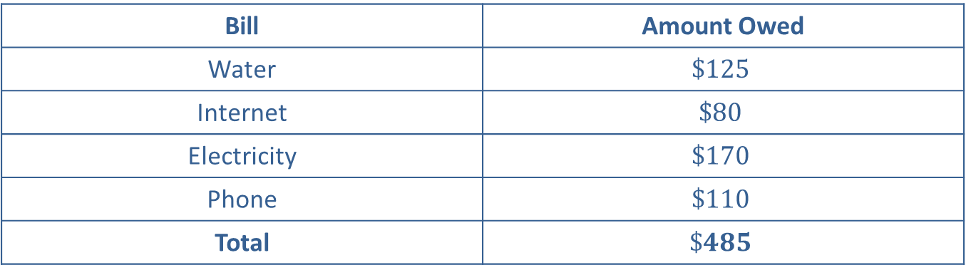
Example 3: Making a List—Slide 1
Stefan has four bills due this month. They are listed in Table 2.
Table 2: Stefan's Monthly Bills
Bill | Amount Owed
Water | $$\$125$$
Internet | $$\$80$$
Electricity | $$\$170$$
Phone | $$\$110$$
Total | $$\$485$$
Stefan only has $350 available to pay his bills. Each company imposes a $25 late fee if the bill is not paid on time. Is it possible for Stefan to pay three of the four bills in order to incur only one late fee?

Slide 27
Example 3: Making a List—Slide 2
Solution
Step 1: Understand the Problem
The problem is asking us whether there is a way to add three of the values from the set of four values and end up with a total that is less than or equal to a particular number (in this case, $350). Notice that the amount of the late fee is given in the problem but is not needed in order to answer the question.

Slide 28
Example 3: Making a List—Slide 3
Step 2: Devise a Plan
To solve this problem, we can make a list of all the possible ways we can add up three of the four bills. We can then check the total to see if it is less than or equal to the amount Stefan has available. We will use a table here, but you can organize your list in any way you would like.

Slide 29
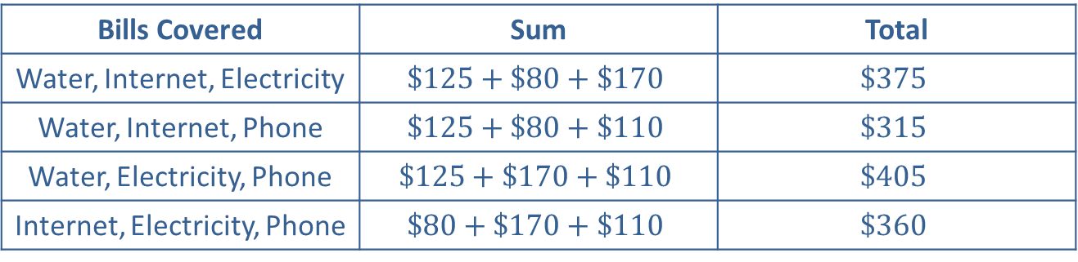
Example 3: Making a List—Slide 4
Step 3: Carry Out the Plan
There are four ways to group three bills at a time. Each of these combinations is listed in the leftmost column in Table 3.
After adding up the total of each of the possible groups of three, we see that the second row is the only one less than Stefan's available $350. This means that yes, it is possible for Stefan to cover three of his bills and only incur one late fee.
Table 3: Bill Combinations
Bills Covered | Sum | Total
Water, Internet, Electricity | $$\$125+\$80+\$170$$ | $$\$375$$
Water, Internet, Phone | $$\$125+\$80+\$110$$ | $$\$315$$
Water, Electricity, Phone | $$\$125+\$170+\$110$$ | $$\$405$$
Internet, Electricity, Phone | $$\$80+\$170+\$110$$ | $$\$360$$

Slide 30
Example 3: Making a List—Slide 5
Table 3: Bill Combinations
Bills Covered | Sum | Total
Water, Internet, Electricity | $$\$125+\$80+\$170$$ | $$\$375$$
Water, Internet, Phone | $$\$125+\$80+\$110$$ | $$\$315$$
Water, Electricity, Phone | $$\$125+\$170+\$110$$ | $$\$405$$
Internet, Electricity, Phone | $$\$80+\$170+\$110$$ | $$\$360$$
Step 4: Look Back
Looking back, we check for errors and see that we didn't make any. We also see that the largest bill, $170 for electricity, didn't make it into the final grouping. Perhaps we could have predicted that if any bill wouldn't be able to be covered, it would be the largest.

Slide 31
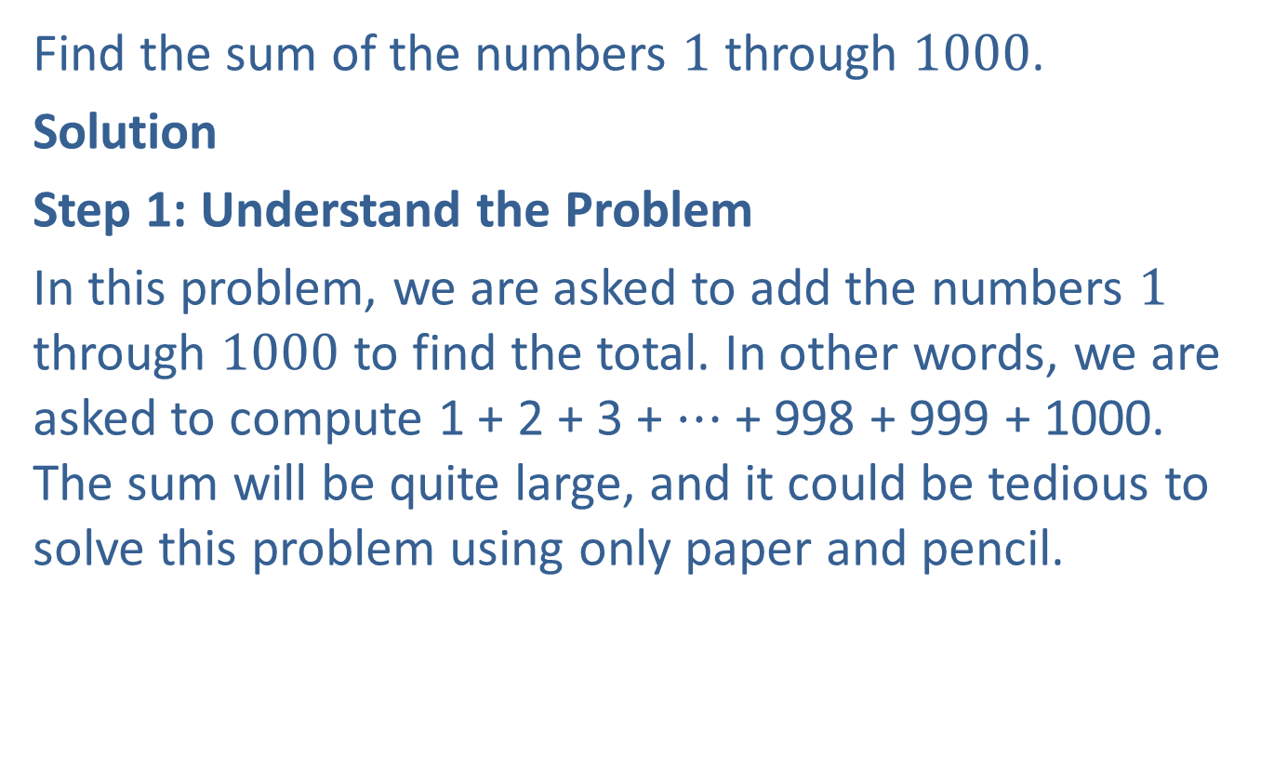
Example 4: Solving a Simpler Problem—Slide 1
Find the sum of the numbers 1 through 1000.
Solution
Step 1: Understand the Problem
In this problem, we are asked to add the numbers 1 through 1000 to find the total. In other words, we are asked to compute 1 + 2 + 3 + $⋯$ + 998 + 999 + 1000. The sum will be quite large, and it could be tedious to solve this problem using only paper and pencil.

Slide 32
Example 4: Solving a Simpler Problem—Slide 2
Step 2: Devise a Plan
One plan we could use is to get out some scratch paper and start calculating. Another strategy could be to use a calculator. We could also break 1000 into 10 groups of 100 numbers each and then find the total sum.
This problem is an example of a classic problem and solution developed by Carl Gauss over 200 years ago. Did he solve the problem using a calculator? Of course not! There were no calculators at the time.
While there are many ways to approach this problem, we are going to use the strategy of solving a simpler problem. Consider just the first few numbers, 1 through 10. If we find the sum of these, we get the following.
1 + 2 + 3 + 4 + 5 + 6 + 7 + 8 + 9 + 10 = 55 = 5 ⋅ 11

Slide 33
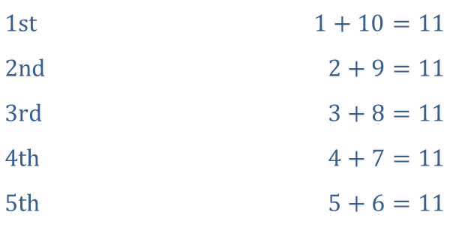
Example 4: Solving a Simpler Problem—Slide 3
How is this helpful? Well, if you notice from our simpler problem of 10 values, if we start with the outside numbers and work our way toward the middle, there are 5 "pairs" of numbers that add to 11.
​
​$\text{1}\text{st}$ | ​$1+10=11$
​$\text{2}\text{nd}$ | ​$2+9=11$
​$\text{3}\text{rd}$ | ​$3+8=11$
​$\text{4}\text{th}$ | ​$4+7=11$
​$\text{5}\text{th}$ | ​$5+6=11$
Using this knowledge, we should be able to carry out a similar plan and find a solution.

Slide 34
Example 4: Solving a Simpler Problem—Slide 4
Step 3:
Carry out the Plan Using the same type of strategy that we devised in Step 2, we can now carry out the plan to find the sum of the numbers 1 through 1000. Using the end numbers and working our way in, we can identify the "pairs" of numbers that add together to give 1001. Notice there will be ​
pairs all together.

Slide 35
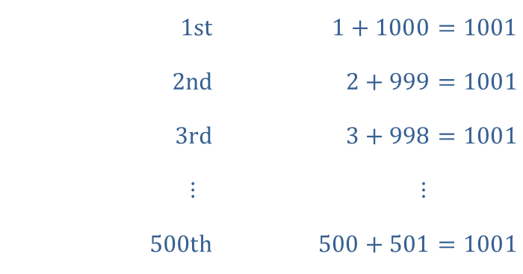
Example 4: Solving a Simpler Problem—Slide 5
This means we will have 500 pairs of 1001. Using our calculators or pencil and paper, we can now obtain the final answer of 500 ⋅ 1001 = 500,500.
​$\text{1}\text{st}$ | ​$1+1000=1001$
​$\text{2}\text{nd}$ | ​$2+999=1001$
​$\text{3}\text{rd}$ | ​$3+998=1001$
​$⋮$ | ​$⋮$
​$\text{500}\text{th}$ | ​$500+501=1001$

Slide 36
Example 4: Solving a Simpler Problem—Slide 6
Step 4: Look Back
We need to determine if the answer makes sense and is feasible. Have we committed any type of mathematical errors? Well, by solving the simpler problem, we have used deductive reasoning. We know the pattern we developed can always be followed as long as the numbers used in the sequence remain consistent. So we have indeed found the solution to be 500,500.

Slide 37
Fun Fact
Example 4 is based on a famous (yet unconfirmed) story about the mathematician Carl Friedrich Gauss. The story goes that as a child in primary school, after the young Gauss misbehaved, his teacher gave him a task to add a list of integers in arithmetic progression (1 to 100). To the teacher's astonishment, young Gauss produced the result in a matter of seconds.
Gauss found the solution by a method of realizing that pairwise addition of terms from opposite ends of the list yielded identical intermediate sums: 1 + 100 = 101; 2 + 99 = 101, 3 + 98 = 101, and so on until 50 + 51 = 101, for a total sum of 50 ⋅ 101 = 5050.

Slide 38

Skill Check 2
Suppose you could spend $$20$ every minute of every day for a year. How much money would you spend in 365 days?
Answer: $10,512,000

Slide 39
Example 5: Finding a Pattern—Slide 1
Rosa tracks her car's gas mileage with an app on her phone. Each time she fills up her tank, she records the number of miles driven since her last fill up and the number of gallons of gas replenished. The ten most recent entries from Rosa's log are shown in Table 4. Looking at the data, do you think Rosa's log is accurate or do you suspect that an entry may have a typo? If so, which one?

Slide 40
Example 5: Finding a Pattern—Slide 2
Table 4: Rosa's Mileage Log
Distance Traveled (Miles) | Gallons Used
320 | 13.2
278 | 11.7
334 | 13.4
313 | 13.3
180 | 7.6
297 | 12.2
311 | 7.4
294 | 12.6
323 | 13.1
308 | 12.9

Slide 41
Example 5: Finding a Pattern—Slide 3
Solution
Step 1: Understand the Problem
This question is asking us to see if any data values seem "out of bounds" compared to the others. We need to inspect the data we've been given, develop a theory about how accurate it is, and be able to justify our theory.

Slide 42
Example 5: Finding a Pattern—Slide 4
Step 2: Devise a Plan
We can inspect data in different ways. One option is to create a graph, which is particularly helpful when there's a lot of data. Another option is to look for patterns. Let's try that strategy here. Note that while Rosa's log tells us the miles driven and the gallons of gas used, it doesn't tell us the "miles per gallon" rate of each entry. As you likely know from personal experience, gas mileage varies based on factors such as weather and driver habits, but in general each car has an expected range. Let's determine the miles per gallon for each row and then inspect our updated table.

Slide 43
Example 5: Finding a Pattern—Slide 5
Step 3: Carry Out the Plan
Calculate the miles per gallon for each entry by dividing the miles driven by the number of gallons of gas purchased. Here's our updated table.

Slide 44
Example 5: Finding a Pattern—Slide 6
Table 5: Rosa's Mileage Log with Miles Per Gallon
Distance Traveled (Miles) | Gallons Used | MPG
320 | 13.2 | 24.24
278 | 11.7 | 23.76
334 | 13.4 | 24.93
313 | 13.3 | 23.53
180 | 7.6 | 23.68
297 | 12.2 | 24.34
311 | 7.4 | 42.03
294 | 12.6 | 23.33
323 | 13.1 | 24.66
308 | 12.9 | 23.88

Slide 45
Example 5: Finding a Pattern—Slide 7
Now we can look for patterns in the entries.
First, you might notice that 180 miles in the distance column is a smaller value than the other entries in that column. That stands out, but when we read the rest of the row, we see that fewer gallons of gas were purchased and the miles per gallon is similar to other entries.
Now you might notice that all of the entries in the miles per gallon column are similar (between 23 and 25 miles per gallon) except for one: the row with a distance of 311 miles, 7.4 gallons of gas, and 42.03 miles per gallon. That should grab our attention. Two rows above that row is an entry with 7.6 gallons of gas used for 180 miles. Compared to this entry with 7.4 gallons of gas used for 311 miles, that's a pretty big difference in miles traveled for a similar amount of gas.
While we can expect variation in gas mileage, it's suspicious that one entry reports gas mileage that is almost double the other entries. It is reasonable to suspect this entry has a typo.

Slide 46
Example 5: Finding a Pattern—Slide 8
Step 4: Look Back
This question asked us to develop a theory and not necessarily to conduct a formal calculation. By inspecting the data, we found that while most entries were similar to each other, one differed from the pattern. The higher gas mileage on the one entry is notable enough to raise suspicion, making our theory reasonable. (We will explore more formal ways of measuring "out of bounds" data in the Statistics chapter.)

Slide 47
Example 6: Drawing a Diagram—Slide 1
A baseball league is being created where each of the teams will play four games against every other team. There are five teams in the league: the Raiders, the Jackals, the Blazers, the Warriors, and the Eagles. Determine how many total games will be played.

Slide 48
Example 6: Drawing a Diagram—Slide 2
Solution
Step 1: Understand the Problem
The problem asks us to consider five teams playing each other in a baseball league where each team will play every other team four times. This means that each team will play 16 games. By this logic, it would appear that the total number of games played will be 80, since each of the 5 teams will play 16 games. We need to actually solve the problem; however, before settling on an answer.

Slide 49
Example 6: Drawing a Diagram—Slide 3
Step 2: Devise a Plan
As with other problems, there are many ways to approach a solution. For this example, we will use a diagram to solve the problem. Our plan is to let each team be represented by their team name and use arrows to connect each team to the other teams, where each connection represents the 4 games played between pairs of teams.

Slide 50

Example 6: Drawing a Diagram—Slide 4
Step 3: Carry Out the Plan
Carrying out the plan here involves creating a visual representation of the problem. We begin with a figure that represents the games the Raiders will play against the Blazers (and consequently, the games the Blazers will play against the Raiders). Because each team plays each other four times, the line represents four games.

Slide 51
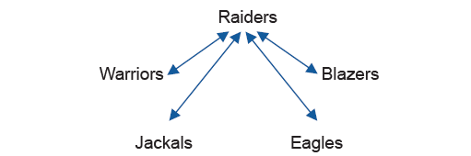
Example 6: Drawing a Diagram—Slide 5
Next, we consider all games that will be played by the Raiders against all the other teams (and the games they all play against the Raiders).
Figure 9: The 16 Games Played by the Raiders

Slide 52
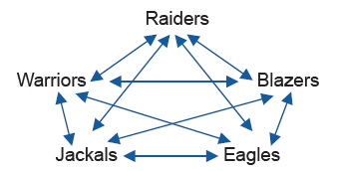
Example 6: Drawing a Diagram—Slide 6
Continuing in this manner, we arrive at all of the possible game matchups.
Figure 10
From the figure, we can see that there are 10 lines. Remembering that each line represents 4 games, we conclude that a total of 40 games will be played.

Slide 53
Example 6: Drawing a Diagram—Slide 7
Step 4: Look Back
Recall from our understanding of the problem that we thought there might be 80 total games played. Why is there a difference in our actual solution? The answer lies in the fact that although the Raiders play the Blazers four times and the Blazers play the Raiders four times, there is a total of only four games between the two teams instead of the expected eight games. With our initial thinking, when each team plays another team, we counted that game as a game for both teams. So in our preliminary discussion of the problem, we made an error when we counted each game twice.

Slide 54
Example 7: Using a Variable—Slide 1
Devon has $100 to spend on a pair of shoes. The pair he wants costs $120. Ignoring sales tax, what is the minimum percentage off Devon would need so he can buy the shoes?
Solution
Step 1: Understand the Problem
We are being asked to find the percentage off the original price of the shoes that leads to a discounted price that is $100 or less. The original price is $120, so Devon needs a discount that is at least $20.

Slide 55
Example 7: Using a Variable—Slide 2
Step 2: Devise a Plan
A discount is typically a percentage of the sale price. We need a discount that is at least $20, so we need to find a percentage that when multiplied by the original price of $120 results in a value of at least $20. We can set up an inequality using a variable, say x, to represent the unknown percentage in decimal form.

Slide 56
Example 7: Using a Variable—Slide 3
Step 3: Carry Out the Plan
We know that we need to find the value of x where $120 multiplied by x is equal to a value that is greater than or equal to $20. We can represent this scenario with the inequality 120x ≥ 20.
​
This tells us that $20 is approximately 17% of the original price. If the original price is reduced by at least 17%, Devon will be able to purchase the shoes.

Slide 57
Example 7: Using a Variable—Slide 4
Step 4: Look Back
We use the look back step to check the accuracy and feasibility of our solution. We can confirm the percent off we found falls into a reasonable range with some quick checks. We know that 10% of $120 would be savings of $12. Similarly, 20% of $120 would be $24. We needed to find the percentage off associated with savings of $20, and our answer of 17% falls between 10% and 20%, as expected.

Slide 58
Skill Check 3
A number is multiplied by 8 and the product is added to 6. If the sum is 30, what is the number?
Answer: 3

