Slide 1
Section 10.1
Introduction to Probability

Slide 2
Helpful Hint 1
The word inclusive indicates that the end points are included in a range of numbers. For example, "natural numbers 1 to 3, inclusive," denotes 1, 2, and 3.

Slide 3
Helpful Hint 2
The outcomes in a sample space can be listed between curly brackets and separated by commas. For instance, the sample space for a coin flip is {head, tail}.

Slide 4
Definition: Probability Terminology
Probability
The probability of something occurring is a number between 0 and 1, inclusive, that represents how likely the event is to occur. If an event cannot occur its probability is 0. If an event is certain to happen its probability is 1.
Probability Experiment
A probability experiment, or a trial, is any process with a result determined by chance.
Outcome
Each individual result that is possible for a probability experiment is an outcome.
Sample Space
The sample space is the set of all possible outcomes for a given probability experiment.

Slide 5
Helpful Hint 3
The sample space is the set of outcomes for an experiment, not the number of outcomes.

Slide 6

Example 1: Determining Sample Spaces
Identify the sample space for each of the following experiments.
a.​ Rolling a single fair six-sided die
b.​ Seat assignments on an airplane where the row options are aisle (A) or window (W), and the section options are business class (B) or economy class (E)
Solution
a​. The sample space consists of all of the possible outcomes of rolling a fair die. It can land on any of the six sides of the die. Therefore, the sample space is the following.
b. The sample space consists of all possible seat assignments. Each outcome is comprised of a seat position in the row and a section in the plane. For example, an aisle seat (A) in the business class (B) could be denoted AB. Using this notation, the sample space can be written as follows.

Slide 7
Skill Check 1
Identify the sample space for tossing two coins together, where H is heads and T is tails.
Answer: {HH, HT, TT, TH}

Slide 8
Definition: Tree Diagram
A tree diagram uses branches to indicate all possible outcomes at each stage for an experiment. Each path of branches in a tree diagram indicates a single possible outcome for the experiment.

Slide 9
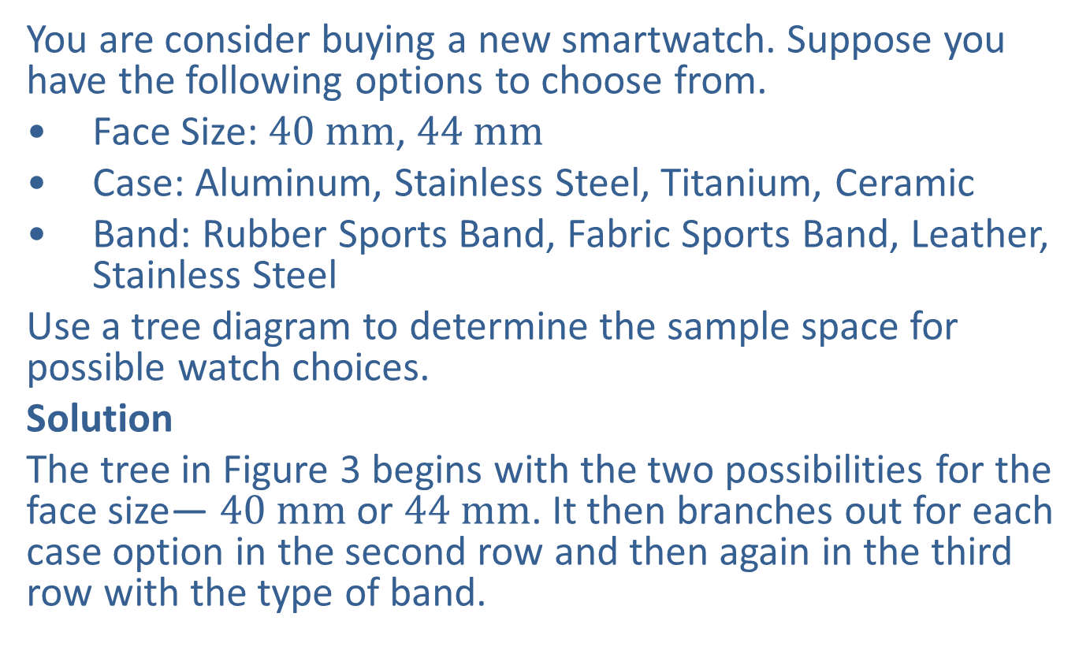
Example 2: Using a Tree Diagram to Determine a Sample Space—Slide 1
You are consider buying a new smartwatch. Suppose you have the following options to choose from.
​Face Size: $40 mm$, $44 mm$
​Case: Aluminum, Stainless Steel, Titanium, Ceramic
​Band: Rubber Sports Band, Fabric Sports Band, Leather, Stainless Steel
Use a tree diagram to determine the sample space for possible watch choices.
Solution
The tree in Figure 3 begins with the two possibilities for the face size— $40 mm$ or $44 mm$. It then branches out for each case option in the second row and then again in the third row with the type of band.

Slide 10
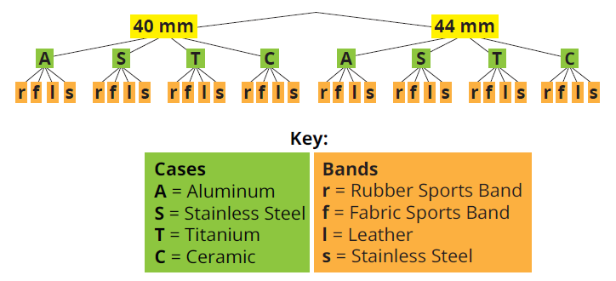
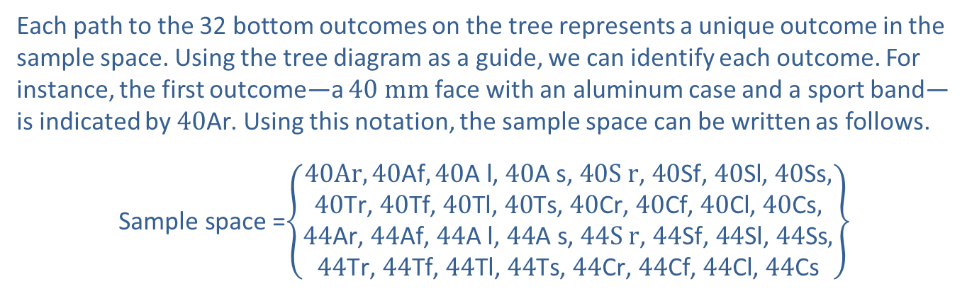
Example 2: Using a Tree Diagram to Determine a Sample Space—Slide 2
Figure 3: Smartwatch Tree Diagra m
Each path to the 32 bottom outcomes on the tree represents a unique outcome in the sample space. Using the tree diagram as a guide, we can identify each outcome. For instance, the first outcome—a $40 mm$ face with an aluminum case and a sport band—is indicated by $40\text{Ar}$. Using this notation, the sample space can be written as follows.
$\text{Sample} \text{space}$ =$\left\{\left.\begin{aligned}40Ar,40\text{Af},40\text{A} \text{l}\text{, }40\text{A} \text{s}\text{, }40\text{S} \text{r}\text{, }40\text{Sf}\text{, }40\text{Sl}\text{, }40\text{Ss}, \\ 40\text{Tr}\text{, }40\text{Tf}\text{, }40\text{Tl}\text{, }40\text{Ts}\text{, }40\text{Cr}\text{, }40\text{Cf}\text{, }40\text{Cl}\text{, }40\text{Cs}, \\ 44\text{Ar}\text{, }44\text{Af}\text{, }44\text{A} \text{l}\text{, }44\text{A} \text{s}\text{, }44\text{S} \text{r}\text{, }44\text{Sf}\text{, }44\text{Sl}\text{, }44\text{Ss}, \\ 44\text{Tr}\text{, }44\text{Tf}\text{, }44\text{Tl}\text{, }44\text{Ts}\text{, }44\text{Cr}\text{, }44\text{Cf}\text{, }44\text{Cl}\text{, }44\text{Cs}\end{aligned}\right\}\right.$

Slide 11
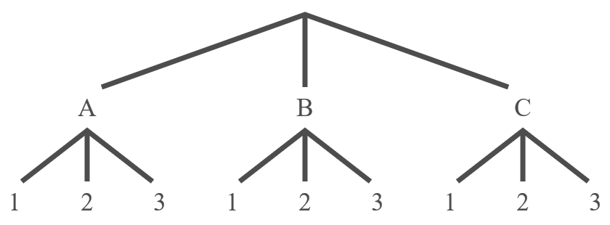
Skill Check 2
Draw a tree diagram for an experiment consisting of 2 stages where each stage has 3 possible outcomes.
Answer:

Slide 12
Definition: Event
An event E is a group, or subset, of outcomes in the sample space.

Slide 13
Helpful Hint 4
Remembering that probability is always a number between 0 and 1 is helpful in identifying inaccurate probability calculations. Any probability greater than 1 or less than 0 must be incorrect.

Slide 14
Definition: Experimental Probability
In experimental probability, if E is an event, then P(E), which is read "the probability that E occurs," is given by
where f is the number of times the event occurs (the frequency of the event) and n is the total number of times the experiment is performed. The value of P(E) will always be a real number between 0 and 1, inclusive.

Slide 15
Example 3: Calculating Experimental Probability—Slide 1
For her elementary school science fair project, Libby is conducting research on the accuracy of the weather prediction from her local news channel. She recorded the forecast and the actual weather for two weeks. The following table shows her results.

Slide 16
Example 3: Calculating Experimental Probability—Slide 2
Table 1: Accuracy of Weather Predictions (cont.)
Forecast | Actual Weather
Rain | Rain
Snow | Rain
Snow | Snow
Cloudy | Clear
Cloudy | Cloudy
Rain | Rain
Clear | Drizzling rain
Clear | Clear
Cloudy | Clear
Snow | Cloudy
Clear | Clear
Clear | Clear
Rain | Rain
Rain | Cloudy

Slide 17
Example 3: Calculating Experimental Probability—Slide 3
a. Using experimental probability, what is the probability that the news channel accurately predicts the next day's weather?
b.​ Discuss what might happen to the calculated probability if Libby records the weather prediction and outcome for another 14 days.

Slide 18
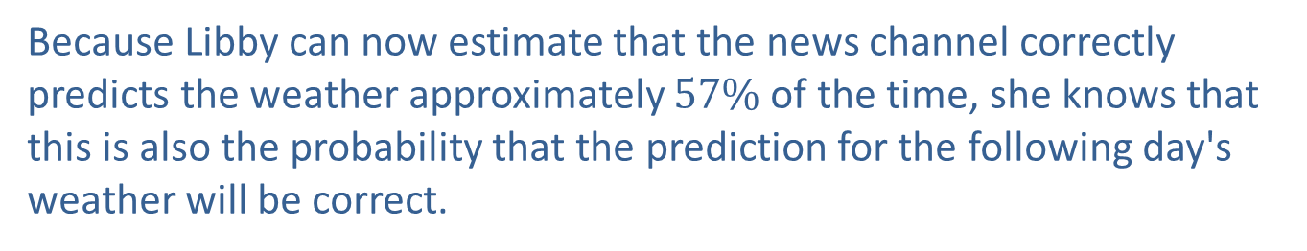
Example 3: Calculating Experimental Probability—Slide 4
Solution
a.​ For Libby to calculate the probability, she needs to count the number of days the weatherman correctly predicted the weather and divide it by 14 (the total number of days she did the experiment).
​
Because Libby can now estimate that the news channel correctly predicts the weather approximately $57\%$ of the time, she knows that this is also the probability that the prediction for the following day's weather will be correct.

Slide 19
Example 3: Calculating Experimental Probability—Slide 5
b.​ With more data points to include in the probability calculation, Libby's experimental probability will get closer to the true probability of the news channel correctly predicting the weather. If the prediction was correct more often in the next 14 days, the calculated probability of a correct prediction would be higher; if the prediction was correct less often, the probability would be lower. Either way, the experimental probability would get closer to the true probability.

Slide 20
Think Back
Remember, when changing from a decimal to a percent, you move the decimal two places to the right and add the % sign.

Slide 21
Definition: Classical Probability
In classical probability, if all outcomes are equally likely to occur, then P(E), which is read "the probability that E occurs," is given by
where n(E) is the number of outcomes in the event and n(S) is the number of outcomes in the sample space. The value of P(E) will always be a real number between 0 and 1, inclusive.

Slide 22
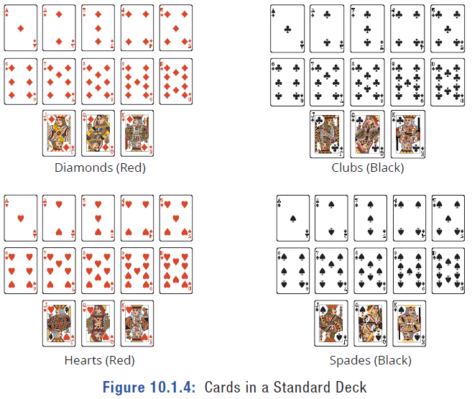
Example 4: Calculating Classical
Probability—Slide 1
Suppose you were asked to draw a card from a standard deck of 52 cards. A standard deck of cards contains the following cards.
Figure 4: Cards in a Standard Deck

Slide 23
Example 4: Calculating Classical
Probability—Slide 2
a. What is the probability that the card you draw is red?
b.​ What is the probability that the card you draw is a diamond?
c.​ What is the probability that the card you draw is a face card (king, queen, or jack)?
d.​ What is the probability of drawing a red spade?
Solution
In all of these questions, we are drawing from a standard deck of cards, which means that each card has the same probability of being chosen and that the sample space contains 52 cards; that is, n(S) = 52.

Slide 24
Example 4: Calculating Classical
Probability—Slide 3
a.​ The event we are interested in is "drawing a red card." Since half of the cards are red, there are 26 red cards; that is, the number of outcomes in the event is 26. So we calculate the probability that the card you draw is red as follows.
​
​
b. The event "drawing a diamond" has 13 outcomes, since there are 13 cards in the diamond suit. So the probability that the card you draw is a diamond is found using the following equation.

Slide 25
Example 4: Calculating Classical
Probability—Slide 4
c.​ The event "drawing a face card" means that we must consider all four suits. Each suit has three face cards—a king, a queen, and a jack. So there are 4 ⋅ 3 = 12 cards in the event. The probability that the card you draw is a face card is calculated as follows.
​
​
d. The event is "drawing a red spade." Because all spades are black, there are no red spades and hence there are no outcomes in the event. Therefore, the probability that the card you draw is a red spade is 0, as shown in the following equation.

Slide 26
Example 5: Calculating Classical
Probability—Slide 1
Suppose that you grab a snack from a bag of chocolates that contains 4 caramel with milk chocolate, 4 mint with white chocolate, 6 mint with dark chocolate, and 2 raspberry with dark chocolate.
a. What is the probability that you randomly grab a raspberry with dark chocolate for your snack?
b. What is the probability that you get a chocolate that does not contain dark chocolate?
c.​ Determine the probability that the snack you grab contains chocolate.

Slide 27
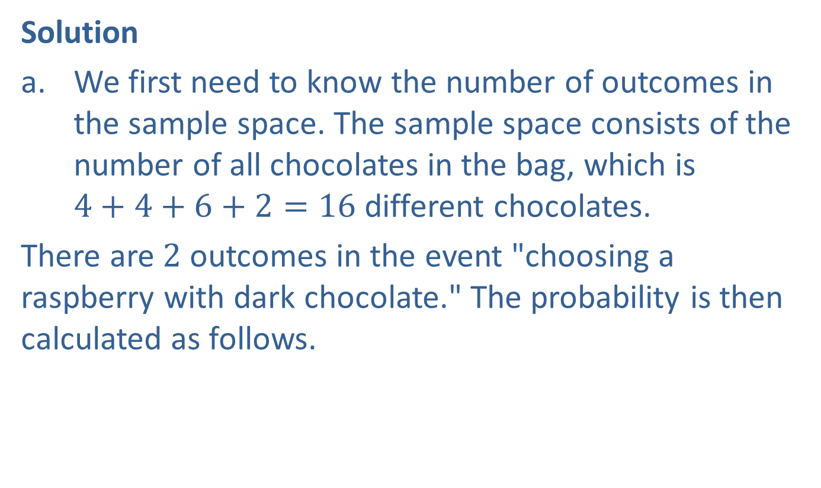
Example 5: Calculating Classical
Probability—Slide 2
Solution
a.​ We first need to know the number of outcomes in the sample space. The sample space consists of the number of all chocolates in the bag, which is
$4+4+6+2=16$ different chocolates.
​There are 2 outcomes in the event "choosing a raspberry with dark chocolate." The probability is then calculated as follows.
​

Slide 28

Example 5: Calculating Classical
Probability—Slide 3
b.​ The event "does not contain dark chocolate" includes the flavors caramel with milk chocolate and mint with white chocolate. Thus, there are
$4+4=8$ pieces that do not contain dark chocolate. The probability is then calculated as follows.
​
​
c. ​Since there are only chocolates in the bag, choosing a chocolate is a certainty. Therefore, the probability is 1.

Slide 29
Skill Check 3
Determine the probability of rolling a four on a fair six-sided die.
Answer:

Slide 30
Example 6: Calculating Classical
Probability—Slide 1
Consider a tennis game between two equally matched players in different age groups. The outcome of each point is that either the older player wins (O) or the younger player wins (Y), and since the players are equally matched, we'll assume these two outcomes are equally likely. What is the probability that the older player will win the first three points?
Solution
Since we are told both outcomes O and Y are equally likely, we can use classical probability. To determine how many outcomes are in the sample space, we can use either a pattern or a tree diagram. Let's use a tree diagram.

Slide 31
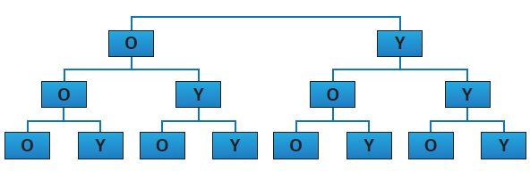

Example 6: Calculating Classical
Probability—Slide 2
This gives 8 possible outcomes for the first three points: $\left\{\text{OOO}\text{, }\text{OOY}\text{, }\text{O} \text{Y} \text{O}\text{, }\text{OYY}\text{, }\text{Y} \text{O} \text{O}\text{, }\text{YOY}\text{, }\text{YYO}\text{, }\text{YYY}\right\}$. Notice that only 1 of the outcomes consists of the older player winning all three times (OOO). Thus, the probability of the older player winning all three of the points is calculated as follows.
Figure 5
Notice that the probability of the younger player winning all three points is also

Slide 32
Example 7: Calculating Classical
Probability—Slide 1
In biology we learn that many traits are genetic. One example is the shape of our hairline, which is either straight or has a V-shape, called a widow's peak. Each person has two alleles that make up their hairline shape gene—either a widow's peak allele or a straight hairline allele, one inherited from each parent. Suppose a child has a mother with a widow's peak allele and a straight hairline allele, and a father who has two straight hairline alleles. What is the probability that the child will have a straight hairline if the widow's peak allele is always dominant over the straight hairline allele? (Note that since the widow's peak is dominant, any gene containing the widow's peak allele will result in having a widow's peak.)

Slide 33
Example 7: Calculating Classical
Probability—Slide 2
Solution
So far, we have listed the outcomes of an experiment in an orderly fashion by using a tree diagram. In biology, a Punnett square is commonly used to help list the outcomes of a genetic experiment. The mother's two alleles of a specific gene are listed along one side of a square, and the father's two alleles of the gene are listed along an adjacent side. The square is then filled in by writing the four possible combinations of alleles inherited—one from each parent.
For this experiment, we will label a widow's peak allele with an uppercase W and a straight hairline allele with a lowercase w. The mother's gene will be labeled Ww since she has both a widow's peak and a straight hairline allele. The father, with two straight hairline alleles, will be labeled ww. These go on the outside of the Punnett square as shown.

Slide 34
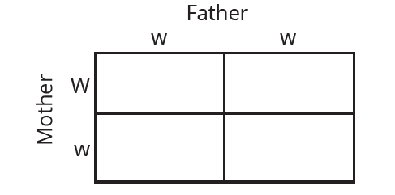
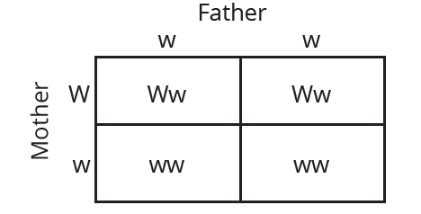
Example 7: Calculating Classical
Probability—Slide 3
Figure 6: Punnett Square for Hairline Genes
Next, we fill in each section of the square by writing the possible combinations of alleles inherited—one from each parent. For instance, the top left section will have a W from the mother and a w from the father.
Figure 7: Punnett Square for Hairline Genes

Slide 35
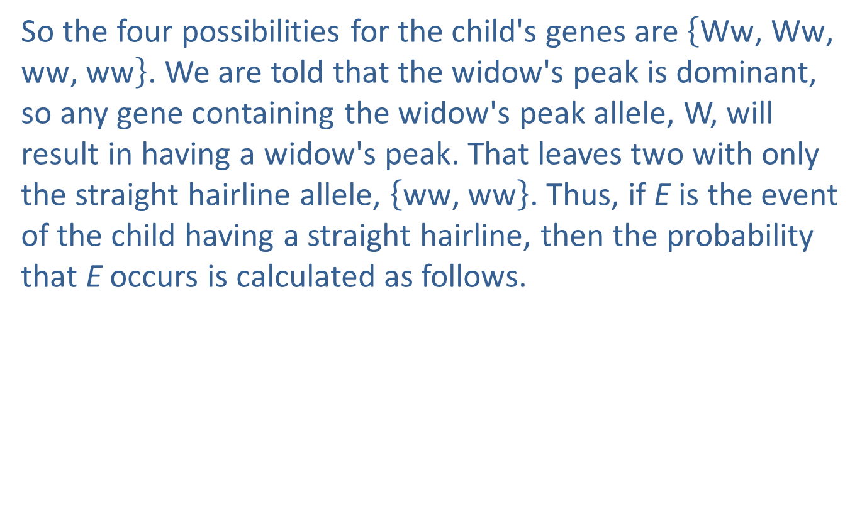

Example 7: Calculating Classical
Probability—Slide 4
So the four possibilities for the child's genes are $\left\{\text{Ww}\text{, }\text{Ww}\text{, }\text{ww}\text{, }\text{ww}\right\}$. We are told that the widow's peak is dominant, so any gene containing the widow's peak allele, W, will result in having a widow's peak. That leaves two with only the straight hairline allele, $\left\{\text{ww}\text{, }\text{ww}\right\}$. Thus, if E is the event of the child having a straight hairline, then the probability that E occurs is calculated as follows.
This means that the child has a $50\%$ chance of having a straight hairline.

Slide 36
Helpful Hint 5
A gene consists of two alleles, one from each parent.

Slide 37
Mathematical Milestone
Reginald Punnett (1875–1967) was a British geneticist who developed the diagram discussed in Example 7, which is named after him, called the Punnett square. He is also known for cofounding the Journal of Genetics and writing one of the first textbooks on genetics.

Slide 38
Example 8: Classical vs. Experimental Probability—Slide 1
Determine if the scenarios given are examples of classical or experimental probability.
a. ​Katie is curious about her chances of winning an e-reader from the student government association. She polled her friends to find out how many of them filled out the survey to be entered in the contest.
b.​ Tristan is interested in his chances of winning at the blackjack table. He determines the probability of what his next card will be by knowing the cards that have already been played.
c. ​Based on the recent United States Census, the local government estimates the amount of growth the community will experience in the coming years.

Slide 39
Example 8: Classical vs. Experimental Probability—Slide 2
Solution
a.​ Because Katie is conducting an informal survey and not all students are included, the probability is experimental.
b.​ This is an example of classical probability since all cards have an equal chance of being dealt at the beginning, and Tristan adjusts his chances by accounting for those cards that have already been drawn.
c.​ Since the United States Census is actually an incomplete count, any probability calculated from it would be experimental.

