Slide 1
Section 10.2
Counting Outcomes

Slide 2
Definition: Fundamental Counting Principle
The Fundamental Counting Principle states that for an experiment with a sequence of n stages where the first stage has k₁ outcomes, the second stage has k₂ outcomes, the third stage has k₃ outcomes, and so forth, the total number of possible outcomes for the experiment is calculated as follows.

Slide 3
Definition: Replacement
When counting possible outcomes with replacement, objects are placed back into consideration for the following choice.
When counting possible outcomes without replacement, objects are not placed back into consideration for the following choice.

Slide 4
Example 1: Using the Fundamental Counting Principle—Slide 1
In order to log in to your new email account, you must create a password. The requirements are that the password needs to be 8 characters long, consisting of 5 lowercase letters and followed by 3 numbers.
a. ​If you are allowed to use a character more than once, that is, with replacement, how many different possibilities are there for passwords?
b.​ How many passwords are possible if the characters may not be duplicated, that is without replacement or without repetition.

Slide 5
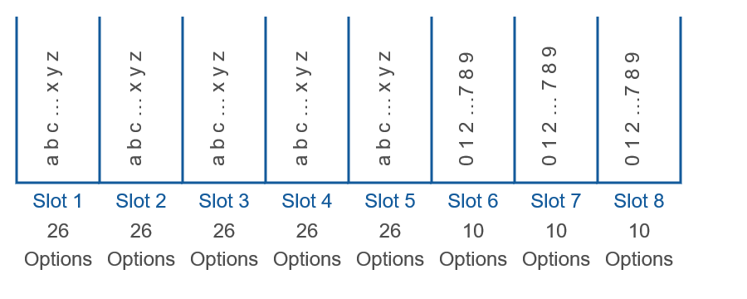
Example 1: Using the Fundamental Counting Principle—Slide 2
Solution
a. ​If we think about each character in the password as a slot to fill, then we have 8 slots that need to be filled. The first 5 can be filled with letters and the last 3 with digits, as shown in Figure 1.
Figure 1

Slide 6
Example 1: Using the Fundamental Counting Principle—Slide 3
​The first 5 slots contain 26 possibilities each, one for each letter of the alphabet. Notice that since we are allowed to have repeating characters in the password, we use the number 26 for each of the five slots and not just the first one. Similarly, the last 3 slots have 10 possible possibilities each, one for each digit 0 through 9. Using the Fundamental Counting Principle, we multiply the numbers of possibilities together to get the total number of possible passwords for the new account.
​
Therefore, when characters are allowed to be used more than once, there are 11,881,376,000 possible passwords.

Slide 7

Example 1: Using the Fundamental Counting Principle—Slide 4
b.​ This time the parameters change slightly. The first slot still has a possibility of 26 letters, but the second slot now only has 25 choices since we used one letter for the first slot and are not allowed to reuse it. Similarly, the third slot has 24 choices, and so forth. A similar thought process is used to fill in the numbers of choices for the digits in the last 3 slots.
Figure 2

Slide 8
Example 1: Using the Fundamental Counting Principle—Slide 5
​Using the Fundamental Counting Principle, we multiply the numbers of options together once again.
​
Therefore, when we are not allowed duplicate characters there are about half as many possible passwords, even though 5,683,392,000 is still a lot of choices.

Slide 9
Skill Check 1
How many 3-digit pin numbers are available using the numbers 1 through 9 if repetition is allowed?
Answer: 729

Slide 10
Example 2: Using the Fundamental Counting Principle—Slide 1
The science section of the ACT test has 40 multiple choice questions, each with answer options A through D.
a.​ How many different ways are there to fill in the answer sheet for the science portion of the ACT if all the questions are answered?
b.​ Suppose a test taker decides to fill in the answers to the science portion randomly. The only restriction he puts on himself is that he can't use the same answer choice back-to-back. For example, if he chooses A for question 1, he can't use A for question 2, but he can use it again for question 3. How many possible ways are there for him to fill in the answer sheet for the science section?

Slide 11

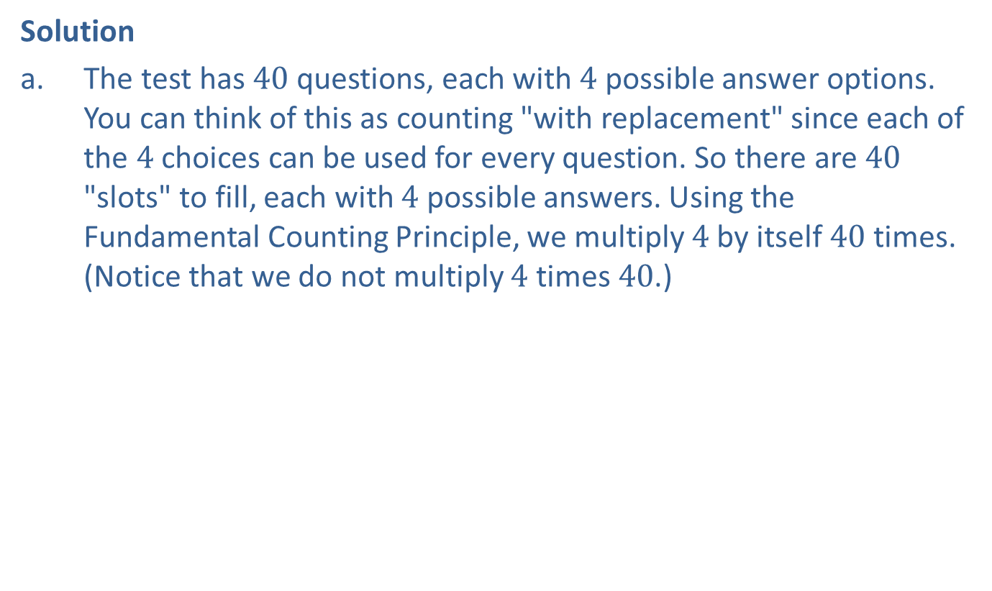
Example 2: Using the Fundamental Counting Principle—Slide 2
Solution
a.​ The test has 40 questions, each with 4 possible answer options. You can think of this as counting "with replacement" since each of the 4 choices can be used for every question. So there are 40 "slots" to fill, each with 4 possible answers. Using the Fundamental Counting Principle, we multiply 4 by itself 40 times. (Notice that we do not multiply 4 times 40.)
​
This number is so large that most of our calculators struggle to display it. Instead, many calculators give the answer in scientific form:
This means there are approximately
  1,208,926,000,000,000,000,000,000 ways to fill in just the science portion of the ACT.

Slide 12

Example 2: Using the Fundamental Counting Principle—Slide 3
b.​ Once again, there are 40 slots. The first slot will have 4 answer options to choose from. After that, each question will essentially have only 3 answer options to choose from since he can never use the answer from the previous question. This happens 39 times. So the multiplication will be as follows.
  Therefore, there are approximately 16,210,220,000,000,000,000 possible ways to fill in the science portion of the ACT if no answer choices are used back-to-back.

Slide 13
Definition: N Factorial
In general,
(read " n factorial") is the product of all
the positive integers less than or equal to n, where n is a positive integer.
The expression
is defined to be 1.

Slide 14
Example 3: Calculating Factorials—Slide 1
Calculate the values of the following factorial expressions.

Slide 15
Example 3: Calculating Factorials—Slide 2
Solution
a.​ The expression
indicates that we need to multiply
together each positive integer less than or equal to 8.
By Hand
  TI-83/84 Plus
  To calculate a factorial of the form
enter the
  value of n in the calculator and press math. Highlight PROB to go to the probability menu and select
The calculator returns 40320.

Slide 16
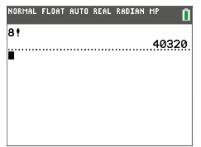
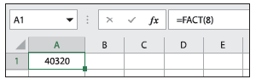
Example 3: Calculating Factorials—Slide 3
Figure 3
  Microsoft Excel
  We can use the built-in factorial function =FACT(number) to evaluate factorials. In an empty cell, type "=FACT(8)" and press Enter. The value is given as 40320.
Figure 4

Slide 17
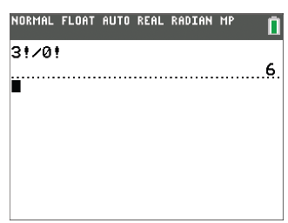
Example 3: Calculating Factorials—Slide 4
Remember that
  so we are not dividing by 0.
  By Hand
  Calculate each factorial and then divide.
Figure 5
  TI-83/84 Plus
  We can do this calculation in one step with the calculator by typing in
The calculator returns 6.

Slide 18
Example 3: Calculating Factorials—Slide 5
  Microsoft Excel
  In an empty cell, type "=FACT(3)/FACT(0)" and press Enter. The value returned is 6.
  By Hand
It would be very cumbersome to multiply out
  and then divide. Instead, we will cancel out some of the common factors that appear in both the numerator and denominator first. Begin by expanding the numerator and then canceling.

Slide 19
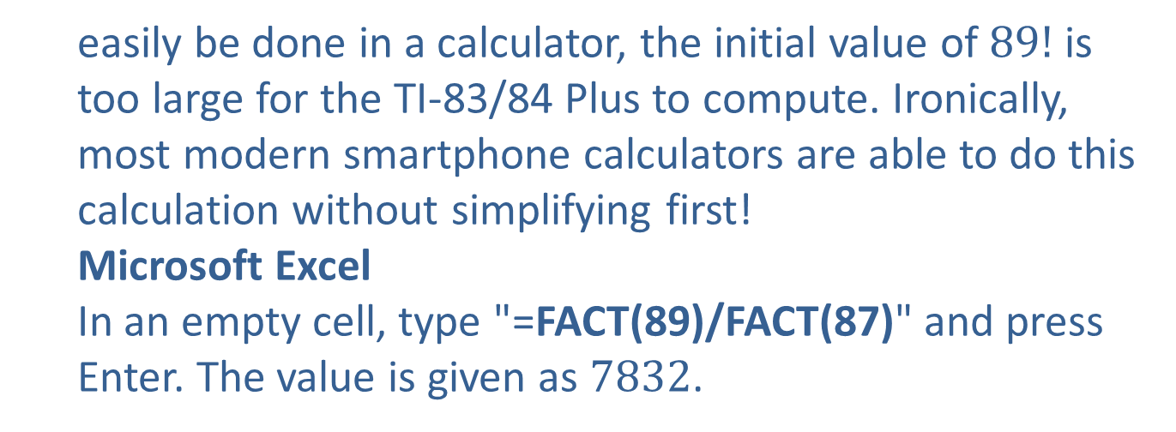
Example 3: Calculating Factorials—Slide 6
  TI-83/84 Plus
  Notice that if you type
into a TI-83/84 Plus, you
will get an overflow error message. Even though the
expression
simplifies to
which can
  easily be done in a calculator, the initial value of $89!$ is too large for the TI-83/84 Plus to compute. Ironically, most modern smartphone calculators are able to do this calculation without simplifying first!
  Microsoft Excel
  In an empty cell, type "=FACT(89)/FACT(87)" and press Enter. The value is given as 7832.

Slide 20
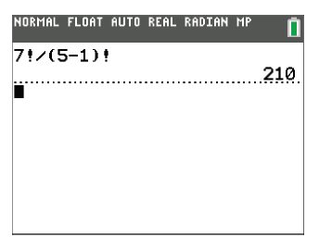
Example 3: Calculating Factorials—Slide 7
  By Hand
  You must begin by evaluating the expression in the parentheses. Next, cancel common factors in the numerator and denominator and then simplify.
  TI-83/84 Plus
  Notice that you can type in the entire expression without simplifying first. Be sure to place the parentheses in the denominator. The calculator returns 210.
Figure 6

Slide 21
Example 3: Calculating Factorials—Slide 8
  Microsoft Excel
  In an empty cell, type "=FACT(7)/FACT(5-1)" and press Enter. The value returned is 210.
  By Hand
  Make sure that you begin by subtracting to simplify the expression in parentheses.

Slide 22
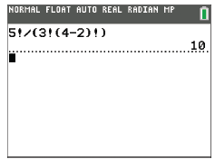
Example 3: Calculating Factorials—Slide 9
  TI-83/84 Plus
  Once again, we can enter the entire original expression in one line. However, we must place parentheses around the entire expression in the denominator, which produces the correct solution of 10.
Figure 7
  Microsoft Excel
  In an empty cell, type "=FACT(5)/(FACT(3)*FACT(4-2))". Be sure to put parentheses around the entire expression in the denominator, which results in the correct solution of 10.

Slide 23
Helpful Hint 1
The TI-83/84 Plus and Microsoft Excel both follow the rules for order of operations, which is why it is so important to place parentheses around the entire expression in the denominator of Example 3 part e. Try the calculation without the parentheses to see how important proper parentheses usage is.

Slide 24
Fun Fact
A combination lock should really be called a permutation lock because the order you put the numbers in matters! A true combination lock would accept both 10-7-67 and 67-7-10 as correct.

Slide 25
Definition: Combinations and Permutations
Combinations
A combination is a selection of objects from a group without regard to their arrangement; that is, their order is not important.
Permutations
A permutation is a selection of objects from a group where the arrangement is specific; that is, their order is important.

Slide 26
Example 4: Comparing Combinations and Permutations—Slide 1
Decide whether you would use a permutation or combination to count the number of outcomes for each of the following scenarios.
a. ​In how many ways can a club elect a president, vice president, and treasurer if there are 30 students participating?
b.​ If each department needs two student representatives from each major on a campus committee, how many ways can the biology department choose the representatives from the 45 students who are majoring in biology?

Slide 27
Example 4: Comparing Combinations and Permutations—Slide 2
Solution
a.​ First notice that the number of students participating in the club does not affect whether we use a permutation or combination to count. What is important is the arrangement of the officers for counting purposes. The assignment of jobs makes a difference, so this is a permutation.
b.​ In this second scenario, we are interested in choosing two of the students from those majoring in biology, where the arrangement is not specified to be important. Therefore, we use a combination to count the number of outcomes.

Slide 28
Skill Check 2
Would you use a combination or a permutation to count the number of ways that five people can line up to buy tickets to a concert?
Answer: Permutation

Slide 29
Formulas: Combinations and Permutations
The following formula is used to calculate the number of combinations.
The following formula is used to calculate the number of permutations.
In both of these formulas, r objects are selected from a group of n distinct objects, so r and n are both positive integers with r ≤ n.

Slide 30
Helpful Hint 2
The following are all alternate notations for combinations and permutations.
Combinations
Permutations

Slide 31
Example 5: Calculating Numbers of Combinations and Permutations—Slide 1
Consider a group of 15 candidates auditioning for a talent search firm.
a.​ How many ways can you arrange the sequence in which the candidates audition in the first round?
b. ​How many ways can you choose 5 of the candidates to move on to the next round?
Solution
a.​ First, notice that the arrangement of the 15 candidates is important for counting purposes because being the first to audition is certainly not the same as being the fifteenth. Therefore, this is a permutation. There are 15 candidates to choose from, so n = 15, and we want to arrange all of them, so r is also fifteen. The number of permutations of 15 things permuted 15 at a time is calculated as follows.

Slide 32
Example 5: Calculating Numbers of Combinations and Permutations—Slide 2
  By Hand
  TI-83/84 Plus
To calculate a permutation of the form
first enter the n
  value, 15. Then press math , highlight PROB to go to the probability menu, and select nPr. Back on the home screen, enter in the r value, 15. The value is given as 1.307674368E12. This value is given in scientific notation and is equivalent to 1,307,674,368,000.

Slide 33
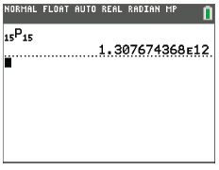
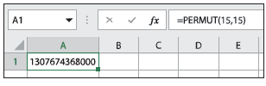
Example 5: Calculating Numbers of Combinations and Permutations—Slide 3
Figure 8
  Microsoft Excel
  We can use the built-in permutation function, PERMUT(number, number_chosen), to evaluate permutations. In an empty cell, type "=PERMUT(15,15)" and press Enter. The value is given as 1,307,674,368,000. (Note that the value is initially given as 1.30767E+12. To see what this value is in expanded form instead of in scientific notation, right-click on the cell and select "Format cells". On the "Number" tab, select "Number" for the category, and click on "Okay".)
Figure 9

Slide 34
Example 5: Calculating Numbers of Combinations and Permutations—Slide 4
  So there are 1,307,674,368,000 possible choices for the candidate lineup. Notice that the result of
  b. The order of the chosen candidates is not important since each one receives the same prize of moving on to the next round, so we are counting the number of combinations of 5 people from a group of 15; that is, n = 15 and r = 5.
  By Hand

Slide 35
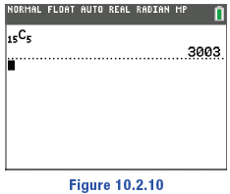
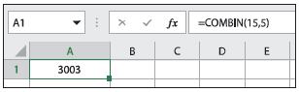
Example 5: Calculating Numbers of Combinations and Permutations—Slide 5
  TI-83/84 Plus
  Calculating a combination of the form
is similar to calculating a permutation. First, enter the n
  value, 15. Then press math, highlight PROB, and select nCr. Back on the home screen, enter in the r value, 5. The calculator returns 3003.
Figure 10
  Microsoft Excel
  Just as there is a formula for permutations, there is a built-in formula that is used to evaluate combinations, COMBIN(number, number_chosen). In an empty cell, type "=COMBIN(15,5)" and press Enter. The value is given as 3003.
Figure 11
  From this we know that there are 3003 distinct ways that 5 candidates can be chosen to move on to the next round.

Slide 36
Helpful Hint 3
In the special permutation where n = r, the result will always equal

Slide 37
Skill Check 3
Use the appropriate formula to calculate each of the following.
a.​ 10 things permuted 3 at a time
b.​ 8 choose 2
Answer:
a.​ 720
b. 28

Slide 38
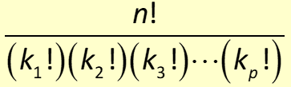

Definition: Permutations with Repeated Objects
The number of distinguishable permutations of n objects, of which k₁ are all alike, k₂ are all alike, and so forth, is given by the following formula.

Slide 39
Example 6: Calculating Numbers of Permutations with Repeated Objects—Slide 1
Consider a football team with an 11-game schedule. Each game ends with a win (W), a loss (L), or a tie (T).
a. ​How many ways can the 11-game schedule be arranged if the last game is always with the local rival team?
b.​ Once the schedule is set, how many ways can the schedule end with 6 wins, 4 losses, and 1 tie?
Solution
a.​ First, notice that the arrangement of the 11 games is important for counting purposes, so this is a permutation. Since the last game is always with the rival team, we really only need to find how many ways the first 10 games can be arranged, so n is 10, and we want to arrange all of them, so r is also 10. Therefore, the number of permutations of 10 things permuted 10 at a time is calculated as follows.

Slide 40
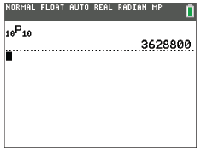
Example 6: Calculating Numbers of Permutations with Repeated Objects—Slide 2
  By Hand
  TI-83/84 Plus
The computation will have the form
with n = 10 and r = 10. The value given is
3628800.
Figure 12
  Therefore, there are 3,628,800 ways to arrange the 11-game schedule such that the last game is always against the rival team.

Slide 41

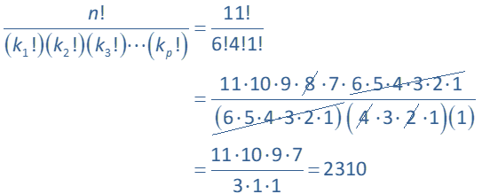

Example 6: Calculating Numbers of Permutations with Repeated Objects—Slide 3
b.​ In the second part, we can think of this as arranging wins (W), losses (L), and ties (T). Although the team might have a different opinion, we can make no distinction between the 6 wins or the 4 losses, so we will consider these to be repeated objects. Since we want to arrange 6 wins, 4 losses, and 1 tie, n $=11$, k₁ = 6, k₂ = 4, and k₃ = 1. Substituting these values into the formula for permutations with repeated objects,
gives the answer.
By Hand

Slide 42
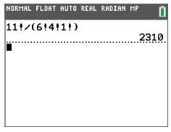
Example 6: Calculating Numbers of Permutations with Repeated Objects—Slide 4
TI-83/84 Plus
Notice that we do not need to simplify first when using the calculator. We simply enter
Be sure to include parentheses around the
denominator. The result is 2310.
Figure 13
Thus, there are 2310 ways that the wins, losses, and ties can be arranged.

Slide 43
Skill Check 4
How many different ways can you arrange the letters in the word Mississippi?
Answer: 34,650

