Slide 1
Section 10.3
Probability of Single Events

Slide 2
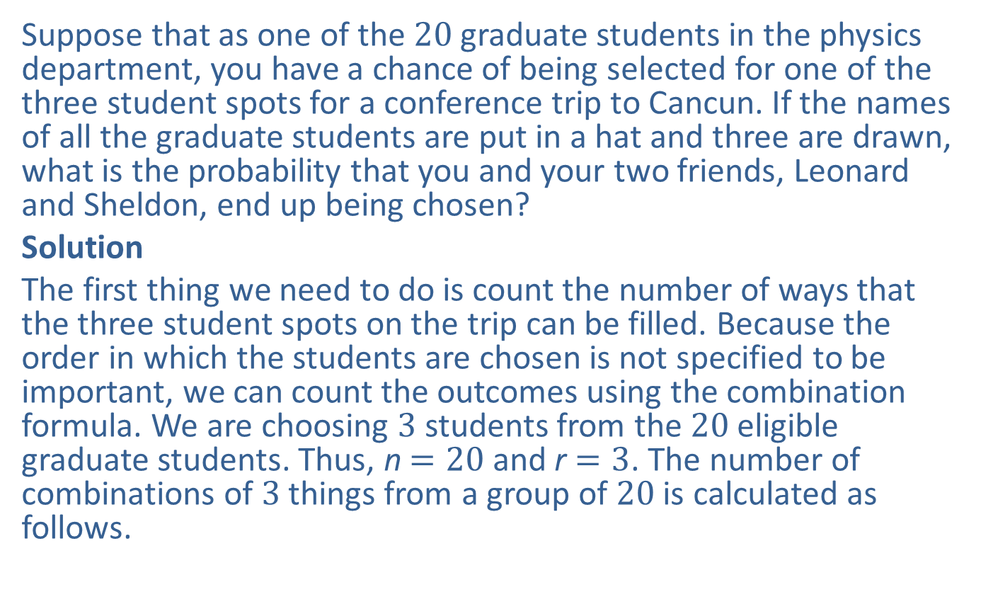
Example 1: Calculating Classical Probability Using Combinations—Slide 1
Suppose that as one of the 20 graduate students in the physics department, you have a chance of being selected for one of the three student spots for a conference trip to Cancun. If the names of all the graduate students are put in a hat and three are drawn, what is the probability that you and your two friends, Leonard and Sheldon, end up being chosen?
Solution
The first thing we need to do is count the number of ways that the three student spots on the trip can be filled. Because the order in which the students are chosen is not specified to be important, we can count the outcomes using the combination formula. We are choosing 3 students from the 20 eligible graduate students. Thus, n $=20$ and r $=3$. The number of combinations of 3 things from a group of 20 is calculated as follows.

Slide 3
Example 1: Calculating Classical Probability Using Combinations—Slide 2
This means that there are 1140 possible ways to choose 3 students from 20 for the trip. Note that there is only one way in which to choose you and your two friends as the students who go on the trip. The probability of this event happening is calculated as follows.
In other words, it is very unlikely that the three of you would randomly be chosen to go on the conference trip to Cancun together.

Slide 4
Example 2: Calculating Classical Probability Using Permutations—Slide 1
Let's change the previous example slightly. Suppose that as one of the 20 graduate students in the physics department, you have a chance of being selected for one of the three student spots for a conference in Cancun. The names of all the graduate students are put in a hat and three are randomly drawn. However, if your name is drawn first, you get all expenses paid. If you are chosen second, everything is paid for except meals. And if you're chosen third, you must pay for your own meals and hotel. (This means that the department still picks up the tab for the flight and conference fees of the three lucky students, so it's not a bad deal!) What is the probability that you and your two friends, Leonard and Sheldon, all end up being chosen, and that your name is drawn first?

Slide 5
Example 2: Calculating Classical Probability Using Permutations—Slide 2
Solution
This time, the order in which the three students are chosen does make a difference when we are counting, so we'll use a permutation. Note that n is still 20 and r is still 3.
Thus, there are 6840 possible ways to choose the three lucky students for the trip. However, let's consider how many outcomes are in the event that you, Sheldon, and Leonard are chosen, and that your name is drawn first; we'll call this event E.
There are only two ways that your name can be drawn first followed by Leonard and Sheldon. The possibilities are {you, Leonard, Sheldon} or {you, Sheldon, Leonard}.
Therefore, the probability that the event described occurs is calculated as follows.
It seems that there is an even smaller chance of this happening, so it's better not to be greedy and wish for the top spot!

Slide 6
Skill Check 1
Using the scenario from Examples 1 and 2, find the probability that you, Sheldon, and Leonard are all chosen for the department trip and you are the third to be chosen.

Slide 7
Example 3: Calculating Classical Probability—Slide 1
A university is putting together a hiring committee of 6 members for the next university provost. The eligible pool of members consists of 8 administrative personnel, 9 faculty, and 7 students.
a.​ In how many ways can the committee be formed?
b.​ In how many ways can the committee be formed if there must be 2 members chosen from each of the 3 subgroups?
c.​ Suppose the committee is chosen at random and with no restrictions. What is the probability that each subgroup has 2 members on the committee?

Slide 8
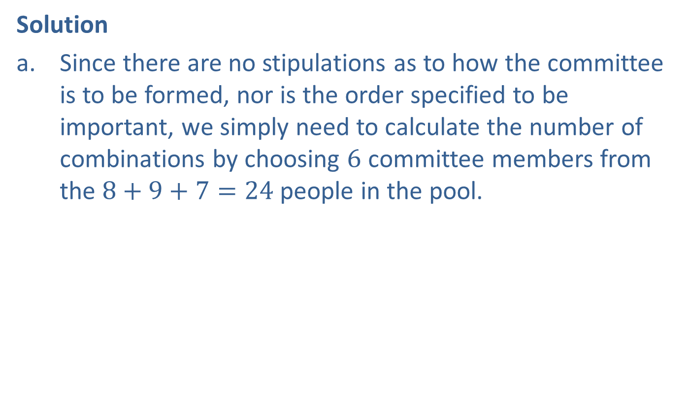
Example 3: Calculating Classical Probability—Slide 2
Solution
a.​ Since there are no stipulations as to how the committee is to be formed, nor is the order specified to be important, we simply need to calculate the number of combinations by choosing 6 committee members from the $8+9+7=24$ people in the pool.
Thus, there are 134,596 ways in which a committee of 6 can be formed.

Slide 9
Example 3: Calculating Classical Probability—Slide 3
b.​ This time we have the stipulation that there must be 2 members from each subgroup on the committee of 6 members. This will require a two-stage solution. First, we need to use the combination formula to count the number of ways we can choose 2 people from each subgroup. Then, we can use the Fundamental Counting Principle and multiply those numbers of combinations together to find out the total number of ways to form the committee.
Begin by finding the number of combinations specific to each subgroup.
Number of Administrative Personnel Combinations:
​
​
Number of Faculty Combinations:

Slide 10
Example 3: Calculating Classical Probability—Slide 4
Number of Student Combinations:
​
Now we multiply these numbers of combinations together.
Thus, there are 21,168 ways to choose the committee if there must be 2 members chosen from each of the 3 subgroups.
c. The final part of this question asks us to find the probability that a committee chosen at random would meet the requirements given in part b. That is, each subgroup would have 2 members on the committee. We can combine our answers from parts a. and b. to find the answer to this probability question.

Slide 11
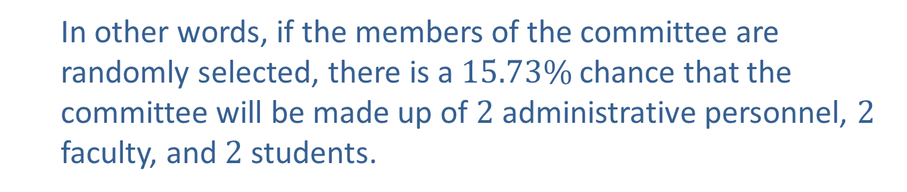
Example 3: Calculating Classical Probability —Slide 5
In other words, if the members of the committee are randomly selected, there is a $15.73\%$ chance that the committee will be made up of 2 administrative personnel, 2 faculty, and 2 students.

Slide 12
Example 4: Calculating Classical Probability—Slide 1
An employee is setting up a new password for his in-house messaging account. The password must contain at least 4 but no more than 6 characters using only lowercase letters and the digits 0 through 9, and each character can only be used once. Suppose he lets the computer randomly set his password using all of the restrictions listed. Use the following steps to calculate the probability that the password generated by the computer would contain all the letters in his dog's name—Bailey.
Step 1: Begin by determining how many different passwords are possible given the restrictions.
Step 2: Determine the number of possible passwords that contain all the letters in the dog’s name.
Step 3: Calculate the probability using the values from Steps 1 and 2.

Slide 13
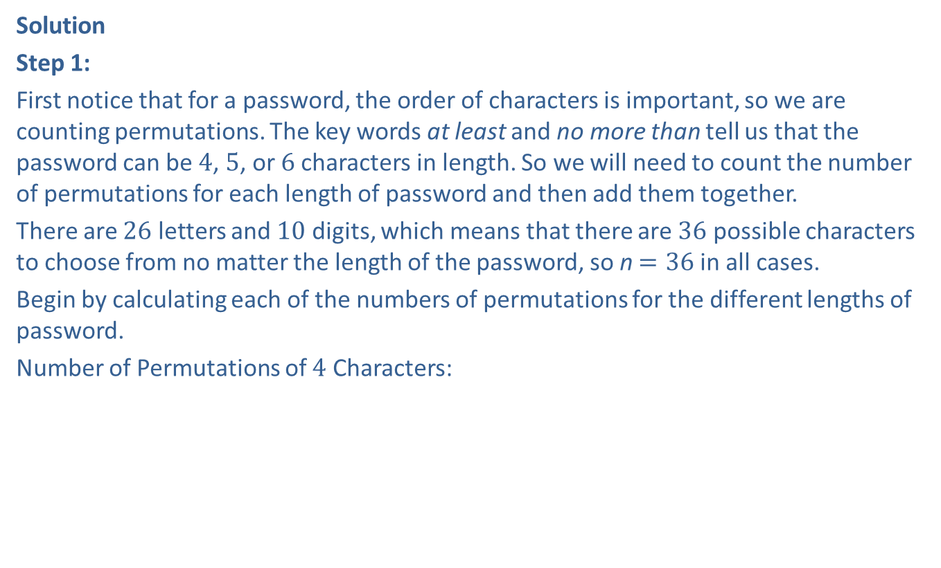
Example 4: Calculating Classical Probability—Slide 2
Solution
Step 1:
First notice that for a password, the order of characters is important, so we are counting permutations. The key words at least and no more than tell us that the password can be 4, 5, or 6 characters in length. So we will need to count the number of permutations for each length of password and then add them together.
There are 26 letters and 10 digits, which means that there are 36 possible characters to choose from no matter the length of the password, so n $=36$ in all cases.
Begin by calculating each of the numbers of permutations for the different lengths of password.
Number of Permutations of 4 Characters:
Number of Permutations of 5 Characters:

Slide 14
Example 4: Calculating Classical Probability —Slide 3
Number of Permutations of 6 Characters:
Now we add all of the numbers of permutations together.
1,413,720 + ,45,239,040 + 1,402,410,240 = 1,449,063,000
Therefore, there are a total of 1,449,063,000 different possibilities for the password if each character can only be used once. Imagine how many possibilities there would be if the password could use up to 9 or 10 characters!
Step 2:
There are 6 letters in the dog's name, Bailey. Finding the number of passwords that can be made using all of these letters requires we need to count the number of permutations of 6 things from a set of 6.
So there are 720 possible passwords using the 6 letters in Bailey's name.

Slide 15
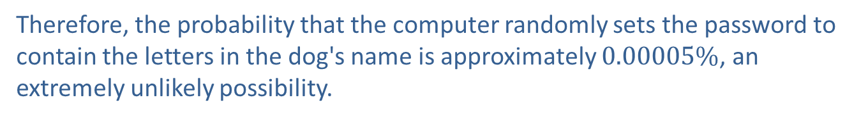
Example 4: Calculating Classical Probability—Slide 4
Step 3:
To find the probability that a randomly generated password would contain the 6 letters from Bailey's name, we need the total number of possible passwords made from the letters in Bailey's name, which we calculated in Step 2, divided by the total number of possible passwords, which we calculated in Step 1.
Thus, the probability is calculated as follows.
Therefore, the probability that the computer randomly sets the password to contain the letters in the dog's name is approximately $0.00005\%$, an extremely unlikely possibility.

Slide 16
Think Back
Remember that in permutations, if n = r, then you can simply calculate

Slide 17
Definition: Complement
The complement of event E, denoted by
consists of
all outcomes in the sample space that are not in event E.

Slide 18
Example 5: Finding the Complement of an Event—Slide 1
Describe the complement for each of the following events.
a.​ Choosing a vowel (a, e, i, o, u) from the English alphabet.
b.​ Choosing a number that doesn't end in 1 from all positive two-digit whole numbers.
c.​ From a class of 52 students, choosing a student who is over 21 years old.

Slide 19
Example 5: Finding the Complement of an Event—Slide 2
Solution
a.​ The English alphabet contains 26 letters, 5 of which are vowels (a, e, i, o, u). Since the 5 vowels are contained in the event, the set of remaining 21 letters (consonants) are the complement.
b.​ The set of all positive two-digit whole numbers includes the numbers 10 through 99. The complement of the event contains all two-digit numbers that do end in 1 (that is, 11, 21, 31, 41, 51, 61, 71, 81, and 91).
c.​ The complement consists of the students in the class who are 21 years old or younger.

Slide 20
Skill Check 2
Let the event E be an odd sum when a pair of dice is rolled. For each of the following, determine if the outcome could be in the complement of E.
a.​ A sum greater than 8
b.​ A sum that is an even number
c.​ A sum less than 5
d.​ A sum that is a multiple of 3
e.​ All of the above
Answer: e

Slide 21
Helpful Hint 1
That is, the outcomes in the event E plus the outcomes
in the complement
equal the entire possible set of
outcomes, which is the sample space S.

Slide 22
Definition: Complement Rules of Probability

Slide 23
Helpful Hint 2
Some of the more common complement phrases and their opposites are as follows.
All are | Not all are Some are not At least one is not
Some are | None are
Some are not | All are
None are | At lease one is

Slide 24
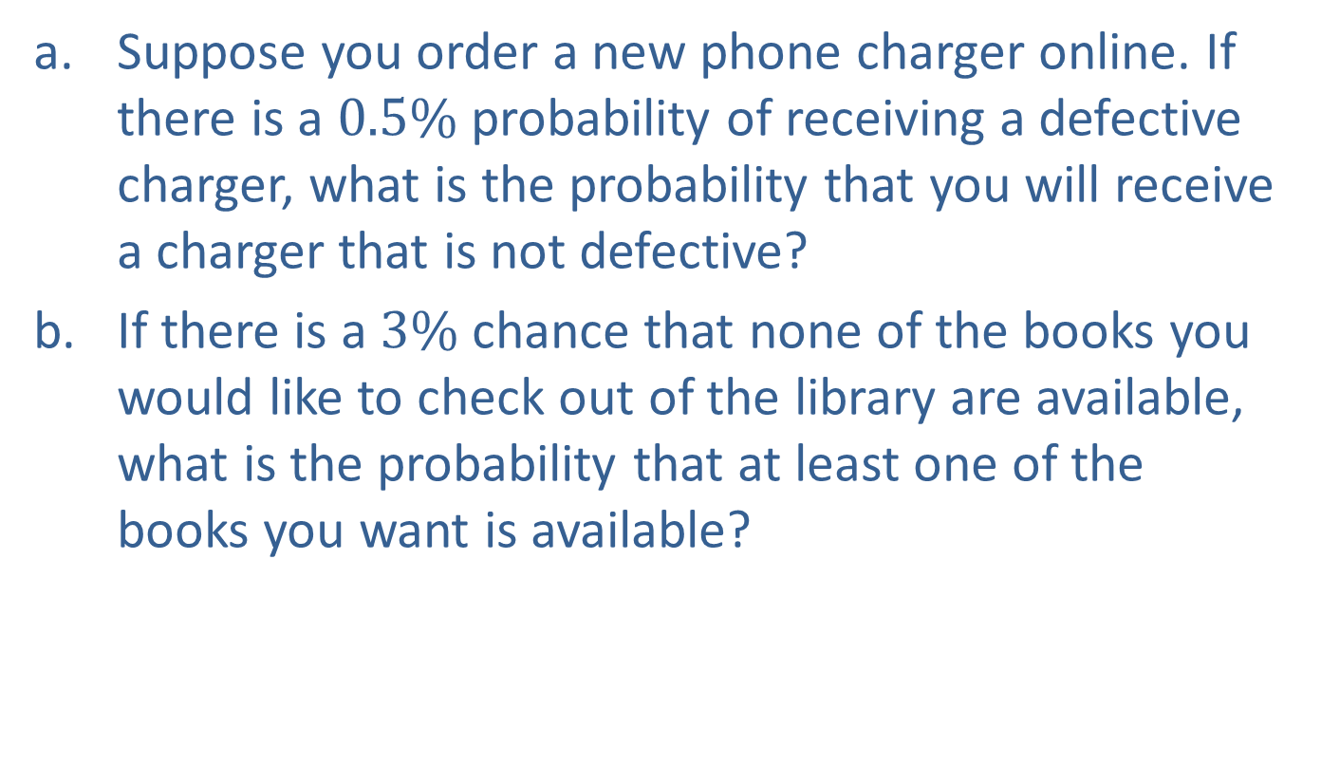
Example 6: Calculating Probability Using Complements—Slide 1
a.​ Suppose you order a new phone charger online. If there is a $0.5\%$ probability of receiving a defective charger, what is the probability that you will receive a charger that is not defective?
b.​ If there is a $3\%$ chance that none of the books you would like to check out of the library are available, what is the probability that at least one of the books you want is available?

Slide 25

Example 6: Calculating Probability Using Complements—Slide 2
Solution
a.​ The complement to the outcome of receiving a charger that is not defective is receiving a defective one. Thus, the probability of receiving a charger that is not defective can be calculated as follows.
So the good news is that there is a $99.5\%$ chance of getting a charger that works.

Slide 26

Example 6: Calculating Probability Using Complements—Slide 3
b.​ The complement to having none of something is having at least one of that thing. Thus, the probability can be calculated as follows.
Thus, there is a $97\%$ chance that at least one of the books you want is available.

Slide 27
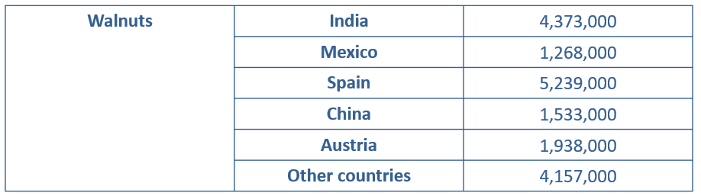
Example 7: Calculating Probability Using Complements—Slide 1
Using the data in Table 1, find the following probabilities involving nuts imported into the United States from 2006 to 2011.
Table 1: US Import Sources by Weight (in Pounds) for Fresh or Dried Walnuts and Pistachios, 2006–2011

Slide 28
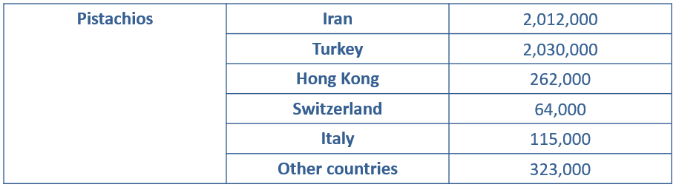
Example 7: Calculating Probability Using Complements—Slide 2
Table 1: US Import Sources by Weight (in Pounds) for Fresh or Dried Walnuts and Pistachios, 2006–2011 (cont.)
Source: USDA. "Fruit and Tree Nut Data." http://www.ers.usda.gov/data-products/fruitand-tree-nut-data/data-by-commodity.aspx

Slide 29
Example 7: Calculating Probability Using Complements—Slide 3
a.​ Calculate the probability that imported walnuts purchased in the United States during this period were from Austria.
b.​ Calculate the probability that imported walnuts purchased in the United States during this period were from somewhere other than Austria.
c.​ Calculate the probability that imported pistachios purchased in the United States during this period were from somewhere other than Italy or Switzerland.

Slide 30
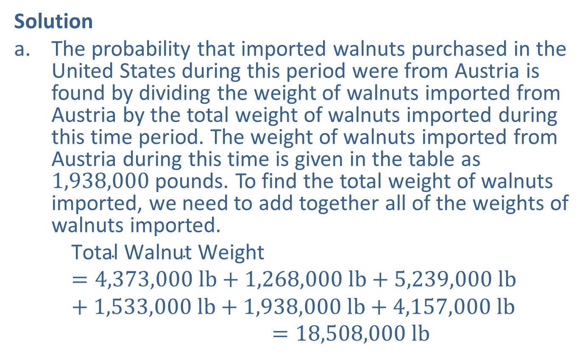
Example 7: Calculating Probability Using Complements—Slide 4
Solution
a.​ The probability that imported walnuts purchased in the United States during this period were from Austria is found by dividing the weight of walnuts imported from Austria by the total weight of walnuts imported during this time period. The weight of walnuts imported from Austria during this time is given in the table as 1,938,000 pounds. To find the total weight of walnuts imported, we need to add together all of the weights of walnuts imported.
Total Walnut Weight=4,373,000 lb+1,268,000 lb+5,239,000 lb+1,533,000 lb+1,938,000 lb+4,157,000 lbTotal Walnut Weight=18,508,000 lb

Slide 31

Example 7: Calculating Probability Using Complements—Slide 5
​The probability that walnuts purchased during this time period were from Austria is found as follows.
​
Therefore, the probability that imported walnuts purchased during this time period were from Austria is approximately $10.47\%$.
b.​ We could find the probability that imported walnuts purchased in the United States came from somewhere other than Austria by combining all the remaining places together. However, given that we just calculated the probability that the walnuts were from Austria, it is easier to use the complement.

Slide 32
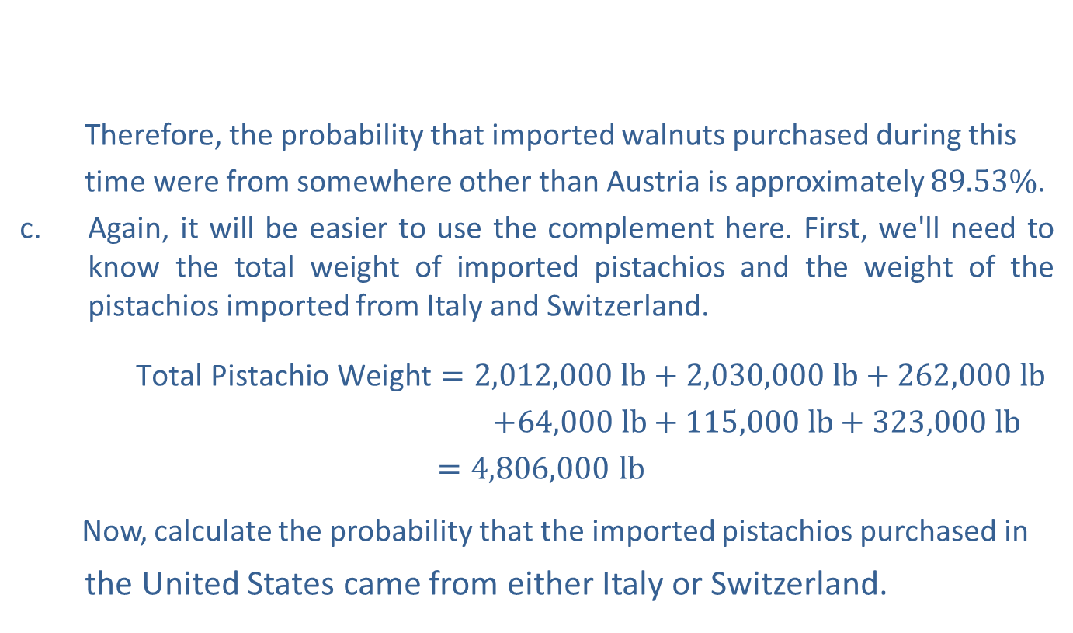
Example 7: Calculating Probability Using Complements—Slide 6
​
Therefore, the probability that imported walnuts purchased during this
time were from somewhere other than Austria is approximately $89.53\%$.
c.​ Again, it will be easier to use the complement here. First, we'll need to know the total weight of imported pistachios and the weight of the pistachios imported from Italy and Switzerland.
$\text{Total} \text{Pistachio} \text{Weight}=2,012,000 lb+2,030,000 lb+262,000 lb$
$+64,000 lb$ $+ 115,000 lb+323,000 lb$
$=4,806,000 lb$
Now, calculate the probability that the imported pistachios purchased in
the United States came from either Italy or Switzerland.

Slide 33

Example 7: Calculating Probability Using Complements—Slide 7
To calculate the probability that the pistachios came from somewhere other than Switzerland or Italy, we'll find the probability of the complement.
Therefore, the probability that the pistachios came from somewhere other than Switzerland or Italy is approximately $96.28\%$.

Slide 34
Fun Fact
A bookie is the informal name for a bookmaker—a person that arranges and accepts bets.

Slide 35
Helpful Hint 3
“The odds of a:b against ” is often shortened to “the odds of a:b.”

Slide 36
Definition: Odds
The odds against an event E are given as follows.
The odds in favor of an event E are given as follows.
Here, a is the number of unfavorable outcomes and b is the number of favorable outcomes.

Slide 37
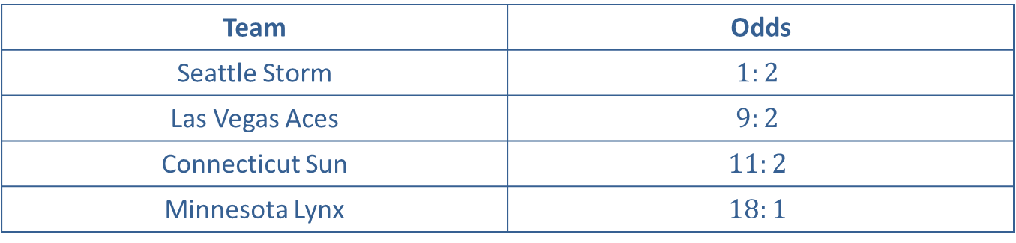
Example 8: Determining Probability From Odds—Slide 1
The Women's National Basketball Association (WNBA) was comprised of 12 teams in 2020. During the playoffs in late September, a week before the finals were set to begin, an online betting site gave the following odds to use when betting on the winner of the 2020 WNBA Finals. Use Table 2 to answer the following questions. Note that the odds in Table 2 are the odds against each team winning the finals.
Table 2: Odds to Win 2020 WNBA Finals (9/30/2020)
Team | Odds
Seattle Storm | $$1:2$$
Las Vegas Aces | $$9:2$$
Connecticut Sun | $$11:2$$
Minnesota Lynx | $$18:1$$
Source: " WNBA Futures Odds: 2020 WNBA Finals Odds," VegasInsider.com, accessed September 30, 2020, https://www.vegasinsider.com/wnba/odds/futures/.

Slide 38
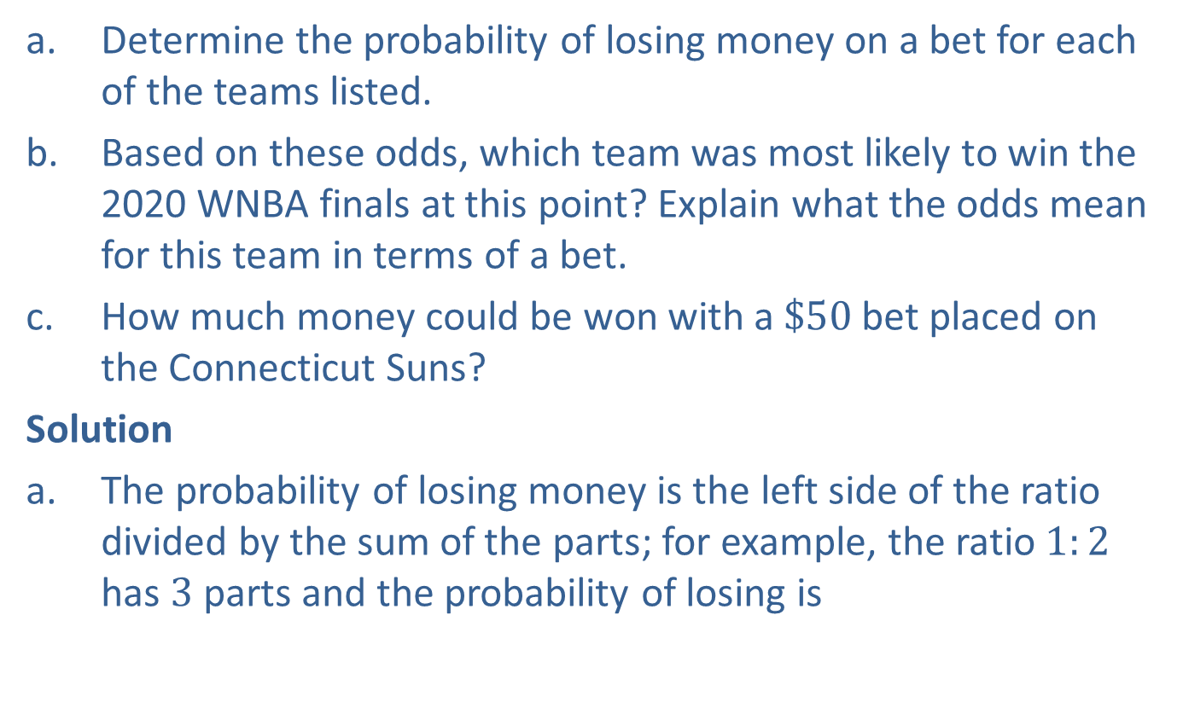
Example 8: Determining Probability From Odds—Slide 2
a.​ Determine the probability of losing money on a bet for each of the teams listed.
b.​ Based on these odds, which team was most likely to win the 2020 WNBA finals at this point? Explain what the odds mean for this team in terms of a bet.
c. ​How much money could be won with a $\$50$ bet placed on the Connecticut Suns?
Solution
a.​ The probability of losing money is the left side of the ratio divided by the sum of the parts; for example, the ratio $1:2$ has 3 parts and the probability of losing is

Slide 39
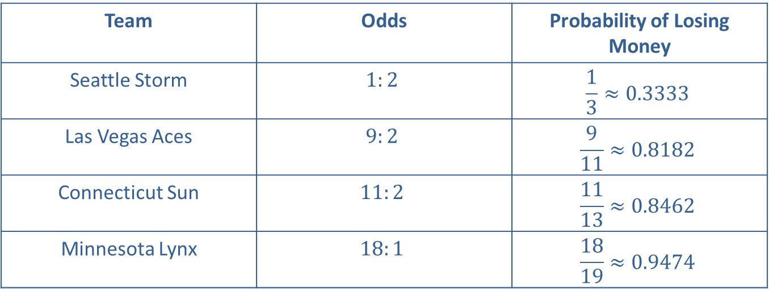
Example 8: Determining Probability From Odds—Slide 3
Table 3: 2020 WNBA Finals Odds and Probability
Team | Odds | Probability of Losing Money
Seattle Storm | $$1:2$$ | $$\frac{1}{3}≈0.3333$$
Las Vegas Aces | $$9:2$$ | $$\frac{9}{11}≈0.8182$$
Connecticut Sun | $$11:2$$ | $$\frac{11}{13}≈0.8462$$
Minnesota Lynx | $$18:1$$ | $$\frac{18}{19}≈0.9474$$
Notice that these probabilities add to more than 1 and we've only included 4 of the 12 teams. Remember that this is not the probability that a team will win the WNBA finals, but an assessment by the bookie of the probability that you will lose money on a bet for that team.

Slide 40
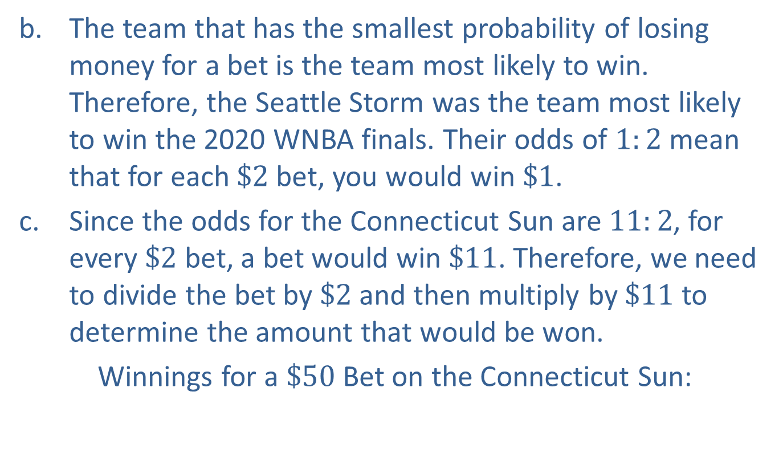
Example 8: Determining Probability From Odds—Slide 4
b. The team that has the smallest probability of losing money for a bet is the team most likely to win. Therefore, the Seattle Storm was the team most likely to win the 2020 WNBA finals. Their odds of $1:2$ mean that for each $\$2$ bet, you would win $\$1$.
c. ​Since the odds for the Connecticut Sun are $11:2$, for every $\$2$ bet, a bet would win $\$11$. Therefore, we need to divide the bet by $\$2$ and then multiply by $\$11$ to determine the amount that would be won.
​Winnings for a $\$50$ Bet on the Connecticut Sun:

Slide 41

Skill Check 3
If the odds on a bet are $4:1$ against, what is the probability of winning?

