Slide 1
Section 10.4
Addition and Multiplication Rules of Probability

Slide 2
Definition: Addition Rule of Probability
The Addition Rule of Probability states that the probability of event A happening or event B happening is given by the following formula.
P (A or B ) = P (A) + P (B ) − P(A and B )

Slide 3
Example 1: Using the Addition Rule of Probability—Slide 1
Suppose that a student is chosen at random to receive a gift card for filling out a survey. The following table shows a breakdown of who filled out the survey.
Table 1: Breakdown of Survey Takers
Class | Student Government Member | Not a Student Government Member | Total
Freshman | 3 | 15 | 18
Sophomore | 1 | 11 | 12
Junior | 2 | 7 | 9
Senior | 4 | 3 | 7
Total | 10 | 36 | 46
What is the probability that the winner is either a freshman or a member of student government?

Slide 4
Example 1: Using the Addition Rule of Probability—Slide 2
Solution
The key word or tells us we will be using the Addition Rule of Probability to find the solution.
P(Freshman or Student Government) = P(Freshman) + P(Student Government) − P(Freshman and Student Government)
We begin by finding the probability of choosing each of the individual criteria. We can see from the table that there were a total of 46 students who filled out the survey. The number of freshmen who filled it out was 18. So the probability of choosing a freshman is calculated as follows.

Slide 5
Example 1: Using the Addition Rule of Probability—Slide 3
In previous sections, we converted our probability answers from fractions to decimals. However, since we are going to use the Addition Rule of Probability, which requires us to add probabilities together, it's better to leave them as nonreduced fractions so that we avoid any error in rounding.
There were 10 members of the student government who filled out the survey, so the probability of choosing a member of the student governing board is as follows.

Slide 6

Example 1: Using the Addition Rule of Probability—Slide 4
There are 3 students who are both freshmen and members of the student government, so the probability of choosing a student who is in both groups is calculated as follows.
We can now use the Addition Rule of Probability to calculate the probability of the winner being either a freshman or a member of student government.
Thus, the probability that the winner of the gift card is either a freshman or a member of student government is about $54.35\%$.

Slide 7
Skill Check 1
Using Table 1 in the previous example, calculate the probability that the winner was either a senior or not a member of the student government.
Answer: 86.96%

Slide 8
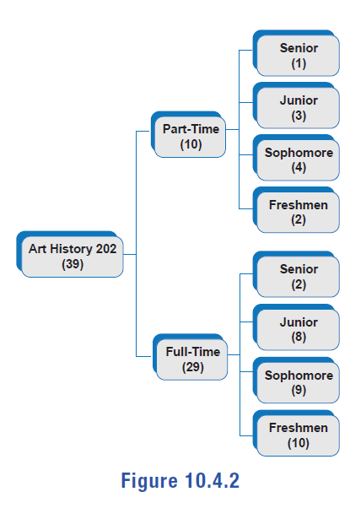
Example 2: Using the Addition Rule of Probability—Slide 1
The tree diagram in Figure 2 illustrates the makeup of students in Art History 202. The number of students fitting each descriptor is given in the parentheses. Suppose a student is chosen at random from the class to attend the annual regional art conference. Use the diagram to answer the following questions.
a.​ What is the probability that the student chosen is a full-time senior?
b. ​What is the probability that the student chosen is either a full-time student or a senior?
c.​ What is the probability that the student chosen is neither a full-time student nor a senior?
Figure 2

Slide 9
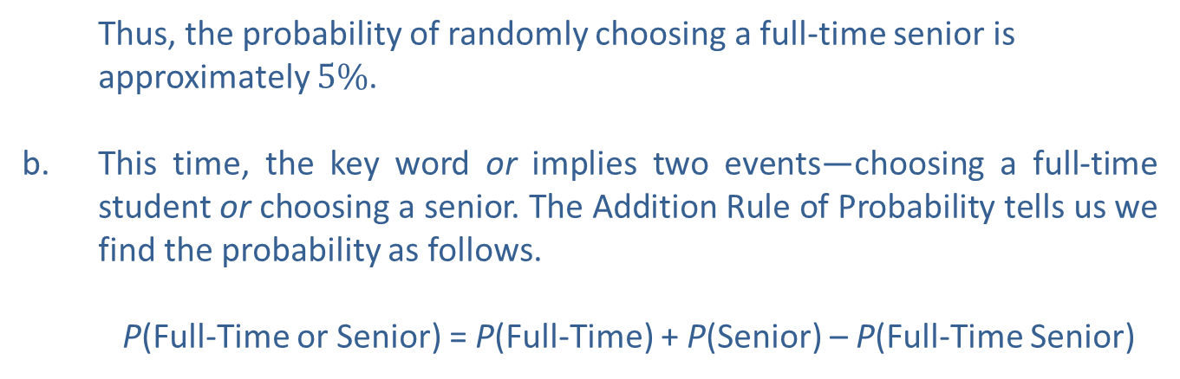
Example 2: Using the Addition Rule of Probability—Slide 2
Solution
a.​ Notice that the first question is a simple probability question involving only one event—choosing a full-time senior. Since there are 39 students to choose from and 2 of them are full-time seniors, we calculate the probability as follows.
Thus, the probability of randomly choosing a full-time senior is approximately $5\%$.
b.​ This time, the key word or implies two events—choosing a full-time student or choosing a senior. The Addition Rule of Probability tells us we find the probability as follows.
P(Full-Time or Senior) = P(Full-Time) + P(Senior) – P(Full-Time Senior)

Slide 10
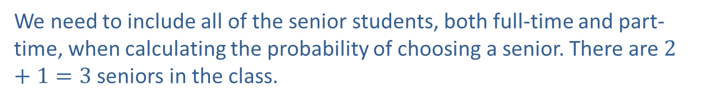

Example 2: Using the Addition Rule of Probability—Slide 3
We calculated the last part of this formula in part a., so we only need to calculate the other two probabilities. The chart shows that there are 29 full-time students.
​
​
We need to include all of the senior students, both full-time and part-time, when calculating the probability of choosing a senior. There are $2+1=3$ seniors in the class.
Substituting these into the formula, we can calculate the probability.
Thus, the probability of choosing either a full-time student or a senior is approximately $77\%$.

Slide 11

Example 2: Using the Addition Rule of Probability—Slide 4
c.​ Finally, we are asked to find the probability that the student is not a full-time student nor a senior. We can either determine the number of people who fall into this category, or we can use the complement rule and simply subtract the answer we found in part b. from 1.
Thus, the probability of choosing a student who is neither a full-time student nor a senior is approximately $23.08\%$.

Slide 12
Definition: Mutually Exclusive Events
Mutually exclusive events are events that have no outcomes in common.

Slide 13
Example 3: Identifying Mutually Exclusive Events
Determine if the following pairs of events are mutually exclusive.
a. ​Let the first event consist of randomly selecting an adult from the mall who has shopped online at least once in the past 6 months. Let the second event consist of randomly selecting an adult from the mall who has never shopped online.
b. ​Let event A consist of selecting an even number and event B consist of selecting a prime number.
Solution
a.​ Notice that it is impossible for a person to be in both of the events "shopped online at least once in the past 6 months" and "never shopped online." Therefore, these are mutually exclusive events.
b.​ There exists one even number that is also prime, namely 2. Therefore, events A and B are not mutually exclusive events.

Slide 14
Definition: Addition Rule of Probability for Mutually Exclusive Events
The Addition Rule of Probability for Mutually Exclusive Events states that the probability of event A happening or event B happening when A and B have no outcomes in common is given by the following formula.
P(A or B) = P(A) + P(B)

Slide 15
Example 4: Applying the Addition Rule of Mutually Exclusive Events—Slide 1
Suppose that you have decided you'd like to get a pet. Your renter's agreement allows you only one pet, and you decide to go to the local animal shelter to adopt one of their animals. Because you can't decide between a dog and a cat, you've left the choice up to chance. You're going to run your finger down the list of available animals without looking and let the lucky pet be the one you stop on. The graph in Figure 3 shows the distribution of animals currently at the shelter. Unfortunately, you didn't consider that other kinds of animals might be on the shelter's list. What is the probability that you randomly choose either a cat or a dog to take home with you?

Slide 16
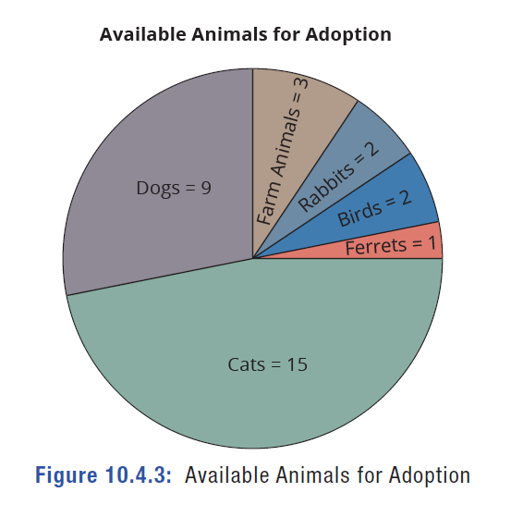
Example 4: Applying the Addition Rule of Mutually Exclusive Events—Slide 2
Figure 3: Available Animals for Adoption

Slide 17
Example 4: Applying the Addition Rule of Mutually Exclusive Events—Slide 3
Solution
The key word or implies that we need to use the Addition Rule of Probability. However, because an animal cannot be both a cat and a dog at the same time, these are mutually exclusive events, and thus have no outcomes in common. So we can use the Addition Rule of Mutually Exclusive Events, which gives us the following equation.
P (Cat or Dog) = P (Cat) + P (Dog)
By adding the numbers all of the different animals together, we know that there are currently 32 animals available at the shelter.
The probability of choosing a cat is found by dividing the number of cats by the total number of animals.

Slide 18

Example 4: Applying the Addition Rule of Mutually Exclusive Events—Slide 4
The probability of choosing a dog is found by dividing the number of dogs by the total number of animals.
Substituting these probabilities into the formula, we have the following.
Even though you forgot about the fact that other animals might be at the shelter, you still have a $75\%$ chance of randomly choosing a cat or a dog. However, that means there is also a $25\%$ chance you will select one of the other animals, some of which your landlord might not approve of!

Slide 19
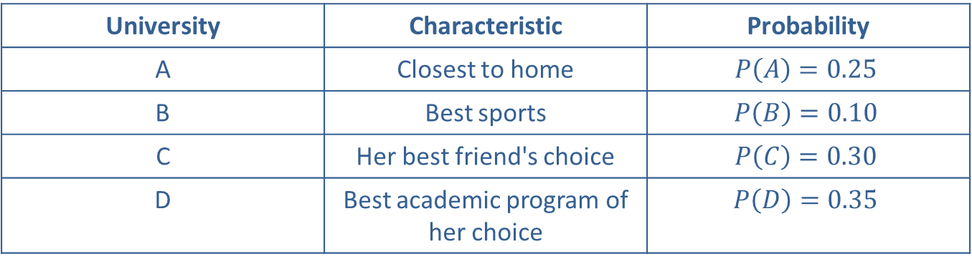
Example 5: Applying the Addition Rule of Mutually Exclusive Events—Slide 1
Choosing a college can be an exciting and nerve-racking experience in the life of a high school student. Emma has finally narrowed down her choices to the top four. She's also given each school a probability based on certain characteristics. What is the probability that Emma ends up at University B or University D?
Table 2: University Probabilities
University | Characteristic | Probability
A | Closest to home | $$P\left(A\right)=0.25$$
B | Best sports | $$P\left(B\right)=0.10$$
C | Her best friend's choice | $$P\left(C\right)=0.30$$
D | Best academic program of her choice | $$P\left(D\right)=0.35$$

Slide 20
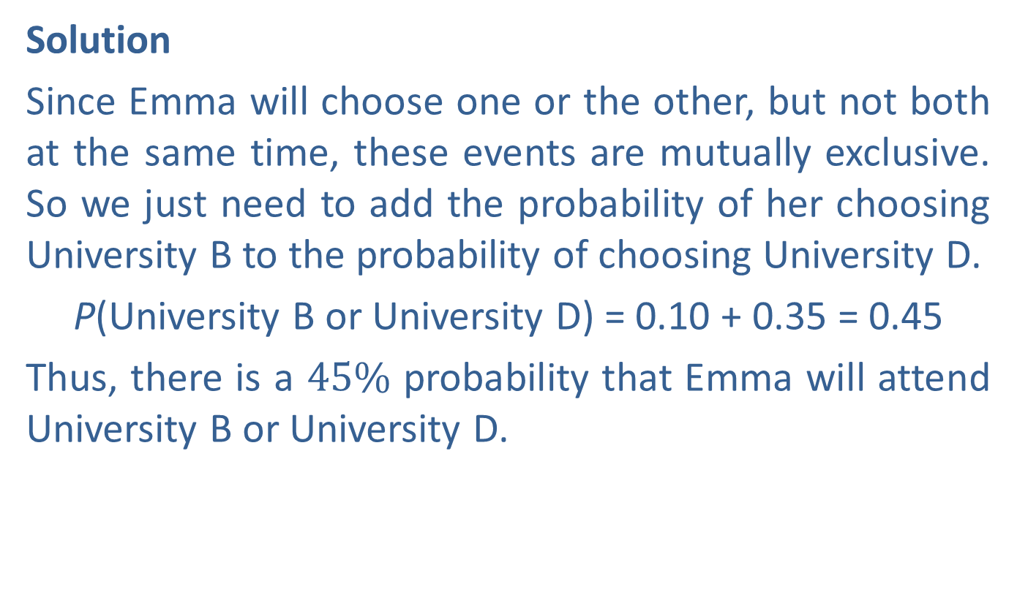
Example 5: Applying the Addition Rule of Mutually Exclusive Events—Slide 2
Solution
Since Emma will choose one or the other, but not both at the same time, these events are mutually exclusive. So we just need to add the probability of her choosing University B to the probability of choosing University D.
P(University B or University D) = 0.10 + 0.35 = 0.45
Thus, there is a $45\%$ probability that Emma will attend University B or University D.

Slide 21
Definition: Independent Events and Dependent Events
Independent events are events where the result of one event does not influence the probability of the other event happening.
Dependent events are events where the result of one event influences the probability of the other event happening.

Slide 22
Example 6: Identifying Independent and Dependent Events—Slide 1
Determine if the following pairs of events are independent.
a.​ Event A: Eating a red candy from a new bag of Skittles
Event B: Pulling a second Skittle from the same bag that is also red
b.​ Event A: A woman giving birth to a daughter
Event B: The same woman's second child is also a girl
c.​ Event A: Tina is the first woman to finish the 2030 Boston Marathon.
Event B: Tina is the first woman to finish the 2031 New York Marathon.
Solution
a.​ These events are dependent. The chances of drawing a second red Skittle from the bag decreases after the first one is drawn, because it obviously was not replaced in the bag. It was eaten.
b.​ Although these events might appear dependent on one another, the probability that a child is a girl is the same for any given pregnancy. It is not affected by the gender of a child from any previous pregnancy. Therefore, these events are independent.

Slide 23
Example 6: Identifying Independent and Dependent Events—Slide 2
c.​ At first glance these events might seem independent of one another. You might think that winning one race has no effect on winning a second race. However, the best starting positions for runners in large marathons are given to winners of previous races. This means that the first race does have an effect on the second race. At the same time, running two marathons in consecutive years will have an effect on your body when training for and running the second one (whether that effect is positive or negative). Therefore, these events are dependent.
This example highlights the fact that the dependence of events isn't always obvious. Sometimes our own personal knowledge or experiences are not enough to rely on, and we need to look to experts in other fields to help us determine whether events are dependent or not.

Slide 24
Skill Check 2
Determine if the following events are independent or dependent.
a.​ Finding the batteries in your calculator are dead and then finding that the battery in your car is dead.
b. ​Parking your car illegally and then getting a parking ticket.
Answer:
a.​ Independent
b.​ Dependent

Slide 25
Definition: Multiplication Rule of Probability for Independent Events
The Multiplication Rule of Probability for Independent Events states that for two independent events, A and B, the probability of event A happening and event B happening is given by the following formula.

Slide 26
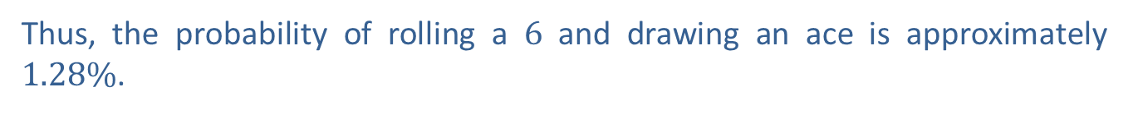
Example 7: Using the Multiplication Rule of Probability for Independent Events
Given a fair six-sided die and a standard deck of 52 cards, find the probability of rolling a 6 and drawing an ace.
Solution
Because the number rolled on the die does not affect the card drawn from the deck, and vice versa, the events here are independent. Using the Multiplication Rule of Probability for Independent Events, we have the following.
Thus, the probability of rolling a 6 and drawing an ace is approximately $1.28\%$.

Slide 27
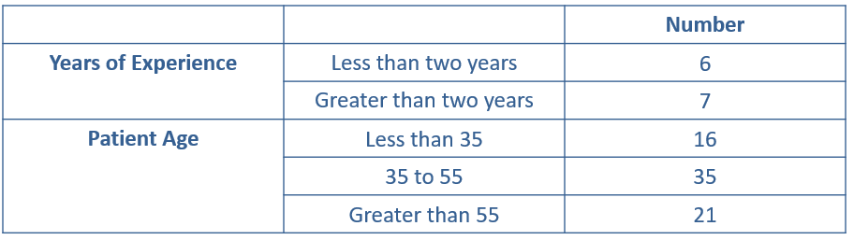
Example 8: Using the Multiplication Rule of Probability for Independent Events—Slide 1
Suppose we know the following breakdown for internal medicine hospitalists who work at Madison Regional Hospital and the ages of their patients on a given day.
Table: 3: Hospitalists at Madison Regional Hospital
What is the probability that the first patient treated is over 55 years old and treated by a hospitalist with less than two years of experience at Madison Regional Hospital?

Slide 28
Example 8: Using the Multiplication Rule of Probability for Independent Events—Slide 2
Solution
Because the age of the patient and the experience of the hospitalist have no effect on one another, these events are independent. So we use the Multiplication Rule of Probability for Independent Events and multiply the individual probabilities together. Let's find the individual probabilities first.

Slide 29
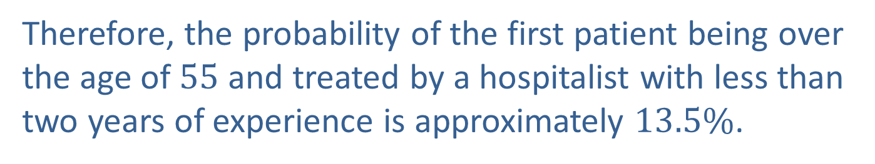
Example 8: Using the Multiplication Rule of Probability for Independent Events—Slide 3
Using the Multiplication Rule of Probability for Independent Events, we have the following equation.
Therefore, the probability of the first patient being over the age of 55 and treated by a hospitalist with less than two years of experience is approximately $13.5\%$.

Slide 30
Definition: Conditional Probability
Conditional probability, denoted
and read "the
probability of B given A," is the probability of event B occurring given that event A occurs first.

Slide 31
Definition: Multiplication Rule of Probability for Dependent Events
The Multiplication Rule of Probability for Dependent Events states that if A and B are dependent events, the probability of A and B occurring is given by the following formula.

Slide 32
Helpful Hint
A standard deck of cards is 52 cards with four suits (hearts, diamonds, spades, and clubs) and 13 cards in each suit. The cards in each suit are ace, king, queen, jack, 10, 9, 8, 7, 6, 5, 4, 3, and 2. The king, queen, and jack are called face cards.

Slide 33
Example 9: Using the Multiplication Rule of Probability for—Slide 1
Find the probability that, from a standard deck of cards, you're dealt two particular cards in a row: the queen of hearts and then a face card. Assume the cards are chosen without replacement.
Solution
Recall that without replacement means the first card is not placed back into consideration before drawing the next card. Therefore, being dealt the queen of hearts for the first card reduces the number of face cards as well as the total number of cards left in the deck for the second card. That means that these events are dependent, and we need to use the Multiplication Rule for Dependent Events. We begin by calculating the probability of first being dealt the queen of hearts. Note that all cards are available.

Slide 34
Example 9: Using the Multiplication Rule of Probability for—Slide 2
When the second card is dealt, there are no longer 12 face cards in the deck. Only 11 face cards remain in a deck of 51 cards (remember that there is one fewer card). So the probability of drawing a face card given that the queen of hearts has already been drawn is calculated as follows.
Finally, substitute these values into the Multiplication Rule for Dependent Events.

Slide 35
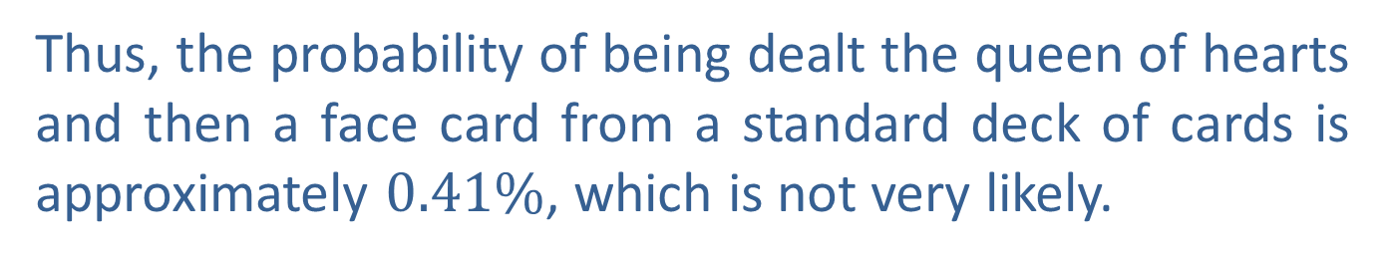
Example 9: Using the Multiplication Rule of Probability for—Slide 3
Thus, the probability of being dealt the queen of hearts and then a face card from a standard deck of cards is approximately $0.41\%$, which is not very likely.

Slide 36
Example 10: Calculating Conditional Probability—Slide 1
Suppose 290 students were randomly selected and asked about their satisfaction with their interactions with the financial aid office on campus. Their responses are given in the following table.
Table 4: Financial Aid Office Satisfaction
Class | Satisfied | Dissatisfied | Did Not Use
Freshman | 55 | 21 | 13
Sophomore | 15 | 33 | 24
Junior | 48 | 6 | 8
Senior | 22 | 18 | 3
Graduate | 4 | 1 | 19

Slide 37
Example 10: Calculating Conditional Probability—Slide 2
If one response was selected at random, find the probability that the following occurred.
a. The response indicated that the student was satisfied with their experience.
b.​ The response indicated that the student was satisfied given that they were a senior.
c. ​The response indicated that the student was dissatisfied given that they were a freshman or sophomore.
d. ​The response indicated that the student was a graduate student given that they did not use the financial aid office.

Slide 38
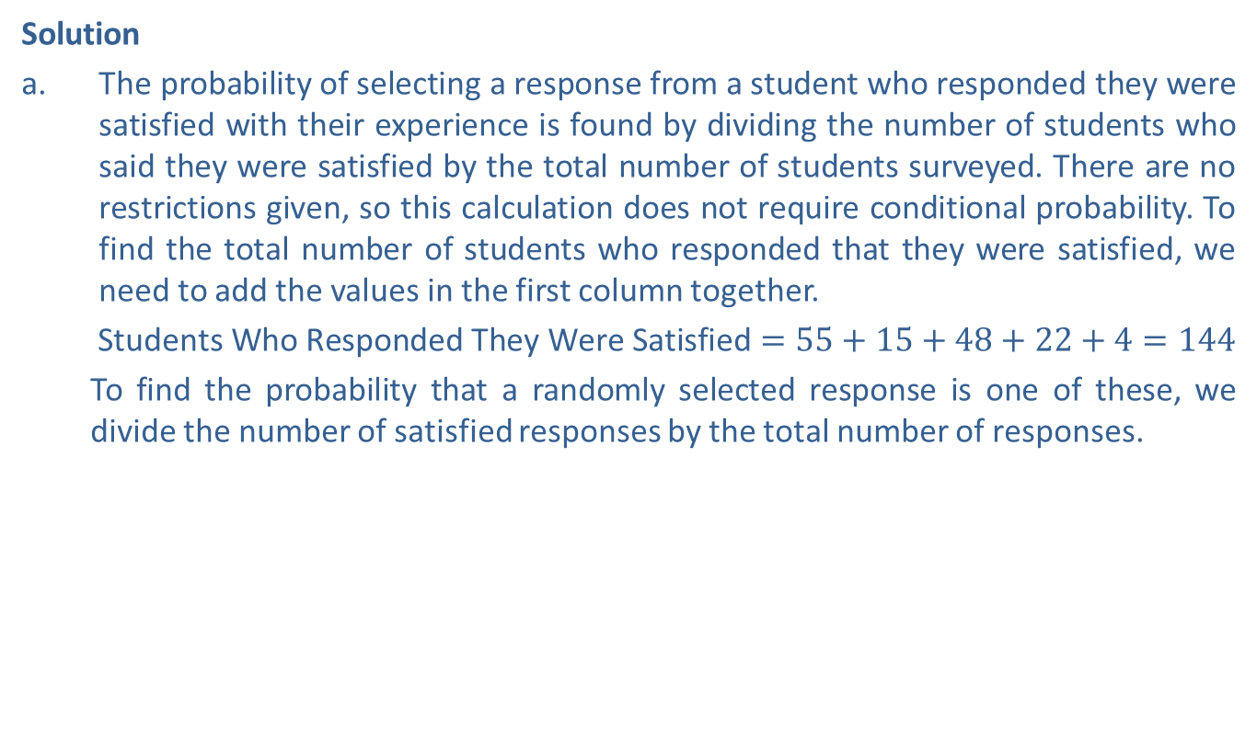
Example 10: Calculating Conditional Probability—Slide 3
Solution
​The probability of selecting a response from a student who responded they were satisfied with their experience is found by dividing the number of students who said they were satisfied by the total number of students surveyed. There are no restrictions given, so this calculation does not require conditional probability. To find the total number of students who responded that they were satisfied, we need to add the values in the first column together.
​$\text{Students} \text{Who} \text{Responded} \text{They} \text{Were} \text{Satisfied}=55+15+48+22+4=144$
To find the probability that a randomly selected response is one of these, we divide the number of satisfied responses by the total number of responses.
​
Therefore, the probability of randomly selecting a student who responded that they were satisfied with their financial aid experience is approximately $49.66\%$.

Slide 39
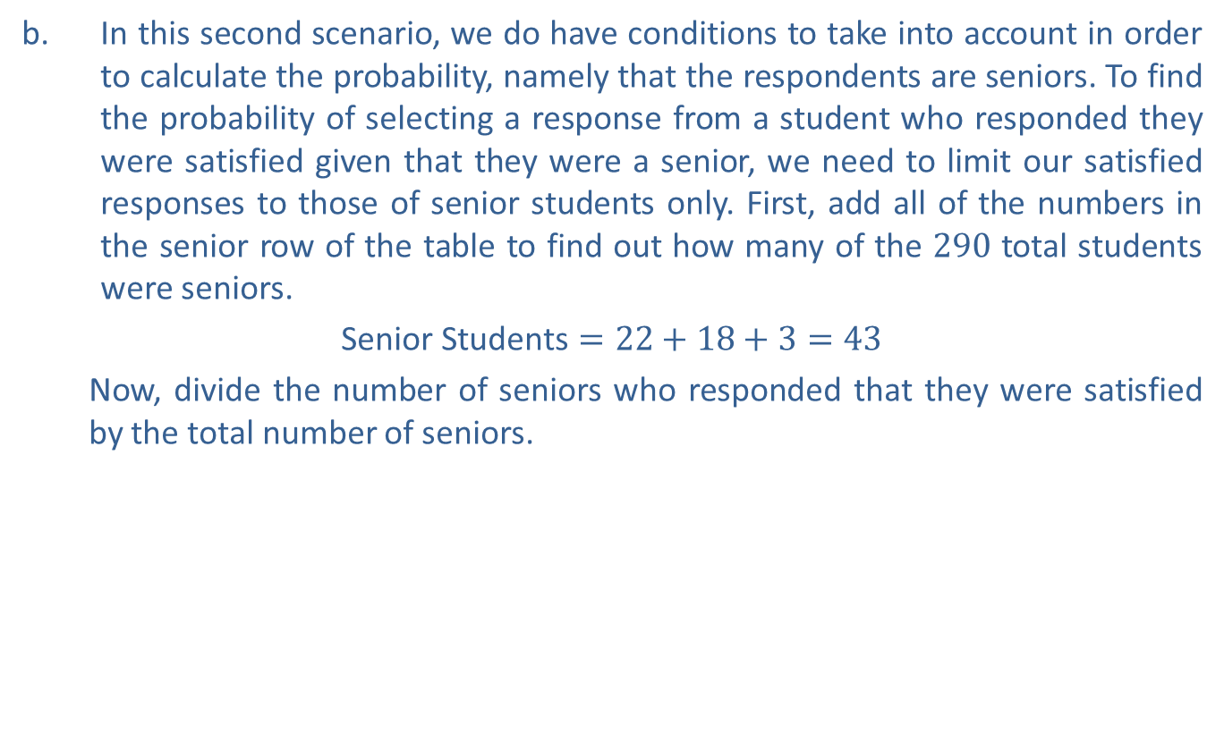
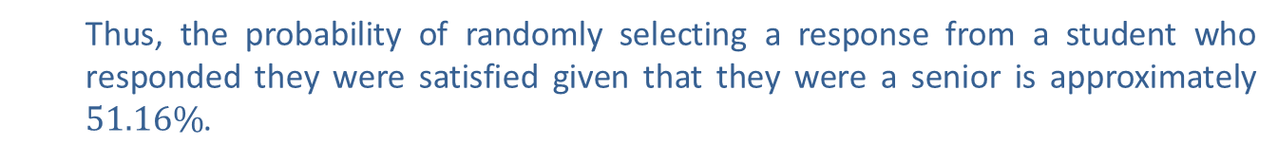
Example 10: Calculating Conditional Probability—Slide 4
b.​ In this second scenario, we do have conditions to take into account in order to calculate the probability, namely that the respondents are seniors. To find the probability of selecting a response from a student who responded they were satisfied given that they were a senior, we need to limit our satisfied responses to those of senior students only. First, add all of the numbers in the senior row of the table to find out how many of the 290 total students were seniors.
​$\text{Senior} \text{Students}=22+18+3=43$
Now, divide the number of seniors who responded that they were satisfied by the total number of seniors.
Thus, the probability of randomly selecting a response from a student who responded they were satisfied given that they were a senior is approximately $51.16\%$.

Slide 40
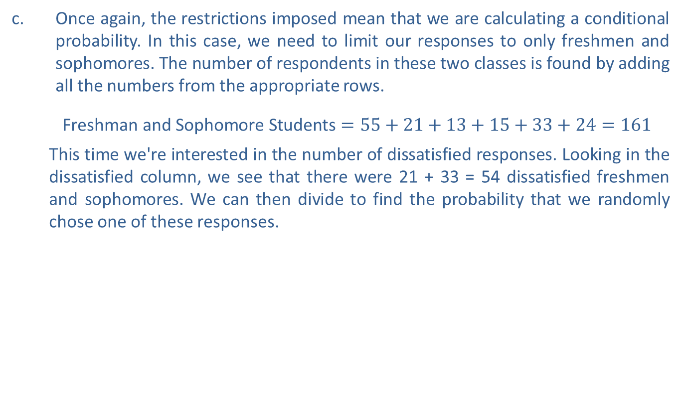

Example 10: Calculating Conditional Probability—Slide 5
c.​ Once again, the restrictions imposed mean that we are calculating a conditional probability. In this case, we need to limit our responses to only freshmen and sophomores. The number of respondents in these two classes is found by adding all the numbers from the appropriate rows.
​$\text{Freshman} \text{and} \text{Sophomore} \text{Students}=55+21+13+15+33+24=161$
This time we're interested in the number of dissatisfied responses. Looking in the dissatisfied column, we see that there were 21 + 33 = 54 dissatisfied freshmen and sophomores. We can then divide to find the probability that we randomly chose one of these responses.
𝑃Dissatisfied, Freshman or Sophomores
Therefore, the probability that a randomly chosen response was from a student who responded that they were dissatisfied given that they were either a freshman or sophomore is approximately $33.54\%$.

Slide 41
Example 10: Calculating Conditional Probability—Slide 6
d.​ This final conditional probability requires us to consider only the column of responses from students who did not use the financial aid office.
Of these 67 responses, 19 of them were from graduate students. Thus, the probability that we randomly chose the response of a graduate student given that they did not use the financial aid office is calculated as follows.
There is approximately a $28.36\%$ chance of randomly choosing a response from a graduate student given that they did not use the financial aid office.

Slide 42
Math Milestone
Likely born in 1701 or 1702, Reverend Thomas Bayes was an English statistician, philosopher, and Presbyterian minister. He died before ever publishing what would become his most famous work.

Slide 43
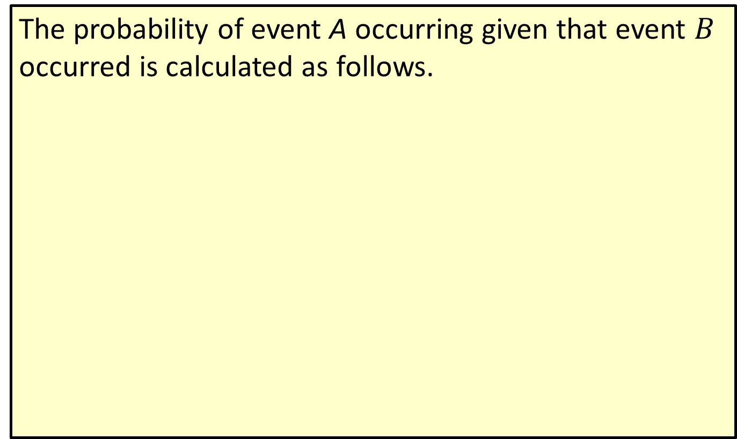
Theorem: Bayes' Theorem
The probability of event A occurring given that event $B$ occurred is calculated as follows.
Here, P(B) ≠ 0.

Slide 44
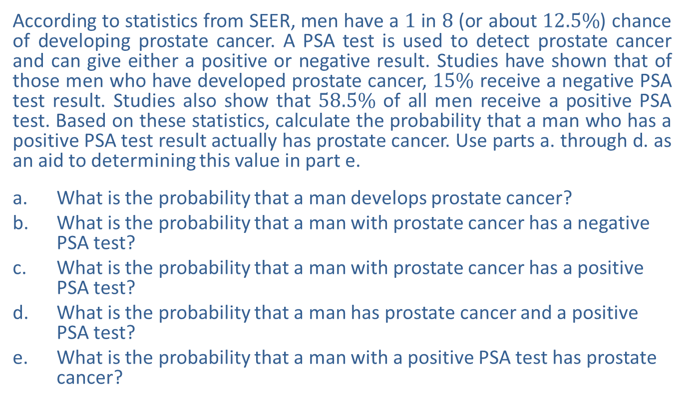
Example 11: Calculating Probability Using Bayes' Theorem—Slide 1
According to statistics from SEER, men have a 1 in 8 (or about $12.5\%$) chance of developing prostate cancer. A PSA test is used to detect prostate cancer and can give either a positive or negative result. Studies have shown that of those men who have developed prostate cancer, $15\%$ receive a negative PSA test result. Studies also show that $58.5\%$ of all men receive a positive PSA test. Based on these statistics, calculate the probability that a man who has a positive PSA test result actually has prostate cancer. Use parts a. through d. as an aid to determining this value in part e.
a.​ What is the probability that a man develops prostate cancer?
b.​ What is the probability that a man with prostate cancer has a negative PSA test?
c. ​What is the probability that a man with prostate cancer has a positive PSA test?
d. ​What is the probability that a man has prostate cancer and a positive PSA test?
e. ​What is the probability that a man with a positive PSA test has prostate cancer?

Slide 45
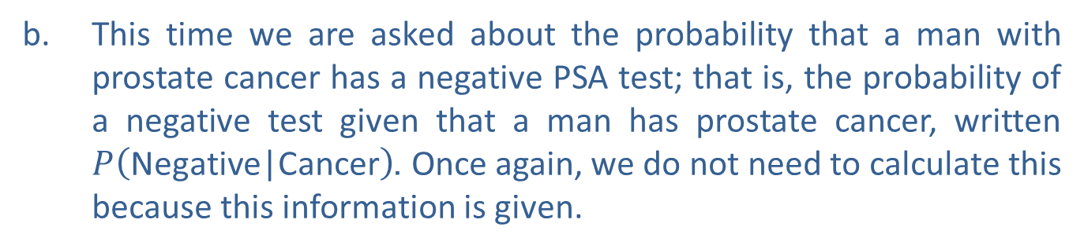
Example 11: Calculating Probability Using Bayes' Theorem—Slide 2
Solution
a.​ We are asked to calculate the probability that a man develops prostate cancer. We are actually told this probability in the information given.
b.​ This time we are asked about the probability that a man with prostate cancer has a negative PSA test; that is, the probability of a negative test given that a man has prostate cancer, written $P⁡\left(\text{Negative}\text{|}\text{Cancer}\right)$. Once again, we do not need to calculate this because this information is given.

Slide 46
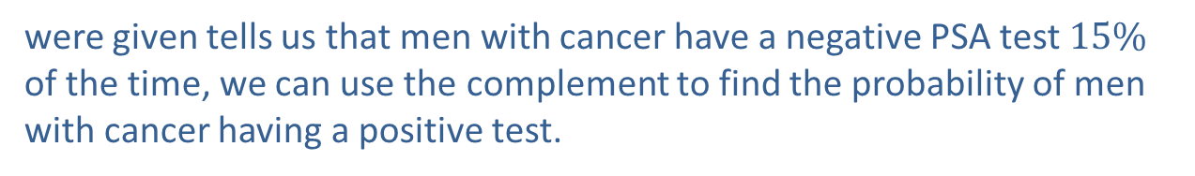
Example 11: Calculating Probability Using Bayes' Theorem—Slide 3
c. Here, we want to know the probability of a positive test, given that a man has cancer; that is,
Since the information we
were given tells us that men with cancer have a negative PSA test $15\%$
of the time, we can use the complement to find the probability of men
with cancer having a positive test.

Slide 47

Example 11: Calculating Probability Using Bayes' Theorem—Slide 4
d.​ Notice that the wording is different this time. We are asked to find the probability that a man has prostate cancer and a positive PSA test result; that is, P(Prostate Cancer and Positive). We know from the Multiplication Rule for Dependent Events that we can calculate this as follows, using the results we found in parts a. and c.
Therefore, the probability that a man has both prostate cancer and a positive test is $10.625\%$.

Slide 48

Example 11: Calculating Probability Using Bayes' Theorem—Slide 5
e.​ Be careful how you read this question. It's slightly different than the one in part d. This time we want to know the probability of a man actually having prostate cancer, given that he has a positive test; that is, $P⁡\left(\text{Prostate} \text{Cancer}\text{|}\text{Positive}\right)$. We can use Bayes' Theorem along with our previous calculations to find this probability. Bayes' Theorem is written again for you here.
​
​
​
Thus, we are looking to calculate the following probability.

Slide 49


Example 11: Calculating Probability Using Bayes' Theorem—Slide 6
We know the numerator of the fraction from parts a. and c.:
P(Prostate Cancer)$=0.125$ and P(Positive | Prostate Cancer) $=0.85$. From the problem statement, we also know that $58.5\%$ of all men receive a positive PSA test; that is, P(Positive)$=0.585$. Substituting these values into Bayes' Theorem, we have the following equation.
This means if a man has a positive PSA test, the probability that he actually has prostate cancer is approximately 0.1816, or $18.16\%$.

Slide 50
Example 11: Calculating Probability Using Bayes' Theorem—Slide 7
Take a moment and think about the difference between parts d. and e. In part d., we found the probability that a random man has prostate cancer and a positive PSA test. This is not as useful to an individual male who receives a positive PSA test. The conditional probability we found in part e.—the probability that he actually has prostate cancer given that his PSA test came back positive—is more helpful when considering test results.

