Slide 1
Section 10.5
Binomial Probability

Slide 2
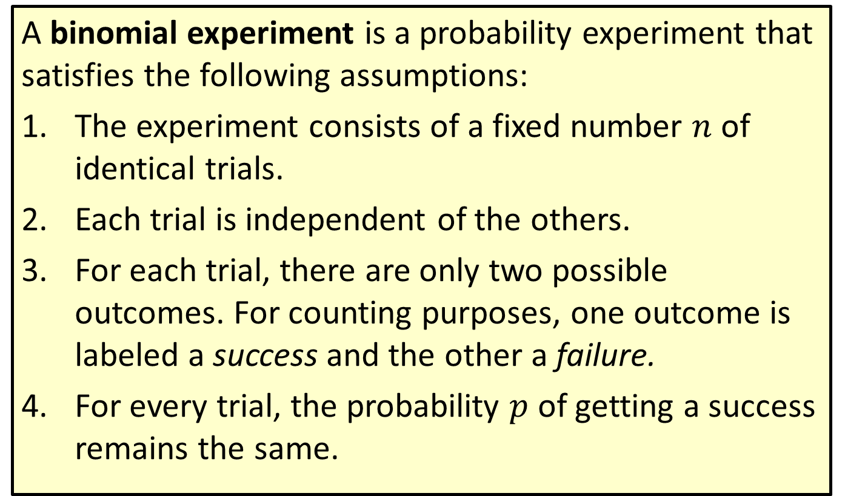
Definition: Binomial Experiment
A binomial experiment is a probability experiment that satisfies the following assumptions:
1.​ The experiment consists of a fixed number $n$ of identical trials.
2.​ Each trial is independent of the others.
3.​ For each trial, there are only two possible outcomes. For counting purposes, one outcome is labeled a success and the other a failure.
4.​ For every trial, the probability $p$ of getting a success remains the same.

Slide 3
Example 1: Determining If an Experiment Is Binomial—Slide 1
Determine whether the given procedure meets the criteria of a binomial experiment. If not, identify at least one requirement that is not satisfied.
a.​ Surveying the student ratings of the food in the campus dining hall on a scale of 1 to 10.
b.​ Counting the number of times a professional basketball player makes a free-throw shot during a game.
c.​ Randomly choosing 3 seniors from a mixed group of 40 students for a panel of judges.
Solution
a.​ No; this experiment does not meet the criteria of a binomial experiment. There are ten outcomes for each trial instead of just two (the ratings 1, 2, 3, 4, 5, 6, 7, 8, 9, and 10). Also, there is not a fixed number of trials.

Slide 4
Example 1: Determining If an Experiment Is Binomial—Slide 2
b.​ Yes; this experiment does meet the criteria of a binomial experiment. There are two outcomes: makes a shot or does not make a shot. Each shot is an independent trial. There are a fixed number of trials (the number of free-throw shots the player takes in the game) and the probability of success is the same for every free-throw shot.
c.​ No; this experiment does not meet the criteria of a binomial experiment. Although there are only two possible outcomes (choosing a senior or not) and there are a fixed number of trials (3), the probability of choosing a senior does not stay the same for each trial. After each student is chosen for the panel, the probability of choosing a senior changes for the next student selection.

Slide 5
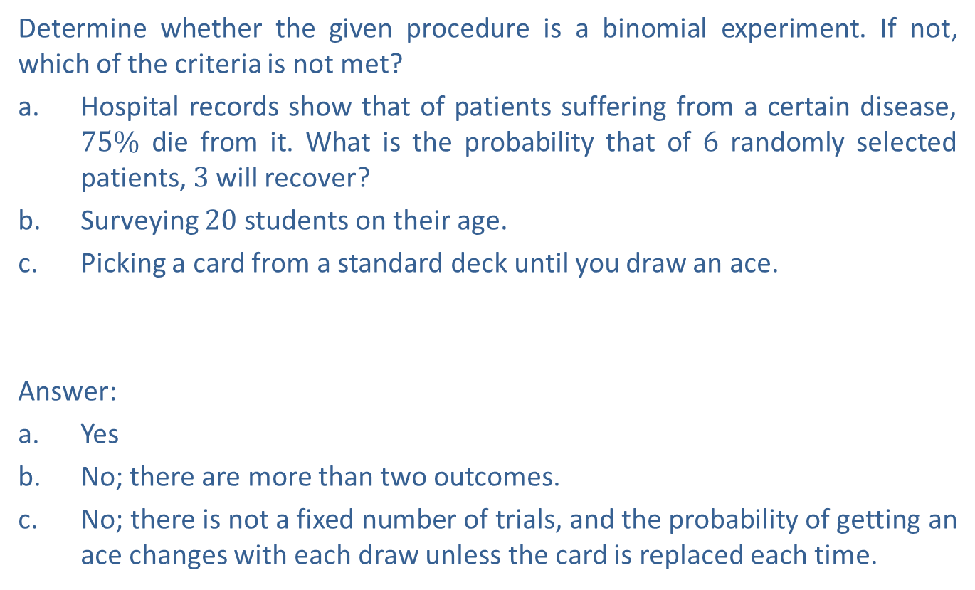
Skill Check 1
Determine whether the given procedure is a binomial experiment. If not, which of the criteria is not met?
a.​ Hospital records show that of patients suffering from a certain disease, $75\%$ die from it. What is the probability that of 6 randomly selected patients, 3 will recover?
b.​ Surveying 20 students on their age.
c.​ Picking a card from a standard deck until you draw an ace.
Answer:
a.​ Yes
b. ​No; there are more than two outcomes.
c.​ No; there is not a fixed number of trials, and the probability of getting an ace changes with each draw unless the card is replaced each time.

Slide 6
Definition: Binomial Probability Formula
The probability of obtaining x successes in n independent trials of a binomial probability experiment is given by
where x is the number of successes,
n is the number of trials, and
p is the probability of getting a success on any trial.

Slide 7
Think Back

Slide 8
Example 2: Calculating Binomial Probability—Slide 1
What is the probability of getting exactly six heads in 10 coin tosses?
Solution
As we said earlier, coin tosses meet the criteria of a binomial experiment. And since we have a fixed number of tosses, we can use the binomial probability formula to calculate this probability. We will define a success as getting a head. Therefore, we want the probability of exactly six successes, so x = 6. The probability of flipping a head in one coin toss is 0.5, which means that
p = 0.5. There are 10 coin tosses, so n = 10.

Slide 9
Example 2: Calculating Binomial Probability—Slide 2
By Hand
Substituting these values into the binomial probability formula gives us the following.
TI-83/84 Plus
The TI-83/84 Plus has a built-in binomial probability formula that can be accessed by pressing 2nd vars to open the distr menu, scrolling down, and selecting binompdf(. You will be prompted to enter the following values.
trials is the number of trials in the experiment.
p is the probability of getting a success on any trial.
x value is the number of successes.

Slide 10
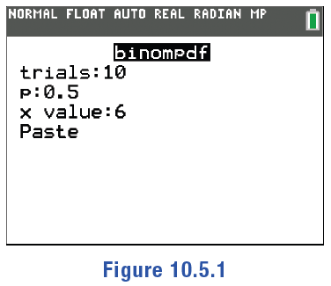
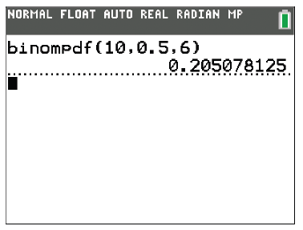
Example 2: Calculating Binomial Probability—Slide 3
We will enter 10 for trials since there are 10 coin tosses. The probability of flipping a head in one coin toss is 0.5, so we'll enter 0.5 for p. Since we are finding the probability of exactly six successes, we'll enter 6 for the x value. Move the cursor down to highlight Paste and press enter twice. The calculator will give the result 0.205078125.
Figure 1
Figure 2
Microsoft Excel
We can use the built-in binomial distribution function, BINOM.DIST(number_s, trials, probability_s, cumulative).

Slide 11
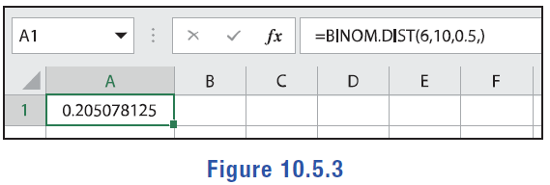
Example 2: Calculating Binomial Probability—Slide 4
number_s is the number of successes.
trials is the number of trials.
probability_s is the probability of a success on any trial.
cumulative should be TRUE if you are finding the probability of at most x successes (which is called the cumulative probability and will be discussed later in the section) and it should be FALSE if you are finding the probability of exactly x successes. Default is FALSE.
Since we want to know the probability of getting exactly six heads, we want to use the probability mass function, which means we should either type FALSE for the last entry or leave it blank. In an empty cell, type "=BINOM.DIST (6, 10, 0.5, FALSE)" and press Enter. The value given is 0.205078125.
Figure 3

Slide 12

Example 2: Calculating Binomial Probability—Slide 5
Since we want to know the probability of getting exactly six heads, we want to use the probability mass function, which means we should either type FALSE for the last entry or leave it blank. In an empty cell, type "=BINOM.DIST (6, 10, 0.5, FALSE)" and press Enter. The value given is 0.205078125.
Figure 3
Therefore, the probability of getting exactly six heads in 10 coin tosses is approximately $20.51\%$.

Slide 13
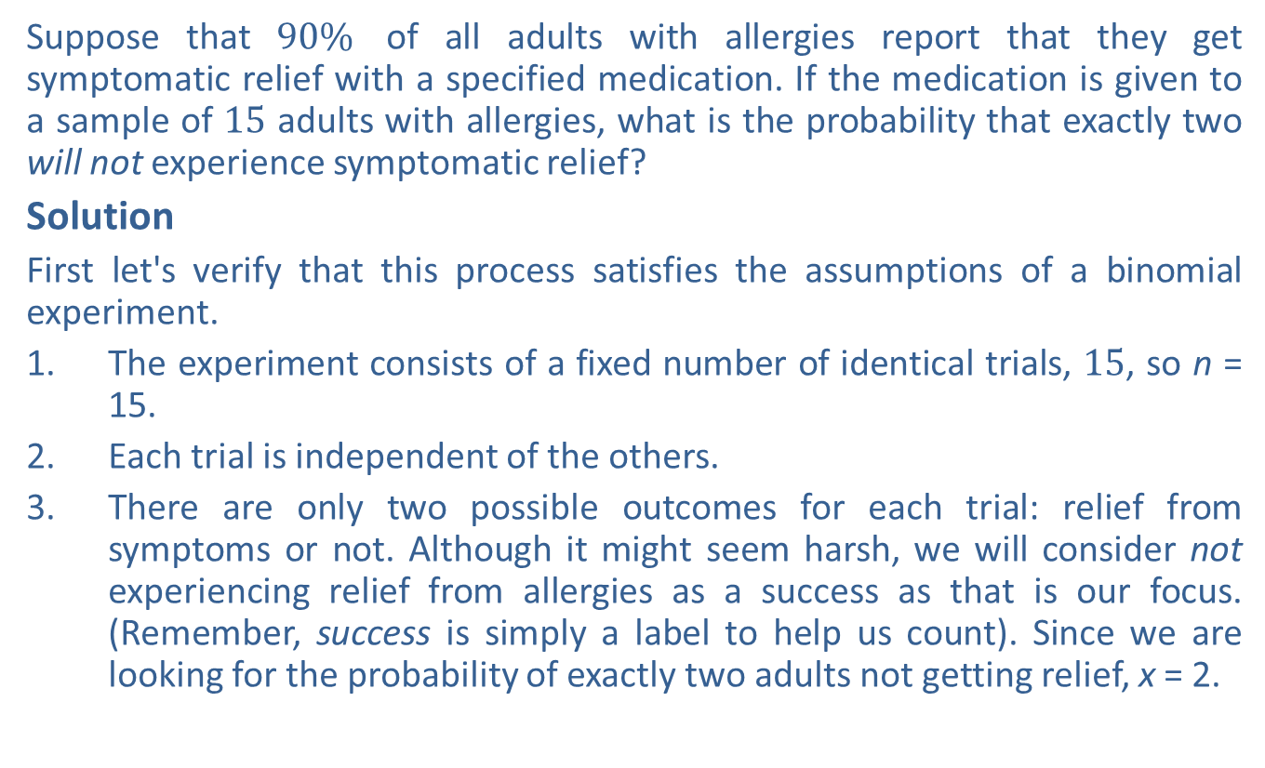
Example 3: Calculating Binomial Probability—Slide 1
Suppose that $90\%$ of all adults with allergies report that they get symptomatic relief with a specified medication. If the medication is given to a sample of 15 adults with allergies, what is the probability that exactly two will not experience symptomatic relief?
Solution
First let's verify that this process satisfies the assumptions of a binomial experiment.
1.​ The experiment consists of a fixed number of identical trials, 15, so n = 15.
2. ​Each trial is independent of the others.
3.​ There are only two possible outcomes for each trial: relief from symptoms or not. Although it might seem harsh, we will consider not experiencing relief from allergies as a success as that is our focus. (Remember, success is simply a label to help us count). Since we are looking for the probability of exactly two adults not getting relief, x = 2.

Slide 14

Example 3: Calculating Binomial Probability—Slide 2
4.​ For every trial, the probability of getting a success remains the same. Since $90\%$ get symptomatic relief, $10\%$ do not report relief. Therefore, P = 0.1.
By Hand
Using the binomial probability formula for our solution gives us the following equation.

Slide 15
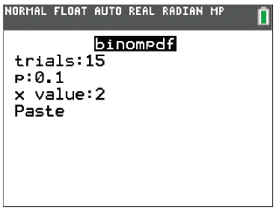
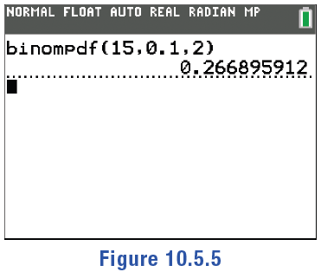
Example 3: Calculating Binomial Probability—Slide 3
TI-83/84 Plus
As in the previous example, we can use the binompdf (formula from the distr menu. This time, trials = 15, p = 0.1, and x value = 2. The calculator will give the result 0.266895912.
Figure 4
Figure 5
Microsoft Excel
Again, we can use the binomial distribution function, BINOM.DIST(
number_s, trials, probability_s, cumulative).

Slide 16
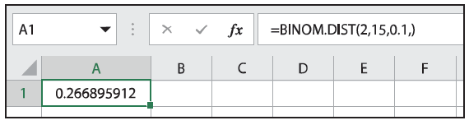

Example 3: Calculating Binomial Probability—Slide 4
Since we want to know the probability that exactly two people do not experience symptomatic relief, we want to use the probability mass function, which means we should either type FALSE for the last entry or leave it blank. In an empty cell, type "BINOM.DIST(2, 15, 0.1, FALSE)" and press Enter. The value given is 0.266895912.
Figure 6
Therefore, the probability that exactly two out of the 15 adults will not experience symptomatic relief is $26.69\%$.

Slide 17
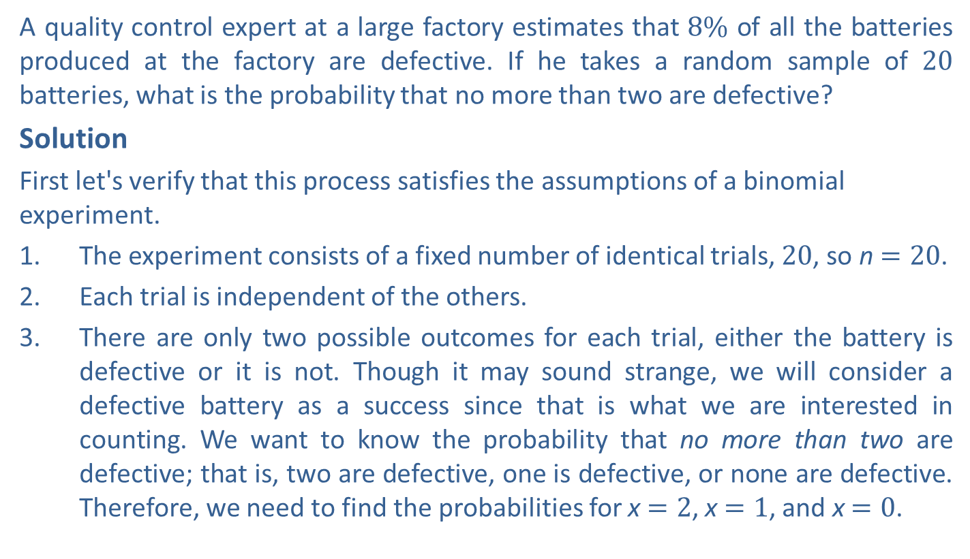
Example 4: Calculating Cumulative Binomial Probability—Slide 1
A quality control expert at a large factory estimates that $8\%$ of all the batteries produced at the factory are defective. If he takes a random sample of 20 batteries, what is the probability that no more than two are defective?
Solution
First let's verify that this process satisfies the assumptions of a binomial experiment.
1.​ The experiment consists of a fixed number of identical trials, 20, so n $=20$.
2. ​Each trial is independent of the others.
3.​ There are only two possible outcomes for each trial, either the battery is defective or it is not. Though it may sound strange, we will consider a defective battery as a success since that is what we are interested in counting. We want to know the probability that no more than two are defective; that is, two are defective, one is defective, or none are defective. Therefore, we need to find the probabilities for x $=2$, x $=1$, and x $=0$.

Slide 18

Example 4: Calculating Cumulative Binomial Probability—Slide 2
4.​ For every trial, the probability of getting a success remains the same. Since $8\%$ of all batteries produced are defective, the probability of getting an individual success is p $=0.08$.
By Hand
We can find the probability of no more than two by adding together the three individual probabilities. Using the binomial probability formula for our solution gives us the following expression.

Slide 19
Example 4: Calculating Cumulative Binomial Probability—Slide 3
TI-83/84 Plus
Since we are not trying to find the probability of exactly x successes, we will not use the binomialpdf(formula. In addition to the binomial probability formula, the TI-83/84 Plus has a built-in cumulative probability formula. This formula can be used to find the probability of at most x successes. It can be accessed by pressing 2nd vars to open the distr menu, scrolling down and selecting binomcdf(. Enter 20 for trials, 0.08 for p, and 2 for x value. Using an x-value of 2 with cumulative probability means finding the probability that there are no more than 2 successes. Once Paste is highlighted, press enter twice. The calculator will give the result 0.7879462459.

Slide 20
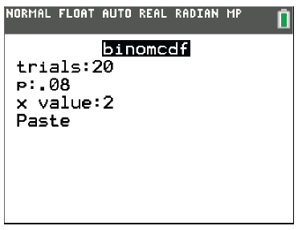
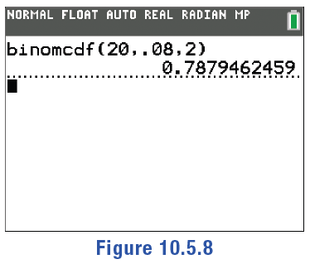
Example 4: Calculating Cumulative Binomial Probability—Slide 4
Figure 7
Figure 8
Microsoft Excel
As in the previous two examples, we can use the binomial distribution function, BINOM.DIST(number_s, trials, probability_s, cumulative).

Slide 21
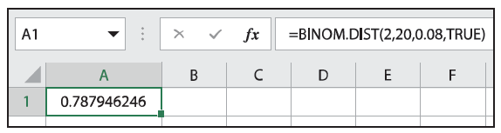

Example 4: Calculating Cumulative Binomial Probability—Slide 5
This time, however, since we are looking for the probability of no more than 2 successes, we want to use the cumulative mass function. This means we should use TRUE for the last entry. In an empty cell, type "=BINOM.DIST(2, 20, 0.08, TRUE)" and press Enter. The value given is 0.787946246.
Figure 9
Therefore, the probability that no more than two out of the 20 batteries are defective is approximately $78.8\%$.

Slide 22
Tech Tip
Note the difference in commands on a TI-83/84 Plus calculator.
binompdf is for a single binomial probability.
binomcdf is for a cumulative binomial probability. Keep in mind that binomcdf is only for the probability of less than or equal to a certain amount of successes.

Slide 23
Skill Check 2
Suppose you are interested in finding the probability of rolling at least 4 sixes out of 10 rolls of a single fair six-sided die. Set up the general binomial probability equation that would be used to calculate this.
Answer:

Slide 24

Example 5: Calculating Cumulative Binomial Probability—Slide 1
A baseball player's on-base percentage (OBP) is a measure of the likelihood that a runner will reach base safely each time at bat, taking into account things such as hitting the ball, being walked by the pitcher, or even being hit by a pitch. In 2019, Mike Trout had the leading OBP for Major League Baseball at $43.8\%$. This means that he reached first base $43.8\%$ of the times he came up to bat. Assuming that each of his six at bats in a game is independent of any other at bat, what is the probability that he gets on base more than four times?

Slide 25
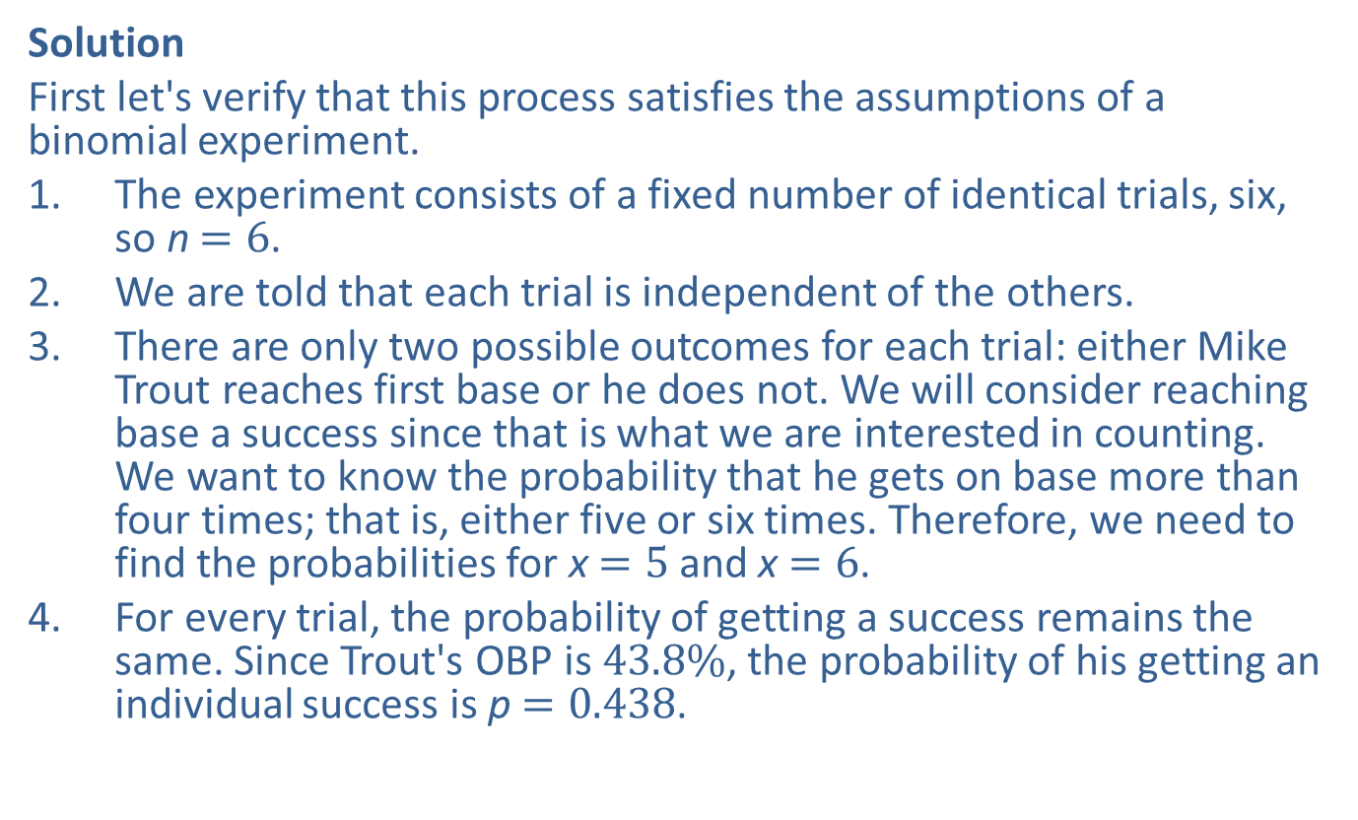
Example 5: Calculating Cumulative Binomial Probability—Slide 2
Solution
First let's verify that this process satisfies the assumptions of a binomial experiment.
1.​ The experiment consists of a fixed number of identical trials, six, so n $=6$.
2.​ We are told that each trial is independent of the others.
3.​ There are only two possible outcomes for each trial: either Mike Trout reaches first base or he does not. We will consider reaching base a success since that is what we are interested in counting. We want to know the probability that he gets on base more than four times; that is, either five or six times. Therefore, we need to find the probabilities for x $=5$ and x $=6$.
4. For every trial, the probability of getting a success remains the same. Since Trout's OBP is $43.8\%$, the probability of his getting an individual success is p $=0.438$.

Slide 26
Example 5: Calculating Cumulative Binomial Probability—Slide 3
By Hand
The probability of more than four successes can be found by adding together the two individual probabilities. Using the binomial probability formula for our solution gives us the following equation.
TI-83/84 Plus
Notice that the probability of more than four successes is the same thing as 1 minus the probability of four or fewer successes. Since the binomcdf( function in the calculator returns the probability of x or fewer successes, we will need to find the value of 1 minus the cumulative probability of 4 or fewer successes.

Slide 27
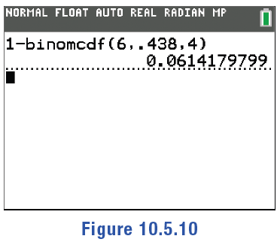
Example 5: Calculating Cumulative Binomial Probability—Slide 4
First, enter 1 - into the calculator. Then access the distr menu, scroll down, and select binomcdf(. Enter 6 for trials, 0.438 for p, and 4 for the x value. Highlight Paste and press enter twice. The calculator will give the result 0.0614179799.
Figure 10
Microsoft Excel
We can again use the binomial distribution function, BINOM.DIST( number_s, trials, probability_s, cumulative), to find the probability

Slide 28
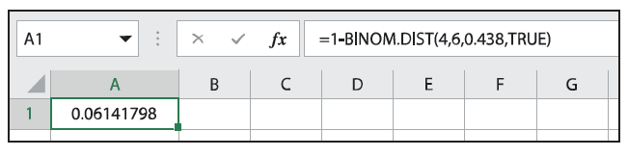

Example 5: Calculating Cumulative Binomial Probability—Slide 5
of 4 or fewer hits. This number subtracted from 1 is the probability of more than 4 hits.
Note that we’ll be using TRUE for the cumulative argument since we are not finding the probability of exactly 4 hits.
In an empty cell, type "=1-BINOM.DIST(4, 6, 0.438, TRUE)" and press Enter. The value given is 0.06141798.
Figure 11
Therefore, the probability that Mike Trout reaches base more than four times out of six at bats is approximately $6.14\%$.

Slide 29
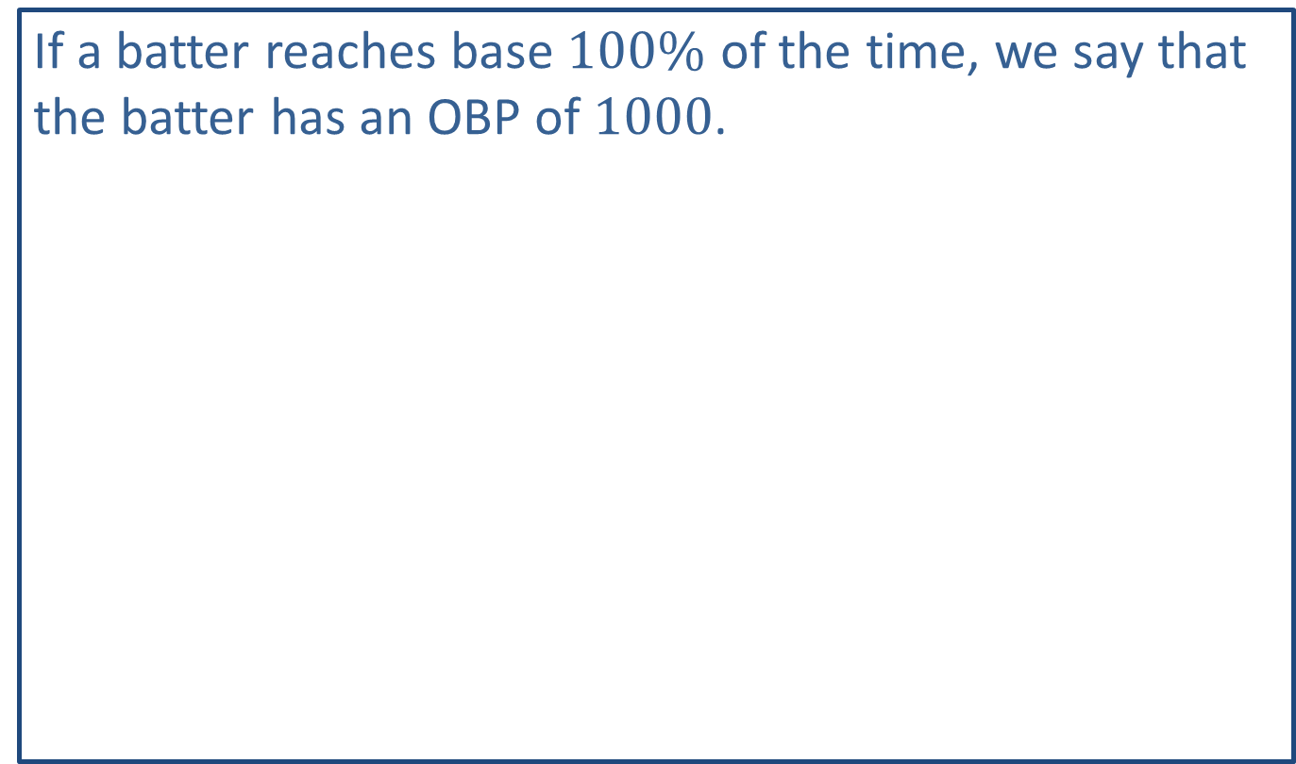
Fun Fact
If a batter reaches base $100\%$ of the time, we say that the batter has an OBP of 1000.

Slide 30
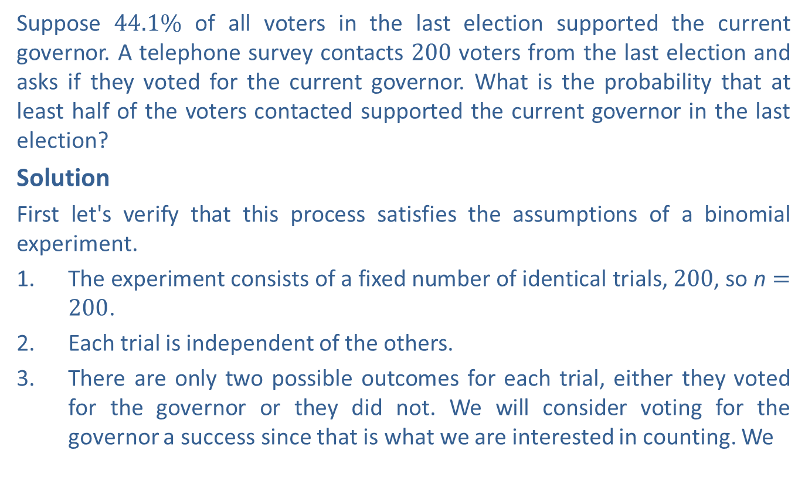
Example 6: Calculating Cumulative Binomial Probability—Slide 1
Suppose $44.1\%$ of all voters in the last election supported the current governor. A telephone survey contacts 200 voters from the last election and asks if they voted for the current governor. What is the probability that at least half of the voters contacted supported the current governor in the last election?
Solution
First let's verify that this process satisfies the assumptions of a binomial experiment.
1.​ The experiment consists of a fixed number of identical trials, 200, so n $=200$.
2.​ Each trial is independent of the others.
3. There are only two possible outcomes for each trial, either they voted for the governor or they did not. We will consider voting for the governor a success since that is what we are interested in counting. We

Slide 31
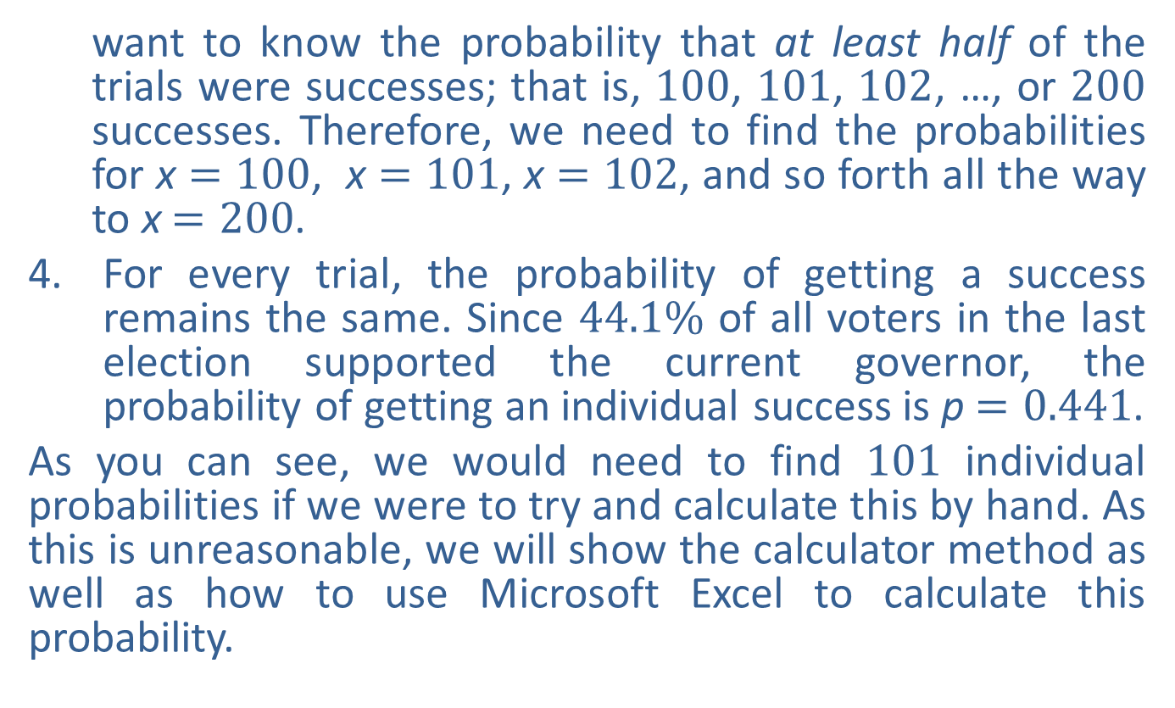
Example 6: Calculating Cumulative Binomial Probability—Slide 2
want to know the probability that at least half of the trials were successes; that is, 100, 101, 102, …, or 200 successes. Therefore, we need to find the probabilities for x $=100$, x $=101$, x $=102$, and so forth all the way to x $=200$.
4.​ For every trial, the probability of getting a success remains the same. Since $44.1\%$ of all voters in the last election supported the current governor, the probability of getting an individual success is p $=0.441$.
As you can see, we would need to find 101 individual probabilities if we were to try and calculate this by hand. As this is unreasonable, we will show the calculator method as well as how to use Microsoft Excel to calculate this probability.

Slide 32
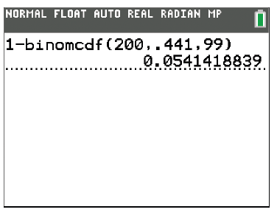
Example 6: Calculating Cumulative Binomial Probability—Slide 3
TI-83/84 Plus
The probability that at least half of the survey respondents voted for the current governor is the same thing as 1 minus the probability that less than half of the respondents voted for the current governor. So we will use the calculator to find 1 minus the cumulative probability of 99 or fewer successes.
First, enter 1- into the calculator. Then access the distr menu, scroll down, and select binomcdf(. Enter 200 for trials, 0.441 for p, and 99 for the x value. Highlight Paste and press enter . Press enter again. The calculator will give the result 0.0541418839.
Figure 12

Slide 33
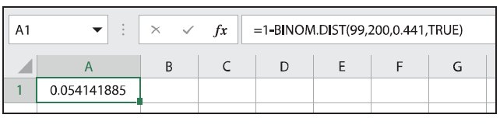
Example 6: Calculating Cumulative Binomial Probability—Slide 4
Microsoft Excel
We can use the binomial distribution function, BINOM.DIST(number_s, trials, probability_s, cumulative) to find the probability that less than half of the survey respondents voted for the current governor. This number subtracted from 1 is the probability that at least half of the respondents voted for the current governor.
In an empty cell, type "=1-BINOM.DIST(99, 200, 0.441, TRUE)" and press Enter. The value given is 0.054141885.
Figure 13
Therefore, the probability that more than half of the survey respondents voted for the current governor in the last election is approximately $5.4\%$.

