Slide 1
Section 10.6
Expected Value

Slide 2
Definition: Random Variable
A random variable is a variable whose numeric value is determined by the outcome of a probability experiment.

Slide 3

Definition: Expected Value
The expected value E of a random variable W is calculated by multiplying each possible outcome by the probability of it occurring and then adding these products together.
Here,
are possible outcomes of random
variable W with respective probabilities of occurring

Slide 4
Helpful Hint 1
Expected value is a long-term average of random numerical outcomes.

Slide 5
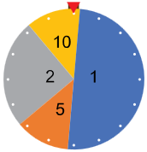
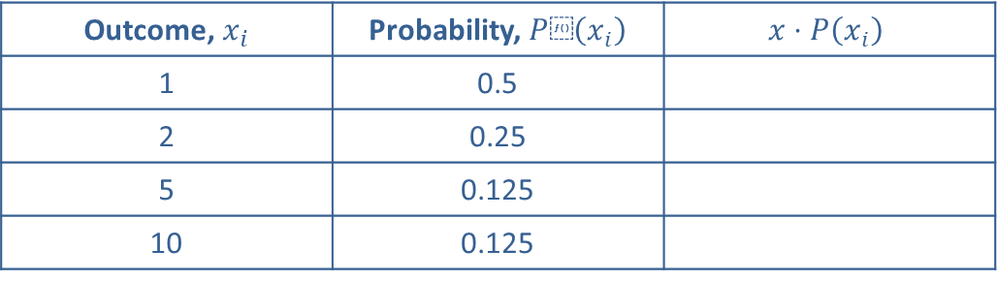
Example 1: Calculating Expected Value—Slide 1
Figure 1 shows a wheel used in a carnival game at a children's party where a player spins and wins the amount of candy the wheel lands on. Table 1 lists the possible outcomes along with their respective probabilities for the wheel.
a.​ Use the wheel to determine the expected number of pieces of candy each player wins.
b.​ The host of the party does not want to run out of candy. If 15 children each play the game 5 times, how many pieces of candy should the host expect to give out?
c.​ What are the maximum and minimum amounts of candy that the host should expect to hand out at this game?
Table 1: Outcomes and Probabilities for Carnival Game
Outcome, $x_{i}$ | Probability, $P⁡\left(x_{i}\right)$ | $$x⋅P\left(x_{i}\right)$$
1 | 0.5
2 | 0.25
5 | 0.125
10 | 0.125
Figure 10.6.1: Carnival Spinner

Slide 6
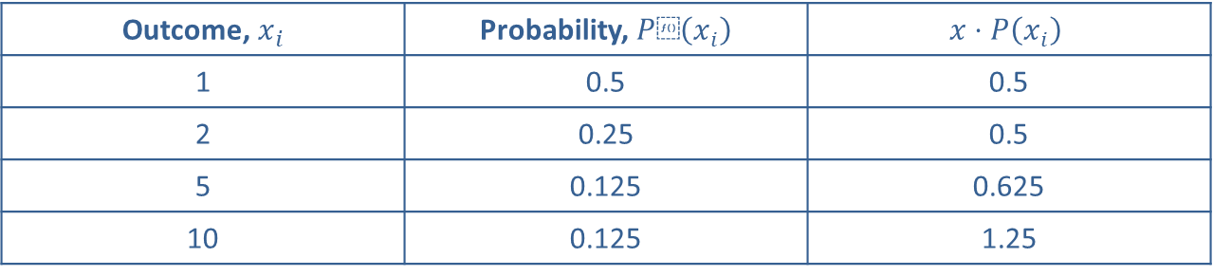
Example 1: Calculating Expected Value—Slide 2
Solution
​In order to calculate the expected value, we need to multiply each outcome by its probability, and then add the resulting products.
By Hand
The third column shows each outcome multiplied by its probability.
Table 2: Outcomes and Probabilities for Carnival Game
Outcome, $x_{i}$ | Probability, $P⁡\left(x_{i}\right)$ | $$x⋅P\left(x_{i}\right)$$
1 | 0.5 | 0.5
2 | 0.25 | 0.5
5 | 0.125 | 0.625
10 | 0.125 | 1.25
The expected value is then the sum of the values in the third column.

Slide 7
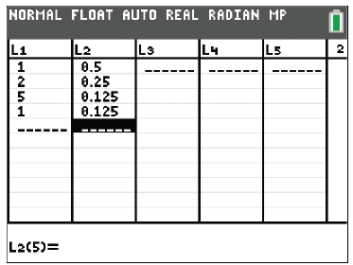
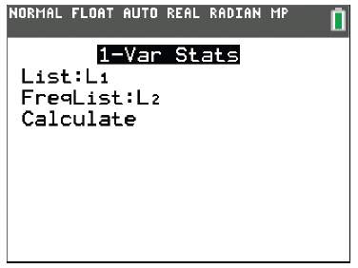
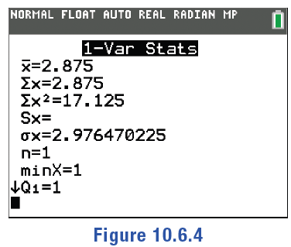
Example 1: Calculating Expected Value—Slide 3
TI-83/84 Plus
We can store information as lists in the TI-83/84 Plus and then use built-in functions to analyze the data. Specifically, we can find the expected value.
Press stat and then EDIT to access lists. Enter the outcomes, x, in L1 and the probabilities, P(x), in L2. Now that you have two lists, press stat again and highlight CALC. Select 1-Var Stats. L1 should automatically appear for List, but you'll need to input L2 for FreqList. To do this, press 2nd 2. Move the cursor down to highlight Calculate and press enter . The first number listed,
is the expected
value and is given as 2.875.
Figure 2
Figure 3
Figure 4

Slide 8
Example 1: Calculating Expected Value—Slide 4
​Microsoft Excel
We can also use Excel to calculate the expected value. For clarity, we'll begin by labeling the columns "Outcome, x", "Probability P(x)", and "x*P(x)" in A1 through C1, respectively. Next enter the necessary data into the first two empty columns; that is, enter the values of x in column A and their probabilities in column B. In cell C2, type the formula for the product, "=A2*B2", and press Enter. The value will appear as 0.5.
Drag the bottom right-hand corner of cell C2 down through cell C5. This will copy the formula into cells C3, C4, and C5 while updating the referenced cells. The values 0.5, 0.625, and 0.125, will appear in cells C3, C4, and C5, respectively.
The expected value is the sum of these products, which are now all located in column C. We can use the SUM(number1, [number2],…) formula to find this sum. In cell C6, type "=sum(" and then highlight the four cells we need to add: C2, C3, C4, and C5. Then type the closing parenthesis and press Enter. Alternatively, you could type "=sum(C1, C2, C3, C4)" or "=sum(C1:C4)". The resulting value is 2.875.

Slide 9
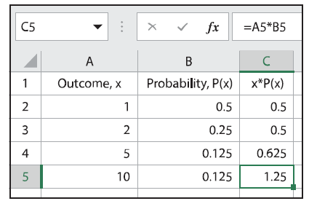
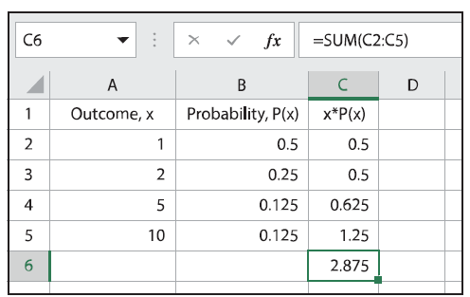
Example 1: Calculating Expected Value—Slide 5
Figure 5
Figure 6
Thus, the expected value of spinning the wheel at the party is 2.875. In other words, over time, the average spin will win 2.875 pieces of candy, even though a single spin will never win that amount.

Slide 10
Example 1: Calculating Expected Value—Slide 6
b.​ If each of the 15 children spin the wheel 5 times, there will be
spins on the wheel. To find the amount of candy the host should expect
to give out, we multiply the total number of spins by the expected value
of 2.875.
Therefore, the host should expect to give out about 216 pieces of candy.
c.​ The host would give out the maximum amount of candy if each of the 75 spins landed on 10 pieces. Thus,
pieces of candy would
be given out. The minimum would happen if all spins landed on 1 piece, in which case only 75 pieces of candy would be given out. This large difference in candy amounts shows why the expected value is a better gage of the amount of candy the host will need. This way the host is less likely to buy too much or too little candy. Notice that the expected value is not the average of the minimum and maximum amounts. We leave this for you to verify for yourself.

Slide 11
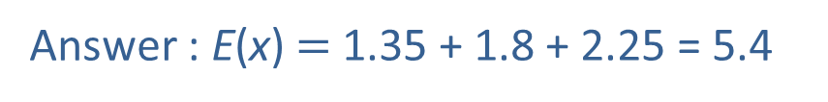
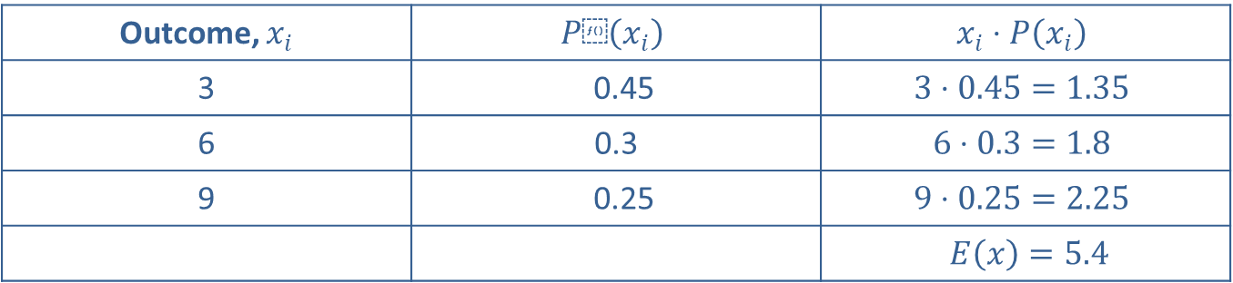
Skill Check 1
Given the following table of outcomes for an event and their respective probabilities, complete the table and then determine the expected value of the event.
Table 3
Outcome, $x_{i}$ | $$P⁡\left(x_{i}\right)$$ | $$x_{i}⋅P\left(x_{i}\right)$$
3 | 0.45 | $$3⋅0.45=1.35$$
6 | 0.3 | $$6⋅0.3=1.8$$
9 | 0.25 | $$9⋅0.25=2.25$$
 |  | $E\left(x\right)=5.4$
Answer : E(x)$=$ 1.35 + 1.8 + 2.25 = 5.4

Slide 12
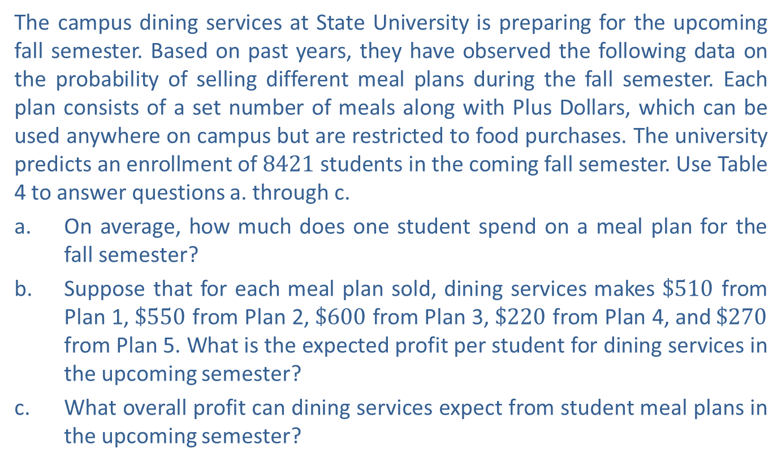
Example 2: Calculating Expected Value—Slide 1
The campus dining services at State University is preparing for the upcoming fall semester. Based on past years, they have observed the following data on the probability of selling different meal plans during the fall semester. Each plan consists of a set number of meals along with Plus Dollars, which can be used anywhere on campus but are restricted to food purchases. The university predicts an enrollment of 8421 students in the coming fall semester. Use Table 4 to answer questions a. through c.
a.​ On average, how much does one student spend on a meal plan for the fall semester?
b.​ Suppose that for each meal plan sold, dining services makes $\$510$ from Plan 1, $\$550$ from Plan 2, $\$600$ from Plan 3, $\$220$ from Plan 4, and $\$270$ from Plan 5. What is the expected profit per student for dining services in the upcoming semester?
c.​ What overall profit can dining services expect from student meal plans in the upcoming semester?

Slide 13
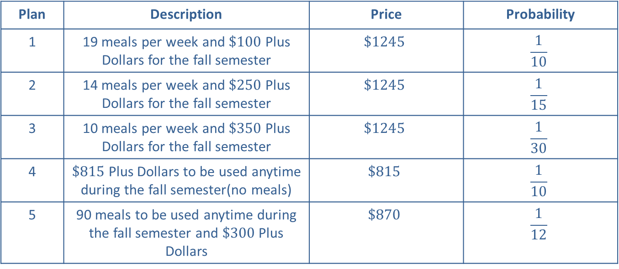
Example 2: Calculating Expected Value—Slide 2
Table 4: Meals Plan
Plan | Description | Price | Probability
1 | 19 meals per week and $\$100$ Plus Dollars for the fall semester | $$\$1245$$ | $$\frac{1}{10}$$
2 | 14 meals per week and $\$250$ Plus Dollars for the fall semester | $$\$1245$$ | $$\frac{1}{15}$$
3 | 10 meals per week and $\$350$ Plus Dollars for the fall semester | $$\$1245$$ | $$\frac{1}{30}$$
4 | $\$815$ Plus Dollars to be used anytime during the fall semester(no meals) | $$\$815$$ | $$\frac{1}{10}$$
5 | 90 meals to be used anytime during the fall semester and $\$300$ Plus Dollars | $$\$870$$ | $$\frac{1}{12}$$
Note: Students have the option of choosing to not buy a meal plan.

Slide 14
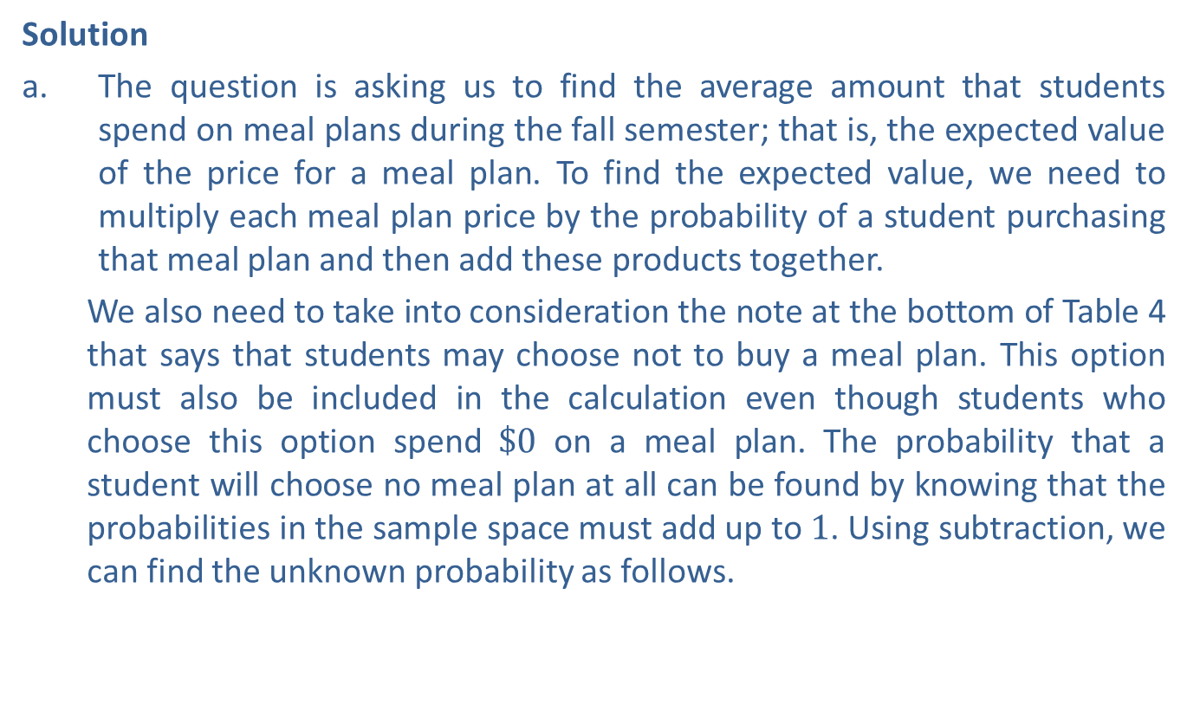
Example 2: Calculating Expected Value—Slide 3
Solution
a.​ The question is asking us to find the average amount that students spend on meal plans during the fall semester; that is, the expected value of the price for a meal plan. To find the expected value, we need to multiply each meal plan price by the probability of a student purchasing that meal plan and then add these products together.
We also need to take into consideration the note at the bottom of Table 4 that says that students may choose not to buy a meal plan. This option must also be included in the calculation even though students who choose this option spend $\$0$ on a meal plan. The probability that a student will choose no meal plan at all can be found by knowing that the probabilities in the sample space must add up to 1. Using subtraction, we can find the unknown probability as follows.

Slide 15
Example 2: Calculating Expected Value—Slide 4
​Now that we know the probabilities for all possible amounts a student can spend on meal plans, we can calculate the amount we should expect one student to spend on average on a meal plan.
By Hand
Substituting these values into the expected value formula, we have the following equation.
​

Slide 16
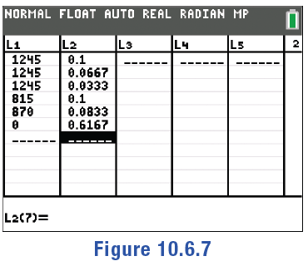
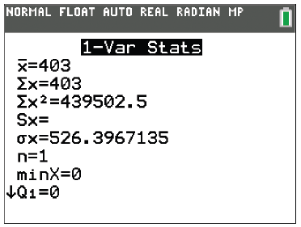
Example 2: Calculating Expected Value—Slide 5
TI-83/84 Plus
We can again use the calculator's built-in functions to find the expected value. Press stat and EDIT to access lists. Enter the price of each meal plan in L1 and the probabilities in L2. (Notice that the fractions entered in L2 are converted to decimal form.) Press stat again and highlight CALC. Select 1-Var Stats. Use L1 for List and L2 for FreqList. Move the cursor down to highlight Calculate and press enter . The first number listed,
is the expected value and is given as 403.
Figure 7
Figure 8

Slide 17
Example 2: Calculating Expected Value—Slide 6
​Microsoft Excel
We can also use Excel to calculate the expected value. For clarity, we'll begin by labeling columns "Price, x", "Probability P(x)", and "x*P(x)" in A1 through C1, respectively. Enter the price of each plan into column A and the probability that each plan will be chosen into column B. (Notice that the fractions entered in column B are converted to decimal form.) In cell C2, type the formula for the product of the first row, "=A2*B2" and press Enter. The value in C2 will appear as 124.5. To copy this formula down column C, drag the lower right-hand corner of the cell down the column. The row references will update in the formula and the values 83, 41.5, 81.5, 72.5, and 0 will appear in cells C3 through C7, respectively.

Slide 18
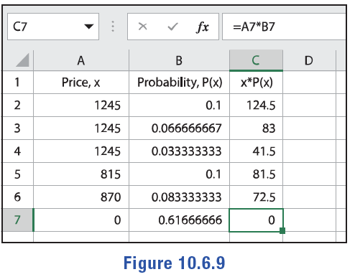
Example 2: Calculating Expected Value—Slide 7
Figure 9
Next, use the SUM(number1, [number2],…) formula in cell C8 to determine the sum of the values in column C. The resulting value is 403.

Slide 19
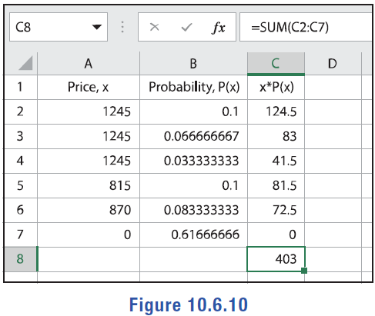
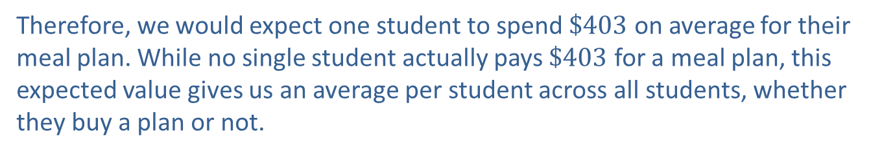
Example 2: Calculating Expected Value—Slide 8
Figure 10
Therefore, we would expect one student to spend $\$403$ on average for their meal plan. While no single student actually pays $\$403$ for a meal plan, this expected value gives us an average per student across all students, whether they buy a plan or not.

Slide 20
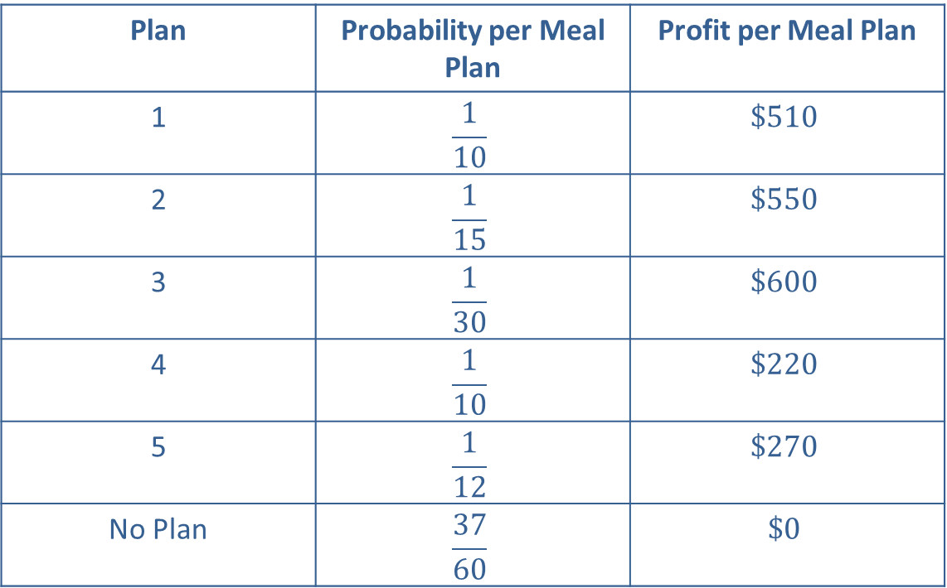
Example 2: Calculating Expected Value—Slide 9
b.​ The profits per meal plan are summarized in Table 5.
Table 5: Meals Plan Profits
Plan | Probability per Meal Plan | Profit per Meal Plan
1 | $$\frac{1}{10}$$ | $$\$510$$
2 | $$\frac{1}{15}$$ | $$\$550$$
3 | $$\frac{1}{30}$$ | $$\$600$$
4 | $$\frac{1}{10}$$ | $$\$220$$
5 | $$\frac{1}{12}$$ | $$\$270$$
No Plan | $$\frac{37}{60}$$ | $$\$0$$

Slide 21
Example 2: Calculating Expected Value—Slide 10
​In order to calculate the expected profit per student, multiply the estimated profit for each meal plan by the probability of that meal plan being chosen.
By Hand
Substituting these values into the expected value formula, we have the following equation.
​

Slide 22
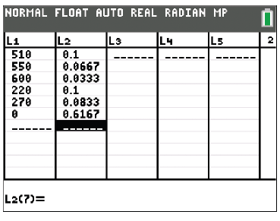
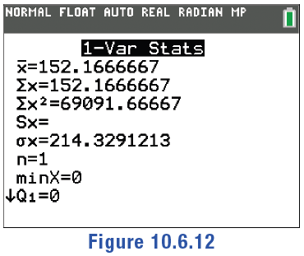
Example 2: Calculating Expected Value—Slide 11
TI 83/84 Plus
Press … and EDIT to access the list function. Enter the profit per meal plan in L1 and the probabilities in L2. Press y z to return to the home screen. Press … again and highlight CALC. Select 1-Var Stats. Use L1 for List and L2 for FreqList. Move the cursor down to highlight Calculate and press Í. The first number listed,
is the expected value.
Figure 11
Figure 12

Slide 23
Example 2: Calculating Expected Value—Slide 12
​Microsoft Excel
Begin by labeling columns "Profit, x", "Probability, P(x)", and "x*P(x)" in cells A1 through C1. Enter the profit per meal plan into column A and the probabilities into column B. In cell C2, type the formula for the product of the first row, "=A2*B2", and press Enter. The value in C2 will appear as 51. To copy this formula down column C, drag the lower right-hand corner of the cell down the column. The row references will update in the formula and the values 36.66667, 20, 22, 22.5, and 0 will appear in cells C3 through C7, respectively. (Notice that the value in C3 may vary in length depending on the width of the cell.)
Next, use the =SUM(number1, [number2],…) formula in cell C8 to determine the sum of the values in column C. The resulting value is 152.1667.

Slide 24
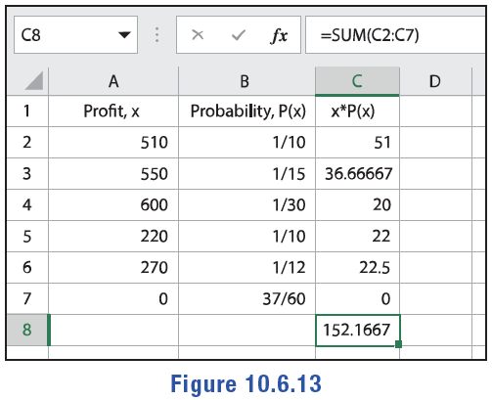
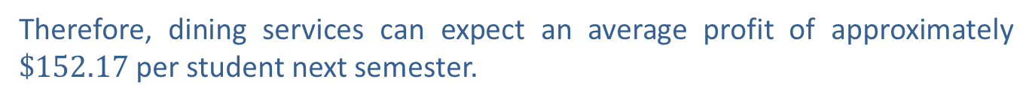
Example 2: Calculating Expected Value—Slide 13
Figure 13
Therefore, dining services can expect an average profit of approximately $\$152.17$ per student next semester.

Slide 25
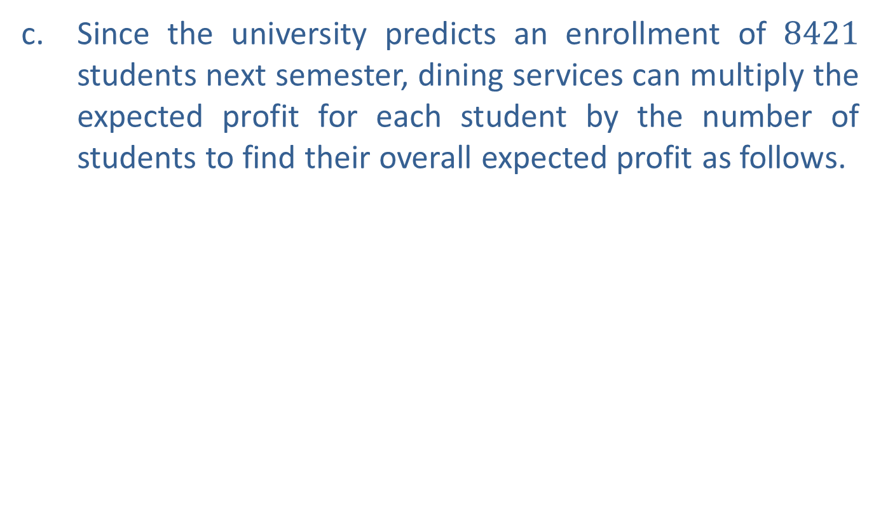
Example 2: Calculating Expected Value—Slide 14
c. ​Since the university predicts an enrollment of 8421 students next semester, dining services can multiply the expected profit for each student by the number of students to find their overall expected profit as follows.
​

Slide 26
Helpful Hint 2
Recall that the sum of all the probabilities of all the outcomes in a sample space must equal 1.

Slide 27
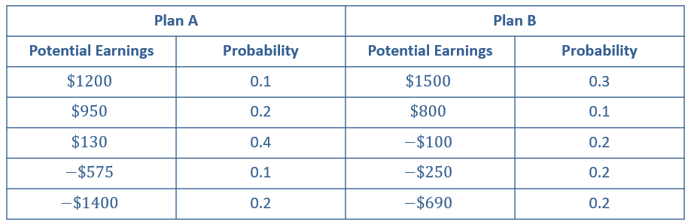
Example 3: Calculating Expected Value—Slide 1
Suppose you are trying to decide between two different investment opportunities. The two plans are summarized in Table 6. The left column for each plan gives the potential earnings, and the right columns give their respective probabilities. Which plan should you choose?
Table 6: Investment Plans

Slide 28
Example 3: Calculating Expected Value—Slide 2
Solution
It is difficult to determine which plan will yield the higher return simply by looking at the table. However, we can calculate the expected value for each plan in order to compare them. We will calculate the expected value using Microsoft Excel.
For investment Plan A, begin by labeling the columns "Earnings, x", "Probability, P(x)", and "x*P(x)". Enter the potential earnings of Plan B into column A and the probabilities into column B. In cell C2, type the formula for the product of the earnings and the probability for the first row of the table, "=A2*B2" and press Enter. The value in C2 will appear as 120. To copy this formula down column C, drag the lower right-hand corner of cell C2 down the column. The row references will update in the formula and the values 190, 52, 57.5, and −280 will appear in cells C3 through C6, respectively.

Slide 29
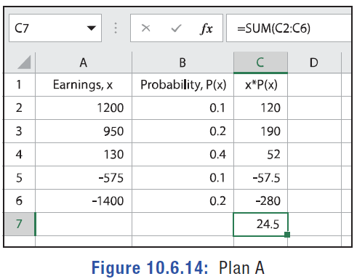


Example 3: Calculating Expected Value—Slide 3
Finally, use the SUM(number1, [number2], …) formula in cell C7 to determine the sum of the values in column C. The resulting value is $\$24.5$.
Figure 14: Plan A
Thus, the expected value for Plan A is $\$24.5$.

Slide 30
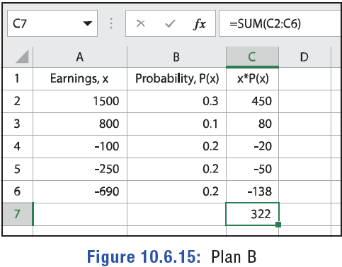
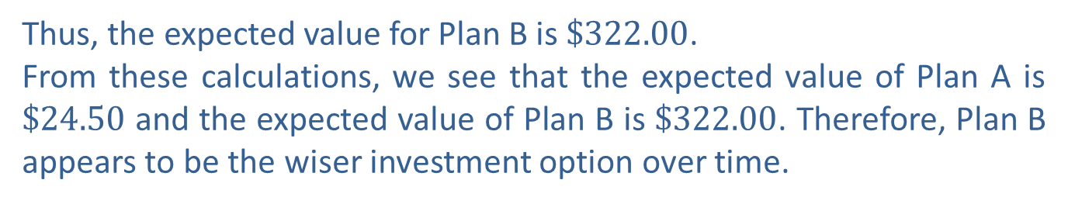
Example 3: Calculating Expected Value—Slide 4
Repeat this process in Excel for Plan B.
Figure 15: Plan B
Thus, the expected value for Plan B is $\$322.00$.
From these calculations, we see that the expected value of Plan A is $\$24.50$ and the expected value of Plan B is $\$322.00$. Therefore, Plan B appears to be the wiser investment option over time.

Slide 31
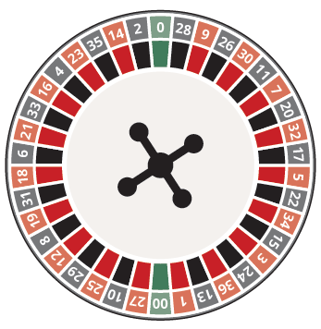
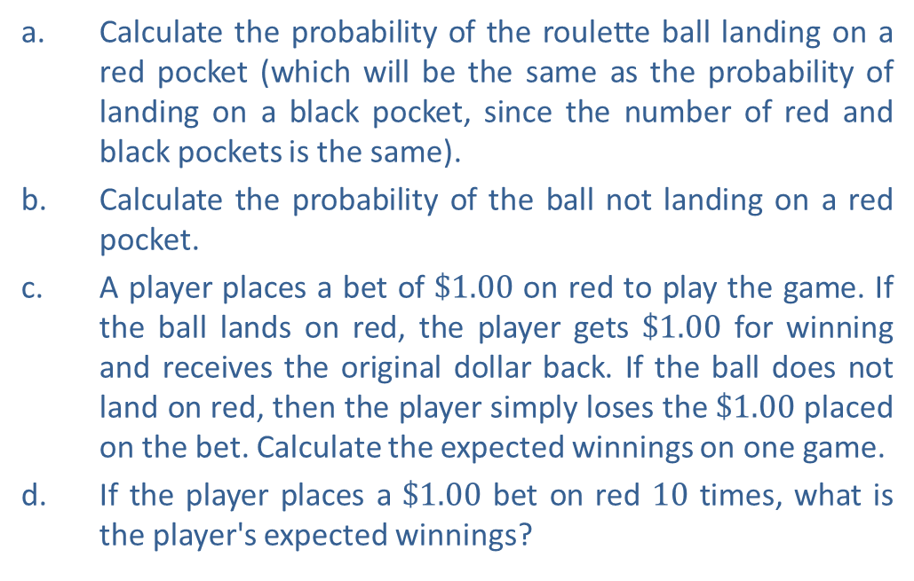
Example 4: Calculating Expected Winnings—Slide 1
In American roulette, the wheel contains the numbers 1 through 36, alternating between black and red. There are two green spaces numbered 0 and 00.
a.​ Calculate the probability of the roulette ball landing on a red pocket (which will be the same as the probability of landing on a black pocket, since the number of red and black pockets is the same).
b.​ Calculate the probability of the ball not landing on a red pocket.
c. A player places a bet of $\$1.00$ on red to play the game. If the ball lands on red, the player gets $\$1.00$ for winning and receives the original dollar back. If the ball does not land on red, then the player simply loses the $\$1.00$ placed on the bet. Calculate the expected winnings on one game.
d. ​If the player places a $\$1.00$ bet on red 10 times, what is the player's expected winnings?
Figure 16: American Roulette Wheel

Slide 32
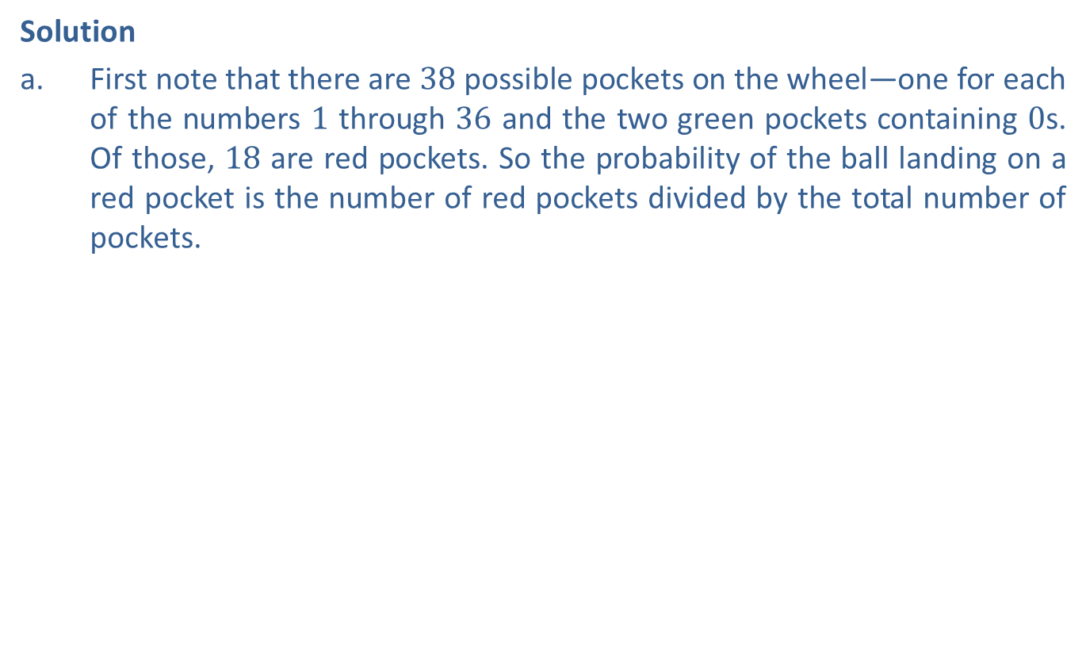
Example 4: Calculating Expected Winnings—Slide 2
Solution
a. ​First note that there are 38 possible pockets on the wheel—one for each of the numbers 1 through 36 and the two green pockets containing 0s. Of those, 18 are red pockets. So the probability of the ball landing on a red pocket is the number of red pockets divided by the total number of pockets.
​
𝑃Not Red
b.​ The event that the ball does not land on a red pocket is the complement of the ball landing on a red pocket, so we can calculate the probability as follows.

Slide 33

Example 4: Calculating Expected Winnings—Slide 3
c. ​If a player bets $\$1.00$ on red, the chance of winning a dollar
and the chance of losing a dollar
Multiply each dollar amount by its respective probability and then add the products to find the player's expected winnings.
This means that the player can expect to lose about 5¢ on average for every dollar bet on red while at the roulette table. Of course, a player never actually loses 5¢ on a single bet, but this is the expected average outcome for multiple trials.

Slide 34

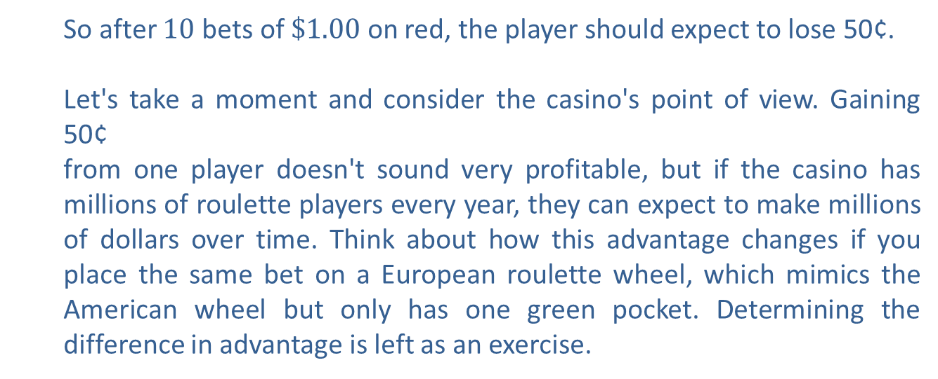
Example 4: Calculating Expected Winnings—Slide 4
d.​ If the player made the same bet (that is, $\$1.00$ on red) 10 times, then we multiply the expected winnings by 10 to determine his anticipated result.
So after 10 bets of $\$1.00$ on red, the player should expect to lose 50¢.
Let's take a moment and consider the casino's point of view. Gaining 50¢
from one player doesn't sound very profitable, but if the casino has millions of roulette players every year, they can expect to make millions of dollars over time. Think about how this advantage changes if you place the same bet on a European roulette wheel, which mimics the American wheel but only has one green pocket. Determining the difference in advantage is left as an exercise.

Slide 35
Fun Fact
On August 18th, 1913, gamblers at the Monte Carlo Casino lost millions of francs at the roulette wheel. The ball fell on black (not red) 26 times in a row. More and more gamblers kept thinking, "It has to be red next time." Of course, the probability of the ball falling on red didn't change each spin and was no more or less likely to fall on red the next spin—a roulette wheel doesn't remember the color it landed on last time! This idea that past behavior influences future behavior is called the gambler's fallacy or aptly the Monte Carlo fallacy.

