Slide 1
Chapter 10
Review

Slide 2
Definition: Probability
The probability of something occurring is a number between 0 and 1, inclusive, that represents how likely the event is to occur. If an event cannot occur its probability is 0. If an event is certain to happen its probability is 1.

Slide 3
Definition: Probability Experiment
A probability experiment, or a trial, is any process with a result determined by chance.

Slide 4
Definition: Outcome
Each individual result that is possible for a probability experiment is an outcome.

Slide 5
Definition: Sample Space
The sample space is the set of all possible outcomes for a given probability experiment.

Slide 6
Definition: Tree Diagram
A tree diagram uses branches to indicate all possible outcomes at each stage for an experiment. Each path of branches in a tree diagram indicates a single possible outcome for the experiment.

Slide 7
Definition: Event
An event E is a group, or subset, of outcomes in the sample space.

Slide 8
Formula: Experimental Probability
In experimental probability, if E is an event, then P(E), which is read "the probability that E occurs," is given by
where f is the number of times the event occurs (the frequency of the event) and n is the total number of times the experiment is performed. The value of P(E) will always be a real number between 0 and 1, inclusive.

Slide 9
Formula: Classical Probability
In classical probability, if all outcomes are equally likely to occur, then P(E), which is read "the probability that E occurs," is given by
Where n(E)is the number of outcomes in the event and n(S) is the number of outcomes in the sample space. The value of P(E) will always be a real number between 0 and 1, inclusive.

Slide 10
Definition: Fundamental Counting Principle
The Fundamental Counting Principle states that for an experiment with a sequence of n stages where the first stage has k₁ outcomes, the second stage has k₂ outcomes, the third stage has k₃ outcomes, and so forth, the total number of possible outcomes for the experiment is calculated as follows.

Slide 11
Definition: Replacement
When counting possible outcomes with replacement, objects are placed back into consideration for the following choice.
When counting possible outcomes without replacement, objects are not placed back into consideration for the following choice.

Slide 12

Definition: $n$ Factorial
is the product of all the
In general,
positive integers less than or equal to n, where n is a positive integer.
The expression
is defined to be 1.

Slide 13
Definition: Combinations
A combination is a selection of objects from a group without regard to their arrangement; that is, their order is not important.

Slide 14
Definition: Permutations
A permutation is a selection of objects from a group where the arrangement is specific; that is, their order is important.

Slide 15
Formula: Combinations
The following formula is used to calculate the number of combinations.

Slide 16
Formula: Permutations
The following formula is used to calculate the number of permutations.
In both of these formulas, r objects are selected from a group of n distinct objects, so r and n are both positive integers with r ≤ n.

Slide 17
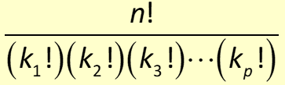

Formula: Permutations with Repeated Objects
The number of distinguishable permutations of n objects, of which k₁ are all alike, k₂ are all alike, and so forth, is given by the following formula.

Slide 18
Definition: Complement
consists of
The complement of event E, denoted by
all outcomes in the sample space that are not in event E.

Slide 19
Definition: Odds
The odds against an event E are given as follows.
The odds in favor of an event E are given as follows.
Here, a is the number of unfavorable outcomes and b is the number of favorable outcomes.

Slide 20
Properties: Complement Rules of Probability

Slide 21
Definition: Mutually Exclusive Events
Mutually exclusive events are events that have no outcomes in common.

Slide 22
Definition: Independent Events
Independent events are events where the result of one event does not influence the probability of the other event happening.

Slide 23
Definition: Dependent Events
Dependent events are events where the result of one event influences the probability of the other event happening.

Slide 24
Definition: Conditional Probability
Conditional probability, denoted P(B, A) and read "the probability of B given A," is the probability of event B occurring given that event A occurs first.

Slide 25
Formula: Addition Rule of Probability
The Addition Rule of Probability states that the probability of event A happening or event B happening is given by the following formula.

Slide 26
Formula: Addition Rule of Probability for Mutually Exclusive Events
The Addition Rule of Probability for Mutually Exclusive Events states that the probability of event A happening or event B happening when A and B have no outcomes in common is given by the following formula.

Slide 27
Formula: Multiplication Rule of Probability for Independent Events
The Multiplication Rule of Probability for Independent Events states that for two independent events, A and B, the probability of event A happening and event B happening is given by the following formula.

Slide 28
Formula: Multiplication Rule of Probability for Dependent Events
The Multiplication Rule of Probability for Dependent Events states that if A and B are dependent events, the probability of A and B occurring is given by the following formula.

Slide 29
Theorem: Bayes' Theorem
The probability of event A occurring given that event B occurred is calculated as follows.
Here, P(B) ≠ 0.

Slide 30
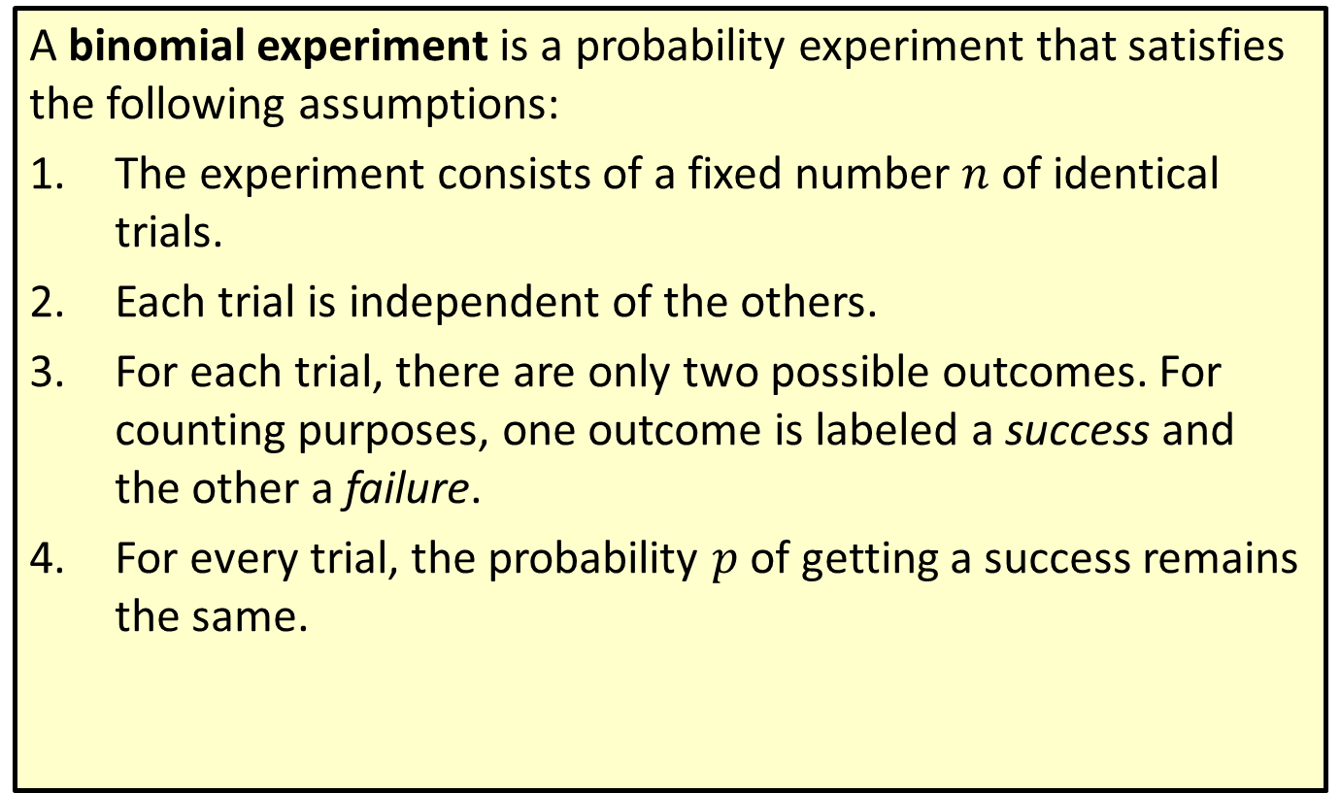
Definition: Binomial Experiment
A binomial experiment is a probability experiment that satisfies the following assumptions:
1.​ The experiment consists of a fixed number $n$ of identical trials.
2. ​Each trial is independent of the others.
3.​ For each trial, there are only two possible outcomes. For counting purposes, one outcome is labeled a success and the other a failure.
4.​ For every trial, the probability $p$ of getting a success remains the same.

Slide 31
Formula: Binomial Probability Formula
The probability of obtaining x successes in n independent trials of a binomial probability experiment is given by
where x is the number of successes,
n is the number of trials, and
p is the probability of getting a success on any trial.

Slide 32
Definition: Random Variable
A random variable is a variable whose numeric value is determined by the outcome of a probability experiment.

Slide 33

Formula: Expected Value
The expected value E of a random variable W is calculated by multiplying each possible outcome by the probability of it occurring and then adding these products together.
Here,
are possible outcomes of random
variable W with respective probabilities of occurring

