Slide 1
Section 11.2
Displaying Data

Slide 2
Definition: Frequency Distribution, Class, and Relative Frequency
Frequency Distribution
A frequency distribution is a display of the values that occur in a data set and how often each value, or range of values, occurs.
Class
In a frequency distribution, a class is a category of data.
Relative Frequency
The relative frequency is the percentage of the data set that falls into a particular class.
Here, f is the class frequency and n is the total number of members in the data set.

Slide 3
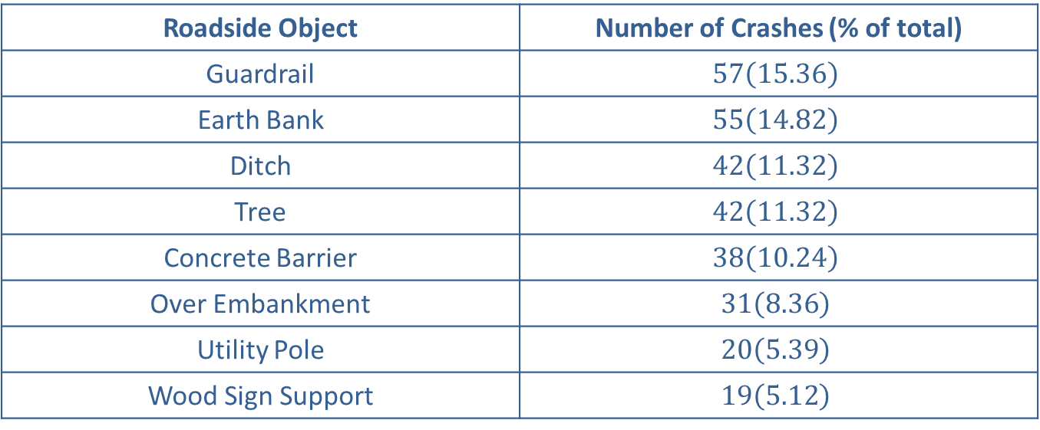
Example 1: Interpreting a Frequency Distribution—Slide 1
In the state of Washington, researchers hoped to better understand the effects of roadside objects on vehicle accident frequency and severity. Table 3 shows data collected on the number of accidents involving roadside objects along State Route 3 in the state of Washington. Answer the following questions based on the table.
Table 3: Vehicle Accidents with Roadside Objects Along State Route 3, Washington
Roadside Object | Number of Crashes (% of total)
Guardrail | $$57\left(15.36\right)$$
Earth Bank | $$55\left(14.82\right)$$
Ditch | $$42\left(11.32\right)$$
Tree | $$42\left(11.32\right)$$
Concrete Barrier | $$38\left(10.24\right)$$
Over Embankment | $$31\left(8.36\right)$$
Utility Pole | $$20\left(5.39\right)$$
Wood Sign Support | $$19\left(5.12\right)$$

Slide 4
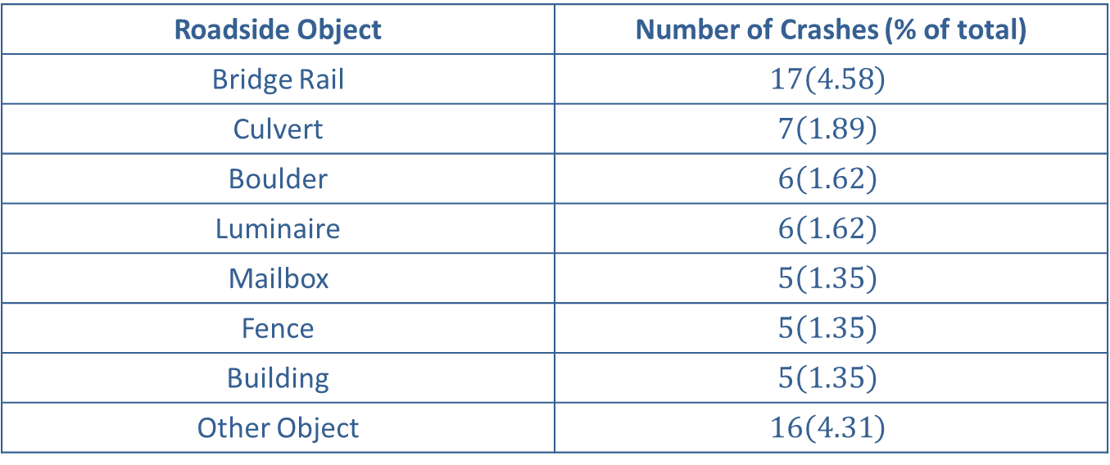
Example 1: Interpreting a Frequency Distribution—Slide 2
Table 3: Vehicle Accidents with Roadside Objects Along State Route 3, Washington
Roadside Object | Number of Crashes (% of total)
Bridge Rail | $$17\left(4.58\right)$$
Culvert | $$7\left(1.89\right)$$
Boulder | $$6\left(1.62\right)$$
Luminaire | $$6\left(1.62\right)$$
Mailbox | $$5\left(1.35\right)$$
Fence | $$5\left(1.35\right)$$
Building | $$5\left(1.35\right)$$
Other Object | $$16\left(4.31\right)$$
Source: Jinsun Lee and Fred Manning. "Analysis of Roadside Accident Frequency and Severity and Roadside Safety Management." Washington State Transportation Commission. December 1999. http://www.wsdot.wa.gov/research/reports/fullreports/475.1.pdf

Slide 5
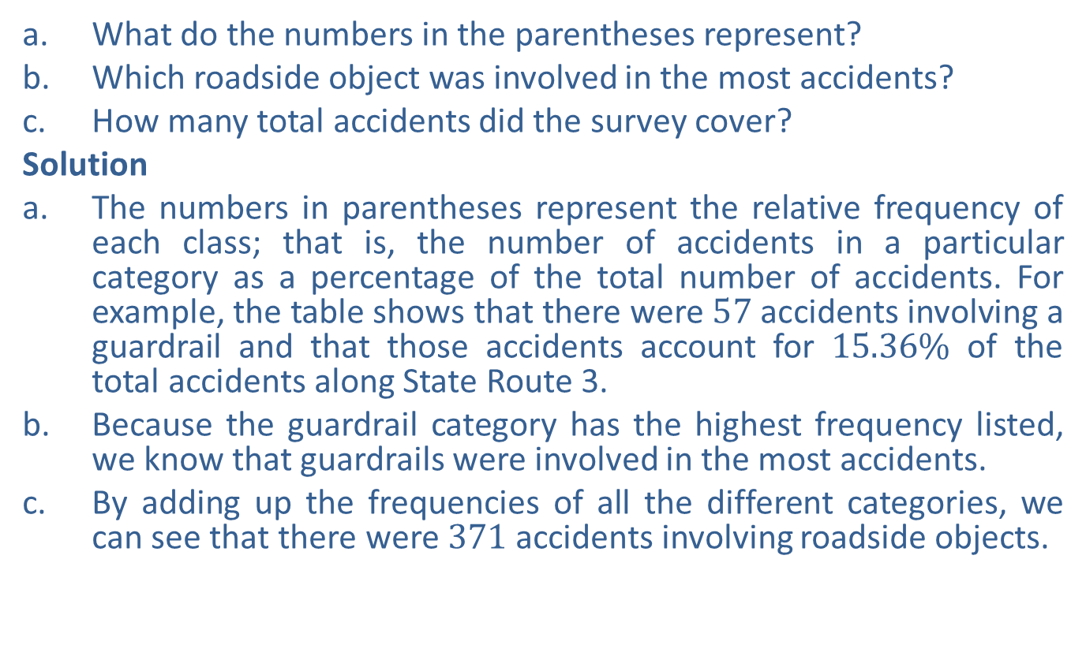
Example 1: Interpreting a Frequency Distribution—Slide 3
a. ​What do the numbers in the parentheses represent?
b. Which roadside object was involved in the most accidents?
c. How many total accidents did the survey cover?
Solution
a. The numbers in parentheses represent the relative frequency of each class; that is, the number of accidents in a particular category as a percentage of the total number of accidents. For example, the table shows that there were 57 accidents involving a guardrail and that those accidents account for $15.36\%$ of the total accidents along State Route 3.
b. Because the guardrail category has the highest frequency listed, we know that guardrails were involved in the most accidents.
c. ​By adding up the frequencies of all the different categories, we can see that there were 371 accidents involving roadside objects.

Slide 6
Skill Check 1
Which roadside object in Example 1 was involved in the smallest number of crashes?
Answer: Mailboxes, fencing, and buildings were all tied for the smallest number of crashes at 5 each.

Slide 7
Definition: Grouped Frequency Distributions
Grouped Frequency Distribution
A frequency distribution in which each category represents a range of values is call a grouped frequency distribution.
Class Width
The class width is the difference between the lower limits or upper limits of two consecutive classes of a frequency distribution.
Lower Class Limit
The lower class limit is the smallest number that can belong to a particular class.
Upper Class Limit
The upper class limit is the largest number that can belong to a particular class.

Slide 8
Helpful Hint 1
Although choosing the smallest data value as the first lower class limit is easy, it's not necessary to start there. Classes can begin with any number at or below the smallest data value.

Slide 9
Procedure: Constructing a Frequency Distribution—Slide 1
1. Decide on the number of classes for the distribution. There are typically between 5 and 20 classes. Having too many class divisions does not add any value over simply listing every data point and can be overwhelming. Having too few class divisions results in the data being lumped together and lacks detail.
2. ​Choose an appropriate class width. In some cases, the data set lends itself to natural divisions, such as decades or years. In other cases, you need to choose an appropriate class width so that the classes formed present a clear representation of the data and include all members of the data set. One method of finding the class width is to subtract the lowest number in the data set from the highest number and divide the difference by the number of classes.

Slide 10
Procedure: Constructing a Frequency Distribution—Slide 2
3. ​Find the class limits. Begin by determining the lower class limit of the first class. You should choose the first lower limit so that reasonable classes will be produced. Using the minimum data value is a good place to start.
4. ​Determine the frequency of each class. Make a tally mark for each data value in the appropriate class. Count the marks to find the total frequency for each class.

Slide 11
Example 2: Constructing a Grouped Frequency Distribution—Slide 1
The number of text messages used per month for 52 individuals was recorded and is listed. Construct a grouped frequency distribution for the data using six classes.
357 | 239 | 379 | 381 | 298 | 377 | 130 | 312 | 333 | 287 | 389 | 357 | 328
345 | 301 | 278 | 222 | 388 | 391 | 295 | 342 | 327 | 276 | 289 | 367 | 399
265 | 298 | 326 | 301 | 333 | 344 | 313 | 389 | 372 | 369 | 328 | 337 | 317
352 | 189 | 355 | 318 | 272 | 361 | 340 | 322 | 371 | 358 | 266 | 345 | 207

Slide 12
Example 2: Constructing a Grouped Frequency Distribution—Slide 2
Solution
The first thing we need to do is identify the smallest and largest pieces of data to ensure that our distribution will include all of the data values. The smallest number of text messages used was 130 and the largest was 399. Because we were told how many classes to include, we will begin with Step 2 in the procedure: choosing an appropriate class width. Subtract the lowest data value from the highest and divide by the number of classes, as shown.

Slide 13
Example 2: Constructing a Grouped Frequency Distribution—Slide 3
This would give us a class width of approximately 45. We will stop here and consider some options. Choosing a class width of 45 is reasonable from a theoretical point of view. However, rounding the number up to 50 makes the arithmetic more convenient and the frequency distribution more easily understood. Therefore, we will choose a class width of 50.
If our classes each have a width of 50, where should the first class start? Let's try with the smallest data value. By adding the width to 130, we can find each of the other five lower class limits.
Table 5: Number of Text Messages Used per Month
Number of Text Messages Used per Month | Frequency
130 –
180 –
230 –
280 –
330 –
380 –

Slide 14
Example 2: Constructing a Grouped Frequency Distribution—Slide 4
Next, in order to find upper class limits, we can use the lower limits. For the first upper limit, simply count backward one unit from the lower limit of the second class, making sure the classes don't overlap with one another. For example, the first upper class limit will be 180 − 1 = 179. We could continue this same process of subtraction to obtain the remaining upper limits. Alternatively, we can add the class width of 50 to the upper limit we just found. Either method produces identical upper limits. We then have the following table.
Table 6: Number of Text Messages Used per Month
Number of Text Messages Used per Month | Frequency
130 – 179
180 – 229
230 – 279
280 – 329
330 – 379
380 – 429

Slide 15
Example 2: Constructing a Grouped Frequency Distribution—Slide 5
Finally, we tabulate the number of data values that occur in each class. This produces the following frequency table.
Table 7: Number of Text Messages Used per Month
130 – 179 | 1
180 – 229 | 3
230 – 279 | 6
280 – 329 | 16
330 – 379 | 20
380 – 429 | 6

Slide 16
Skill Check 2
Identify the lower and upper class limits of the 4th class in Example 2
Answer: Lower class limit of the 4th class: 280; Upper class limit of the 4th class: 329

Slide 17
Example 3: Interpreting a Grouped Frequency Distribution—Slide 1
In the Fall of 2017, the US Energy Information Administration produced a report entitled International Energy Outlook 2017. Among other things, it predicted the world's energy use through 2050. The predictions are given in quadrillion BTUs (quad BTU) by region. A quad BTU is approximately equal to the amount of energy in 45 million tons of coal, or 1 trillion cubic feet of natural gas, or 170 million barrels of crude oil. The predictions for both 2020 and 2030 are given in Table 8 and a frequency distribution of the results are shown in Table 9. Use the tables to answer the following questions.

Slide 18
Example 3: Interpreting a Grouped Frequency Distribution—Slide 2
Table 8: Raw Data of World Total Primary Energy Consumption by Region (in Quad BTU)
Region | 2020 | 2030
Australia and New Zealand | 7.2 | 8.4
Mexico and Chile | 9.1 | 10.2
South Korea | 12.8 | 14.7
Brazil | 14.8 | 17.5
Canada | 15.1 | 15.5
Other Non-OECD Americas | 16.2 | 17.9
Other Non-OECD Europe and Eurasia | 17.7 | 17.7
Japan | 19.2 | 19.4

Slide 19
Example 3: Interpreting a Grouped Frequency Distribution—Slide 3
Table 8: Raw Data of World Total Primary Energy Consumption by Region (in Quad BTU)
Region | 2020 | 2030
Africa | 24.2 | 27.9
Russia | 29.8 | 30
India | 33.3 | 44.3
Middle East | 36.4 | 41.8
Other Non-OECD Asia | 42.2 | 54.8
OECD Europe | 80.5 | 83
United States | 100.2 | 99.1
China | 146.4 | 161.2
Total World | 604.9 | 663.2

Slide 20
Example 3: Interpreting a Grouped Frequency Distribution—Slide 4
Table 9: Frequency Distribution of Quad BTU Predicted Use by Region
Quad BTU | 2020 | 2030
0.1 – 10 | 2 | 1
10.1 – 20 | 6 | 7
20.1 – 30 | 2 | 1
30.1 – 40 | 2 | 1
40.1 – 50 | 1 | 2
50.1 – 60 | 0 | 1
60.1 – 70 | 0 | 0
70.1 – 80 | 0 | 0

Slide 21
Example 3: Interpreting a Grouped Frequency Distribution—Slide 5
Table 9: Frequency Distribution of Quad BTU Predicted Use by Region
Quad BTU | 2020 | 2030
80.1 – 90 | 1 | 1
90.1 – 100 | 0 | 1
100.1 – 110 | 1 | 0
110.1 – 120 | 0 | 0
120.1 – 130 | 0 | 0
130.1 – 140 | 0 | 0
140.1 – 150 | 1 | 0
150.1 – 160 | 0 | 0
160.1 – 170 | 0 | 1

Slide 22
Example 3: Interpreting a Grouped Frequency Distribution—Slide 6
a. How many classes are there in the frequency distribution?
b. What is the class width of the frequency distribution?
c. How many regions are represented in the report? In which table is this information found?
d. Which table would be best to use if you wanted to know which particular region used the most or least BTUs? Explain your choice.
e. ​Is the statement "Most regions are predicted to use between 10.1 and 20.0 quad BTUs in 2020" a true statement? Explain your answer and indicate which table you used to find your answer.
f. ​Is it appropriate to remove the six classes that have no data points in either 2020 or 2030 so that the frequency distribution is easier to read? Explain your answer.

Slide 23
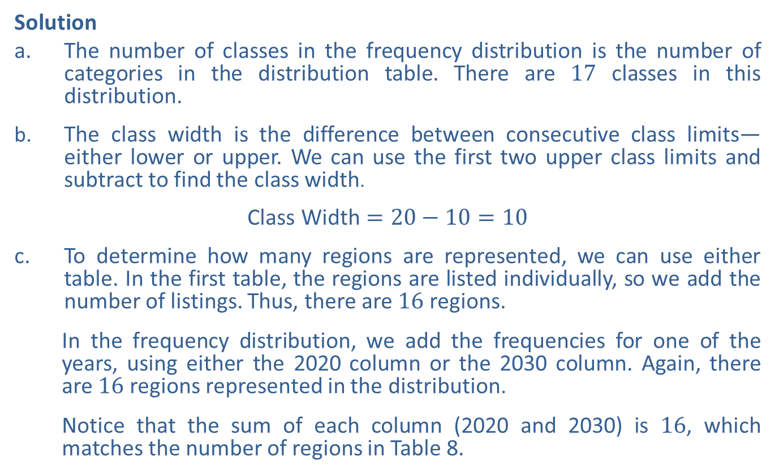
Example 3: Interpreting a Grouped Frequency Distribution—Slide 7
Solution
a. ​The number of classes in the frequency distribution is the number of categories in the distribution table. There are 17 classes in this distribution.
b. The class width is the difference between consecutive class limits—either lower or upper. We can use the first two upper class limits and subtract to find the class width.
​$\text{Class} \text{Width}=20−10=10$
c. To determine how many regions are represented, we can use either table. In the first table, the regions are listed individually, so we add the number of listings. Thus, there are 16 regions.
In the frequency distribution, we add the frequencies for one of the years, using either the 2020 column or the 2030 column. Again, there are 16 regions represented in the distribution.
​Notice that the sum of each column (2020 and 2030) is 16, which matches the number of regions in Table 8.

Slide 24
Example 11.2.3: Interpreting a Grouped Frequency Distribution—Slide 8
d. By design, a frequency distribution loses some of the uniqueness of each data point because we group them together into categories. For instance, we can know that two regions fell in the lowest usage category in the distribution, but we are not able to tell which regions they are. If we want to know which particular region used the most or least BTUs, we need to use the raw data that lists the regions individually, which is found in Table 8.
e. Although the class of 10.1 – 20 quad BTUs is the class with the most data points in the frequency distribution, that does not mean that "most regions" fall into this class. In order to have the most regions, the class would need to contain more than half of all the regions. We know that there are 16 regions represented, which means 6 is not more than half of the regions. Therefore, the statement is not true. However, it is true that the class 10.1 – 20 contains the most regions in the distribution.
f. It would not be appropriate to remove the classes that have no data points. Removing them would create a distortion of the gap between the data.

Slide 25
Definition: Graph and Legend
Graph
A graph is a picture of the data that allows us to view patterns at a glance.
Legend
A legend is a description of how each data category is identified in a graph.

Slide 26
Definition: Pie Chart
A pie chart is a circular graph that depicts parts of a whole and shows the size of each category of data in relation to the whole.

Slide 27
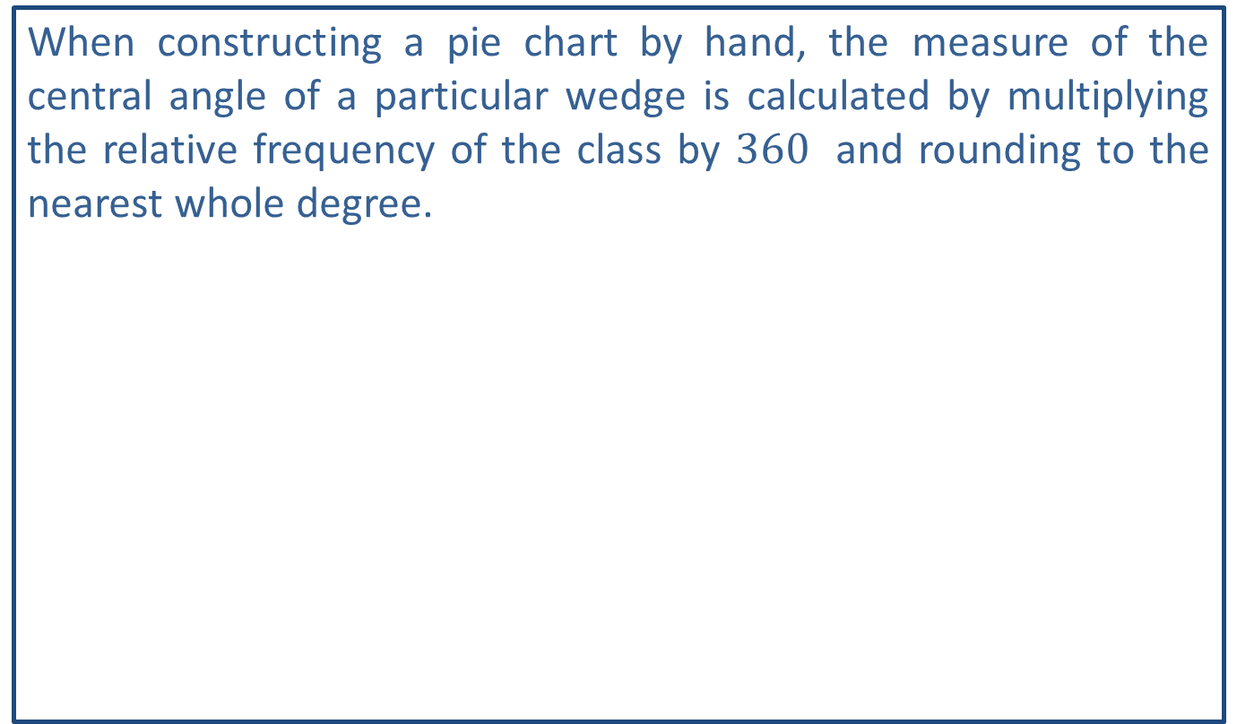
Helpful Hint 2
When constructing a pie chart by hand, the measure of the central angle of a particular wedge is calculated by multiplying the relative frequency of the class by ${360}^{ }$ and rounding to the nearest whole degree.

Slide 28
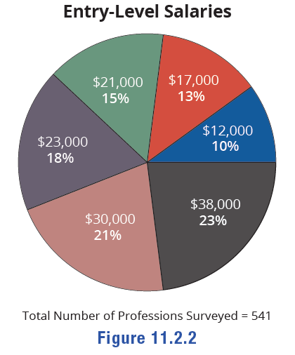

Example 4: Interpreting a Pie Chart—Slide 1
Entry-level salaries for a variety of professions are shown in the pie chart in Figure 2. Use the chart to answer the following questions.
a. ​Which salary level occurred the most?
b. How many of the entry-level salaries were $\$30,000$?
c. ​What percentage of salaries were above $\$25,000$?
d. ​Is the statement "Most jobs in the study had entry-level salaries that were more than $\$25,000$ " true? Explain your answer.
Figure 2

Slide 29
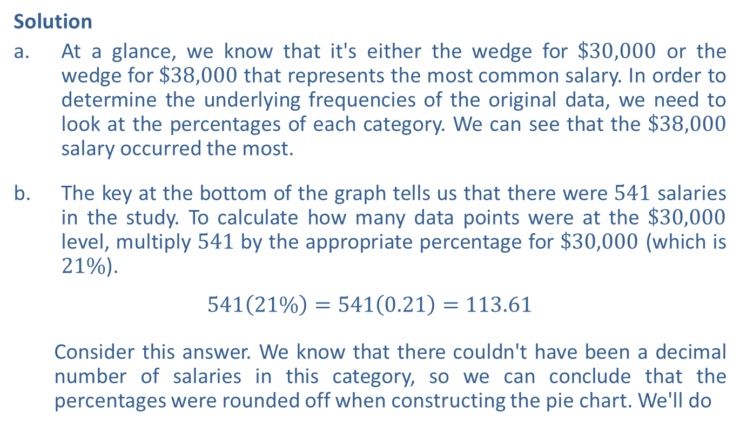
Example 4: Interpreting a Pie Chart—Slide 2
Solution
a. ​At a glance, we know that it's either the wedge for $\$30,000$ or the wedge for $\$38,000$ that represents the most common salary. In order to determine the underlying frequencies of the original data, we need to look at the percentages of each category. We can see that the $\$38,000$ salary occurred the most.
b. The key at the bottom of the graph tells us that there were 541 salaries in the study. To calculate how many data points were at the $\$30,000$ level, multiply 541 by the appropriate percentage for $\$30,000$ (which is $21\%$).
​$541\left(21\%\right)=541\left(0.21\right)=113.61$
Consider this answer. We know that there couldn't have been a decimal number of salaries in this category, so we can conclude that the percentages were rounded off when constructing the pie chart. We'll do

Slide 30
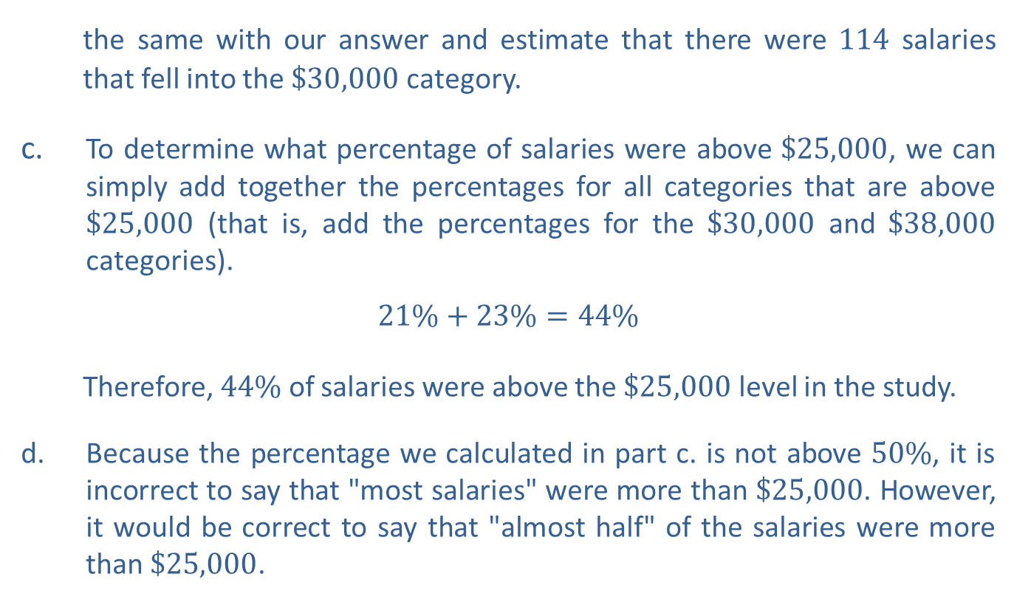
Example 4: Interpreting a Pie Chart—Slide 3
​the same with our answer and estimate that there were 114 salaries that fell into the $\$30,000$ category.
c. To determine what percentage of salaries were above $\$25,000$, we can simply add together the percentages for all categories that are above $\$25,000$ (that is, add the percentages for the $\$30,000$ and $\$38,000$ categories).
​$21\%+23\%=44\%$
Therefore, $44\%$ of salaries were above the $\$25,000$ level in the study.
d. Because the percentage we calculated in part c. is not above $50\%$, it is incorrect to say that "most salaries" were more than $\$25,000$. However, it would be correct to say that "almost half" of the salaries were more than $\$25,000$.

Slide 31
Definition: Bar Graph
A bar graph is a graph that uses bars to represents the amount of data in each category.

Slide 32
Helpful Hint 3
Although there is no difference between using vertical bars versus horizontal bars in a graph, Microsoft Excel refers to a vertical bar graph as a "column graph" since the bars in the graph look like vertical columns. It uses horizontal bars to create what it calls a "bar graph."

Slide 33
Example 5: Interpreting a Side-by-Side Bar Graph—Slide 1
The Surveillance, Epidemiology, and End Results (SEER) Program of the National Cancer Institute works to provide information on cancer statistics in an effort to reduce the burden of cancer among the US population⁷. In order for the results of their studies to have the best impact, SEER researchers need representative samples of the US population. The following side‑by‑side bar graph shows the demographic breakdown of participants in a study by the institute versus the same demographic breakdown in the overall US population. Use the graph to answer the following questions.
a. Approximately what percentage of the United States population is foreign born? Compare this to the percentage of the SEER study participants with the same characteristic.
b. Which subpopulation is slightly underrepresented in the SEER sample?
c. ​Is it possible to determine how many participants are in the SEER sample? If so, estimate that number.
7 “Population Characteristics,” Surveillance, Epidemiology, and End Results Program, accessed June 10, 2021, https://seer.cancer.gov/registries/characteristics.html

Slide 34
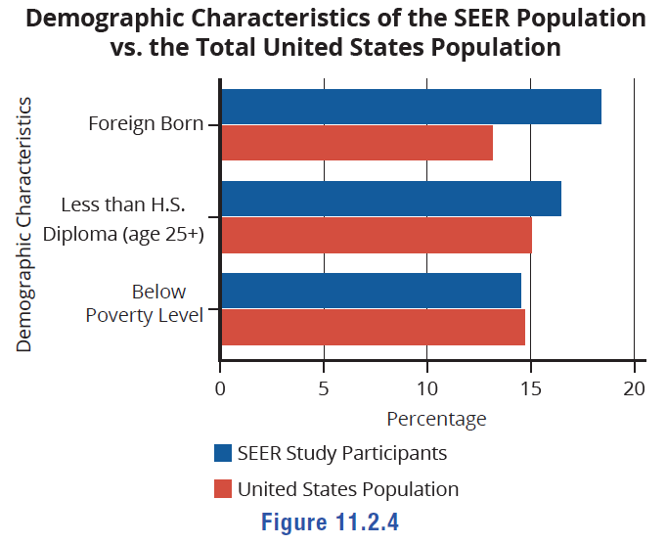
Example 5: Interpreting a Side-by-Side Bar Graph—Slide 2
Figure 4

Slide 35
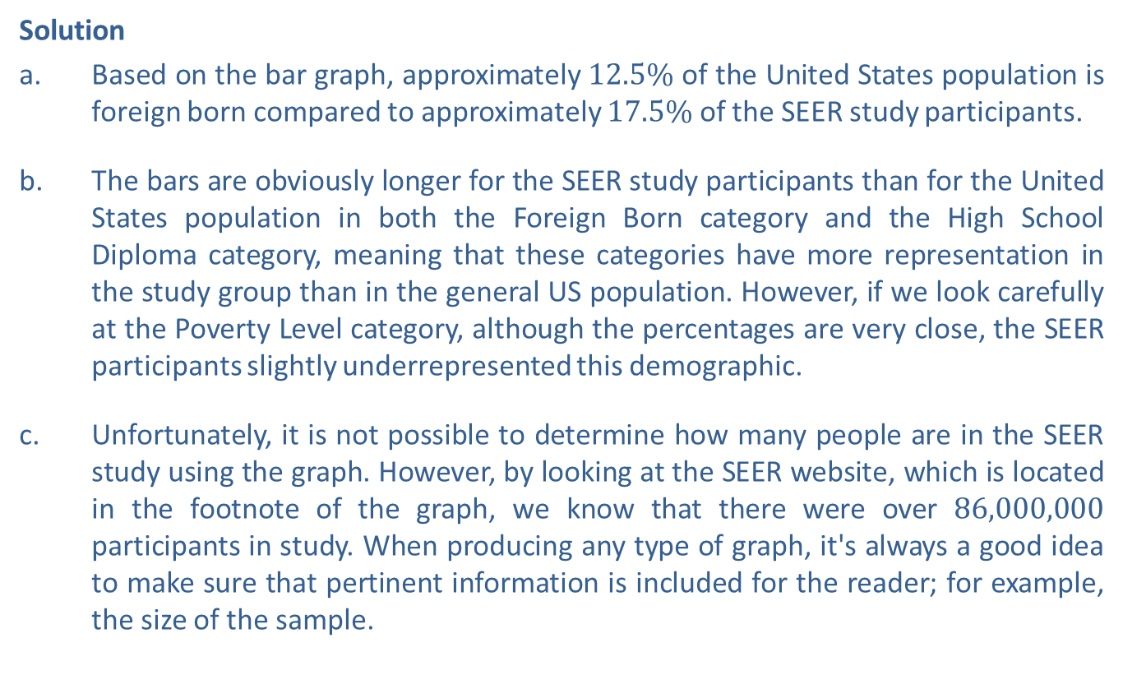
Example 5: Interpreting a Side-by-Side Bar Graph—Slide 3
Solution
a. Based on the bar graph, approximately $12.5\%$ of the United States population is foreign born compared to approximately $17.5\%$ of the SEER study participants.
b. The bars are obviously longer for the SEER study participants than for the United States population in both the Foreign Born category and the High School Diploma category, meaning that these categories have more representation in the study group than in the general US population. However, if we look carefully at the Poverty Level category, although the percentages are very close, the SEER participants slightly underrepresented this demographic.
c. Unfortunately, it is not possible to determine how many people are in the SEER study using the graph. However, by looking at the SEER website, which is located in the footnote of the graph, we know that there were over 86,000,000 participants in study. When producing any type of graph, it's always a good idea to make sure that pertinent information is included for the reader; for example, the size of the sample.

Slide 36
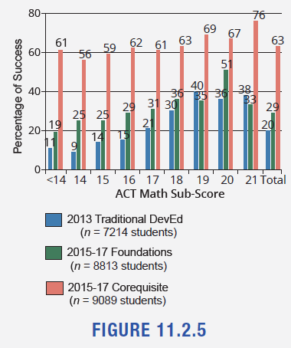
Skill Check 11.2.3
For students with an ACT score of 17, which method of teaching provided the most success in a gateway math course?⁸
Figure 5
Answer: Corequisite
8 National Academies of Sciences, Engineering, and Medicine. (2019). Increasing Student Success in Developmental Mathematics: Proceedings of a Workshop. Washington, DC: The National Academies Press. https://doi.org/10.17226/25547.

Slide 37
Definition: Frequency Histogram
A frequency histogram is a bar graph displaying a frequency distribution where the horizontal axis is a number line. The height of each bar represents the frequency of each class.

Slide 38
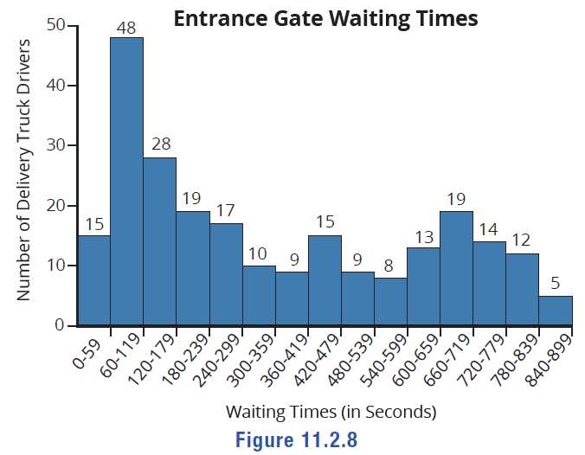
Example 6: Interpreting a Histogram—Slide 1
The following histogram displays data collected from delivery truck drivers. They were asked to record their wait times when an address had a closed entrance gate. Use the histogram to answer the questions.
a. Determine how many wait times were recorded in the survey.
b. ​How many wait times were between 60 seconds and 179 seconds?
c. ​Approximately what percentage of wait times were at least 11 minutes?
d. What was the most common wait time for drivers?
e. The middle bar represents 420 – 479 seconds. Is it accurate to say that about half of the wait times were more than 420 seconds? Why or why not?
Figure 8

Slide 39
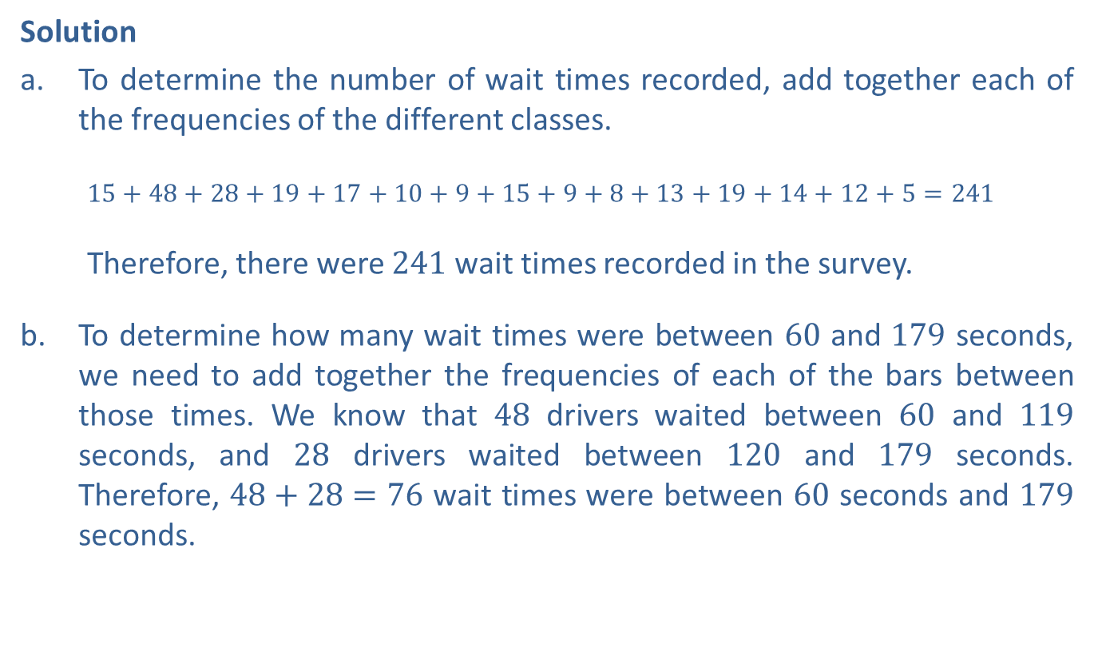
Example 6: Interpreting a Histogram—Slide 2
Solution
a. ​To determine the number of wait times recorded, add together each of the frequencies of the different classes.
​$15+48+28+19+17+10+9+15+9+8+13+19+14+12+5=241$
​Therefore, there were 241 wait times recorded in the survey.
b. To determine how many wait times were between 60 and 179 seconds, we need to add together the frequencies of each of the bars between those times. We know that 48 drivers waited between 60 and 119 seconds, and 28 drivers waited between 120 and 179 seconds. Therefore, $48+28=76$ wait times were between 60 seconds and 179 seconds.

Slide 40
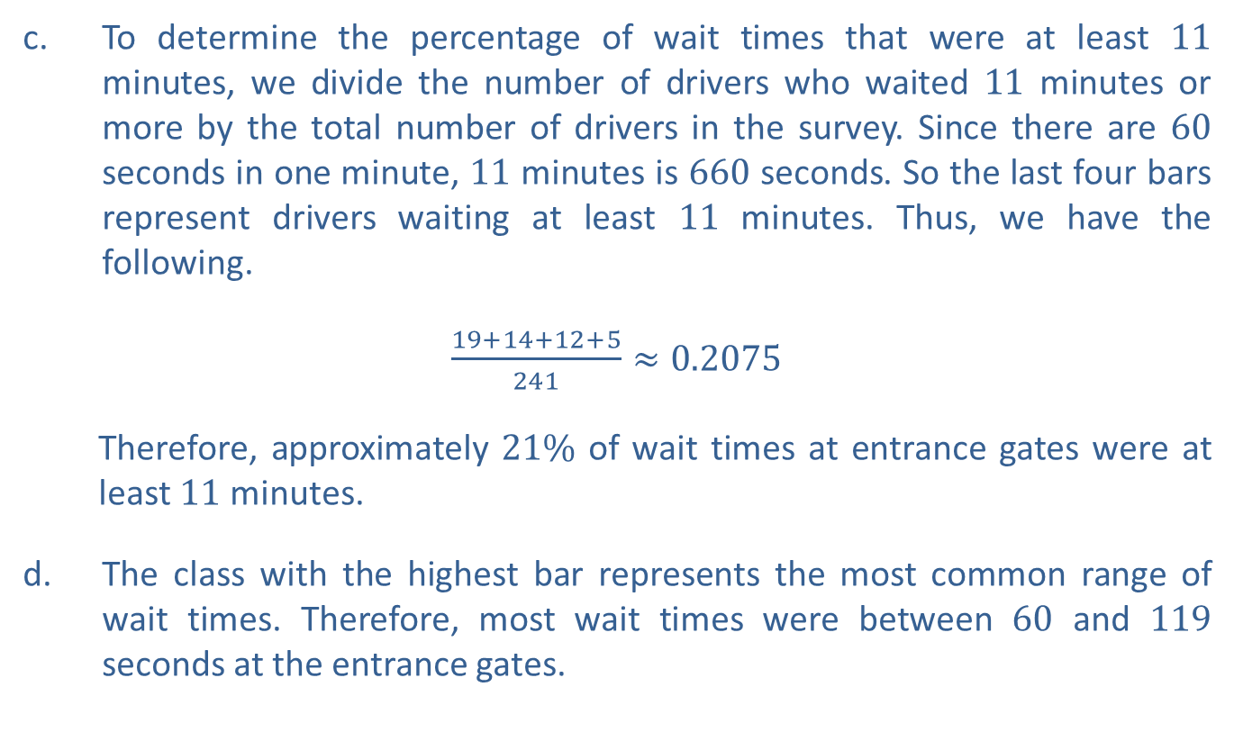
Example 6: Interpreting a Histogram—Slide 3
c. To determine the percentage of wait times that were at least 11 minutes, we divide the number of drivers who waited 11 minutes or more by the total number of drivers in the survey. Since there are 60 seconds in one minute, 11 minutes is 660 seconds. So the last four bars represent drivers waiting at least 11 minutes. Thus, we have the following.
​$\frac{19+14+12+5}{241}≈0.2075$
Therefore, approximately $21\%$ of wait times at entrance gates were at least 11 minutes.
d. The class with the highest bar represents the most common range of wait times. Therefore, most wait times were between 60 and 119 seconds at the entrance gates.

Slide 41
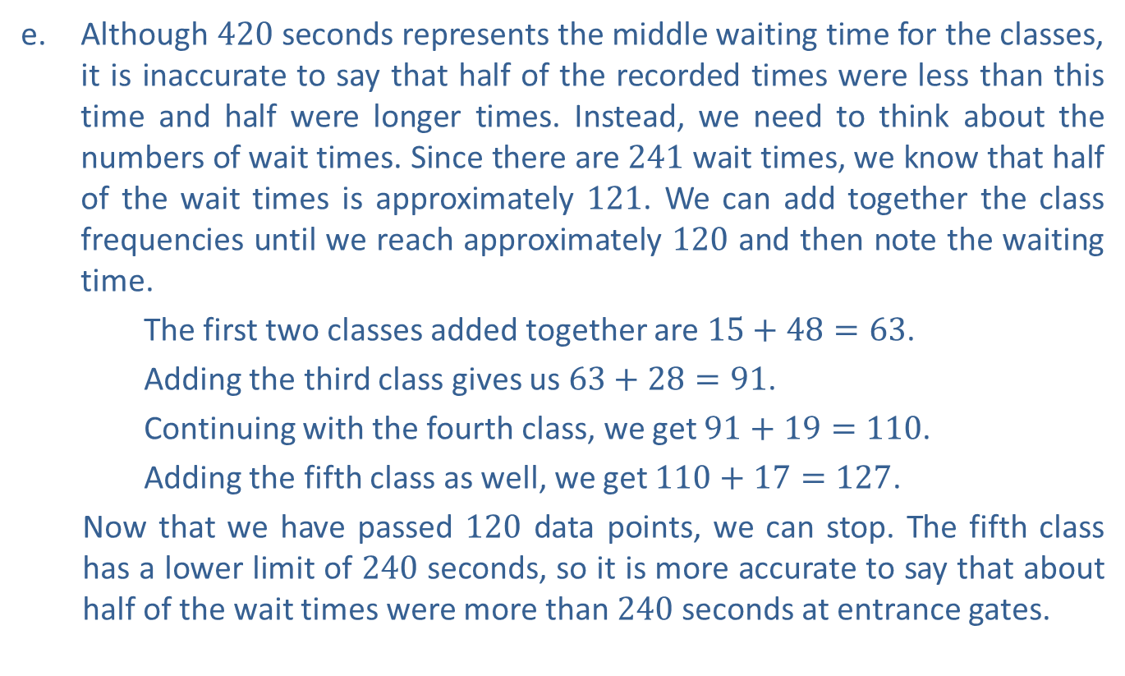
Example 6: Interpreting a Histogram—Slide 4
e. Although 420 seconds represents the middle waiting time for the classes, it is inaccurate to say that half of the recorded times were less than this time and half were longer times. Instead, we need to think about the numbers of wait times. Since there are 241 wait times, we know that half of the wait times is approximately 121. We can add together the class frequencies until we reach approximately 120 and then note the waiting time.
​The first two classes added together are $15+48=63$.
​Adding the third class gives us $63+28=91$.
Continuing with the fourth class, we get $91+19=110$.
Adding the fifth class as well, we get $110+17=127$.
Now that we have passed 120 data points, we can stop. The fifth class has a lower limit of 240 seconds, so it is more accurate to say that about half of the wait times were more than 240 seconds at entrance gates.

Slide 42
Definition: Line Graph
A line graph is a graph that uses points to represent data values at a particular time in history and then joins the points with line segments. Line graphs display changes in a variable over time.

Slide 43
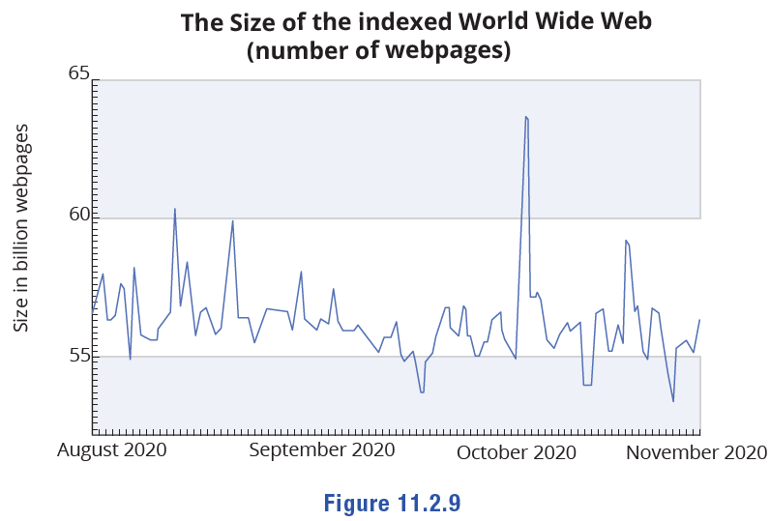
Example 7: Interpreting a Line Graph—Slide 1
Figure 9 shows the approximate size of the internet based on the number of pages from August 2020 to November 2020. Use the graph to answer the following questions about the internet at that time.
a. Approximately when did the number of pages peak during this time period?
b. Suppose you are writing an article about the size of the internet and referencing this graph. Would the headline "The Internet is Shrinking" be a fair representation of the information contained in this graph?
Figure 9

Slide 44
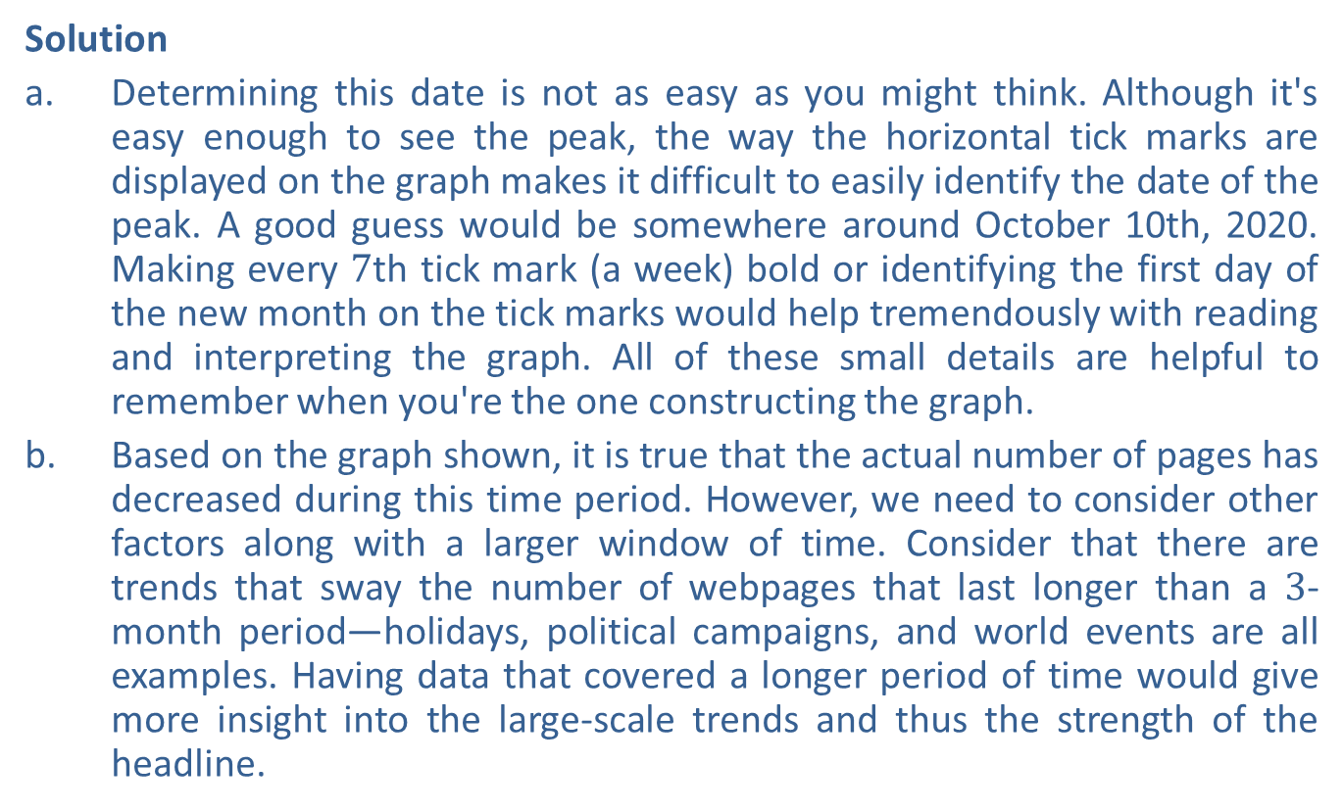
Example 7: Interpreting a Line Graph—Slide 2
Solution
a. Determining this date is not as easy as you might think. Although it's easy enough to see the peak, the way the horizontal tick marks are displayed on the graph makes it difficult to easily identify the date of the peak. A good guess would be somewhere around October 10th, 2020. Making every $7\text{th}$ tick mark (a week) bold or identifying the first day of the new month on the tick marks would help tremendously with reading and interpreting the graph. All of these small details are helpful to remember when you're the one constructing the graph.
b. ​Based on the graph shown, it is true that the actual number of pages has decreased during this time period. However, we need to consider other factors along with a larger window of time. Consider that there are trends that sway the number of webpages that last longer than a 3-month period—holidays, political campaigns, and world events are all examples. Having data that covered a longer period of time would give more insight into the large-scale trends and thus the strength of the headline.

Slide 45
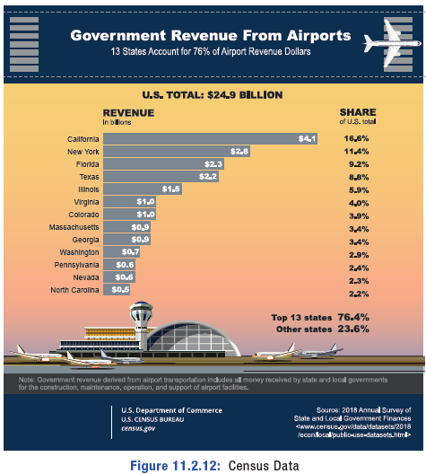
Example 8: Enhancing Graphs—Slide 1
Consider the following two graphs carefully.
​Describe how the following graph could be improved for the reader⁹.
​These graphs appeared in the online text of a report by the Pew Research Center that contained the relevant information about how and when the data was collected.¹⁰ Describe how the graphs could be improved for the reader.
Figure 12: Census Data

Slide 46
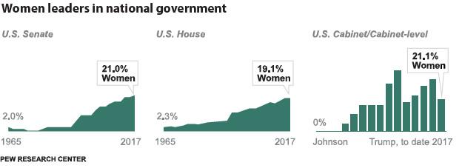
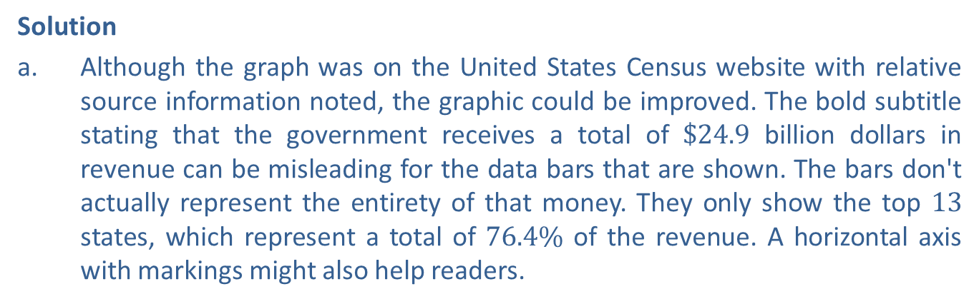
Example 8: Enhancing Graphs—Slide 2
Figure 13: Pew Research Center Data
Solution
a. ​Although the graph was on the United States Census website with relative source information noted, the graphic could be improved. The bold subtitle stating that the government receives a total of $\$24.9$ billion dollars in revenue can be misleading for the data bars that are shown. The bars don't actually represent the entirety of that money. They only show the top 13 states, which represent a total of $76.4\%$ of the revenue. A horizontal axis with markings might also help readers.

Slide 47

Example 8: Enhancing Graphs—Slide 3
b. ​We are told that the graphs are included in the text, along with the data they represent. However, since the graphs are displayed side-by-side, having consistency with the horizontal labels as well as the type of graph would be an improvement. Notice that dates are given in the first two graphs while presidents' names are given in the third graph. It's also worth noting that $21.0\%$ in the first graph is visually higher than $21.1\%$ in the last graph.
9 “Government Revenue from Airports,” United States Census Bureau, last modified October 27, 2020, https://www.census.gov/library/visualizations/2020/comm/revenue-airports.html
10 Anna Brown, “Despite gains, women remain underrepresented among U.S. political and business leaders,” Pew Research Center, last modified March 20, 2017, https://www.pewresearch.org/fact-tank/2017/03/20/
despite-gains-women-remain-underrepresented-among-u-s-political-and-business-leaders/

