Slide 1
Section 11.3
Describing and Analyzing Data

Slide 2
Formula: Arithmetic Mean
The arithmetic mean, or mean, is the sum of all of the data points divided by the number of data points. Formally, the formula for population mean µ is as follows.
The formula for the sample mean
Here, x _{i} is the i ^{th} data value, N is the number of data values in the population, and n is the number of data values in the sample.

Slide 3
Helpful Hint 1
When calculating the mean, round to one more decimal place than the largest number of decimal places given in the data. Occasional exceptions to this rule can be made when the type of data lends itself to a more natural rounding method such as rounding currency values to two decimal places.

Slide 4
Example 1: Calculating the Mean—Slide 1
A sample of the number of sick days taken by employees at Witt's Insurance Agency during the last year is listed below. Calculate the mean of the sample data.
14, 5, 7, 11, 9, 7, 12, 6
Solution
Because we are given a sample of employee sick days, we are calculating a sample mean.
  By Hand
  Add all the values together and divide by 8, which is the number of data values in the sample.

Slide 5
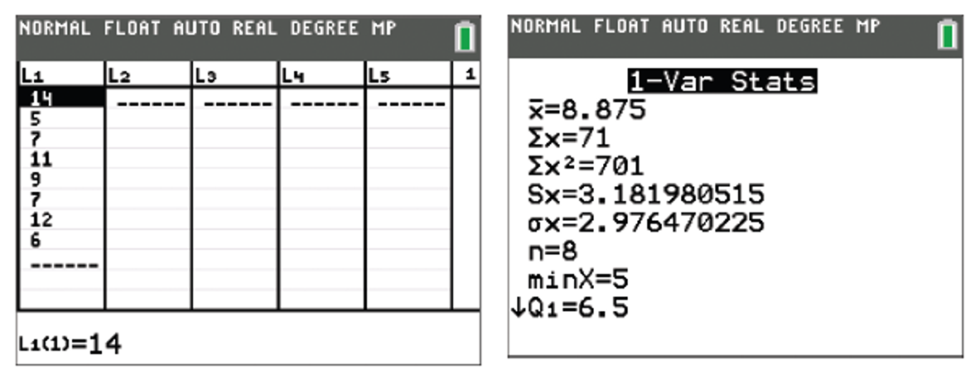
Example 1: Calculating the Mean—Slide 2
TI-83/84 Plus
To calculate the mean using a TI-83/84 Plus calculator, we first need to input the data into the list function. Press stat , select Edit…, and enter the values into L1. Press stat again, but this time select CALC and choose 1-Var Stats. Be sure that L1 is in the entry for List: and that the entry for FreqList: is blank. Highlight Calculate and press enter . The first value that the calculator returns is
Figures 1 and 2

Slide 6
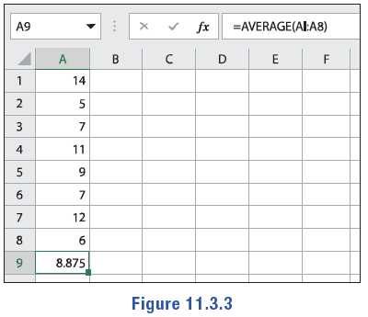
Example 1: Calculating the Mean—Slide 3
Microsoft Excel
Excel has a built-in AVERAGE function that we can use to find the mean of a set of numbers. Enter the values into an empty column and in another cell, type "=average(". Then highlight the cells containing the values and press Enter. The value will appear as 8.875.
Figure 3
At the end of the calculation, round to one decimal place since the data values are whole numbers. Therefore, the mean for the number of sick days employees took at Witt's Insurance Agency last year is approximately 8.9.

Slide 7
Tech Tip
If there are already values stored in this list, you can clear them out by pressing the up arrow to highlight the column name, L1, and pressing clear .

Slide 8

Example 2: Using the Mean to Find a Data Point—Slide 1
A plane that ferries visitors to a small resort island has strict guidelines on the weight allowed for passenger luggage. Consequently, the six passengers are limited to a maximum average luggage weight of 35 pounds ($lb$). The following are the weights of four out of six pieces of luggage: $39 lb$, $32 lb$, $35 lb$, $37 lb$. If the two pieces of luggage that haven't been weighed evenly split the remaining weight allowance, determine the weight for each remaining bag.

Slide 9
Example 2: Using the Mean to Find a Data Point—Slide 2
Solution
Since we are given the value of the population mean (35 pounds), we can use algebra techniques paired with the mean formula to find the remaining weight to be split. Substituting all the values we are given into the formula for the mean, we have the following.
Therefore, the two remaining pieces of luggage must evenly split the 77
pounds. In other words, each bag will weigh

Slide 10
Definition: Median
The median of a data set is the middle value in an ordered list of the data. To find the median, follow the following steps.
1. ​List the data in ascending or descending order.
2. ​If the data set contains an odd number of values, the median is the middle value in the ordered list.
3. ​If the data set contains an even number of values, the median is the arithmetic mean of the two middle values in the ordered list. Notice that this implies that the median might not be a value in the data set.

Slide 11
Example 3: Finding the Median—Slide 1
A VO₂ max score is the maximum amount of oxygen that one's body can transport and use during exercise. It is measured in liters of oxygen per minute (L/min). Given the following VO₂ max scores for 12 athletes, find the median score.
28.3, 27.7, 23.0, 25.5, 27.1, 26.94, 27.0, 27.52, 26.8, 27.2, 26.97, 27.53
Solution
  By Hand
  First, put the data in ascending numerical order.
23.0, 25.5, 26.8, 26.94, 26.97, 27.0, 27.1, 27.2, 27.52, 27.53, 27.7, 28.3

Slide 12
Example 3: Finding the Median—Slide 2
  Since there are an even number of data points (12), the median will be the value between the middle two data points, 27.0 and 27.1. To find this, add the two together and divide by two.

Slide 13
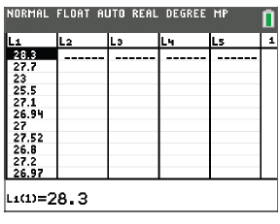
Example 3: Finding the Median—Slide 3
TI-83/84 Plus
To calculate the median using a TI-83/84 calculator, we need to first enter the data by pressing stat and select Edit… to input the data as L1 in the list function. Press 2nd mode to return to the home screen. From here, there are two ways to find the median.
Figure 5
One way is to press stat again, this time selecting CALC and choosing 1-Var Stats, as we did when finding the mean. Highlight Calculate and press enter . Using the down arrow key, you will find that Med = 27.05.

Slide 14
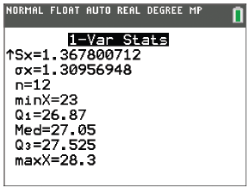
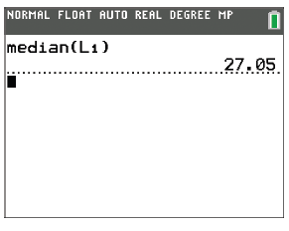
Example 3: Finding the Median—Slide 4
Figure 6
Figure 7
Alternatively, once you've input the data and returned to the home screen, you can press 2nd stat and arrow over to the MATH menu. Highlight median( and press enter . Press 2nd stat again and select L1. Back on the main screen, press ) and enter. The calculator returns a value of 27.05.
Microsoft Excel
Excel has a built-in MEDIAN function that we can use to find the median of a set of numbers. Enter the values into an empty column and in an empty cell, type "=median(". Then highlight the cells containing the values and press Enter. The value will appear as 27.05.

Slide 15
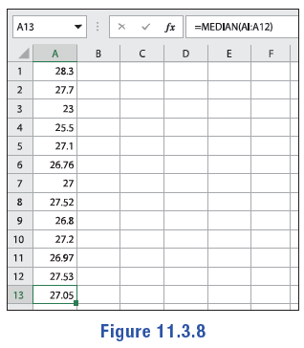
Example 3: Finding the Median—Slide 5
Figure 8
Thus, the median VO₂ max score is 27.05. Notice that the value of this "average" is not a member of the data set. However, it is a typical value in the sense that it is located in the middle of the data set when it is arranged numerically.

Slide 16
Helpful Hint 2
To find the mode of a data set, it is often helpful to first put the data in an ordered list.

Slide 17
Definition: Mode
The mode of a data set is the value that occurs most frequently.
No mode describes a data set in which all of the data values occur only once, or each value occurs an equal number of times.
Unimodal describes a data set in which only one data value occurs most often.
Bimodal describes a data set in which exactly two data values occur equally often and more than any other data value.
Multimodal describes a data set in which more than two data values occur equally often and more than any other data value.

Slide 18
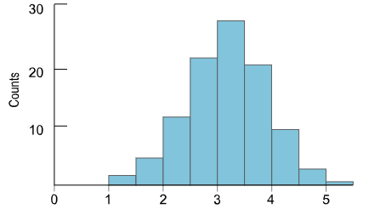
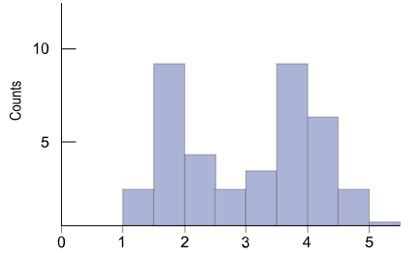
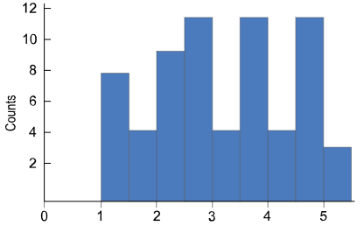
Helpful Hint 3
Figure 9: Unimodal
Figure 10: Bimodal
Figure 11: Multimodal

Slide 19
Example 4: Finding the Mode—Slide 1
Find the mode of each of the following sets of data. State if the data set is unimodal, bimodal, multimodal, or has no mode.
a. ​The set of preferred cell phone case colors among students
​lemon, gunmetal, violet, turquoise, lime, violet, lemon, orange, red, lemon, pink, violet, lime, violet, lemon, pink, gunmetal, red, turquoise, violet, violet, gunmetal, turquoise, red, violet, turquoise, orange, pink, violet, violet, turquoise, violet, pink
b. ​The set of favorite football jersey numbers
​32, 18, 99, 12, 7, 10, 28, 56, 13, 16, 19, 51, 23, 78
c. ​The set of ages of children at the community playground one afternoon
​12, 4, 2, 7, 8, 4, 10, 6, 5, 7, 7, 4, 3
d. The set of the number of ATM withdrawals per hour at the downtown branch of University Bank
​10, 13, 9, 13, 9, 14, 10, 14

Slide 20
Example 4: Finding the Mode—Slide 2
Solution
a. The color violet occurs more than any other color, so the mode is violet. This data set is unimodal.
b. Each value occurs only once, so there is no mode.
c. The values 4 and 7 both occur three times, which is more than any other value. Thus, the set is bimodal with the modes 4 and 7.
d. Be careful here. Since each value occurs the same number of times, there is no mode in this data set.

Slide 21
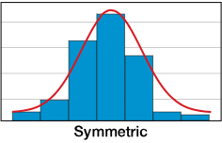
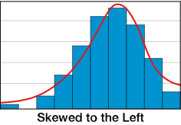
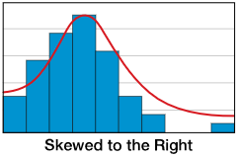
Helpful Hint 4
Figure 13
Figure 14
Figure 15

Slide 22
Definition: Outliers and Skewed Data Sets
Outlier
An outlier is a data value that is extreme compared with the rest of the data values in the set.
Skewed to the Right
A graph's shape is skewed to the right when a majority of the data fall on the left side of the distribution.
Skewed to the Left
A graph's shape is skewed to the left when a majority of the data fall on the right side of the distribution.

Slide 23
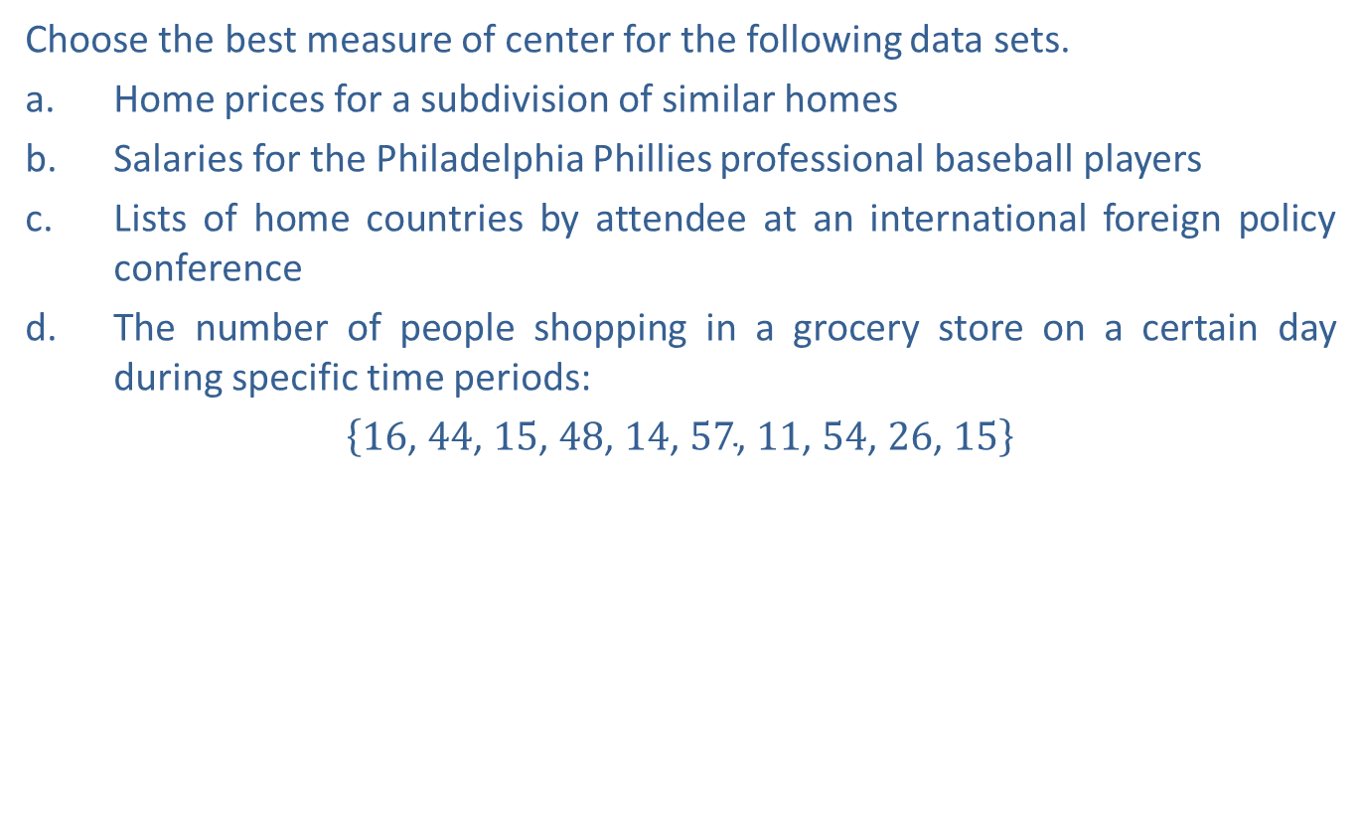
Example 5: Choosing the Most Appropriate Measure of Center—Slide 1
Choose the best measure of center for the following data sets.
a. Home prices for a subdivision of similar homes
b. Salaries for the Philadelphia Phillies professional baseball players
c. Lists of home countries by attendee at an international foreign policy conference
d. ​The number of people shopping in a grocery store on a certain day during specific time periods:
​$\left\{16\text{, }44\text{, }15\text{, }48\text{, }14\text{, }57\text{, }11\text{, }54\text{, }26\text{, }15\right\}$

Slide 24
Example 5: Choosing the Most Appropriate Measure of Center—Slide 2
Solution
a. ​Home prices are numerical counts. Since the homes are similar, there are not likely to be outliers in the subdivision. Therefore, the mean is the best choice.
b. ​The players' salaries are also numerical counts, but they do have outliers since the superstars on the team make substantially more than the other players. Therefore, the median is the best choice.
c. ​Countries are labels, and not counts or measurements, so it is best to use the mode as a measure of center.
d. Although there is a mode of 15, there is not really an outlier in the data, so the mean would be the best measure of center for this data.

Slide 25

Skill Check 1
Find the mean, median, and mode of the following data set.
$$\left\{8\text{, }12\text{, }10\text{, }11\text{, }13\text{, }12\text{, }15\text{, }9\text{, }11\text{, }16\right\}$$
Answer: Mean $=11.7$; Median $=11.5$; Mode $=\left.11\text{, }12\right.$

Slide 26
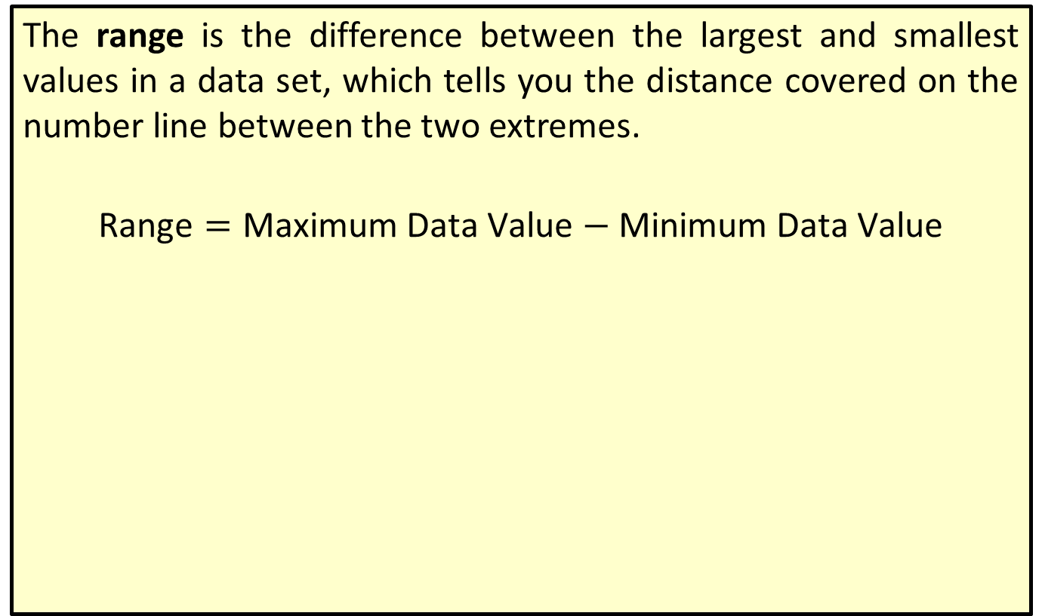
Definition: Range
The range is the difference between the largest and smallest values in a data set, which tells you the distance covered on the number line between the two extremes.
$$\text{Range}=\text{Maximum} \text{Data} \text{Value}−\text{Minimum} \text{Data} \text{Value}$$

Slide 27
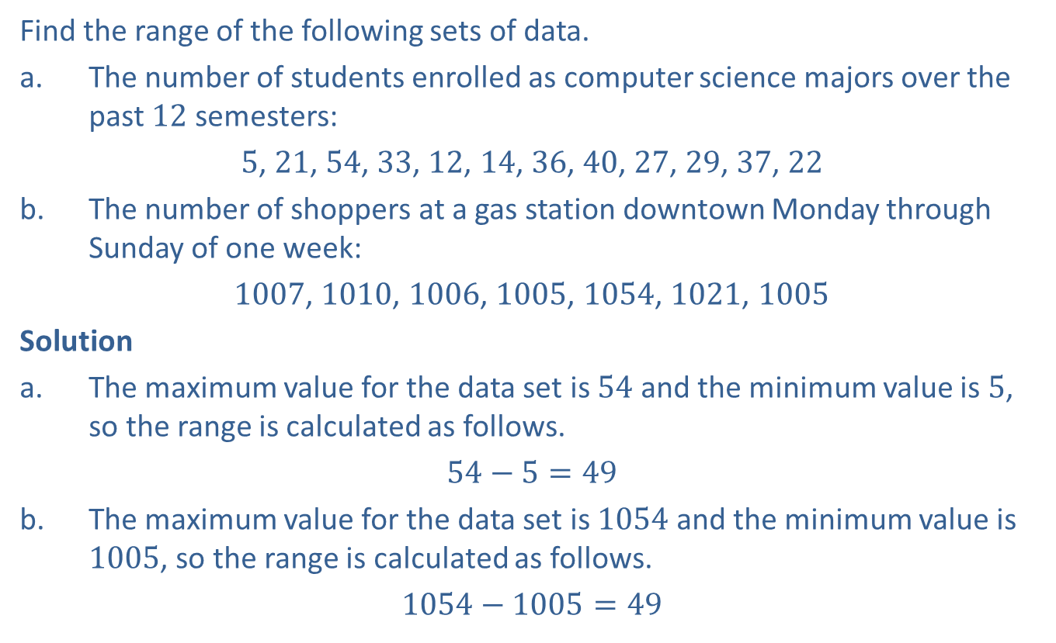
Example 6: Finding the Range
Find the range of the following sets of data.
a. The number of students enrolled as computer science majors over the past 12 semesters:
​5, 21, 54, 33, 12, 14, 36, 40, 27, 29, 37, 22
b. The number of shoppers at a gas station downtown Monday through Sunday of one week:
​1007, 1010, 1006, 1005, 1054, 1021, 1005
Solution
a. ​The maximum value for the data set is 54 and the minimum value is 5, so the range is calculated as follows.
​$54−5=49$
b. The maximum value for the data set is 1054 and the minimum value is 1005, so the range is calculated as follows.
​$1054−1005=49$

Slide 28
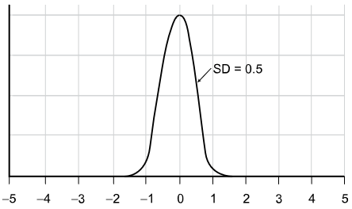
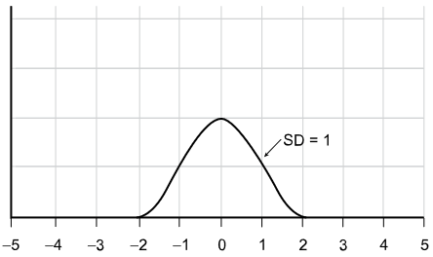
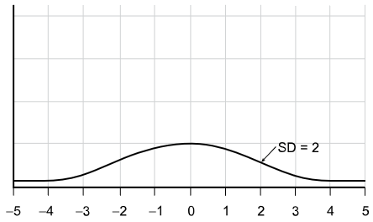
Helpful Hint 5
Figure 16:
Small Variation
Figure 17:
Moderate Variation
Figure 18:
Large Variation

Slide 29

Definition: Standard Deviation
The standard deviation is a measure of how much we might expect a member of the data set to differ from the mean.
The formula for finding the population standard deviation $σ$ is as follows.
Here, x _{i} is the i ^{th} data value, µ is the population mean, and N is the size of the population. The formula for finding the sample standard deviation s is as follows.
Here, x _{i} is the i ^{th} data value,
is the sample mean, and n is the sample size.

Slide 30
Helpful Hint 6
When calculating the standard deviation, round to one more decimal place than the largest number of decimal places given in the data. Occasional exceptions to this rule can be made when the type of data lends itself to a more natural rounding method such as rounding currency values to two decimal places.

Slide 31
Example 7: Calculating Standard
Deviation—Slide 1
The SAT Critical Reading scores for 12 of the members of the senior class at Richmond Prep High School are given in Table 1.
a. ​Calculate the appropriate standard deviation for the scores.
b. Describe what the standard deviation indicates about the SAT scores.
c. ​If you were part of the administration team at Richmond Prep High School, explain if you would rather see a smaller standard deviation on these scores or a larger one.
Table 1: SAT Critical Reading Scores
640 | 750 | 560 | 630
600 | 590 | 610 | 710
600 | 640 | 550 | 610

Slide 32
Example 7: Calculating Standard
Deviation—Slide 2
Solution
a. ​First note that the data given is a sample, because it consists of 12 of the members of the senior class, not the entire class. So we will use the formula for sample standard deviation given here.
​Sample Standard Deviation
  By Hand
  When calculating the standard deviation by hand, the variables we need are the sample size n, the sample mean
data points x _{i},
We are told n = 12, and we calculate that the sample mean is

Slide 33
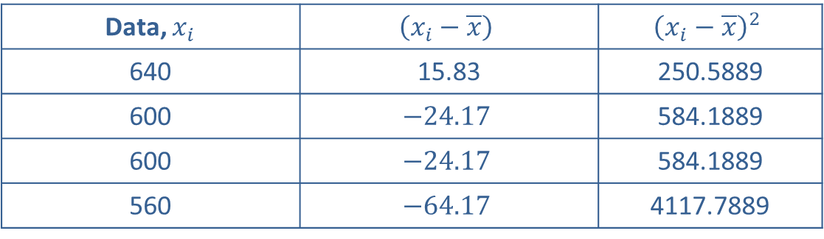
Example 7: Calculating Standard
Deviation—Slide 3
  Next, we subtract the mean from each data point,
This is the deviation of each score from the mean. Then, we square each of the deviations to find the squared deviations of the data points,
Finally, we find the sum of the squared deviations,
which is the numerator of the fraction.
When calculating standard deviation by hand, it's helpful to use a table like Table 2 to keep everything organized.
Table 2: Deviations and Squared Deviations of the Data
Data, $x_{i}$ | $$\left(x_{i}−\overline{x}\right)$$ | $${\left(x_{i}−\overline{x}\right)}^{2}$$
640 | 15.83 | 250.5889
600 | $$−24.17$$ | 584.1889
600 | $$−24.17$$ | 584.1889
560 | $$−64.17$$ | 4117.7889

Slide 34
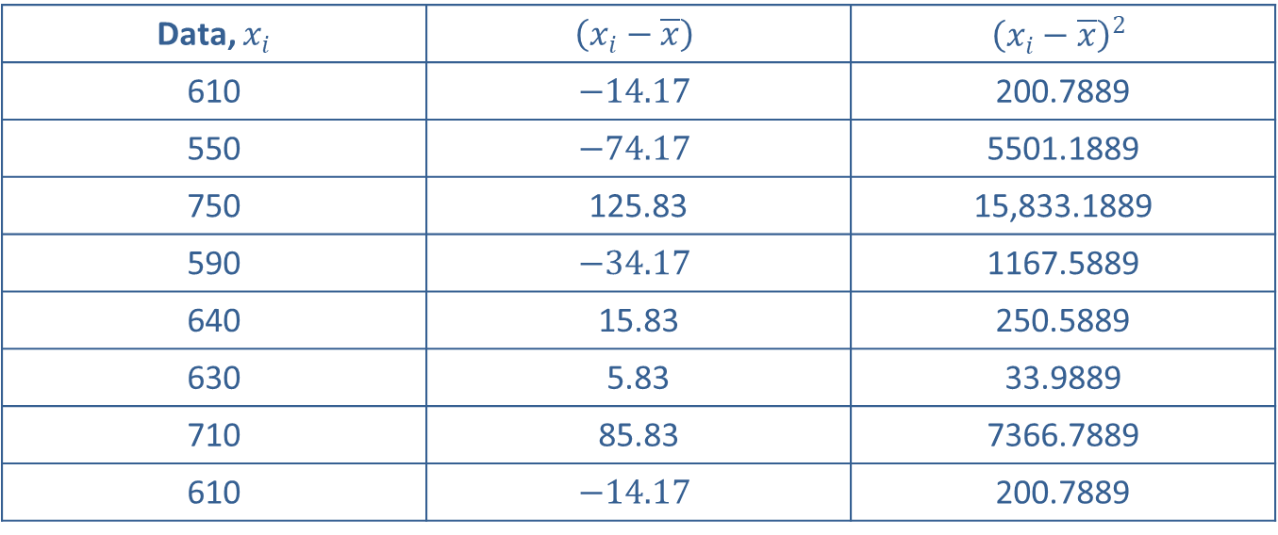
Example 7: Calculating Standard
Deviation—Slide 4
Table 2: Deviations and Squared Deviations of the Data
Data, $x_{i}$ | $$\left(x_{i}−\overline{x}\right)$$ | $${\left(x_{i}−\overline{x}\right)}^{2}$$
610 | $$−14.17$$ | 200.7889
550 | $$−74.17$$ | 5501.1889
750 | 125.83 | 15,833.1889
590 | $$−34.17$$ | 1167.5889
640 | 15.83 | 250.5889
630 | 5.83 | 33.9889
710 | 85.83 | 7366.7889
610 | $$−14.17$$ | 200.7889

Slide 35
Example 7: Calculating Standard
Deviation—Slide 5
Finally, substitute the appropriate values into the formula for sample standard deviation.

Slide 36
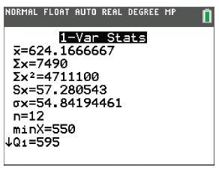
Example 7: Calculating Standard
Deviation—Slide 6
TI-83/84 Plus
In order to calculate the sample standard deviation using a TI-83/84 Plus calculator, begin by pressing stat, selecting Edit…, and entering the data values in L1. Press stat again, scroll over to the CALC menu and select 1-Var Stats. Highlight Calculate and press enter. Notice that this is the same screen we've seen before when finding other statistics such as the mean. The sample standard deviation is given as Sx = 57.280543.
Figure 19

Slide 37
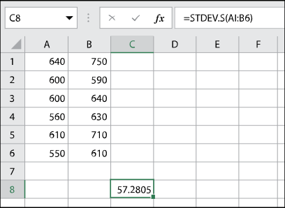
Example 7: Calculating Standard
Deviation—Slide 7
​Microsoft Excel
Excel has built-in function for standard deviation of a set of values. For sample standard deviation the function is STDEV.S. Enter the values into empty cells. In another cell, type "=stdev.s(". Then highlight the cells containing the data points and press Enter. The sample standard deviation will appear as 57.2805.
Figure 20

Slide 38
Example 7: Calculating Standard
Deviation—Slide 8
  Therefore, the sample standard deviation for the SAT Critical Reading scores is approximately 57.3 points.
The standard deviation indicates that the SAT scores differ from the mean score on average by 57.3 points. Notice that the mean is approximately 624.17. Although there is not an actual score of 624.17, you can see that many of the student's scores fall within about 60 points (or 1 standard deviation) of that mean, either larger or smaller.
​As an administrator, a small standard deviation is a sign that students are preforming similarly. If the SAT scores are on the high end, this is a good fact. However, if the SAT scores are low, then a small standard deviation indicates that the students are all scoring poorly and would raise concern. If the standard deviation was relatively large, this is an indicator that SAT scores are more varied. As an administrator you would want to look at the data individually to determine any problem areas in your classes.

Slide 39
Helpful Hint 7
In an effort to minimize any error introduced from rounding, it is helpful to leave intermediate calculations with more decimal places.

Slide 40
Helpful Hint 8
On the TI-83/84 Plus, the sample standard deviation is Sx and the population standard deviation is σx.

Slide 41
Skill Check 2
Find the population standard deviation of the following data. Round to the nearest tenth.
8, 12, 10, 11, 13, 12, 15, 9, 11, 16
Answer: 2.5

Slide 42
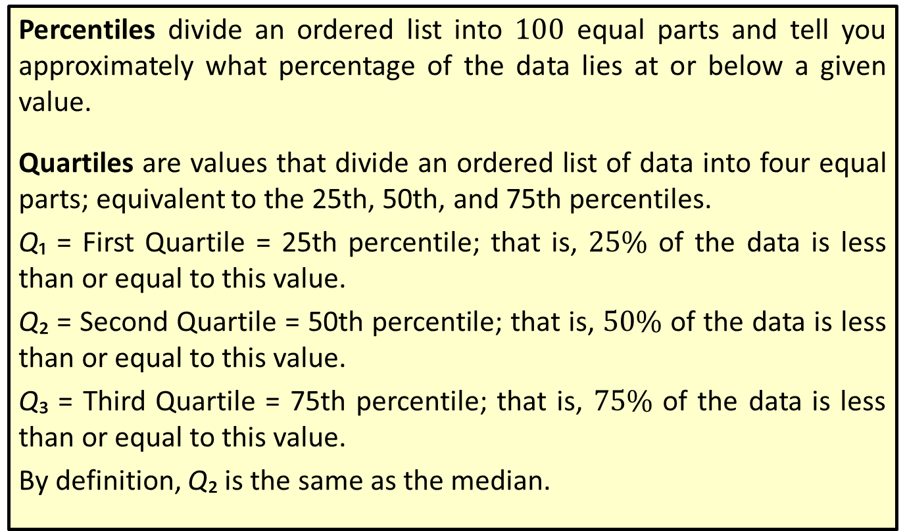
Definition: Percentiles and Quartiles
Percentiles divide an ordered list into 100 equal parts and tell you approximately what percentage of the data lies at or below a given value.
Quartiles are values that divide an ordered list of data into four equal parts; equivalent to the 25th, 50th, and 75th percentiles.
Q₁ = First Quartile = 25th percentile; that is, $25\%$ of the data is less than or equal to this value.
Q₂ = Second Quartile = 50th percentile; that is, $50\%$ of the data is less than or equal to this value.
Q₃ = Third Quartile = 75th percentile; that is, $75\%$ of the data is less than or equal to this value.
By definition, Q₂ is the same as the median.

Slide 43
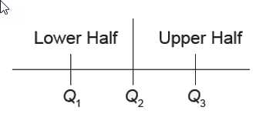
Helpful Hint 9
To divide something into 4 parts, you only need 3 dividers, as the figure illustrates.
Figure 21

Slide 44
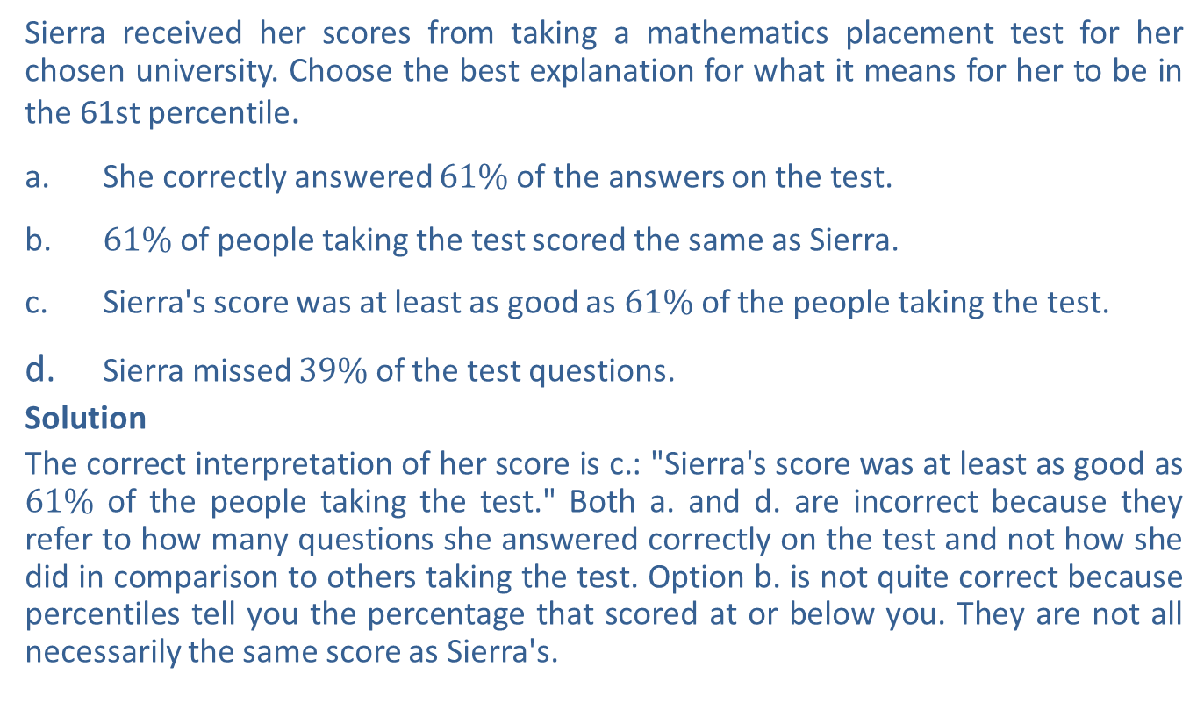
Example 8: Interpreting Percentiles
Sierra received her scores from taking a mathematics placement test for her chosen university. Choose the best explanation for what it means for her to be in the 61st percentile.
a. ​She correctly answered $61\%$ of the answers on the test.
b. ​$61\%$ of people taking the test scored the same as Sierra.
c. ​Sierra's score was at least as good as $61\%$ of the people taking the test.
d. Sierra missed $39\%$ of the test questions.
Solution
The correct interpretation of her score is c.: "Sierra's score was at least as good as $61\%$ of the people taking the test." Both a. and d. are incorrect because they refer to how many questions she answered correctly on the test and not how she did in comparison to others taking the test. Option b. is not quite correct because percentiles tell you the percentage that scored at or below you. They are not all necessarily the same score as Sierra's.

Slide 45
Example 9: Interpreting Quartiles
On Karl's recent standardized test results, the picture graph of his score showed he was above the third quartile in language arts. His classmate, Asher, said his score was at the 70th percentile, while Rylie said hers was at the 79th percentile. Which of the three had the best language arts test score?
Solution
We know the percentile ranks of both Asher and Rylie are the 70th and 79th respectively. What we know about Karl's score is that it was above the third quartile. Since the third quartile is the same as the 75th percentile, we know that his score was somewhere at or above the 75th percentile. We can conclude that he did better than Asher, whose score was at the 70th percentile, but we can make no definite comparison with Rylie, whose score was at the 79th percentile, because we do not know for sure which one had the best language arts score.

Slide 46
Skill Check 3
Calculate the three quartiles for the following set of data.
60, 62, 63, 65, 65, 67, 70, 71, 71, 75, 78, 79, 80, 81
Answer: Q₁ = 65, Q₂ = 70.5, Q₃ = 78

Slide 47
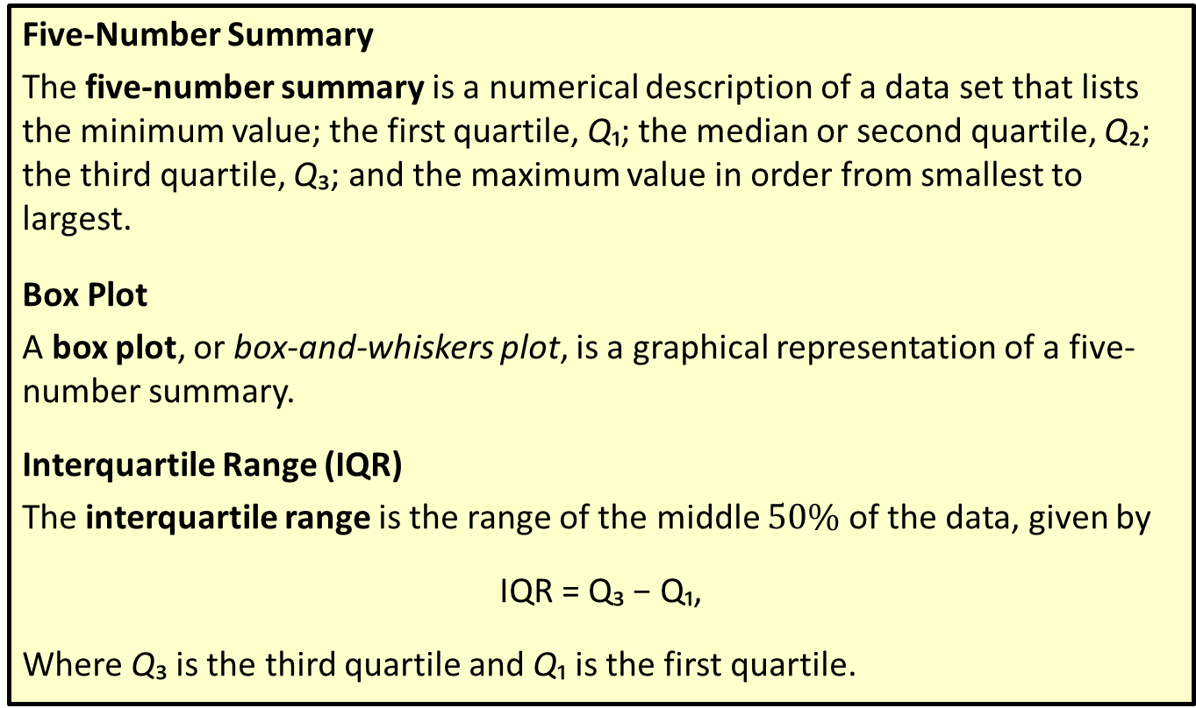
Definition: Five-Number Summary and Box Plots
Five-Number Summary
The five-number summary is a numerical description of a data set that lists the minimum value; the first quartile, Q₁; the median or second quartile, Q₂; the third quartile, Q₃; and the maximum value in order from smallest to largest.
Box Plot
A box plot, or box-and-whiskers plot, is a graphical representation of a five-number summary.
Interquartile Range (IQR)
The interquartile range is the range of the middle $50\%$ of the data, given by
IQR = Q₃ − Q₁,
Where Q₃ is the third quartile and Q₁ is the first quartile.

Slide 48
Procedure: Creating a Box Plot
1. ​Draw a horizontal (or vertical) number line that contains the five-number summary.
2. Draw a small line segment above (or next to) the number line to represent each of the numbers in the five-number summary.
3. Connect the line segment that represents the first quartile to the line segment representing the third quartile, forming a box with the median's line segment in between.
4. ​Connect the "box" to the line segments representing the minimum and maximum values to form the "whiskers."

Slide 49
Example 10: Creating a Box Plot—Slide 1
A random sample of 20 adults was taken at an athletic training facility. Create a box plot to display the training heart rates of this sample.
Table 3: Training Heart Rates
130 | 124 | 125 | 133 | 129
126 | 126 | 130 | 124 | 121
136 | 116 | 113 | 128 | 127
119 | 126 | 127 | 132 | 131
Solution
The first thing we need to do is calculate the five-number summary.
  By Hand
  Begin by ordering the data set, which is essential to finding the values for the five-number summary by hand.

Slide 50
Example 10: Creating a Box Plot—Slide 2
113 | 116 | 119 | 121 | 124 | 124 | 125 | 126 | 126 | 126
127 | 127 | 128 | 129 | 130 | 130 | 131 | 132 | 133 | 136
The minimum value and maximum value are then easy to identify: minimum = 113; maximum = 136. The next step is to identify the quartiles. Begin with the median.
Since n = 20, the median is the arithmetic mean of the values in the 10th and 11th positions.

Slide 51
Example 10: Creating a Box Plot—Slide 3
To find Q₁ and Q₃, we find the median of the lower half of data as well as the median of the upper half. Both halves contain 10 data values, so we need the arithmetic mean of the values in the 5th and 6th positions for Q₁ and the arithmetic mean of the values in the 15th and 16th positions for Q₃.
Stop and note that although we did the calculations for Q₁ and Q₃, the arithmetic mean of two identical numbers is always equal to that number.

Slide 52
Example 10: Creating a Box Plot—Slide 4
  TI-83/84 Plus
  The first step to calculating the five-number summary on a TI-83/84 Plus is to store our data by pressing stat , selecting Edit…, and entering the data values in L1. Once the values have been entered, press stat again, arrow over to the CALC menu, and select 1-Var Stats. Highlight Calculate and press enter . As we've seen before, 1-Var Stats provides lots of information about the data set, including all of the values for the 5-number summary. Using the down arrow key, you will find that minX = 113, Q1 = 124, Med = 126.5, Q3 = 130, and maxX = 136.

Slide 53
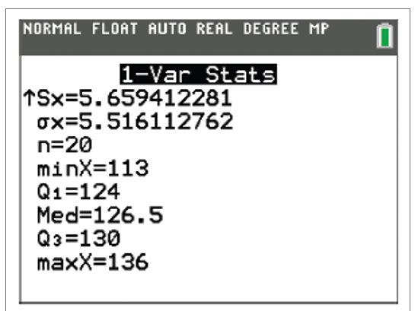
Example 10: Creating a Box Plot—Slide 5
Figure 23
Thus, the five-number summary is 113, 124, 126.5, 130, and 136.

Slide 54
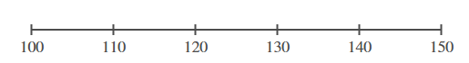
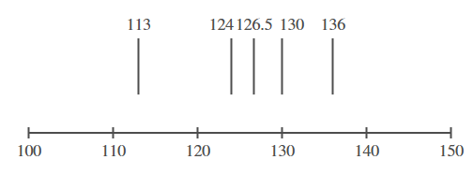
Example 10: Creating a Box Plot—Slide 6
To create the box plot from the five-number summary, we'll follow the procedure steps given for creating a box plot.
Step 1:
Label the horizontal axis at even intervals, choosing a range that is large enough to include both the minimum value and the maximum value of the five-number summary.
Figure 24
Step 2:
Place a small line segment above each of the numbers in the five-number summary.
Figure 25

Slide 55
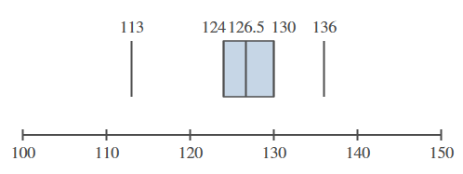
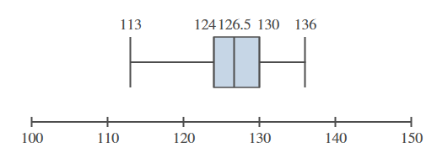
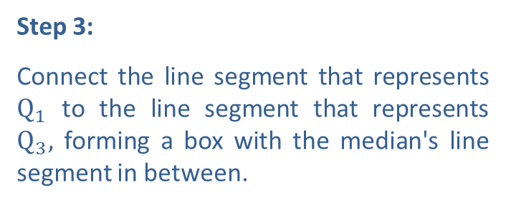
Example 10: Creating a Box Plot—Slide 7
Step 3:
Connect the line segment that represents $Q_{1}$ to the line segment that represents $Q_{3},$ forming a box with the median's line segment in between.
Figure 26
Step 4:
Connect the “box” to the line segments representing the minimum and maximum to form the “whiskers.”
Figure 27

Slide 56
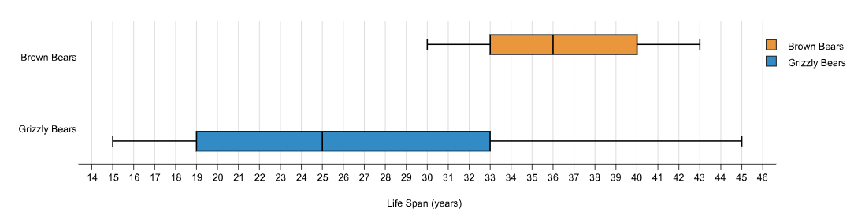
Example 11: Interpreting Box Plots—Slide 1
The box plots in Figure 28 show the life spans of grizzly bears compared to the life spans of brown bears. Use them to answer the following questions.
Figure 28
a. What is the range of life spans for each type of bear?
b. ​Based on the box plots, how long does the average brown bear live? Grizzly bear?
c. Which type of bear has the largest interquartile range for their life span? Interpret your answer.
d. Based on the box plots, which bears live longer? Explain your answer.

Slide 57
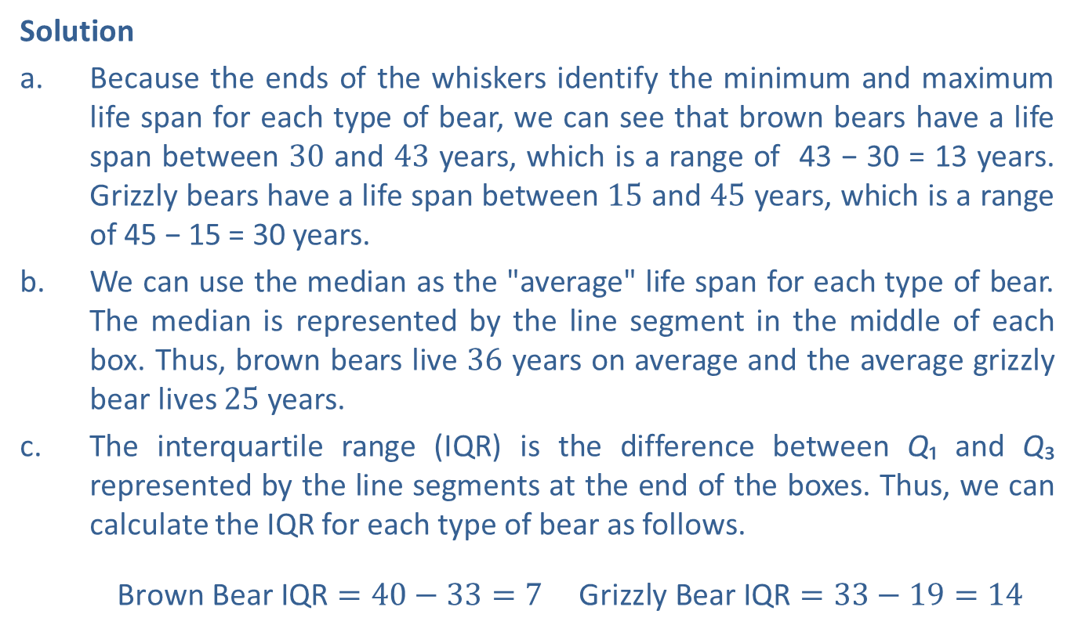
Example 11: Interpreting Box Plots—Slide 2
Solution
a. Because the ends of the whiskers identify the minimum and maximum life span for each type of bear, we can see that brown bears have a life span between 30 and 43 years, which is a range of 43 − 30 = 13 years. Grizzly bears have a life span between 15 and 45 years, which is a range of 45 − 15 = 30 years.
b. We can use the median as the "average" life span for each type of bear. The median is represented by the line segment in the middle of each box. Thus, brown bears live 36 years on average and the average grizzly bear lives 25 years.
c. The interquartile range (IQR) is the difference between Q₁ and Q₃ represented by the line segments at the end of the boxes. Thus, we can calculate the IQR for each type of bear as follows.
​ $\text{Brown} \text{Bear} \text{IQR}=40−33=7$ $\text{Grizzly} \text{Bear} \text{IQR}=33−19=14$

Slide 58
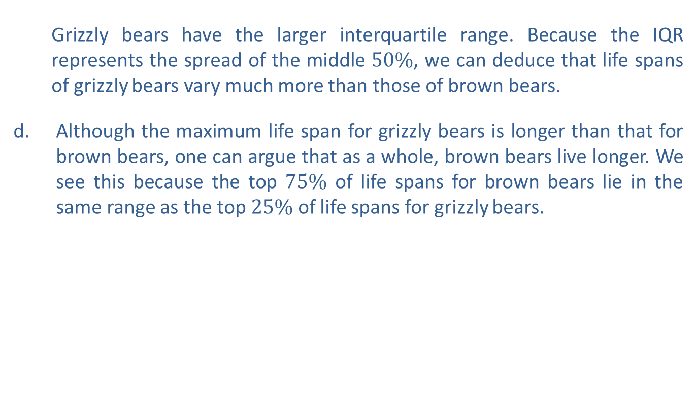
Example 11: Interpreting Box Plots—Slide 3
  Grizzly bears have the larger interquartile range. Because the IQR represents the spread of the middle $50\%$, we can deduce that life spans of grizzly bears vary much more than those of brown bears.
Although the maximum life span for grizzly bears is longer than that for brown bears, one can argue that as a whole, brown bears live longer. We see this because the top $75\%$ of life spans for brown bears lie in the same range as the top $25\%$ of life spans for grizzly bears.

