Slide 1
Section 11.4
The Normal Distribution

Slide 2
Definition: Discrete and Continuous Variables
Discrete Variable
A discrete variable is a variable whose numeric value can only take on particular values and is usually a count.
Continuous Variable
A continuous variable is a variable whose numeric value can take on any value in a given interval and is usually a measurement.

Slide 3
Helpful Hint 1
Common continuous distributions include
​Normal distribution
​Chi-square distribution
F-distribution

Slide 4
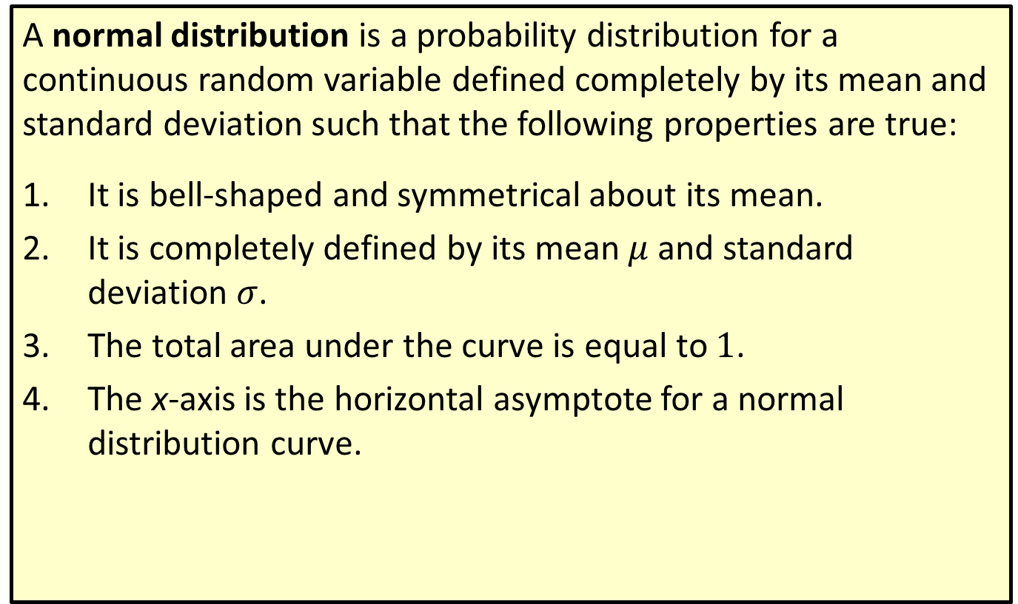
Definition: Normal Distribution—Slide 1
A normal distribution is a probability distribution for a continuous random variable defined completely by its mean and standard deviation such that the following properties are true:
1. ​It is bell-shaped and symmetrical about its mean.
2. It is completely defined by its mean $μ$ and standard deviation $σ$.
3. The total area under the curve is equal to 1.
4. The x-axis is the horizontal asymptote for a normal distribution curve.

Slide 5
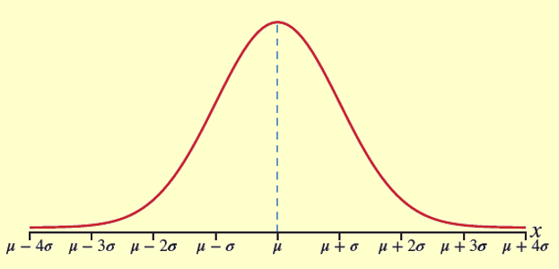
Definition: Normal Distribution—Slide 2
Figure 2

Slide 6
Think Back 1
A horizontal asymptote is a horizontal line that a graph approaches but never touches or crosses.

Slide 7
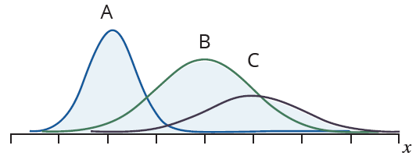
Example 1: Identifying Properties of a Normal Curve—Slide 1
Below are three normal distributions drawn on the same graph. Use them to answer the following questions.
Figure 4
a. Determine which distribution has the largest mean and which has the smallest.
b. ​Determine which distribution has the largest standard deviation and which has the smallest.
c. What does the position of curve B in relation to curve A tell you about the data of the distribution?

Slide 8
Example 1: Identifying Properties of a Normal Curve—Slide 2
Solution
a. We know that normal distributions curves are centered at their means. Therefore, we can determine the mean of each distribution by identifying where its peak is located along the x-axis. Even though the x-axis is not labeled, we can tell from the location of the peaks which mean is larger or smaller in relation to the other curves. Curve C has the largest mean and curve A has the smallest mean.
b. ​Normal distributions with a larger standard deviation will have a curve that appears more spread out from the mean. On the other hand, smaller deviations result in graphs that appear narrower and more concentrated around the mean. Therefore, curve C appears to have the largest standard deviation, whereas curve A appears to have the smallest standard deviation.
c. Because most of curve B is to the right of curve A along the x-axis, curve B appears to have larger data values than curve A does.

Slide 9
Helpful Hint 2
The Empirical Rule is also referred to as the Three Sigma Rule or the 68−95−99.7 Rule.

Slide 10
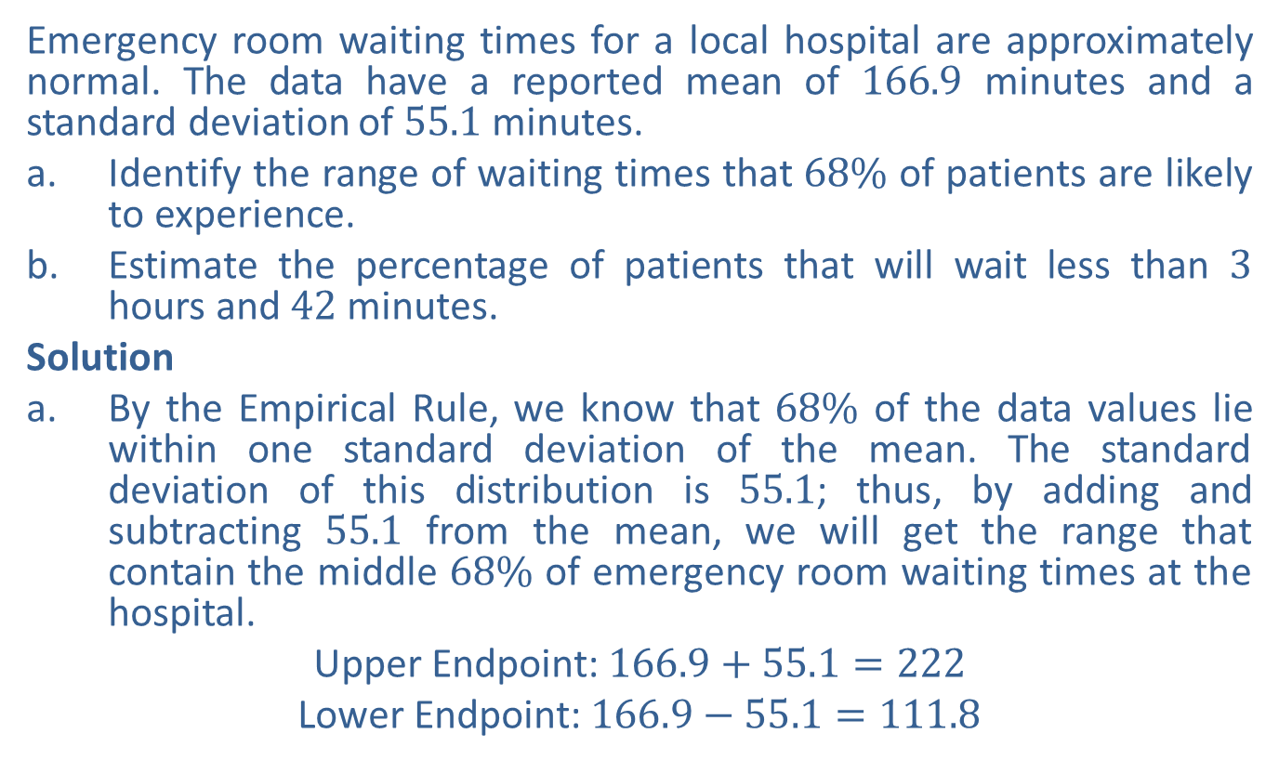
Example 2: Using the Empirical Rule—Slide 1
Emergency room waiting times for a local hospital are approximately normal. The data have a reported mean of 166.9 minutes and a standard deviation of 55.1 minutes.
a. Identify the range of waiting times that $68\%$ of patients are likely to experience.
b. ​Estimate the percentage of patients that will wait less than 3 hours and 42 minutes.
Solution
a. By the Empirical Rule, we know that $68\%$ of the data values lie within one standard deviation of the mean. The standard deviation of this distribution is 55.1; thus, by adding and subtracting 55.1 from the mean, we will get the range that contain the middle $68\%$ of emergency room waiting times at the hospital.
​Upper Endpoint: $166.9+55.1=222$
​Lower Endpoint: $166.9−55.1=111.8$

Slide 11
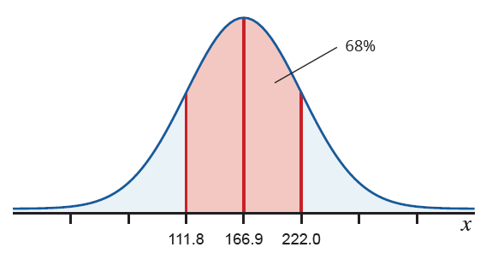

Example 2: Using the Empirical Rule—Slide 2
​Thus, we can estimate that $68\%$ of emergency room waiting times for the local hospital are between 111.8 minutes and 222 minutes. We've sketched this on a normal curve in Figure 8.
​
Figure 8: Emergency Room Wait Times (in Minutes)

Slide 12
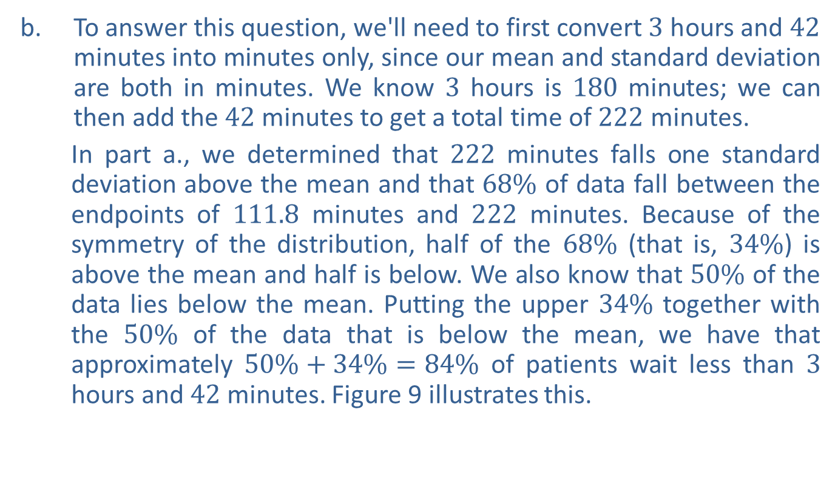
Example 2: Using the Empirical Rule—Slide 3
b. To answer this question, we'll need to first convert 3 hours and 42 minutes into minutes only, since our mean and standard deviation are both in minutes. We know 3 hours is 180 minutes; we can then add the 42 minutes to get a total time of 222 minutes.
In part a., we determined that 222 minutes falls one standard deviation above the mean and that $68\%$ of data fall between the endpoints of 111.8 minutes and 222 minutes. Because of the symmetry of the distribution, half of the $68\%$ (that is, $34\%$) is above the mean and half is below. We also know that $50\%$ of the data lies below the mean. Putting the upper $34\%$ together with the $50\%$ of the data that is below the mean, we have that approximately $50\%+34\%=84\%$ of patients wait less than 3 hours and 42 minutes. Figure 9 illustrates this.
​

Slide 13
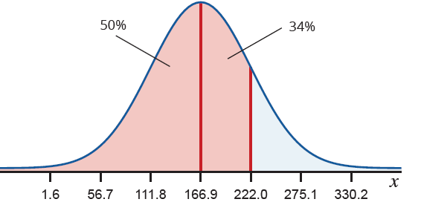
Example 2: Using the Empirical Rule—Slide 4
Figure 9: Emergency Room Wait Times (in Minutes)

Slide 14

Skill Check 1
Estimate the range of emergency room waiting times that $95\%$ of patients are likely to experience based on Example 2.
Answer: Between 56.7 minutes and 277.1 minutes

Slide 15
Helpful Hint 3
A standard score may also be referred to as a z-score or z-value. Statisticians use these terms interchangeably.

Slide 16

Definition: Standard Score ($z$-Score)
A standard score, or z-score, is the number of standard deviations a particular data value lies away from the mean in a normal distribution.
The standard score for a population value is given by
where x is the value of interest from the population, µ is the population mean, and σ is the population standard deviation.
The standard score for a sample value is given by
where x is the value of interest from the sample,
is the sample mean, and s
is the sample standard deviation.

Slide 17
Helpful Hint 4
Standard scores are normally rounded to the nearest hundredth.

Slide 18
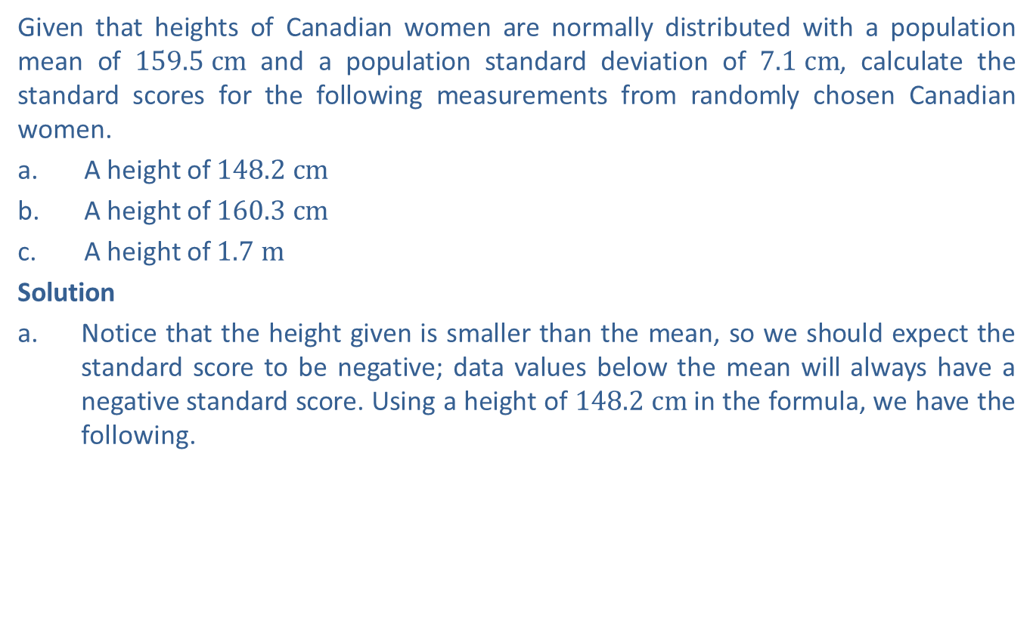
Example 3: Calculating a Standard Score—Slide 1
Given that heights of Canadian women are normally distributed with a population mean of $159.5 cm$ and a population standard deviation of $7.1 cm$, calculate the standard scores for the following measurements from randomly chosen Canadian women.
a. ​A height of $148.2 cm$
b. A height of $160.3 cm$
c. A height of $1.7 m$
Solution
​Notice that the height given is smaller than the mean, so we should expect the standard score to be negative; data values below the mean will always have a negative standard score. Using a height of $148.2 cm$ in the formula, we have the following.
What this tells us is that a height of $148.2 cm$ is 1.59 standard deviations below the mean.

Slide 19

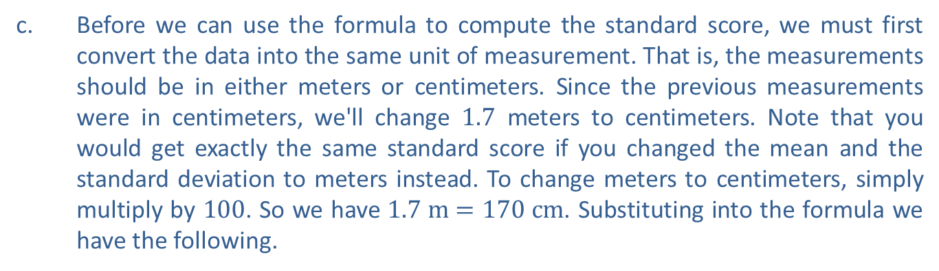
Example 3: Calculating a Standard Score—Slide 2
b. ​A data value greater than the mean will always have a positive standard score; thus, we should expect a positive number. The standard score for a height of $160.3 cm$ is calculated as follows.
This tells us that a height of $160.3 cm$, which we know is only slightly larger than the mean, is 0.11 standard deviations above the mean.
c. Before we can use the formula to compute the standard score, we must first convert the data into the same unit of measurement. That is, the measurements should be in either meters or centimeters. Since the previous measurements were in centimeters, we'll change 1.7 meters to centimeters. Note that you would get exactly the same standard score if you changed the mean and the standard deviation to meters instead. To change meters to centimeters, simply multiply by 100. So we have $1.7 m=170 cm$. Substituting into the formula we have the following.

Slide 20
Example 3: Calculating a Standard Score—Slide 3
So a height of $1.7 m$ is 1.48 standard deviations above the mean.

Slide 21

Skill Check 2
Given that the heights of women in Malaysia are normally distributed with a mean of $154.7 cm$ and a standard deviation of $6.46 cm$, calculate the standard score of a Malaysian woman who is $159.1 cm$ tall.
Answer: z ≈ 0.68

Slide 22
Example 4: Comparing Standard Scores—Slide 1
On Karl's recent standardized test results, he scored an 18 in language arts. The mean was 15 and the standard deviation was 1.4. His classmate, Asher, took the test on a different date and also scored an 18 in language arts, but on that day the mean for the test was 17 and the standard deviation was 1.9. Another friend, Rylie, took the test in a different state, where the mean was 15.46 and the standard deviation was 0.8, and scored a 16 in language arts. Which of the three students actually performed the best on the language arts portion of the test compared to the others?
Solution
In order to compare the language arts scores, we need to calculate the standard score for each student using the appropriate mean and standard deviation for each.

Slide 23
Example 4: Comparing Standard Scores—Slide 2
Comparing each of the respective standard scores, we can see that Karl did the best on his test, even though his raw score was the same as Asher's. Karl's score of 18 was 2.14 standard deviations above the mean. Asher and Rylie's scores were fewer standard deviations above their respective means. The larger the standard score, the further above the mean a data point lies.

Slide 24
Think Back 2
In Example 9, we compared standardized test scores by looking at their percentiles. In this example, we make similar comparisons of standardized tests using standard scores.

Slide 25
Example 5: Finding the Area to the Left of a z-Value—Slide 1
Find the area under the normal curve to the left of each of the standard scores.
a. z = 1.04
b. ​z = −2.11
Solution
a. Begin by considering what value we expect to get when we look up the standard score. Since the standard score is positive, we should expect that the area under the curve to the left of this value will be greater than half of the total area (0.5000) as shown in the following figure.

Slide 26
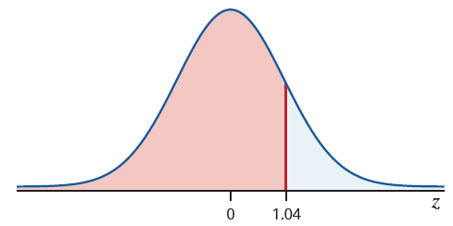
Example 5: Finding the Area to the Left of a z-Value—Slide 2
Figure 11
​Tables
To use the table, we must break the given z-value (1.04) into two parts: one containing the first decimal place (1.0) and the other containing the second decimal place (0.04). Because the z-value is positive, we use Table B from Appendix A. Look across the row labeled 1.0 and down the column labeled 0.04. The row and column intersect at 0.8508. Notice that this value aligns with what we were expecting.

Slide 27
Example 5: Finding the Area to the Left of a z-Value—Slide 3
Table 2: Excerpt from Table B: Standard Normal Distribution
z | 0.02 | 0.03 | 0.04 | 0.05 | 0.06
0.8 | 0.7939 | 0.7967 | 0.7995 | 0.8023 | 0.8051
0.9 | 0.8212 | 0.8238 | 0.8264 | 0.8289 | 0.8315
1.0 | 0.8461 | 0.8485 | 0.8508 | 0.8531 | 0.8554
1.1 | 0.8686 | 0.8708 | 0.8729 | 0.8749 | 0.8770
1.2 | 0.8888 | 0.8907 | 0.8925 | 0.8944 | 0.8962
1.3 | 0.9066 | 0.9082 | 0.9099 | 0.9115 | 0.9131

Slide 28
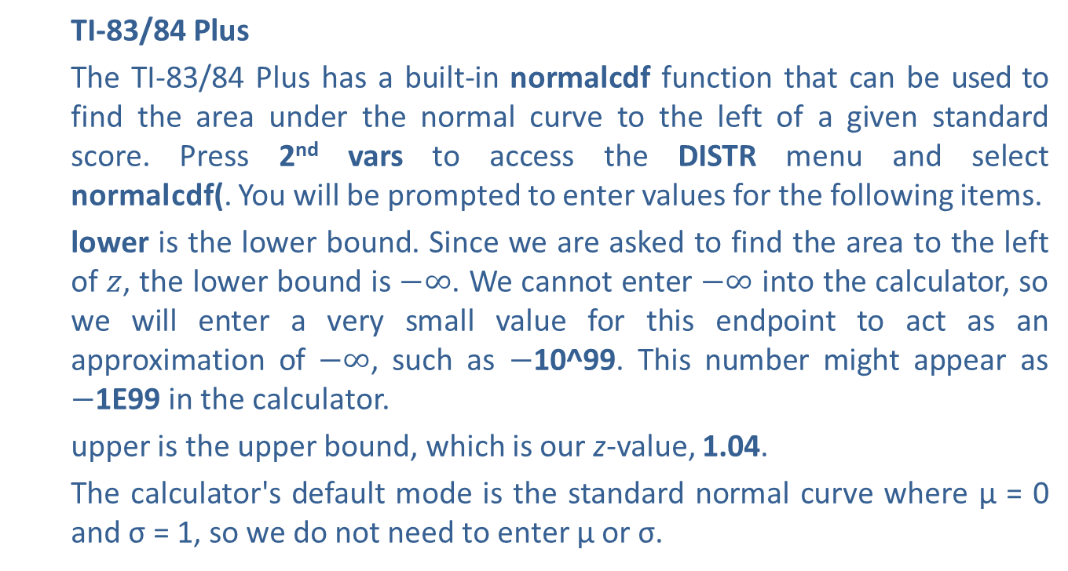
Example 5: Finding the Area to the Left of a z-Value—Slide 4
TI-83/84 Plus
The TI-83/84 Plus has a built-in normal cdf function that can be used to find the area under the normal curve to the left of a given standard score. Press 2nd vars to access the DISTR menu and select normal cdf(. You will be prompted to enter values for the following items.
lower is the lower bound. Since we are asked to find the area to the left of $z$, the lower bound is $−∞$. We cannot enter $−∞$ into the calculator, so we will enter a very small value for this endpoint to act as an approximation of $−∞$, such as $−$10^99. This number might appear as $−$1E99 in the calculator.
upper is the upper bound, which is our z-value, 1.04.
The calculator's default mode is the standard normal curve where µ = 0 and σ = 1, so we do not need to enter µ or σ.

Slide 29
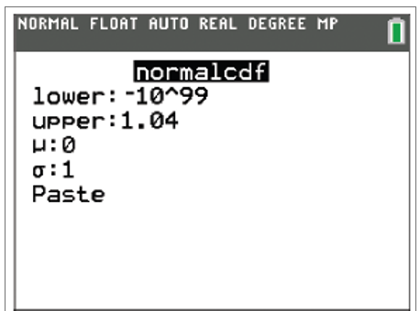
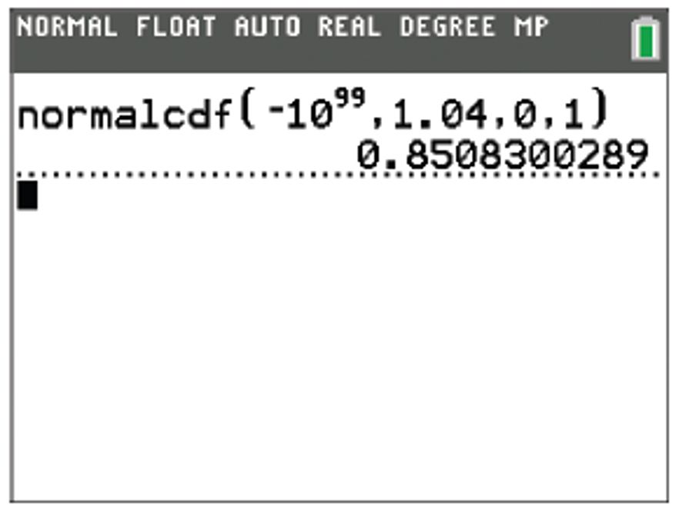
Example 5: Finding the Area to the Left of a z-Value—Slide 5
Figure 12
Highlight Paste and press enter . Back on the home screen, press enter again, and the calculator returns 0.8508300289.
Figure 13
​Thus, the area under the standard normal curve to the left of z = 1.04 is approximately 0.8508.

Slide 30
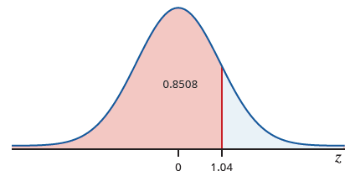
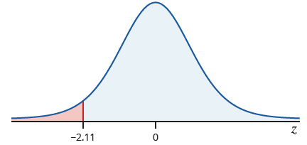
Example 5: Finding the Area to the Left of a z-Value—Slide 6
Figure 14
b. Begin by noting that since we are asked to find an area to the left of a negative z-value, we should expect an area under the curve that is less than 0.5000.
Figure 15

Slide 31
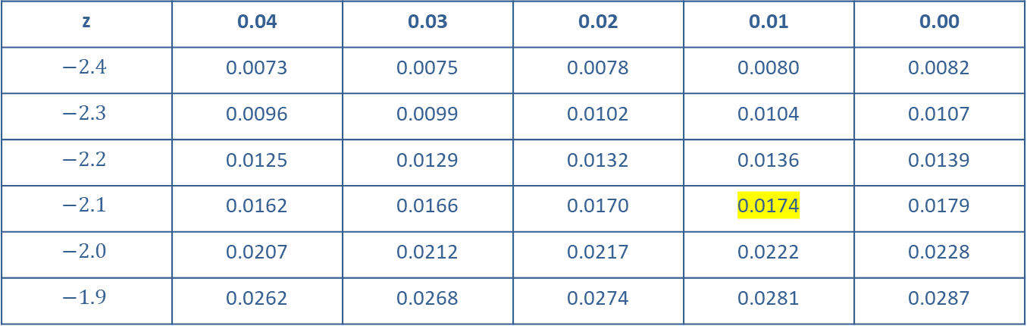

Example 5: Finding the Area to the Left of a z-Value—Slide 7
​Tables
Notice that the first part of the z-value is $−2.1$ and the second part is 0.01. This time, use Table A from Appendix A since the $z$-value is negative. On the chart, look across the row labeled $−2.1$ and down the column labeled 0.01 (be careful to get the correct column here). The row and column intersect at 0.0174.
Table 3: Excerpt from Table A: Standard Normal Distribution
z | 0.04 | 0.03 | 0.02 | 0.01 | 0.00
$$−2.4$$ | 0.0073 | 0.0075 | 0.0078 | 0.0080 | 0.0082
$$−2.3$$ | 0.0096 | 0.0099 | 0.0102 | 0.0104 | 0.0107
$$−2.2$$ | 0.0125 | 0.0129 | 0.0132 | 0.0136 | 0.0139
$$−2.1$$ | 0.0162 | 0.0166 | 0.0170 | 0.0174 | 0.0179
$$−2.0$$ | 0.0207 | 0.0212 | 0.0217 | 0.0222 | 0.0228
$$−1.9$$ | 0.0262 | 0.0268 | 0.0274 | 0.0281 | 0.0287

Slide 32
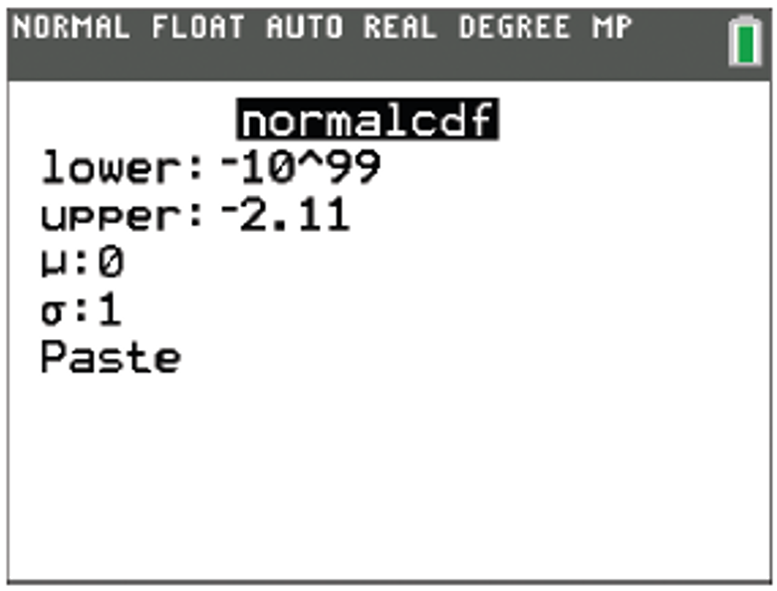
Example 5: Finding the Area to the Left of a z-Value—Slide 8
TI-83/84 Plus
The built-in normal cdf function on a TI-83/84 Plus can again be used to find the area under the normal curve to the left of a given standard score. Press 2nd vars to access the DISTR menu and select normal cdf(. Since the lower bound is −∞, which we can't enter into the calculator, use −10^99 for lower. The upper bound is the given z-score, −2.11, so use −2.11 for upper.
Figure 16

Slide 33
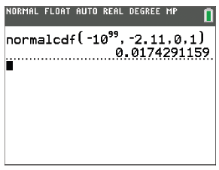
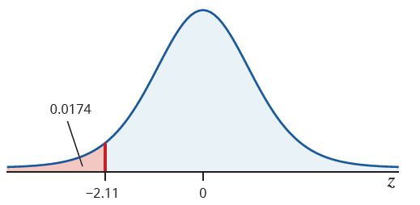

Example 11.4.5: Finding the Area to the Left of a $z$-Value—Slide 9
Highlight Paste and press enter. Back on the home screen, press enter again, and the calculator returns 0.0174291159.
Figure 17
Figure 18
​Thus, the area under the standard normal curve to the left of z = −2.11 is approximately 0.0174.

Slide 34
Skill Check 3
Find the area under the standard normal curve to the left of z = 1.76.
Answer: 0.9608

Slide 35
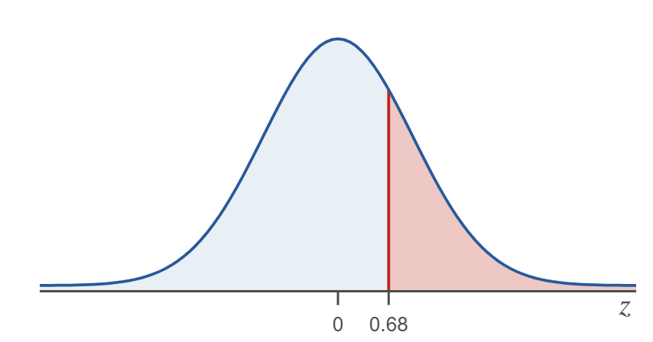

Example 6: Finding the Area to the Right of a z-Value—Slide 1
Find the area under the normal curve to the right of each of the $z$-scores.
a. z = 0.68​
b. z = −1.32
Solution
a. ​Once again, consider how large the area will be. Since we are looking for the area to the right of a positive z-value, our answer should be a value less than 0.5000, as illustrated in Figure 20.
Figure 20

Slide 36
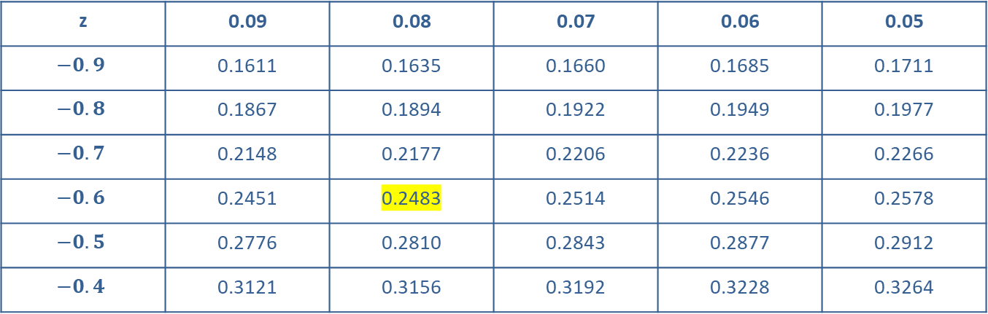
Example 6: Finding the Area to the Right of a z-Value—Slide 2
​Tables
To find the area to the right of z = 0.68, we will look up the negative of the z-value, z = −0.68, in Table A from Appendix A. This gives an area of 0.2483.
Table 4: Excerpt from Table A: Standard Normal Distribution
z | 0.09 | 0.08 | 0.07 | 0.06 | 0.05
$$−0.9$$ | 0.1611 | 0.1635 | 0.1660 | 0.1685 | 0.1711
$$−0.8$$ | 0.1867 | 0.1894 | 0.1922 | 0.1949 | 0.1977
$$−0.7$$ | 0.2148 | 0.2177 | 0.2206 | 0.2236 | 0.2266
$$−0.6$$ | 0.2451 | 0.2483 | 0.2514 | 0.2546 | 0.2578
$$−0.5$$ | 0.2776 | 0.2810 | 0.2843 | 0.2877 | 0.2912
$$−0.4$$ | 0.3121 | 0.3156 | 0.3192 | 0.3228 | 0.3264

Slide 37
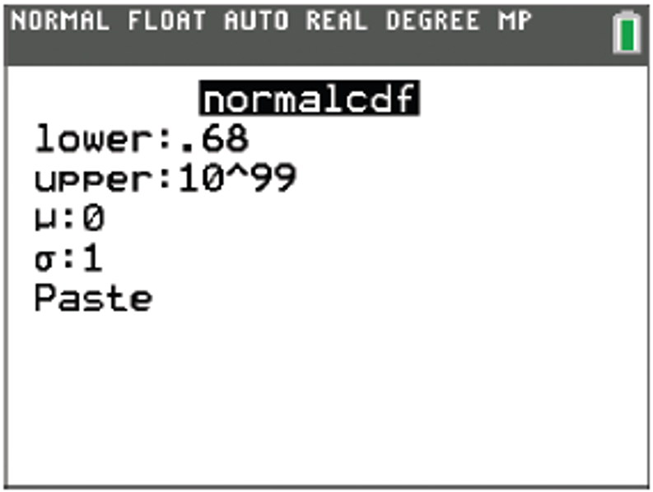
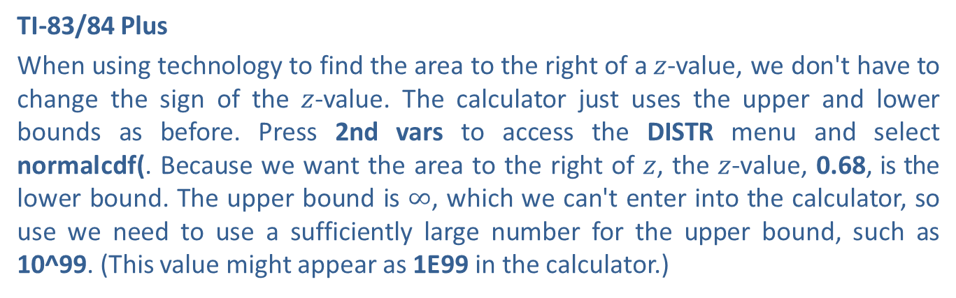
Example 6: Finding the Area to the Right of a z-Value—Slide 3
TI-83/84 Plus
When using technology to find the area to the right of a $z$-value, we don't have to change the sign of the $z$-value. The calculator just uses the upper and lower bounds as before. Press 2nd vars to access the DISTR menu and select normal cdf(. Because we want the area to the right of $z$, the $z$-value, 0.68, is the lower bound. The upper bound is $∞$, which we can't enter into the calculator, so use we need to use a sufficiently large number for the upper bound, such as 10^99. (This value might appear as 1E99 in the calculator.)
Figure 21

Slide 38
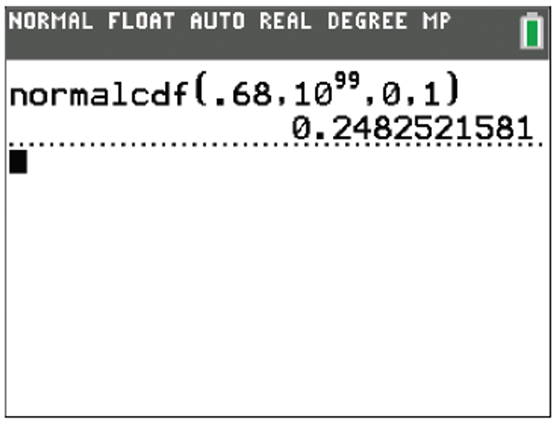
Example 6: Finding the Area to the Right of a z-Value—Slide 4
Highlight Paste and press enter . Back on the home screen, press enter again, and the calculator returns 0.2482521581.
Figure 22
​Thus, the area under the standard normal curve to the right of z = 0.68 is approximately 0.2483.

Slide 39
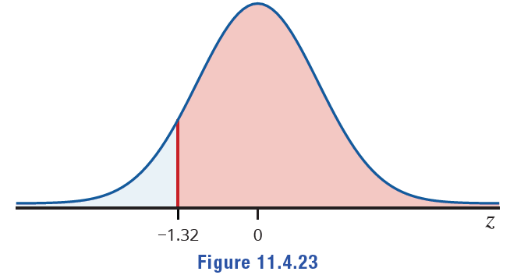
Example 6: Finding the Area to the Right of a z-Value—Slide 5
b. Begin by considering how much area is to the right of a negative z-value. The figure below illustrates that the area we are looking for will be larger than 0.5000.
​
Figure 23

Slide 40
Example 6: Finding the Area to the Right of a z-Value—Slide 6
​Tables
Look up the negative of the z-value, which is z = 1.32, in Table B from Appendix A. This gives an area of 0.9066.
Table 5: Excerpt from Table B: Standard Normal Distribution
z | 0.01 | 0.02 | 0.03 | 0.04 | 0.05
0.9 | 0.8186 | 0.8212 | 0.8238 | 0.8264 | 0.8289
1.0 | 0.8438 | 0.8461 | 0.8485 | 0.8508 | 0.8531
1.1 | 0.8665 | 0.8686 | 0.8708 | 0.8729 | 0.8749
1.2 | 0.8869 | 0.8888 | 0.8907 | 0.8925 | 0.8944
1.3 | 0.9049 | 0.9066 | 0.9082 | 0.9099 | 0.9115
1.4 | 0.9207 | 0.9222 | 0.9236 | 0.9251 | 0.9265

Slide 41
Example 6: Finding the Area to the Right of a z-Value—Slide 7
TI-83/84 Plus
Press 2nd vars to access the DISTR menu and select normal cdf(. Because we want the area to the right of z, the z-value, −1.32, is the lower bound. The upper bound is ∞, which we can't enter into the calculator, so we need to use a sufficiently large number for the upper bound, such as 10^99.
Highlight Paste and press enter. Back on the home screen, press enter again, and the calculator returns 0.9065824276.

Slide 42
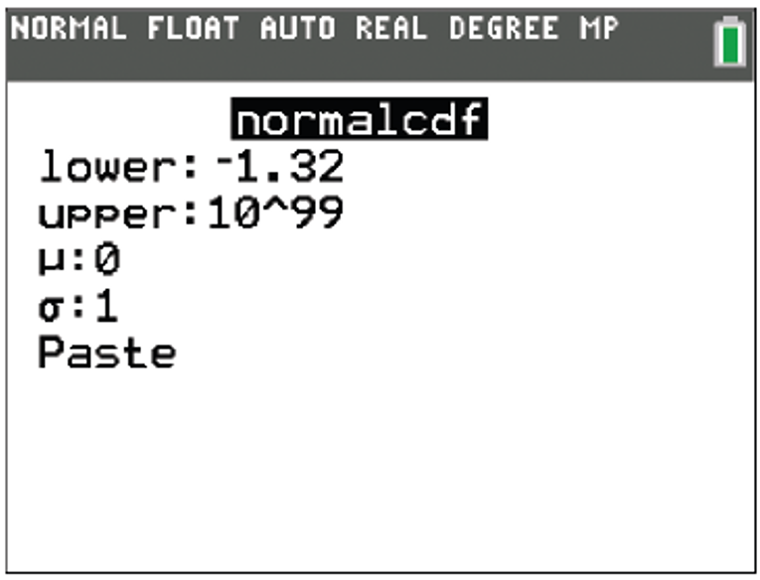
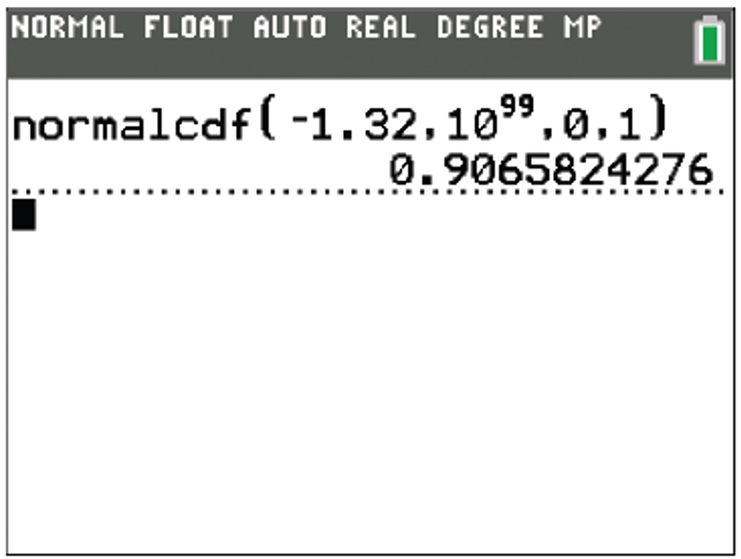
Example 6: Finding the Area to the Right of a z-Value—Slide 8
Figure 24
Figure 25
Thus, the area under the standard normal curve to the right of z = −1.32 is approximately 0.9066.

Slide 43
Skill Check 4
Find the area under the standard normal curve to the right of z = −0.62.
Answer: 0.7324

Slide 44
Example 7: Finding the Area between Two z-Values—Slide 1
Find the area under the normal curve that is between z₁ = −0.56 and z₂ = 2.22.
Solution
Tables
Begin by looking up the area to the left of each z-value using the tables in Appendix A.
Area to the left of z₁ = −0.56 is 0.2877.
Area to the left of z₂ = 2.22 is 0.9868.

Slide 45
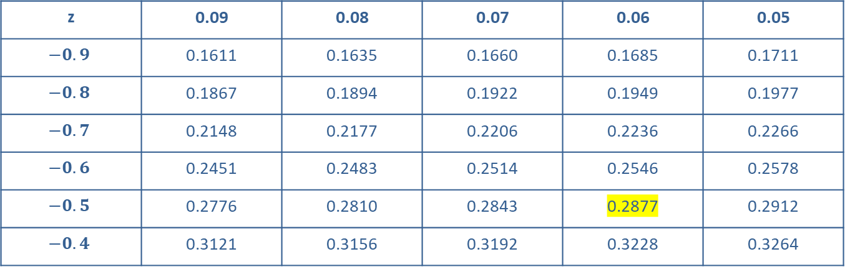
Example 7: Finding the Area between Two z-Values—Slide 2
Table 6: Excerpt from Table A: Standard Normal Distribution
z | 0.09 | 0.08 | 0.07 | 0.06 | 0.05
$$−0.9$$ | 0.1611 | 0.1635 | 0.1660 | 0.1685 | 0.1711
$$−0.8$$ | 0.1867 | 0.1894 | 0.1922 | 0.1949 | 0.1977
$$−0.7$$ | 0.2148 | 0.2177 | 0.2206 | 0.2236 | 0.2266
$$−0.6$$ | 0.2451 | 0.2483 | 0.2514 | 0.2546 | 0.2578
$$−0.5$$ | 0.2776 | 0.2810 | 0.2843 | 0.2877 | 0.2912
$$−0.4$$ | 0.3121 | 0.3156 | 0.3192 | 0.3228 | 0.3264

Slide 46
Example 7: Finding the Area between Two z-Values —Slide 3
Table 7: Excerpt from Table B: Standard Normal Distribution
z | 0.01 | 0.02 | 0.03 | 0.04 | 0.05
2.0 | 0.9778 | 0.9783 | 0.9788 | 0.9793 | 0.9798
2.1 | 0.9826 | 0.9830 | 0.9834 | 0.9838 | 0.9842
2.2 | 0.9864 | 0.9868 | 0.9871 | 0.9875 | 0.9878
2.3 | 0.9896 | 0.9898 | 0.9901 | 0.9904 | 0.9906
2.4 | 0.9920 | 0.9922 | 0.9925 | 0.9927 | 0.9929
2.5 | 0.9940 | 0.9941 | 0.9943 | 0.9945 | 0.9946

Slide 47
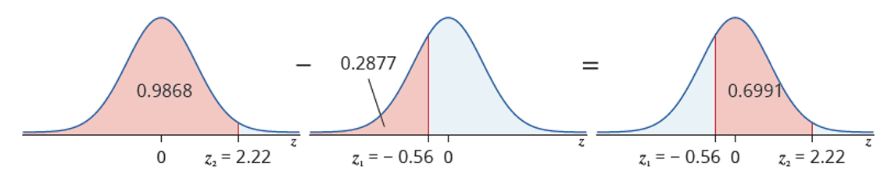
Example 7: Finding the Area between Two z-Values —Slide 4
Then, subtract the smaller from the larger: 0.9868 – 0.2877 = 0.6991.
Figure 27

Slide 48
Example 7: Finding the Area between Two z-Values—Slide 5
TI-83/84 Plus
Instead of having to look up two values and subtract them as we would need to do when using tables, the calculator finds the area between two z-values in one step. Press 2nd vars to access the DISTR menu and select normal cdf(. Because we want the area between two z-values, the smaller z-value will be the lower bound and the larger z-value will be the upper bound. So use −0.56 for lower and 2.22 for upper.
Highlight Paste and press enter . Back on the home screen, press enter again, and the calculator returns 0.6990509792.

Slide 49
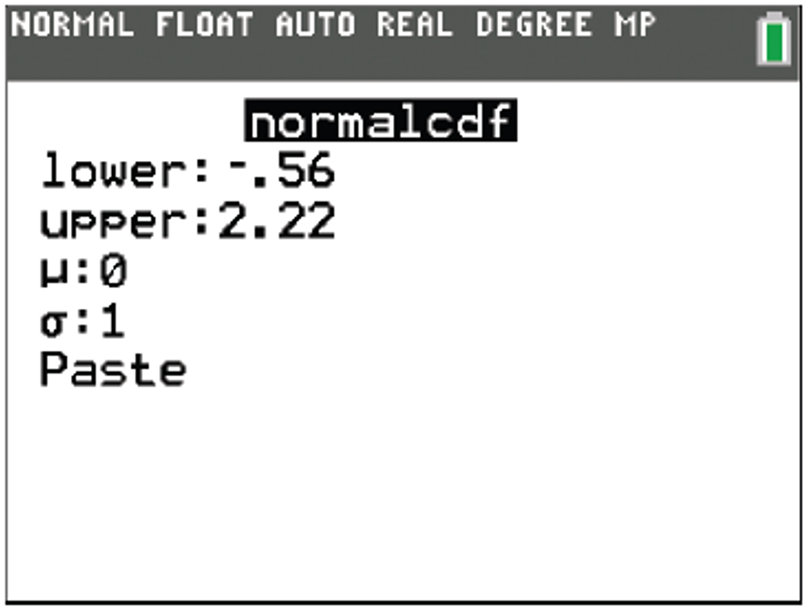
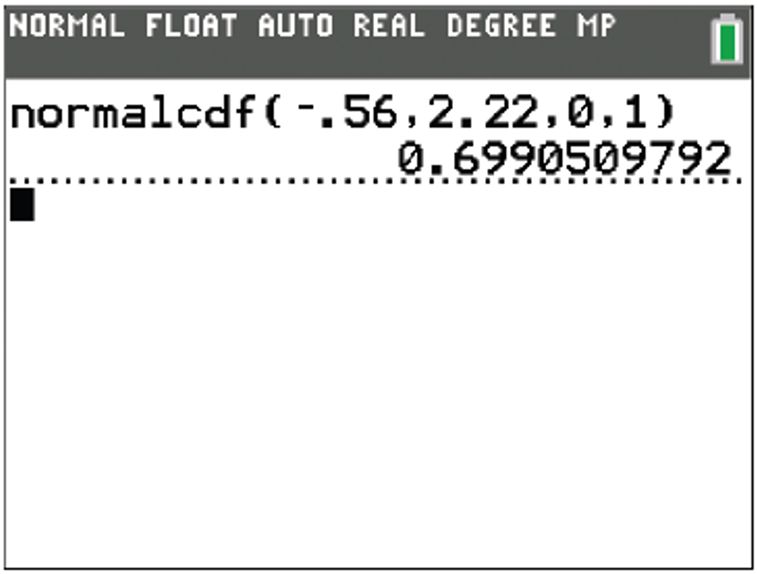
Example 7: Finding the Area between Two z-Values—Slide 6
Figure 28
Figure 29
Thus, the area between the two z-values is approximately 0.6991.

Slide 50
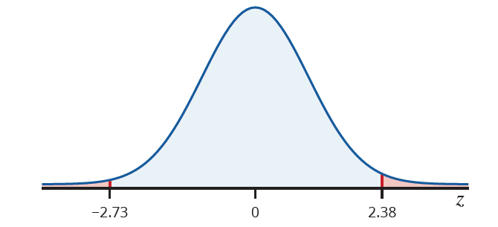
Example 8: Finding the Area in the Tails for Two z-Values—Slide 1
Find the total of the areas under the normal curve to the left of z₁ = −2.73 and to the right of z₂ = 2.38.
Solution
The area we are interested in is shown in the following figure.
Figure 31
To find the total area we are interested in, we need to find each of the areas separately, and then add them together.

Slide 51
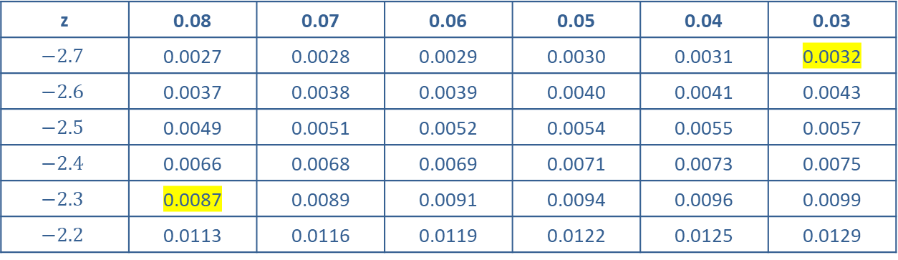
Example 8: Finding the Area in the Tails for Two z-Values—Slide 2
Tables
Find the area to the left of z₁ = −2.73 by looking it up in Table A. This gives us 0.0032.
Find the area to the right of z₂ = 2.38 by looking up its negative value, z₂ = −2.38. This is equal to 0.0087.
Table 8: Excerpt from Table A: Standard Normal Distribution
z | 0.08 | 0.07 | 0.06 | 0.05 | 0.04 | 0.03
$$−2.7$$ | 0.0027 | 0.0028 | 0.0029 | 0.0030 | 0.0031 | 0.0032
$$−2.6$$ | 0.0037 | 0.0038 | 0.0039 | 0.0040 | 0.0041 | 0.0043
$$−2.5$$ | 0.0049 | 0.0051 | 0.0052 | 0.0054 | 0.0055 | 0.0057
$$−2.4$$ | 0.0066 | 0.0068 | 0.0069 | 0.0071 | 0.0073 | 0.0075
$$−2.3$$ | 0.0087 | 0.0089 | 0.0091 | 0.0094 | 0.0096 | 0.0099
$$−2.2$$ | 0.0113 | 0.0116 | 0.0119 | 0.0122 | 0.0125 | 0.0129
Adding these two values gives us 0.0032 + 0.0087 = 0.0119.

Slide 52
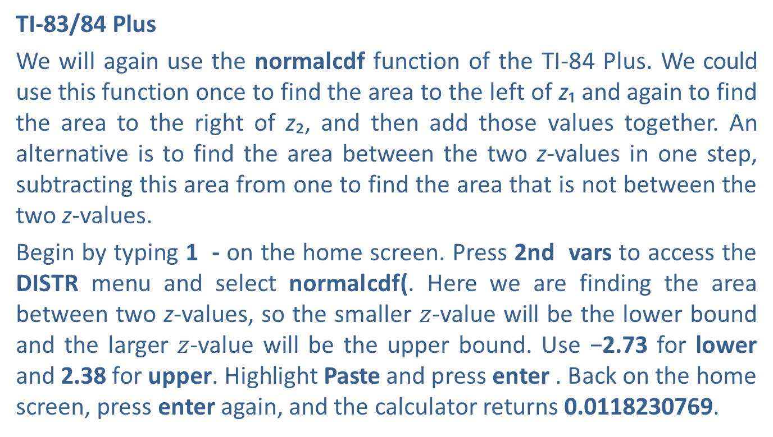
Example 8: Finding the Area in the Tails for Two z-Values—Slide 3
TI-83/84 Plus
We will again use the normal cdf function of the TI-84 Plus. We could use this function once to find the area to the left of z₁ and again to find the area to the right of z₂, and then add those values together. An alternative is to find the area between the two z-values in one step, subtracting this area from one to find the area that is not between the two z-values.
Begin by typing 1 - on the home screen. Press 2nd vars to access the DISTR menu and select normal cdf(. Here we are finding the area between two z-values, so the smaller $z$-value will be the lower bound and the larger $z$-value will be the upper bound. Use −2.73 for lower and 2.38 for upper. Highlight Paste and press enter . Back on the home screen, press enter again, and the calculator returns 0.0118230769.

Slide 53
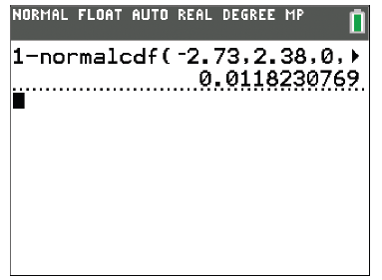
Example 8: Finding the Area in the Tails for Two z-Values—Slide 4
Figure 32
Thus, the total area in the tails is approximately 0.0119.

Slide 54
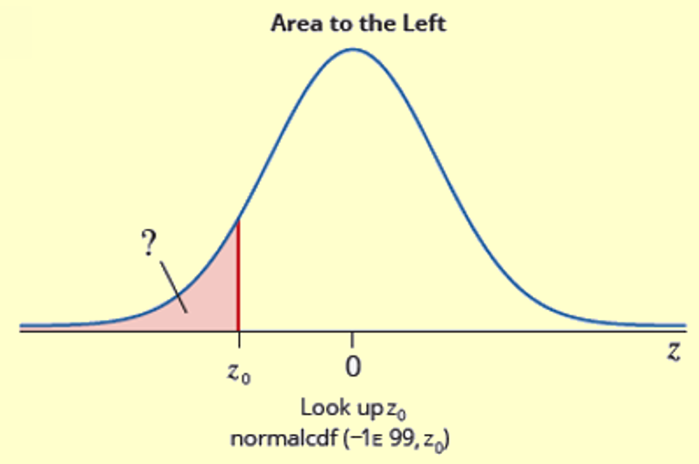
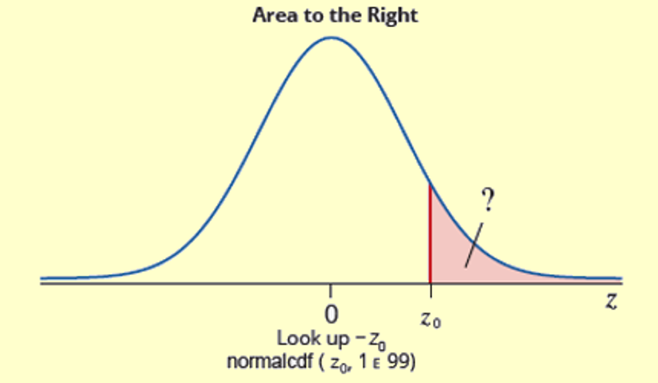
Procedure: Using the Cumulative Normal Distribution Tables to Find Areas under the Standard Normal Curve—Slide 1

Slide 55
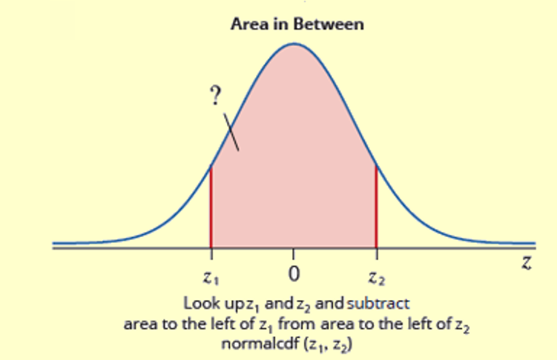
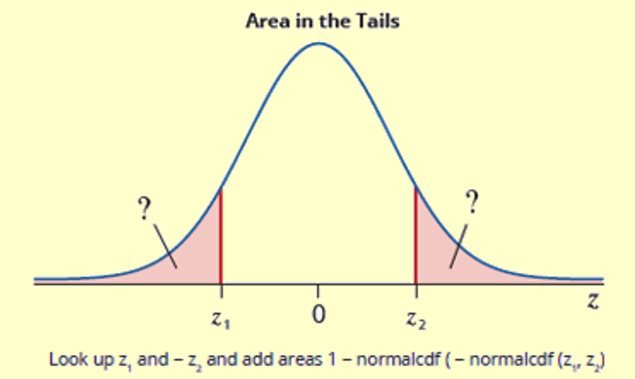
Procedure: Using the Cumulative Normal Distribution Tables to Find Areas under the Standard Normal Curve—Slide 2
Figure 33

Slide 56
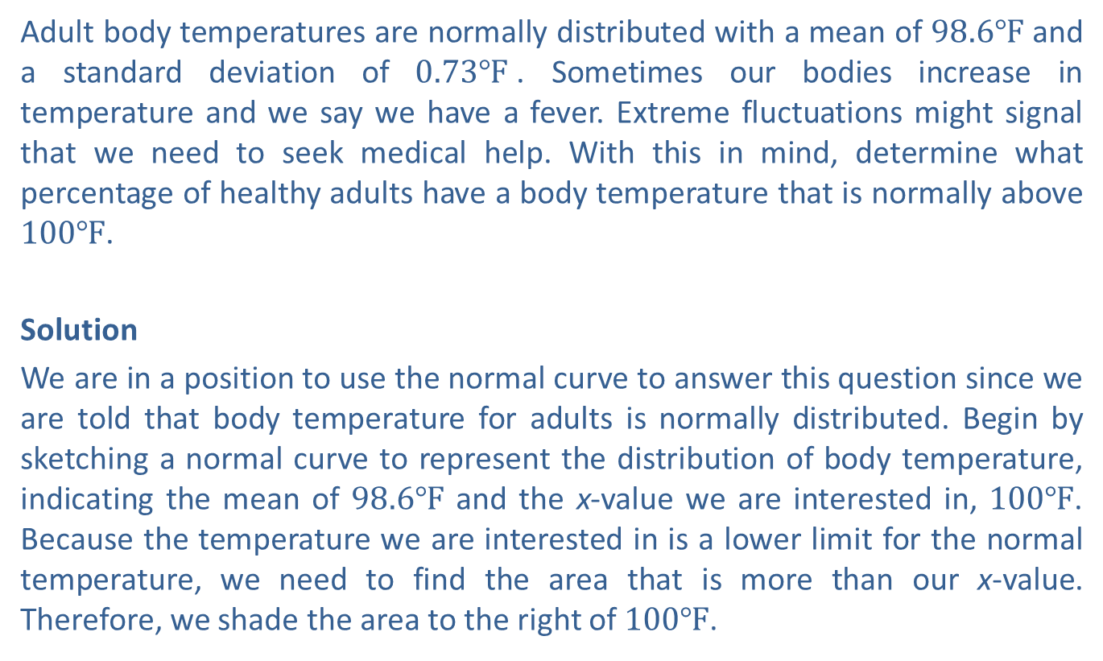
Example 9: Finding Percentages Using the Normal Distribution—Slide 1
Adult body temperatures are normally distributed with a mean of $98.6℉$ and a standard deviation of $0.73℉$. Sometimes our bodies increase in temperature and we say we have a fever. Extreme fluctuations might signal that we need to seek medical help. With this in mind, determine what percentage of healthy adults have a body temperature that is normally above $100℉$.
Solution
We are in a position to use the normal curve to answer this question since we are told that body temperature for adults is normally distributed. Begin by sketching a normal curve to represent the distribution of body temperature, indicating the mean of $98.6℉$ and the x-value we are interested in, $100℉$. Because the temperature we are interested in is a lower limit for the normal temperature, we need to find the area that is more than our x-value. Therefore, we shade the area to the right of $100℉$.

Slide 57
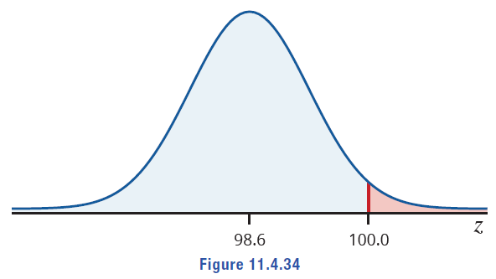
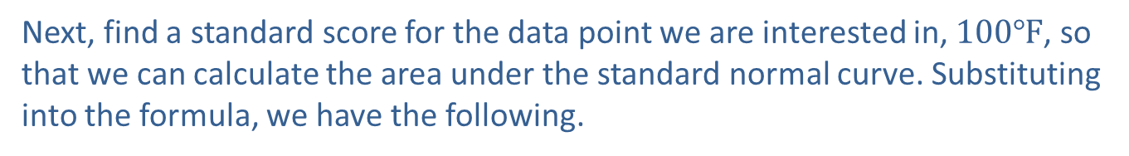
Example 9: Finding Percentages Using the Normal Distribution—Slide 2
Figure 34
Notice that we can expect the value we find to be smaller than 0.5000 based on our normal curve drawing.
Next, find a standard score for the data point we are interested in, $100℉$, so that we can calculate the area under the standard normal curve. Substituting into the formula, we have the following.

Slide 58
Example 9: Finding Percentages Using the Normal Distribution—Slide 3
This z-value indicates that a normal temperature of 100.0 is 1.92 standard deviations above the mean normal temperature. Using either tables or technology, we now need to find the value to the right of z = 1.92.
Tables
Because we want the area to the right, we will look up the negative of the z-value in Table A, which is z = −1.92. This gives us a value of 0.0274.

Slide 59
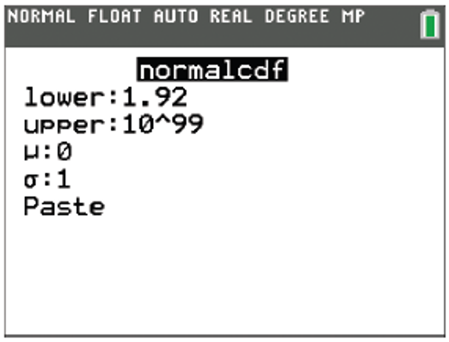
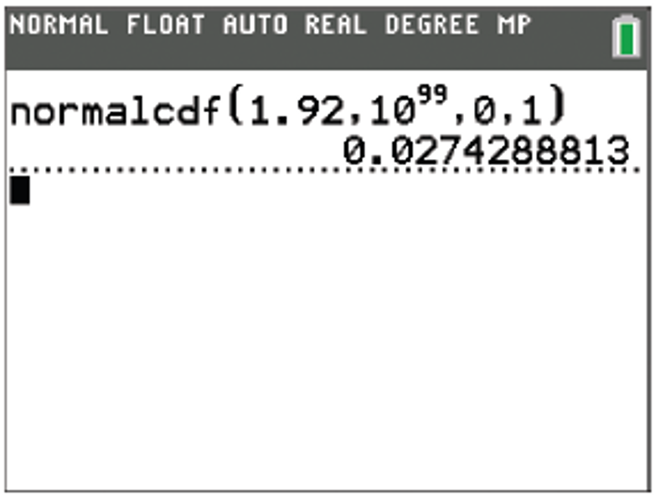


Example 9: Finding Percentages Using the Normal Distribution—Slide 4
TI-83/84 Plus
Press 2nd vars to access the DISTR menu and select normal cdf(. We are looking for the area to the right of z = 1.92, so that will be our lower bound. The upper bound is $∞$, so we will use
Highlight Paste and press enter.
Back on the home screen, press enter again, and the calculator returns 0.0274288813.
Figure 35
Figure 36
Thus, the percentage of healthy adults who have a body temperature of more than $100℉$ is approximately $2.74\%$.

Slide 60
Example 10: Finding Probabilities Using the Normal Distribution—Slide 1
Many kids love the thrill of attending the state fair and riding rides of all types. However, not everyone gets to ride every attraction because there are height restrictions on some of the rides. Suppose for one ride guests must be at least 40 inches tall to ride. If heights for 6-year-olds are normally distributed with a mean of 3 feet 9 inches and a standard deviation of 2 inches, determine the probability that a random 6-year-old is shorter than the height restriction and is not allowed on the ride.
Solution
Note that we are told heights are normally distributed, and we can, therefore, use the normal distribution to answer the question. Since the height restriction is given in inches, we will first convert the mean into inches.
µ = 3 ft 9 in. = 45 in.
Draw a normal curve to represent the distribution of the heights of 6-year-olds with a mean of 45 inches and denote 40 inches on the x-axis to indicate the height restriction. Because this is an upper limit for heights, we are interested in finding the probability that a random 6-year-old's height is less than 40 inches. Therefore, we shade the area to the left of 40 on the curve.

Slide 61

Example 10: Finding Probabilities Using the Normal Distribution—Slide 2
Figure 37
Notice that the area shaded is less than half of the area under the curve, so we can expect the value we find to be less than 0.5000.
Begin by finding a z-score for the data point we are interested in: 40 inches. Substituting into the formula, we have the following.

Slide 62
Example 10: Finding Probabilities Using the Normal Distribution—Slide 3
Using either tables or technology, find the value to the left of z = −2.5.
Tables
Looking up z = −2.5 in Table A we see that the shaded region has an area of approximately 0.0062.
TI-83/84 Plus
Press 2nd vars to access the DISTR menu and select normal cdf(. We are looking for the area to the left of z = −2.5, so the lower bound is −∞. Since we can't enter that into the calculator, we will use
to approximate the lower bound.
For the upper bound, use z = −2.5. Highlight Paste and press enter. Back on the home screen, press enter again, and the calculator returns 0.0062096799.

Slide 63



Example 10: Finding Probabilities Using the Normal Distribution—Slide 4
Figure 38
Figure 39
Thus, the probability of a 6-year-old having a height of less than 40 inches, and therefore not being allowed on the ride, is approximately 0.0062. We can also interpret this to mean that $0.62\%$ of 6-year-olds have a height of less than 40 inches. Therefore, only a small percentage of 6-year-olds (less than $1\%$) are excluded from riding this ride.

