Slide 1
Section 11.5
Confidence Intervals

Slide 2
Definition: Inferential Statistics
The branch of inferential statistics, as a science, involves using descriptive statistics to estimate population parameters.

Slide 3
Definition: Point Estimate
A point estimate is a single-number estimate of a population parameter.

Slide 4
Helpful Hint
A sample proportion is the fraction of a sample that has a certain characteristic.

Slide 5
Fun Fact
Article 1, Section 2, of the US Constitution mandates that the country conduct a count of its population once every 10 years. The 2020 Census marked the 24th time that the country has counted its population; the first was in 1790.

Slide 6
Example 1: Finding a Point Estimate for a Population Mean
Find the best point estimate for the population mean of test scores on a standardized psychology final exam. The following is a simple random sample taken from the population of test scores.
​68 | ​83 | ​68 | ​90 | ​91 | ​72
​86 | ​92 | ​85 | ​93 | ​45 | ​69
​76 | ​81 | ​76 | ​71 | ​97 | ​70
​99 | ​100 | ​96 | ​88 | ​84 | ​89
​100 | ​91 | ​55 | ​75 | ​74 | ​85
Solution
The best point estimate for the population mean is the sample mean because it is an unbiased estimator. The sample mean for the given sample of test scores can be found as follows.
Thus, the best point estimate for the population mean of test scores on this standardized exam is 81.6.

Slide 7
Skill Check 1
Out of 432 randomly selected students, 301 live in campus housing. Use the best point estimate to estimate the proportion of all students who live in campus housing.
Answer:

Slide 8
Definition: Confidence Intervals
Interval Estimate
An interval estimate is a range of possible values for a population parameter.
Level of Confidence
The level of confidence, denoted by c, is the percentage of all possible samples of a given size that will produce interval estimates that contain the actual parameter.
Confidence Interval
A confidence interval is an interval estimate associated with a certain level of confidence.

Slide 9
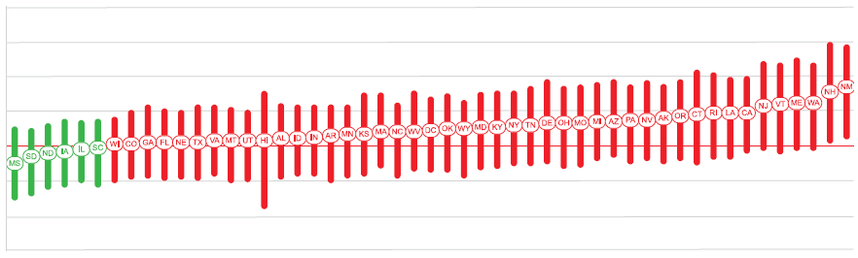

Example 2: Interpreting Confidence
Intervals—Slide 1
During the 2020 global pandemic of COVID-19, the reproduction rate of the virus (R _{t}) was a measure of how fast the virus was spreading in the United States ¹⁸. That is, R _{t} measured the average number of people who became infected by an infectious person. When R _{t} was below 1.0, the virus was not spreading. Below is an excerpt from November 2020, which shows $80\%$ confidence intervals for each state's R _{t} value. Each state's initials inside the oval represent the sample mean. Use the excerpt to answer the following questions.
Figure 2
18 Rt: Effective Reproduction Number, last accessed November 23, 2020, https://rt.live/.

Slide 10
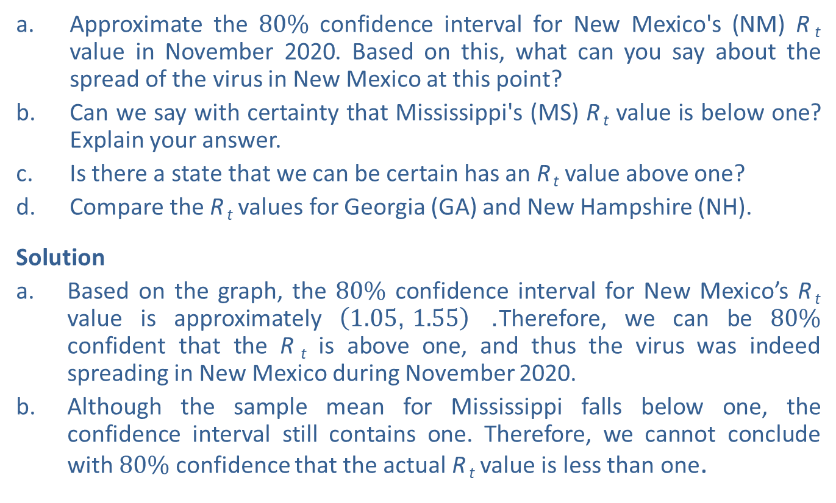
Example 2: Interpreting Confidence
Intervals—Slide 2
a. Approximate the $80\%$ confidence interval for New Mexico's (NM) R _{t} value in November 2020. Based on this, what can you say about the spread of the virus in New Mexico at this point?
b. ​Can we say with certainty that Mississippi's (MS) R _{t} value is below one? Explain your answer.
c. Is there a state that we can be certain has an R _{t} value above one?
d. Compare the R _{t} values for Georgia (GA) and New Hampshire (NH).
Solution
​Based on the graph, the $80\%$ confidence interval for New Mexico’s R _{t} value is approximately $\left(1.05\text{, }1.55\right)$. Therefore, we can be $80\%$ confident that the R _{t} is above one, and thus the virus was indeed spreading in New Mexico during November 2020.
​Although the sample mean for Mississippi falls below one, the confidence interval still contains one. Therefore, we cannot conclude with $80\%$ confidence that the actual R _{t} value is less than one.

Slide 11
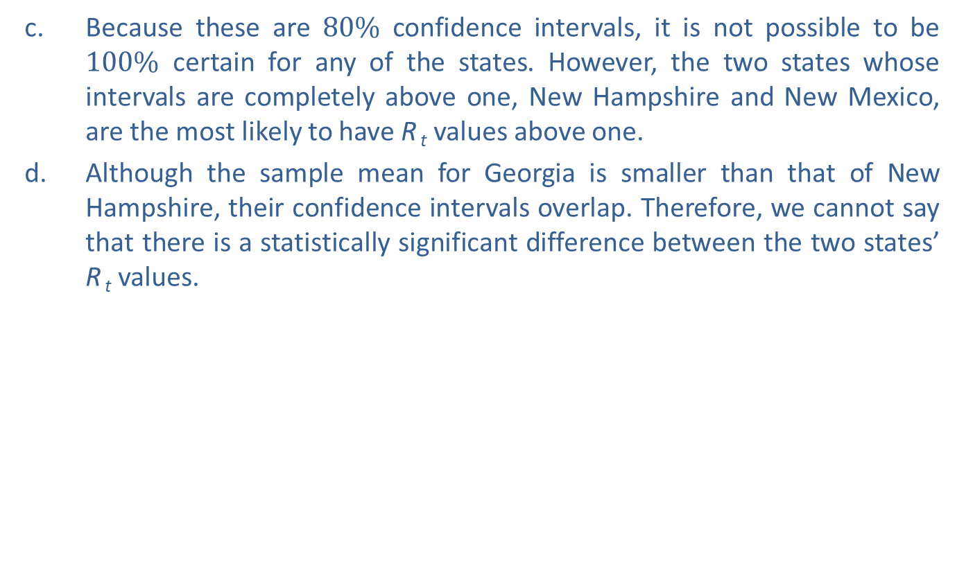
Example 2: Interpreting Confidence
Intervals—Slide 3
c. Because these are $80\%$ confidence intervals, it is not possible to be $100\%$ certain for any of the states. However, the two states whose intervals are completely above one, New Hampshire and New Mexico, are the most likely to have R _{t} values above one.
d. Although the sample mean for Georgia is smaller than that of New Hampshire, their confidence intervals overlap. Therefore, we cannot say that there is a statistically significant difference between the two states’ R _{t} values.
​

Slide 12
Definition: Margin of Error
The margin of error, or maximum error of estimate, E, is the largest possible distance from the point estimate that a confidence interval will cover.

Slide 13

Example 3: Constructing a Confidence Interval with a Given Margin of Error—Slide 1
Suppose we wish to estimate the mean systolic blood pressure in adults. A sample of 3534 participants had a sample mean of $127.3 mm Hg$ (millimeters of mercury) with a standard deviation of $19.0 mm Hg$. If the margin of error for the data using a $95\%$ level of confidence is E = 0.63, construct a $95\%$ confidence interval for the mean systolic blood pressure. Interpret your results.
Solution
To construct a confidence interval, we need the best point estimate for the population mean, which is the sample mean. So we will use
as the point estimate for this population parameter. Since we are given the value of the margin of error, we need to find the lower endpoint of the interval by subtracting E from the point estimate and the upper endpoint by adding E to the point estimate.

Slide 14

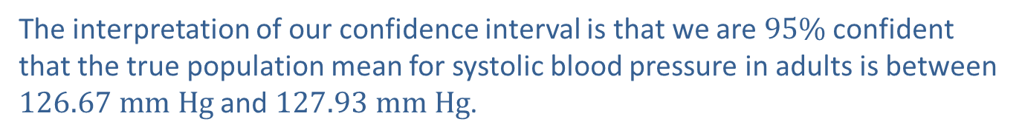
Example 3: Constructing a Confidence Interval with a Given Margin of Error—Slide 2
Therefore, the confidence interval ranges from $126.67 mm Hg$ to $127.93 mm Hg$. The confidence interval can be written mathematically using either inequality symbols or interval notation.
The interpretation of our confidence interval is that we are $95\%$ confident that the true population mean for systolic blood pressure in adults is between $126.67 mm Hg$ and $127.93 mm Hg$.

Slide 15

Skill Check 2
A sample of 3076 Americans 18 and older found that $29\%$ of participants were unmarried. Construct a $95\%$ confidence interval for the percentage of American adults who are unmarried if the margin of error is E = 1.8%.
Answer: (27.2%, 30.8%)

Slide 16
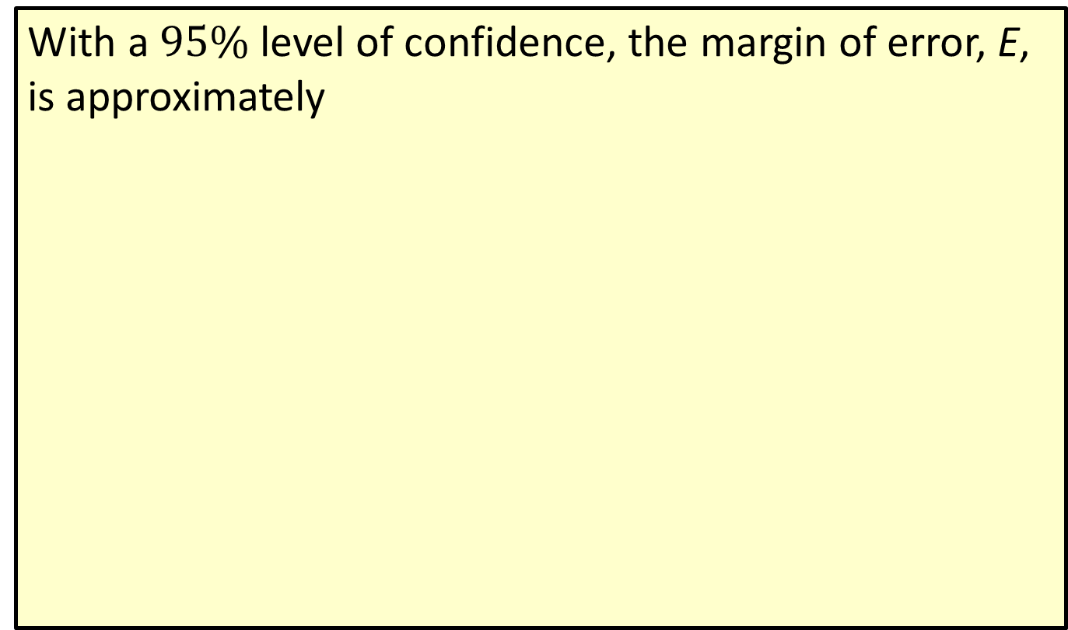
Formula: Rule of Thumb for Margin of Error in a Survey
With a $95\%$ level of confidence, the margin of error, E, is approximately
for a random sample of size n.

Slide 17
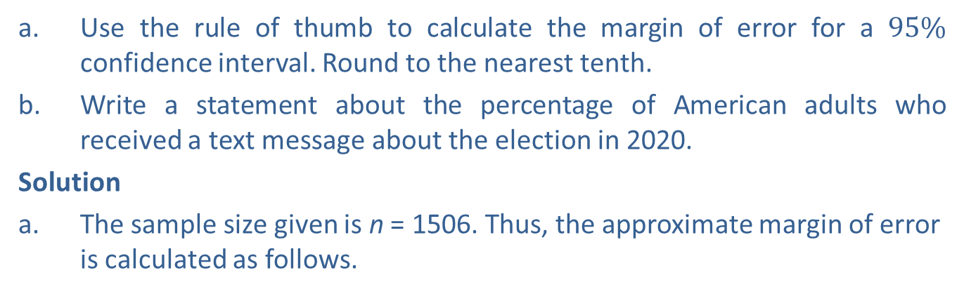
Example 4: Constructing a Confidence Interval for a Population Proportion—Slide 1
In a random sample of 1506 American adults in 2020,
of the adults
indicated that they received a text message about the upcoming presidential election.
a. Use the rule of thumb to calculate the margin of error for a $95\%$ confidence interval. Round to the nearest tenth.
b. ​Write a statement about the percentage of American adults who received a text message about the election in 2020.
Solution
a. ​The sample size given is n = 1506. Thus, the approximate margin of error is calculated as follows.

Slide 18
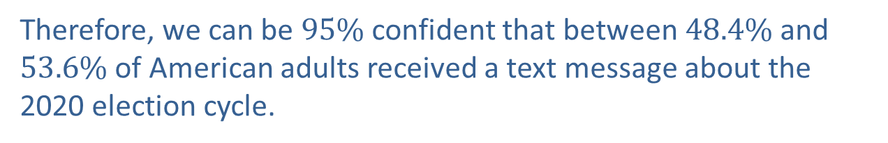
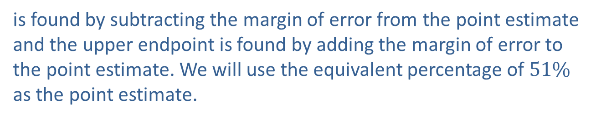
Example 4: Constructing a Confidence Interval for a Population Proportion—Slide 2
b. ​The best point estimate for a population proportion is a sample proportion,
Thus, we can use the sample proportion given,
to find the $95\%$ confidence interval. The lower endpoint
is found by subtracting the margin of error from the point estimate and the upper endpoint is found by adding the margin of error to the point estimate. We will use the equivalent percentage of $51\%$ as the point estimate.
​Therefore, we can be $95\%$ confident that between $48.4\%$ and $53.6\%$ of American adults received a text message about the 2020 election cycle.

Slide 19
Skill Check 3
A total of 937 university students were polled on their eating habits. Find the margin of error for this survey using the rule of thumb.
Answer: 3.3%

Slide 20
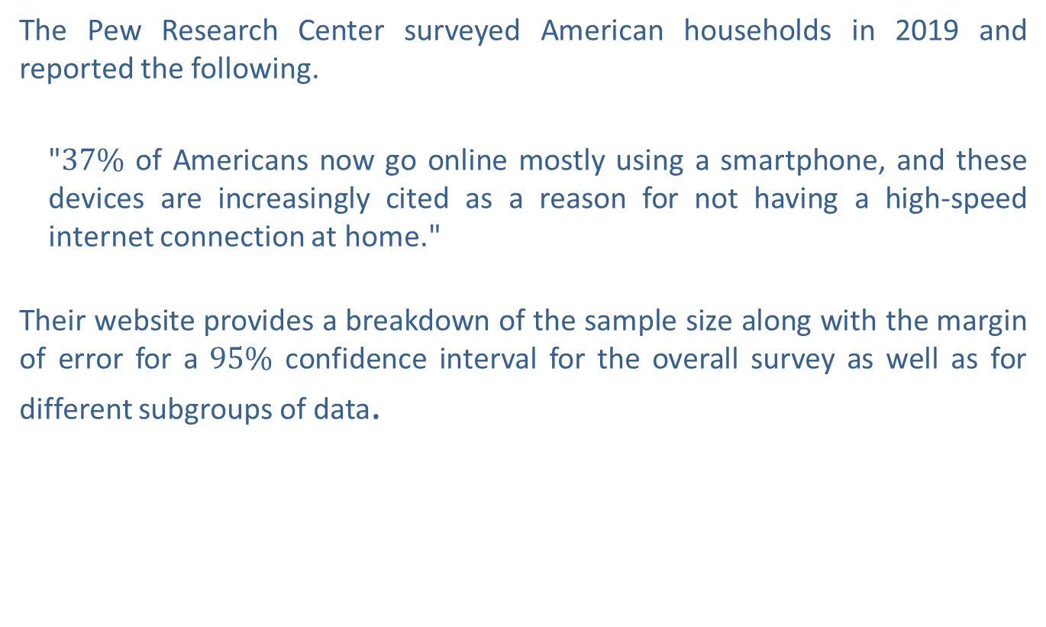
Example 5: Interpreting Margin of Error—Slide 1
The Pew Research Center surveyed American households in 2019 and reported the following.
"$37\%$ of Americans now go online mostly using a smartphone, and these devices are increasingly cited as a reason for not having a high-speed internet connection at home."
Their website provides a breakdown of the sample size along with the margin of error for a $95\%$ confidence interval for the overall survey as well as for different subgroups of data.

Slide 21
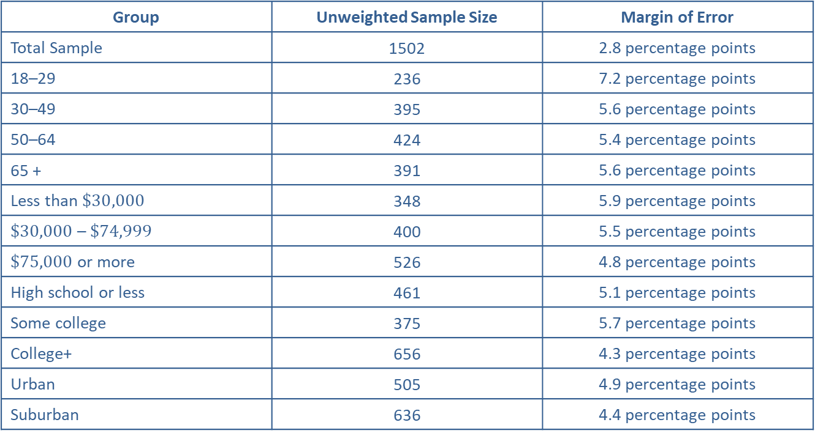
Example 5: Interpreting Margin of Error—Slide 2
Table 1: Sample Breakdown
Group | Unweighted Sample Size | Margin of Error
Total Sample | 1502 | 2.8 percentage points
18–29 | 236 | 7.2 percentage points
30–49 | 395 | 5.6 percentage points
50–64 | 424 | 5.4 percentage points
65 + | 391 | 5.6 percentage points
Less than $\$30,000$ | 348 | 5.9 percentage points
$\$30,000$ – $\$74,999$ | 400 | 5.5 percentage points
$\$75,000$ or more | 526 | 4.8 percentage points
High school or less | 461 | 5.1 percentage points
Some college | 375 | 5.7 percentage points
College+ | 656 | 4.3 percentage points
Urban | 505 | 4.9 percentage points
Suburban | 636 | 4.4 percentage points

Slide 22
Example 5: Interpreting Margin of Error—Slide 3
Table 1: Sample Breakdown
Group | Unweighted Sample Size | Margin of Error
Rural | 258 | 6.9 percentage points
Smartphone users | 1219 | 3.2 percentage points
Non-broadband users | 400 | 5.5 percentage points
Smartphone only internet users | 248 | 7.0 percentage points
Source: Monica Anderson, "Methodology," Pew Research Center, June 13, 2019, https://www.pewresearch.org/internet/2019/06/13/mobile-technology
-and-home-broadband-methodology/
a. Use the data in Table 1 to create a graph of the sample sizes of each category versus the margin of error percentage points. For each point (x, y), let x represent the sample size and y represent the margin of error.
b. ​Based on the graph from part a., what can you say about the margin of error compared with the sample size?
c. Is it possible to create confidence intervals for the population percentages in each category using the data from Table 1?

Slide 23
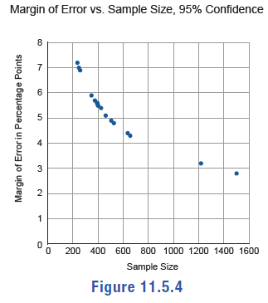
Example 5: Interpreting Margin of Error—Slide 4
Solution
​Using the data from Table 1, where x is the sample size and y is the margin of error, we can plot each point on the graph.
​
b. ​The graph shows us that as the sample size increases, the margin of error gets smaller. This means that with the same level of confidence we can create a tighter confidence interval, which gives a better approximation of the population parameter.
c. A confidence interval for a population parameter is constructed using a sample statistic and a margin of error. Since we are only given the margin of error and not the sample statistics, we do not have enough information to construct the confidence intervals.
Figure 4

Slide 24
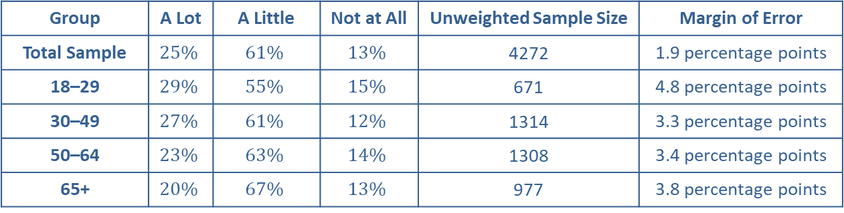
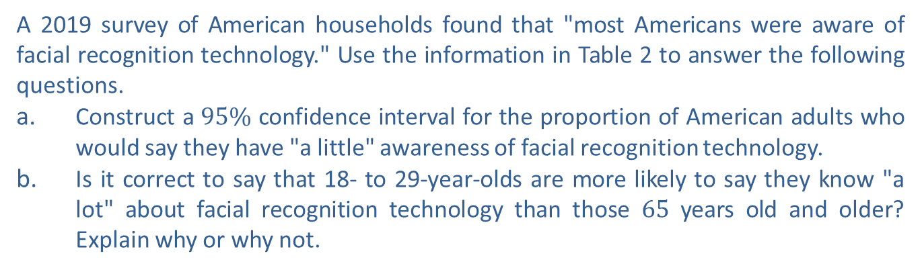
Example 6: Interpreting Margin of Error—Slide 1
A 2019 survey of American households found that "most Americans were aware of facial recognition technology." Use the information in Table 2 to answer the following questions.
a. Construct a $95\%$ confidence interval for the proportion of American adults who would say they have "a little" awareness of facial recognition technology.
b. Is it correct to say that 18- to 29-year-olds are more likely to say they know "a lot" about facial recognition technology than those 65 years old and older? Explain why or why not.
Table 2: Awareness of Facial Recognition Technology
Group | A Lot | A Little | Not at All | Unweighted Sample Size | Margin of Error
Total Sample | $$25\%$$ | $$61\%$$ | $$13\%$$ | 4272 | 1.9 percentage points
18–29 | $$29\%$$ | $$55\%$$ | $$15\%$$ | 671 | 4.8 percentage points
30–49 | $$27\%$$ | $$61\%$$ | $$12\%$$ | 1314 | 3.3 percentage points
50–64 | $$23\%$$ | $$63\%$$ | $$14\%$$ | 1308 | 3.4 percentage points
65+ | $$20\%$$ | $$67\%$$ | $$13\%$$ | 977 | 3.8 percentage points
Source: Aaron Smith, "More Than Half of U.S. Adults Trust Law Enforcement to Use Facial Recognition Responsibly," Pew Research Center, September 5, 2019, https://www.pewresearch.org/internet/2019/09/05/more-than-half-of-u-s-adults-trust-law-enforcement-to-use-facial-recognition-responsibly/

Slide 25
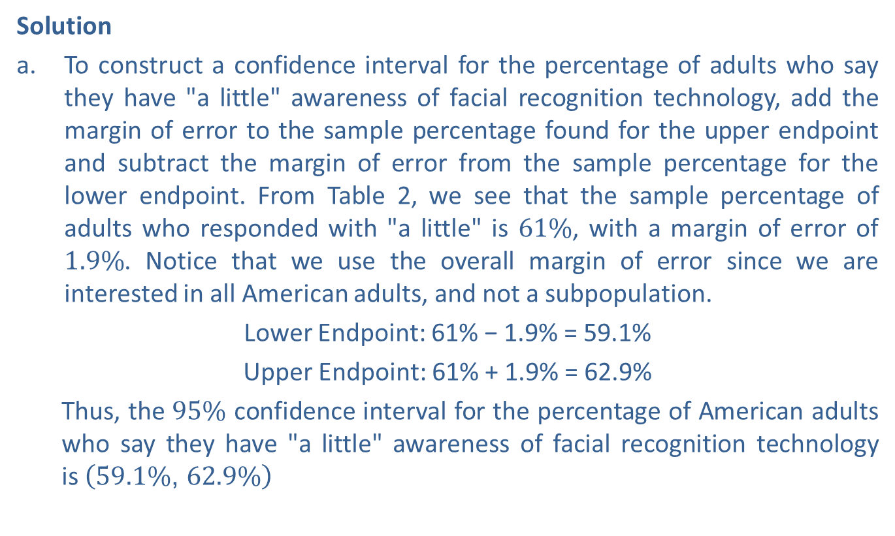
Example 6: Interpreting Margin of Error—Slide 2
Solution
a. ​To construct a confidence interval for the percentage of adults who say they have "a little" awareness of facial recognition technology, add the margin of error to the sample percentage found for the upper endpoint and subtract the margin of error from the sample percentage for the lower endpoint. From Table 2, we see that the sample percentage of adults who responded with "a little" is $61\%$, with a margin of error of $1.9\%$. Notice that we use the overall margin of error since we are interested in all American adults, and not a subpopulation.
​Lower Endpoint: 61% − 1.9% = 59.1%
​Upper Endpoint: 61% + 1.9% = 62.9%
  Thus, the $95\%$ confidence interval for the percentage of American adults who say they have "a little" awareness of facial recognition technology is$\left(59.1\%\text{, }62.9\%\right)$

Slide 26
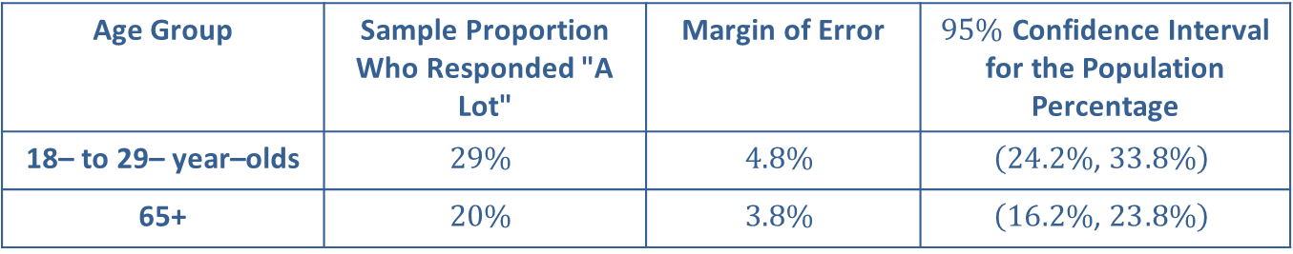

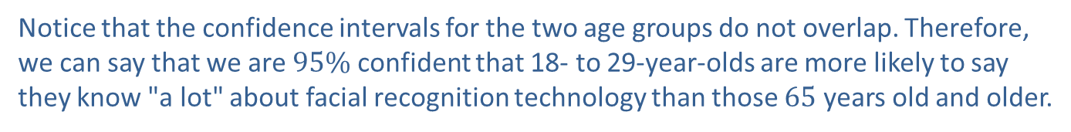
Example 6: Interpreting Margin of Error—Slide 3
b. To establish if there is a statistical difference between the two subgroups, we can look at the confidence intervals for each of them and determine if the intervals overlap. If they do overlap, we cannot say that there is a statistical difference between the two. If they do not overlap, we can be $95\%$ confident that one population parameter is different than the other. Begin by constructing the confidence intervals in the same manner as in part a., using the margin of errors given for each subpopulation.
Table 3
Age Group | Sample Proportion Who Responded "A Lot" | Margin of Error | $95\%$ Confidence Interval for the Population Percentage
18– to 29– year–olds | $$29\%$$ | $$4.8\%$$ | $$\left(24.2\%\text{, }33.8\%\right)$$
65+ | $$20\%$$ | $$3.8\%$$ | $$\left(16.2\%\text{, }23.8\%\right)$$
Notice that the confidence intervals for the two age groups do not overlap. Therefore, we can say that we are $95\%$ confident that 18- to 29-year-olds are more likely to say they know "a lot" about facial recognition technology than those 65 years old and older.

