Slide 1
Chapter 11
Review

Slide 2
Definition: Statistics
Statistics is the science of gathering, describing, and analyzing data.
or
Statistics is the actual numerical description of sample data.

Slide 3
Definition: Population, Variables, and Data
Population
A population is the particular group of interest in a statistical study.
Variable
A variable is a value or characteristic that changes among members of the population.
Data
Data are the counts, measurements, or observations gathered about a specific variable in a population in order to study it.

Slide 4
Definition: Representative Sample and Bias
Representative Sample
A representative sample is one that has the same relevant characteristics as the population and does not favor one group of the population over another.
Bias
A bias is a favoring of a certain outcome in a study.

Slide 5
Definition: Terms Related to Populations and Subsets
Census
A census is a study involving data obtained from every member of the population.
Parameter
A parameter is the numerical description of a particular population characteristic.
Sample
A sample is a subset of a population from which data are collected in a statistical study.
Sample Statistic
A sample statistic is the numerical description of a particular sample characteristic.

Slide 6
Definition: Observational Study and Experiment
Observational Study
An observational study observes existing data.
Experiment
An experiment generates data to help identify cause-and-effect relationships.

Slide 7
Definition: Parts of an Experiment
Treatment
A treatment is a certain condition that is applied to a group of subjects in an experiment.
Subjects
Subjects are the people or things being studied in an experiment.
Participants
Subjects in an experiment that consist solely of people are participants.
Response Variable
The response variable is the variable in an experiment that measures any response to the treatment.
Explanatory Variable
The explanatory variable is the variable in an experiment that causes the change in the response variable.

Slide 8
Definition: Terms Related to Experiments—Slide 1
Control Group
A control group is a group of subjects to which no treatment is applied in an experiment.
Treatment Group
A treatment group is a group of subjects that researchers apply a treatment to in an experiment.
Confounding Variables
Factors other than the treatment that cause an effect on the subjects of an experiment are called confounding variables.
Placebo Effect
The placebo effect is a response to the power of suggestion, rather than the treatment itself, by participants of an experiment.

Slide 9
Definition: Terms Related to Experiments—Slide 2
Placebo
A placebo is a substance that appears identical to the actual treatment but contains no intrinsic beneficial elements.
Single-Blind
In a single-blind experiment, subjects do not know if they are in the control group or the treatment group, but the people interacting with the subjects in the experiment know which group each subject has been placed in.
Double-Blind
In a double-blind experiment, neither the subjects not the people interacting with the subjects know group each subject belongs to.

Slide 10
Procedure: Conducting a Statistical Study
1. ​Design the study.
  a. State the question to be studied.
  b. Determine the population and variables.
  c. ​Determine the type of study: observational or experimental.
2. Collect the data.
3. Organize the data.
4. ​Analyze the data to answer the question.

Slide 11
Definition: Sampling Methods
Random Sampling – Every member of the population has an equal chance of being selected.
Stratified Sampling (Quota Sampling) – A few members from each stratum (or group) are randomly chosen.
Cluster Sampling – All members from a few randomly chosen clusters (or groups) are selected.
Systematic Sampling – Every n ^{th} member of the population is chosen.
Convenience Sampling – The sample is chosen because it is convenient for the researcher.

Slide 12
Procedure: Principles of Experimental Design
1. ​Randomize the control and treatment groups.
2. Control for outside effects on the response variable.
3. Replicate the experiment a significant number of times to see meaningful patterns.

Slide 13
Definition: Frequency Distribution, Class, and Relative Frequency
Frequency Distribution
A frequency distribution is a display of the values that occur in a data set and how often each value, or range of values, occurs.
Class
In a frequency distribution, a class is a category of data.
Relative Frequency
The relative frequency is the percentage of the data set that falls into a particular class.
Here, f is the class frequency and n is the total number of members in the data set.

Slide 14
Definition: Grouped Frequency Distributions
Grouped Frequency Distribution
A frequency distribution in which each category represents a range of values is call a grouped frequency distribution.
Class Width
The class width is the difference between the lower limits or upper limits of two consecutive classes of a frequency distribution.
Lower Class Limit
The lower class limit is the smallest number that can belong to a particular class.
Upper Class Limit
The upper class limit is the largest number that can belong to a particular class.

Slide 15
Definition: Graph and Legend
Graph
A graph is a picture of the data that allows us to view patterns at a glance.
Legend
A legend is a description of how each data category is identified in a graph.

Slide 16
Definition: Pie Chart
A pie chart is a circular graph that depicts parts of a whole and shows the size of each category of data in relation to the whole.

Slide 17
Definition: Bar Graph
A bar graph is a graph that uses bars to represents the amount of data in each category.

Slide 18
Definition: Frequency Histogram
A frequency histogram is a bar graph displaying a frequency distribution where the horizontal axis is a number line. The height of each bar represents the frequency of each class.

Slide 19
Definition: Line Graph
A line graph is a graph that uses points to represent data values at a particular time in history and then joins the points with line segments. Line graphs display changes in a variable over time.

Slide 20
Procedure: Constructing a Frequency Distribution—Slide 1
1. Decide on the number of classes for the distribution. There are typically between 5 and 20 classes. Having too many class divisions does not add any value over simply listing every data point and can be overwhelming. Having too few class divisions results in the data being lumped together and lacks detail.
2. ​Choose an appropriate class width. In some cases, the data set lends itself to natural divisions, such as decades or years. In other cases, you need to choose an appropriate class width so that the classes formed present a clear representation of the data and include all members of the data set. One method of finding the class width is to subtract the lowest number in the data set from the highest number and divide the difference by the number of classes.

Slide 21
Procedure: Constructing a Frequency Distribution—Slide 2
3. ​Find the class limits. Begin by determining the lower class limit of the first class. You should choose the first lower limit so that reasonable classes will be produced. Using the minimum data value is a good place to start.
4. ​Determine the frequency of each class. Make a tally mark for each data value in the appropriate class. Count the marks to find the total frequency for each class.

Slide 22
Definition: Outliers and Skewed Data Sets
Outlier
An outlier is a data value that is extreme compared with the rest of the data values in the set.
Skewed to the Right
A graph's shape is skewed to the right when a majority of the data fall on the left side of the distribution.
Skewed to the Left
A graph's shape is skewed to the left when a majority of the data fall on the right side of the distribution.

Slide 23
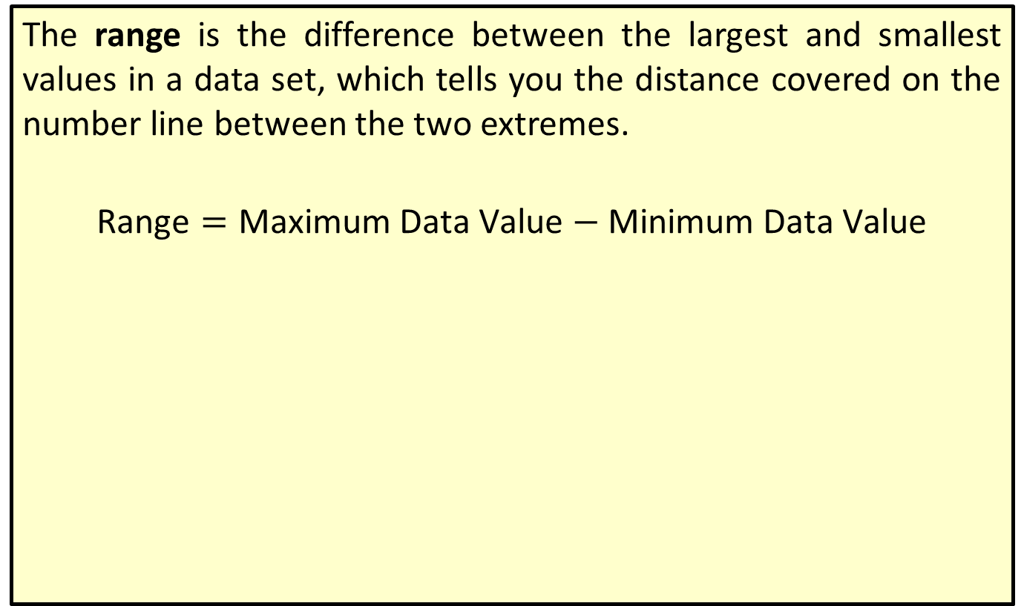
Definition: Range
The range is the difference between the largest and smallest values in a data set, which tells you the distance covered on the number line between the two extremes.
$$\text{Range}=\text{Maximum} \text{Data} \text{Value}−\text{Minimum} \text{Data} \text{Value}$$

Slide 24
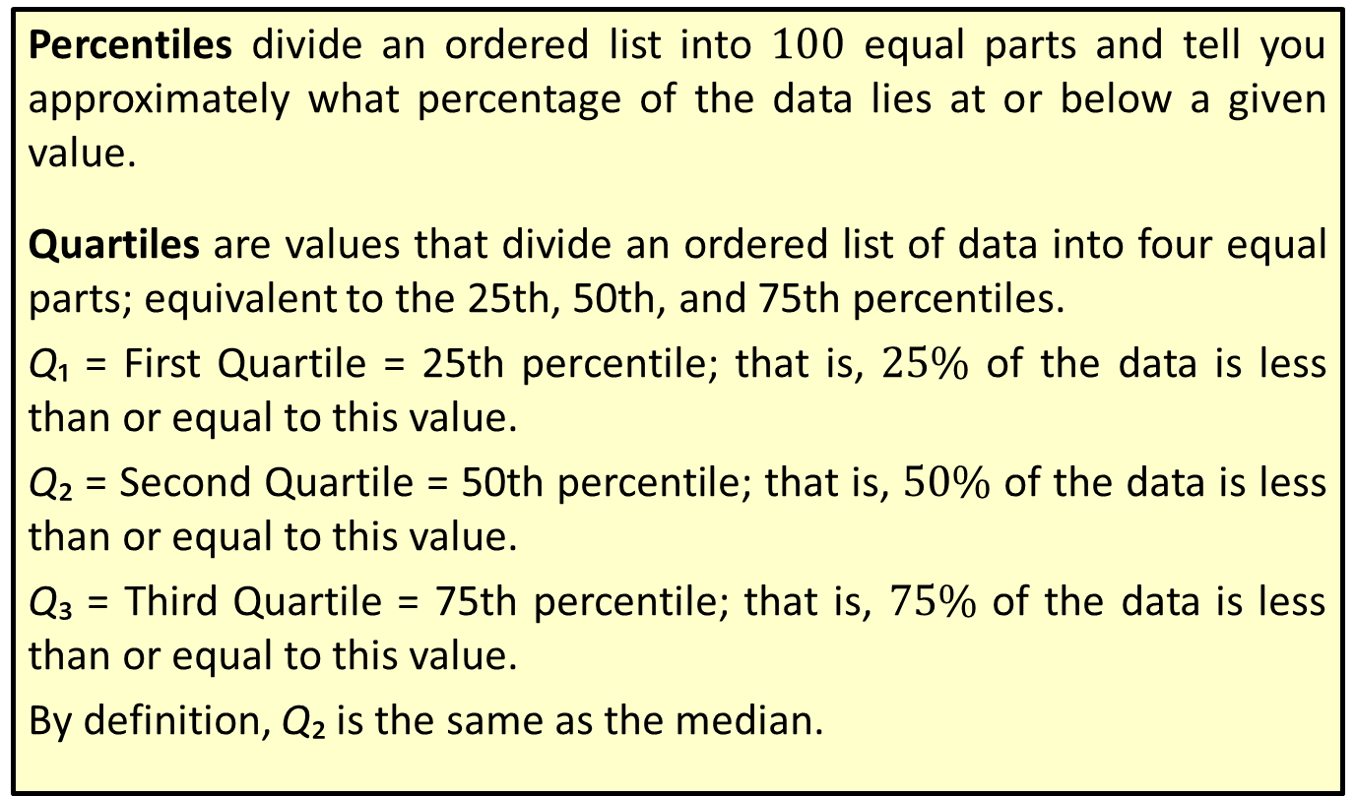
Definition: Percentiles and Quartiles
Percentiles divide an ordered list into 100 equal parts and tell you approximately what percentage of the data lies at or below a given value.
Quartiles are values that divide an ordered list of data into four equal parts; equivalent to the 25th, 50th, and 75th percentiles.
Q₁ = First Quartile = 25th percentile; that is, $25\%$ of the data is less than or equal to this value.
Q₂ = Second Quartile = 50th percentile; that is, $50\%$ of the data is less than or equal to this value.
Q₃ = Third Quartile = 75th percentile; that is, $75\%$ of the data is less than or equal to this value.
By definition, Q₂ is the same as the median.

Slide 25
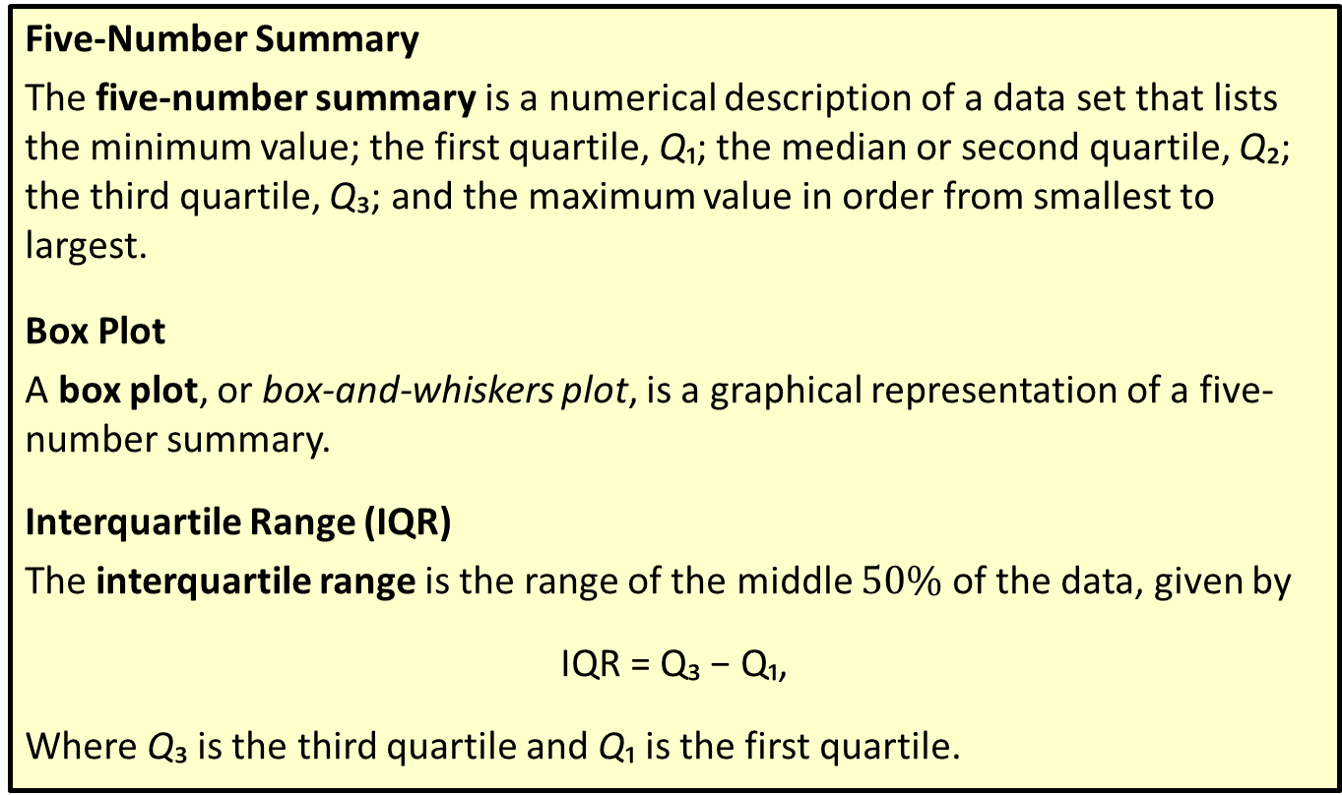
Definition: Five-Number Summary and Box Plots
Five-Number Summary
The five-number summary is a numerical description of a data set that lists the minimum value; the first quartile, Q₁; the median or second quartile, Q₂; the third quartile, Q₃; and the maximum value in order from smallest to largest.
Box Plot
A box plot, or box-and-whiskers plot, is a graphical representation of a five-number summary.
Interquartile Range (IQR)
The interquartile range is the range of the middle $50\%$ of the data, given by
IQR = Q₃ − Q₁,
Where Q₃ is the third quartile and Q₁ is the first quartile.

Slide 26
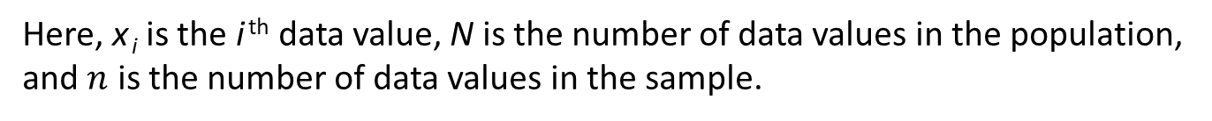
Formula: Arithmetic Mean
The arithmetic mean, or mean, is the sum of all of the data points divided by the number of data points. Formally, the formula for population mean µ is as follows.
The formula for the sample mean
Here, x _{i} is the i ^{th} data value, N is the number of data values in the population, and $n$ is the number of data values in the sample.

Slide 27

Definition: Standard Deviation
The standard deviation is a measure of how much we might expect a member of the data set to differ from the mean.
The formula for finding the population standard deviation $σ$ is as follows.
Here, x _{i} is the i ^{th} data value, µ is the population mean, and N is the size of the population. The formula for finding the sample standard deviation s is as follows.
Here, x _{i} is the i ^{th} data value,
is the sample mean, and n is the sample size.

Slide 28
Definition: Mode
The mode of a data set is the value that occurs most frequently.
No mode describes a data set in which all of the data values occur only once, or each value occurs an equal number of times.
Unimodal describes a data set in which only one data value occurs most often.
Bimodal describes a data set in which exactly two data values occur equally often and more than any other data value.
Multimodal describes a data set in which more than two data values occur equally often and more than any other data value.

Slide 29
Definition: Median
The median of a data set is the middle value in an ordered list of the data. To find the median, follow the following steps.
1. ​List the data in ascending or descending order.
2. ​If the data set contains an odd number of values, the median is the middle value in the ordered list.
3. ​If the data set contains an even number of values, the median is the arithmetic mean of the two middle values in the ordered list. Notice that this implies that the median might not be a value in the data set.

Slide 30
Procedure: Creating a Box Plot
1. ​Draw a horizontal (or vertical) number line that contains the five-number summary.
2. Draw a small line segment above (or next to) the number line to represent each of the numbers in the five-number summary.
3. Connect the line segment that represents the first quartile to the line segment representing the third quartile, forming a box with the median's line segment in between.
4. ​Connect the "box" to the line segments representing the minimum and maximum values to form the "whiskers."

Slide 31
Definition: Discrete and Continuous Variables
Discrete Variable
A discrete variable is a variable whose numeric value can only take on particular values and is usually a count.
Continuous Variable
A continuous variable is a variable whose numeric value can take on any value in a given interval and is usually a measurement.

Slide 32

Definition: Standard Score ($z$-Score)
A standard score, or z-score, is the number of standard deviations a particular data value lies away from the mean in a normal distribution.
The standard score for a population value is given by
where x is the value of interest from the population, µ is the population mean, and σ is the population standard deviation.
The standard score for a sample value is given by
where x is the value of interest from the sample,
is the sample mean, and s
is the sample standard deviation.

Slide 33
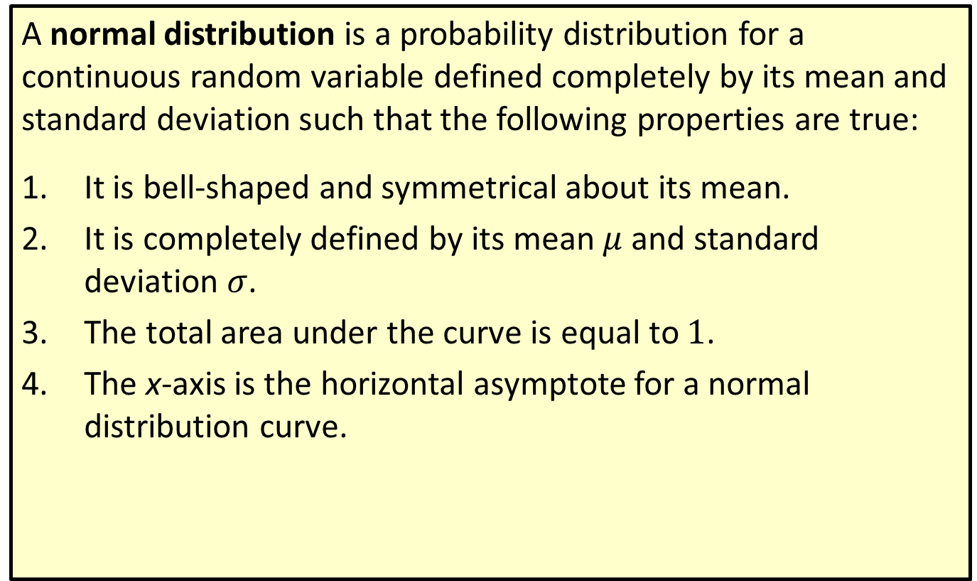
Definition: Normal Distribution—Slide 1
A normal distribution is a probability distribution for a continuous random variable defined completely by its mean and standard deviation such that the following properties are true:
1. ​It is bell-shaped and symmetrical about its mean.
2. It is completely defined by its mean $μ$ and standard deviation $σ$.
3. The total area under the curve is equal to 1.
4. The x-axis is the horizontal asymptote for a normal distribution curve.

Slide 34
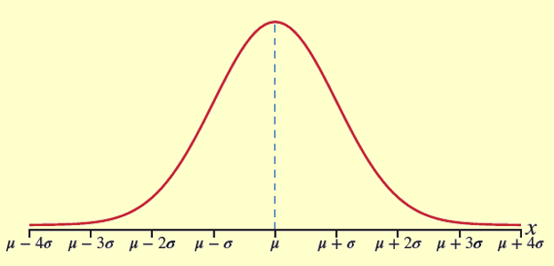
Definition: Normal Distribution—Slide 2
Figure 2

Slide 35
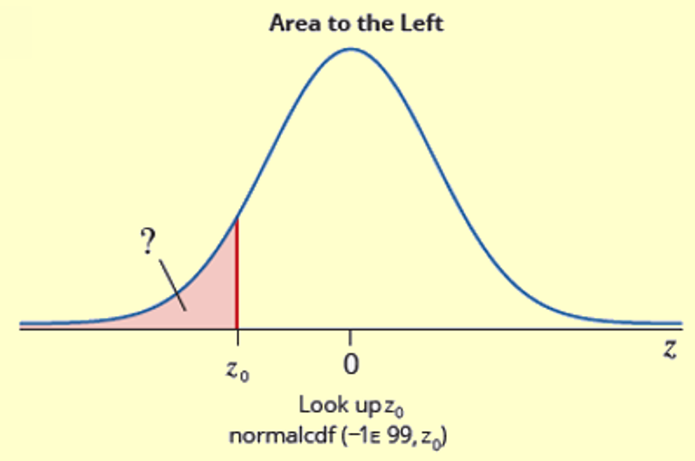
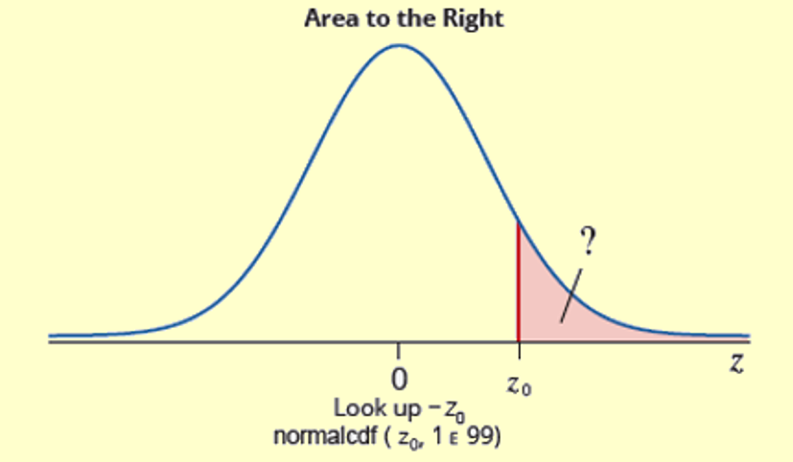
Procedure: Using the Cumulative Normal Distribution Tables to Find Areas under the Standard Normal Curve—Slide 1

Slide 36
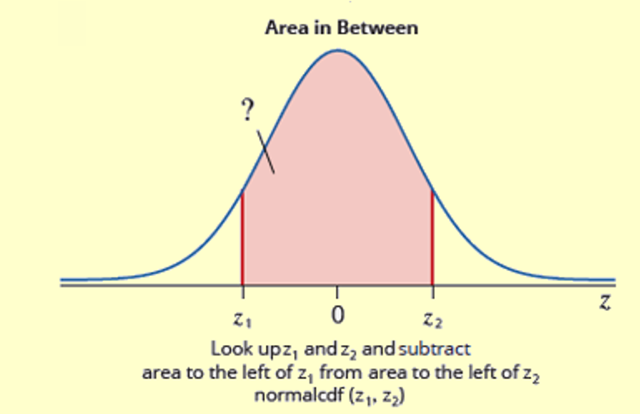
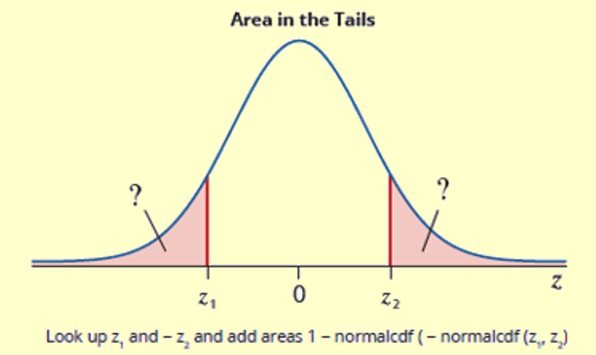
Procedure: Using the Cumulative Normal Distribution Tables to Find Areas under the Standard Normal Curve—Slide 2
Figure 33

Slide 37
Definition: Inferential Statistics
The branch of inferential statistics, as a science, involves using descriptive statistics to estimate population parameters.

Slide 38
Definition: Point Estimate
A point estimate is a single-number estimate of a population parameter.

Slide 39
Definition: Confidence Intervals
Interval Estimate
An interval estimate is a range of possible values for a population parameter.
Level of Confidence
The level of confidence, denoted by c, is the percentage of all possible samples of a given size that will produce interval estimates that contain the actual parameter.
Confidence Interval
A confidence interval is an interval estimate associated with a certain level of confidence.

Slide 40
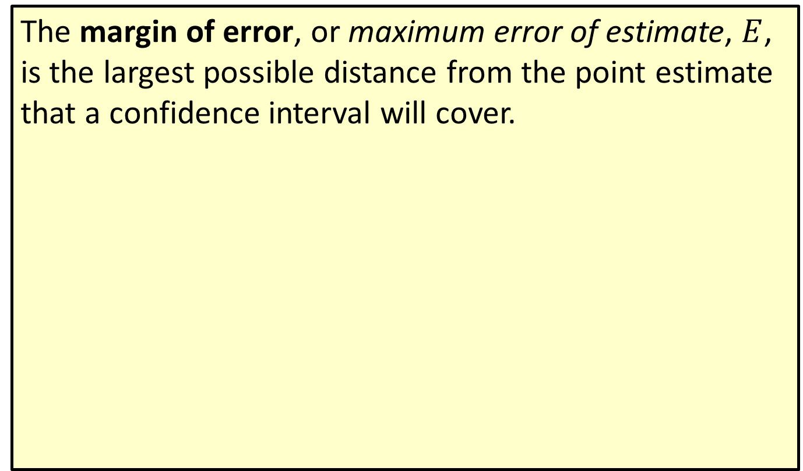
Definition: Margin of Error
The margin of error, or maximum error of estimate, $E$, is the largest possible distance from the point estimate that a confidence interval will cover.

Slide 41
Formula: Rule of Thumb for Margin of Error in a Survey
With a $95\%$ level of confidence, the margin of error, E, is approximately
for a random sample of size n.

