Slide 1
Section 12.2
Data Wrangling

Slide 2
Definition: Data Wrangling
Data wrangling, or data munging, is the process of acquiring raw data, cleaning it, organizing it, and transforming it so that the data is user-friendly.

Slide 3
Example 1: Importing a CSV file into Microsoft—Slide 1
Figure 3 shows a sample of raw data containing information from a police department regarding traffic accidents. When you click on the CSV link on the county's website, the data is displayed in the following format. Import the data into Microsoft Excel, separating each detail into its own column. (The full data set is available for download from math.hawkeslearning.com.)

Slide 4
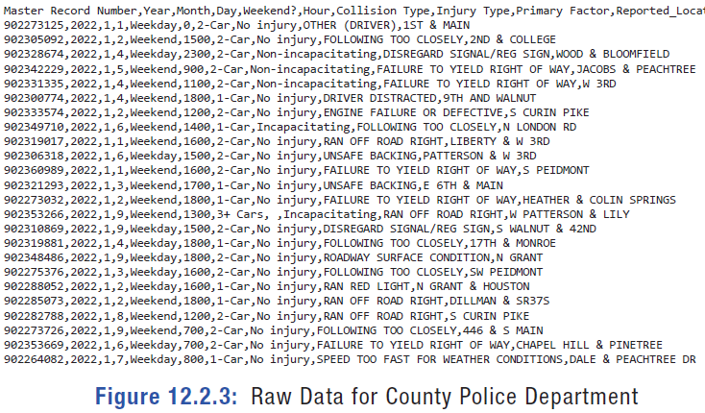
Example 1: Importing a CSV file into Microsoft—Slide 2
Figure 3: Raw Data for County Police Department

Slide 5
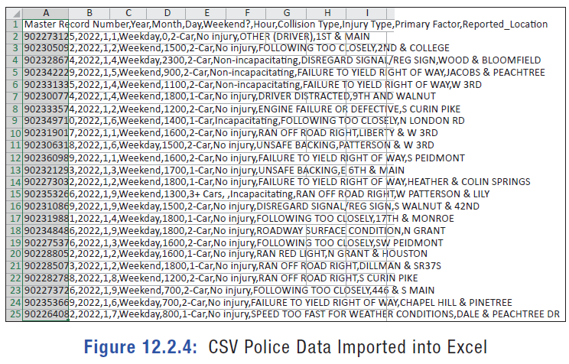
Example 1: Importing a CSV file into Microsoft—Slide 3
Solution
We know that the data appears in comma-separated form since we downloaded a CSV file. To put it in a usable format, we need to copy the data and paste it in cell A1 of a new Excel spreadsheet.
Figure 4: CSV Police Data Imported into Excel

Slide 6
Example 1: Importing a CSV file into Microsoft—Slide 4
Notice that although the lines of characters appear to run across multiple columns, the data is actually all in the first cell of each row. We need to distribute the data into columns.
First, select the cells that you wish to distribute. Then, under the Data menu, click Text to Columns. In the pop-up window that appears, select Delimited and then click Next.

Slide 7
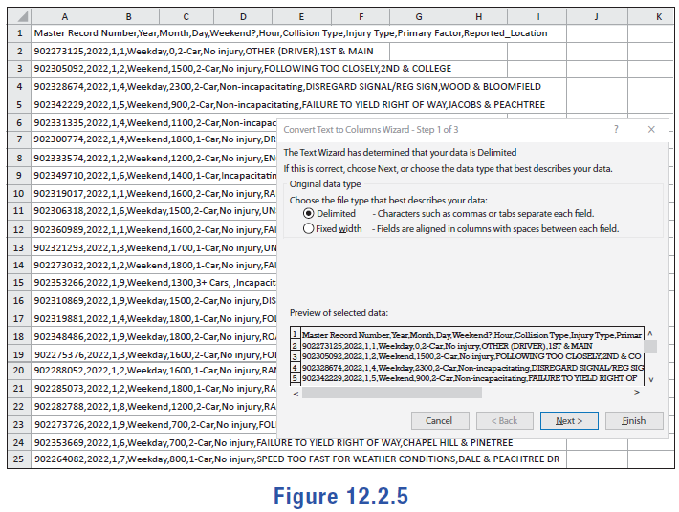
Example 1: Importing a CSV file into Microsoft—Slide 5
Figure 5

Slide 8
Example 1: Importing a CSV file into Microsoft—Slide 6
In the window that appears, check the box next to Comma as the delimiter and make sure all other boxes are unchecked. (Note: if your data file used a different separator character, a different character would be selected as the delimiter.) Click Next again. If you need the data to appear in specific columns, adjust the Destination field; we will keep this as it is. Click Finish. The spreadsheet then appears as shown in Figure 6.

Slide 9
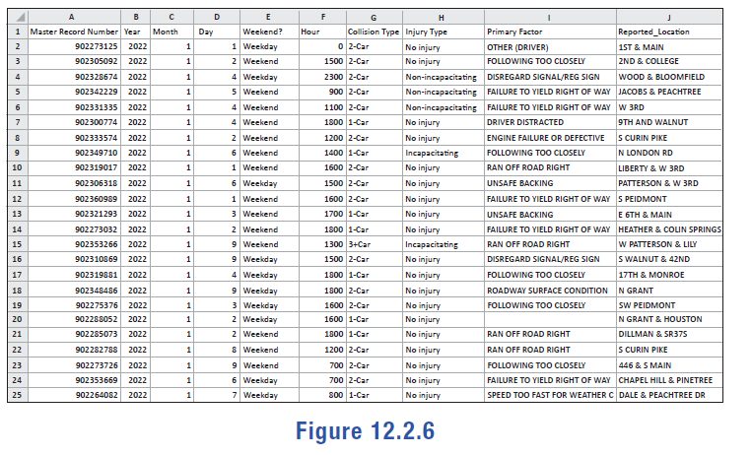
Example 1: Importing a CSV file into Microsoft—Slide 7
Figure 6

Slide 10
Example 1: Importing a CSV file into Microsoft—Slide 8
One important feature to note is that the Text to Columns option in Excel deletes the delimiter character once it separates the data. Notice that the commas are no longer part of the traffic data in the spreadsheet.

Slide 11
Tech Tip 1
When using Text to Columns, the original data will be overwritten if the Destination field contains the column with the original data, but this is typically okay because you will not need the original data once it has been split into columns.

Slide 12
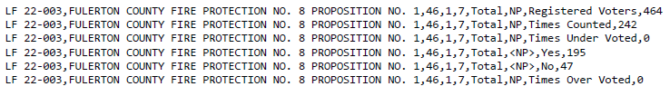
Skill Check 1
Determine how many columns Excel will use to distribute the following when the Text to Columns feature is used.
Figure 7
Answer: 9 Columns

Slide 13
Definition: Text String
A text string, or string, is a group of characters used as data.

Slide 14
Example 2: Eliminating Spaces in Excel—Slide 1
The text from Alice's Adventures in Wonderland by Lewis Carroll has been loaded into an Excel file in column A. Clean up the table of contents by removing any extra spaces in lines 46 through 57. (The full data set is available for download from math.hawkeslearning.com in Microsoft Excel format.)

Slide 15
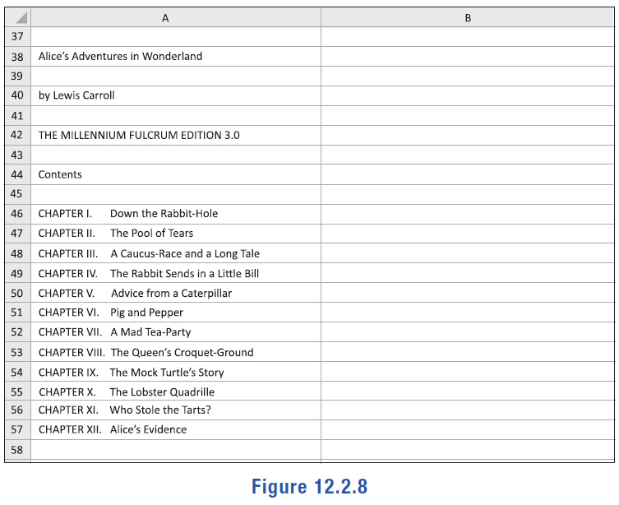
Example 2: Eliminating Spaces in Excel—Slide 2
Figure 8

Slide 16
Example 2: Eliminating Spaces in Excel—Slide 3
Solution
We can remove all extra spaces in a cell by using the TRIM([text]) function. The text argument can be either the actual text to be trimmed or a cell reference to the text you want trimmed.
We will place the trimmed table of contents in column B. In cell B46, type "=TRIM(A46)" and then press Enter. The contents in cell B46 will be the chapter title with only single spaces between words.

Slide 17
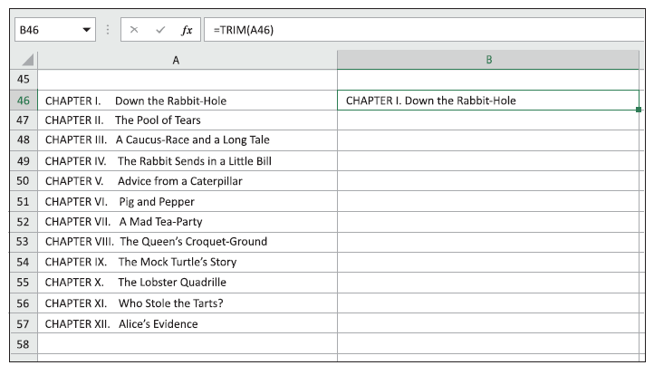
Example 2: Eliminating Spaces in Excel—Slide 4
Figure 9

Slide 18
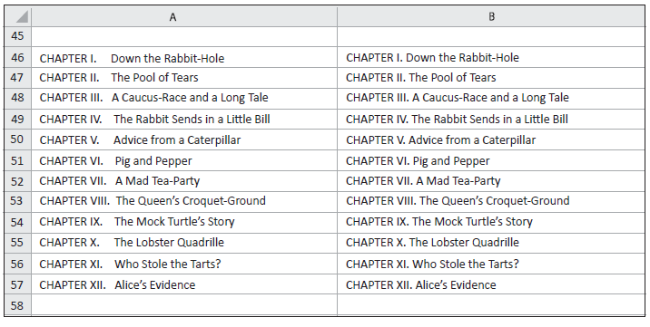
Example 2: Eliminating Spaces in Excel—Slide 5
Next, drag the corner of cell B46 down to copy the formula to trim the extra spaces from the remaining titles. The resulting cleaned up table of contents is shown in Figure 10.
Figure 10

Slide 19
Example 3: Eliminating Blank Cells or Rows in Excel—Slide 6
A sample of employment data from the human resource department is found in the spreadsheet shown in Figure 11 (The full data set is available for download from math.hawkeslearning.com in Microsoft Excel format.)

Slide 20
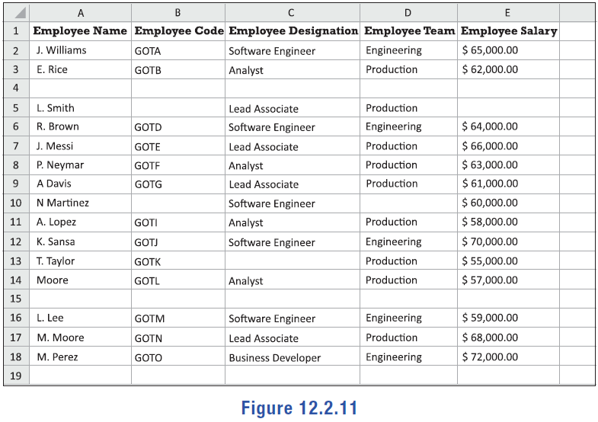
Example 3: Eliminating Blank Cells or Rows in Excel—Slide 7
Figure 11

Slide 21
Example 3: Eliminating Blank Cells or Rows in Excel—Slide 8
Clean up the data set using the following steps.
a.​ Delete empty rows.
b.​ Use the Find and Replace tool to enter "Not Available" in each cell that is missing a data entry.
Solution
a.​ Before deleting any rows, we will begin by numbering the data entries so that we can return to this initial ordering of the data at any point in the wrangling phase. First add a new column to the left of the Employee Name by right-clicking on the column heading A and select "insert" from the menu. In the empty first column, enter the numbers 1 through 17, starting in the second row, next to the first employee's name.

Slide 22
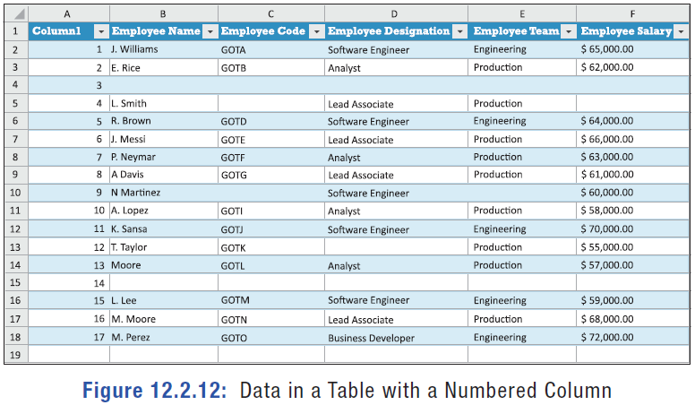
Example 3: Eliminating Blank Cells or Rows in Excel—Slide 9
Next, we will format our data as a table so we can more easily sort it. Select all of the data, starting with the top of new column A and going to the last row of the last column. Click on the Insert tab and select Table. Since your data already includes headers in the first row, make sure that the box for "My table has headers" is checked. Click OK.
​
Figure 12

Slide 23
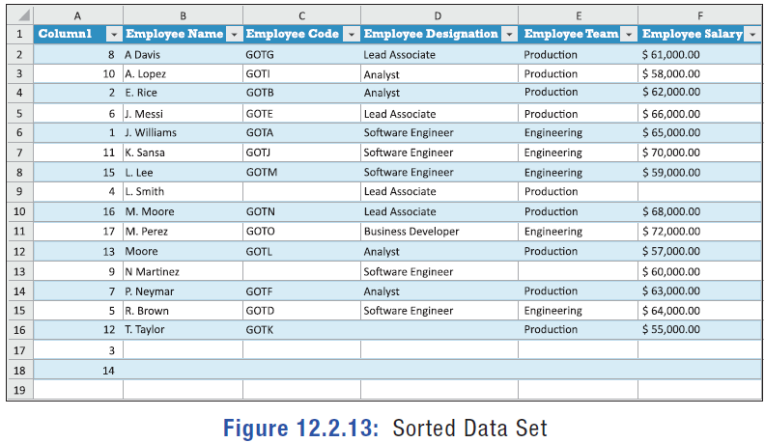
Example 3: Eliminating Blank Cells or Rows in Excel—Slide 10
Next, click the drop-down arrow next to "Employee Name" and select "Sort A to Z." Once sorted, the empty cells in this column will appear at the bottom of the data set.
​
Figure 13: Sorted Data Set

Slide 24
Example 3: Eliminating Blank Cells or Rows in Excel—Slide 11
You will notice that sorting this way has moved the empty rows to the bottom of the data set. Select the empty the rows, right-click anywhere in the selected region, and click Delete. Because we sorted the second column alphabetically, the rows of data are no longer in their original order. If the data needs to be sorted in the original order, you can select the drop-down arrow in our numbering Column1 and select "Sort smallest to largest."
​

Slide 25
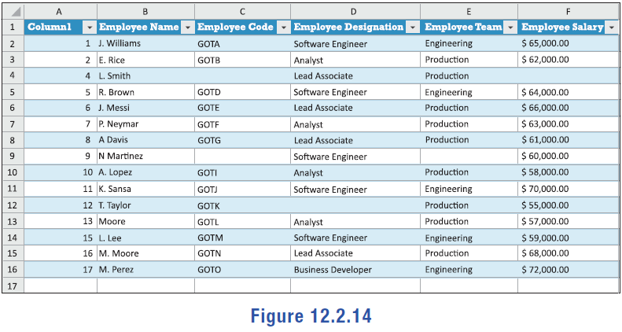
Example 3: Eliminating Blank Cells or Rows in Excel—Slide 12
Figure 14

Slide 26
Example 3: Eliminating Blank Cells or Rows in Excel—Slide 13
b.​ To fill in the remaining empty cells, we will use the Find and Replace tool. First, select the entire table to tell Excel where to look. On the Home tab, in the Editing section, click the Find & Select button. From the drop-down menu, choose Replace…. In the window that appears, leave the "Find what:" field empty and in the "Replace with:" field, type "Not Available", and click Replace All. A new window will appear telling you how many replacements were made. Click OK in that window and click Close in the Find and Replace window.

Slide 27
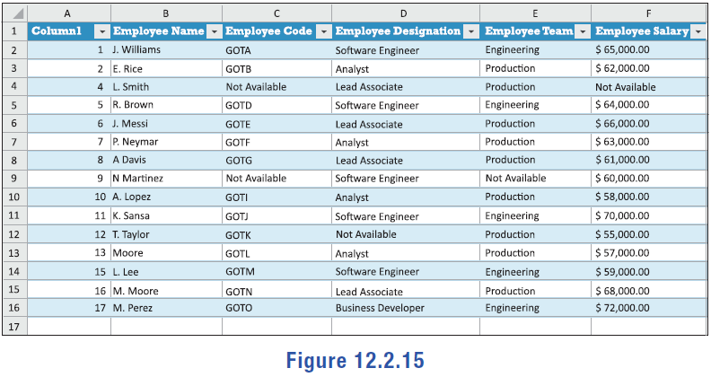
Example 3: Eliminating Blank Cells or Rows in Excel—Slide 14
Figure 15

Slide 28
Tech Tip 2
When inserting new columns in an excel spreadsheet, the new columns will always be inserted to the left. In this case, the new column to the left of column A becomes the new column A, while the existing column A becomes column B.

Slide 29
Example 4: Formatting Data—Slide 1
Lauren started a book club and asked members to send their contact information so she could start a group chat. Figure 16 is a list of the phone numbers in their original format. Use Excel's Find and Replace tool to standardize each phone number so that they are all in the form XXX-XXX-XXXX. (The full data set is available for download from math.hawkeslearning.com in Microsoft Excel format.)

Slide 30
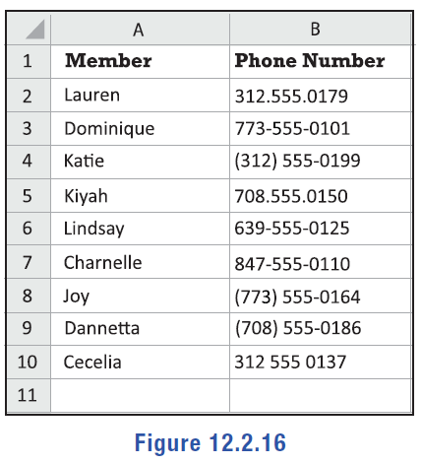
Example 4: Formatting Data—Slide 2
Figure 16

Slide 31
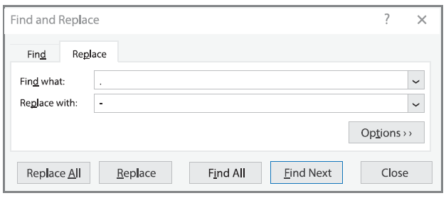
Example 4: Formatting Data—Slide 3
Solution
Notice that some of the phone numbers include parentheses, some have hyphens, and some use periods. First, we will replace any periods with a hyphen. Select all of the phone numbers. On the Home tab, in the Editing section, click the Find & Select button. Choose Replace… from the drop-down menu. In the window that appears, type a period in the "Find what:" field and type a hyphen in the "Replace with:" field. Then click Replace All.
Figure 17

Slide 32
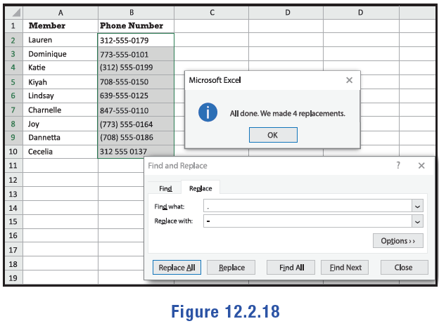
Example 4: Formatting Data—Slide 4
A pop up will appear alerting you that four replacements were made.
Figure 18

Slide 33
Example 4: Formatting Data—Slide 5
Next, we will fix the phone numbers that have parentheses around the area code. Since the area codes vary, we will have to use Replace twice: once for the opening parenthesis and once for the closing parenthesis.
Once again, open the Find and Replace tool. In the "Find what:" field, type an opening parenthesis. This time, the "Replace with:" field should be empty. Click Replace All. Repeat the same steps, this time with a closing parenthesis in the "Find what:" field.
Now we need to find any blank spaces between numbers and replace those spaces with hyphens. Using the Find and Replace tool once more, type a single space in the "Find what:" field and a hyphen in the "Replace with:" field. Click Replace All.

Slide 34
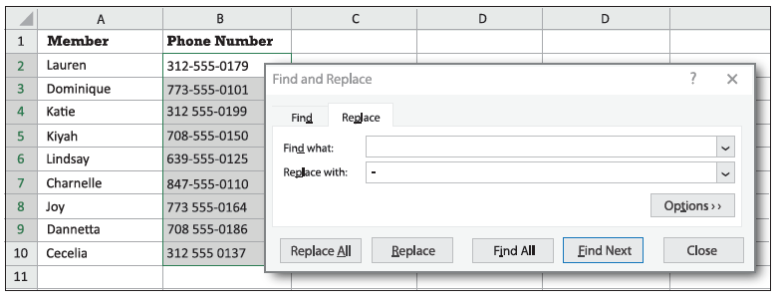
Example 4: Formatting Data—Slide 6
Figure 19

Slide 35
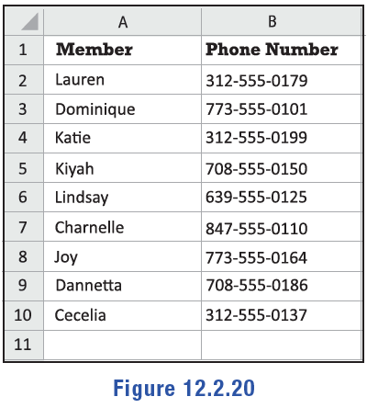
Example 4: Formatting Data—Slide 7
Now all of the phone numbers have the same format of XXX-XXX-XXXX.
Figure 20

Slide 36
Tech Tip 3
The keyboard shortcut ctrl + H brings up the Find and Replace tool in Excel.

Slide 37
Skill Check 2
Which of the following data will Excel find if you run the command "Find ?et" and select the "Match case" option?
bets
meet
pet
etc.
Answer : Pet

Slide 38
Example 5: Identifying Duplicates in Excel—Slide 1
The following is a sample of data from a website submission. Users were asked to submit information to enter for a chance to win a drawing. Users were only allowed to be entered in the drawing once. However, some users hit the submit button twice thinking the form had not actually submitted. (The full data set is available for download from math.hawkeslearning.com in Microsoft Excel format.)
a.​ Highlight any duplicates in the data to determine if duplicates should be removed.
b. ​Delete any duplicate entries in the data.

Slide 39
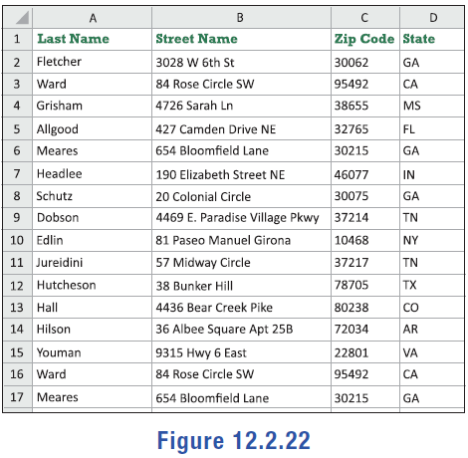
Example 5: Identifying Duplicates in Excel—Slide 2
Figure 22

Slide 40
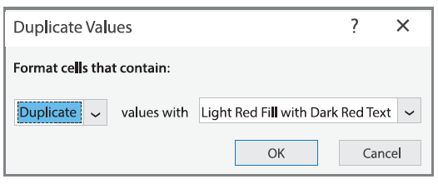
Example 5: Identifying Duplicates in Excel—Slide 3
Solution
a. ​To highlight any duplicates in the data, we will use Conditional Formatting. First, select the data. On the Home tab, click Conditional Formatting. In the drop-down menu, under Highlight Cell Rules, choose Duplicate Values. A pop-up window will appear. Choose Duplicate for the first drop-down menu. For the second drop-down menu, you can choose your preferred option, but "Light Red Fill with Dark Red Text" is the standard choice. Click OK.
​
Figure 23

Slide 41
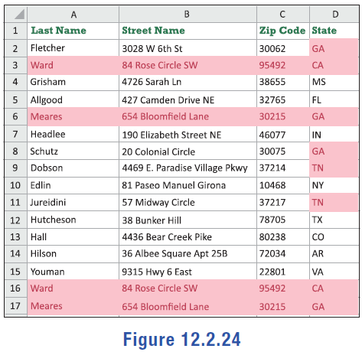
Example 5: Identifying Duplicates in Excel—Slide 4
Notice in Figure 24 that the Conditional Formatting has flagged both entire rows that are identical as well as individual cells that are repeated within a column. This feature allows us to quickly check the data and confirm that we do want to remove duplicate rows in our data.
Figure 24

Slide 42
Example 5: Identifying Duplicates in Excel—Slide 5
b.​ To remove duplicate entries, we use the Remove Duplicates tool in Excel. As before, you'll first need to select the data. On the Data tab, in the Data Tools section, select Remove Duplicates. A window will appear in which you will select the columns that might contain duplicates. Ensure all columns are selected and then click OK. An alert window will appear informing you that two duplicates were removed and that 14 unique values remain. Figure 25 shows the list of submissions with duplicates removed. Notice that a few cells are still highlighted in the state column because several people live in the same state. These duplicates are fine since we were only concerned about entire entries being duplicated.

Slide 43
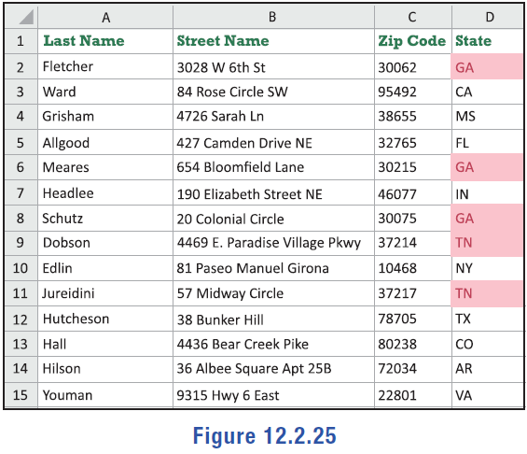
Example 5: Identifying Duplicates in Excel—Slide 6
Figure 25

Slide 44
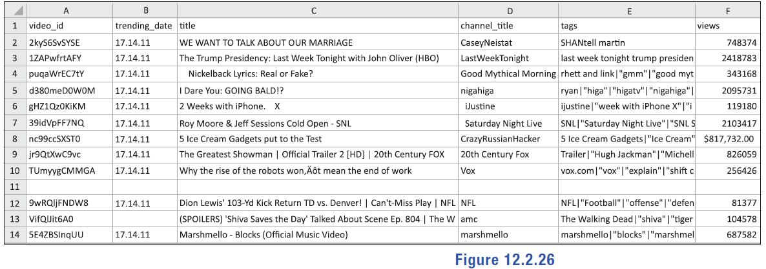
Example 6: Identifying Issues within Data—Slide 1
Figure 26 is a partial spreadsheet from several months of data on daily trending YouTube videos in the United States. The data includes the video id, trending date, video title, channel title, tags, and views. Examine the spreadsheet and identify any issues that might need to be addressed before analysis can begin.
Figure 26

Slide 45
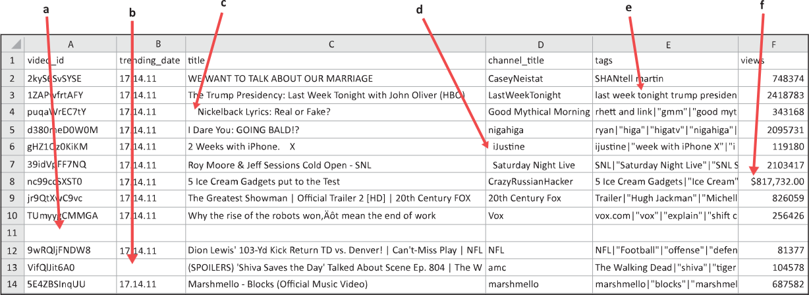
Example 6: Identifying Issues within Data—Slide 2
Solution
a.​ Line 11 is an empty line and needs to be deleted.
b. ​Cell B13 is missing data. Since this is a date and all other dates are the same, the best assumption would be that it is the same date.
c.​ Cell C4 has extra leading spaces that need to be removed.

Slide 46
Example 6: Identifying Issues within Data—Slide 3
d.​ Cells D6 and D7 also contain leading spaces to be removed.
e.​ Column E lists any tags the video received. Since the tags are all contained in one cell separated by the | character, we can use the Text to Column feature to separate them into different columns.
f.​ The number of views in cell F8 is listed as currency and needs to be changed to a general number.

Slide 47
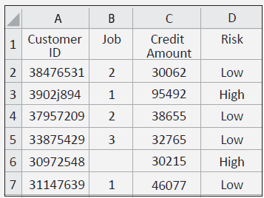
Skill Check 3
Identify the rows in the following spreadsheet that have potential data issues that need to be resolved.
Figure 27
Answer : Rows 3 and 6

Slide 48
Example 7: Extracting Text from a String in Excel—Slide 1
Figure 29 shows the credit card transactions for a kitchen renovation project completed by Jenn's Interior Solutions. For accounting to accurately keep track of spending on the project, both the date and the vender need to be separated into their own columns. (The full data set is available for download from math.hawkeslearning.com in Microsoft Excel format.)
a.​ Use the MID function to parse out the date for each transaction.
b.​ Use MID function along with the FIND tool to identify the vender in each transaction.

Slide 49
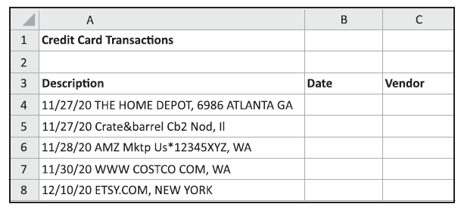
Example 7: Extracting Text from a String in Excel—Slide 2
Figure 29
Solution
a.​ To parse the date from each description, we will use the MID(text, start_num, num_chars) function, where "text" is the text string to be parsed and can either be entered directly or as a cell reference, "start_num" is the position of the first character you want to extract in the text, and "num_chars" specifies the number of characters you want to extract. All three of these values are required in the formula.

Slide 50
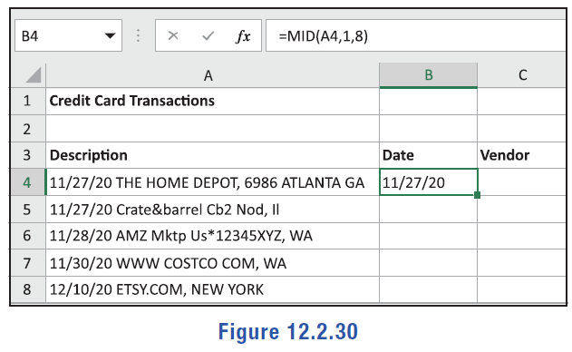
Example 7: Extracting Text from a String in Excel—Slide 3
In the Description column, the date is the first piece of information provided, which means start_num = 1. Each date has the format DD/MM/YY, which has 8 characters (including the slashes), so num_chars = 8. The cell reference will change for each instance of the formula, but since the first description is contained in cell A4, we'll start with text = A4.
Start by typing "=MID(A4,1,8)" in cell B4 and press Enter.
​
Figure 30

Slide 51
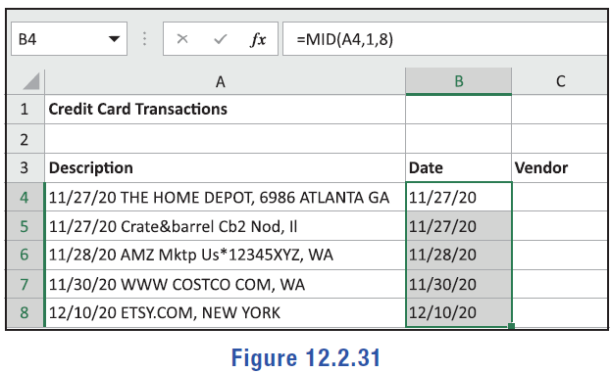
Example 7: Extracting Text from a String in Excel—Slide 4
To parse the date from the remaining transactions, drag the green square at the bottom-right corner of cell B4 down through cell B8.
Figure 31

Slide 52
Example 7: Extracting Text from a String in Excel—Slide 5
b.​ To pull out the vendor, we can once again use the MID function. However, unlike the dates in part a., we cannot guarantee that the name of each vendor contains the same number of characters. Instead of inserting the number of characters to extract, we can tell the computer where to find the end of the string using the FIND(find_text, within_text, [start_num]) function. In this function, "find_text" is the character or string of text we need to find, "within_text" is the text we are searching in, and "start_num" tells the function where to start. The only optional argument is "start_num," which is considered to be 1 if the value is omitted from the function.
Since each vendor name has a comma after it, we will use the FIND function to locate the comma, thus finding the end of the string that we want to extract. We will use "," for find_text. Again, the cell reference will change for each transaction description, but the first reference is in A4, so we'll use A4 for within_text. We'll omit the value for start_num. So for the first transaction description, we will use "FIND(",",A4)". This function returns the location of the comma in cell A4. Excel

Slide 53
Example 7: Extracting Text from a String in Excel—Slide 6
returns a value of 24 for FIND(",",A4), which means that the comma is the 24th character in cell A4. We will use this finding as an internal value in the MID function.
We know that the name of the vendor starts on character 10, because the date is 8 characters long and is followed by a space. We now also know that the name of the vendor ends on whatever value is found by FIND(",",A4). So for the MID function, the number of characters we are extracting, or the length of the string we are extracting, will be the value found by FIND(",",A4) minus 10. This means that we will use FIND(",",A4)-10 for the num_chars argument in the MID function and we will use 10 for start_num.
Now we can use the MID function. In cell C4, type "=MID(A4,10,FIND(",",A4)-10)".

Slide 54
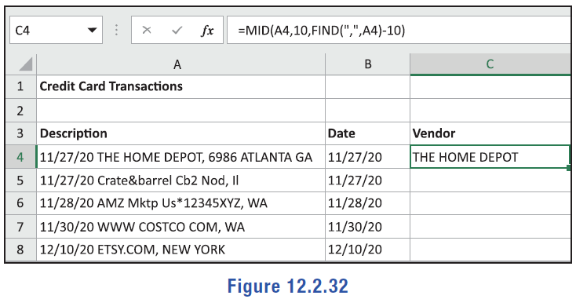
Example 7: Extracting Text from a String in Excel—Slide 7
Figure 32

Slide 55
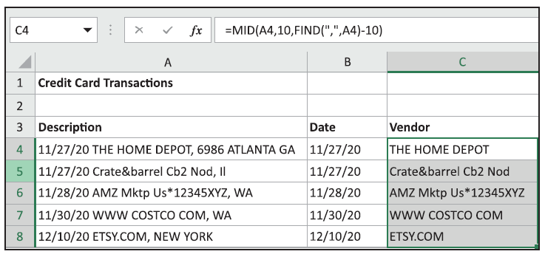
Example 7: Extracting Text from a String in Excel—Slide 8
To complete the vendor column, drag the green square at the bottom-right corner of cell B4 down through cell C8.
Figure 33

Slide 56
Tech Tip 4
Within Excel functions, strings of text must be contained within quotation marks.

Slide 57
Helpful Hint
Pivot tables can be thought of as a summary of filtering the original format of the data set. In the pivot tables in Figures 34 and 35, the data values in the rows are the count of how many items remain in the No. of Seats column when the original data is filtered by Style and Year. For instance, if the Style column is filtered to "Sedan" and the Year column is filtered to "2021", then 4 items will remain in the No. of Seats column.

Slide 58
Tech Tip 5
Along with the PivotTable tool, Excel has a tool called PivotCharts that creates a pivot table along with a graphical representation.

Slide 59
Example 8: Creating a Pivot Table in Excel—Slide 1
Airbnb began listing vacation rental properties in 2008. Figure 43 shows the first 19 listings of 48,879 along with characteristics for accommodations in New York City, New York, for 2019. (The full data set is available for download from math.hawkeslearning.com in Microsoft Excel format.)

Slide 60
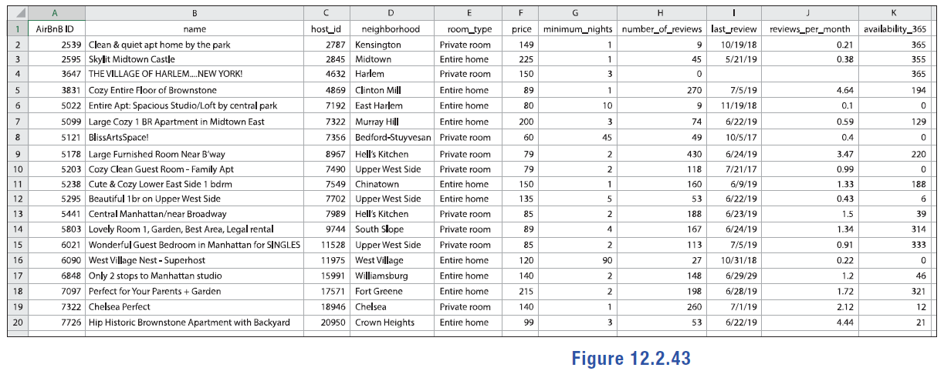
Example 8: Creating a Pivot Table in Excel—Slide 2
Figure 43

Slide 61
Example 8: Creating a Pivot Table in Excel—Slide 3
a.​ Create a pivot table in Excel to summarize the data using the neighborhood of the listing as row labels and the count of name as values.
b.​ Determine which neighborhood had the most rentals during 2019.
c.​ How many of the 48,879 rentals were available to rent all 365 days of the year, possibly indicating that they were full-time rentals?

Slide 62
Example 8: Creating a Pivot Table in Excel—Slide 4
Solution
a.​ Open the Excel spreadsheet with the Airbnb data. Select the columns of data and then click the PivotTable button on the Insert tab. In the window that pops up, ensure the selected range is correct and select for the pivot table to appear in a new spreadsheet. Then press OK. A new spreadsheet will open in the same Excel workbook with the pivot table options on the right side.
In the PivotTable Fields pane, check the boxes next to name and neighborhood. Both will appear in the Rows area. Drag and drop the name field to the Values area. The label will change to "count of name" and two columns will appear in your pivot table, as shown in Figure 44.

Slide 63
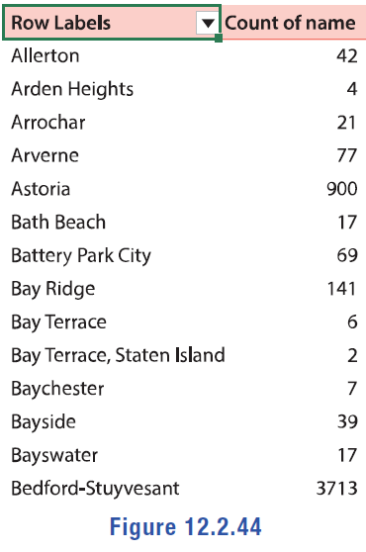
Example 8: Creating a Pivot Table in Excel—Slide 5
Figure 44

Slide 64
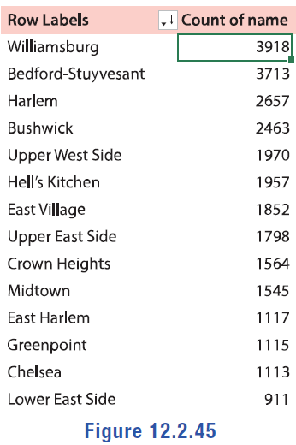
Example 8: Creating a Pivot Table in Excel—Slide 6
b.​ To find the neighborhood with the most rentals in 2019, we need to sort the Count of name column from smallest to largest. Select any cell in the Count of name column, then go to the Data tab and click the button for Sort Largest to Smallest. After sorting, it's clear that Williamsburg had the most rentals in 2019.
Figure 45

Slide 65
Example 8: Creating a Pivot Table in Excel—Slide 7
c.​ To determine how many rentals were available to rent all 365 days of the year, we need to add another field to our pivot table. In the PivotTable Fields pane, check the box next to availability_365. This field will be added to the Values area as "sum of availability_365". (You'll notice that a column is added to the table with the sum of the availability of all properties in each neighborhood, which is not helpful!) Drag and drop the availability_365 field to the Filter area. You'll notice a filter appear above the pivot table. Click the drop-down, then type "365" in the search bar, and press Enter. The data will be filtered to only include properties that are available for rent all year long, as shown in Figure 46.

Slide 66
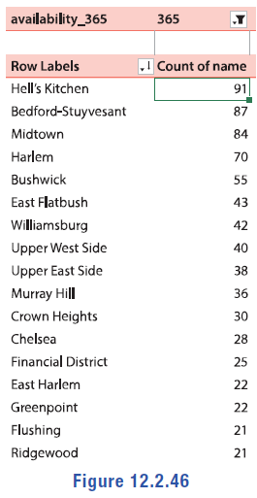
Example 8: Creating a Pivot Table in Excel—Slide 8
Figure 46

Slide 67
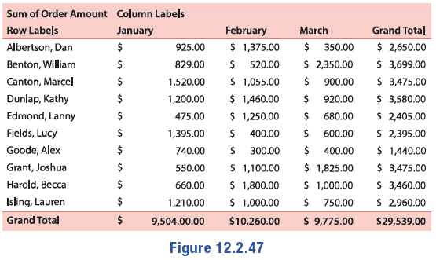
Skill Check 4
The sales data for the first quarter is shown in the pivot table.
a.​ Which salesperson had the most sales in each month?
b.​ Who had the most sales in the first quarter?
Figure 47
Answer : a. January: Marcel Canton; February: Becca Harold; March: William Benton; b. William Benton

Slide 68
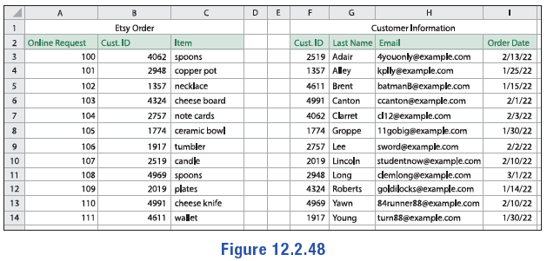
Example 9: Joining Data Sets
The spreadsheet in Figure 48 is comprised of two tables containing order and customer information for an Etsy store. Determine the identifier that should be used to join these data tables together using the LOOKUP function in Excel.
Figure 48
Solution
In order to join datasets using the LOOKUP function in Excel, we need a unique identifier for each row of data. Both tables contain the common identifier "Cust. ID", which can be used for merging tables.

Slide 69
Skill Check 5
Suppose you were given multiple datasets on student enrollment for your institution. Identify at least one unique identifier that could be used to join data in an Excel spreadsheet.
Answer: Answers could include student IDs or SSN numbers

Slide 70
Example 10: Using LOOKUP in Excel—Slide 1
KMJ Carpets gives a quarterly bonus to the Regional Sales Manager with the highest sales. You have received a spreadsheet from the sales team containing the totals for each salesperson and a spreadsheet from the HR department identifying the specific region for each salesperson. Each unique employee ID number is given in both spreadsheets. You've combined the two spreadsheets into one document. The spreadsheet from the sales team is titled "Sales Report" and the spreadsheet from HR is titled "Sales Regions." (The full data sets are available for download from math.hawkeslearning.com in Microsoft Excel format.)

Slide 71
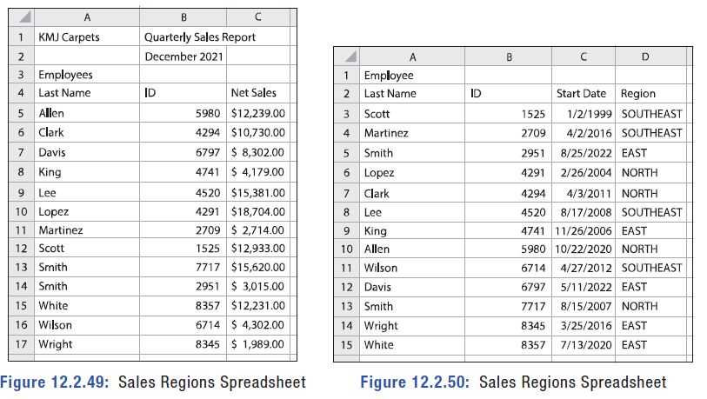
Example 10: Using LOOKUP in Excel—Slide 2
Figure 49: Sales Regions Spreadsheet
Figure 50: Sales Regions Spreadsheet

Slide 72
Example 10: Using LOOKUP in Excel—Slide 3
a. ​Add a Region column to the Sales Report spreadsheet using the LOOKUP function.
b.​ Use a pivot table to determine which regional sales manager will win the bonus.
Solution
a.​ Notice that the employees are listed in alphabetical order in the Sales Report spreadsheet, but they are listed by employee ID number in the Sales Regions spreadsheet. Therefore, a simple copy and paste from one sheet to the next will not work. Notice that using last names doesn't work either since there are multiple employees with the last name "Smith.“
​We will use the LOOKUP(lookup_value, lookup_vector, [result_vector]) function to pull data from the Sales Regions spreadsheet and place it into the Sales Report spreadsheet. In the LOOKUP function, lookup_value is the value we're looking for in the Sales Regions spread-

Slide 73
Example 10: Using LOOKUP in Excel—Slide 4
​sheet (this can be a cell reference), lookup_vector is the area of the data table that we're searching for the lookup_value in, and result_vector is the area of the data table that we will pull a value from.
​The lookup_vector will be a range from the "Sales Regions" spreadsheet;it will be in the form ‘[spreadsheet_name]’![beginning_cell]:
[ending_cell]. We want to search the ID column, so the beginning_cell = $B$4 and the ending_cell = $B$16. This gives us lookup_vector = ‘Sales Regions'!$B$3:$B$15. (Note: the use of the $ in the range tells Excel that we want to lock these values if we copy and paste the formula to other cells. We use them here because the ranges in the lookup functions need to remain the same.)
The result_vector has the same format. We want to return the sales region for the specific salesperson, so we have result_vector = ‘Sales Regions'!$D$3:$D$15.

Slide 74
Example 10: Using LOOKUP in Excel—Slide 5
​Type "Region" in cell D4 of the Sales Report spreadsheet to label the column. In cell D5, type "=LOOKUP(B5,'Sales Regions'!$B$3:$B$15,'Sales Regions'!$D$3:$D$15)" and press Enter. The LOOKUP function will return the sales region for Allen. (Verify this yourself by checking the ID in the Sales Regions spreadsheet).

Slide 75
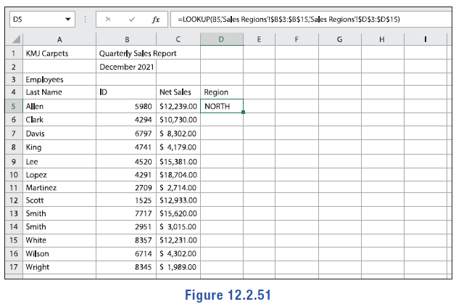
Example 10: Using LOOKUP in Excel—Slide 6
Figure 51

Slide 76
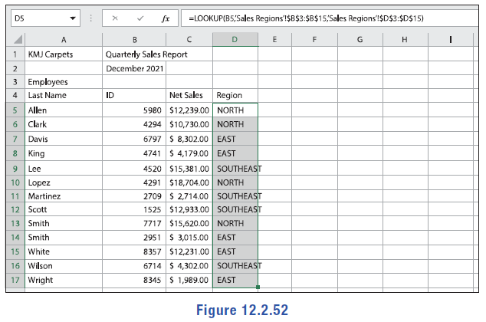
Example 10: Using LOOKUP in Excel—Slide 7
​To complete the column, drag the bottom-right corner of cell D4 down through cell D17. The results should appear as in Figure 52. If your results return errors, check your formula to ensure you included the dollar signs in your cell references to lock the lookup region.
Figure 52

Slide 77
Example 10: Using LOOKUP in Excel—Slide 8
b.​ To determine which region sales manager will receive a bonus, we need to determine the total amount of sales in each region. While we could do this by hand, we will employ the use of a pivot table.
Select the data for the Net Sales and the Region, including those headers. This is the data we want to analyze. Click Insert > Pivot Table. This time, we'll insert the pivot table in the same spreadsheet. In the Create PivotTable box, select the radio button next to Existing Spreadsheet and type F4 for the location. Then click OK. The pivot table tool will appear on the right side of the spreadsheet.
Select the check boxes next to Region and Net Sales. If necessary, drag and drop Region to the Rows area and Net Sales to the Values area. The complete pivot table will appear as in Figure 53.

Slide 78
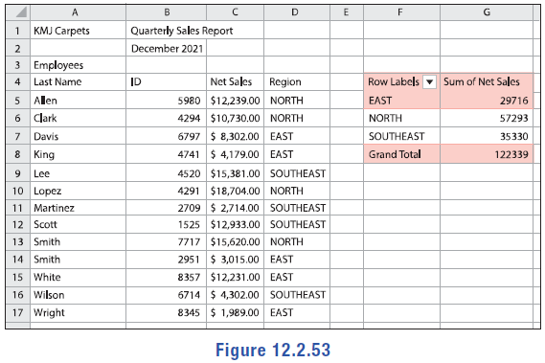
Example 10: Using LOOKUP in Excel—Slide 9
Figure 53
We can see from the pivot table that the North region made the most sales with a total of $57,293. As a result, the sales manager of the North will receive a bonus this quarter.

