Slide 1
Section 12.3
Data Exploration

Slide 2
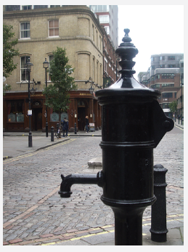
Fun Fact
John Snow was a British doctor and scientist who is viewed as the father of modern epidemiology because of his work on cholera. His reputation in anesthesiology at the time was so considerable that he was asked to administer chloroform to Queen Victoria at the birth of two of her children, Prince Leopold in 1853 and Princess Beatrice in 1857.
Figure 1: John Snow Memorial Pump

Slide 3
Definition: Scatter Plot
A scatter plot is a graphical display of data that is used to show how variables might relate to one another. The most common type of scatter plot is created by plotting two variables on the coordinate plane, where each piece of data is represented by a point.

Slide 4
Helpful Hint 1
Quantitative variables are counts or measurements. See Section 11.1 for more on types of variables.

Slide 5
Example 1: Creating a Scatter Plot to Identify Trends in Data—Slide 1
Providers of cloud computing offer services such as email hosting, data storage, and online office applications—all available over the internet. Consider the following data collected from a sample of small businesses regarding the number of years they have been in business and the approximate percentage of their workload that is in the cloud, whether public or private. Use the data in Table 1 to create a scatter plot that shows the relationship between the number of years in business and the percentage of workload in the cloud. Remember to label both axes as well as the graph itself.
Table 1: Sample of Cloud Usage by Small Businesses
Number of Years in Business | 1.25 | 8.0 | 0.5 | 3.75 | 5.0 | 12.25 | 3.5 | 2.25
% of Workload in the Cloud | $$88\%$$ | $$25\%$$ | $$100\%$$ | $$75\%$$ | $$50\%$$ | $$10\%$$ | $$25\%$$ | $$80\%$$

Slide 6
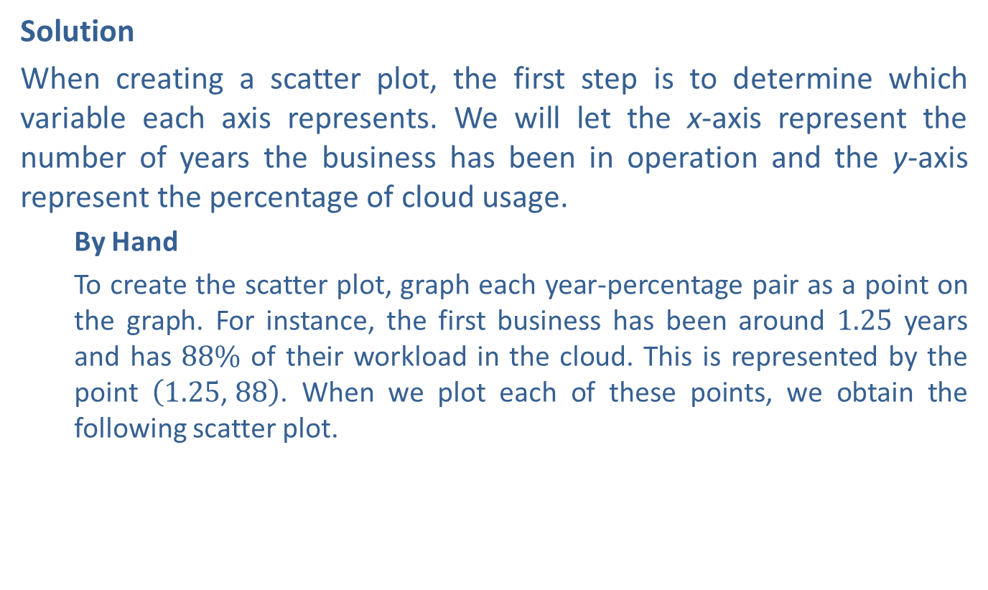
Example 1: Creating a Scatter Plot to Identify Trends in Data—Slide 2
Solution
When creating a scatter plot, the first step is to determine which variable each axis represents. We will let the x-axis represent the number of years the business has been in operation and the y-axis represent the percentage of cloud usage.
  By Hand
  To create the scatter plot, graph each year-percentage pair as a point on the graph. For instance, the first business has been around 1.25 years and has $88\%$ of their workload in the cloud. This is represented by the point $\left(1.25\text{, }88\right)$. When we plot each of these points, we obtain the following scatter plot.

Slide 7
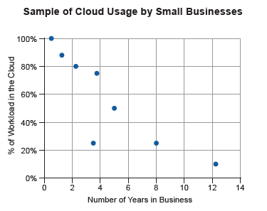
Example 1: Creating a Scatter Plot to Identify Trends in Data—Slide 3
Figure 3

Slide 8
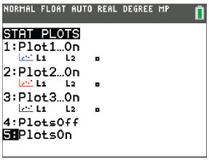
Example 1: Creating a Scatter Plot to Identify Trends in Data—Slide 4
TI-83/84 Plus
  To create a scatter plot using a TI-83/84 Plus CE calculator, start by turning on STAT PLOT. Press 2nd then y= . Select Plot1 and highlight On. Press enter and then press 2nd mode to return to the home screen.
Figure 4
  Now press y= and clear any functions listed.

Slide 9
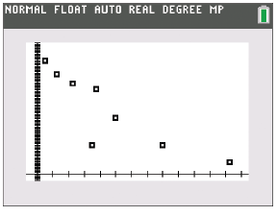
Example 1: Creating a Scatter Plot to Identify Trends in Data—Slide 5
  Press stat and select Edit…. Enter the scatter plot values in L1 and L2. Be sure you are entering the number of years in business in L1 and the percentage of cloud usage in L2. Once all the values are entered, press zoom and select ZoomStat. The scatter plot will appear as in Figure 5.
Figure 5
Notice that the points fall in a linear pattern that moves downward from left to right. This type of pattern can be described as a linear relationship with a negative slope.

Slide 10
Helpful Hint 2
Figure 3 appears to have an outlier, a data value that is extreme compared with the rest of the data values. See Section 11.3 for more on outliers.

Slide 11
Definition: Linear Correlation
Positive Linear Correlation
When data are plotted in a scatter plot and there appears to be an upward trend (that is, as one variable increases, the other variable increases as well), we say there is a positive linear correlation between the variables.
Negative Linear Correlation
When data are plotted in a scatter plot and there appears to be a downward trend (that is, as one variable increases, the other decreases), we say there is a negative linear correlation between the variables.

Slide 12
Example 2: Identifying Correlations—Slide 1
Consider the relationship between the following variables and what kind of correlation might show up in a scatter plot of the data. Decide if the variables would likely have a positive linear correlation, a negative linear correlation, or no linear correlation.
a.​ The number of cigarettes smoked and the probability of lung cancer
b.​ The amount of credit card debt incurred by college freshmen and their IQ score
c.​ The number of minutes spent on social media sites by college students and their first semester grades

Slide 13
Example 2: Identifying Correlations—Slide 2
Solution
a.​ As the number of cigarettes smoked increases, so does the chance of lung cancer. Thus, the scatter plot is likely to have upward-trending data points. The variables would have a positive linear correlation.
b.​ The scatter plot for these variables would likely contain a wide range of credit card debt and a wide range of IQ scores. It would be unlikely that there is a linear relationship between these two variables. Thus, they have neither a positive linear correlation nor a negative linear correlation.
c.​ As the number of minutes (or hours) spent on social media sites increases, a student's grades are likely to decrease. This would result in a downward-trending scatter plot, which would indicate a negative linear correlation between the amount of time spent on social media sites and grade point average.

Slide 14
Skill Check 1
Identify two variables that would likely have a positive linear correlation.
Answer: Correct responses suggest that as one variable increases, so does the other. For example, the number of candy bars consumed on a daily basis and weight gain; or the distance between two locations and the length of time it takes to drive between the two.

Slide 15
Definition: Pearson Correlation Coefficient
The Pearson correlation coefficient is the parameter that measures the strength of a linear relationship between two quantitative variables. The correlation coefficient for a sample is denoted by r. It always takes a value between −1 and 1, inclusive.
−1 ≤ r ≤ 1

Slide 16
Helpful Hint 3
The correlation coefficient is usually rounded to the nearest ten thousandth.

Slide 17

Example 3: Calculating the Correlation Coefficient—Slide 1
The following is a small sample of data collected from male participants in a $161 km$ trail ultramarathon. The survey collected the Body Mass Index (BMI) of each participant and their age. A table of the data, along with the scatter plot of the data, is given. Find the correlation coefficient r between the variables and interpret your results.
Table 2: BMI vs. Age of Men in a 161 km Trail Ultramarathon
BMI | 23.4 | 25.7 | 23.3 | 25.9 | 24.1 | 23.0 | 22.4 | 21.6 | 23.4 | 24.8 | 24.3 | 24.7
AGE | 53 | 47 | 28 | 52 | 60 | 34 | 39 | 36 | 52 | 54 | 53 | 53

Slide 18
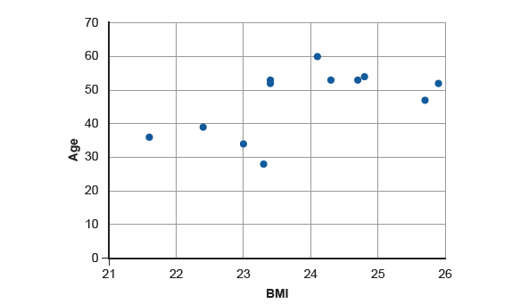
Example 3: Calculating the Correlation Coefficient—Slide 2
Figure 7: BMI vs. Age of Men in a 161 km Trail Ultramarathon

Slide 19
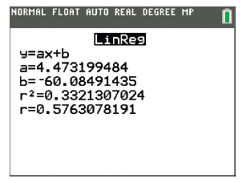
Example 3: Calculating the Correlation Coefficient—Slide 3
Solution
  TI-83/84 Plus
  To calculate the Pearson correlation coefficient, we need to input the data in the calculator. Begin by pressing stat and select Edit…. Enter the values for the BMIs in L1 and the values for the ages in L2. Then press stat, choose CALC and select LinReg(ax+b). Be sure that L1 is listed for Xlist:, L2 is listed for Ylist:, and FreqList: is left blank. Highlight Calculate and press enter . The output should appear as shown in Figure 8.
Figure 8

Slide 20
Example 3: Calculating the Correlation Coefficient—Slide 4
  Microsoft Excel
  To calculate the Pearson correlation coefficient in Excel, we will use the PEARSON(array1, array2) function, where "array1" refers to the cells containing the x-values and "array2" refers to the cells containing the y-values.
  Enter labels for your columns in cells A1 and B1, then enter the values for BMI in column A and the values for age in column B. In an empty cell, type "=PEARSON(A2:A13,B2:B13)" and press Enter. The value of r will appear in the cell.

Slide 21
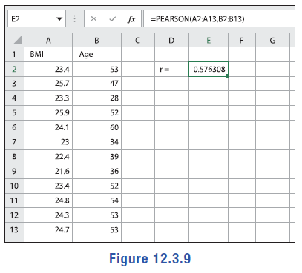
Example 3: Calculating the Correlation Coefficient—Slide 5
Figure 9
Notice that the value of r is positive, which matches with the positive slope of the scatter plot. Since r ≈ 0.5763, we know that there is a weak positive linear correlation between a male participant's BMI and his age.

Slide 22
Tech Tip
To view the Pearson correlation coefficient, you will need to turn on diagnostics. This only needs to be done once unless you reset your calculator. To turn this on, press 2nd then 0. Scroll down to DiagnosticON and press enter twice.

Slide 23
Skill Check 2
Calculate the correlation coefficient for the following data.
Table 3
Age (in Years) | 34 | 43 | 49 | 51 | 65
Bone Density (in mg/cm²) | 946 | 875 | 804 | 723 | 691
Answer: r ≈ −0.9396

Slide 24
Definition: Level of Confidence and Level of Significance
Level of Confidence
The level of confidence, c, is the probability that the assertions made about the data are correct.
Level of Significance
The level of significance, α, is the probability that the assertions made about the data are incorrect.
c + α = 1

Slide 25
Definition: Statistically Significant
If
is greater than the critical value listed in Pearson's Correlation table, then
r is statistically significant, which means the relationship is unlikely to have occurred by chance.

Slide 26
Example 4: Identifying Statistical Significance—Slide 1
Use the critical values in Table 5 to determine if the correlation between BMI and age from the previous example is statistically significant. Recall that r ≈ 0.5763. Use a 0.05 level of significance.
Table 5: BMI vs. Age for Men in a 161 km Trail Ultramarathon
BMI | 23.4 | 25.7 | 23.3 | 25.9 | 24.1 | 23.0 | 22.4 | 21.6 | 23.4 | 24.8 | 24.3 | 24.7
AGE | 53 | 47 | 28 | 52 | 60 | 34 | 39 | 36 | 52 | 54 | 53 | 53
Solution
There are twelve pairs of data in Example 3, so the sample size, n, is 12. We are told to use a 0.05 level of significance, so α = 0.05. In Table 6, the critical value is found where the row for n = 12 intersects the column for α = 0.05.

Slide 27
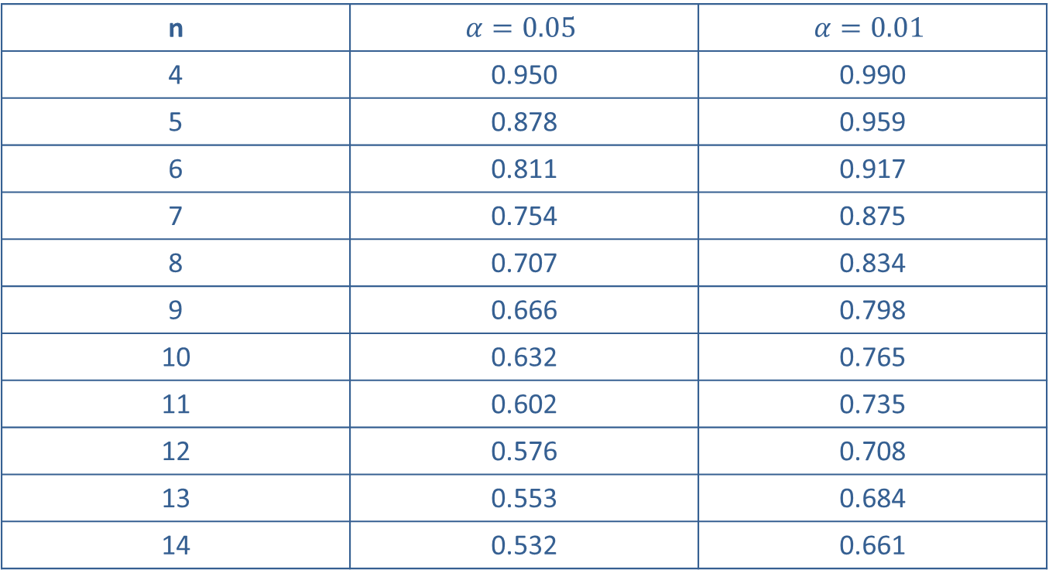
Example 4: Identifying Statistical Significance—Slide 2
Table 6: Critical Values of the Pearson Correlation Coefficient
n | $$α=0.05$$ | $$α=0.01$$
4 | 0.950 | 0.990
5 | 0.878 | 0.959
6 | 0.811 | 0.917
7 | 0.754 | 0.875
8 | 0.707 | 0.834
9 | 0.666 | 0.798
10 | 0.632 | 0.765
11 | 0.602 | 0.735
12 | 0.576 | 0.708
13 | 0.553 | 0.684
14 | 0.532 | 0.661

Slide 28
Example 4: Identifying Statistical Significance—Slide 3
Thus, the critical value is 0.576. Comparing this critical value to the absolute value of the correlation coefficient we found for the data in Example 3, we have
So the linear relationship
between the variables is statistically significant at the 0.05 level of significance. Therefore, we have enough evidence to conclude that a linear relationship exists between BMI and age for male ultramarathoners.

Slide 29
Skill Check 3
Determine whether the correlation coefficient is statistically significant at the specified level of significance assuming that the scatter plot of the data shows a linear pattern.
r = −0.499, α = 0.01, n = 26
Answer: Yes, r is statistically significant.

Slide 30
Definition: Regression Line
The regression line, also known as the line of best fit, is the line for which the average variation from the data is the smallest. It can be represented by
Where a is the slope of the line and b is the y-intercept.

Slide 31
Helpful Hint 4
Excel can also quickly calculate the necessary variables for the regression line, as we will demonstrate in Example 5.

Slide 32
Helpful Hint 5
A prediction should not be made with a regression model if any of the following statements are true.
​The data do not fall in a linear pattern when graphed on a scatter plot.
​The correlation coefficient is not statistically significant.
​You wish to make a prediction about a value outside the range of the sample data.
​The population is different than that from which the sample data were drawn.

Slide 33
Example 5: Predictions Using the Regression Line—Slide 1
The following data set gives the teen birth rates (per 1000) during one year in fourteen of the northeastern states along with the percent of the state's population who are living with incomes below the federally defined poverty level. Use the data, along with its scatter plot, to answer the following questions.
Tables 8: State Poverty Levels vs. Teen Birth Rate (per 1000)
State | Poverty % | Birth Rate (ages 15–19)
Maine | 12.0 | 11.1
New Hampshire | 6.6 | 8
Vermont | 9.2 | 8.8
Massachusetts | 10.0 | 7.2
New York | 11.9 | 11.7
Pennsylvania | 11.4 | 14.1
Connecticut | 10.4 | 8.3

Slide 34
Example 5: Predictions Using the Regression Line—Slide 2
Tables 8: State Poverty Levels vs. Teen Birth Rate (per 1000) (cont.)
State | Poverty % | Birth Rate (ages 15–19)
Rhode Island | 10.1 | 11.5
New Jersey | 9.1 | 10.3
Delaware | 8.1 | 16.7
Maryland | 7.8 | 14.1
Ohio | 12.4 | 18.9
Virginia | 10.1 | 14.3
West Virginia | 16.5 | 25.4

Slide 35
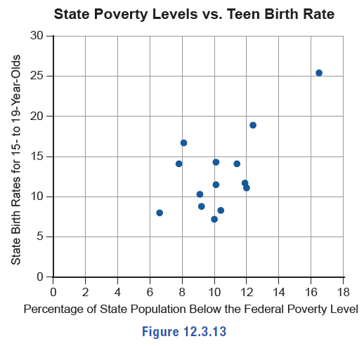
Example 5: Predictions Using the Regression Line—Slide 3
Figure 13

Slide 36
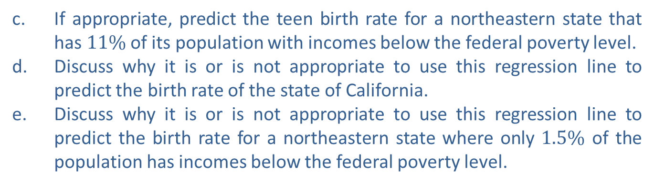
Example 5: Predictions Using the Regression Line—Slide 4
a.​ Determine if there is a statistically significant relationship between state poverty levels and teen birth rates at the 0.05 level.
b.​ If the relationship is significant, find the linear regression line in the form
for these data.
c.​ If appropriate, predict the teen birth rate for a northeastern state that has $11\%$ of its population with incomes below the federal poverty level.
d.​ Discuss why it is or is not appropriate to use this regression line to predict the birth rate of the state of California.
e.​ Discuss why it is or is not appropriate to use this regression line to predict the birth rate for a northeastern state where only $1.5\%$ of the population has incomes below the federal poverty level.

Slide 37
Example 5: Predictions Using the Regression Line—Slide 5
Solution
a.​ Begin by letting the variable x represent the poverty percentages in each state and the variable y represent the teen birth rates. We can see from the scatter plot that the points do fall in somewhat of a linear pattern. In order to determine if there is a statistically significant relationship, we must calculate the value of the correlation coefficient, r.
    TI-83/84 Plus
    Begin by pressing stat and selecting Edit…. Enter the values for the poverty percentages in L1 and the values for birth rates in L2. Then press stat and choose CALC and select LinReg(ax+b). Be sure that L1 is listed for Xlist:, L2 is listed for Ylist:, and FreqList: is left blank. Highlight Calculate and press enter . The output should appear as shown in Figure 14.

Slide 38
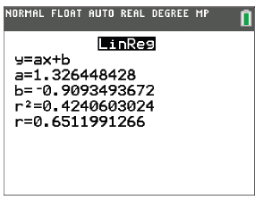
Example 5: Predictions Using the Regression Line—Slide 6
Figure 14
    Microsoft Excel
    To calculate the Pearson correlation coefficient, we will again use the PEARSON(array1, array2) function, where "array1" refers to the cells containing the x-values and "array2" refers to the cells containing the y-values.
    Enter labels for your columns in cells A1 and B1, then enter the values for the poverty percentages in column A and the values for the birth rates in column B. In an empty cell, type "=PEARSON(A2:A15,B2:
    B15)" and press Enter. The value of r will appear in the cell.

Slide 39
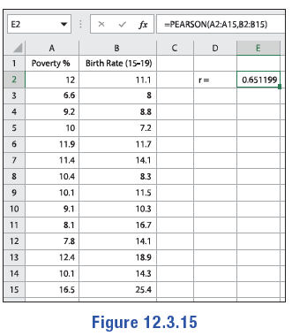
Example 5: Predictions Using the Regression Line—Slide 7
Figure 15
    Using Table C in Appendix A, we find that with a sample size of 14 and a 0.05 level of significance, the critical value is 0.532. The absolute value of the correlation coefficient,
is greater than 0.532, so there is
enough evidence at the 0.05 level of significance to conclude that the correlation between the two variables is statistically significant.

Slide 40
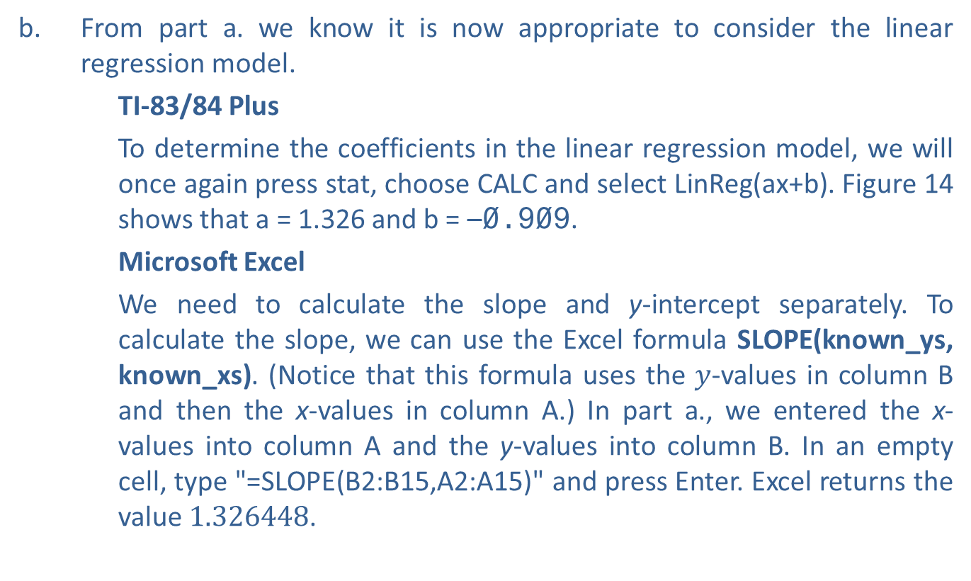
Example 5: Predictions Using the Regression Line—Slide 8
b.​ From part a. we know it is now appropriate to consider the linear regression model.
    TI-83/84 Plus
    To determine the coefficients in the linear regression model, we will once again press stat, choose CALC and select LinReg(ax+b). Figure 14 shows that a = 1.326 and b = –0.909.
    Microsoft Excel
    We need to calculate the slope and y-intercept separately. To calculate the slope, we can use the Excel formula SLOPE(known_ys, known_xs). (Notice that this formula uses the $y$-values in column B and then the x-values in column A.) In part a., we entered the x-values into column A and the y-values into column B. In an empty cell, type "=SLOPE(B2:B15,A2:A15)" and press Enter. Excel returns the value 1.326448.

Slide 41
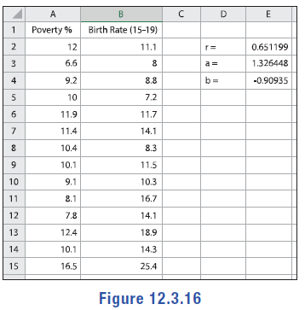

Example 5: Predictions Using the Regression Line—Slide 9
    Similarly, to calculate the y-intercept, we can use the Excel formula INTERCEPT(known_ys, known_xs). In an empty cell, type "=INTERCEPT(B2:B15,A2,A15)" and press Enter. Excel returns the value $−0.90935$.
    ​
Figure 16

Slide 42
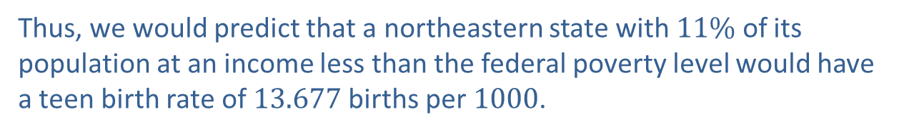
Example 5: Predictions Using the Regression Line—Slide 10
    Thus, the equation of the regression line, in the form
    ​
  ​
    is as follows.
c.​ To make a prediction, substitute the value x = 11 into the regression line and solve for
Thus, we would predict that a northeastern state with $11\%$ of its population at an income less than the federal poverty level would have a teen birth rate of 13.677 births per 1000.

Slide 43
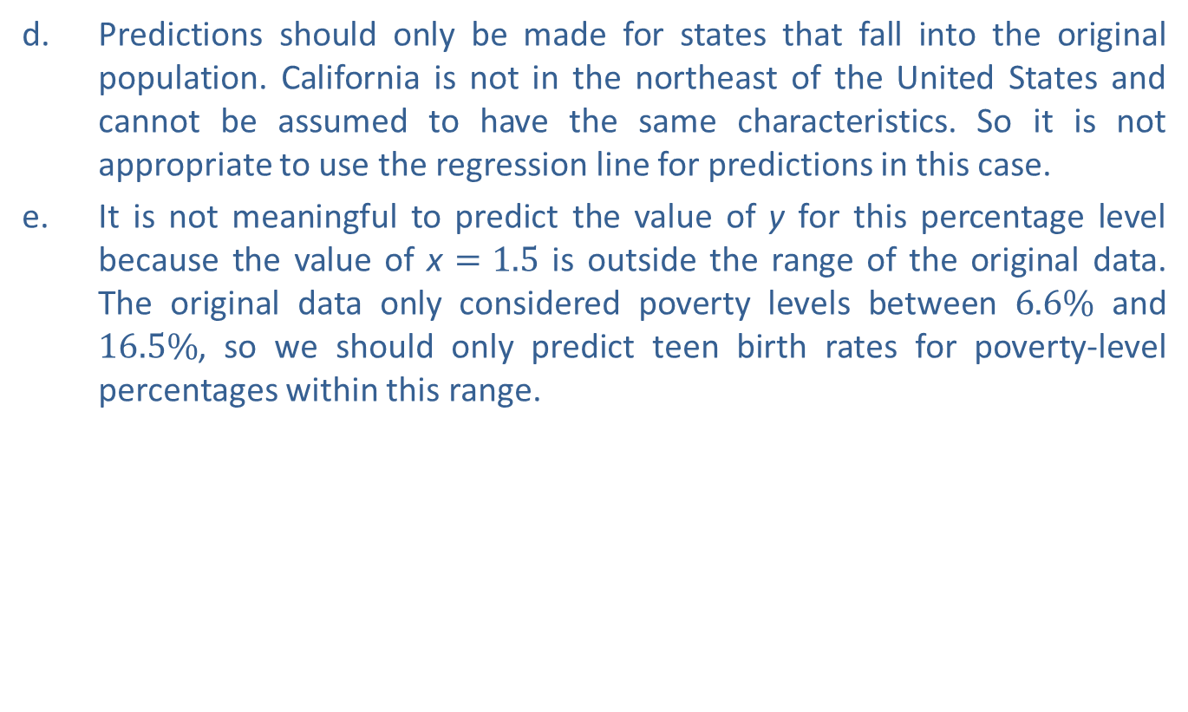
Example 5: Predictions Using the Regression Line—Slide 11
d.​ Predictions should only be made for states that fall into the original population. California is not in the northeast of the United States and cannot be assumed to have the same characteristics. So it is not appropriate to use the regression line for predictions in this case.
e. ​It is not meaningful to predict the value of y for this percentage level because the value of x $=1.5$ is outside the range of the original data. The original data only considered poverty levels between $6.6\%$ and $16.5\%$, so we should only predict teen birth rates for poverty-level percentages within this range.

Slide 44
Skill Check 4
The average temperature in Florida has a statistically significant correlation to the monthly precipitation in inches in the state. The regression line
models this relationship when the temperature is between
75 and 90. Use the line to predict the monthly precipitation if the temperature is 80 degrees.
Answer: 2.58 inches

