Slide 1
Section 12.4
Data Storytelling

Slide 2
Fun Fact 1
British chef Jamie Oliver kicked off his 2014 TED talk, "Teach Every Child about Food," with this powerful opening line:
"Sadly, in the next eighteen minutes, when I do our chat, four Americans that are alive will be dead from the food they eat."
Watch the full TED talk here: hawkes.biz/OliverTEDTalk

Slide 3
Fun Fact 2
Professor David Spiegelhalter, Chair of the Winton Centre for Risk and Evidence Communication at the University of Cambridge, won the 2020 Faraday Prize for his ability to vividly illustrate key insights from the disciplines of statistics and probability to the public at large and to key decision makers. He urges people to think about their emotional reactions to numbers.

Slide 4
Skill Check 1
Brainstorm appropriate engagement activities for the following audiences:
a.​ A club's fundraising committee
b.​ A women's motivational conference
c. ​A training session for new sales associates
Answer: Answers will vary. For example,
a.​ Tell a story about past fundraising experiences
b. ​Tell a funny story about unmotivated people
c.​ Do an icebreaker activity

Slide 5
Helpful Hint 1
Eye contact between the speaker and the audience is very powerful. Hold your head up and look into the eyes of your audience—just try not to stare at a single person.

Slide 6
Skill Check 2
Think of at least two gestures not listed in Table 1 and explain what the gestures might suggest.
Answer: Answers will vary.
a.​ Scratching head suggests confusion or uncertainty.
b.​ Raising eyebrows suggests shock or disbelief.
c.​ Bowing suggests gratitude or respect.
d.​ Sitting down (with good posture) suggests comfort/ease or focus on something else.

Slide 7
Helpful Hint 2
Don't turn your back to the audience and read from the screen. Doing so suggests that you don't know what it says or that you've lost your place.

Slide 8
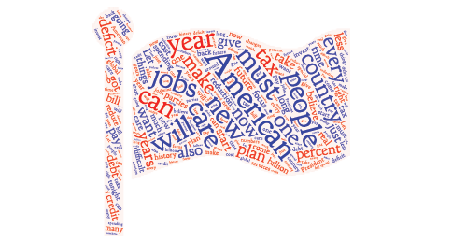
Example 1: Interpreting Word Clouds—Slide 1
Bill Clinton's first State of the Union address, delivered on February 17, 1993, was one of the most-watched State of the Union addresses in history according to the Nielsen TV ratings, pulling in nearly 67 million viewers. The flag word cloud in Figure 5 is made from the text of his speech.
Figure 5: Word Cloud of President Clinton’s Speech
a.​ Based on the word cloud, what do you think was the main policy focus that President Clinton laid out in his speech?

Slide 9
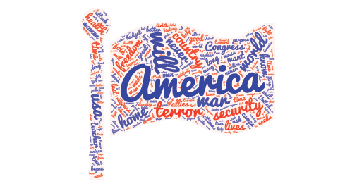
Example 1: Interpreting Word Clouds—Slide 2
b.​ How might you modify the word cloud to help make those main points more prominent?
c.​ Compare the word cloud of President Clinton's speech to the word cloud in Figure 6 of the second State of the Union speech from President George W. Bush, who became president after Clinton. In his speech, President Bush was addressing the September 11th terrorist attacks on the World Trade Center in New York. Can you recognize the different topics that were addressed in January 2002?
Figure 6: Word Cloud of President Bush’s Speech

Slide 10
Example 1: Interpreting Word Clouds—Slide 3
Solution
a.​ The most prominent words are American, people, will, must, and new. However, other weighty words are to do with jobs, tax cuts, healthcare, and the deficit. The focus may have been on improving the economy.
b.​ Removing some of the common but less informative words like will, can, and must would make the policy intentions more pronounced.
c.​ The words will and American are still very prominent, but there is more focus on security and terror in the world since the September 11th terrorist attacks occurred only 4 months before.

Slide 11
Example 2: Creating Word Clouds—Slide 1
Create a word cloud of the text of Little Women by Louisa May Alcott, downloaded from Project Gutenberg website (gutenberg.org). Use your word cloud to deduce who is the main protagonist, as well as supporting characters.
Solution
The first step in creating a word cloud of Little Women is to obtain the full text from Project Gutenberg. To do this, go to Gutenberg.org and search for "Little Women". After selecting the correct book from the results, click on the link for the text in the Plain Text UTF-8 format. This will open the .txt file in a separate browser window. (If you wanted to download the text, you would need to right-click on the link and select "Save link as.") Note that the link is "https://www.gutenberg.org/cache/epub/514/pg514.txt". This will be useful in the next step.

Slide 12
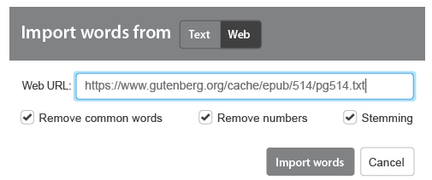
Example 2: Creating Word Clouds—Slide 2
Next, go to wordart.com and click on the "Create Now" link. In the new browser window that opens, remove any existing words from the "Words" area, then click the "Import" button. In the pop-up box, select the "Web" option and enter the Web URL of the .txt file of Little Women in the box, as shown in Figure 7.
Figure 7
Ensure that the boxes next to "Remove common words," "Remove numbers," and "Stemming" are checked. Then, click "Import words." Once the words are selected, click "Visualize." The resulting word cloud will look similar to Figure 8. (Note that the visualization is randomized, so your word cloud will look different.)

Slide 13
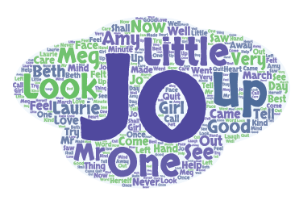
Example 2: Creating Word Clouds—Slide 3
Figure 8
Judging from the word cloud, Louisa May Alcott's main character in the book Little Women is Jo. Other characters include Meg, Laurie, Amy, and Beth.

Slide 14
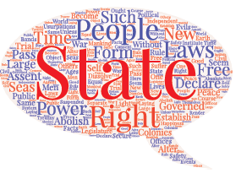
Skill Check 3
Identify the most used word in the text of the Declaration of Independence based on the word cloud. Name the next three most prevalent words in the text. Can you tell how many times each word was used?
Figure 9
Answer: Most used word is State. Next three highest used words are People, Laws, and Right; No, you cannot tell how many times each word was used in a word cloud.

Slide 15
Fun Fact 3
Hans Rosling dispelled common myths about the so-called developing world with his first Ted Talk presentation in 2006. With almost 15,000,000 on-line views since then, his bubble charts have become legendary around the world. His bio on the website accurately states that "In Hans Rosling's hands, data sings." You can watch his Ted Talk here: https://www.ted.com/talks/hans_
rosling_the_best_stats_you_ve_ever_seen?language=en#t-182992

Slide 16
Example 3: Interpreting a Bubble Chart—Slide 1
Figure 11 shows a bubble chart made from data shown in Table 2. The table lists the top ten NBA players with the highest average points per game between 1996 and 2020 according to data.world.
Table 2: Top Ten NBA Players between 1996 and 2020
Name | Total Games | Total Points | Total Assists
Allen Iverson | 914 | 23,823 | 5484
Anthony Davis | 519 | 12,430 | 1181
Damian Lillard | 606 | 14,733 | 3962
James Harden | 824 | 20,727 | 5161
Kevin Durant | 849 | 22,824 | 3502
Kobe Bryant | 1346 | 32,573 | 6407
LeBron James | 1256 | 33,993 | 9346
Luka Dončić | 123 | 3050 | 904
Michael Jordan | 306 | 7742 | 1285
Trae Young | 139 | 3371 | 1202

Slide 17
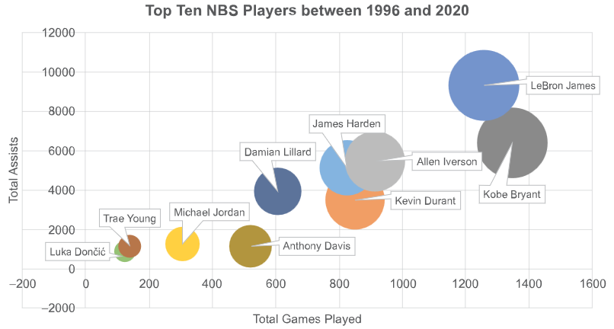
Example 3: Interpreting a Bubble Chart—Slide 2
a.​ What does the size of each bubble represent?
b. ​Given that Michael Jordan began his NBA career in 1984 and retired for good in 2003, (retiring twice in between by sitting out four of those years) do you think this bubble chart fairly represents his career?
Figure 11
c. What can you deduce from the bubble chart about the relationship between the number of games played and the number of points a player had, as well as the number of assists and the number of points?

Slide 18
Example 3: Interpreting a Bubble Chart—Slide 3
Solution
a.​ From the bubble chart, we can see that the horizontal and vertical axes represent the number of games played and the number of assists for each player. Thus, the size of the bubbles represents the total number of points each player scored.
b.​ Because Michael Jordan began his career in the NBA in 1984, these data only contain about half of his games, career total points and assists. Therefore, we can say that this bubble chart does not represent his whole career fairly.
c.​ The number of points a player attained is represented by the size of the bubble. In general, each player's bubble gets bigger as you move along the x-axis. The bubbles also increase in size as you move up the y-axis. Thus, the more games a player played, the more points he scored. Similarly, a player with more assists tended to score more points. The exception to this second point is with Anthony Davis. The size of his bubble, indicating the number of points he scored, is larger in comparison to the three other players with similar numbers of assists.

Slide 19
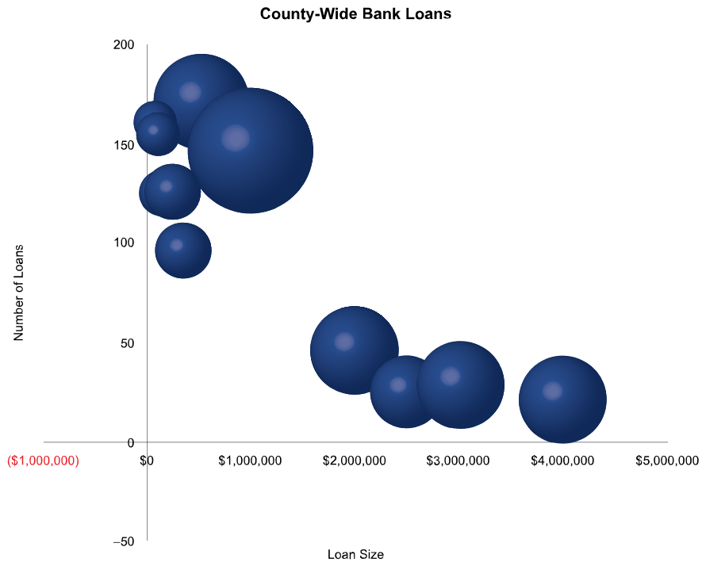
Example 4: Interpreting a Bubble Chart—Slide 1
Data for six-month's worth of loans made in a certain county in Illinois is displayed in the bubble chart in Figure 12. The x-axis shows the size of the loan, the y-axis shows the number of loans made at that level, and the size of the bubbles represents the total amount of money the banks needed to fund the loans at that level.
Figure 12

Slide 20
Example 4: Interpreting a Bubble Chart—Slide 2
Use the bubble chart to answer the following questions.
a.​ What is the largest loan that was made?
b. ​What level of loan was made most during the six months?
c.​ Which level of loan required the most funds from the bank during this time?
d.​ Why are the answers to questions a. and b. different?
e. ​If you were presenting the answers to questions a. through d. to a local civic group, would you use the bubble chart in your presentation?
f.​ A bank is planning to open a new branch in this county. Based on the bubble chart, what types of loans should the bank expect to have applications for? How would this influence the staffing of the bank and marketing targets?

Slide 21
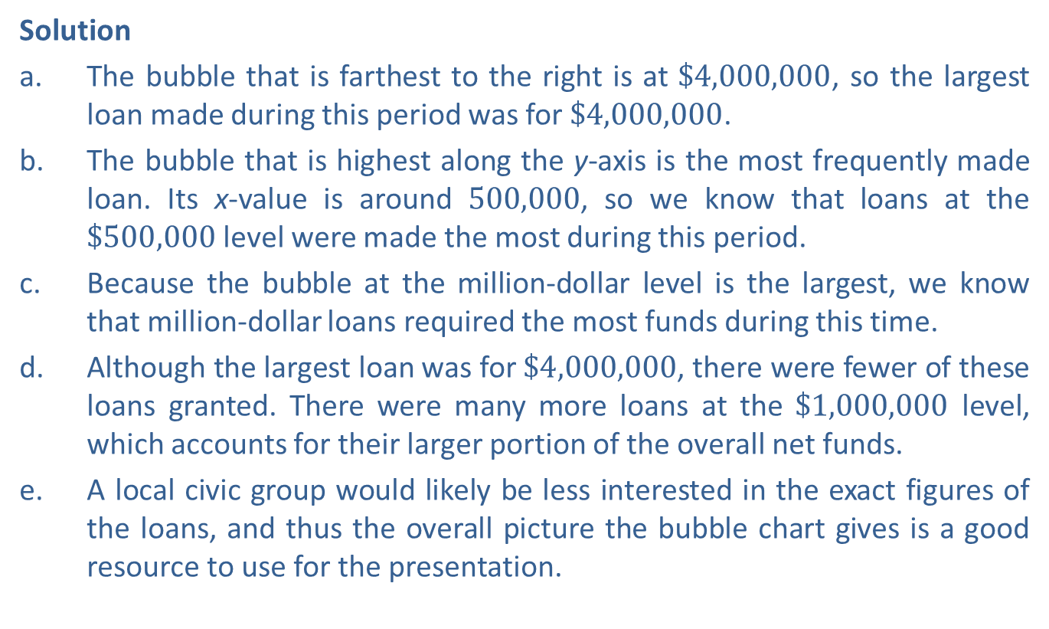
Example 4: Interpreting a Bubble Chart—Slide 3
Solution
a.​ The bubble that is farthest to the right is at $\$4,000,000$, so the largest loan made during this period was for $\$4,000,000$.
b.​ The bubble that is highest along the y-axis is the most frequently made loan. Its x-value is around 500,000, so we know that loans at the $\$500,000$ level were made the most during this period.
c.​ Because the bubble at the million-dollar level is the largest, we know that million-dollar loans required the most funds during this time.
d.​ Although the largest loan was for $\$4,000,000$, there were fewer of these loans granted. There were many more loans at the $\$1,000,000$ level, which accounts for their larger portion of the overall net funds.
e.​ A local civic group would likely be less interested in the exact figures of the loans, and thus the overall picture the bubble chart gives is a good resource to use for the presentation.

Slide 22

Example 4: Interpreting a Bubble Chart—Slide 4
f.​ Loans at or below the $\$1,000,000$ level account for both the most loans granted and the largest portion of overall net funds. Therefore, the bank should expect most applications to be for loans at or below $\$1,000,000$, with few loans above $\$2,000,000$. The bank should train employees to process loans in this range and focus marketing campaigns aimed at attracting customers needing loans up to $\$1,000,000$.

Slide 23
Example 5: Interpreting Infographics—Slide 1
The portion of an infographic⁵ shown in Figure 14 is from the University of Southern California Rossier's online teaching degree program. In it they compare the amount of money spent on education to education performance metrics for the United States and eleven other countries.
a. Who spends the most overall on education among the 12 countries?
b.​ Who spends the most per school-aged child among the 12 countries?
c.​ Where does the US rank in math test scores among the 12 countries?
d.​ Do you think this is an effective infographic? Why or why not?
Rossier Staff, "U.S. Education Spending and Performance vs. The World [INFOGRAPHIC]", USCROssier, February 9, 2011, https://rossieronline.usc.edu/blog/u-s-education-versus-the-world-infographic/.

Slide 24
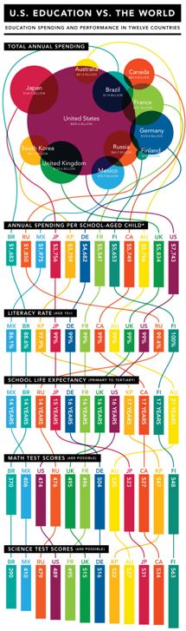
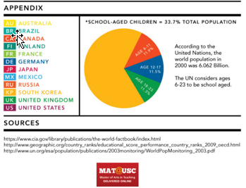
Example 5: Interpreting Infographics—Slide 2
Figure 14

Slide 25
Example 5: Interpreting Infographics—Slide 3
Solution
a.​ The size of the circle indicates that out of the twelve countries shown, the United States spends the most on education.
b.​ Based on the bar graphs in the first line, we can see that the United States also has the highest per-child spending amount.
c. ​Math test scores rankings are shown on the fourth line of bar charts. The United States is the tenth out of the twelve countries for math test scores.
d. The infographic is both eye-catching and memorable. The use of lines joining the data to its respective country communicates a sense of complexity that is almost certainly involved in the data story. However, it is a very busy graphic, which might turn some users away. The use of the total amount spent on education as the main category could be questioned since the United States is the wealthiest country in the list. The per-student spending amount would have been a better metric to use at the top.

Slide 26
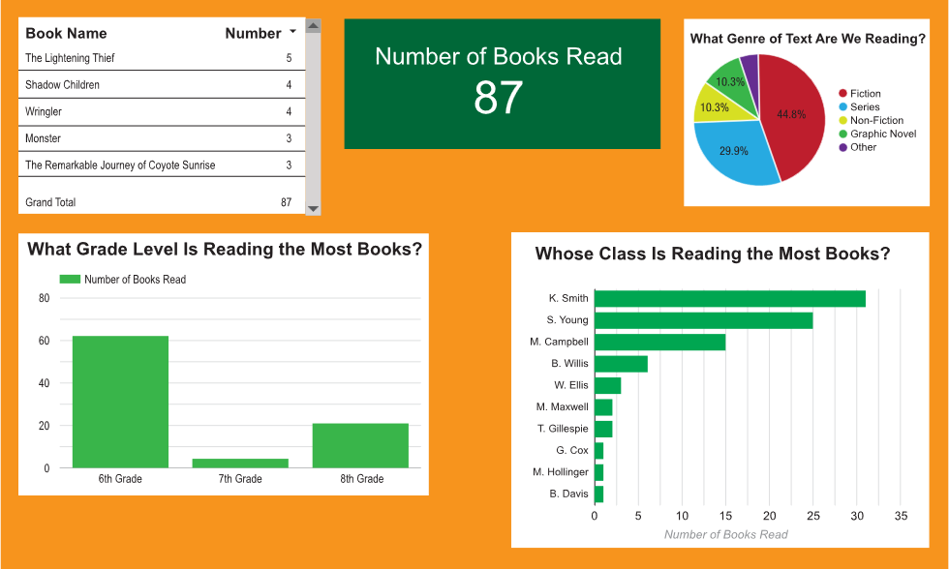
Example 6: Reading Dashboards—Slide 1
As part of the push to increase student reading outside of class assignments, Peace Middle School put together the following reading dashboard for their students.
Figure 16

Slide 27
Example 6: Reading Dashboards—Slide 2
a.​ Describe what each of the five graphics displays and any connections that exist between the graphs.
b.​ How many grades levels are represented in the dashboard? How many teachers are represented?
c.​ How many fiction books were read to date?
d.​ How could you change the graphic for "Number of Books Read" so that it tells a better story?
e.​ Does the dashboard give you a good sense of where the school is on their progress for reading? List any ways that you might make the dashboard better and explain your reasoning.

Slide 28
Example 6: Reading Dashboards—Slide 3
Solution
a.​ There are five graphics, and each displays a different type of data.
​Top Left: This graphic displays the book titles that students are reading along with the number of times a student has read the book. The "Grand Total" at the bottom will be the same as the middle figure, "Number of Books Read."
​Top Middle: The grand total matches the sum of the bars in the bottom left graph as well as the sum of the bars in the bottom right graph.
​Top Right: The pie chart displays the percentages of each genre of book read.
​Bottom Left: This bar chart displays of the numbers of books read by each grade level.
​Bottom Right: This bar graph displays the numbers of books read by the students, grouped by teacher.

Slide 29

Example 6: Reading Dashboards—Slide 4
b.​ The bottom-left bar chart shows that there are three grades (6th, 7th, and 8th) represented in the dashboard. The bottom-right bar graph shows that the classrooms of 12 teachers are represented.
c.​ Although the number of fiction books is not directly given on the dashboard, we can calculate this number by multiplying the percentage of fiction books read, $44.8\%$, by the total number of books read, 87.
  Thus, approximately 39 of the books read were fiction.
  d.​ Including a target goal for the "Number of Books Read" would strengthen the dashboard. The graphic could be a gauge, a thermometer, or a line graph showing the overall progress.

Slide 30
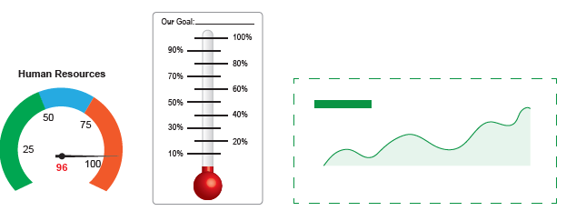
Example 6: Reading Dashboards—Slide 5
​
Figure 17: Suggestions to Improve the Dashboard
e.​ Overall, the dashboard gives a good snapshot of which students in general are reading, and which grade levels and classes could be doing a better job. All of the different graphs are very easy to read, and the dashboard does not feel overcrowded. However, there is nothing on the dashboard which gives a sense of how this rate of book reading compares to other years, or what goals each grade

Slide 31
Example 6: Reading Dashboards—Slide 6
is trying to attain. Having a graphic such as the one described in part d. could help in this area. There is also nothing to indicate how current the data in the charts are or how many students there are in each grade. Lastly, the bar chart showing breakdown by teacher does not provide any indication what grade level each teacher teaches. It could be helpful as a link between the two bar charts.

