Slide 1
Section 13.1
How to Determine a Winner

Slide 2
Definition: Preference Ballot
A preference ballot is a ballot that allows a voter to rank the items in order of preference from most preferred to least preferred.

Slide 3
Definition: Preference Table
A preference table summarizes all of the individual preference ballots in an election by tallying the number of ballots with the same order of ranking.

Slide 4
Think Back
The Fundamental Counting Principle states that for a sequence of n experiments where the first experiment has k ₁ outcomes, the second experiment has k ₂ outcomes, the third experiment has k ₃ outcomes, and so on, the total number of possible outcomes for the sequence of experiments is

Slide 5
Example 1: Reading a Preference Table—Slide 1
Answer the following questions about the preference table shown for the election for Senior Class President at Clarkstown High School.
a. How many different rankings were possible for the election?
b. How many students voted in the election?
c. Which candidate had the most first-lace votes?
d. How many students thought that the order of candidates should be Ava, Carley, Sydney, Ryan, then Zaire?
Table 2: Preference Table for Senior Class President
Rankings
1st | Sydney | Ava | Ava | Carley | Carley
2nd | Ryan | Carley | Carley | Zaire | Sydney
3rd | Ava | Ryan | Sydney | Ryan | Ava
4th | Carley | Zaire | Ryan | Ava | Zaire
5th | Zaire | Sydney | Zaire | Sydney | Ryan
Total Votes | 15 | 29 | 6 | 24 | 1

Slide 6
Example 1: Reading a Preference Table—Slide 2
Solution
a. Because there were five candidates on the ballot, we can use factorials to find the number of possible rankings.
b. ​To find the total number of students that voted in the election, we add the numbers in the row labeled "Total Votes."
Thus, there were 75 students who voted in the election.
c. ​To find the candidate with the most first-place votes, we need to count the number of votes each candidate received where they were ranked in first place. By looking across the 1st row, we see that there was only one ranking order that placed Sydney first. At the bottom of that column, we know that this particular ranking received 15 votes. So Sydney received 15 first-place votes overall.

Slide 7
Example 1: Reading a Preference Table—Slide 3
Table 3: Preference Table for Senior Class President
Rankings
1st | Sydney | Ava | Ava | Carley | Carley
2nd | Ryan | Carley | Carley | Zaire | Sydney
3rd | Ava | Ryan | Sydney | Ryan | Ava
4th | Carley | Zaire | Ryan | Ava | Zaire
5th | Zaire | Sydney | Zaire | Sydney | Ryan
Total Votes | 15 | 29 | 6 | 24 | 1
There were two rankings in which Ava received first-place votes: the second column of rankings and the third. Therefore, Ava had a total of 29 + 6 = 35 first-place votes.

Slide 8
Example 1: Reading a Preference Table—Slide 4
Table 4: Preference Table for Senior Class President
Rankings
1st | Sydney | Ava | Ava | Carley | Carley
2nd | Ryan | Carley | Carley | Zaire | Sydney
3rd | Ava | Ryan | Sydney | Ryan | Ava
4th | Carley | Zaire | Ryan | Ava | Zaire
5th | Zaire | Sydney | Zaire | Sydney | Ryan
Total Votes | 15 | 29 | 6 | 24 | 1
Carley was also ranked first in two rankings, which are shown in the last two columns of the table. Her first-place rankings total 24 + 1 = 25.

Slide 9
Example 1: Reading a Preference Table—Slide 5
Table 5: Preference Table for Senior Class President
Rankings
1st | Sydney | Ava | Ava | Carley | Carley
2nd | Ryan | Carley | Carley | Zaire | Sydney
3rd | Ava | Ryan | Sydney | Ryan | Ava
4th | Carley | Zaire | Ryan | Ava | Zaire
5th | Zaire | Sydney | Zaire | Sydney | Ryan
Total Votes | 15 | 29 | 6 | 24 | 1
Notice that there are no rankings that place either Ryan or Zaire in first. Therefore, Ava received the most first place rankings with a total of 35 votes.
d. ​The number of students who prefer the order of ranking to be Ava, Carley, Sydney, Ryan, and then Zaire is found in the third column of rankings. The total votes for this column is 6, so there were 6 students who chose this ranking.

Slide 10
Skill Check 1
Which candidate in Example 1 had the most rankings for fifth place?
Answer: Sydney, with 53 votes that gave her a fifth place ranking.

Slide 11
Example 2: Using the Majority Rule Decision—Slide 1
Use the majority rule decision to determine a winner in the election results from Satou, Williams, Tremblay, and Russo. The preference table is reprinted as Table 6 for ease of reference.
Table 6: Preference Table for Candidates
Rankings
1st | Williams | Tremblay | Satou | Russo
2nd | Satou | Satou | Williams | Williams
3rd | Tremblay | Williams | Tremblay | Satou
4th | Russo | Russo | Russo | Tremblay
Total Votes | 132 | 210 | 167 | 267

Slide 12
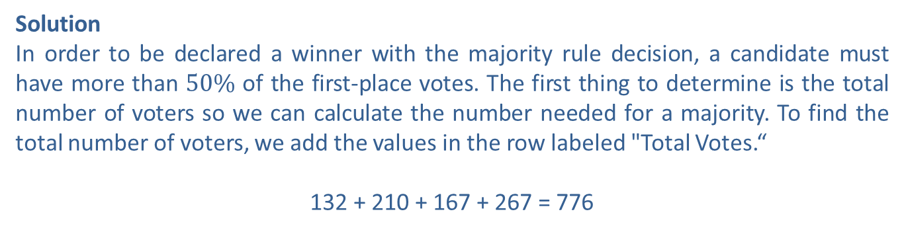
Example 2: Using the Majority Rule Decision—Slide 2
Solution
In order to be declared a winner with the majority rule decision, a candidate must have more than $50\%$ of the first-place votes. The first thing to determine is the total number of voters so we can calculate the number needed for a majority. To find the total number of voters, we add the values in the row labeled "Total Votes.“
132 + 210 + 167 + 267 = 776
There were 776 votes cast in this election. To have a majority, a candidate needs more than half of the votes, or more than
So a minimum of 389 votes are needed for a majority.
Looking across the first row, we can see that each candidate has only one ranking where they were placed first. The number of first place rankings are as follows.

Slide 13
Example 2: Using the Majority Rule Decision—Slide 3
Russo: | 267 first-place votes
Satou: | 167 first-place votes
Tremblay: | 210 first-place votes
Williams: | 132 first-place votes
This means that no candidate obtained the minimum of 389 first-place votes needed for a majority. Therefore, using the majority rule decision, we cannot declare an immediate winner. Instead, an alternative method for choosing a winner will be needed.

Slide 14
Example 3: Using the Plurality Method—Slide 1
Use a plurality method to determine a winner with the four candidates: Satou, Williams, Tremblay, and Russo. The preference table is reprinted as Table 7.
Table 7: Preference Table for Candidates
Rankings
1st | Williams | Tremblay | Satou | Russo
2nd | Satou | Satou | Williams | Williams
3rd | Tremblay | Williams | Tremblay | Satou
4th | Russo | Russo | Russo | Tremblay
Total Votes | 132 | 210 | 167 | 267

Slide 15
Example 3: Using the Plurality Method—Slide 2
Solution
When using the plurality method, the only consideration is who has the most first-place votes. The other rankings play no role in the process here. Recall each candidate's first-place votes from Example 2.
Russo: | 267 first-place votes
Satou: | 167 first-place votes
Tremblay: | 210 first-place votes
Williams: | 132 first-place votes
Therefore, Russo wins the election using the plurality method with 267 first-place votes.

Slide 16
Math Milestone
The Borda count method was named after 18th-century French mathematician Jean-Charles de Borda. The French Academy of Science used this method to elect its members for almost two decades. Borda was not only a mathematician, but a scientist and a sailor as well. Among his many accomplishments, he helped fight in the American Revolutionary War and is known for constructing instruments to measure angles. The Borda crater on the moon is named in honor of him, as well as asteroid #175726.

Slide 17
Example 4: Using the Borda Count Method—Slide 1
Use the Borda count method to determine a winner with our four candidates. The preference table is reprinted as Table 8.
Table 8: Preference Table for Candidates
Rankings
1st | Williams | Tremblay | Satou | Russo
2nd | Satou | Satou | Williams | Williams
3rd | Tremblay | Williams | Tremblay | Satou
4th | Russo | Russo | Russo | Tremblay
Total Votes | 132 | 210 | 167 | 267

Slide 18
Example 4: Using the Borda Count Method—Slide 2
Solution
The Borda count method requires that we assign points for each ranking. Because there are four candidates in our election, each ranking will receive the following number of points.
1st place = 4 points
3rd place = 2 points
2nd place = 3 points
4th place = 1 point
To help keep the information straight, the calculations for each candidate are organized in a table. For instance, Russo was ranked fourth in the first three rankings, so each of those votes gets 1 point. He then gets four points for each of the 267 votes that had him ranked in first place. Added together, this gives Russo a total of 1577 points.

Slide 19
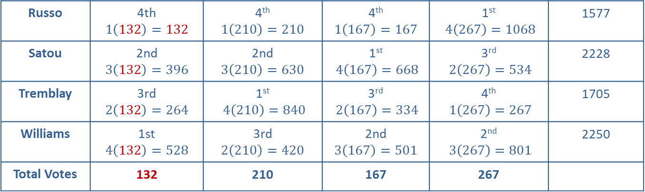
Example 4: Using the Borda Count Method—Slide 3
Table 9: Borda Count Tally
Rankings
Total Points
Russo | 4th $$1\left(132\right)=132$$ | 4th $$1\left(210\right)=210$$ | 4th $$1\left(167\right)=167$$ | 1st $4\left(267\right)=1068$ | 1577
Satou | 2nd $$3\left(132\right)=396$$ | 2nd $$3\left(210\right)=630$$ | 1st $4\left(167\right)=668$ | 3rd $2\left(267\right)=534$ | 2228
Tremblay | 3rd $$2\left(132\right)=264$$ | 1st $4\left(210\right)=840$ | 3rd $2\left(167\right)=334$ | 4th $1\left(267\right)=267$ | 1705
Williams | 1st $$4\left(132\right)=528$$ | 3rd $$2\left(210\right)=420$$ | 2nd $$3\left(167\right)=501$$ | 2nd $3\left(267\right)=801$ | 2250
Total Votes | 132 | 210 | 167 | 267

Slide 20
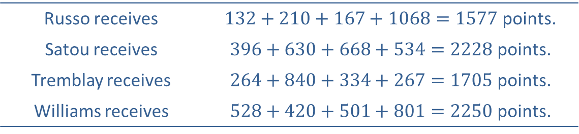
Example 4: Using the Borda Count Method—Slide 4
The final column in the table calculates each candidate's point total as follows.
Russo receives | $132+210+167+1068=1577$ points.
Satou receives | $396+630+668+534=2228$ points.
Tremblay receives | $264+840+334+267=1705$ points.
Williams receives | $528+420+501+801=2250$ points.
When we take into account the ranking preferences of all the voters, we have Williams as the overall winner with 2250 total points. Recall from the previous example that he received the fewest first-place votes.

Slide 21
Helpful Hint 1
The Plurality with Elimination Method is also referred to as instant run-off voting.

Slide 22
Example 5: Using the Plurality with Elimination Method—Slide 1
Use a plurality with elimination to determine a winner with the four candidates. The preference table is reprinted as Table 10.
Table 10: Preference Table for Candidates
Rankings
1st | Williams | Tremblay | Satou | Russo
2nd | Satou | Satou | Williams | Williams
3rd | Tremblay | Williams | Tremblay | Satou
4th | Russo | Russo | Russo | Tremblay
Total Votes | 132 | 210 | 167 | 267

Slide 23
Example 5: Using the Plurality with Elimination Method—Slide 2
Solution
In the plurality with elimination process, only first-place votes are considered in each counting cycle. By looking at the preference table, we know that each of the candidates has the following number of first-place votes. Recall that a majority of the votes in this election is 389.
Russo: | 267 first-place votes
Satou: | 167 first-place votes
Tremblay: | 210 first-place votes
Williams: | 132 first-place votes
We already know that Russo would win in a plurality contest with his 267 votes, but since he doesn’t have the required 389 votes for a majority, an elimination must happen. Since Williams has the least amount of first-place votes with 132, he is eliminated, as shown in Table 11.

Slide 24
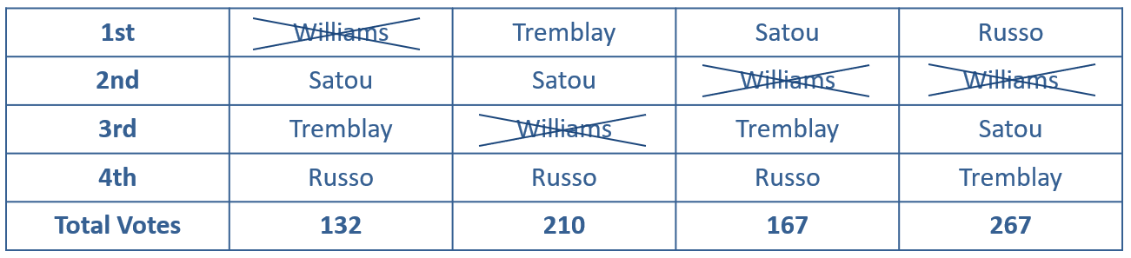
Example 5: Using the Plurality with Elimination Method—Slide 3
Table 11: Plurality with Elimination Cycle 1
Rankings
Now, the preference table must be adjusted accordingly. In the first column, Satou will now be ranked first, Tremblay second, and Russo third. In the second rankings column, Tremblay and Satou remain in first and second place, but Russo will move into third place. In the third rankings column, both Tremblay and Russo move up one place. Finally, in the last rankings column, Satou and Tremblay move up one place. The new preference table for the second cycle is shown in Table 12. Note that the total votes in the bottom row will stay the same in each cycle.

Slide 25
Example 5: Using the Plurality with Elimination Method—Slide 4
Table 12: Plurality with Elimination Cycle 1 Simplified
Rankings
1st | Satou | Tremblay | Satou | Russo
2nd | Tremblay | Satou | Tremblay | Satou
3rd | Russo | Russo | Russo | Tremblay
Total Votes | 132 | 210 | 167 | 267
Now, we recount the number of first-place votes for each candidate and determine if anyone has the required 389 votes for a majority.
Satou now has two rankings that place him in first place, which gives him a total of

Slide 26
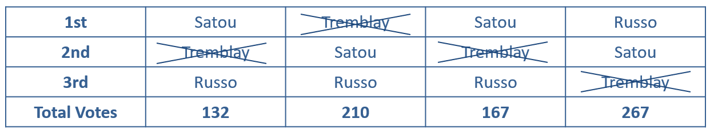
Example 5: Using the Plurality with Elimination Method—Slide 5
Tremblay and Russo remain the same with 210 and 267 first-place votes, respectively.
Although Satou is now the leader with 299 first place votes, he does not have a majority, so we must remove a candidate and continue with another elimination. This time it is Tremblay who has the least amount of first-place votes, so he is eliminated.
Table 13: Plurality with Elimination Cycle 2
Rankings
Adjusting the table in the same manner as before, we have the following preference table with the two remaining candidates, Satou and Russo.

Slide 27
Example 5: Using the Plurality with Elimination Method—Slide 6
Table 14: Plurality with Elimination Cycle 2
Rankings
1st | Satou | Satou | Satou | Russo
2nd | Russo | Russo | Russo | Satou
Total Votes | 132 | 210 | 167 | 267
Counting the votes, we see that Satou now has 132 + 210 + 167 = 509 first-place votes to Russo's 267. Therefore, Satou now wins with a majority of the first-place votes.

Slide 28
Definition: Number of Pairwise Comparisons
The number of pairwise comparisons that must be made if there are n candidates is

Slide 29
Helpful Hint 2
We can think of the number of pairwise comparisons as the combination of choosing two candidates from a pool of n candidates, or

Slide 30
Example 6: Using the Pairwise Comparison Method—Slide 1
Use the pairwise comparison method to determine a winner with our four candidates. The preference table is reprinted as Table 15.
Table 15: Preference Table for Candidates
Rankings
1st | Williams | Tremblay | Satou | Russo
2nd | Satou | Satou | Williams | Williams
3rd | Tremblay | Williams | Tremblay | Satou
4th | Russo | Russo | Russo | Tremblay
Total Votes | 132 | 210 | 167 | 267

Slide 31
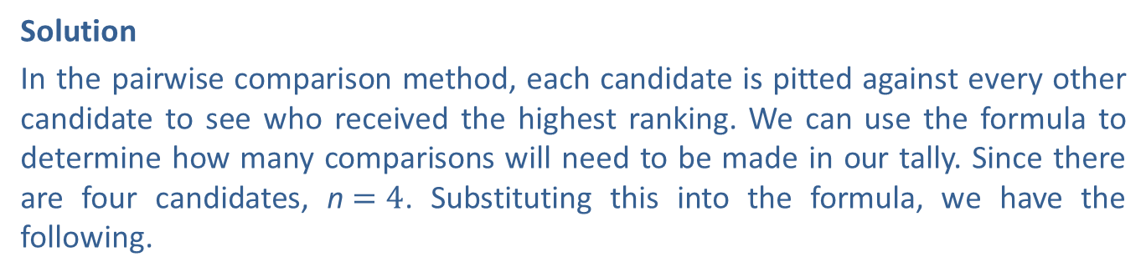
Example 6: Using the Pairwise Comparison Method—Slide 2
Solution
In the pairwise comparison method, each candidate is pitted against every other candidate to see who received the highest ranking. We can use the formula to determine how many comparisons will need to be made in our tally. Since there are four candidates, n$=4$. Substituting this into the formula, we have the following.
In order to help us keep track of all six comparisons, we'll create a table where each candidate has a column and a row. Since there is no need for comparisons between a candidate and himself, an X is placed in the cells that appear on the diagonal. Notice that each head‑to-head comparison is listed twice in the chart; that is, a comparison between Russo and Satou (Row 1, Column 2) is the same as a comparison between Satou and Russo (Row 2, Column 1). Since there is no need to duplicate the comparisons, we've grayed out the cells that are duplicates. Check for yourself that this leaves us with the required six comparisons.

Slide 32
Example 6: Using the Pairwise Comparison Method—Slide 3
Table 16: Pairwise Comparison Grid
 | Russo | Satou | Tremblay | Williams
Russo | X
Satou |  | X
Tremblay |  |  | X
Williams |  |  |  | X
In each head-to-head cell, list the candidate with the higher ranking from each of the four original rankings and the number of votes he received from that ranking. For the comparison in the Russo vs. Satou cell, we can create a table to compare the rankings for the two candidates.

Slide 33
Example 6: Using the Pairwise Comparison Method—Slide 4
Table 17: Head-to-Head Comparison for Russo and Satou
Rankings
Russo | 4th | 4th | 4th | 1st
Satou | 2nd | 2nd | 1st | 3rd
Total Votes | 132 | 210 | 167 | 267
Using Table 17, we can see that Satou is ranked higher in the first three columns, so he receives all of the votes for those rankings. The last 267 votes go to Russo in this head‑to‑head comparison. The same is done for each of the head-to-head matchups, and the results are shown in Table 18.

Slide 34
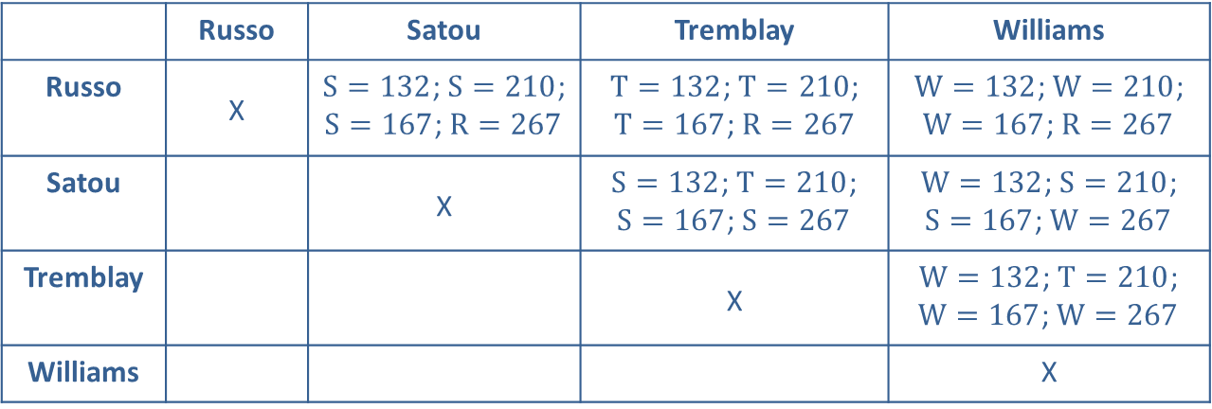
Example 6: Using the Pairwise Comparison Method—Slide 5
Table 18: Completed Pairwise Comparison Grid
 | Russo | Satou | Tremblay | Williams
Russo | X | $S=132$; $S=210$; $S=167$; $R=267$ | $T=132$; $T=210$; $T=167$; $R=267$ | $W=132$; $W=210$; $W=167$; $R=267$
Satou |  | X | $S=132$; $T=210$; $S=167$; $S=267$ | $W=132$; $S=210$; $S=167$; $W=267$
Tremblay |  |  | X | $W=132$; $T=210$; $W=167$; $W=267$
Williams |  |  |  | X
Once all of the votes have been awarded based on the different rankings, the overall winner in each head-to-head matchup is given 1 point. If there is a tie in the votes,
each candidate gets
of a point. Table 19 shows who received the point for each matchup.

Slide 35
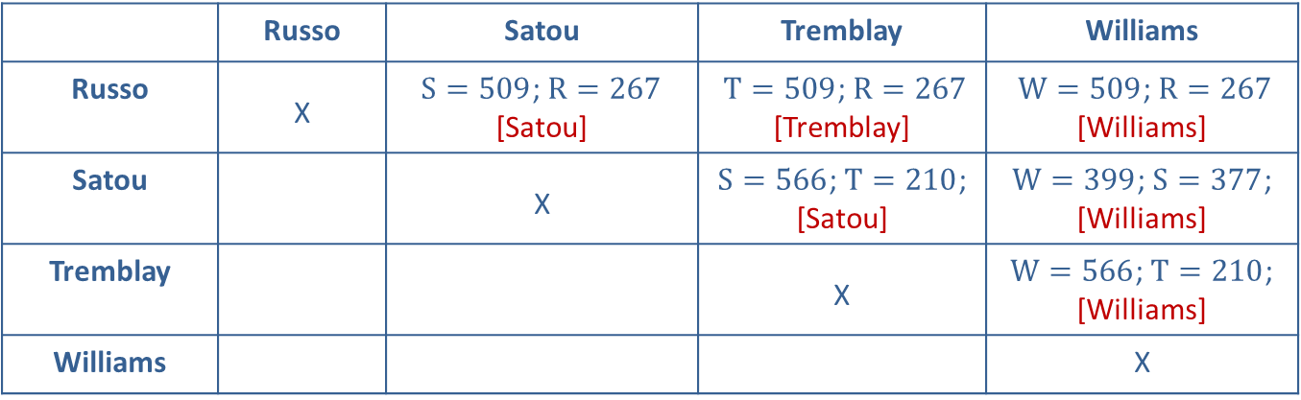
Example 6: Using the Pairwise Comparison Method—Slide 6
Table 19: Pairwise Comparison Grid of Winners
 | Russo | Satou | Tremblay | Williams
Russo | X | $S=509$; $R=267$ [Satou] | $T=509$; $R=267$ [Tremblay] | $W=509$; $R=267$ [Williams]
Satou |  | X | $S=566$; $T=210$; [Satou] | $W=399$; $S=377$; [Williams]
Tremblay |  |  | X | $W=566$; $T=210$; [Williams]
Williams |  |  |  | X
We can see that Russo received 0 points, Satou received 2 points, Tremblay received 1 point, and Williams received 3 points. Therefore, Williams is the winner when using the pairwise comparison method.

