Slide 1
Section 13.2
Flaws in Voting Methods

Slide 2
Definition: Condorcet Criterion
The Condorcet criterion states that if a candidate wins the head-to-head comparison against every other candidate, then he should also win the overall election in a fair voting system.

Slide 3
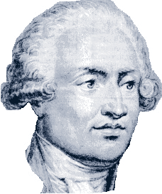
Math Milestone
Marie Jean Antoine Nicolas Caritat, the Marquis de Condorcet, known as Nicolas de Condorcet, was an 18th-century French mathematician and philosopher. After leading a very productive scientific and political career, he died mysteriously in a Paris prison cell after being arrested during the French Revolution for his political views.
Figure 1

Slide 4
Example 1: Condorcet Criterion and the Plurality Method—Slide 1
Three students are in an election for president of the National Society of Collegiate Scholars on campus. Members were asked to rank the three candidates. The results of the membership votes are shown in the following preference table.
Table 1: Preference Table for National Society of Collegiate Scholars
Rankings
1st | Charles | Charles | Andrew | Bethany
2nd | Bethany | Andrew | Charles | Charles
3rd | Andrew | Bethany | Bethany | Andrew
Total Votes | 30 | 31 | 65 | 21
a. ​Determine the winner if the society used the plurality method for determining the winner.
b. ​Determine the winner if the society used the pairwise comparison method to determine the winner.
c. ​Does the plurality method adhere to the Condorcet criterion for this election? Explain your answer.

Slide 5
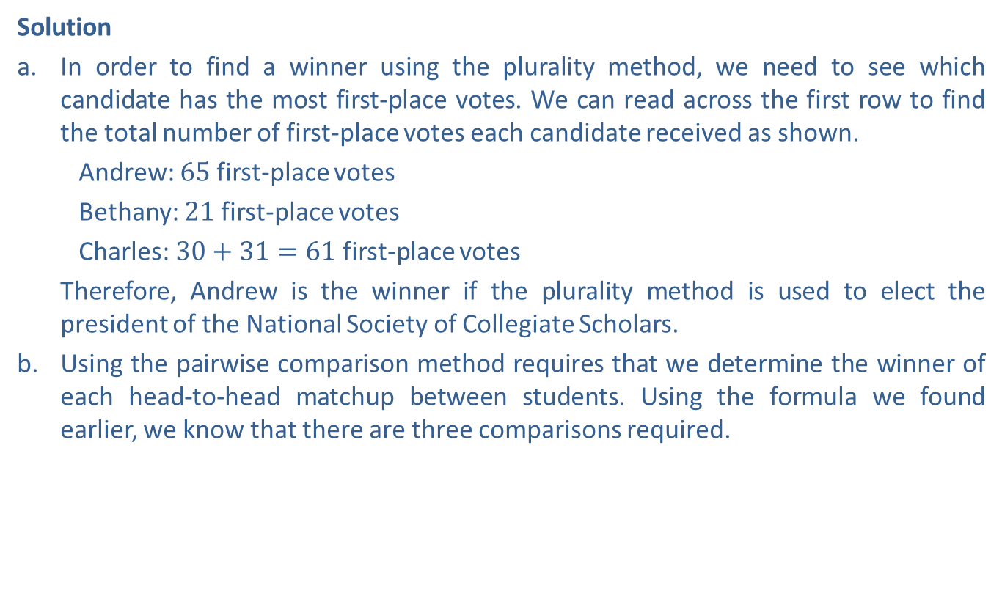
Example 1: Condorcet Criterion and the Plurality Method—Slide 2
Solution
a. ​In order to find a winner using the plurality method, we need to see which candidate has the most first-place votes. We can read across the first row to find the total number of first-place votes each candidate received as shown.
​Andrew: 65 first-place votes
​Bethany: 21 first-place votes
​Charles: $30+31=61$ first-place votes
Therefore, Andrew is the winner if the plurality method is used to elect the president of the National Society of Collegiate Scholars.
b. Using the pairwise comparison method requires that we determine the winner of each head-to-head matchup between students. Using the formula we found earlier, we know that there are three comparisons required.
Therefore, using a comparison table to keep track of the head-to-head comparison, we have the following.

Slide 6
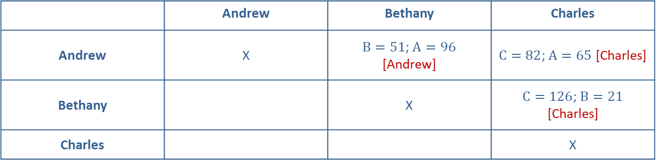
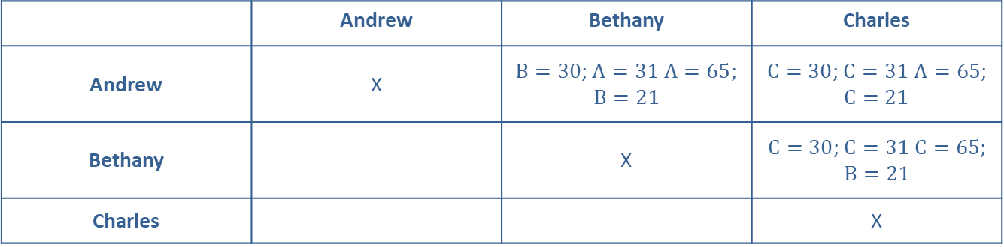
Example 1: Condorcet Criterion and the Plurality Method—Slide 3
Table 2: Completed Pairwise Comparison Grid
 | Andrew | Bethany | Charles
Andrew | X | $B=30$; $A=31$ $A=65$; $B=21$ | $C=30$; $C=31$ $A=65$; $C=21$
Bethany |  | X | $C=30$; $C=31$ $C=65$; $B=21$
Charles |  |  | X
Table 3: Pairwise Comparison Grid of Winners
 | Andrew | Bethany | Charles
Andrew | X | $B=51$; $A=96$ [Andrew] | $C=82$; $A=65$ [Charles]
Bethany |  | X | $C=126$; $B=21$ [Charles]
Charles |  |  | X

Slide 7
Example 1: Condorcet Criterion and the Plurality Method—Slide 4
​ Adding each candidate's votes together in the comparisons, we see that Andrew received 1 point while Charles received 2 points. Therefore, Charles is the winner using the pairwise comparison method. Notice that Charles won the head-to-head comparison against both of the other candidates, Andrew and Bethany.
c. ​In the pairwise comparison of the candidates, Charles wins the head‑to‑head comparisons against all other candidates. However, the plurality method chose Andrew as the winner. This means that for this election, the Condorcet criterion of fairness is violated by the plurality method.

Slide 8
Definition: Majority Criterion
The majority criterion states that if a candidate receives a majority of the votes in an election, that candidate should win.

Slide 9
Example 2: Majority Criterion and the Borda Count Method—Slide 1
In an election for chairman of the board of directors for a major company, shareholders were given the opportunity to rank the top five nominees. The results are posted in Table 4.
Table 4: Preference Table for Chairman Of The Board
Rankings
1st | H. Beridze | M. Gruber | T. Taylor | T. Taylor
2nd | L. Wright | R. Jensen | H. Beridze | H. Beridze
3rd | M. Gruber | H. Beridze | M. Gruber | L. Wright
4th | T. Taylor | T. Taylor | R. Jensen | M. Gruber
5th | R. Jensen | L. Wright | L. Wright | R. Jensen
Total Votes | 2300 | 3100 | 4000 | 2200
a. ​Determine the winner of the board elections using the majority rule decision.
b. Determine the winner of the board elections using the Borda count method.
c. Does the Borda count method satisfy the majority criterion for this election? Explain your answer.

Slide 10
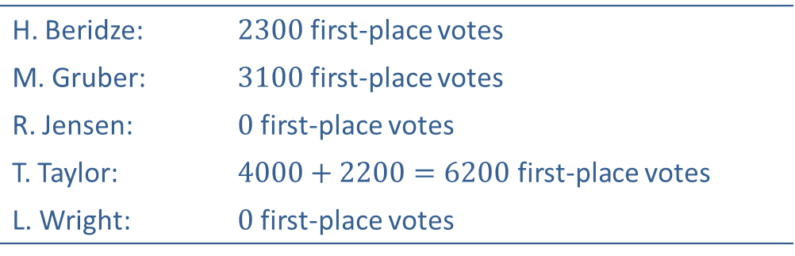
Example 2: Majority Criterion and the Borda Count Method—Slide 2
Solution
a. ​To find a winner using the majority rule decision, we simply count the number of firstplace votes for each candidate. They are as follows.
H. Beridze: | 2300 first-place votes
​M. Gruber: | 3100 first-place votes
R. Jensen: | 0 first-place votes
​T. Taylor: | $4000+2200=6200$ first-place votes
L. Wright: | 0 first-place votes
In order to win an election with a majority rule decision, a candidate needs more than half of the votes. In this case, there are 2300 + 3100 + 4000 + 2200 = 11,600 votes available. Half of the votes would be
So a minimum of 5801 votes are needed for a majority.

Slide 11
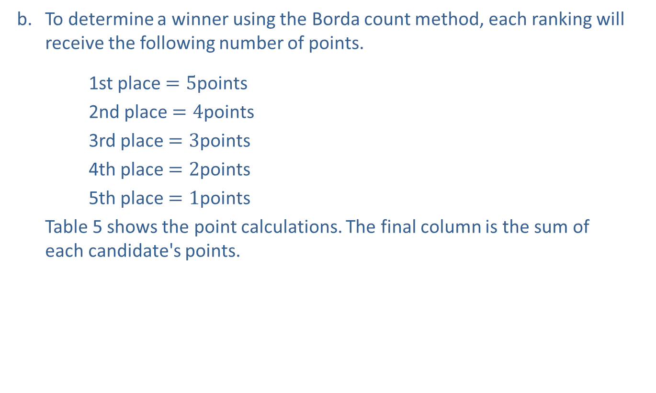
Example 2: Majority Criterion and the Borda Count Method—Slide 3
b. ​To determine a winner using the Borda count method, each ranking will receive the following number of points.
1st place $=5\text{points}$
​2nd place $=4\text{points}$
3rd place $=3\text{points}$
​4th place $=2\text{points}$
5th place $=1\text{points}$
Table 5 shows the point calculations. The final column is the sum of each candidate's points.
​

Slide 12
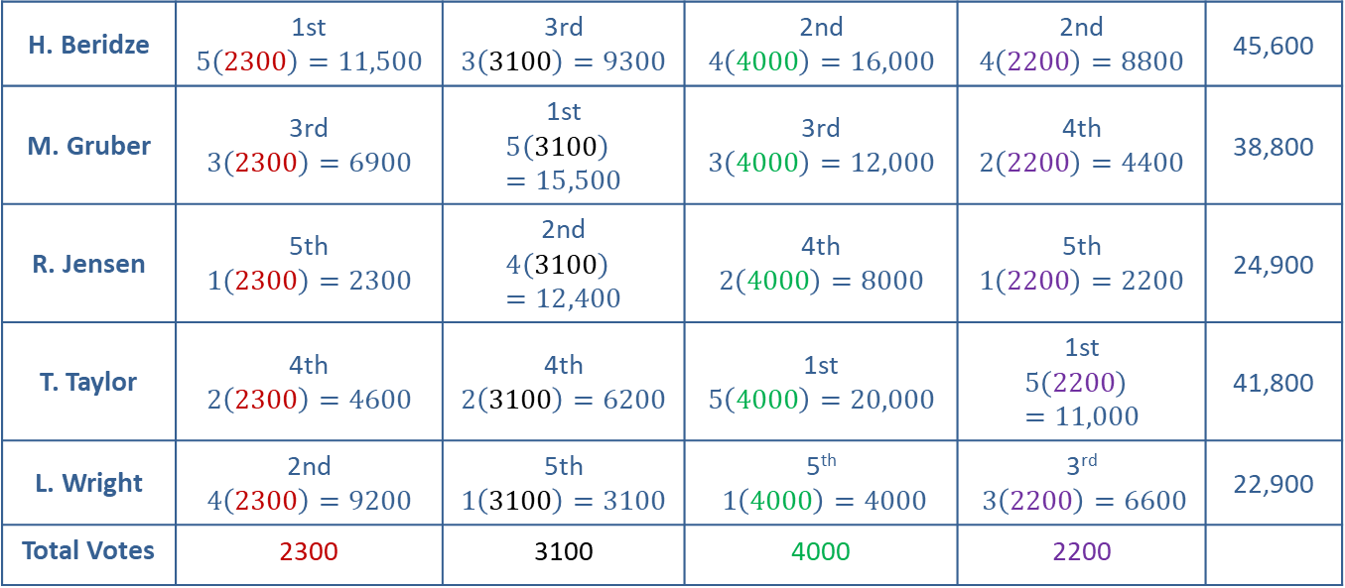
Example 2: Majority Criterion and the Borda Count Method—Slide 4
Table 5: Borda Count Tally for Chairman of the Board
Total Points
Rankings
H. Beridze | 1st $$5\left(2300\right)=11,500$$ | 3rd $$3\left(3100\right)=9300$$ | 2nd $$4\left(4000\right)=16,000$$ | 2nd $$4\left(2200\right)=8800$$ | 45,600
M. Gruber | 3rd $$3\left(2300\right)=6900$$ | 1st $$5\left(3100\right)=15,500$$ | 3rd $$3\left(4000\right)=12,000$$ | 4th $$2\left(2200\right)=4400$$ | 38,800
R. Jensen | 5th $$1\left(2300\right)=2300$$ | 2nd $$4\left(3100\right)=12,400$$ | 4th $$2\left(4000\right)=8000$$ | 5th $$1\left(2200\right)=2200$$ | 24,900
T. Taylor | 4th $$2\left(2300\right)=4600$$ | 4th $$2\left(3100\right)=6200$$ | 1st $$5\left(4000\right)=20,000$$ | 1st $$5\left(2200\right)=11,000$$ | 41,800
L. Wright | 2nd $$4\left(2300\right)=9200$$ | 5th $$1\left(3100\right)=3100$$ | 5th $1\left(4000\right)=4000$ | 3rd $3\left(2200\right)=6600$ | 22,900
Total Votes | 2300 | 3100 | 4000 | 2200

Slide 13
Example 2: Majority Criterion and the Borda Count Method—Slide 5
From the final column, it is clear that H. Beridze is the winner with 45,600 points using the Borda count method.
c. ​Using the Borda count method, H. Berdize would be declared the winner. However, T. Taylor received a majority of the votes and would win using the majority rule method. Therefore, the Borda count method does not satisfy the majority rule criterion in this election.

Slide 14
Definition: Monotonicity Criterion
The monotonicity criterion states that if a candidate wins an early round of an election and only gains support and does not lose support in subsequent rounds, then that candidate should win the election.

Slide 15
Example 3: Monotonicity Criterion and the Plurality with Elimination Method—Slide 1
The city council for the town of Whitman voted to elect a new vice president. All council members were asked to rank the four candidates in order of preference. Show that by using the plurality with elimination method, the monotonicity criterion is violated. Table 6 shows the results of the vote.
Table 6: Preference Table for Whitman City Council Vice President
Rankings
1st | Clarke | Roberts | Green | Green
2nd | Green | Clarke | Roberts | White
3rd | Roberts | White | Clarke | Clarke
4th | White | Green | White | Roberts
Total Votes | 6 | 5 | 4 | 2

Slide 16
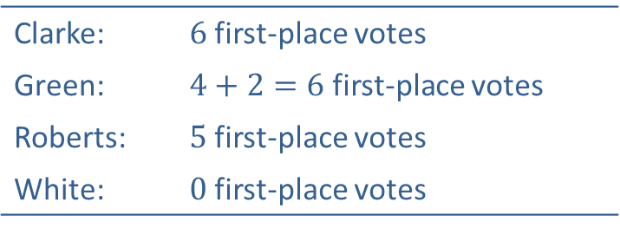
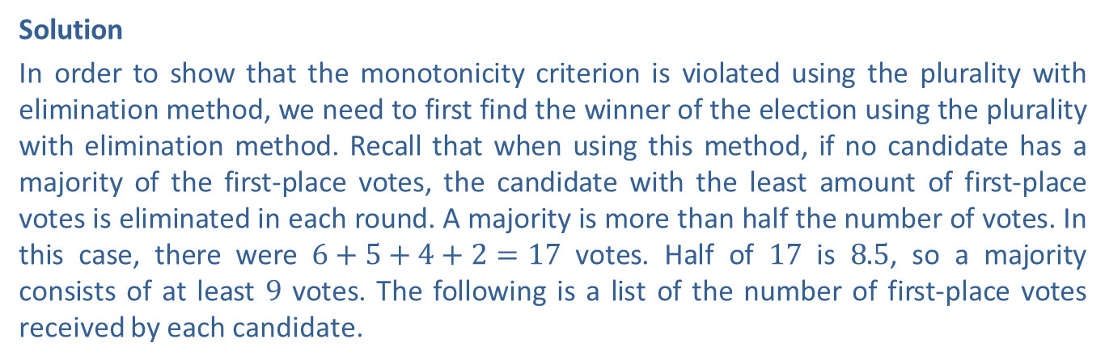
Example 3: Monotonicity Criterion and the Plurality with Elimination Method—Slide 2
Solution
In order to show that the monotonicity criterion is violated using the plurality with elimination method, we need to first find the winner of the election using the plurality with elimination method. Recall that when using this method, if no candidate has a majority of the first-place votes, the candidate with the least amount of first-place votes is eliminated in each round. A majority is more than half the number of votes. In this case, there were $6+5+4+2=17$ votes. Half of 17 is 8.5, so a majority consists of at least 9 votes. The following is a list of the number of first-place votes received by each candidate.
Clarke: | 6 first-place votes
Green: | $4+2=6$ first-place votes
Roberts: | 5 first-place votes
White: | 0 first-place votes
Therefore, since no candidate had a majority of votes, White is eliminated with the least amount of first-place votes.

Slide 17
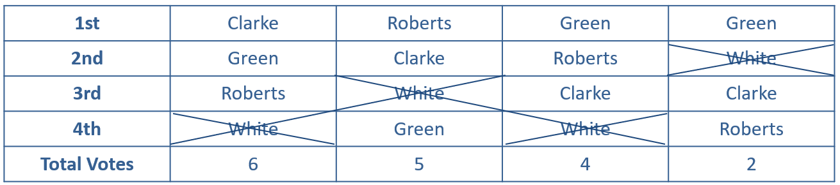
Example 3: Monotonicity Criterion and the Plurality with Elimination Method—Slide 3
Table 7: Plurality with Elimination Cycle 1
Rankings
Note that White did not have any first-place votes, so none of our vote counts change when he is eliminated. So the candidate with the next smallest number of first-place votes, Roberts, is eliminated next.

Slide 18
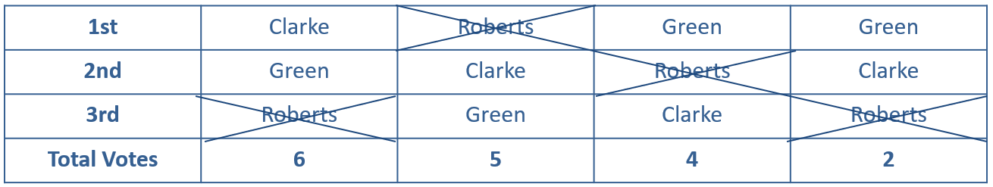
Example 3: Monotonicity Criterion and the Plurality with Elimination Method—Slide 4
Table 8: Plurality with Elimination Cycle 2
Rankings
That leaves Green and Clarke as the only remaining candidates. Table 9 shows the standings without White and Roberts.
Table 9: Plurality with Elimination Cycle 2 Simplified
Rankings
1st | Clarke | Clarke | Green | Green
2nd | Green | Green | Clarke | Clarke
Total Votes | 6 | 5 | 4 | 2

Slide 19
Example 3: Monotonicity Criterion and the Plurality with Elimination Method—Slide 5
We can now compare Green and Clark and determine the winner. Clarke wins in the first two columns of rankings, but Green wins in the final two. Therefore, Clarke has 11 first-place votes and Green has six. Clarke is the winner using the plurality with elimination method.
In order to show that the monotonicity criterion is violated using this method, we need to show that a different winner is produced if some of the council members change their votes in such a way that the winner, Clarke, increases his ranking while the order of the other candidates stays the same. Suppose that the two voters in the last column of the original preference table changed their rankings to place Clarke first. You can see that their rankings for the other candidates stay in the same preference order (Green, White, then Roberts).

Slide 20
Example 3: Monotonicity Criterion and the Plurality with Elimination Method—Slide 6
Table 10: Whitman City Council Vice President Original Election
Rankings
1st | Clarke | Roberts | Green | Green
2nd | Green | Clarke | Roberts | White
3rd | Roberts | White | Clarke | Clarke
4th | White | Green | White | Roberts
Total Votes | 6 | 5 | 4 | 2
Table 11: Whitman City Council Vice President Second Election
Rankings
1st | Clarke | Roberts | Green | Clarke
2nd | Green | Clarke | Roberts | Green
3rd | Roberts | White | Clarke | White
4th | White | Green | White | Roberts
Total Votes | 6 | 5 | 4 | 2

Slide 21
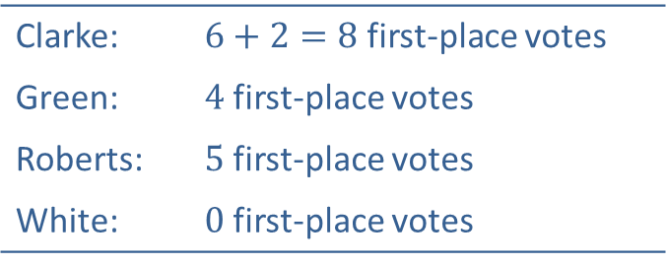
Example 3: Monotonicity Criterion and the Plurality with Elimination Method—Slide 7
We will once again use the plurality with elimination method. Each candidate has the following number of first-place votes.
Clarke: | $6+2=8$ first-place votes
Green: | 4 first-place votes
Roberts: | 5 first-place votes
White: | 0 first-place votes
Once again, White is eliminated without affecting any of the first-place votes. Therefore, we look to find the candidate with the next lowest number of first-place votes. This time, Green is eliminated with only four votes. The following preference table shows both White and Green eliminated.

Slide 22
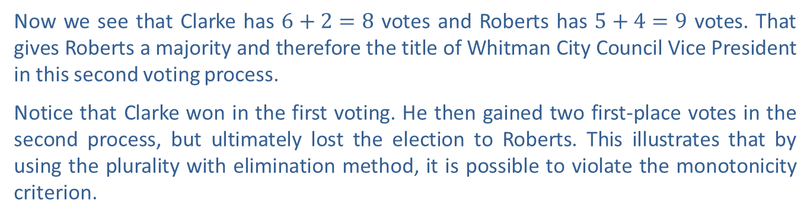
Example 3: Monotonicity Criterion and the Plurality with Elimination Method—Slide 8
Table 12: Plurality with Elimination Cycles 1 and 2 Simplified
Rankings
1st | Clarke | Roberts | Roberts | Clarke
2nd | Roberts | Clarke | Clarke | Roberts
Total Votes | 6 | 5 | 4 | 2
Now we see that Clarke has $6+2=8$ votes and Roberts has $5+4=9$ votes. That gives Roberts a majority and therefore the title of Whitman City Council Vice President in this second voting process.
Notice that Clarke won in the first voting. He then gained two first-place votes in the second process, but ultimately lost the election to Roberts. This illustrates that by using the plurality with elimination method, it is possible to violate the monotonicity criterion.

Slide 23
Definition: Irrelevant Alternative Criterion
The irrelevant alternatives criterion states that if a candidate wins an election, then that same candidate would win the election even if at least one candidate withdraws from the election.

Slide 24
Example 4: Irrelevant Alternatives Criterion and the Pairwise Method of Comparison—Slide 1
As part of the process of choosing the next chancellor of the university, faculty members were asked to rank the four finalists in order of preference. Table 13 summarizes their votes.
Table 13: Preference Table for Chancellor
Rankings
1st | Khan | Khan | Patel | Mason | Mason
2nd | Patel | Lewis | Lewis | Lewis | Khan
3rd | Mason | Patel | Mason | Khan | Lewis
4th | Lewis | Mason | Khan | Patel | Patel
Total Votes | 166 | 290 | 235 | 123 | 236

Slide 25
Example 4: Irrelevant Alternatives Criterion and the Pairwise Method of Comparison—Slide 2
a. Use the pairwise comparison method to determine the favorite candidate among the faculty.
b. Before a chancellor could be named, Patel took a job elsewhere and Lewis decided the university was not the right fit for him after visiting the campus. Consequently, Patel and Lewis withdrew their names from the application pool. Determine the faculty favorite after Patel and Lewis are removed from the ballot.
c. Based on your solutions to parts a. and b., does this election comply with the irrelevant alternative criterion?

Slide 26
Example 4: Irrelevant Alternatives Criterion and the Pairwise Method of Comparison—Slide 3
Solution
a. The pairwise comparison method requires that we determine the winner of each head-to-head matchup between the candidates. Using the formula, we know that there are six comparisons required.
​
Using a table to keep track of the head-to-head comparisons, we have the following.

Slide 27
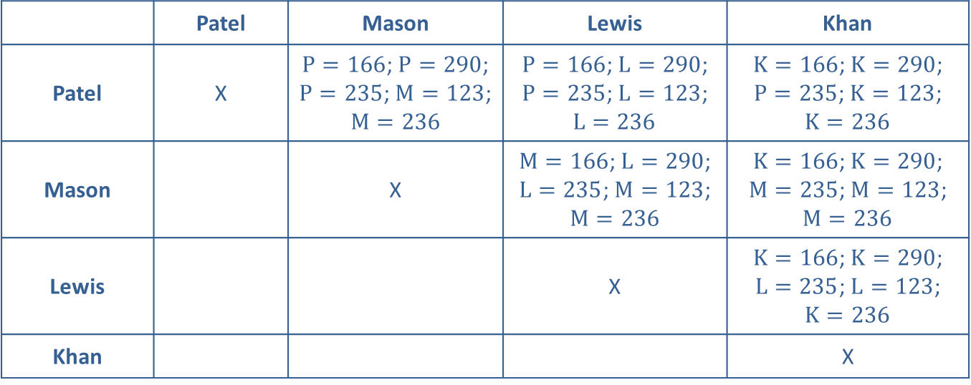
Example 4: Irrelevant Alternatives Criterion and the Pairwise Method of Comparison—Slide 4
Table 14: Completed Pairwise Comparison Grid for Chancellor
 | Patel | Mason | Lewis | Khan
Patel | X | $P=166$; $P=290$; $P=235$; $M=123$; $M=236$ | $P=166$; $L=290$; $P=235$; $L=123$; $L=236$ | $K=166$; $K=290$; $P=235$; $K=123$; $K=236$
Mason |  | X | $M=166$; $L=290$; $L=235$; $M=123$; $M=236$ | $K=166$; $K=290$; $M=235$; $M=123$; $M=236$
Lewis |  |  | X | $K=166$; $K=290$; $L=235$; $L=123$; $K=236$
Khan |  |  |  | X

Slide 28
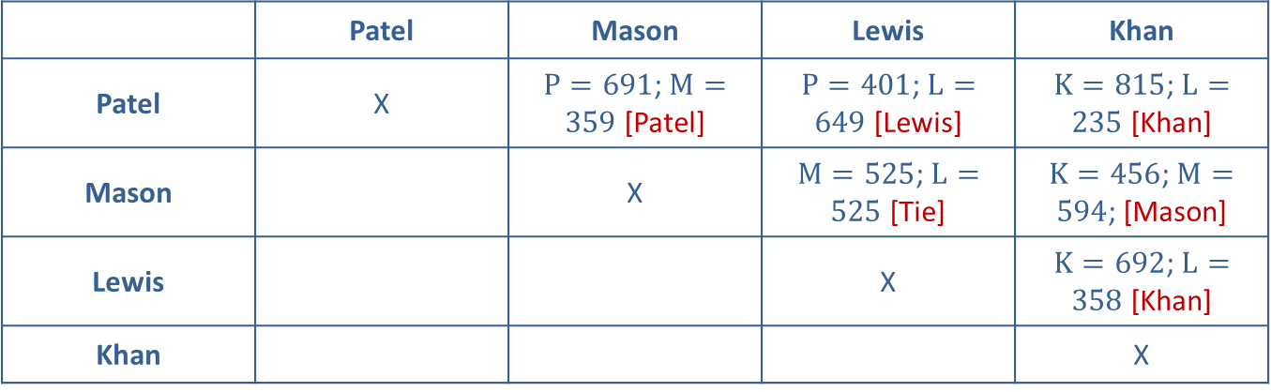
Example 4: Irrelevant Alternatives Criterion and the Pairwise Method of Comparison—Slide 5
Table 15: Pairwise Comparison Grid of Winners for Chancellor
 | Patel | Mason | Lewis | Khan
Patel | X | $P=691$; $M=359$ [Patel] | $P=401$; $L=649$ [Lewis] | $K=815$; $L=235$ [Khan]
Mason |  | X | $M=525$; $L=525$ [Tie] | $K=456$; $M=594$; [Mason]
Lewis |  |  | X | $K=692$; $L=358$ [Khan]
Khan |  |  |  | X

Slide 29
Example 4: Irrelevant Alternatives Criterion and the Pairwise Method of Comparison—Slide 6
b. ​Adding each candidate's votes together in the comparisons, we see that Patel received 1 point, Mason received
Lewis received
and Khan received 2 points. Therefore, Khan is the winner using the pairwise method of comparison.​When both Patel and Lewis withdraw from the race, only Mason and Khan remain. We know from the head-to-head comparison in Table 15, that when these two face one another, Mason is the winner. Therefore, Mason is the winner using the pairwise comparison method after Patel and Lewis withdraw.
c. ​Using the pairwise comparison method both before and after Patel and Lewis withdrew resulted in two different winners. Therefore, this method did not satisfy the irrelevant alternative criterion in this election.

Slide 30
Helpful Hint
Remember that in a head-to-head comparison, a tie gives each candidate
of a point.

Slide 31
Definition: Dictator Criterion
The dictator criterion states that no single vote is allowed to decide the outcome of an election.

