Slide 1
Section 13.3
Apportionment

Slide 2
Definition: Apportionment
Apportionment is a method of fairly dividing resources or items among individuals or groups.

Slide 3
Fun Fact
The US Census is mandated by Article 1 of the Constitution. Every 10 years the government must count the US population. A state's census population then determines the number of representatives it receives in the House of Representatives. For more information on the US Census, visit https://www.census.
gov/programs-surveys/decennial-census/decade/2020/2020-census-main.html

Slide 4
Definition: Standard Divisor
The standard divisor for apportionment is the average number of people per item to be apportioned.

Slide 5
Helpful Hint 1
When computing standard divisor, we will round to four decimal places.

Slide 6
Example 1: Finding the Standard Divisor
At the beginning of each school year, the student body is given 9 delegates on the governing board. The delegates are divided among the four classes (freshmen, sophomores, juniors, seniors) according to student population. Calculate the standard divisor that will be used to assign the delegates.
Table 1: Student Body Class Size
Freshmen | Sophomores | Juniors | Seniors
224 | 267 | 135 | 169
Solution
To calculate the standard divisor, divide the total number of students in the school by the number of delegates to be shared out.
Thus, each student delegate will represent approximately 88.3333 students.

Slide 7
Skill Check 1
A local council has 12 seats. If there are 301,500 people in the district, determine the standard divisor that would be used to apportion the seats.
Answer: 25,125

Slide 8
Definition: Standard Quota
The standard quota for apportionment is the average number of items to be apportioned to each subgroup.

Slide 9
Helpful Hint 2
When computing standard quota, we will round to four decimal places.

Slide 10
Example 2: Finding the Standard Quota—Slide 1
Use the information from Example 1 to determine the standard quota of representatives for each student class on the school governing board. The class sizes are reprinted for you here.
Table 2: Student Body Class Size
Freshmen | Sophomores | Juniors | Seniors
224 | 267 | 135 | 169

Slide 11
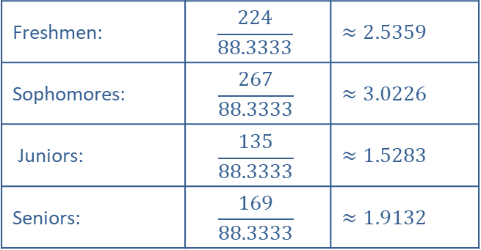
Example 2: Finding the Standard Quota—Slide 2
Solution
In order to find the standard quota for each subpopulation, we need to divide each class size by the standard divisor, which was calculated in Example 1 as 88.3333.
Standard Quotes
Freshmen: | $$\frac{224}{88.3333}$$ | $$≈2.5359$$
Sophomores: | $$\frac{267}{88.3333}$$ | $$≈3.0226$$
Juniors: | $$\frac{135}{88.3333}$$ | $$≈1.5283$$
Seniors: | $$\frac{169}{88.3333}$$ | $$≈1.9132$$

Slide 12
Skill Check 2
Three classes have student populations of 87, 52, and 89, respectively. Determine the standard quota for each class given that the standard divisor is 13.4.
Answer: 6.4925; 3.8806; 6.6418

Slide 13
Procedure: Hamilton's Method of Apportionment
1. Calculate the standard divisor.
2. Calculate the standard quota for each subgroup.
3. ​Calculate the lower quota for each subgroup.
4. Assign each subgroup the number of resources based on its lower quota.
5. Assign any remaining resources based on the fractional remainder of the standard quotas, in order from largest to smallest.

Slide 14
Math Milestone
Before it was ever used, Hamilton's method of apportionment was vetoed by President Washington in 1791, becoming the first veto by a US President. It was later adopted in 1850 and used until 1910.

Slide 15
Example 3: Applying Hamilton's Method—Slide 1
A new suburb of Chicago is seeking a charter to become a city of its own. The suburb will have 25 council members divided among six zones. Use Hamilton's method to determine how the council members will be apportioned between the six zones. The populations for each zone are given in Table 5.
Table 5: Suburb Population by Zone
Zone | Population
1 | 2897
2 | 4538
3 | 3362
4 | 14,003
5 | 8450
6 | 12,339

Slide 16
Example 3: Applying Hamilton's Method—Slide 2
Solution
Begin by calculating the standard divisor. Add all of the subpopulations together and divide by the number of members to be apportioned, which is 25.
Next, calculate the standard quota for each subgroup. We will extend the table to help us keep track of the calculations.

Slide 17
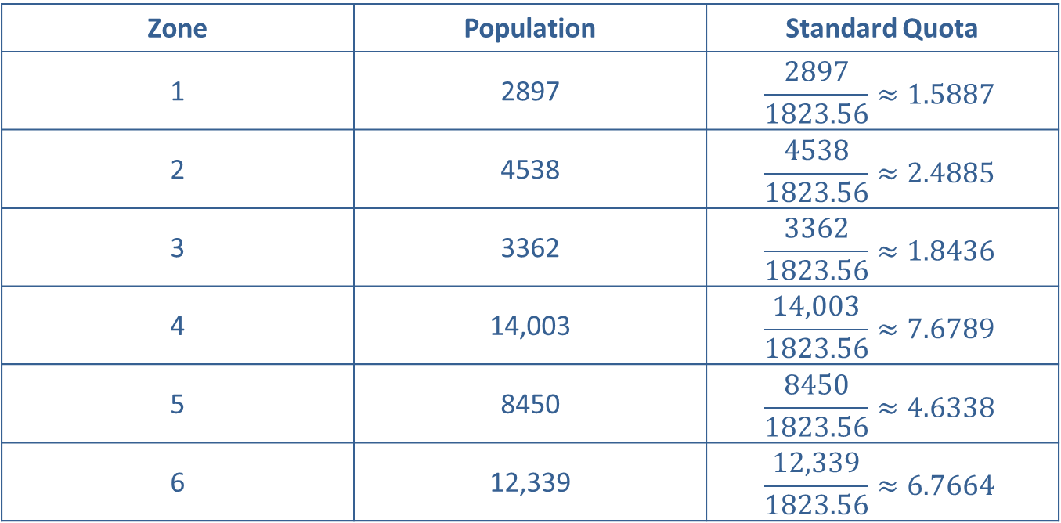
Example 3: Applying Hamilton's Method—Slide 3
Table 6: Suburb Population by Zone
Zone | Population | Standard Quota
1 | 2897 | $$\frac{2897}{1823.56}≈1.5887$$
2 | 4538 | $$\frac{4538}{1823.56}≈2.4885$$
3 | 3362 | $$\frac{3362}{1823.56}≈1.8436$$
4 | 14,003 | $$\frac{14,003}{1823.56}≈7.6789$$
5 | 8450 | $$\frac{8450}{1823.56}≈4.6338$$
6 | 12,339 | $$\frac{12,339}{1823.56}≈6.7664$$

Slide 18
Example 3: Applying Hamilton's Method—Slide 4
To calculate the lower quota for each zone, we round each standard quota down. Thus, we have the following lower quotas.
Table 7: Suburb Population by Zone
Zone | Population | Standard Quota | Lower Quotas
1 | 2897 | 1.5887 | 1
2 | 4538 | 2.4885 | 2
3 | 3362 | 1.8436 | 1
4 | 14,003 | 7.6789 | 7
5 | 8450 | 4.6338 | 4
6 | 12,339 | 6.7664 | 6

Slide 19

Example 3: Applying Hamilton's Method—Slide 5
If we allocate the lower quotas for each zone, we apportion $1+2+1+7+4+6=21$ council seats. That leaves four seats to hand out. Hamilton's method states that we give the four leftover seats to the four subgroups with the largest fractional remainders in their standard quotas.
We will reorder the zones according to their fractional remainder (greatest to least) to help us see which zones get the extra seats.

Slide 20
Example 3: Applying Hamilton's Method—Slide 6
Table 8: Suburb Population by Zone
Zone | Population | Standard Quota Sorted by Fractional Remainder
3 | 3362 | 1.8436
6 | 12,339 | 6.7664
4 | 14,003 | 7.6789
5 | 8450 | 4.6338
1 | 2897 | 1.5886
2 | 4538 | 2.4885
Therefore, Zones 3, 6, 4, and 5 each get1additional council seat. So the council seats are apportioned as follows.

Slide 21
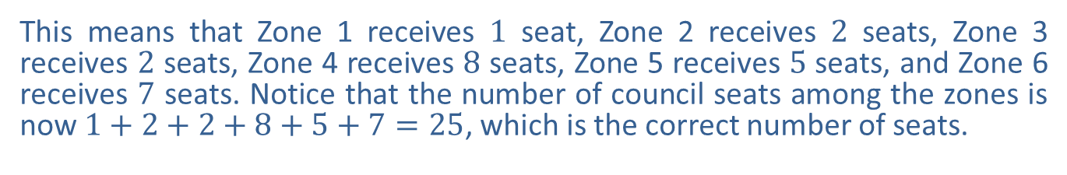
Example 3: Applying Hamilton's Method—Slide 7
Table 9: Suburb Population by Zone
Zone | Population | Standard Quota | Lower Quota | Distribution of Remaining Council Seats | New Apportionment
1 | 2897 | 1.5886 | 1 |  | 1
2 | 4538 | 2.4885 | 2 |  | 2
3 | 3362 | 1.8436 | 1 | 1 | 2
4 | 14,003 | 7.6789 | 7 | 1 | 8
5 | 8450 | 4.6338 | 4 | 1 | 5
6 | 12,339 | 6.7664 | 6 | 1 | 7
Total | 45,589 |  | 21 |  | 25
This means that Zone 1 receives 1 seat, Zone 2 receives 2 seats, Zone 3 receives 2 seats, Zone 4 receives 8 seats, Zone 5 receives 5 seats, and Zone 6 receives 7 seats. Notice that the number of council seats among the zones is now $1+2+2+8+5+7=25$, which is the correct number of seats.

Slide 22
Procedure: Jefferson's Method of Apportionment
1.​ Calculate the standard divisor.
2.​ Calculate the standard quota for each subgroup.
3. Calculate the lower quota for each subgroup.
4. Assign each subgroup the number of resources based on its lower quota.
5. If there are remaining resources to be distributed, chose a modified divisor by trial and error until the sum of the lower quotas equals the number of resources to be apportioned.

Slide 23
Math Milestone 1
The Jefferson method of apportionment was used to apportion US House representatives were apportioned using the Jefferson Method for 40 years, from 1790 to 1830.

Slide 24
Example 4: Applying Jefferson's Method—Slide 1
A university has 18 scholarships to be apportioned among 225 math majors, 417 history majors, and 308 computer science majors. Use Jefferson's method to determine how the scholarships should be apportioned among the three major groups.
Solution
Begin by calculating the standard divisor. Add all of the subpopulations together and divide by the number of scholarships to be apportioned, 18.
Next, steps 2 and 3 of Jefferson's method say to calculate the standard quota and lower quota for each subgroup.

Slide 25
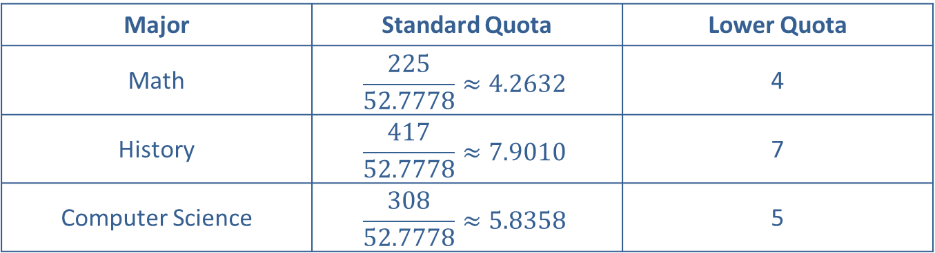
Example 4: Applying Jefferson's Method—Slide 2
Table 10: Standard and Lower Quotas
Major | Standard Quota | Lower Quota
Math | $$\frac{225}{52.7778}≈4.2632$$ | 4
History | $$\frac{417}{52.7778}≈7.9010$$ | 7
Computer Science | $$\frac{308}{52.7778}≈5.8358$$ | 5
Total scholarships 16
This gives out 16 scholarships—two short of the number needed. Jefferson's method tells us that we should modify the divisor either up or down and find the modified quotas. Because we need larger quotas, we want a smaller divisor. Rounding the standard divisor down to 52, we now calculate the modified quotas as shown in Table 11. Remember this is a trial-and-error process, so we could technically choose any number for the modified divisor.

Slide 26
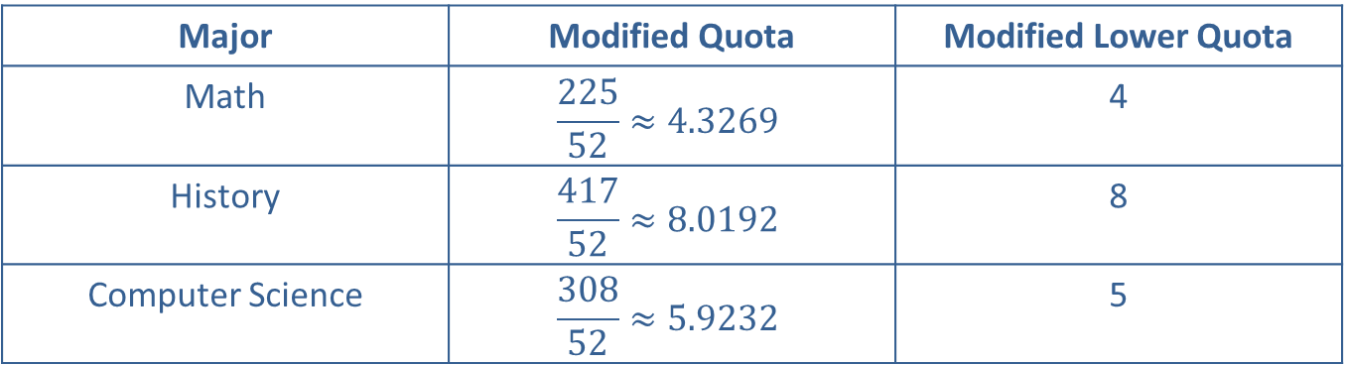
Example 4: Applying Jefferson's Method—Slide 3
Table 11: Modified Quotas and Modified Lower Quotas with a Modified Divisor of 52
Major | Modified Quota | Modified Lower Quota
Math | $$\frac{225}{52}≈4.3269$$ | 4
History | $$\frac{417}{52}≈8.0192$$ | 8
Computer Science | $$\frac{308}{52}≈5.9232$$ | 5
Total scholarships 17
Notice that we have not apportioned all 18 scholarships. So we need adjust the modified divisor once again. Let's use 51 for our divisor this time. The new modified quotas are calculated in Table 12.

Slide 27
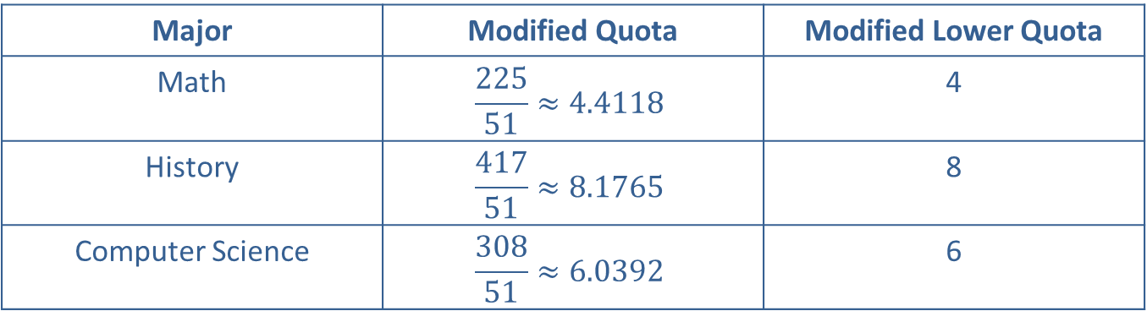
Example 4: Applying Jefferson's Method—Slide 4
Table 12: Modified Quotas and Modified Lower Quotas with a Modified Divisor of 51
Major | Modified Quota | Modified Lower Quota
Math | $$\frac{225}{51}≈4.4118$$ | 4
History | $$\frac{417}{51}≈8.1765$$ | 8
Computer Science | $$\frac{308}{51}≈6.0392$$ | 6
Total scholarships 18
Finally, we have the correct number of scholarships apportioned. Four math majors, eight history majors, and six computer science majors will receive scholarships.

Slide 28
Skill Check 3
Use Hamilton's method to apportion the scholarships in Example 4.
Answer: Math 4; History 8; Computer Science 6

Slide 29
Procedure: Webster's Method of Apportionment
1. ​Calculate the standard divisor.
2. ​Calculate the standard quota for each subgroup.
3. ​Round each quota to the nearest integer.
4. ​Assign each subgroup the number of resources based on the rounded quota.
5. ​If there are remaining resources to be distributed, chose a modified divisor by trial and error until the sum of the rounded quotas equals the number of resources to be apportioned.

Slide 30
Math Milestone 2
Webster’s method was used by the US House of Representatives after the 1840 census. From 1850 to 1900, Congress finally decided to adopt Hamilton’s original method. Webster’s method was later readopted and used from 1910 to 1940.

Slide 31
Example 5: Applying Webster's Method—Slide 1
A computer tech firm has three divisions with 135, 98, and 132 employees, respectively. A total of 11 administrative assistants must be allocated to the three divisions according to their size. Use Webster's method to determine how many administrative assistants should be allocated to each division.
Solution
Begin by calculating the standard divisor. Add all of the subpopulations together and divide by the number of assistants to be apportioned, which is 11.
Steps 2 and 3 in Webster's method say to find the standard quotas for each subgroup and round to the nearest integer. The calculations are shown in Table 13.

Slide 32
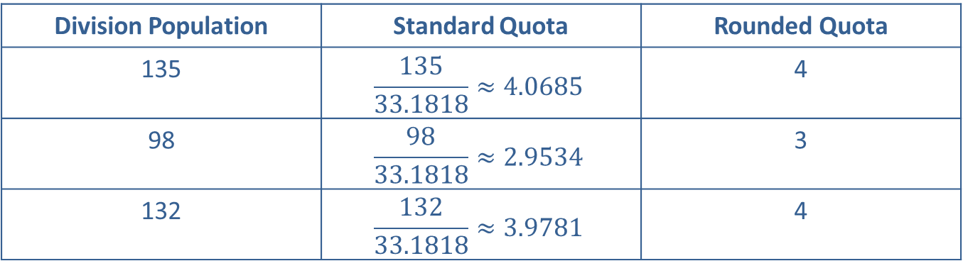
Example 5: Applying Webster's Method—Slide 2
Table 13: Standard Quotas and Rounded Quotas for Administrative Assistants
Division Population | Standard Quota | Rounded Quota
135 | $$\frac{135}{33.1818}≈4.0685$$ | 4
98 | $$\frac{98}{33.1818}≈2.9534$$ | 3
132 | $$\frac{132}{33.1818}≈3.9781$$ | 4
Total Assistants 11
We can see from the bottom row that we have allocated all eleven administrative assistants to the respective divisions. The first division has 4 administrative assistants, the second division has 3, and the third division has 4.

Slide 33

Skill Check 4
Use Hamilton's method to apportion the administrative assistants in Example 5.
Answer: $\text{Div}\text{. }\text{Pop} 135=4$; $\text{Div}\text{. }\text{Pop} 98=3$; $\text{Div}\text{. }\text{Pop} 132=4$

Slide 34
Definition: Geometric Mean
The geometric mean of any two numbers m and n is

Slide 35
Procedure: The Huntington-Hill Method of Apportionment
1. ​Calculate the standard divisor.
2. Calculate the standard quota for each subgroup.
3. ​Calculate the geometric mean of the standard quota for each subgroup.
4. ​If the standard quota is less than the geometric mean, round the quota down. If the standard quota is greater than the geometric mean, round the quota up.
5. ​Assign each subgroup the number of resources based on the rounded quota.
6. ​If there are remaining resources to be distributed, chose a modified divisor by trial and error until the sum of the rounded quotas equals the number of resources to be apportioned.

Slide 36
Example 6: Applying the Huntington-Hill Method—Slide 1
After a census, 100 seats in parliament need to be re-apportioned among 5 counties with the following populations. Use the Huntington-Hill method to apportion the seats.
Table 14: Population per County
County | Population
1 | 35,589
2 | 17,425
3 | 3658
4 | 11,457
5 | 6871
Total | 75,000

Slide 37
Example 6: Applying the Huntington-Hill Method—Slide 2
Solution
Begin by calculating the standard divisor. The total population is given in the table as 75,000.
Step 2 of the Huntington-Hill method says to find the standard quotas for each subgroup. The calculations are shown in Table 15.

Slide 38
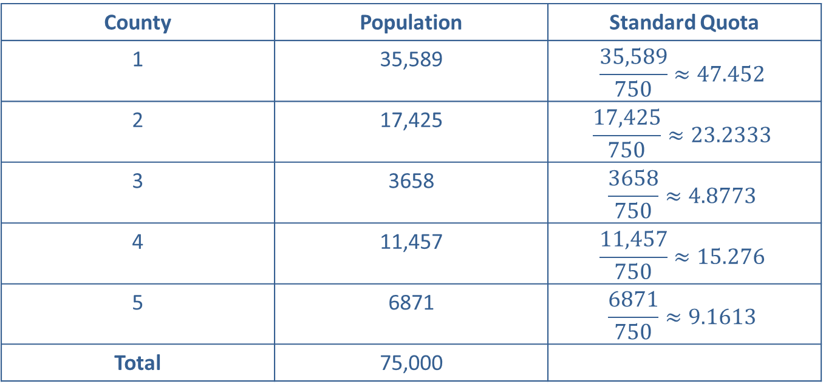
Example 6: Applying the Huntington-Hill Method—Slide 3
Table 15: Standard Quotas by County
County | Population | Standard Quota
1 | 35,589 | $$\frac{35,589}{750}≈47.452$$
2 | 17,425 | $$\frac{17,425}{750}≈23.2333$$
3 | 3658 | $$\frac{3658}{750}≈4.8773$$
4 | 11,457 | $$\frac{11,457}{750}≈15.276$$
5 | 6871 | $$\frac{6871}{750}≈9.1613$$
Total | 75,000

Slide 39
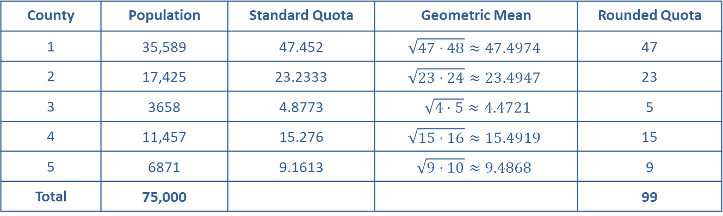
Example 6: Applying the Huntington-Hill Method—Slide 4
The next step is to take the geometric mean of each standard quota. This is the square root of the product of the lower quota and the upper quota. We then compare the standard quota to the geometric mean. If the standard quota is less than the geometric mean, we round it down. If the standard quota is greater than the geometric mean, we round it up. The calculations are shown in Table 16.
Table 16: Rounded Quotas per County
County | Population | Standard Quota | Geometric Mean | Rounded Quota
1 | 35,589 | 47.452 | $$\sqrt{47⋅48}≈47.4974$$ | 47
2 | 17,425 | 23.2333 | $$\sqrt{23⋅24}≈23.4947$$ | 23
3 | 3658 | 4.8773 | $\sqrt{4⋅5}≈4.4721$ | 5
4 | 11,457 | 15.276 | $$\sqrt{15⋅16}≈15.4919$$ | 15
5 | 6871 | 9.1613 | $$\sqrt{9⋅10}≈9.4868$$ | 9
Total | 75,000 |  |  | 99

Slide 40
Example 6: Applying the Huntington-Hill Method—Slide 5
Notice that the only county where the quota was rounded up was County 3. This rounding leaves one seat unassigned. Therefore, we need to modify the divisor and repeat steps 3 through 5. Since we need larger quotas, we will use a smaller divisor, say 749. The calculations with the modified divisor are shown in Table 17.

Slide 41
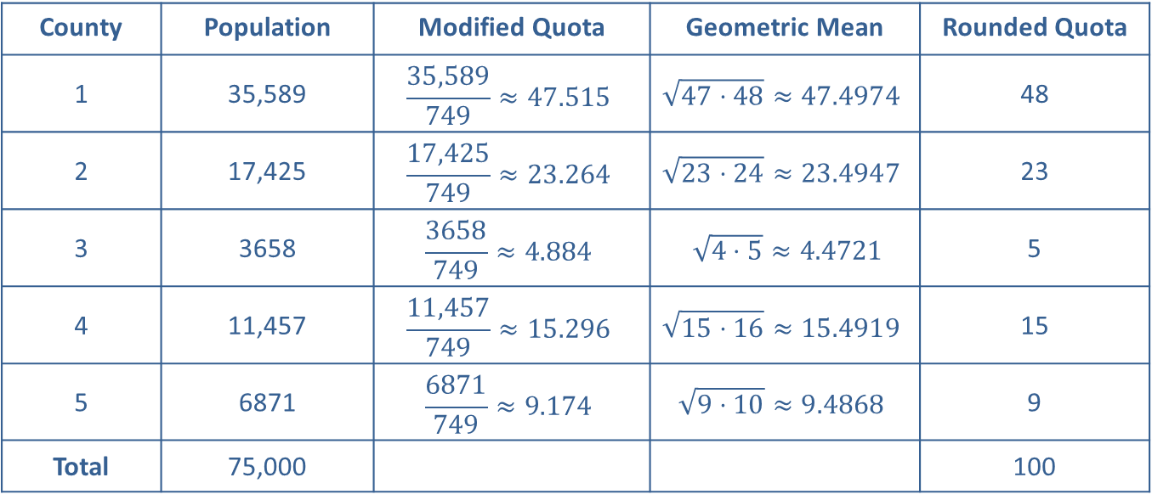
Example 6: Applying the Huntington-Hill Method—Slide 6
Table 17: Rounded Modified Quotas per County
County | Population | Modified Quota | Geometric Mean | Rounded Quota
1 | 35,589 | $$\frac{35,589}{749}≈47.515$$ | $$\sqrt{47⋅48}≈47.4974$$ | 48
2 | 17,425 | $$\frac{17,425}{749}≈23.264$$ | $$\sqrt{23⋅24}≈23.4947$$ | 23
3 | 3658 | $$\frac{3658}{749}≈4.884$$ | $\sqrt{4⋅5}≈4.4721$ | 5
4 | 11,457 | $$\frac{11,457}{749}≈15.296$$ | $$\sqrt{15⋅16}≈15.4919$$ | 15
5 | 6871 | $$\frac{6871}{749}≈9.174$$ | $$\sqrt{9⋅10}≈9.4868$$ | 9
Total | 75,000 |  |  | 100

Slide 42
Example 6: Applying the Huntington-Hill Method—Slide 7
Using the modified divisor of 749, County 1 gains the additional seat, making all the seats apportioned among the counties. This means that County 1 receives 48 seats, County 2 receives 23 seats, County 3 receives 5 seats, County 4 receives 15 seats, and County 5 receives 9 seats.

Slide 43

Skill Check 5
Use Hamilton's method to apportion the scholarships in Example 6.
Answer: County 1 $=48$; County 2 $=23$; County 3 $=5$; County 4 $=15$; County 5 $=9$

Slide 44
Definition: The Alabama Paradox
The Alabama paradox occurs when an increase in the number of items to be apportioned causes a subgroup to lose an item.

Slide 45
Example 7: Illustrating the Alabama Paradox—Slide 1
Due to growth in student population, a school district was given money to hire 10 new middle school teachers for their three middle schools: Brown Middle School, Peachtree Middle School, and MLK Middle School. The teachers will be assigned to the schools based on their student populations using Hamilton's method of apportionment. The student populations are shown in Table 18.
Table 18: Middle School Student Population
Middle School | Student Population
Brown Middle | 203
Peachtree Middle | 588
MLK Middle | 600
Total | 1391
a. Use the Hamilton method to apportion the 10 teachers.
b. Show that the Alabama paradox occurs if the district is able to hire 11 teachers instead of 10.

Slide 46
Example 7: Illustrating the Alabama Paradox—Slide 2
Solution
a. ​To apportion the 10 teachers we need to begin by finding the standard divisor.
Using Hamilton's method, we then find each school's standard quota and round down to assign the teachers. Any unassigned teachers are given out in order of the largest fractional remainders. The calculations are shown in Table 19.

Slide 47
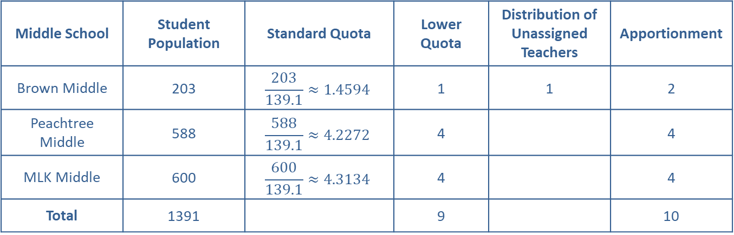
Example 7: Illustrating the Alabama Paradox—Slide 3
Table 19: Hamilton's Method of Apportionment with 10 Teachers
Middle School | Student Population | Standard Quota | Lower Quota | Distribution of Unassigned Teachers | Apportionment
Brown Middle | 203 | $$\frac{203}{139.1}≈1.4594$$ | 1 | 1 | 2
Peachtree Middle | 588 | $$\frac{588}{139.1}≈4.2272$$ | 4 |  | 4
MLK Middle | 600 | $$\frac{600}{139.1}≈4.3134$$ | 4 |  | 4
Total | 1391 |  | 9 |  | 10
​Using Hamilton's method, Brown Middle School receives the additional teacher because their fractional remainder is the largest. Thus, Brown Middle School will receive 2 new teachers while Peachtree Middle School and MLK Middle School will each receive 4 new teachers.

Slide 48
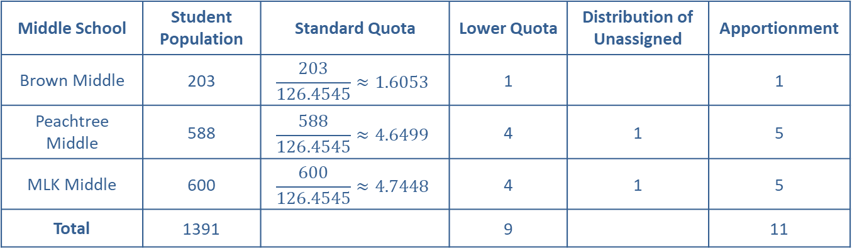
Example 7: Illustrating the Alabama Paradox—Slide 4
b. We need to calculate the standard divisor with 11 teachers this time.
​
Table 20 shows the calculations using Hamilton's method with 11 teachers apportioned among the three middle schools.
Table 20: Hamilton's Method of Apportionment with 11 Teachers
Middle School | Student Population | Standard Quota | Lower Quota | Distribution of Unassigned | Apportionment
Brown Middle | 203 | $$\frac{203}{126.4545}≈1.6053$$ | 1 |  | 1
Peachtree Middle | 588 | $$\frac{588}{126.4545}≈4.6499$$ | 4 | 1 | 5
MLK Middle | 600 | $$\frac{600}{126.4545}≈4.7448$$ | 4 | 1 | 5
Total | 1391 |  | 9 |  | 11

Slide 49
Example 7: Illustrating the Alabama Paradox—Slide 5
With eleven teachers to distribute, Brown Middle School now only receives one new teacher while Peachtree Middle and MLK Middle both receive five new teachers. This means that the Alabama Paradox will occur in the school district if there are eleven teachers instead of ten to apportion—Brown Middle gets fewer teachers even though there are more teachers to distribute.

Slide 50
Definition: The Population Paradox
The population paradox occurs when subgroup A loses an item to subgroup B when the rate of growth of the population of subgroup A is greater than the rate of the growth in subgroup B.

Slide 51
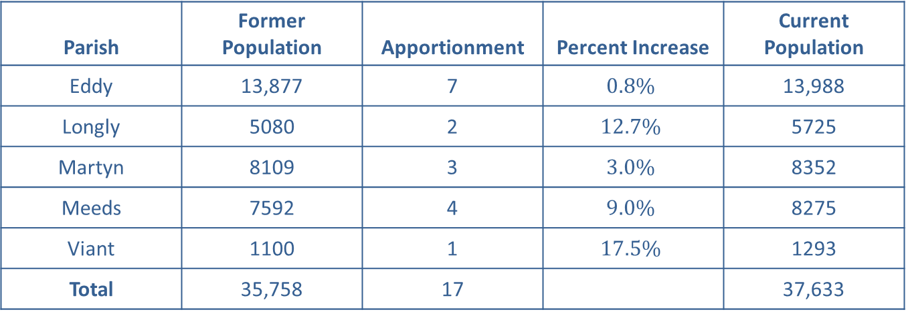
Example 8: Illustrating the Population Paradox—Slide 1
Parish council representatives are to be distributed among the five parishes they represent according to each parish's population. Table 21 shows the current apportionment of the 17 representatives along with the population growth that has occurred since the last apportionment.
Table 21: Apportionment for Parish Representatives and Population Growth
Parish | Former Population | Apportionment | Percent Increase | Current Population
Eddy | 13,877 | 7 | $$0.8\%$$ | 13,988
Longly | 5080 | 2 | $$12.7\%$$ | 5725
Martyn | 8109 | 3 | $$3.0\%$$ | 8352
Meeds | 7592 | 4 | $$9.0\%$$ | 8275
Viant | 1100 | 1 | $$17.5\%$$ | 1293
Total | 35,758 | 17 |  | 37,633
Use Hamilton's method to reapportion the 17 representatives with the new populations, showing that the population paradox occurs.

Slide 52
Example 8: Illustrating the Population Paradox—Slide 2
Solution
Begin by calculating the standard divisor with 17 representatives over the increased population size of 37,633. Thus, the standard divisor is
Table 22 shows the calculations using Hamilton's method with 17 representatives apportioned among the five parishes.

Slide 53
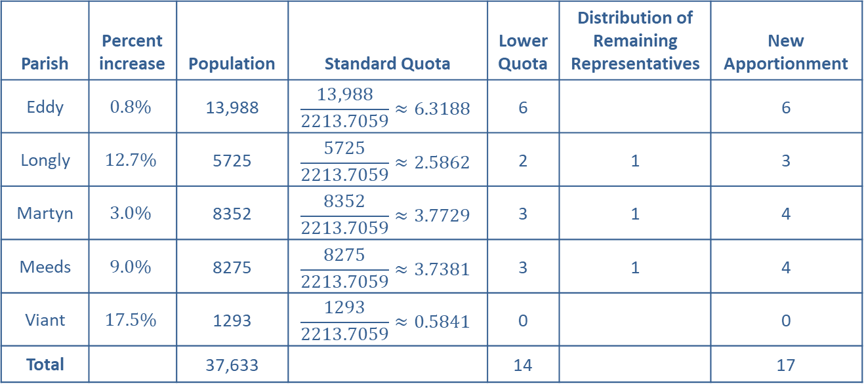
Example 8: Illustrating the Population Paradox—Slide 3
Table 22: Hamilton's Method of Apportionment for Parish Representatives with Population Increases
Parish | Percent increase | Population | Standard Quota | Lower Quota | Distribution of Remaining Representatives | New Apportionment
Eddy | $$0.8\%$$ | 13,988 | $$\frac{13,988}{2213.7059}≈6.3188$$ | 6 |  | 6
Longly | $$12.7\%$$ | 5725 | $$\frac{5725}{2213.7059}≈2.5862$$ | 2 | 1 | 3
Martyn | $$3.0\%$$ | 8352 | $$\frac{8352}{2213.7059}≈3.7729$$ | 3 | 1 | 4
Meeds | $$9.0\%$$ | 8275 | $$\frac{8275}{2213.7059}≈3.7381$$ | 3 | 1 | 4
Viant | $$17.5\%$$ | 1293 | $$\frac{1293}{2213.7059}≈0.5841$$ | 0 |  | 0
Total |  | 37,633 |  | 14 |  | 17

Slide 54
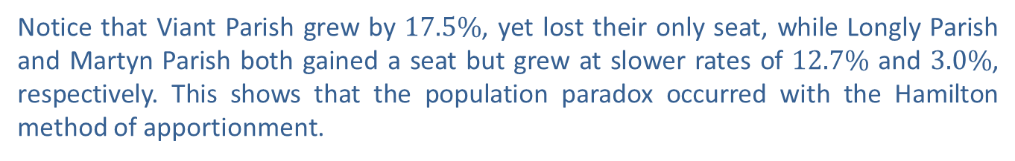
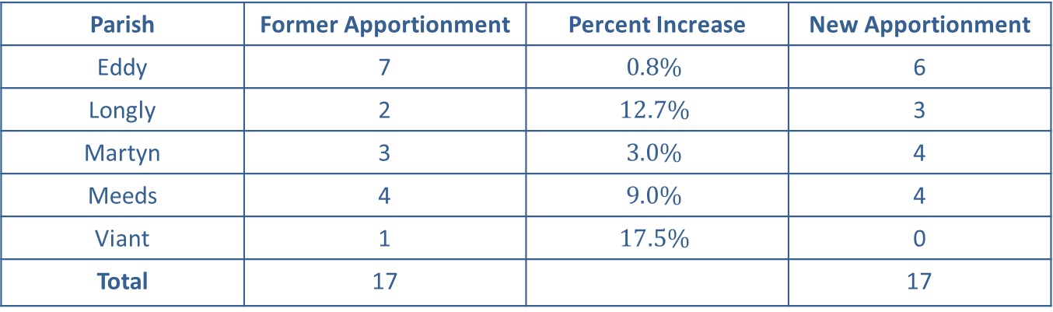
Example 8: Illustrating the Population Paradox—Slide 4
Now we can compare the old distribution to the new distribution in light of the population growth to see if the population paradox occurred. Table 23 shows the comparison.
Table 23: Apportionment for Parish Representatives and Population Growth
Parish | Former Apportionment | Percent Increase | New Apportionment
Eddy | 7 | $$0.8\%$$ | 6
Longly | 2 | $$12.7\%$$ | 3
Martyn | 3 | $$3.0\%$$ | 4
Meeds | 4 | $$9.0\%$$ | 4
Viant | 1 | $$17.5\%$$ | 0
Total | 17 |  | 17
Notice that Viant Parish grew by $17.5\%$, yet lost their only seat, while Longly Parish and Martyn Parish both gained a seat but grew at slower rates of $12.7\%$ and $3.0\%$, respectively. This shows that the population paradox occurred with the Hamilton method of apportionment.

Slide 55
Definition: The New States Paradox
The new states paradox occurs when the addition of a new subgroup, with a corresponding increase in the number of available items, can cause a change in the apportionment of items among the other subgroups.

Slide 56
Example 9: Illustrating the New States Paradox—Slide 1
A college campus has a student leadership board consisting of 13 representatives from the 3 different branches of student life: academic, social, and service. The members of the board are apportioned based on the student enrollment in the organizations of each of the different branches. The calculations using the Hamilton method, with a standard divisor of 894.7692, are shown in Table 24.
Table 24: Hamilton's Method of Apportionment for Student Leadership Board with 3 Branches
Student Life Branch | Population | Standard Quota | Lower Quota | Apportionment
Academic | 3106 | 3.4713 | 3 | 4
Social | 5649 | 6.3134 | 6 | 6
Service | 2877 | 3.2154 | 3 | 3
Total | 11,632 |  |  | 13

Slide 57
Example 9: Illustrating the New States Paradox—Slide 2
The student population has voted to add representation for pre-professional organizations to the leadership board. The standard divisor is 894.7692, which means that there should be 1 representative for every 894.7692, students in pre-professional organizations. Since the new branch has 1363 students, we find
and round that down to 1 so that this new branch adds one representative to the board. Show that the new states paradox occurs with this addition.

Slide 58
Example 9: Illustrating the New States Paradox —Slide 3
Solution
Begin by calculating the new standard divisor with 14 representatives, which includes the new one for the pre-professional branch. The population will increase by 1363 students as well. Thus, the standard divisor is
Table 25 shows the calculations using Hamilton's method with 14 representatives apportioned among the four student life branches.

Slide 59
Example 9: Illustrating the New States Paradox—Slide 4
Table 25: Hamilton's Method of Apportionment for Student Leadership Board With 4 Branches
Student Life Branch | Population | Standard Quota | Lower Quota | Apportionment
Academic | 3106 | 3.3462 | 3 | 3
Social | 5649 | 6.0859 | 6 | 6
Service | 2877 | 3.0995 | 3 | 3
Pre-Professional | 1363 | 1.4684 | 1 | 2
Total | 12,995 |  |  | 14
Notice that once the pre-professional group and its one representative is added in, the apportionment actually assigns the new branch two representatives, while the academic branch loses one. Because the addition of a new subgroup changed the apportionment of another subgroup, the new states paradox has occurred.

Slide 60
Definition: The Quota Rule
The quota rule states that any fair apportionment method should assign every subgroup either its lower quota or its upper quota.

