Slide 1
Section 13.4
Weighted Voting Systems

Slide 2
Fun Fact 1
The US electoral college, as defined in the constitution, is a process to elect the President of the United States. The Founding Fathers established it as a comprise between Congress choosing a president or a popular vote among qualified citizens.

Slide 3
Definition: Weighted Voting System
A weighted voting system consists of n players (P_{n}) each controlling a number of votes (w), called their weight. It is described using the following notation.

Slide 4

Example 1: Identifying the Parts of a Weighted Voting System—Slide 1
The board of directors for a sporting footwear company makes its decisions using a weighted voting system represented by$[25:8, 6, 5, 3, 3, 3, 2, 2, 1, 1, 1, 1]$.
a. Determine the number of players in the voting system.
b. How many total votes are available among all of the players?
c. What is the quota for a proposal to win the board's approval?
d. What is the weight of P ₃?

Slide 5
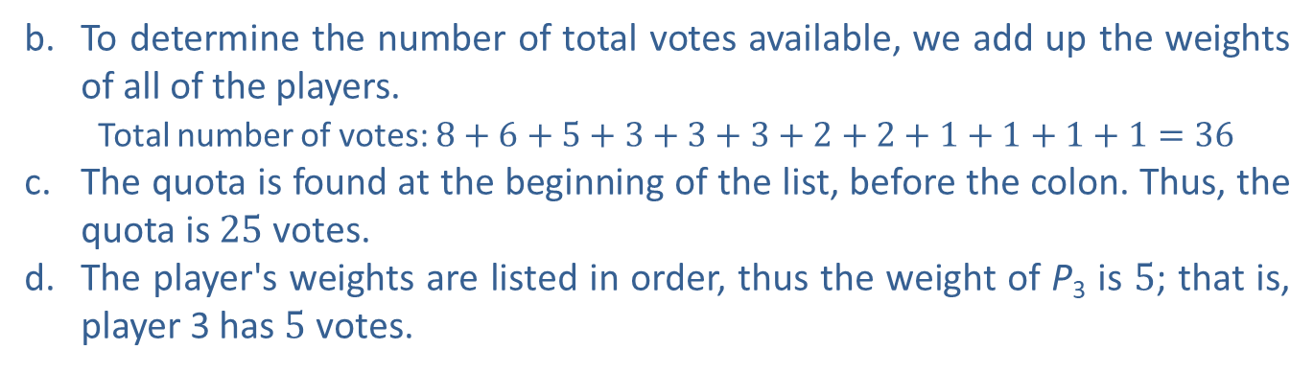
Example 1: Identifying the Parts of a Weighted Voting System—Slide 2
Solution
a. To determine the number of players, we need to count the number of weights that are listed following the quota and colon. Thus, this is a weighted voted system with 12 players
b. To determine the number of total votes available, we add up the weights of all of the players.
  ​ Total number of votes: $8+6+5+3+3+3+2+2+1+1+1+1=36$
c. The quota is found at the beginning of the list, before the colon. Thus, the quota is 25 votes.
d. The player's weights are listed in order, thus the weight of P₃ is 5; that is, player 3 has 5 votes.

Slide 6
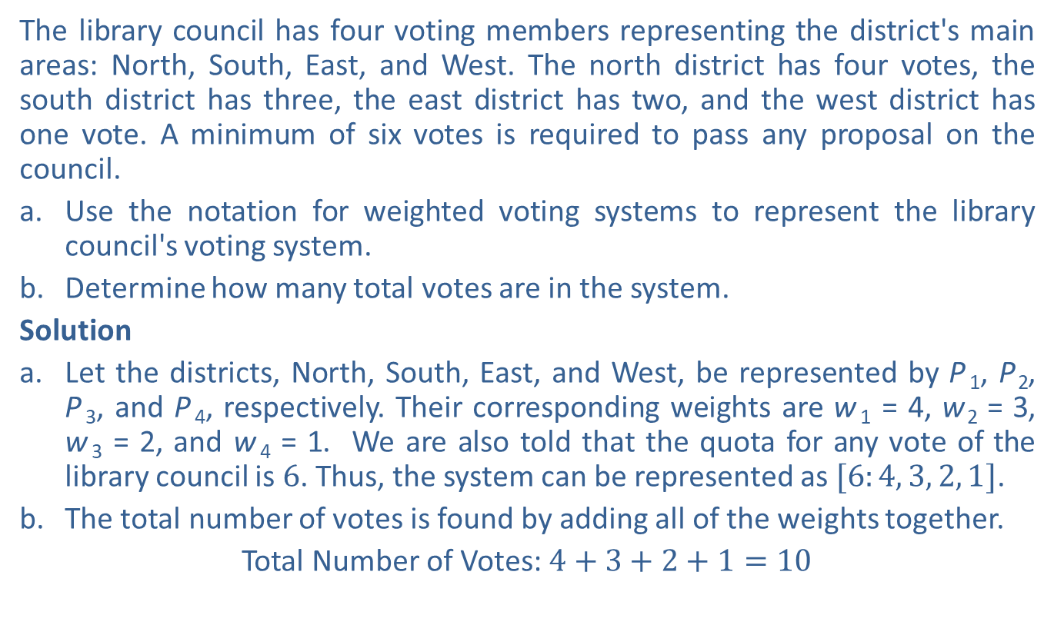
Example 2: Representing a Weighted Voting System
The library council has four voting members representing the district's main areas: North, South, East, and West. The north district has four votes, the south district has three, the east district has two, and the west district has one vote. A minimum of six votes is required to pass any proposal on the council.
a. ​Use the notation for weighted voting systems to represent the library council's voting system.
b.​ Determine how many total votes are in the system.
Solution
a.​ Let the districts, North, South, East, and West, be represented by P ₁, P ₂, P ₃, and P ₄, respectively. Their corresponding weights are w ₁ = 4, w ₂ = 3, w ₃ = 2, and w ₄ = 1. We are also told that the quota for any vote of the library council is 6. Thus, the system can be represented as $[6:4, 3, 2, 1]$.
b. ​The total number of votes is found by adding all of the weights together.
​Total Number of Votes: $4+3+2+1=10$

Slide 7
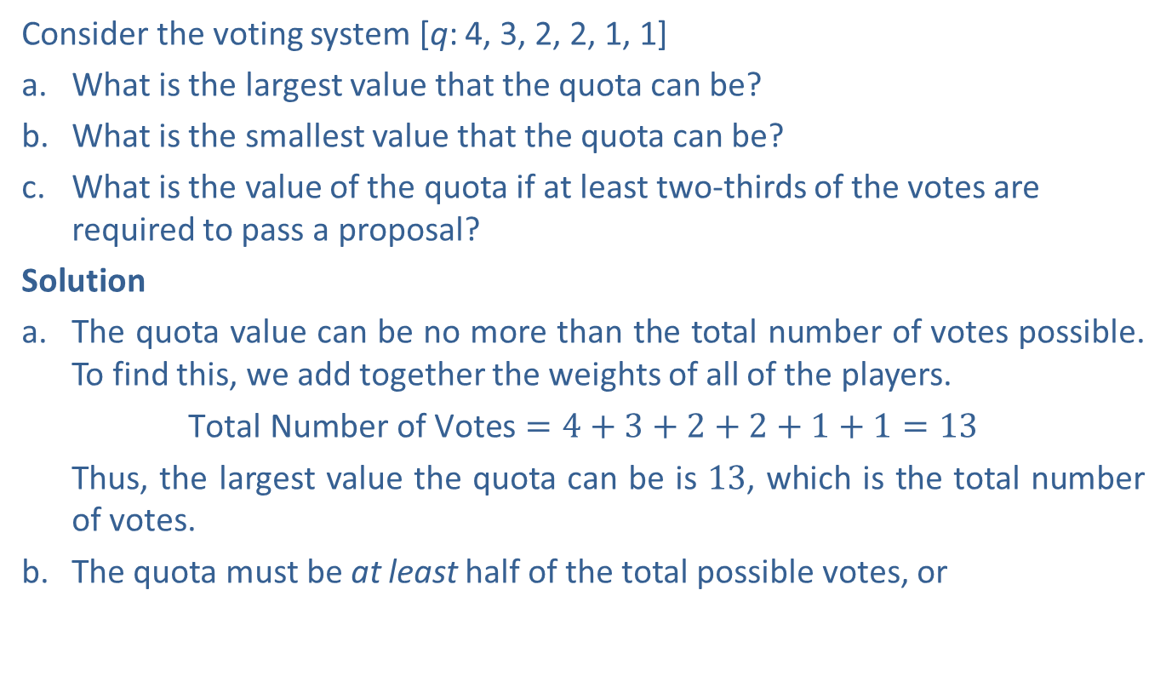
Example 3: Determining the Quota for a Weighted Voting System—Slide 1
Consider the voting system [q: 4, 3, 2, 2, 1, 1]
a. What is the largest value that the quota can be?
b. What is the smallest value that the quota can be?
c. What is the value of the quota if at least two-thirds of the votes are required to pass a proposal?
Solution
a. The quota value can be no more than the total number of votes possible. To find this, we add together the weights of all of the players.
  ​$\text{Total} \text{Number} \text{of} \text{Votes}=4+3+2+2+1+1=13$
  Thus, the largest value the quota can be is 13, which is the total number of votes.
  b. The quota must be at least half of the total possible votes, or
  votes. We have to round this up since rounding down would be too few votes. Thus, the smallest value that the quota can be is 7. This is called a simple majority.

Slide 8
Example 3: Determining the Quota for a Weighted Voting System—Slide 2
c. ​To determine a quota of two-thirds of the votes, we need to multiply the fraction by the total number of possible votes.
  Again, we must round up to the nearest whole number in order to have enough votes. Thus, if two-thirds of the votes are required, the quota is 9. Because this is more than half of the votes, this is called a super majority.

Slide 9

Skill Check 1
Given the voting system represented by $[6:5, 3, 1]$, determine the number of players, the quota, and the total number of votes.
Answer: Players $=3$; Quota $=6$; Total number of votes $=9$

Slide 10
Helpful Hint 1
The difference between a dictator and a player with veto power is that a proposal is guaranteed to pass if a dictator votes in favor of it.

Slide 11
Definition: Player Power in a Weighted Voting System
Dictator
A dictator is a player with the power to pass a proposal single-handedly; that is, the dictator has at least as many votes as the quota.
Veto Power
When a player's votes are needed in order to pass a proposal, that player is said to have veto power.
Dummy Player
A dummy player is a player who does not have enough votes to have an effect on the outcome of a proposal.

Slide 12
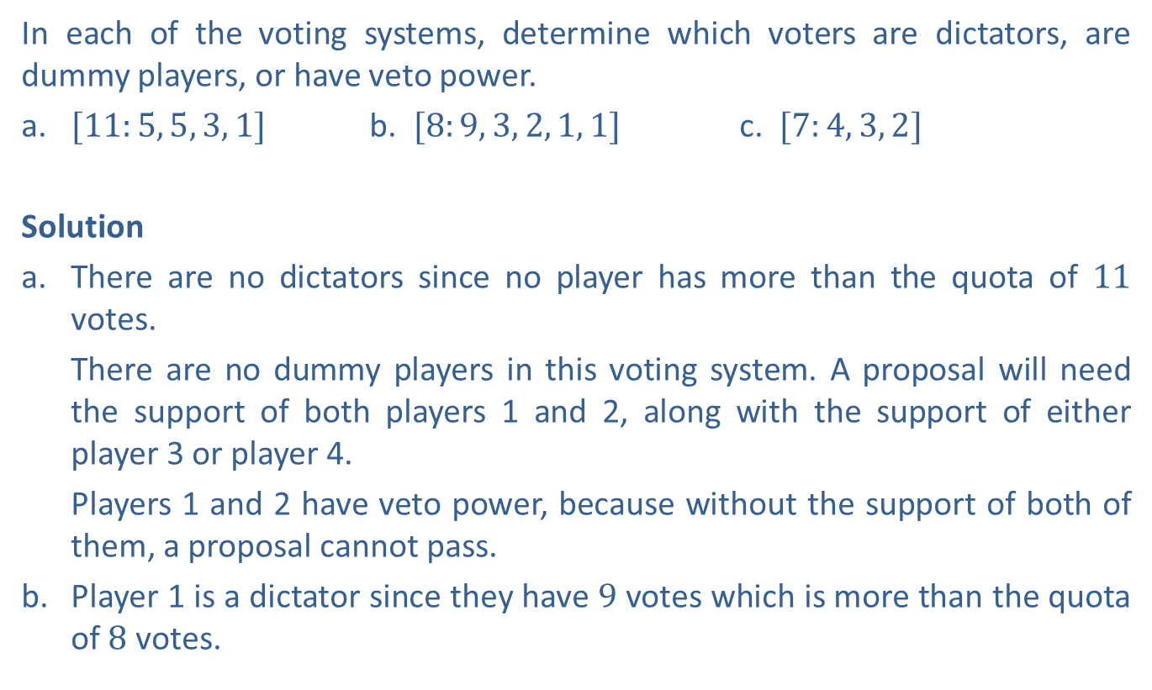
Example 4: Determining Player Power—Slide 1
In each of the voting systems, determine which voters are dictators, are dummy players, or have veto power.
a. $[11:5, 5, 3, 1]$ b. ​$[8:9, 3, 2, 1, 1]$ c. ​$[7:4, 3, 2]$
Solution
a. There are no dictators since no player has more than the quota of 11 votes.
  There are no dummy players in this voting system. A proposal will need the support of both players 1 and 2, along with the support of either player 3 or player 4.
  ​Players 1 and 2 have veto power, because without the support of both of them, a proposal cannot pass.
  b. Player 1 is a dictator since they have 9 votes which is more than the quota of 8 votes.

Slide 13
Example 4: Determining Player Power—Slide 2
  Because there is a dictator, all other players (P ₂, P ₃, P ₄, and P ₅,) are dummy players.
  Only the dictator, player 1, has veto power.
c. There are no dictators since no player has more than the quota of 7 votes.
  Player 3 is a dummy player since Players 1 and 2 must both be in support of a proposal for it to pass, and they don't need the support of player 3.
  Players 1 and 2 both have veto power since without their support a proposal cannot pass.

Slide 14
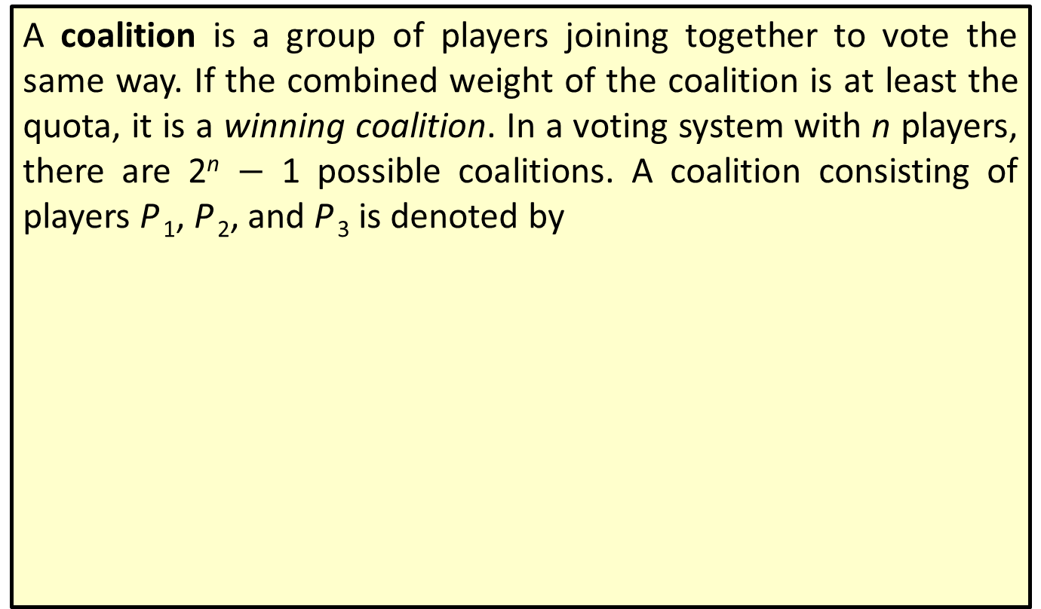
Definition: Coalition
A coalition is a group of players joining together to vote the same way. If the combined weight of the coalition is at least the quota, it is a winning coalition. In a voting system with n players, there are 2^{n} $−$ 1 possible coalitions. A coalition consisting of players P ₁, P ₂, and P ₃ is denoted by

Slide 15
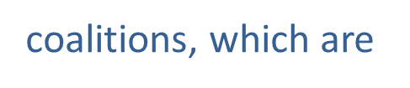
Helpful Hint 2
A coalition can consist of a single player. For instance, in a system with three players, P ₁, P ₂, and P ₃ there are
and

Slide 16
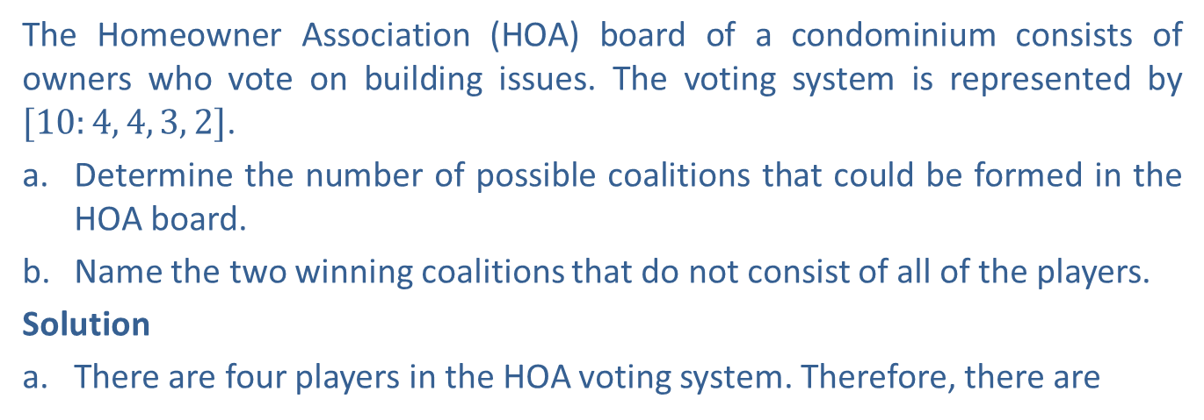
Example 5: Determining Voting Coalitions
The Homeowner Association (HOA) board of a condominium consists of owners who vote on building issues. The voting system is represented by $[10:4, 4, 3, 2]$.
a.​ Determine the number of possible coalitions that could be formed in the HOA board.
b.​ Name the two winning coalitions that do not consist of all of the players.
Solution
a​. There are four players in the HOA voting system. Therefore, there are
possible coalitions.
b. The winning coalitions must have a combined weight of at least 10. In order to reach ten votes, players 1 and 2 must be included in the coalition, but their votes aren't enough to win on their own; either player 3 or player 4 must also be in a winning the coalition. Thus, the two winning coalitions are

Slide 17
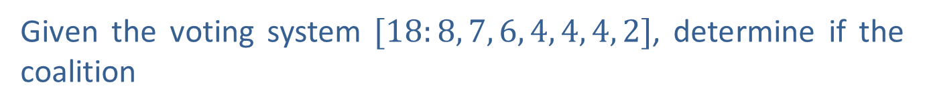
Skill Check 2
Given the voting system $[18:8, 7, 6, 4, 4, 4, 2]$, determine if the coalition
is a winning coalition.
Answer: Yes, it is a winning coalition.

Slide 18
Definition: Critical Player
If a player in a winning coalition were to leave and cause the coalition to become a losing coalition, that player is considered a critical player.

Slide 19
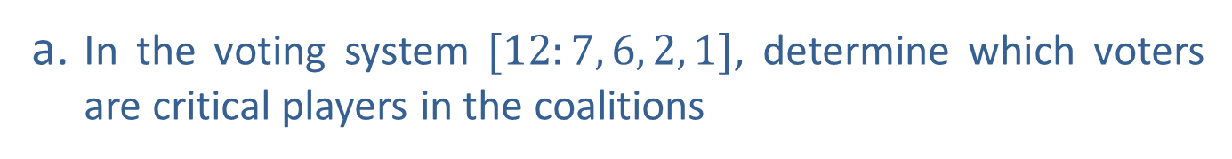
Example 6: Determining Critical Players—Slide 1
a. In the voting system $[12:7, 6, 2, 1]$, determine which voters are critical players in the coalitions
b. In the voting system [20: 12, 5, w, 1], what is the smallest value of w that would make player 3 a critical player in the coalition

Slide 20


Example 6: Determining Critical Players—Slide 2
Solution
a. ​The coalition
has a combined weight of $7+6=13$.
Both players are critical in that their combined weight would drop below the quota of 12 if either left.
  The coalition
has a combined weight of $7+6+2=15$.
If player 1 or player 2 leaves the coalition, the combined weight would fall below the quota, so both are critical. Note that player 3 is not critical because the coalition would still have a combined weight of 13 without them.

Slide 21
Example 6: Determining Critical Players—Slide 3
b. ​For player 3 to be critical, the minimum combined weight of the coalition would need to be equal to the quota, which is 20. This means that the combined votes can be represented by the equation 12 + 5 + w = 20. Solving for w, we get the following.
  Thus, player 3 would need a minimum of 3 votes to be a critical player in the coalition.

Slide 22
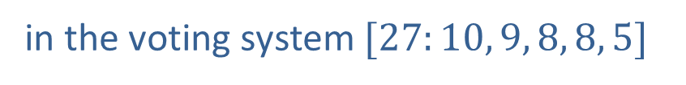
Skill Check 3
Determine if player 4 is a critical player for the coalition
in the voting system $[27:10, 9, 8, 8, 5]$
Answer: Yes, player 4 is critical

Slide 23
Procedure: Calculating the Banzhaf Power Index for Player P _{n}
Step 1: List all winning coalitions for the voting system.
Step 2: Identify the critical players for each winning coalition.
Step 3: Count the total number of times each player is a critical player.
Step 4: Add together the critical player counts found in Step 3.
Step 5: Calculate the Banzhaf Power Index using the following fraction.

Slide 24
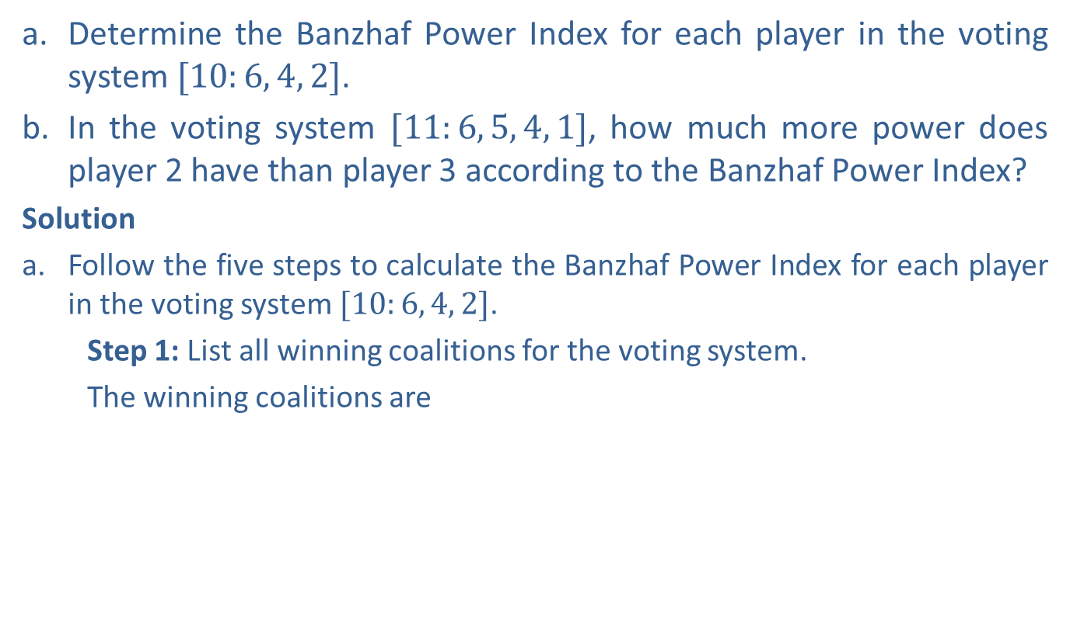
Example 7: Determining the Banzhaf Power Index—Slide 1
a. ​Determine the Banzhaf Power Index for each player in the voting system $[10:6, 4, 2]$.
b.​ In the voting system $[11:6, 5, 4, 1]$, how much more power does player 2 have than player 3 according to the Banzhaf Power Index?
Solution
a.​ Follow the five steps to calculate the Banzhaf Power Index for each player in the voting system $[10:6, 4, 2]$.
  Step 1: List all winning coalitions for the voting system.
  The winning coalitions are

Slide 25
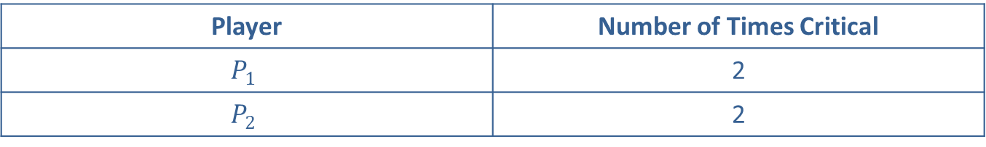
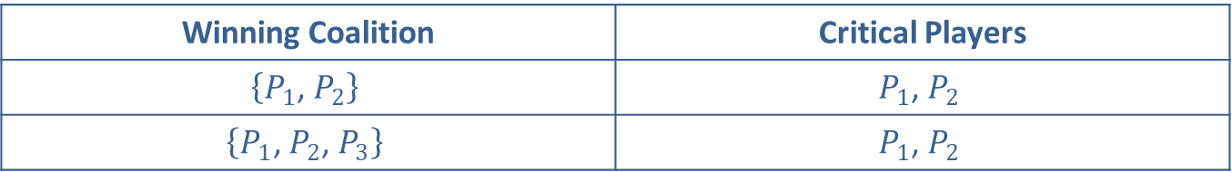
Example 7: Determining the Banzhaf Power Index—Slide 2
Step 2: Identify the critical players for each winning coalition.
Table 1: Winning Coalitions in the Voting System [10: 6, 4, 2]
Winning Coalition | Critical Players
$$\left\{P_{1}\text{, }P_{2}\right\}$$ | $$\left.P_{1}\text{, }P_{2}\right.$$
$$\left\{P_{1}\text{, }P_{2}\text{, }P_{3}\right\}$$ | $$\left.P_{1}\text{, }P_{2}\right.$$
Step 3: Count the total number of times each player is a critical player.
Table 2: Critical Players in the Voting System [10: 6, 4, 2]
Player | Number of Times Critical
$$P_{1}$$ | 2
$$P_{2}$$ | 2
Step 4: Add together the critical player counts found in Step 3.
There are 4 total critical player counts.

Slide 26
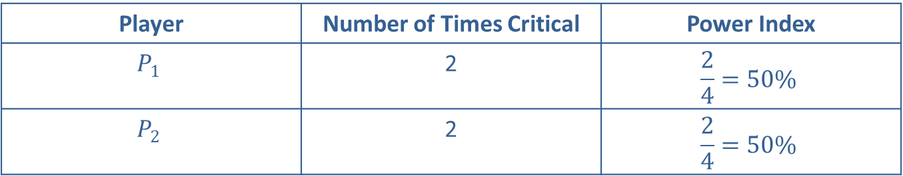
Example 7: Determining the Banzhaf Power Index—Slide 3
Step 5: Calculate the Banzhaf Power Index using the fraction.
Table 3: Banzhaf Power Index for the Voting System [10: 6, 4, 2]
Player | Number of Times Critical | Power Index
$$P_{1}$$ | 2 | $$\frac{2}{4}=50\%$$
$$P_{2}$$ | 2 | $$\frac{2}{4}=50\%$$
Note that even though players 1 and 2 have a different number of votes (6 and 4, respectively), they have equal power indices.

Slide 27
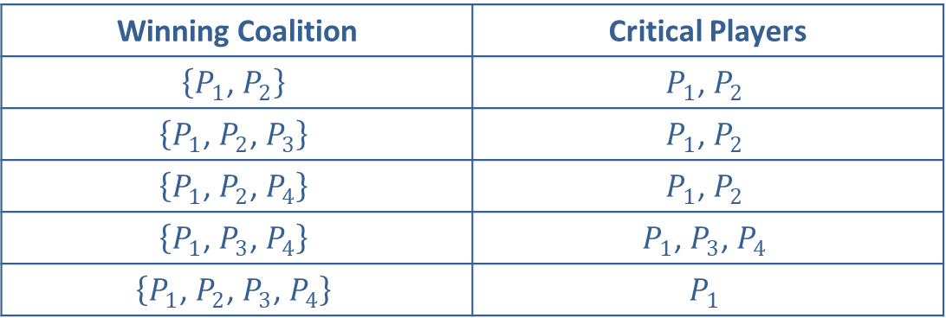
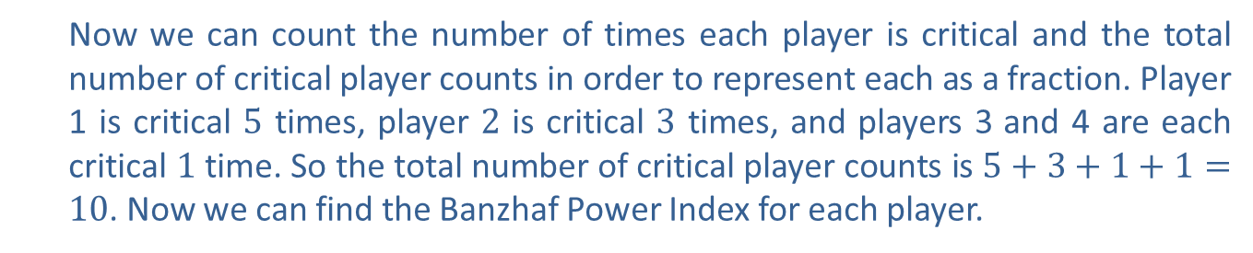
Example 7: Determining the Banzhaf Power Index—Slide 4
b. ​The list of critical players in the winning coalitions in the voting system [11:6, 5,4,1] is as follows.
Table 4: Winning Coalitions in the Voting System [11: 6, 5, 4, 1]
Winning Coalition | Critical Players
$$\left\{P_{1}\text{, }P_{2}\right\}$$ | $$\left.P_{1}\text{, }P_{2}\right.$$
$$\left\{P_{1}\text{, }P_{2}\text{, }P_{3}\right\}$$ | $$\left.P_{1}\text{, }P_{2}\right.$$
$$\left\{P_{1}\text{, }P_{2}\text{, }P_{4}\right\}$$ | $$\left.P_{1}\text{, }P_{2}\right.$$
$$\left\{P_{1}\text{, }P_{3}\text{, }P_{4}\right\}$$ | $$\left.P_{1}\text{, }P_{3}\text{, }P_{4}\right.$$
$$\left\{P_{1}\text{, }P_{2}\text{, }P_{3}\text{, }P_{4}\right\}$$ | $$P_{1}$$
  Now we can count the number of times each player is critical and the total number of critical player counts in order to represent each as a fraction. Player 1 is critical 5 times, player 2 is critical 3 times, and players 3 and 4 are each critical 1 time. So the total number of critical player counts is $5+3+1+1=10$. Now we can find the Banzhaf Power Index for each player.​

Slide 28
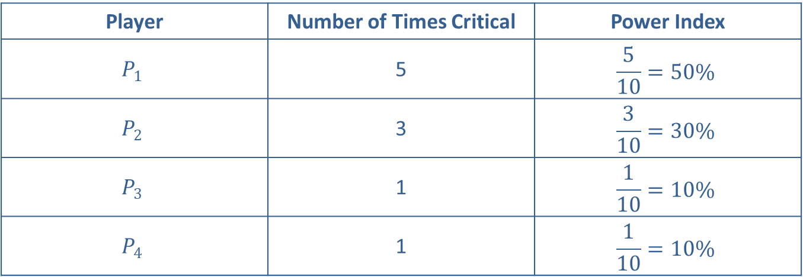
Example 7: Determining the Banzhaf Power Index—Slide 5
Table 5: Banzhaf Power Index for the Voting System [11: 6, 5, 4, 1]
Player | Number of Times Critical | Power Index
$$P_{1}$$ | 5 | $$\frac{5}{10}=50\%$$
$$P_{2}$$ | 3 | $$\frac{3}{10}=30\%$$
$$P_{3}$$ | 1 | $$\frac{1}{10}=10\%$$
$$P_{4}$$ | 1 | $$\frac{1}{10}=10\%$$
Thus, we see that in the given voting system, player 2 has three times more power than player 3.

Slide 29
Helpful Hint 3
There is only one pivotal player in any sequential coalition.

Slide 30

Definition: Sequential Coalition and Pivotal Player
Sequential Coalition
A sequential coalition is a coalition where the order in which $N$ players join is important. It is denoted as
where P ₁, is the first player to join, P ₂, is the second player to join, and so on.
Pivotal Player
A pivotal player is the player who joins a sequential coalition and causes the coalition to change from a losing coalition to a winning coalition.

Slide 31

Example 8: Determining the Pivotal
Player—Slide 1
Wilson, Clinton, & Niese Law Firm has the following voting system $[8:7, 6, 4, 3, 3, 2]$. Determine the pivotal player in each of the sequential coalitions listed.
Solution
The notation for each sequential coalition tells us the order in which the players join the coalition. To determine the pivotal player, we need to keep track of the weight of the coalition as the players join and note when the coalition changes from a losing one to a winning one; that is, when the weight of the coalition is more than the quota. We will use a table in each instance to keep track of the votes. At the top of each table we have included the voting system for your reference.

Slide 32
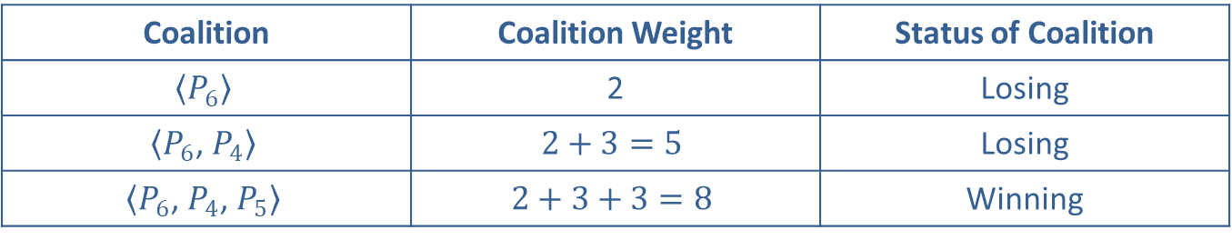
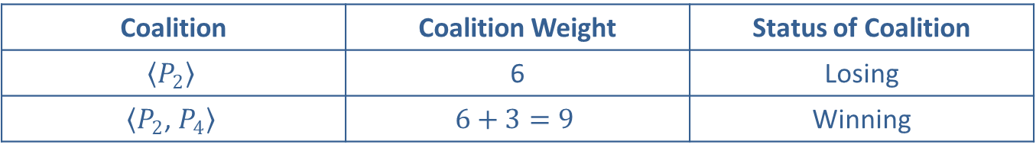
Example 8: Determining the Pivotal
Player—Slide 2
Table 6: System [8: 7, 6, 4, 3, 3, 2] Sequential Coalition ⟨P₂, P₄, P₃, P₆, P₅, P₁ ⟩
Coalition | Coalition Weight | Status of Coalition
$$\left\langle P_{2}\right\rangle$$ | 6 | Losing
$$\left\langle P_{2}\text{, }P_{4}\right\rangle$$ | $$6+3=9$$ | Winning
​Player 4 is the pivotal player in this coalition.
Table 7: System [8: 7, 6, 4, 3, 3, 2] Sequential Coalition ⟨P₆, P₄, P₅, P₃, P₂, P₁ ⟩
Coalition | Coalition Weight | Status of Coalition
$$\left\langle P_{6}\right\rangle$$ | 2 | Losing
$$\left\langle P_{6}\text{, }P_{4}\right\rangle$$ | $$2+3=5$$ | Losing
$$\left\langle P_{6}\text{, }P_{4}\text{, }P_{5}\right\rangle$$ | $$2+3+3=8$$ | Winning
Player 5 is the pivotal player in this coalition.

Slide 33
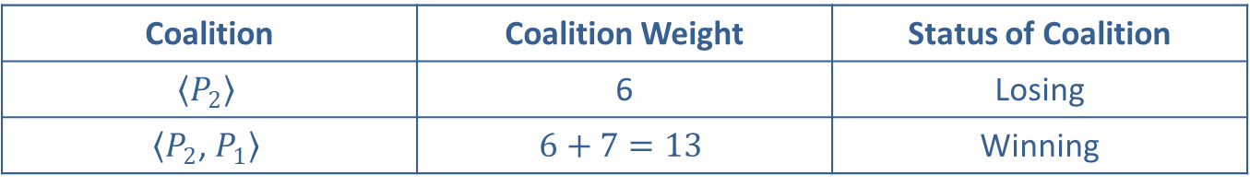
Example 8: Determining the Pivotal
Player—Slide 3
Table 8: System [8: 7, 6, 4, 3, 3, 2] Sequential Coalition ⟨P₂, P₁, P₃, P₄, P₅, P₆ ⟩
Coalition | Coalition Weight | Status of Coalition
$$\left\langle P_{2}\right\rangle$$ | 6 | Losing
$$\left\langle P_{2}\text{, }P_{1}\right\rangle$$ | $$6+7=13$$ | Winning
Player 1 is the pivotal player in this coalition.

Slide 34
Skill Check 4
Determine the pivotal player for the coalition
in the voting system
Answer: Player 1 is the pivotal player

Slide 35
Fun Fact 2
The US House of Representatives has 435 voting members. That means there are
sequential coalitions with all members—more than the number of stars in the universe.

Slide 36
Helpful Hint 4
The Banzhaf Power Index counts all coalitions of all sizes. The Shapley-Shubik Index counts only coalitions of size N.
The Shapley-Shubik Index counts only coalitions of size N.

Slide 37
Procedure: Calculating the Shapley-Shubik Power Index for Player P _{n}
Step 1: List all
sequential coalitions that contain all N players in the voting system.
Step 2: Identify the pivotal player for each sequential coalition.
Step 3: Count the total number of times player P _{n} is a pivotal player.
Step 4: Calculate the Shapley-Shubik Index using the following fraction.

Slide 38

Example 9: Determining the Shapley-Shubik Power Distribution—Slide 1
A charitable organization has a volunteer board of directors with the voting system $[7:4,3,2]$. Determine the Shapley-Shubik Power Distribution for the voting system.
Solution
Step 1: List all
sequential coalitions that contain all N players in the voting system.
There are three players, so there are
sequential coalitions containing all three players. They are as follows.
Step 2: Identify the pivotal player for each sequential coalition.

Slide 39
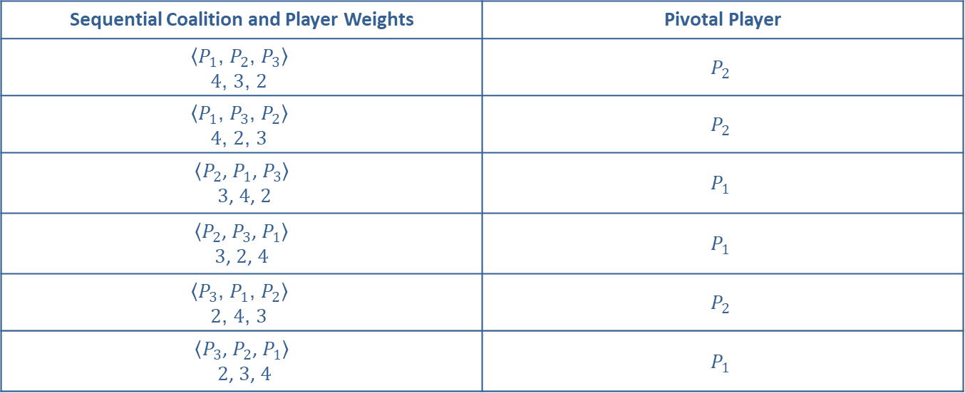
Example 9: Determining the Shapley-Shubik Power Distribution—Slide 2
By listing the sequential coalitions with the weight of each player, we can determine the pivotal player in each coalition by noticing when the weight of the coalition reaches at least the quota of 7.
Table 9
Sequential Coalition and Player Weights | Pivotal Player
$$\left.\begin{aligned}\left\langle P_{1}\text{, }P_{2}\text{, }P_{3}\right\rangle \\ 4\text{, }3\text{, }2\end{aligned}\right.$$ | $$P_{2}$$
$$\left.\begin{aligned}\left\langle P_{1}\text{, }P_{3}\text{, }P_{2}\right\rangle \\ 4\text{, }2\text{, }3\end{aligned}\right.$$ | $$P_{2}$$
$$\left\langle P_{2}\text{, }P_{1}\text{, }P_{3}\right\rangle$$ $\left.3\text{, }4\text{, }2\right.$ | $$P_{1}$$
$\left\langle P_{2}\text{, }P_{3}\text{, }P_{1}\right\rangle$ $$\left.3\text{, }2\text{, }4\right.$$ | $$P_{1}$$
$$\left.\begin{aligned}\left\langle P_{3}\text{, }P_{1}\text{, }P_{2}\right\rangle \\ 2\text{, }4\text{, }3\end{aligned}\right.$$ | $$P_{2}$$
$$\left\langle P_{3}\text{, }P_{2}\text{, }P_{1}\right\rangle$$ $\left.2\text{, }3\text{, }4\right.$ | $$P_{1}$$

Slide 40
Example 9: Determining the Shapley-Shubik Power Distribution—Slide 3
Step 3: Count the total number of times player P _{n} is a pivotal player.
The number of times each player is pivotal is as follows: P ₁ = 3, P ₂ = 3, and P ₃ = 0. Notice, that player 3 is a dummy player because there is not a coalition in which he is a pivotal player.
Step 4: Calculate the Shapley-Shubik Index.
The power distribution indicates that player 1 and player 2 have equal weight on the board, while player 3 has no influence.

Slide 41
Skill Check 5
Determine the Shapley-Shubik Power distribution for the voting system

Slide 42

Example 10: Determining the Power Distributions of a Voting System—Slide 1
Consider the voting system $[9:6,4,2,1]$ for the local government council board.
a. ​ Determine the Banzhaf Power Distribution for the council.
b. ​ Determine the Shapley-Shubik Power Distribution for the council.
c. ​Discuss the power allocation among the council members.

Slide 43
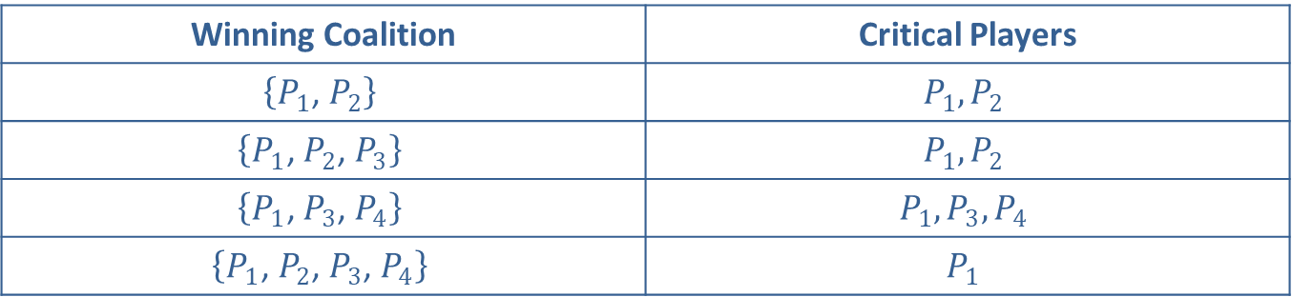
Example 10: Determining the Power Distributions of a Voting System—Slide 2
Solution
a. ​The list of critical players in the winning coalitions is as follows.
​
Table 10: Critical Players in the Winning Coalitions for the
Voting System [9: 6, 4, 2, 1]
Winning Coalition | Critical Players
$$\left\{P_{1}\text{, }P_{2}\right\}$$ | $$P_{1},P_{2}$$
$$\left\{P_{1}\text{, }P_{2}\text{, }P_{3}\right\}$$ | $$P_{1},P_{2}$$
$$\left\{P_{1}\text{, }P_{3}\text{, }P_{4}\right\}$$ | $$P_{1},P_{3},P_{4}$$
$$\left\{P_{1}\text{, }P_{2}\text{, }P_{3}\text{, }P_{4}\right\}$$ | $$P_{1}$$
Now we can count the number of times each player is critical and add these values together to find the total number of critical player counts. We then use those values to find the Banhaf Power Index for each voter.

Slide 44
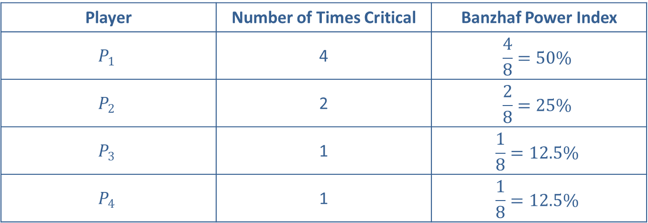
Example 10: Determining the Power Distributions of a Voting System—Slide 3
Table 11: Banzhaf Power Index for the Voting System [9: 6, 4, 2, 1]
Player | Number of Times Critical | Banzhaf Power Index
$$P_{1}$$ | 4 | $$\frac{4}{8}=50\%$$
$$P_{2}$$ | 2 | $$\frac{2}{8}=25\%$$
$$P_{3}$$ | 1 | $$\frac{1}{8}=12.5\%$$
$$P_{4}$$ | 1 | $$\frac{1}{8}=12.5\%$$
b. ​There are four players, so there are
sequential coalitions containing all four players. They are organized in the table below, with the pivotal player identified in each.

Slide 45
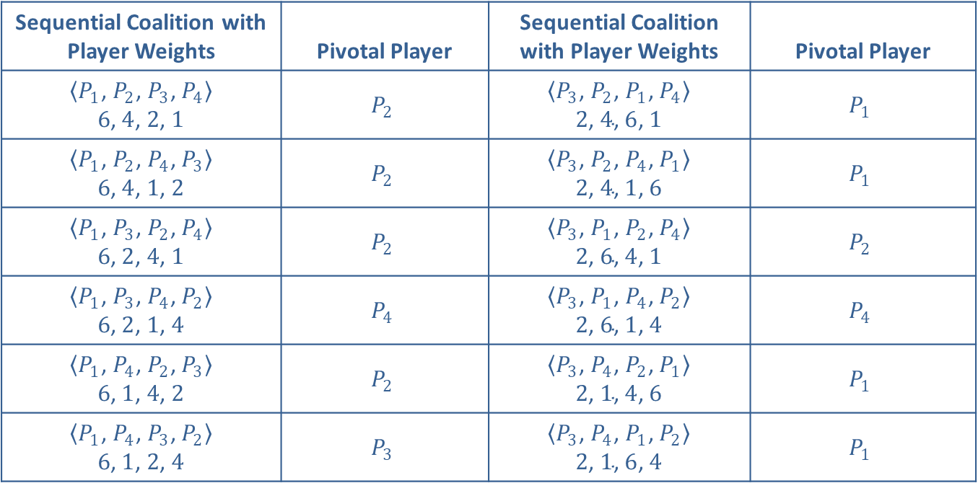
Example 10: Determining the Power Distributions of a Voting System—Slide 4
Table 12: Pivotal Players for the Voting System [9: 6, 4, 2, 1]
Sequential Coalition with Player Weights | Pivotal Player | Sequential Coalition with Player Weights | Pivotal Player
$\left\langle P_{1}\text{, }P_{2}\text{, }P_{3}\text{, }P_{4}\right\rangle$ $$\left.6\text{, }4\text{, }2\text{, }1\right.$$ | $$P_{2}$$ | $\left\langle P_{3}\text{, }P_{2}\text{, }P_{1}\text{, }P_{4}\right\rangle$ $$\left.2\text{, }4\text{, }6\text{, }1\right.$$ | $$P_{1}$$
$\left\langle P_{1}\text{, }P_{2}\text{, }P_{4}\text{, }P_{3}\right\rangle$ $$\left.6\text{, }4\text{, }1\text{, }2\right.$$ | $$P_{2}$$ | $\left\langle P_{3}\text{, }P_{2}\text{, }P_{4}\text{, }P_{1}\right\rangle$ $$\left.2\text{, }4\text{, }1\text{, }6\right.$$ | $$P_{1}$$
$\left\langle P_{1}\text{, }P_{3}\text{, }P_{2}\text{, }P_{4}\right\rangle$ $$\left.6\text{, }2\text{, }4\text{, }1\right.$$ | $$P_{2}$$ | $\left\langle P_{3}\text{, }P_{1}\text{, }P_{2}\text{, }P_{4}\right\rangle$ $$\left.2\text{, }6\text{, }4\text{, }1\right.$$ | $$P_{2}$$
$\left\langle P_{1}\text{, }P_{3}\text{, }P_{4}\text{, }P_{2}\right\rangle$ $$\left.6\text{, }2\text{, }1\text{, }4\right.$$ | $$P_{4}$$ | $\left\langle P_{3}\text{, }P_{1}\text{, }P_{4}\text{, }P_{2}\right\rangle$ $$\left.2\text{, }6\text{, }1\text{, }4\right.$$ | $$P_{4}$$
$\left\langle P_{1}\text{, }P_{4}\text{, }P_{2}\text{, }P_{3}\right\rangle$ $$\left.6\text{, }1\text{, }4\text{, }2\right.$$ | $$P_{2}$$ | $\left\langle P_{3}\text{, }P_{4}\text{, }P_{2}\text{, }P_{1}\right\rangle$ $$\left.2\text{, }1\text{, }4\text{, }6\right.$$ | $$P_{1}$$
$\left\langle P_{1}\text{, }P_{4}\text{, }P_{3}\text{, }P_{2}\right\rangle$ $$\left.6\text{, }1\text{, }2\text{, }4\right.$$ | $$P_{3}$$ | $\left\langle P_{3}\text{, }P_{4}\text{, }P_{1}\text{, }P_{2}\right\rangle$ $$\left.2\text{, }1\text{, }6\text{, }4\right.$$ | $$P_{1}$$

Slide 46
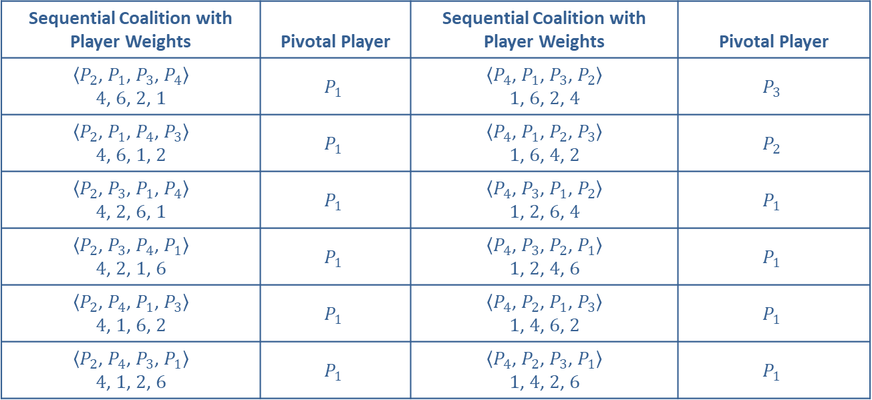
Example 10: Determining the Power Distributions of a Voting System—Slide 5
Table 12: Pivotal Players for the Voting System [9: 6, 4, 2, 1] (cont.)
Sequential Coalition with Player Weights | Pivotal Player | Sequential Coalition with Player Weights | Pivotal Player
$\left\langle P_{2}\text{, }P_{1}\text{, }P_{3}\text{, }P_{4}\right\rangle$ $$\left.4\text{, }6\text{, }2\text{, }1\right.$$ | $$P_{1}$$ | $\left\langle P_{4}\text{, }P_{1}\text{, }P_{3}\text{, }P_{2}\right\rangle$ $$\left.1\text{, }6\text{, }2\text{, }4\right.$$ | $$P_{3}$$
$\left\langle P_{2}\text{, }P_{1}\text{, }P_{4}\text{, }P_{3}\right\rangle$ $$\left.4\text{, }6\text{, }1\text{, }2\right.$$ | $$P_{1}$$ | $\left\langle P_{4}\text{, }P_{1}\text{, }P_{2}\text{, }P_{3}\right\rangle$ $$\left.1\text{, }6\text{, }4\text{, }2\right.$$ | $$P_{2}$$
$\left\langle P_{2}\text{, }P_{3}\text{, }P_{1}\text{, }P_{4}\right\rangle$ $$\left.4\text{, }2\text{, }6\text{, }1\right.$$ | $$P_{1}$$ | $\left\langle P_{4}\text{, }P_{3}\text{, }P_{1}\text{, }P_{2}\right\rangle$ $$\left.1\text{, }2\text{, }6\text{, }4\right.$$ | $$P_{1}$$
$\left\langle P_{2}\text{, }P_{3}\text{, }P_{4}\text{, }P_{1}\right\rangle$ $$\left.4\text{, }2\text{, }1\text{, }6\right.$$ | $$P_{1}$$ | $\left\langle P_{4}\text{, }P_{3}\text{, }P_{2}\text{, }P_{1}\right\rangle$ $$\left.1\text{, }2\text{, }4\text{, }6\right.$$ | $$P_{1}$$
$\left\langle P_{2}\text{, }P_{4}\text{, }P_{1}\text{, }P_{3}\right\rangle$ $$\left.4\text{, }1\text{, }6\text{, }2\right.$$ | $$P_{1}$$ | $\left\langle P_{4}\text{, }P_{2}\text{, }P_{1}\text{, }P_{3}\right\rangle$ $$\left.1\text{, }4\text{, }6\text{, }2\right.$$ | $$P_{1}$$
$\left\langle P_{2}\text{, }P_{4}\text{, }P_{3}\text{, }P_{1}\right\rangle$ $$\left.4\text{, }1\text{, }2\text{, }6\right.$$ | $$P_{1}$$ | $\left\langle P_{4}\text{, }P_{2}\text{, }P_{3}\text{, }P_{1}\right\rangle$ $$\left.1\text{, }4\text{, }2\text{, }6\right.$$ | $$P_{1}$$
Now we can count the number of times each player is pivotal and divide this by
or 24 in this case.

Slide 47
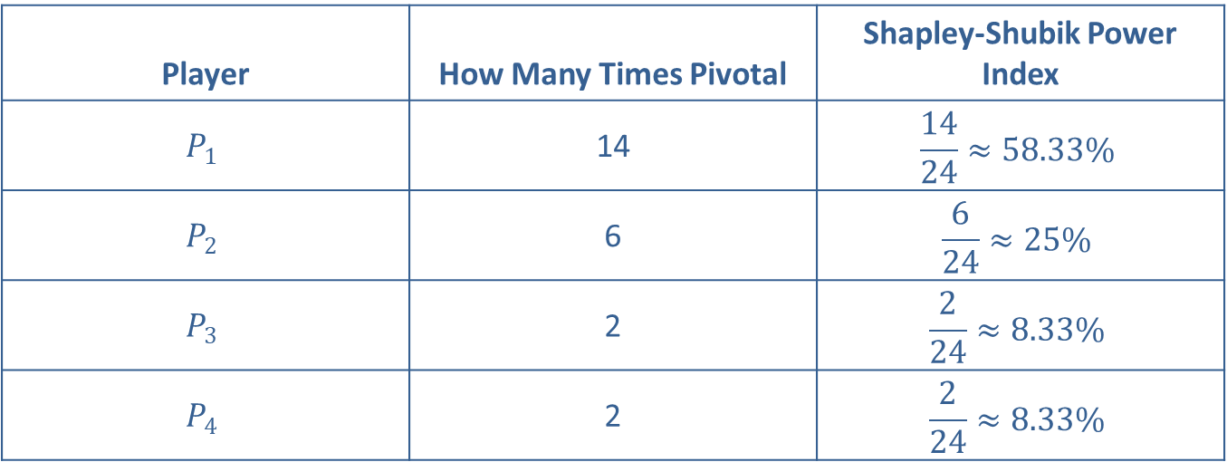
Example 10: Determining the Power Distributions of a Voting System—Slide 6
Table 13: Shapley-Shubik Power Index for the Voting System [9: 6, 4, 2, 1]
Player | How Many Times Pivotal | Shapley-Shubik Power Index
$$P_{1}$$ | 14 | $$\frac{14}{24}≈58.33\%$$
$$P_{2}$$ | 6 | $$\frac{6}{24}≈25\%$$
$$P_{3}$$ | 2 | $$\frac{2}{24}≈8.33\%$$
$$P_{4}$$ | 2 | $$\frac{2}{24}≈8.33\%$$
​Compare the power indices of each player using the two different methods.

Slide 48
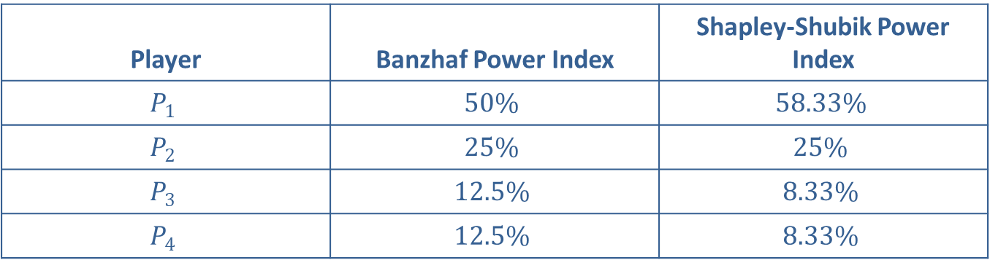
Example 10: Determining the Power Distributions of a Voting System—Slide 7
Table 14: Power Indices for the Voting System [9: 6, 4, 2, 1]
Player | Banzhaf Power Index | Shapley-Shubik Power Index
$$P_{1}$$ | $$50\%$$ | $$58.33\%$$
$$P_{2}$$ | $$25\%$$ | $$25\%$$
$$P_{3}$$ | $$12.5\%$$ | $$8.33\%$$
$$P_{4}$$ | $$12.5\%$$ | $$8.33\%$$
Note that player 1 has more power using the Shapley-Shubik Index. Player 2's power is the same with either method. Players 3 and 4 have equal power using either method with a lower power using the Shapley-Shubik Index. Notice that players 2, 3, and 4 combined have equal power to player 1 using the Banzhaf Power Index.

