Slide 1
Chapter 13
Review

Slide 2
Definition: Preference Ballot
A preference ballot is a ballot that allows a voter to rank the items in order of preference from most preferred to least preferred.

Slide 3
Definition: Preference Table
A preference table summarizes all of the individual preference ballots in an election by tallying the number of ballots with the same order of ranking.

Slide 4
Formula: Number of Pairwise Comparisons
The number of pairwise comparisons that must be made if there are n candidates is

Slide 5
Definition: Condorcet Criterion
The Condorcet criterion states that if a candidate wins the head-to-head comparison against every other candidate, then he should also win the overall election in a fair voting system.

Slide 6
Definition: Majority Criterion
The majority criterion states that if a candidate receives a majority of the votes in an election, that candidate should win.

Slide 7
Definition: Monotonicity Criterion
The monotonicity criterion states that if a candidate wins an early round of an election and only gains support and does not lose support in subsequent rounds, then that candidate should win the election.

Slide 8
Definition: Irrelevant Alternative Criterion
The irrelevant alternatives criterion states that if a candidate wins an election, then that same candidate would win the election even if at least one candidate withdraws from the election.

Slide 9
Definition: Dictator Criterion
The dictator criterion states that no single vote is allowed to decide the outcome of an election.

Slide 10
Definition: Apportionment
Apportionment is a method of fairly dividing resources or items among individuals or groups.

Slide 11
Definition: The Alabama Paradox
The Alabama paradox occurs when an increase in the number of items to be apportioned causes a subgroup to lose an item.

Slide 12
Definition: The Population Paradox
The population paradox occurs when subgroup A loses an item to subgroup B when the rate of growth of the population of subgroup A is greater than the rate of the growth in subgroup B.

Slide 13
Definition: The New States Paradox
The new states paradox occurs when the addition of a new subgroup, with a corresponding increase in the number of available items, can cause a change in the apportionment of items among the other subgroups.

Slide 14
Definition: The Quota Rule
The quota rule states that any fair apportionment method should assign every subgroup either its lower quota or its upper quota.

Slide 15
Formula: Standard Divisor
The standard divisor for apportionment is the average number of people per item to be apportioned.

Slide 16
Formula: Standard Quota
The standard quota for apportionment is the average number of items to be apportioned to each subgroup.

Slide 17
Formula: Geometric Mean
The geometric mean of any two numbers m and n is

Slide 18
Procedure: Hamilton's Method of Apportionment
1. Calculate the standard divisor.
2. Calculate the standard quota for each subgroup.
3. ​Calculate the lower quota for each subgroup.
4. Assign each subgroup the number of resources based on its lower quota.
5. Assign any remaining resources based on the fractional remainder of the standard quotas, in order from largest to smallest.

Slide 19
Procedure: Jefferson's Method of Apportionment
1.​ Calculate the standard divisor.
2.​ Calculate the standard quota for each subgroup.
3. Calculate the lower quota for each subgroup.
4. Assign each subgroup the number of resources based on its lower quota.
5. If there are remaining resources to be distributed, chose a modified divisor by trial and error until the sum of the lower quotas equals the number of resources to be apportioned.

Slide 20
Procedure: Webster's Method of Apportionment
1. ​Calculate the standard divisor.
2. ​Calculate the standard quota for each subgroup.
3. ​Round each quota to the nearest integer.
4. ​Assign each subgroup the number of resources based on the rounded quota.
5. ​If there are remaining resources to be distributed, chose a modified divisor by trial and error until the sum of the rounded quotas equals the number of resources to be apportioned.

Slide 21
Procedure: The Huntington-Hill Method of Apportionment
1. ​Calculate the standard divisor.
2. Calculate the standard quota for each subgroup.
3. ​Calculate the geometric mean of the standard quota for each subgroup.
4. ​If the standard quota is less than the geometric mean, round the quota down. If the standard quota is greater than the geometric mean, round the quota up.
5. ​Assign each subgroup the number of resources based on the rounded quota.
6. ​If there are remaining resources to be distributed, chose a modified divisor by trial and error until the sum of the rounded quotas equals the number of resources to be apportioned.

Slide 22
Definition: Weighted Voting System
A weighted voting system consists of n players (P_{n}) each controlling a number of votes (w), called their weight. It is described using the following notation.

Slide 23
Definition: Dictator
A dictator is a player with the power to pass a proposal single-handedly; that is, the dictator has at least as many votes as the quota.

Slide 24
Definition: Veto Power
When a player's votes are needed in order to pass a proposal, that player is said to have veto power.

Slide 25
Definition: Dummy Player
A dummy player is a player who does not have enough votes to have an effect on the outcome of a proposal.

Slide 26
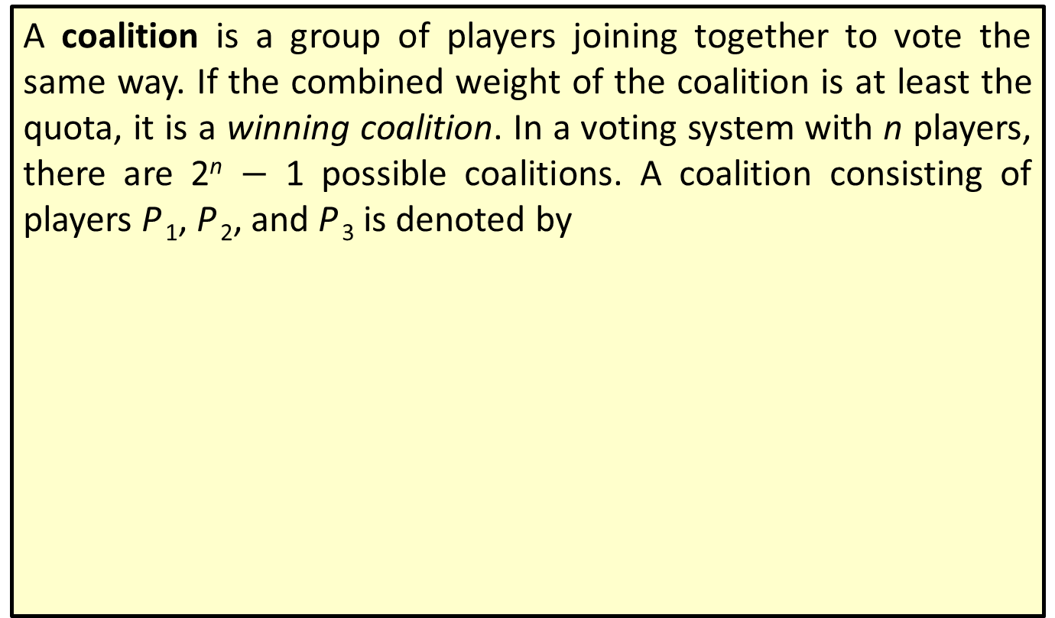
Definition: Coalition
A coalition is a group of players joining together to vote the same way. If the combined weight of the coalition is at least the quota, it is a winning coalition. In a voting system with n players, there are 2^{n} $−$ 1 possible coalitions. A coalition consisting of players P ₁, P ₂, and P ₃ is denoted by

Slide 27
Definition: Critical Player
If a player in a winning coalition were to leave and cause the coalition to become a losing coalition, that player is considered a critical player.

Slide 28
Definition: Sequential Coalition
A sequential coalition is a coalition where the order in which N players join is important. It is denoted as
where P ₁ is the first player to join, P ₂ is the second player to join, and so on.

Slide 29
Definition: Pivotal Player
A pivotal player is the player who joins a sequential coalition and causes the coalition to change from a losing coalition to a winning coalition.

Slide 30
Procedure: Calculating the Banzhaf Power Index for Player P _{n}
Step 1: List all winning coalitions for the voting system.
Step 2: Identify the critical players for each winning coalition.
Step 3: Count the total number of times each player is a critical player.
Step 4: Add together the critical player counts found in Step 3.
Step 5: Calculate the Banzhaf Power Index using the following fraction.

Slide 31
Procedure: Calculating the Shapley-Shubik Power Index for Player P _{n}
Step 1: List all
sequential coalitions that contain all N players in the voting system.
Step 2: Identify the pivotal player for each sequential coalition.
Step 3: Count the total number of times player P _{n} is a pivotal player.
Step 4: Calculate the Shapley-Shubik Index using the following fraction.

