Slide 1
Section 14.1
Introduction to Graph Theory

Slide 2
Definition: Graph
A graph consists of a set of vertices and a set of edges that join pairs of vertices together. Graphs are generally represented with a capital letter, such as G.

Slide 3
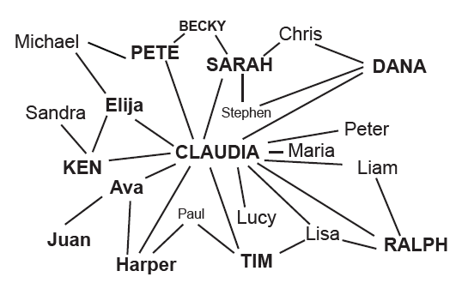
Example 1: Identifying Parts of a Graph
In graph A, identify the vertices and edges.
Figure 2: Graph A
Solution
In graph A, the vertices are represented by the names and the edges are the lines joining the names to one another.

Slide 4
Helpful Hint—Slide 1
The singular form of vertices is vertex.

Slide 5
Definition: Loop
A loop is an edge that has the same vertex for both of its ends.

Slide 6
Helpful Hint—Slide 2
A graph can be thought of as a bunch of plastic balls connected with a number of strings. The essential information about the graph is which balls are connected via strings. The balls can either be in a big clump or spread out in any way, but it's still the same graph.

Slide 7
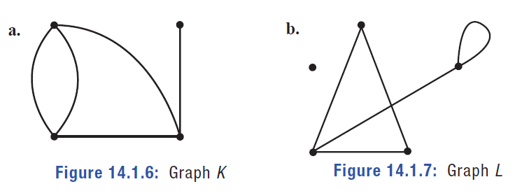
Example 2: Identifying Parts of a Graph—Slide 1
For the given graphs, label each vertex and edge. Identify any loops.
​
Figure 6: Graph K
Figure 7: Graph L

Slide 8
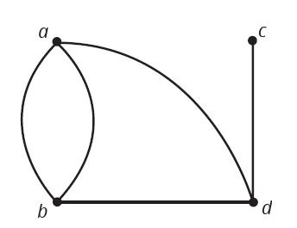
Example 2: Identifying Parts of a Graph—Slide 2
Solution
a. First, label the four vertices in graph K with lowercase letters. We'll use a, b, c, and d. Note that the assignment of the letters is not critical; they can be in any order.
​
Figure 8: Graph K

Slide 9
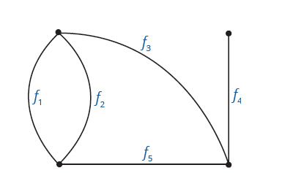
Example 2: Identifying Parts of a Graph—Slide 3
Second, since the graph has two edges between the vertices a and b, it is not sufficient to use the ends as labels. Instead, use distinct identifiers in order to distinguish between the edges. We will use f ₁, f ₂, f ₃, f ₄, and f ₅.
Although graph K might appear to have a loop on the left-hand side of it, there is not an edge that begins and ends at the same vertex. Therefore, there are no loops in graph K.
Figure 9: Graph K

Slide 10
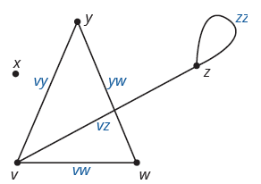
Example 2: Identifying Parts of a Graph—Slide 4
​In graph L, label the five vertices with lowercase letters. We use v, w, x, y, and z. Since there is at most one edge between any pair of vertices, we can label the edges using either format. This time, we will use the pairing method to label the edges. Note that there are only five vertices and not six, remembering that there is not a vertex every time edges intersect.
Figure 10: Graph L
Notice that edge z z begins and ends at vertex z and is, therefore, a loop.​

Slide 11
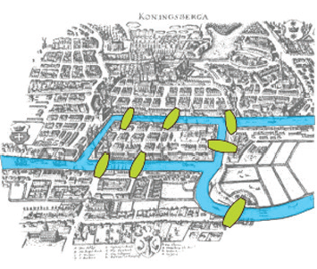
Fun Fact—Slide 1
The city of Königsberg, Prussia, is now Kaliningrad, Russia. Only two of the original seven bridges from Euler's time still remain in Kaliningrad.
Figure 11

Slide 12
Definition: Walk
A walk in a graph is a finite list of alternating vertices and connecting edges that begins and ends with a vertex.

Slide 13
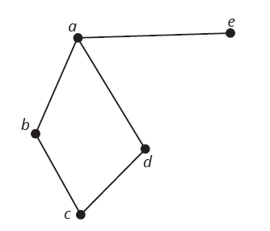
Example 3: Identifying a Walk—Slide 1
Use graph B to answer the following questions. Notice that since there is only one edge between each pair of vertices, we do not need to label the edges.
Figure 14: Graph B
a. Identify a walk of length 2 that starts at vertex a and ends at vertex c.
b. Is the walk you just found a closed walk?

Slide 14
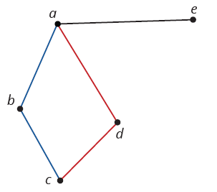
Example 3: Identifying a Walk—Slide 2
Solution
a. There are two possible walks that start at vertex a, end at vertex c, and have a length of 2. The walk a, b, c is highlighted in blue and the walk a, d, c is highlighted in red. Either is an acceptable answer.
​
Figure 15: Graph B
b. Because the walks do not start and end at the same vertex, neither walk is closed.

Slide 15
Skill Check 1
Identify a walk of length 3 in graph B in Example 3. Start the walk at vertex c.
Answer: Any of the following:c, b, a, e; c, b, a, d; c, b, a, b; c, b, c, b; c, d, a, e; c, d, a, b; c, d, a, d; c, d, c, d

Slide 16
Definition: Path
A path is a walk with no repeated edges or vertices.

Slide 17
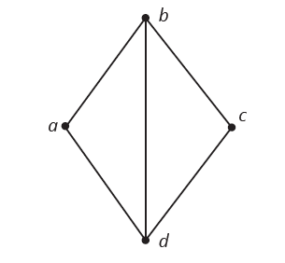
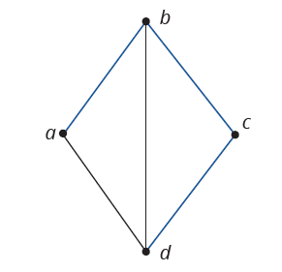
Example 4: Identifying a Path
Identify a path of length 3 starting at vertex a and ending at vertex d in graph C.
Figure 17: Graph C
Figure 18: Graph C
Solution
Since the path must be of length 3 and start at vertex a and end at d, we cannot go straight to d. We need to move from a to b. From there, if we move to d next, we still only have a path of length 2. Instead, we need to move from b to c and then to d.
This walk a, b, c, d, is a walk of length 3 and only crosses each vertex once and never duplicates an edge. Therefore, it is the required path.

Slide 18
Definition: Connected and Disconnected Graphs
A graph is connected if there is at least one path connecting each pair of distinct vertices.
A graph is disconnected if it has at least one pair of vertices that is not connected by a path.

Slide 19
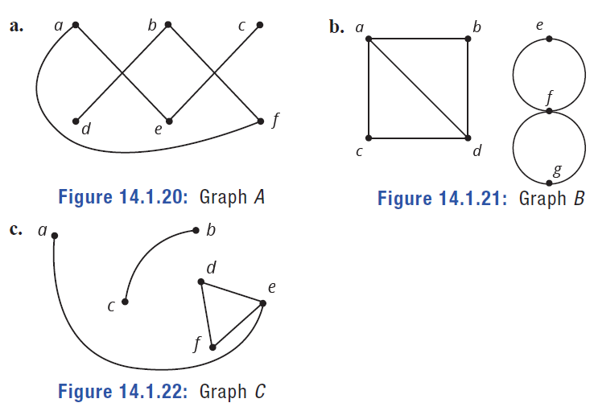
Example 5: Identifying Connected and Disconnected Graphs—Slide 1
Label each graph as connected or disconnected. Explain your answer.
​
Figure 20: Graph A
Figure 21: Graph B
Figure 22: Graph C

Slide 20
Example 5: Identifying Connected and Disconnected Graphs—Slide 2
Solution
a. Even though each vertex is not directly connected with every other vertex by single edges, this graph is connected because there are paths between each pair of vertices.
b. Because there is no path connecting vertex b to vertex e, the graph is disconnected. Only one example is needed to show that a graph is disconnected.
c. This graph is disconnected because there is no path between vertices a and c.

Slide 21
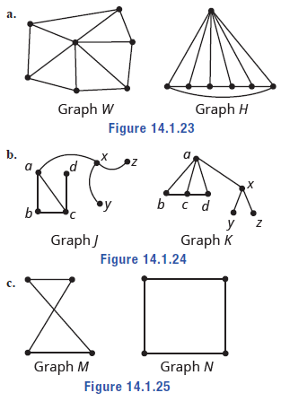
Example 6: Identifying Different Views of the Same Graph—Slide 1
Decide whether the pairs of graphs shown could be different views of the same graph or not. Explain your answer.
​
Figure 23
Figure 24
Figure 25

Slide 22
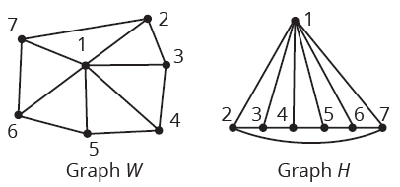
Example 6: Identifying Different Views of the Same Graph—Slide 2
Solution
a. ​In both graphs W and H, there are seven vertices. If you think of numbering the vertices 1 through 7, you can check that the edges join the same vertices in both diagrams. Check this for yourself in the following figure. Therefore, these are different views of the same graph.
​
Figure 26

Slide 23
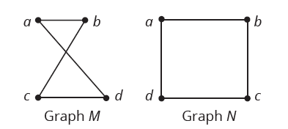
Example 6: Identifying Different Views of the Same Graph—Slide 3
b. Graphs J and K are not the same. Graph J does not include an edge between the vertices a and d; however, graph K does. Therefore, graphs J and K cannot be different views of the same graph.
c. Both graphs M and N contain four vertices. If you label the vertices of each graph carefully, you can see that the edge sets of Graph M and Graph N are identical. Therefore, these are different views of the same graph.
Figure 27

Slide 24
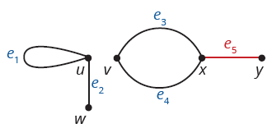
Skill Check 2
Identify all pairs of adjacent vertices and all pairs of incident edges in Figure 28, shown again here.
Figure 28: Graph G
Answer: Adjacent vertices: x and y; u and w; v and x;
Incident edges: e ₁ and e ₂; e ₃ and e ₄; e ₃ and e ₅; e ₄ and e ₅

Slide 25
Definition: Properties of Vertices and Edges
Adjacent
Two vertices that share an edge are adjacent.
Incident
Two edges that share a vertex are incident to one another. Also, a vertex is incident to the edges that have that vertex as an endpoint.
Degree
The degree of a vertex denoted d(u), is the number of edges that are incident to u.

Slide 26
Fun Fact—Slide 2
In the field of computer science, it is particularly useful for some graphs to be described by using an adjacency matrix. This matrix is an organized list to show which pairs of vertices are connected together and which are not.

Slide 27
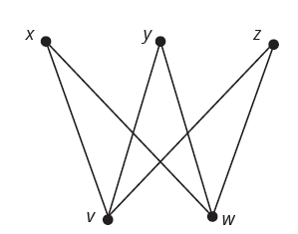

Example 7: Identifying Parts of a Graph—Slide 1
Use Graph $A$ to solve the following problems.
a. Determine the degree of each of the vertices.
b. Name the pairs of vertices that are adjacent.
c. Name the pairs of edges that are incident.
Figure 29

Slide 28
Example 7: Identifying Parts of a Graph—Slide 2
Solution
a. ​To determine the degree of each vertex, we simply count the number of edges incident to that vertex. Therefore,​
b. Two vertices are adjacent if they are ends of the same edge. Therefore, all the following pairs of vertices are adjacent.
x, v y, w
x, w z, v
​y, v ​​z, w
c. Two edges are incident if they share a common vertex. Therefore, all of the following sets of edges are incident.
xv, xw xv, yv, zv
​yv, yw xw, yw, zw
zv, zw

Slide 29
Example 8: Drawing a Graph Given the Edges—Slide 1
a. Draw a five point star; that is, draw a graph with five vertices, v ₁, v ₂, v ₃, v ₄, and v ₅, whose edges are v ₁ v ₃, v ₃ v ₅, v ₅ v ₂, v ₂ v ₄, and v ₄ v ₁.
b. ​Determine the degree of each vertex.
c. Redraw the graph without edges crossing.
d. Determine the degree of each vertex in the new drawing.
Solution
a. Begin by placing the five vertices on the page and labeling them v ₁ through v ₅ . Remember, the placement of the vertices is not important.

Slide 30
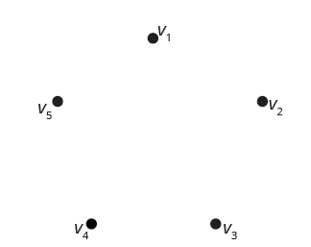
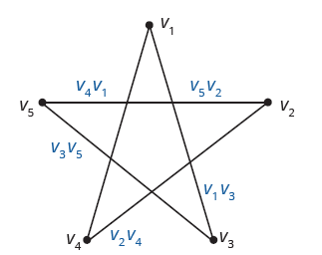
Example 8: Drawing a Graph Given the Edges—Slide 2
Figure 30
Now, connect the vertices with the given edges. For example, edge v ₁ v ₃ connects vertex v ₁ with vertex v ₃. The following graph shows the completed graph.
Figure 31

Slide 31
Example 8: Drawing a Graph Given the Edges—Slide 3
b. To determine the degree of each vertex, count the number of edges incident to each vertex.
c. To redraw the graph without edges crossing, think of "pulling" edge v ₁ v ₃ to the outside of the graph as shown in the following figure.
Next, do the same with edge v ₃ v ₅.

Slide 32
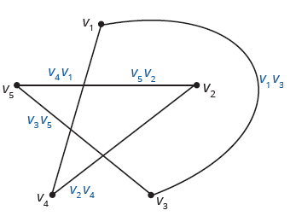
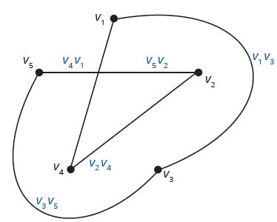
Example 8: Drawing a Graph Given the Edges—Slide 4
Figure 32
Figure 33
​The last thing to do is to pull vertices v ₂ and v ₄ out of the middle. When you do, think of flipping their position, as shown in the following graph. Check for yourself that the edges are all still the same in this new layout.

Slide 33
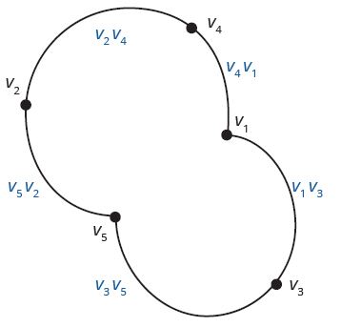
Example 8: Drawing a Graph Given the Edges—Slide 5
Figure 34
The graph is now drawn without any edges crossing. You can see that the "star" now looks round.
The degree of each vertex does not change when the graph is redrawn. Each vertex still has the same edges connected to it and, hence, the same degree. (This will always be the case with any graph.) Therefore, all vertices in this graph still have degree 2.

Slide 34
Example 9: Drawing a Graph without Edges Predetermined—Slide 1
A research chemist is analyzing the structure of compounds of aluminum, iron, and oxygen. Each aluminum atom makes three chemical bonds, each oxygen atom makes two chemical bonds, and each iron atom makes six chemical bonds. Create a possible form for a molecule of two aluminum atoms, two oxygen atoms, and one iron atom where no atom makes a chemical bond to itself.
Solution
To create the structure of the molecule, we will represent the atoms and their bonds as a graph. Each vertex will represent an atom and each edge will represent a chemical bond that joins one atom with another. So we have to draw a graph with no loops that has two vertices of degree 3, two vertices of degree 2, and one of degree 6.

Slide 35
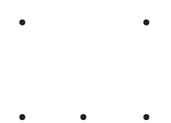
Example 9: Drawing a Graph without Edges Predetermined—Slide 2
Unlike the previous example, there are many graphs that meet the requirements given since there are no restrictions on which vertices must be joined together by edges. We will show one possible form for a molecule of this type.
First notice that there must be a total of five vertices, one for each atom. Place the vertices on the graph.
Figure 35

Slide 36
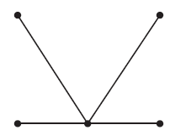
Example 9: Drawing a Graph without Edges Predetermined—Slide 3
Let's begin with the vertex with the highest degree of degree 6. Recall that the degree of a vertex is the number of edges that are connected to it, not the number of vertices. Because there are no loops allowed, the vertex must have six edges joined to it. We'll join each of the other four vertices to it, giving us a vertex of degree 4.
Figure 36

Slide 37
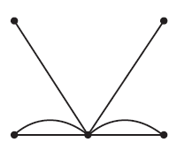
Example 9: Drawing a Graph without Edges Predetermined—Slide 4
To get to degree 6, we'll need to draw two more edges somewhere. We'll choose to give the bottom two vertices on either side another edges with our central vertex, as shown.
Figure 37
Let's stop and determine what the graph looks like so far. We have a graph with five vertices: one of degree 6, two with degree 2, and two with degree 1. Recall that we need two vertices of degree 3, two vertices of degree 2, and one of degree 6.

Slide 38
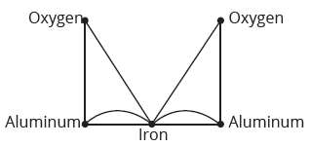
Example 9: Drawing a Graph without Edges Predetermined—Slide 5
Notice that we have more than one possible ways to complete our graph here. One way is to join each vertex of degree 1 to a vertex of degree 2, which increases each of their degrees by one, giving us the desired degree count. Our final graph for the molecule's form is as follows.
Figure 38

Slide 39
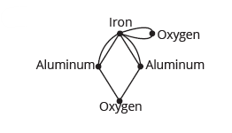
Skill Check 3
Draw a different graph with the same restrictions as in Example 9: no loops, having two vertices of degree 3, two vertices of degree 2, and one of degree 6.
Answer:
Answers will vary. For example,

Slide 40
Definition: Vertex Coverings
Vertex Cover
A vertex cover is a set of vertices A so that every vertex in the graph is either in A or adjacent to a vertex in A.
Minimum Vertex Cover
When a vertex cover A is as small as possible, A is called a minimum vertex cover.

Slide 41
Example 10: Finding a Minimum Vertex Cover—Slide 1
Using the graph we created in Figure 41, determine the minimum number of security guards that would be needed if a guard can secure their room and all the rooms adjacent to it.
Solution
We can begin by placing a guard in room j, represented by a blue G. That way, rooms d, f, g, h, and i are all covered since they are adjacent to j.

Slide 42
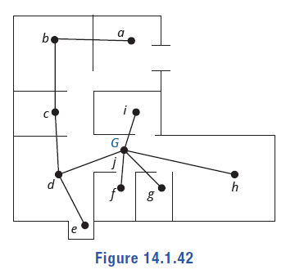
Example 10: Finding a Minimum Vertex Cover—Slide 2
Figure 42
Then, we have the remaining four rooms a, b, c, and e that need a guard. Since these four rooms are connected in a row, this will require a minimum of two guards. One guard in room b who can cover room b as well as a and c, and one guard in either room d or e.

Slide 43
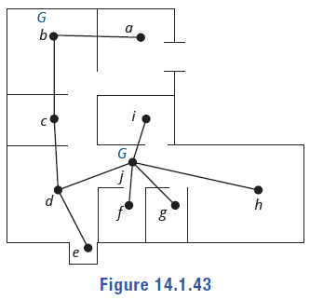
Example 10: Finding a Minimum Vertex Cover—Slide 3
Figure 43
Here's where we can use our best judgment for the scenario. Although room d is secured by the guard in room j, the guard in room j might be a little overworked with all the rooms assigned to his position. We could technically place the final guard in room e and accomplish our objective. However, placing the guard in room d might be a more sensible solution, helping to ease the job of the guard in room j. Unless, of course, room e contains an incredibly valuable jewel. Either way, the minimum number of guards needed to cover every room in the museum is three.

Slide 44
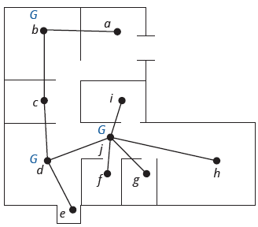
Example 10: Finding a Minimum Vertex Cover—Slide 4
Figure 44
The set of vertices that form the guards' post assignments,
is a minimum vertex cover for the museum graph.

Slide 45
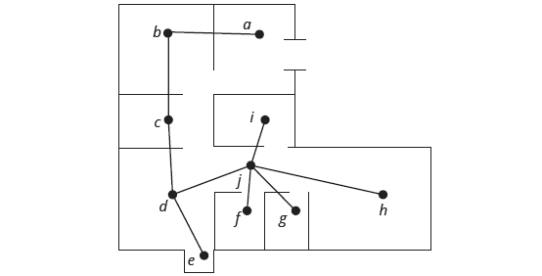
Skill Check 4
Find another minimum vertex covering for the museum graph from Example 10.
Figure 41: Museum Blueprint Graph with Vertices and Edges

Slide 46
Definition: Vertex Colorings
Vertex Coloring
A vertex coloring of a graph is an assignment of colors to the vertices of the graph so that adjacent vertices receive different colors.
Chromatic Number
When the number of colors used in a vertex coloring is as small as possible, this number is called the chromatic number of a graph and is denoted χ(G), read "chi of G."

Slide 47
Example 11: Finding a Vertex Coloring—Slide 1
A wireless communications service provider needs to place cell towers in all counties of the state in such a way that the frequencies for each tower do not interfere with each other. A vertex in the graph represents a county and an edge represents a shared border between counties.
When two cell towers are placed in adjacent counties, they interfere with each other's signal unless they are on different frequencies. The provider could place a different frequency in each county and have 11 frequencies for the state. However, to minimize their costs, the provider needs to use as few frequencies as possible. Find the chromatic number of the graph and determine the best arrangement of the frequencies of the cell towers for the provider.

Slide 48
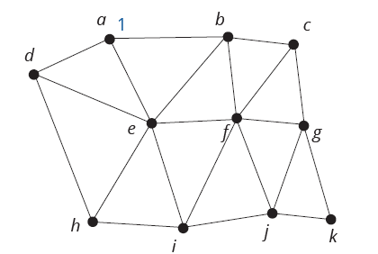
Example 11: Finding a Vertex Coloring—Slide 2
Solution
We can represent the frequencies of a cell tower by using a number. Let's begin by putting the first frequency in county a, as shown with the number 1 on the graph.
Figure 48

Slide 49
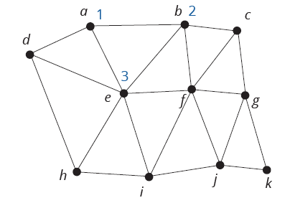
Example 11: Finding a Vertex Coloring—Slide 3
Any county (vertex) adjacent to county a is not allowed to use frequency 1. So, the counties b, d, and e all need new frequencies. Start by giving county b frequency 2. Notice that county e can't be on 1 or 2 since it connects to both a and b, so we need to give it frequency 3. Here's how the graph looks so far.
Figure 49

Slide 50
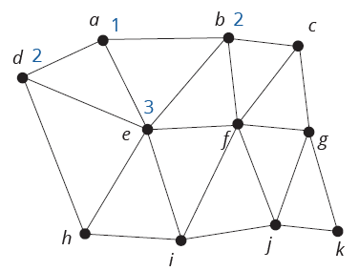
Example 11: Finding a Vertex Coloring—Slide 4
Returning to county d, we know that it cannot be the same as either of the adjoining counties a and e, which have frequencies 1 and 3 respectively. Since frequency 2 is available, we'll use it again, as we are trying to use as few frequencies as possible.
Figure 50

Slide 51
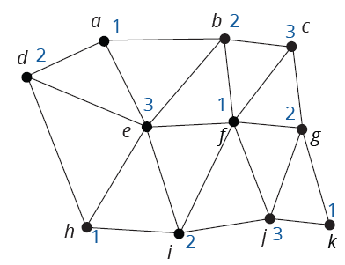
Example 11: Finding a Vertex Coloring—Slide 5
Continue in the same manner until all vertices are numbered.
Figure 51
You can see that we needed three different frequencies to cover all the counties without interference. Therefore, the county graph has a chromatic number of 3; that is, χ(G) = 3.

Slide 52
Definition: Cycle
A cycle is a walk that starts and ends at the same vertex and has no edges or vertices repeated except for the starting vertex.

Slide 53
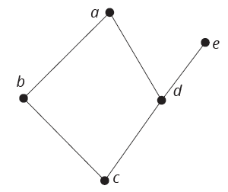
Example 12: Identifying a Cycle in a Graph—Slide 1
Identify a cycle in graph G and determine its length.
Figure 54: Graph G
Solution
The only cycle in graph G is the cycle among the vertices a, b, c, and d. To refer to the cycle we can begin at any of the vertices and list them in order as we trace the cycle. For instance, beginning with vertex b, the cycle is b, c, d, a. Beginning with the vertex a, the same cycle is a, d, c, b. Changing the direction or the starting vertex does not create a different cycle. Because the cycle has four vertices and four edges, the cycle has length 4.

Slide 54
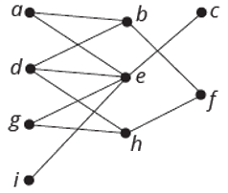
Skill Check 5
Identify a cycle of length 6 in the following graph.
Figure 55
Answer: Answers will vary. For example, a, b, d, h, g, e; g, e, a, b, f, h; b, f, h, d, e, a; d, e, g, h, f, b.

