Slide 1
Section 14.2
Trees

Slide 2
Definition: Tree
A connected graph with no cycles is called a tree.

Slide 3
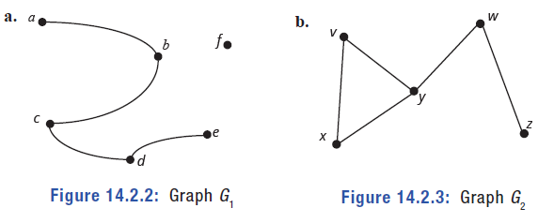
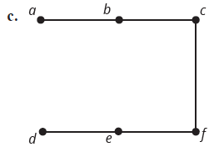
Example 1: Identifying Trees—Slide 1
Determine if each of the following graphs is a tree.
Figure 2: Graph G₁
Figure 3: Graph G₂
Figure 4: Graph G₃

Slide 4
Example 1: Identifying Trees—Slide 2
Solution
a. Although G ₁ does not have a cycle in it, it is not a connected graph because there is not a path between vertex f and other vertices. Therefore, it is not a tree.
b. G ₂ is not a tree because there is a cycle among the vertices v, x, and y.
c. G ₃ is a tree because it is a connected graph without any cycles.

Slide 5
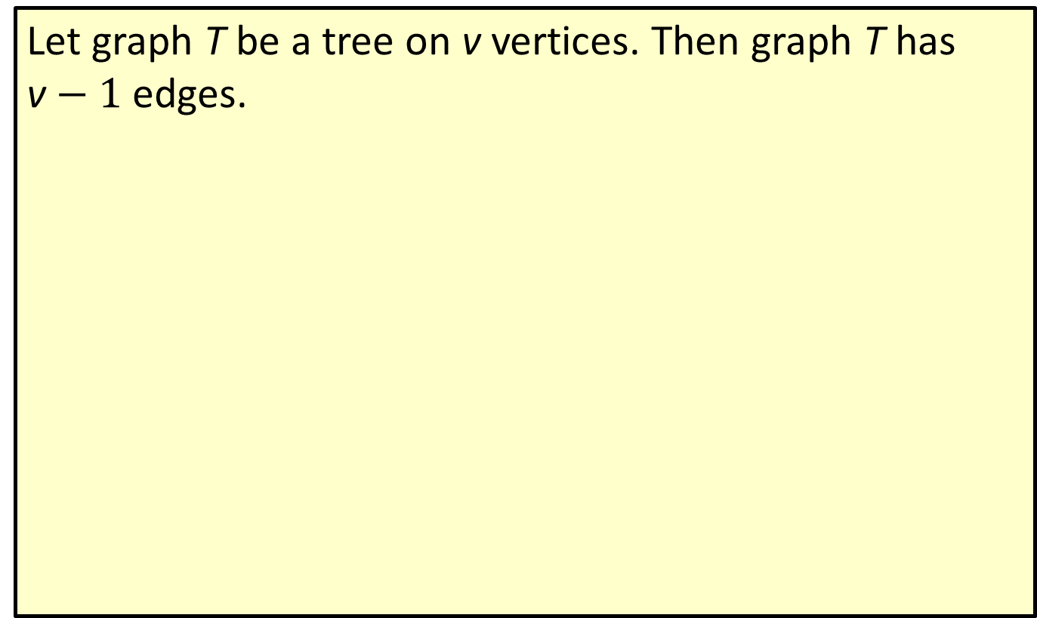
Definition: Tree Theorem
Let graph T be a tree on v vertices. Then graph T has v$− 1$ edges.

Slide 6
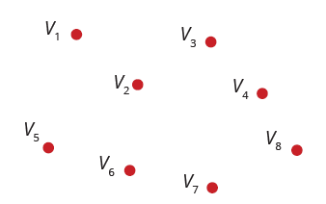
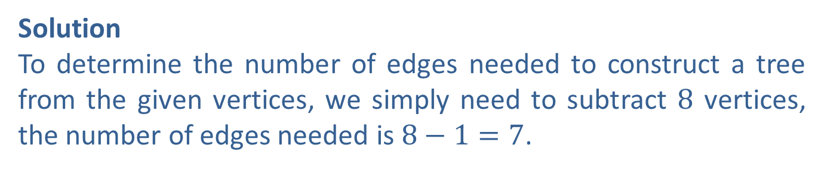
Example 2: Determining the Number of Edges Needed for a Tree
Determine the number of edges needed to connect the given vertices so that the resulting graph is a tree.
Figure 8
Solution
To determine the number of edges needed to construct a tree from the given vertices, we simply need to subtract 8 vertices, the number of edges needed is $8−1=7$.

Slide 7
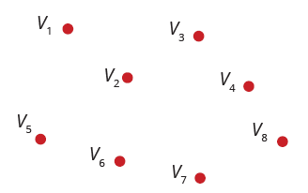
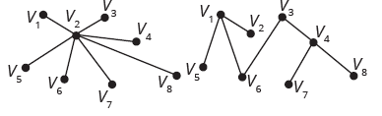
Skill Check 1
Construct two different trees with the vertices in Example 2, shown again here.
Figure 8
Answer:

Slide 8
Definition: Spanning Tree
A spanning tree is a subgraph of a connected graph, which is itself connected and contains all the vertices of the original graph, but has no cycles.

Slide 9
Procedure: Steps for Constructing A Spanning Tree
1. In a connected graph G, identify a cycle. If more than one cycle exists, choose one at random.
2. Choose an edge from the cycle selected and delete it from the graph.
3. While the graph contains a cycle, repeat Steps 1 and 2.

Slide 10
Example 3: Using Spanning Trees—Slide 1
In an interview in Premier Magazine in 1994, Kevin Bacon commented that he had acted together with almost everyone in Hollywood. The game "Six Degrees of Kevin Bacon" was invented based on this comment. The goal is to link any named actor to Kevin Bacon by beginning with the named actor and naming no more than six actors, ending with Kevin Bacon, where each successive pair of actors have appeared in a movie together.
Find a spanning tree for the following graph, in which the vertices are actors, and two actors are joined by an edge if they appeared together in a movie, where the edges are labeled with the movie.

Slide 11
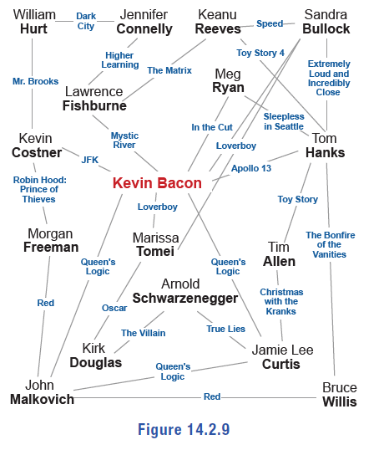
Example 3: Using Spanning Trees—Slide 2
Figure 9

Slide 12
Example 3: Using Spanning Trees—Slide 3
Solution
The algorithm says that we have to identify cycles one by one, then eliminate edges until no more cycles remain. There are lots of cycles to choose from here, but let's begin with the following cycle.
Kevin Bacon, Sandra Bullock, Marisa Tomei
Do you see this cycle on the graph? We are free to delete any of the edges of this cycle to construct the spanning tree. Let's remove the edge Loverboy joining Sandra Bullock and Marisa Tomei.
The next cycle we'll consider is the following.
Kevin Bacon, Sandra Bullock, Tom Hanks
Remove the edge Loverboy connecting Kevin Bacon and Sandra Bullock.
Staying with Sandra Bullock and Tom Hanks, let's remove the edge Toy Story 4 between Tom Hanks and Keanu Reeves, which is in the cycle Tom Hanks, Keanu Reeves, Sandra Bullock.

Slide 13
Example 3: Using Spanning Trees—Slide 4
Now were starting to make some progress. Look at the following cycle.
Kevin Bacon, Lawrence Fishburne, Keanu Reeves, Sandra Bullock, Tom Hanks
We can remove Speed to eliminate the cycle.
The next cycle we'll consider is the following.
Kevin Bacon, Lawrence Fishburne, Jennifer Connelly, William Hurt, Kevin Costner
This time let's remove the Mr. Brooks edge. While we're at it, let's also remove the edge that joins Kevin Costner to Morgan Freeman. That eliminates the cycle
Kevin Bacon, Kevin Costner, Morgan Freeman, John Malkovich.
We can eliminate the cycle
Kevin Bacon, Marisa Tomei, Kirk Douglas, Arnold Schwarzenegger, Jamie Lee Curtis
by removing the The Villain edge that joins Kirk Douglas to Arnold Schwarzenegger.

Slide 14
Example 3: Using Spanning Trees—Slide 5
Although Jamie Lee Curtis and John Malkovich were both in Queen's Logic with Kevin Bacon, let's remove the edge that joins Jamie Lee Curtis and John Malkovich to break that cycle of length three. Now, there are three cycles that remain. Can you see them?
Kevin Bacon, John Malkovich, Bruce Willis, Tom Hanks
forms a cycle, so let's delete the The Bonfire of the Vanities edge.
Kevin Bacon, Tom Hanks, Tim Allen, Jamie Lee Curtis
also forms a cycle, so we'll delete the Toy Story edge. Finally, there is one cycle remaining:
Kevin Bacon, Meg Ryan, Tom Hanks.
We will remove this cycle by deleting the In the Cut edge. Now, we have the following spanning tree.

Slide 15
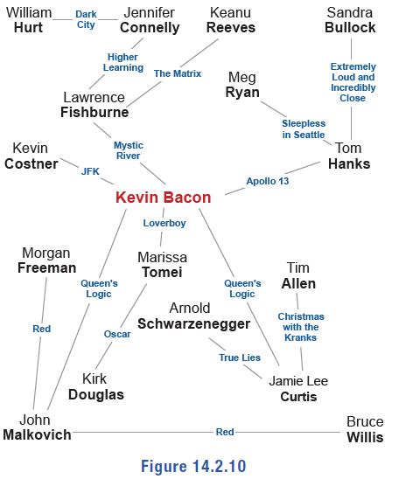
Example 3: Using Spanning Trees—Slide 6
Figure 10

Slide 16
Math Milestone
The Six Degrees of Kevin Bacon game is based on the small world phenomenon and was created in 1994 by four Albright College students after Kevin Bacon mentioned in an interview that he had worked with everybody in Hollywood or someone who has worked with them. The number of degrees an actor is from Kevin Bacon is called their "Bacon number".

Slide 17
Fun Fact
You can determine the Bacon number of most actors by using the search feature on the website Oracle of Bacon: https://oracleofbacon.org.

Slide 18
Skill Check 2
Find another spanning tree for the Kevin Bacon graph in Example 3, shown again here, by deleting a different set of edges.
Figure 9
Answer: Answers will vary.

Slide 19
Procedure: Steps for Constructing A Minimum-Weight Spanning Tree
1. Consider each edge in the graph in order of descending weight.
2. If the edge being considered is part of a cycle, remove it. If not, it must remain in the graph, and you can move on to the next edge.
3. Repeat Steps 1 and 2 until all edges have been considered.

Slide 20
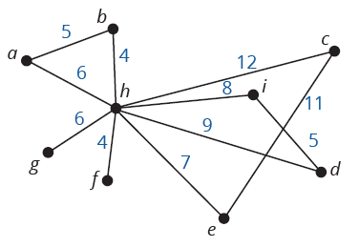
Example 4: Constructing a Minimum‑Weight Spanning Tree—Slide 1
SpeedFirst Telecommunications is going to run its fiber optic cable in a new development. The edges in the given graph represent the possible ways that the cable can be run. The weight of each edge is the length of the cable needed, in meters. Find the minimum spanning tree using the algorithm to obtain the most cost-efficient way for SpeedFirst to run the cable. What is the minimum amount of cable that SpeedFirst will need to run in the new development?
Figure 11

Slide 21
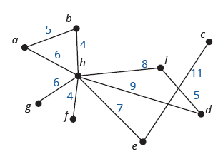

Example 4: Constructing a Minimum‑Weight Spanning Tree—Slide 2
Solution
We begin with the edge with the largest weight, which is the edge hc$=12$. Since it has the highest weight and is part of cycle h, c, e, we can remove it, as shown in Figure 12.
Figure 12

Slide 22
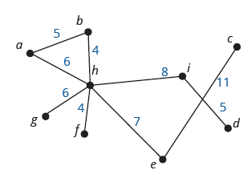

Example 4: Constructing a Minimum‑Weight Spanning Tree—Slide 3
Next, look at edge ec$=11$. This edge is no longer part of a cycle since the edge hc was removed, so this edge must remain in order to connect vertex $c$ to the graph.
The next highest weighted edge is hd$=9$. This edge is part of the cycle h, d, i, so we can remove this edge. Figure 13 shows the graph as it stands now.
Figure 13

Slide 23
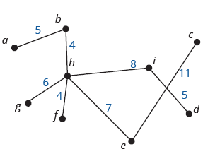
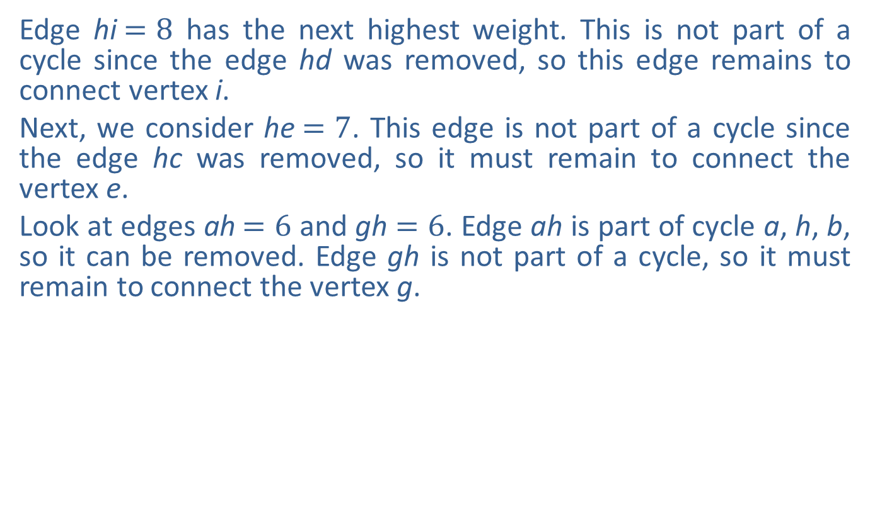
Example 4: Constructing a Minimum‑Weight Spanning Tree—Slide 4
Edge hi$=8$ has the next highest weight. This is not part of a cycle since the edge hd was removed, so this edge remains to connect vertex i.
Next, we consider he$=7$. This edge is not part of a cycle since the edge hc was removed, so it must remain to connect the vertex e.
Look at edges ah$=6$ and gh$=6$. Edge ah is part of cycle a, h, b, so it can be removed. Edge gh is not part of a cycle, so it must remain to connect the vertex g.
Figure 14

Slide 24
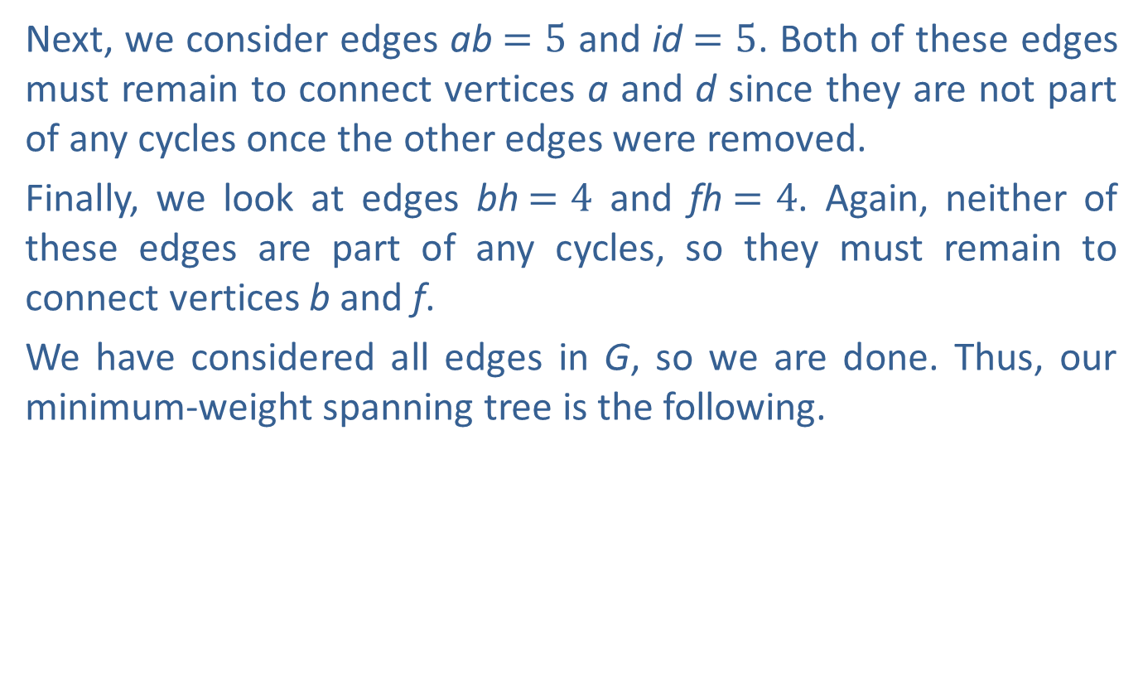
Example 4: Constructing a Minimum‑Weight Spanning Tree—Slide 5
Next, we consider edges ab$=5$ and id$=5$. Both of these edges must remain to connect vertices a and d since they are not part of any cycles once the other edges were removed.
Finally, we look at edges bh$=4$ and fh$=4$. Again, neither of these edges are part of any cycles, so they must remain to connect vertices b and f.
We have considered all edges in G, so we are done. Thus, our minimum-weight spanning tree is the following.

Slide 25
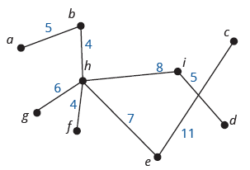
Example 4: Constructing a Minimum‑Weight Spanning Tree—Slide 6
Figure 15
We can determine the minimum length of cable that SpeedFirst will need to run by adding together all of the weights in the minimum spanning tree.

Slide 26
Definition: Leaf
A vertex of degree 1 in a tree is called a leaf.

Slide 27
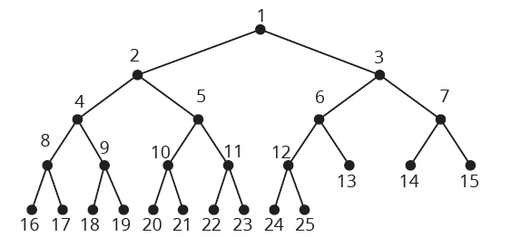
Example 5: Determining the Number of Leaves on a Tree—Slide 1
Determine the number of leaves on the tree T.
Figure 16

Slide 28
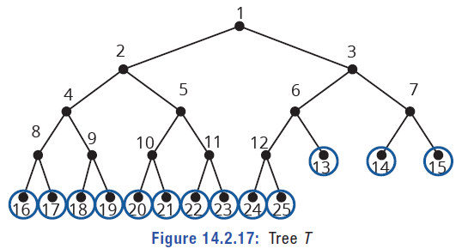
Example 5: Determining the Number of Leaves on a Tree—Slide 2
Solution
To find the leaves in T, we need to look for vertices of degree 1. These will be vertices with only one edge connected to them. We've circled the leaves in Figure 17
Figure 17
There are 13 leaves on tree $T$.

Slide 29
Definition: Number of Leaves on a Tree
If a tree has k vertices with degrees
each greater than 1, then the number of leaves on the tree is

Slide 30
Helpful Hint
∑ is the Greek letter Sigma and is used to indicate "the sum of."

Slide 31
Example 6: Determining the Number of Leaves on a Tree—Slide 1
Governor Airlines has airport hubs in seven cities. Those seven cities have connecting flights to 2, 3, 6, 8, 7, 4, and 5 cities, respectively. If the graph formed by joining each pair of available flights is a tree, how many different destinations does Governor Airlines fly to?
Solution
The total number of destinations is the number of vertices in the tree. That number of vertices consists of the number of leaves on the tree as well as the internal vertices. We know that there are seven internal vertices representing the seven airport hubs. To completely count the number of destinations, we need to know the number of leaves.
The formula for the number of leaves is
Where k is the number of vertices with degree greater than 1.

Slide 32
Example 6: Determining the Number of Leaves on a Tree—Slide 2
So, the number of leaves will be calculated as follows.
Adding this to the number of airport hubs, the total number of destinations the airline serves is 23 + 7 = 30.

