Slide 1
Section 14.3
Matchings

Slide 2
Definition: Bipartite Graph
A bipartite graph is a graph in which the vertices can be partitioned into precisely two subsets so that every edge joins a vertex in one subset to a vertex in the other subset.

Slide 3
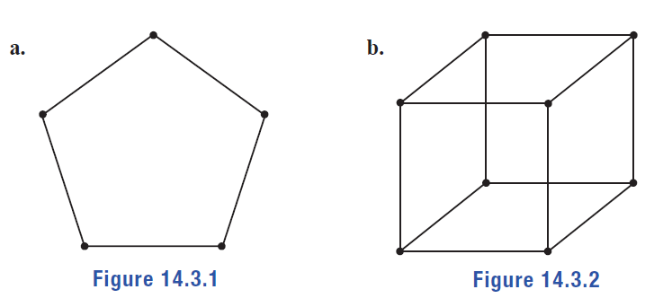
Example 1: Identifying Bipartite Graphs—Slide 1
Determine if the following graphs are bipartite.
Figure 1
Figure 2

Slide 4
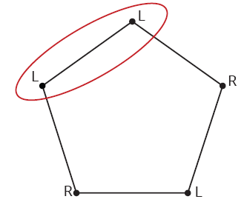
Example 1: Identifying Bipartite Graphs—Slide 2
Solution
a.​ To determine if the graph is bipartite, we need to show that the vertices can be divided into two groups. Let's assume there are two groups, the left-side group and the right‑side group. Begin by labeling the vertices either L for the left-hand side or R for the right‑hand side. We will start at the top and label the vertices alternately as we go clock-wise around the graph. If vertices are adjacent, they cannot have the same label.
Figure 3
Notice that we end up with two adjacent vertices both labeled L. Therefore, this graph is not bipartite.

Slide 5
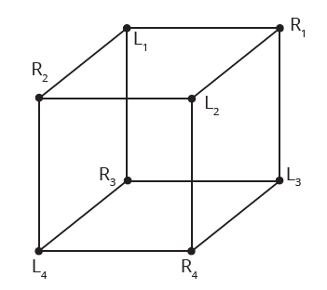
Example 1: Identifying Bipartite Graphs—Slide 3
b. We can carry out the same process of labeling vertices with either L or R for the cube. We've also numbered each vertex to help keep track of them.
​
Figure 4

Slide 6
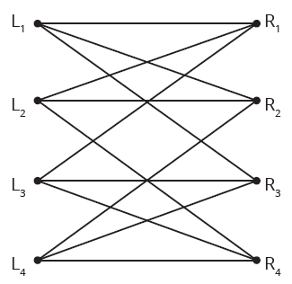
Example 1: Identifying Bipartite Graphs—Slide 4
Notice that no adjacent vertices have the same label. Therefore, this graph is bipartite. Figure 5 is an alternate drawing showing the vertices on their left and right sides.
​
Figure 5

Slide 7
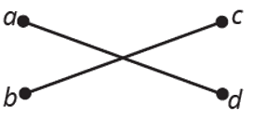
Skill Check 1
Determine if the following graph is bipartite.
Figure 6
Answer: Yes

Slide 8
Definition: Matching
A matching is a subset of edges in a graph so that each vertex is incident with at most one edge.

Slide 9
Helpful Hint
A matching with no unmatched vertices is called a perfect matching.

Slide 10
Definition: Neighborhood
If we have a set of vertices A, then the neighborhood of A, denoted N(A), is the set of all vertices adjacent to a vertex in A.

Slide 11
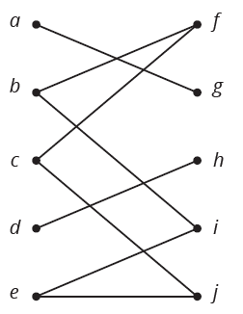

Example 2: Identifying a Neighborhood—Slide 1
in the Graph G below.
Let $A$ be the set of vertices
Identify the neighborhood of A.
Figure 9: Graph G

Slide 12
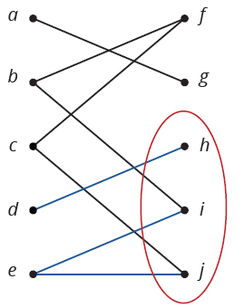
Example 2: Identifying a Neighborhood—Slide 2
Solution
To find the neighborhood of A, we need to find all the vertices on the right‑hand side that are adjacent to the vertices in A. Vertex d is adjacent to vertex h on the right‑side and vertex e is adjacent to both vertices i and j.
Figure 10: Graph G

Slide 13
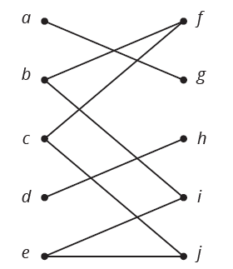
Skill Check 2
Let B be the set of vertices
from the graph in Example 2. Identify the neighborhood of B.
Figure 9: Graph G

Slide 14
Definition: Hall's Marriage Theorem
Let G be a bipartite graph. Then there is a matching of the left-hand vertices into the right-hand vertices if and only if for every subset of left-hand vertices A, the number of vertices in N(A) is at least as large as the number of vertices in A.

Slide 15
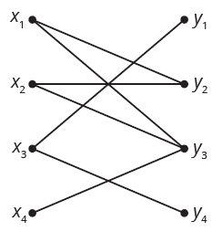
Example 3: Determining If a Matching Is Possible—Slide 1
Use Hall's Marriage Theorem to determine if a matching is possible for the following graphs.
a.​
Figure 12
b. Three top prizes are to be given to the three highest salespeople—a new phone, a flight voucher, and a gift card of choice. John, Mo, and Richard have their sights set on the prizes they would prefer to win. John would like either the new phone or the gift card. Mo prefers the flight voucher, while Richard’s top pick is the new phone. Is there a way for each salesperson to receive a prize they prefer if there is only one of each prize?

Slide 16
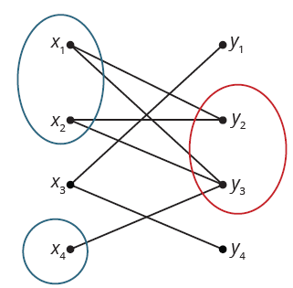
Example 3: Determining If a Matching Is Possible—Slide 2
Solution
a. ​Hall's Marriage Theorem says that for there to be a matching, whichever subset of vertices we choose on the left, their neighborhood on the right must be at least as large. For several subsets of vertices on the left this property is satisfied. For instance, consider
which has
Figure 13
But if we look at
the neighborhood is
which violates Hall's Marriage Theorem and shows that a matching is not possible.

Slide 17
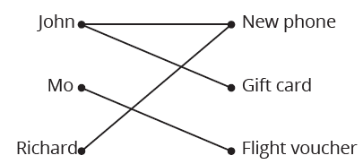
Example 3: Determining If a Matching Is Possible—Slide 3
b. ​To begin represent the salesmen and prizes as a graph with the salesmen on the left and the prizes on the right, as in Figure 14.
Figure 14
A matching from the left into the right is a way for each salesman to win a different top prize. You can probably see that this can be done by looking at the graph, but let's see how Hall's Marriage Theorem also establishes this.
To use Hall's Marriage Theorem we need to consider each possible subset of salesman vertices and check the size of the neighborhood. We have seven subsets to work through. We will deal with them one at a time.​

Slide 18
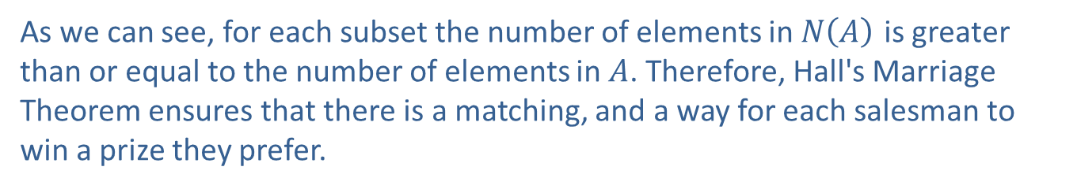
Example 3: Determining If a Matching Is Possible—Slide 4
As we can see, for each subset the number of elements in $N⁡\left(A\right)$ is greater than or equal to the number of elements in $A$. Therefore, Hall's Marriage Theorem ensures that there is a matching, and a way for each salesman to win a prize they prefer.

Slide 19
Definition: Regular Graph, and Regular Bipartite Graph
Regular Graph
A regular graph is a graph where every vertex has the same degree.
Regular Bipartite Graph
A regular bipartite graph is a regular graph with the same number of vertices on both the left-hand side as the right-hand side.

Slide 20
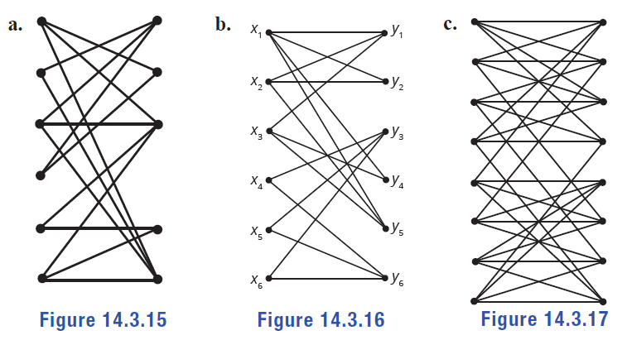
Example 4: Identifying a Regular Bipartite Graph—Slide 1
Determine whether each graph is a regular bipartite graph.
Figure 15
Figure 16
Figure 17

Slide 21
Example 4: Identifying a Regular Bipartite Graph—Slide 2
Solution
a. ​A regular bipartite graph always has the same number of vertices on the left and right-hand sides. This graph has six vertices on the left-hand side and five on the right. Therefore, this graph is not a regular bipartite graph.
b. ​This graph has six vertices on the left and right-hand sides. In a regular bipartite graph, every vertex has the same degree. Among lots of other differences, vertex x ₁ has degree 4, but vertex x ₂ has degree 3. Therefore, this graph is not a regular bipartite graph.
c. This graph has eight vertices on each side, and every vertex has degree 4. Therefore, it is a regular bipartite graph.

Slide 22
Definition: Regular Bipartite Graph Theorem
A regular bipartite graph has a matching.

Slide 23
Example 5: Determining If a Matching Is Possible—Slide 1
Let's consider the following scenario. At the British Museum in London, multimedia tours are offered in English, Korean, Arabic, French, German, Italian, Japanese, Mandarin, Russian, and Spanish. A group of ten students wonder if they can listen to the museum tour in a language they understand with each student listening to a different language. The graph shows which languages each student can understand. Determine if the graph has a matching that would allow the students to each have a unique language for their tour.

Slide 24
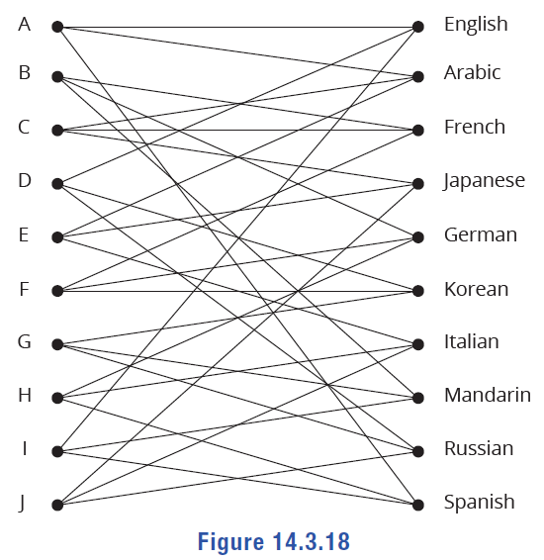
Example 5: Determining If a Matching Is Possible—Slide 2
Figure 18

Slide 25
Example 5: Determining If a Matching Is Possible—Slide 3
Solution
One way to determine if the graph has a matching is to show it is a regular bipartite graph. To do this, we need to check for two things:
1.​ All vertices must have the same degree.
2. ​The number of vertices on the left-hand side must be the same as the number of vertices on the right-hand side.
First to determine the degree of each vertex, we need to count the number of edges incident to each vertex on both sides of the graph.

Slide 26
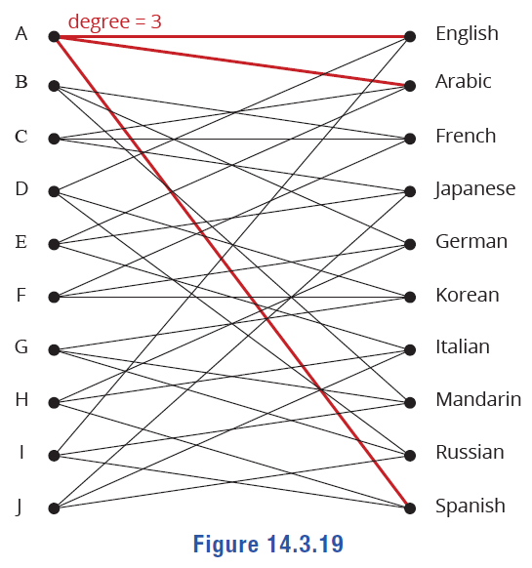
Example 5: Determining If a Matching Is Possible—Slide 4
Figure 19
We see that all vertices have degree 3, so the first criterion is met.

Slide 27
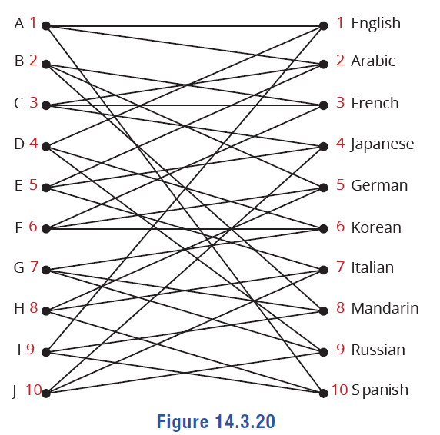
Example 5: Determining If a Matching Is Possible—Slide 5
We can count the number of vertices on each side of the graph to make sure there are equal numbers in each.
Figure 20
Since this graph is a regular bipartite graph, we know from the theorem that it has a matching.

Slide 28
Procedure: Schriver's Algorithm
Steps for Finding a Matching in a Regular Bipartite Graph
1. Given a regular bipartite graph G, give every edge in G a weight of 1.
2.​ Let C be a cycle in the edges of positive weight.
a. ​Number the edges of C successively in turn.
b.​ Increase the weight of the even-numbered edges by 1.
c. Decrease the weight of the odd-numbered edges by 1.
3. ​Repeat Step 2 until the edges with positive weight contain no cycle.
4. ​The positively weighted edges form a matching.

Slide 29
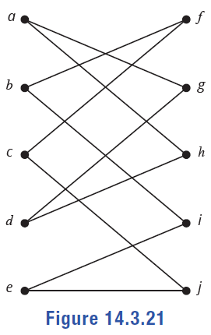
Example 6: Finding a Matching—Slide 1
Find a matching for the following regular bipartite graph.
Figure 21
Solution
We'll use Schriver's Algorithm to find a matching. Let every edge have a weight of 1. Now, find a cycle in the graph. Take a moment and see if you can find one first before looking at the next figure that shows the cycle. Sometimes the hardest part is finding the first cycle.
After finding a cycle, label the edges consecutively. Figure 22 shows the cycle a, h, d, g with the edges labeled in order, not by weight.

Slide 30
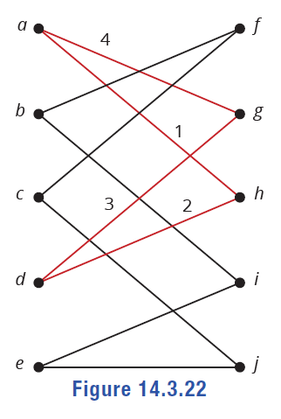
Example 6: Finding a Matching—Slide 2
The next step is to increase the weights of the even numbered edges 2 and 4 by 1, which means they will now each have a weight of 2. We then decrease the odd numbered edges 1 and 3 by 1, which means they have a weight of 0 and can no longer be considered in the algorithm because only positive weighted edges are considered.
Figure 22

Slide 31
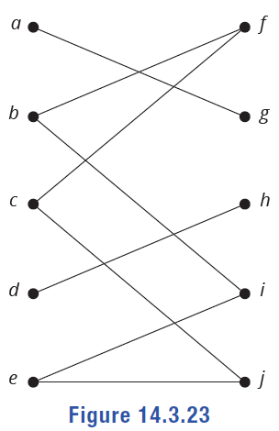
Example 6: Finding a Matching—Slide 3
In Figure 23, the edges with positive weights are shown and the edges with zero weights are removed since they are not part of the matching.
Figure 23

Slide 32
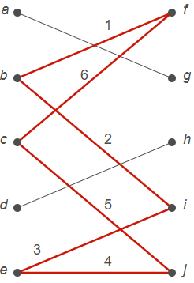
Example 6: Finding a Matching—Slide 4
We begin again at Step 2 by finding a cycle from the edges with positive weights. The only remaining cycle is f, b, i, e, j, c. Label the cycle with consecutive numbers, as shown in Figure 24.
Figure 24

Slide 33
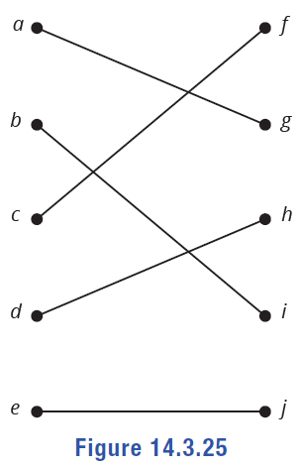
Example 6: Finding a Matching—Slide 5
Once again, increase the weight of the even numbered edges by 1 and decrease the odd edges by 1. The only remaining positive weighted edges give us the following graph.
Figure 25
Because there are no more cycles, we can stop. The remaining edges form the matching we required.

Slide 34
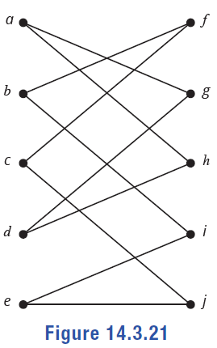
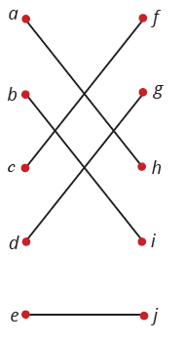
Skill Check 3
Find a different matching for the graph in Example 6.
Figure 21
Answer: Answers will vary. For example,

