Slide 1
Section 14.4
Planar Graphs

Slide 2
Definition: Planner Graphs
Graphs that can be drawn on a plane without edges crossing are called planar graphs.

Slide 3
Think Back 1
Recall that a plane is a flat surface without thickness, depth, or boundaries; like an infinite piece of paper.

Slide 4
Fun Fact 1
The website https://www.jasondavies.com/planarity/ has a browser-based game related to untangling planar graphs!

Slide 5
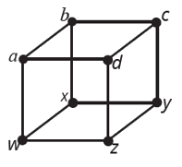
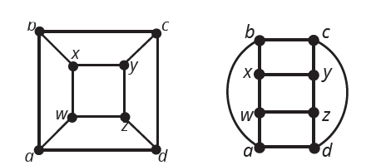
Skill Check 1
Draw the following planar graph without any edges crossing.
Figure 4
Answer: Answers will vary. Two possibilities are as follows.

Slide 6
Definition: Face
In a planar graph, a face is a region inside a cycle of edges or the infinite exterior region on the outside of the graph. We denote the number of faces of a graph by f.

Slide 7
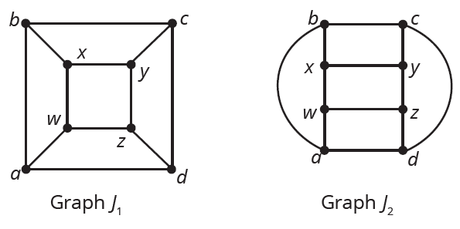
Example 1: Determining the Number of Faces in a Planar Graph—Slide 1
Two drawings of the same graph j are shown. Verify that both drawings have the same number of faces.
Figure 7

Slide 8
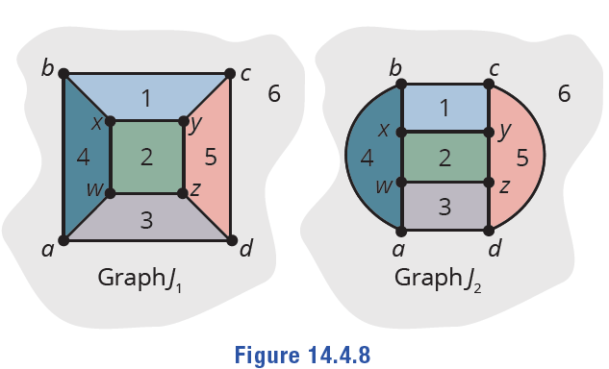
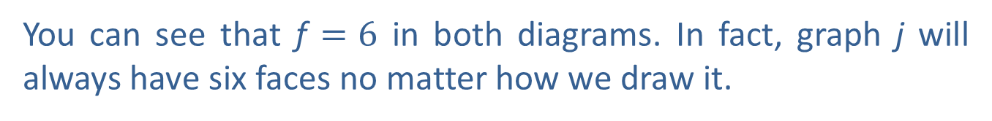
Example 1: Determining the Number of Faces in a Planar Graph—Slide 2
Solution
We can count each of the faces by counting the contained spaces in the graph as well as the exterior face. We've numbered the spaces for each graph in the following figure.
Figure 8
You can see that f $=6$ in both diagrams. In fact, graph j will always have six faces no matter how we draw it.

Slide 9
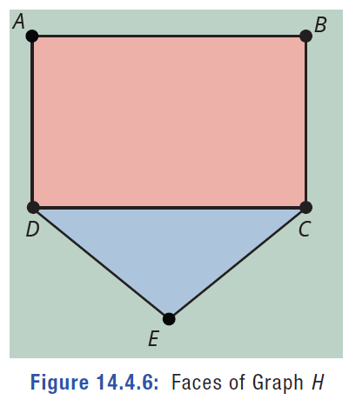
Skill Check 2
a.​ What would happen if we removed the edge CE from the original graph H in Figure 6?
b.​ What would happen if we add the edge BD to the original graph H in Figure 6?
Answer:
a.​ There would then only be two faces.
b.​ We'd split the orange face in two, creating four faces in total.
Figure 8: Faces of Graph H

Slide 10
Definition: Euler's Formula
If G is a connected planar graph with v vertices, e edges, and f faces, then
v + f – e = 2.

Slide 11
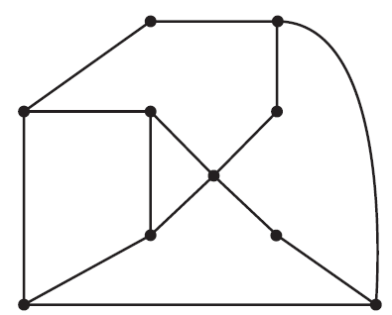
Example 2: Verifying Euler's Formula for a Graph—Slide 1
Confirm Euler's formula for the planar graph G.
Figure 11: Graph H
Solution
We can see that G has 10 vertices and 14 edges. All that remains is to find the number of faces. It has 5 internal faces, as indicated in Figure 12.

Slide 12
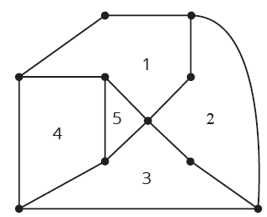
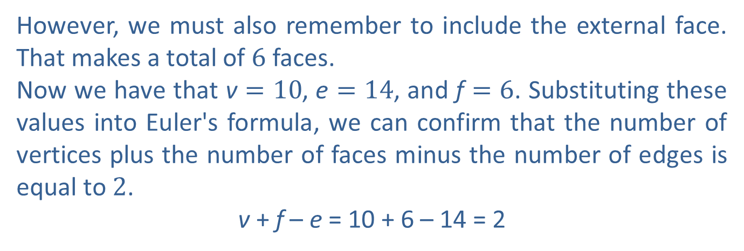
Example 2: Verifying Euler's Formula for a Graph—Slide 2
Figure 12: Graph G
However, we must also remember to include the external face. That makes a total of 6 faces.
Now we have that v $=10$, e $=14$, and f $=6$. Substituting these values into Euler's formula, we can confirm that the number of vertices plus the number of faces minus the number of edges is equal to 2.
v + f – e = 10 + 6 – 14 = 2

Slide 13
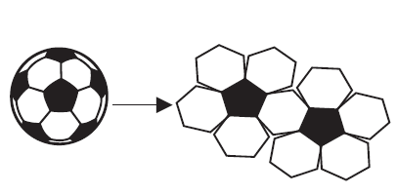
Example 3: Applying Euler's Formula—Slide 1
A soccer ball traditionally consists of hexagonal white faces and pentagonal black faces. Suppose that we use a box cutter and cut out one of the white, hexagonal faces from the ball to make a hole. Now, imagine that we could stretch the ball covering outward at the hole we made, so that it lies completely flat in a plane as shown. How many black pentagonal faces are there?
Figure 13

Slide 14
Example 3: Applying Euler's Formula—Slide 2
Solution
Remember that Euler's formula says that the number of vertices plus the number of faces minus the number of edges in a planar graph must equal 2. To use Euler's formula, we need to find a way to express the number of vertices, edges, and faces in a soccer ball, and then substitute them into the formula.
Let's tackle the vertices first. On the soccer ball, each black pentagon has five vertices, and each white hexagon has six vertices. We can count the total number of vertices on the entire ball one face at a time by counting 5 for every black pentagon and 6 for every white hexagon. If we let P represent the number of pentagonal faces, we can multiply it by 5. Similarly, we'll let H represent the number of hexagonal faces and multiply it by 6. Then, the total number of vertices can be represented by the sum 5P + 6H.
However, notice that every vertex on the soccer ball is a vertex of three adjacent faces. The following diagram shows how vertex v is adjacent to the three faces labeled A, B, and C.

Slide 15
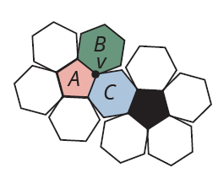
Example 3: Applying Euler's Formula—Slide 3
Figure 14
If we claim the number of vertices on the soccer ball is 5P + 6H, we end up counting each vertex multiple times. Look at vertex v in the previous figure again. It will be counted as part of each of the three faces in which it lies. In fact, every vertex lies in three faces, which means every vertex will be counted three times as we count around the faces. So, we must divide the number of vertices by 3 to give the following value for v.

Slide 16
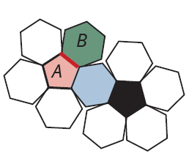
Example 3: Applying Euler's Formula—Slide 4
We can do the same to count the number of edges on the soccer ball. Every black pentagon has five edges, and every white hexagon has six edges. Again, we must be careful not to over count the edges. Notice that every edge is on the boundary of two faces. For instance, the edge highlighted is on the boundary of the face labeled A as well as the face labeled B.
Figure 15

Slide 17
Example 3: Applying Euler's Formula—Slide 5
So, the number of edges is given by the following.
Now that we've found expressions for the number of vertices and edges, we just need to express the number of faces. The total number of faces will be the number of black pentagons P plus the number of white hexagons H. (Recall that we cut out one of the white hexagonal faces, which counts as the exterior face. As a result, we do not need to count an exterior face.) Substituting these expressions into the formula we have the following.

Slide 18
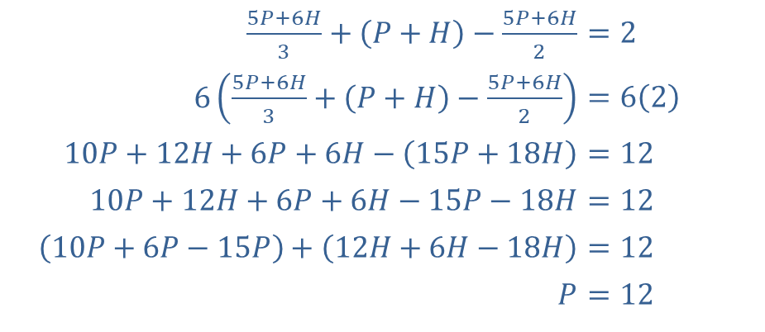
Example 3: Applying Euler's Formula—Slide 6
Next, simplify this equation by removing the fractions and combining like terms together.
​
​$\frac{5P+6H}{3}+\left(P+H\right)−\frac{5P+6H}{2}$ | ​$=2$
​$6\left(\frac{5P+6H}{3}+\left(P+H\right)−\frac{5P+6H}{2}\right)$ | ​$=6\left(2\right)$
​$10P+12H+6P+6H−\left(15P+18H\right)$ | ​$=12$
​$10P+12H+6P+6H−15P−18H$ | ​$=12$
​$\left(10P+6P−15P\right)+\left(12H+6H−18H\right)$ | ​$=12$
​$P$ | ​$=12$
This means that no matter how many hexagons there are, there must always be precisely 12 black pentagons on the soccer ball.

Slide 19
Think Back 2
Recall that a pentagon is a five‑sided figure and that a hexagon is a six‑sided figure.

Slide 20
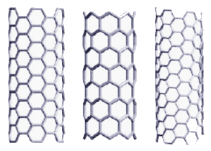
Fun Fact 2
The mathematics used in this example not only applies to the construction of soccer balls, but also to the Nobel Prize winning work that gave rise to Buckminsterfullerene and nanotubes used in medicine, electronics, and quantum computing, just to name a few. In the figure, the nanotube on the left is called armchair, the nanotube in the middle is called zigzag, and the nanotube on the right is called chiral.
Figure 16

Slide 21
Formula: Corollary of Euler's Formula
A planar graph G with v vertices has at most 3v - 6 edges. That is, e ≤ 3v - 6.

Slide 22
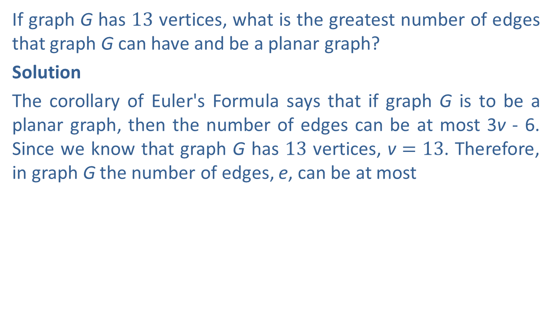
Example 4: Applying the Corollary of Euler's Formula—Slide 1
If graph G has 13 vertices, what is the greatest number of edges that graph G can have and be a planar graph?
Solution
The corollary of Euler's Formula says that if graph G is to be a planar graph, then the number of edges can be at most 3v - 6. Since we know that graph G has 13 vertices, v $=13$. Therefore, in graph G the number of edges, e, can be at most

Slide 23
Skill Check 3
What is the maximum number of edges that a five-vertex graph can have and still be planar? (Hint: Draw a graph to help you find the answer.)
Answer: Nine edges

Slide 24
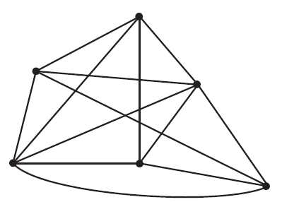
Example 5: Establishing That a Graph Is Not Planar Using Euler's Corollary—Slide 1
Use the corollary of Euler's formula to establish that graph G is not planar.
Figure 17: Graph G

Slide 25
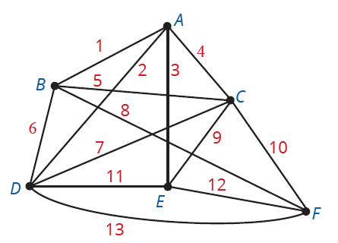
Example 5: Establishing That a Graph Is Not Planar Using Euler's Corollary—Slide 2
Solution
To use the corollary of Euler's formula, we need to count the number of edges and the number of vertices in graph G. There are six vertices (labeled alphabetically) and 13 edges (labeled numerically) as labeled in the following graph.
Figure 18: Graph G

Slide 26

Example 5: Establishing That a Graph Is Not Planar Using Euler's Corollary—Slide 3
So v $=6$ and e $=13$. Now we can substitute these values into the corollary to see if graph G meets the restriction to be planar.
The number of edges is too large, therefore it is not possible for G to be planar.

Slide 27
Definition: Complete Graphs
A complete graph, kₙ, is the graph on n vertices in which every vertex is joined to every other vertex by a single edge.

Slide 28
Fun Fact 3
Complete graphs are represented by the capital letter K. Some sources claim that the K stands for the German word for complete, komplett, while others say that the notation gives honor to the graph theorist Kazimierz Kuratowski.

Slide 29
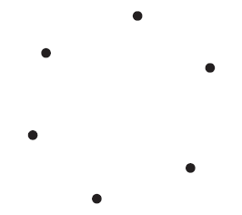
Example 6: Drawing Complete Graphs—Slide 1
Draw the complete graph K₆.
Solution
The complete graph K₆ is the graph with six vertices, each joined to every other vertex by a single edge. Begin by arranging the six vertices in a circle.
Figure 19
We will use a systematic way to join each vertex to every other vertex so that each pair of vertices has a single edge between them. We started in the upper left corner and joined the vertex to each of the others in a clockwise motion, as shown in Figure 20. Moving in a clockwise motion around the circle of vertices, we draw edges to join each vertex to each other vertex.

Slide 30
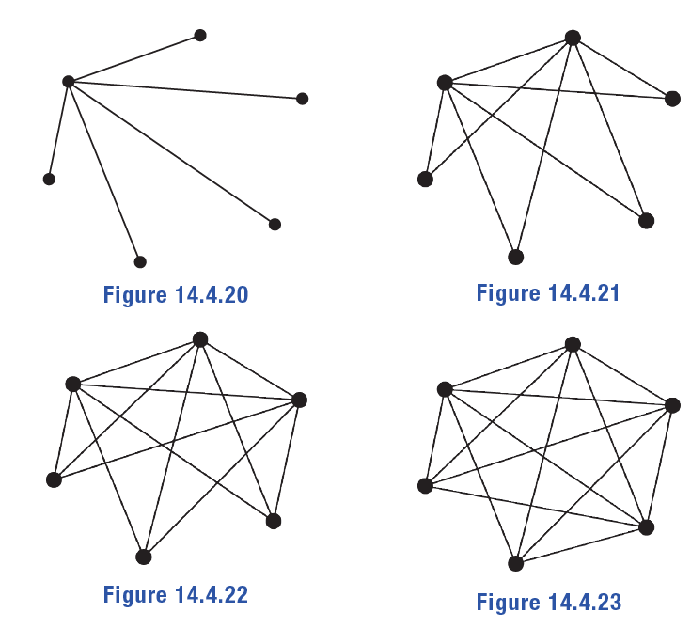
Example 6: Drawing Complete Graphs—Slide 2
Figure 20
Figure 21
Figure 22
Figure 23

Slide 31
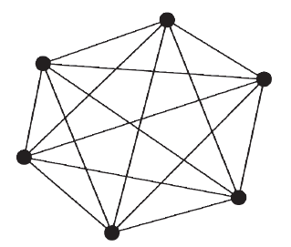
Example 6: Drawing Complete Graphs—Slide 3
The complete K₆ graph is shown in Figure 24.
Figure 24: Complete K₆

Slide 32
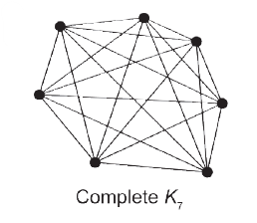
Skill Check 4
Draw the complete graph K₇.
Answer:

Slide 33
Definition: Complete Bipartite Graph
A complete bipartite graph kₘ, ₙ is the bipartite graph with m vertices on the left-hand side and n vertices on the right-hand side. Each vertex on the left is joined to every vertex on the right with a single edge.

Slide 34
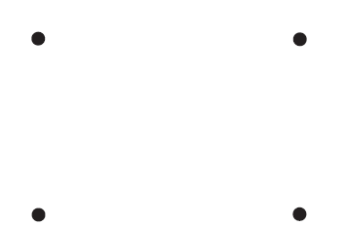
Example 7: Drawing Complete Bipartite Graphs—Slide 1
a.​ Draw the complete bipartite graph K₂, ₂.
b. Is the complete bipartite graph K₂, ₂ planar?
Solution
a.​ The complete bipartite graph K₂, ₂ has two vertices on the left-hand side and two vertices on the right-hand side of the graph. Begin by arranging the four vertices, two on each side.
Figure 27
Then join each vertex on the left with both vertices on the right.

Slide 35
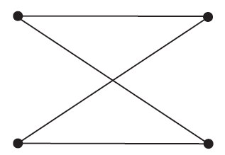
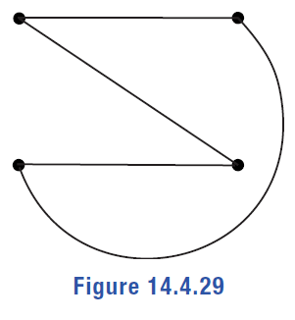
Example 7: Drawing Complete Bipartite Graphs—Slide 2
Figure 28
b. We can establish that K₂, ₂ is planar by drawing it so that the edges do not cross. If there is no way to do that, then K₂, ₂ is not planar. Notice that if we draw one of the crossing edges on the outside of the vertices, we can see that K₂, ₂ is planar.
Figure 29

Slide 36
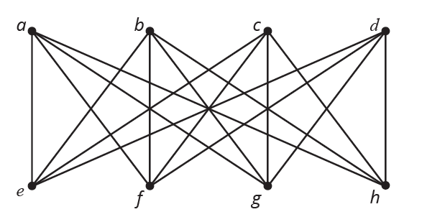
Example 8: Classifying Graphs as Planar or Not—Slide 1
Decide whether graph F is planar or not.
Figure 33: Graph F

Slide 37

Example 8: Classifying Graphs as Planar or Not—Slide 2
Solution
Graph F has v $=8$ vertices and e $=16$ edges.
Let's first check that this satisfies the corollary of Euler's formula.
​
It does satisfy the inequality. However, that doesn't guarantee that graph F is planar. Notice that graph F has a subgraph on a, b, c, e, f, g that is the same as K₃, ₃ , which we saw is not planar.

Slide 38
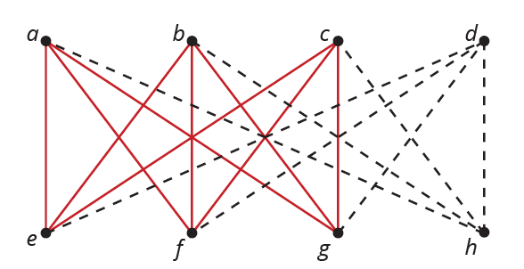
Example 8: Classifying Graphs as Planar or Not—Slide 3
Figure 34: Graph F
Since we can't draw K₃, ₃ without edges crossing, then graph F cannot be planar.

Slide 39
Theorem: Planar Subgraph Theorem
Graph G is not planar if any subgraph of G is not planar.

Slide 40
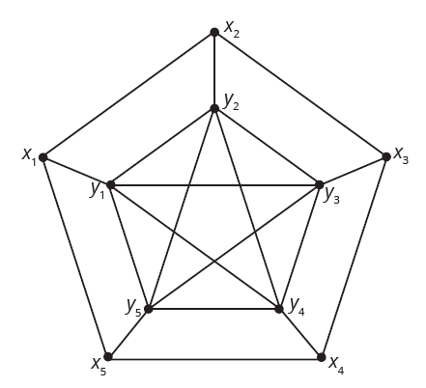
Example 9: Establishing that a Graph Is Not Planar Using Subgraphs—Slide 1
Use the planar subgraph theorem to show that the graph L is not planar by finding a suitable subgraph.
Figure 35: Graph L
Solution
In order to show that graph L is not planar, it is enough to find either a K₅ or K₃, ₃ subgraph. Let's consider the five vertices in the middle of the graph labelled y₁, y₂, y₃, y₄, and y₅. If they form the graph K₅, meaning each vertex is connected to all other vertices, then the graph is not planar.

Slide 41
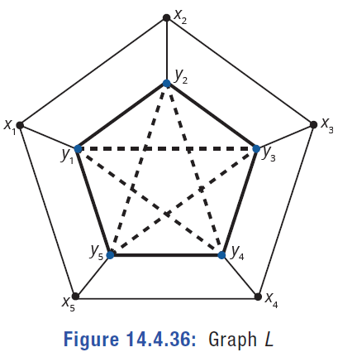
Example 9: Establishing that a Graph Is Not Planar Using Subgraphs—Slide 2
Figure 36: Graph L
Notice that each of the vertices y₁ through y₅ have degree 4 and are all connected to each other. Check this for yourself. The existence of this subgraph is sufficient to say that graph L is not planar.

Slide 42
Theorem: Planar Graph Theorem
G is planar if and only if G has neither K₃, ₃ nor K₅ as a minor.

Slide 43
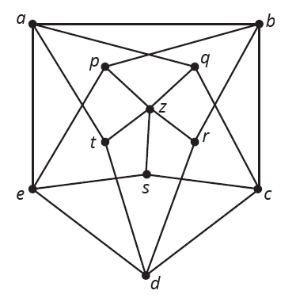
Example 10: Classifying Graphs as Planar or Not—Slide 1
The following is a famous graph called the Grötzsch graph. Show that it is not planar by finding a K₅ minor of the graph.
Figure 38: Grötzsch Graph

Slide 44
Example 10: Classifying Graphs as Planar or Not—Slide 2
Solution
In order to show that the Grötzsch graph is not planar, we need to show that it contains a K₅ minor. Without stronger algorithms that are beyond the scope of this text, we need to simply "find" a minor by a process of deleting vertices, deleting edges, or using edge contractions. Remember that looking for a K₅ minor means that we are looking for five vertices that are all connected to each other. Obviously, there are too many vertices in the original graph, so we'll begin by deleting the middle vertex z. When we delete a vertex from a graph, all edges connected to it also get deleted because they no longer have a vertex at both of their ends. Figure 39 shows the Grötzsch graph after deleting z.

Slide 45
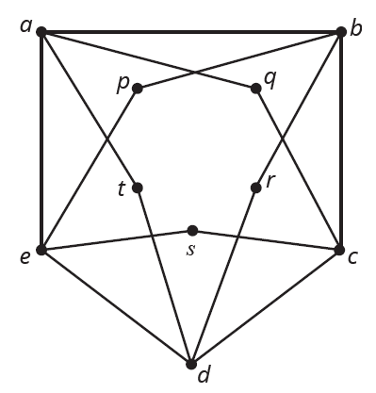
Example 10: Classifying Graphs as Planar or Not—Slide 3
Figure 39
Can you begin to see where the five vertices in the minor might come from? If we can eliminate the inner vertices, we might just have the graph we are seeking. Begin by contracting edge aq so that the vertices a and q become one. We now have one edge between aq and c as the following graph shows.

Slide 46
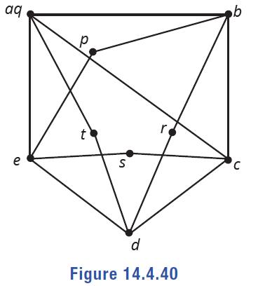
Example 10: Classifying Graphs as Planar or Not—Slide 4
Figure 40
In the same manner, we can contract the edge pb as well as edge sc. Figure 41 shows the contracted graph so far.

Slide 47
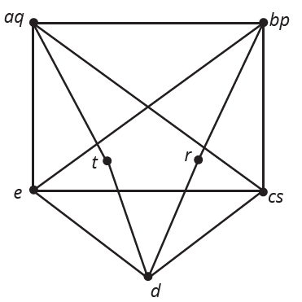
Example 10: Classifying Graphs as Planar or Not—Slide 5
Figure 41
What remains is to contract edges td and rd. Once this is done, we have the following graph of five vertices of degree 4 all connected together. In other words, a K₅ minor of the Grötzsch graph.

Slide 48
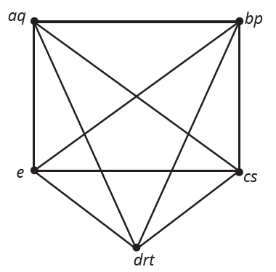
Example 10: Classifying Graphs as Planar or Not—Slide 6
Figure 42
Hence, we have shown that the Grötzsch graph is not planar since it contains a K₅ minor.

Slide 49
Math Milestone
The Grötzsch graph is the smallest triangle-free graph with chromatic number 4. It is named after German mathematician Herbert Grötzsch, born in 1902 in Halle, Germany. He died in 1993, a week before his 91st birthday.

