Slide 1
Chapter 14
Review

Slide 2
Definition: Graph
A graph consists of a set of vertices and a set of edges that join pairs of vertices together. Graphs are generally represented with a capital letter, such as G.

Slide 3
Definition: Loop
A loop is an edge that has the same vertex for both of its ends.

Slide 4
Definition: Walk
A walk in a graph is a finite list of alternating vertices and connecting edges that begins and ends with a vertex.

Slide 5
Definition: Path
A path is a walk with no repeated edges or vertices.

Slide 6
Definition: Connected Graph
A graph is connected if there is at least one path connecting each pair of distinct vertices.

Slide 7
Definition: Disconnected Graphs
A graph is disconnected if it has at least one pair of vertices that is not connected by a path.

Slide 8
Definition: Adjacent
Two vertices that share an edge are adjacent.

Slide 9
Definition: Incident
Two edges that share a vertex are incident to one another. Also, a vertex is incident to the edges that have that vertex as an endpoint.

Slide 10
Definition: Degree
The degree of a vertex denoted d(u), is the number of edges that are incident to u.

Slide 11
Definition: Vertex Cover
A vertex cover is a set of vertices A so that every vertex in the graph is either in A or adjacent to a vertex in A.

Slide 12
Definition: Minimum Vertex Cover
When a vertex cover A is as small as possible, A is called a minimum vertex cover.

Slide 13
Definition: Vertex Coloring
A vertex coloring of a graph is an assignment of colors to the vertices of the graph so that adjacent vertices receive different colors.

Slide 14
Definition: Chromatic Number
When the number of colors used in a vertex coloring is as small as possible, this number is called the chromatic number of a graph and is denoted χ(G), read "chi of G."

Slide 15
Definition: Cycle
A cycle is a walk that starts and ends at the same vertex and has no edges or vertices repeated except for the starting vertex.

Slide 16
Definition: Tree
A connected graph with no cycles is called a tree.

Slide 17
Definition: Spanning Tree
A spanning tree is a subgraph of a connected graph, which is itself connected and contains all the vertices of the original graph, but has no cycles.

Slide 18
Definition: Leaf
A vertex of degree 1 in a tree is called a leaf.

Slide 19
Procedure: Steps for Constructing A Spanning Tree
1. In a connected graph G, identify a cycle. If more than one cycle exists, choose one at random.
2. Choose an edge from the cycle selected and delete it from the graph.
3. While the graph contains a cycle, repeat Steps 1 and 2.

Slide 20
Procedure: Steps for Constructing A Minimum-Weight Spanning Tree
1. Consider each edge in the graph in order of descending weight.
2. If the edge being considered is part of a cycle, remove it. If not, it must remain in the graph, and you can move on to the next edge.
3. Repeat Steps 1 and 2 until all edges have been considered.

Slide 21
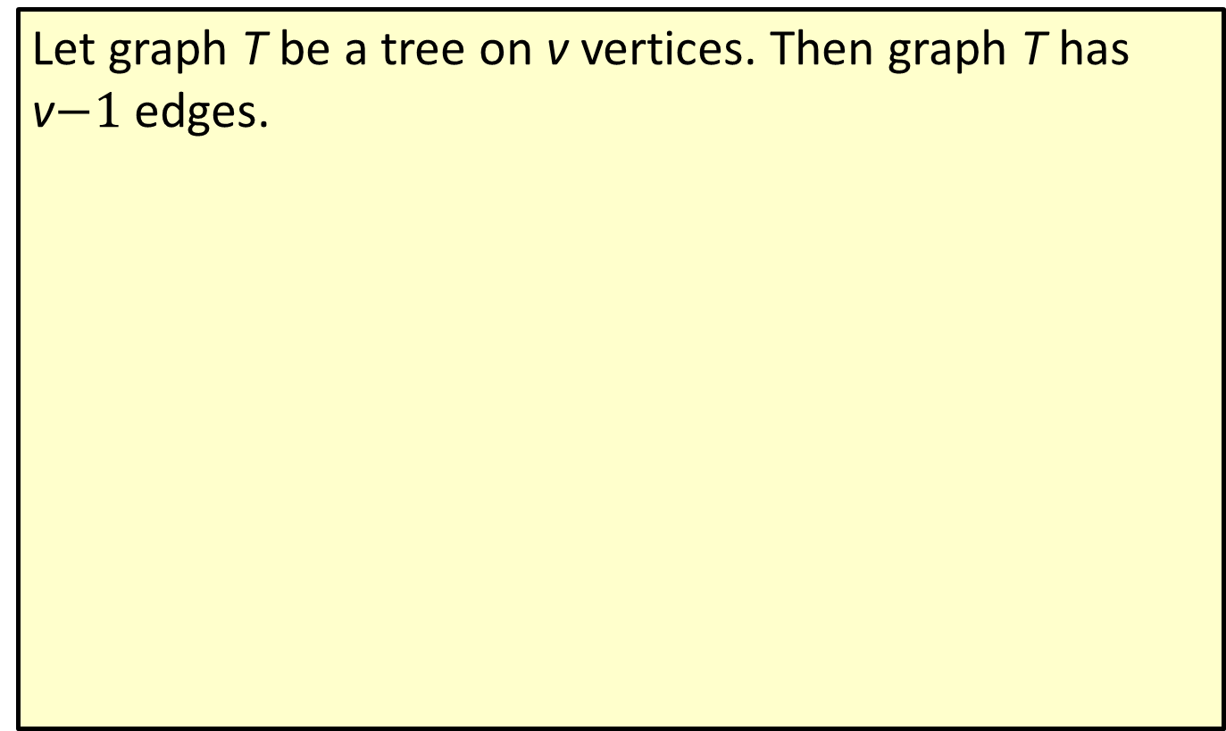
Theorem: Tree Theorem
Let graph T be a tree on v vertices. Then graph T has v$−1$ edges.

Slide 22
Formula: Number of Leaves on a Tree
If a tree has k vertices with degrees
each greater than 1, then the number of leaves on the tree is

Slide 23
Definition: Bipartite Graph
A bipartite graph is a graph in which the vertices can be partitioned into precisely two subsets so that every edge joins a vertex in one subset to a vertex in the other subset.

Slide 24
Definition: Matching
A matching is a subset of edges in a graph so that each vertex is incident with at most one edge.

Slide 25
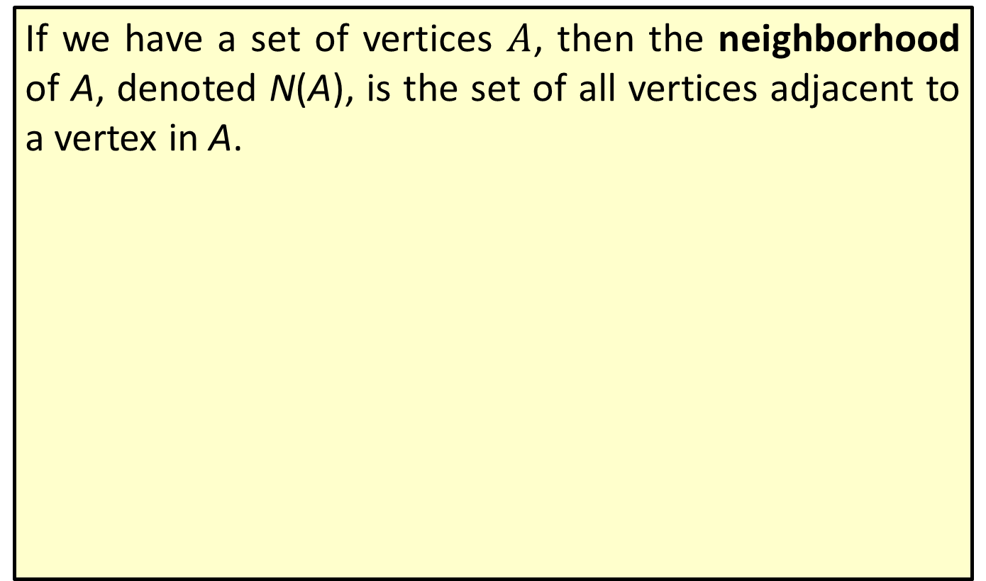
Definition: Neighborhood
If we have a set of vertices $A$, then the neighborhood of A, denoted N(A), is the set of all vertices adjacent to a vertex in A.

Slide 26
Definition: Regular Graph
A regular graph is a graph where every vertex has the same degree.

Slide 27
Definition: Regular Bipartite Graph
A regular bipartite graph is a regular graph with the same number of vertices on both the left-hand side as the right-hand side.

Slide 28
Theorem: Hall's Marriage Theorem
Let G be a bipartite graph. Then there is a matching of the left-hand vertices into the right-hand vertices if and only if for every subset of left-hand vertices A, the number of vertices in N(A) is at least as large as the number of vertices in A.

Slide 29
Theorem: Regular Bipartite Graph Theorem
A regular bipartite graph has a matching.

Slide 30
Procedure: Schriver's Algorithm
Steps for Finding a Matching in a Regular Bipartite Graph
1. Given a regular bipartite graph G, give every edge in G a weight of 1.
2. ​Let C be a cycle in the edges of positive weight.
  a. Number the edges of C successively in turn.
  b.​ Increase ​the weight of the even-numbered edges by 1.
  c.​ Decrease the weight of the odd-numbered edges by 1.
3.​ Repeat Step 2 until the edges with positive weight contain no cycle.
4.​ The positively weighted edges form a matching.

Slide 31
Definition: Planar Graphs
Graphs that can be drawn on a plane without edges crossing are called planar graphs.

Slide 32
Definition: Face
In a planar graph, a face is a region inside a cycle of edges or the infinite exterior region on the outside of the graph. We denote the number of faces of a graph by f.

Slide 33
Definition: Complete Graphs
A complete graph, K_{n}, is the graph on n vertices in which every vertex is joined to every other vertex by a single edge.

Slide 34
Definition: Complete Bipartite Graph
A complete bipartite graph K_{m}, _{n} is the bipartite graph with m vertices on the left-hand side and n vertices on the right-hand side. Each vertex on the left is joined to every vertex on the right with a single edge.

Slide 35
Formula: Euler's Formula
If G is a connected planar graph with v vertices, e edges, and f faces, then
v + f – e = 2.

Slide 36
Formula: Corollary of Euler's Formula
A planar graph G with v vertices has at most 3v – 6 edges. That is, e ≤ 3v – 6.

Slide 37
Theorem: Planar Subgraph Theorem
Graph G is not planar if any subgraph of G is not planar.

Slide 38
Theorem: Planar Graph Theorem
G is planar if and only if G has neither K₃, ₃ nor K₅ as a minor.

