Slide 1
Section 2.1
Set Notation

Slide 2
Definition: Set
A set is a collection of objects made up of specified elements, or members.

Slide 3
Definition: Roster Method
Roster notation specifies the members of a set by listing all of the elements in the set, separated by commas and surrounded by curly braces.

Slide 4
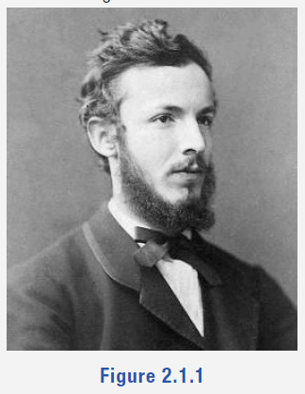
Fun Fact
Georg Cantor was born in St. Petersburg, Russia, and moved to Germany when he was 11. Although an exceptional mathematician, he was also regarded as an outstanding violinist. Here he is around the age of 25.
A set is a Many that allows itself to be thought of as a One.
—Georg Cantor
Figure 1

Slide 5
Example 1: Representing a Set with Roster Notation—Slide 1
Use roster notation to represent the following sets.
a. S is the set of states in the United States that begin with the letter M.
​b. Given the sets
let T be the set of sets that contain the element "red."

Slide 6
Example 1: Representing a Set with Roster Notation—Slide 2
Solution
​a. There are eight states in the United States that begin with the letter M.
Note that although we listed the elements of S in alphabetical order for the ease of the reader, this is not necessary when using roster notation. The order of elements does not matter in a set.
b. Three of the sets listed contain the element "red."

Slide 7
Definition: Equal Sets
Two sets are said to be equal if they contain exactly the same elements. If sets A and B are equal, we write A = B.

Slide 8
Helpful Hint 1
can mean either the cardinality of set A
The notation
or the absolute value of some number A. The meaning of the notation depends on context.

Slide 9
Definition: Cardinal Number and Equivalent Sets
Cardinal Number
The number of elements contained in a finite set is called the cardinal number of the set, or the cardinality. The cardinal number of set A is denoted by
Equivalent Sets
Two sets are said to be equivalent if they have the same cardinal number. If set A is equivalent to set B, we write A ∼ B.

Slide 10
Helpful Hint 2
The cardinal number may also be denoted by

Slide 11
Helpful Hint 3
When describing set equality, X = Y means the same as Y = X. The same holds true with equivalences.

Slide 12
Example 2: Determining Equal and Equivalent Sets—Slide 1
Determine if the given pairs of sets are equal, equivalent, or neither.
a. A = {Public Health, International Studies, Mechanical Engineering, Music Education, Political Science},
B = {Tim, Gloria, Alan, Warren, Kalif}.
​b. X = {2, 4, 6, 8, 10, 12, 14, 16, 18, 20},
Y = {20, 18, 16, 14, 12, 10, 8, 6, 4, 2}.

Slide 13
Example 2: Determining Equal and Equivalent Sets—Slide 2
Solution​
​
therefore, the sets are equivalent
to one another, and we can write A ∼ B. However, because they do not contain the same elements, they are not equal to one another.
Even though the order of the
elements is different, both contain the even numbers from 2 to 20. Therefore, the sets are equal, and we can write X = Y. When two sets are equal, they are also always equivalent.

Slide 14
Skill Check 1
Find the cardinality of W and Y. Determine if the sets are equal, equivalent, or neither.
W = {3, 6, 12, 24} and Y = {2, 4, 8, 16, 32}
Answer:
W and Y are neither equal nor equivalent.

Slide 15
Helpful Hint 4
Not all numbers can be written as fractions. The irrational number π is a number between 3 and 4 that would not be a member of the set A.

Slide 16
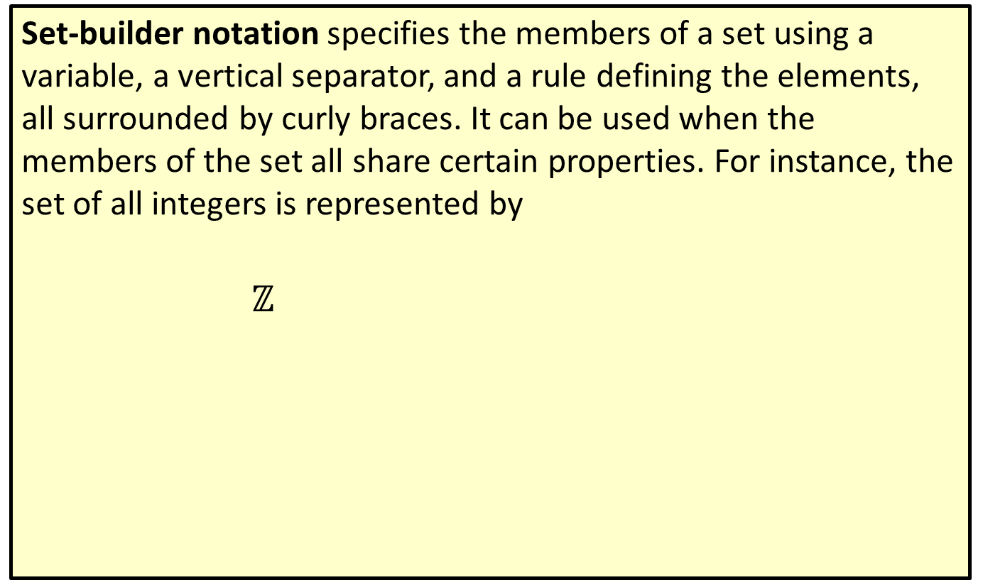
Definition: Set-Builder Notation
Set-builder notation specifies the members of a set using a variable, a vertical separator, and a rule defining the elements, all surrounded by curly braces. It can be used when the members of the set all share certain properties. For instance, the set of all integers is represented by
$ℤ$
and is read, " $ℤ$ is the set of all n such that n is an integer."

Slide 17
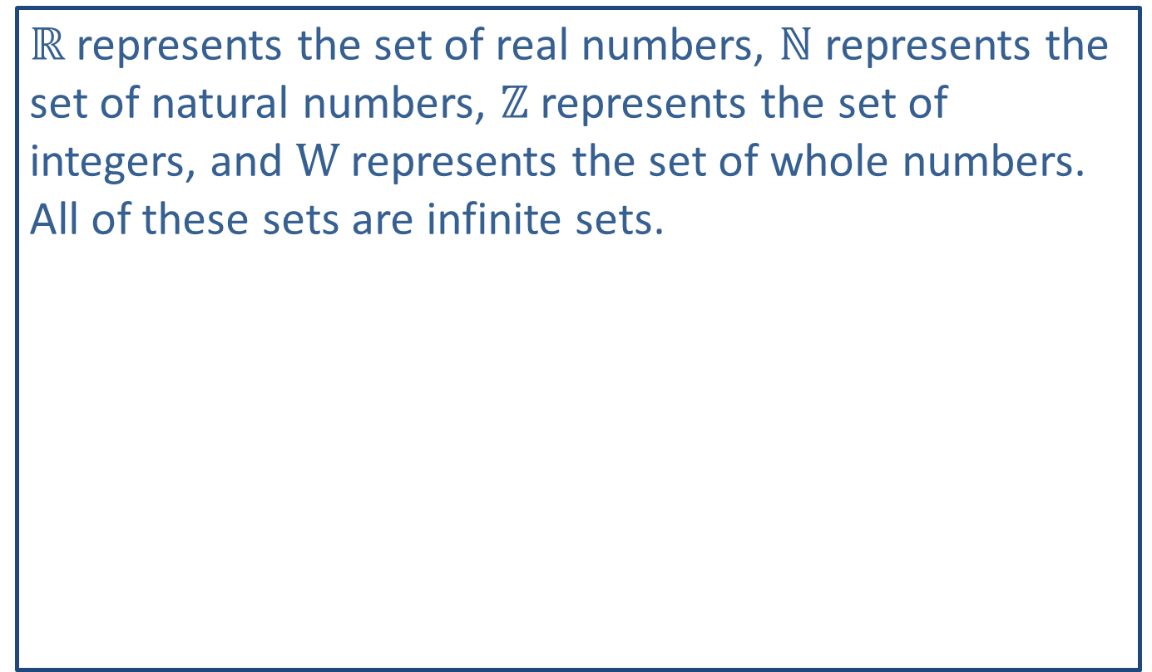
Think Back
$ℝ$ represents the set of real numbers, $ℕ$ represents the set of natural numbers, $ℤ$ represents the set of integers, and W represents the set of whole numbers. All of these sets are infinite sets.

Slide 18
Example 3: Representing a Set with Set-Builder Notation—Slide 1
Use set-builder notation to represent Y, the set of all even integers.
Solution
When we use set-builder notation, there is often more than one way to state the rule for the elements of the set. When you are choosing, it is best to be as precise and clear as you can be. In this case, the cleanest way to describe the even integers is to simply state that an element must be an even integer. Thus, we have the following.

Slide 19

Example 3: Representing a Set with Set-Builder Notation—Slide 2
However, we could also describe the even integers as elements that are members of the set of integers and are even numbers.
Alternatively, we could describe the even integers as any integer multiplied by two.
All of these notations are valid ways to describe the set of even integers.

Slide 20
Helpful Hint 5
Set-builder notation may also use a colon instead of a vertical line as a separator. For example,

Slide 21
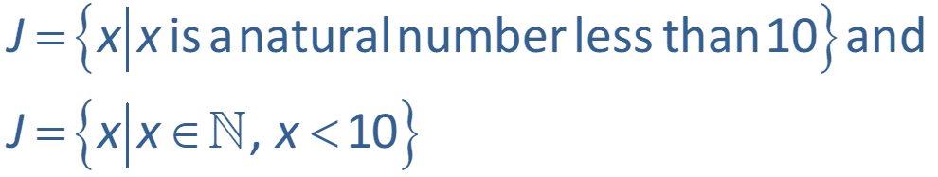
Skill Check 2
Represent the set J, which consists of all natural numbers less than 10, using both roster notation and set-builder notation.
Answer:
Roster notation: J = {1,2,3,4,5,6,7,8,9};
Set-builder notation: possible answers include

Slide 22
Definition: Empty Set
The empty set is the set that contains no elements. If set A is empty, we write
The cardinality of the empty set is 0.

Slide 23
Example 4: Identifying the Empty Set—Slide 1
Determine if the following sets are the empty sets.
b. The set B of any state that contains the letter q in its name.

Slide 24
Example 4: Identifying the Empty Set—Slide 2
Solution
​a. Since it is the case that all negative numbers are less than 100, the set A is not empty. In fact, it is a set with infinitely many elements.
​b. Since there are no states with the letter q in their name, this set is empty. That is, B = φ.
​c. The set C contains the underscore character, so it is not empty.

Slide 25

Skill Check 3
Determine if set Y is the empty set.
Answer: Yes, Y = $∅$.

Slide 26
Definition: Universal Set
The set of all elements being considered for any particular situation is called the universal set and is denoted by U.

Slide 27
Definition: Complement
The complement of set A consists of all the elements in the given universal set that are not contained in A. The complement of A is denoted

Slide 28
Helpful Hint 6
The complement of A can be denoted by

Slide 29

Example 5: Determining the Complement of a Set—Slide 1
According to a recent poll, approximately $30\%$ of American adults have at least one tattoo.¹
Let
Write the complements of A and B using set-builder notation.
¹Chris Jackson, “More Americans Have Tattoos Today than Seven Years Ago,” Ipsos, August 29, 2019, https://www.ipsos.com/en-us/news-polls/more-americans-have-tattoos-today

Slide 30
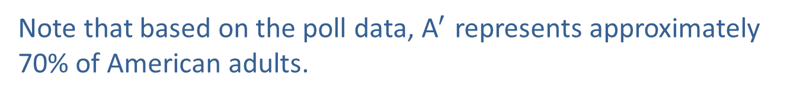
Example 5: Determining the Complement of a Set—Slide 2
Solution
Since A consists of American adults who have at least one tattoo, the complement of A consists of American adults who do not have at least one tattoo. We know that at least one means greater than or equal to one, so does not have at least one implies has less than one or simply no tattoos at all. We can write the complement of A as follows.
This could also be written as
Note that based on the poll data, ${\text{A}}^{′}$ represents approximately 70% of American adults.

Slide 31
Example 5: Determining the Complement of a Set—Slide 3
B is the set of American adults with exactly two tattoos. The complement of B includes all of the elements in our universal set that are not contained in B. This translates to American adults that do not have exactly two tattoos. The complement of B therefore contains adults with 0 tattoos, 1 tattoo, or 3 or more tattoos. We can write the complement of B in either of the following ways.

Slide 32
Skill Check 4
Let
2. Is it possible for you to have read a book in
Answer:
2. Yes, but not as an e-book; perhaps as a printed or audio book.

