Slide 1
Section 2.2
Subsets and Venn Diagrams

Slide 2
Helpful Hint 1
Neither the size of the circles representing the sets nor the size of the rectangle representing the universal set have any significance in a Venn diagram.

Slide 3
Definition: Venn Diagram
A Venn diagram is a visualization of the relationships between a collection of sets. In a Venn diagram, the sets are represented by circles (or ovals) contained within a rectangular region that represents the universal set.

Slide 4
Math Milestone
Leonhard Euler (1707-1783) is commonly attributed with first using circles as a means of representing relationships among sets. Euler's diagrams however, only illustrated relationships that exist in reality. In the 1800s, Venn expanded on Euler's idea and used circles to show all possible theoretical relationships. Because he popularized the idea, Venn's name is more commonly used for both types of diagrams—those representing reality and those that are strictly theoretical. For simplicity, we will use the term Venn diagram throughout the chapter.

Slide 5
Example 1: Interpreting Venn Diagrams—Slide 1
The following Venn diagram represents the sets S, T, and V within the universal set
The sets are defined as

Slide 6
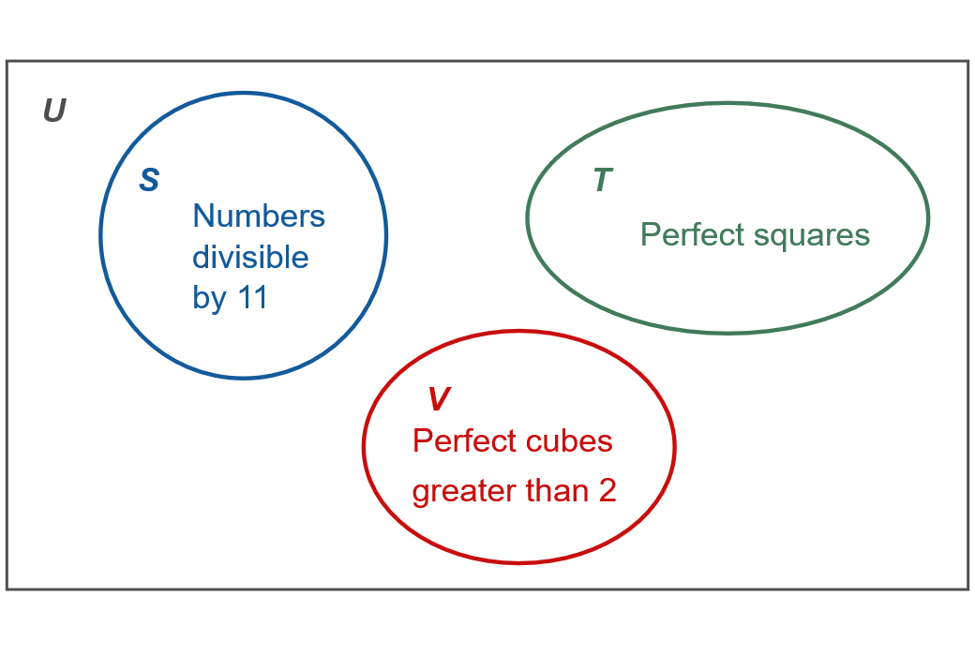
Example 1: Interpreting Venn Diagrams—Slide 2
Use the diagram to answer the following questions.
Figure 5
List the elements of the sets S, T, and V in roster notation.
d. Is S = V? Is S ∼ V ? Explain your answers.

Slide 7
Example 1: Interpreting Venn Diagrams—Slide 3
Solution
a. ​The elements of each set in roster form are as follows.
​ S = {11, 12},
​ T = {1, 4, 9, 16, 25},
​ V = {8, 27}.
​ Remember that the order in which the elements are listed is not important. Therefore, it is also correct to
list the elements of each set in a different order.
b. ​To find the cardinal number of each set (S, T, and V,), we need to count the number of elements in each set. Therefore,

Slide 8
Example 1: Interpreting Venn Diagrams—Slide 4
c. Recall that
contains all of the elements in the
universal set that are not in T. Be careful to list all elements not in T and not just the elements in the other sets. Therefore
d. To have S = V, the two sets would need to have exactly the same elements. Since this is not the case, S ≠ V. However, S is equivalent to V since both sets have the same cardinal number. So S ∼ V.

Slide 9
Think Back
Sets A and B are equal if they contain exactly the same elements, denoted A = B. Sets A and B are equivalent if they have the same cardinal number, denoted A ∼ B.

Slide 10
Example 2: Interpreting Venn Diagrams—Slide 1
An increasing number of electric vehicles are on the roads in the United States. The number of charging locations available for these cars varies from state to state. The five states with the most public and private electric charging locations are California, New York, Florida, Texas, and Massachusetts.
Let
all public and private electric charging locations in the {United States}
all public and private electric charging locations in {California}
all public and private electric charging locations in the {New York}
all public and private electric charging locations in {Florida}
all public and private electric charging locations in the {Texas}
all public and private electric charging locations in {Massachusetts}

Slide 11
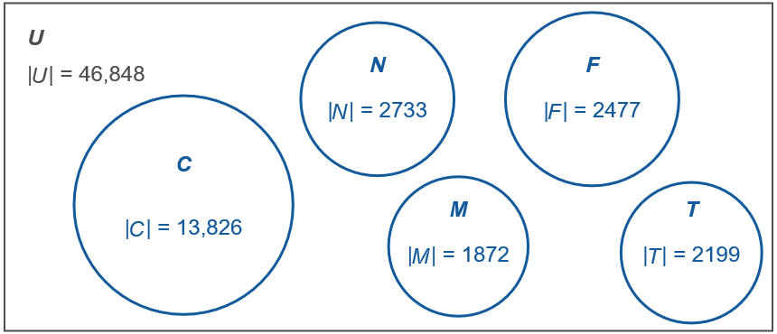
Example 2: Interpreting Venn Diagrams—Slide 2
The following Venn diagram depicts the five states with the most electric charging locations. The cardinal number for each set is shown inside the appropriate circle.
Figure 6

Slide 12
Example 2: Interpreting Venn Diagrams—Slide 3
Use the Venn diagram to answer the following questions. Assume all questions refer to both public and private locations.
a. Which state has the most electric charging locations?
b. ​Which state has the second highest number of charging locations?
c. ​How many electric charging locations do these five states have all together?
d. ​How many charging locations are in the United States but are not in one of the five states in the diagram?

Slide 13
Example 2: Interpreting Venn Diagrams—Slide 4
Solution
a. ​Using the Venn diagram, we can see that California has the most charging locations with 13,826 in the state.
b. ​Don't be fooled by the size of the circles in the diagram. Remember that the size of a circle is of no consequence in a Venn diagram. Looking at the size of the sets by their cardinality, we see that New York has the second highest number of charging locations with 2733 locations.

Slide 14
Example 2: Interpreting Venn Diagrams—Slide 5
c. ​In order to determine how many combined charging locations there are in these five states, we need to add together the size of all five sets.
So the five states with the most electric charging locations have a combined total of 23,107.

Slide 15
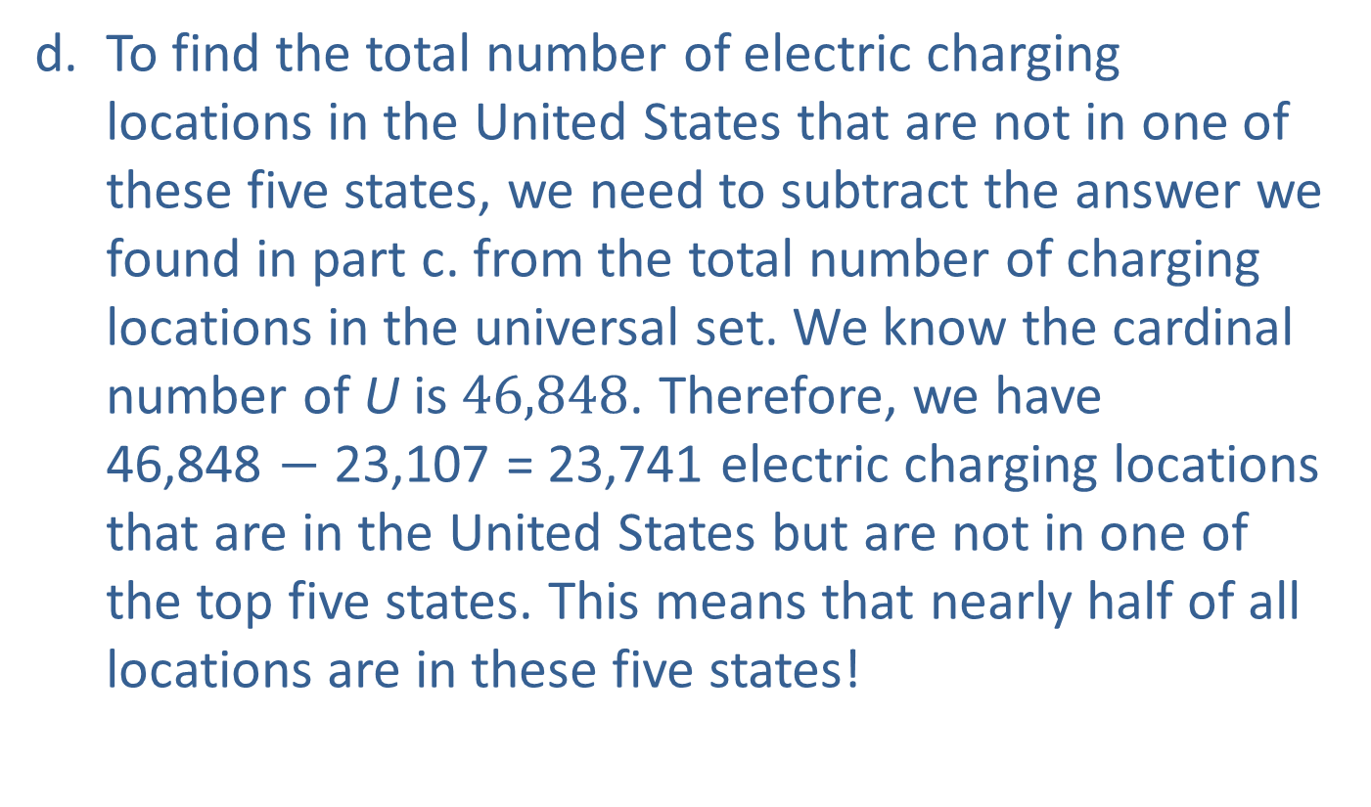
Example 2: Interpreting Venn Diagrams—Slide 6
d. ​To find the total number of electric charging locations in the United States that are not in one of these five states, we need to subtract the answer we found in part c. from the total number of charging locations in the universal set. We know the cardinal number of U is 46,848. Therefore, we have
46,848 $−$ 23,107 = 23,741 electric charging locations that are in the United States but are not in one of the top five states. This means that nearly half of all locations are in these five states!

Slide 16
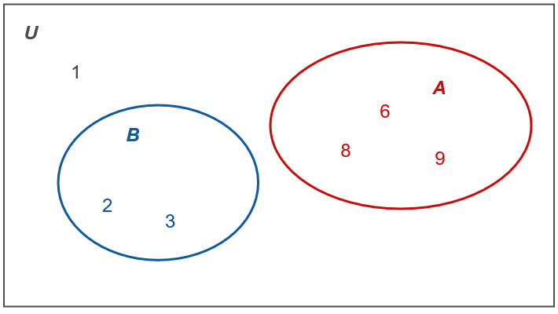
Skill Check 1
List the elements in
Figure 7
Answer: 1, 2, 3

Slide 17
Definition: Subset
Let A and B be sets. The set B is a subset of A if every element of B is also an element of A. This is denoted by

Slide 18
Helpful Hint 2
Every set is a subset of itself.
The empty set is a subset of every set.

Slide 19
Example 3: Determining Subsets—Slide 1
The school orchestra is divided into four sections: strings, woodwinds, brass, and percussion. Let S represent the four instruments in the strings section,
S = {violin, viola, cello, double bass}. List all of the subsets of S.

Slide 20
Example 3: Determining Subsets—Slide 2
Solution
We know from our discussion that the empty set (which has 0 elements) and the entire set (which has 4 elements) will both be subsets of S. We'll need to find all possible subsets with 1 element, 2 elements, and 3 elements. We can use a table to help us list the subsets so that we don't miss any. Remember that the order of elements in a set is not important, so the set {violin, cello} is the same as {cello, violin}. Be careful not to list any subsets more than once!

Slide 21
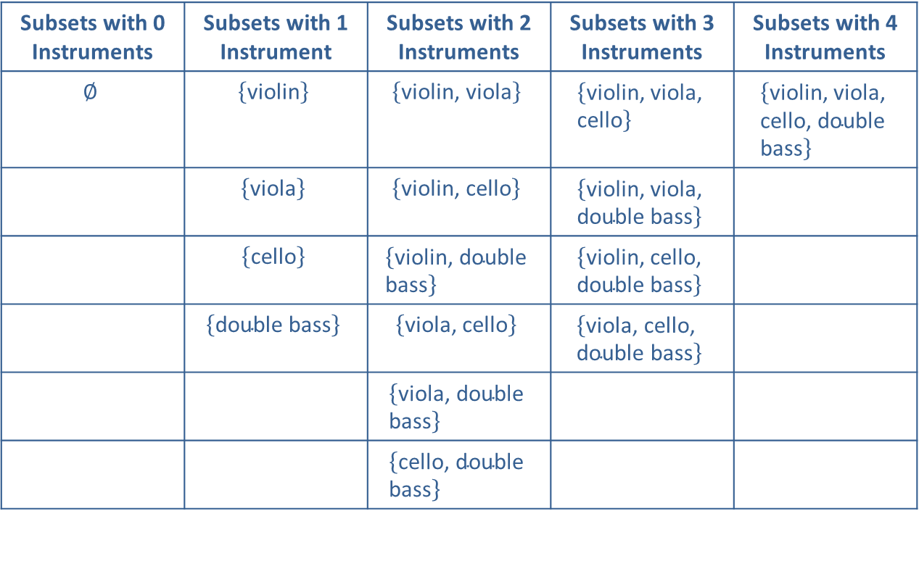
Example 3: Determining Subsets—Slide 3
Table 1: Subsets of the String Section
Subsets with 0 Instruments | Subsets with 1 Instrument | Subsets with 2 Instruments | Subsets with 3 Instruments | Subsets with 4 Instruments
$$∅$$ | $$\left\{\text{violin}\right\}$$ | $$\left\{\text{violin}\text{, }\text{viola}\right\}$$ | $$\left\{\text{violin}\text{, }\text{viola}\text{, }\text{cello}\right\}$$ | $$\left\{\text{violin}\text{, }\text{viola}\text{, }\text{cello}\text{, }\text{double} \text{bass}\right\}$$
 | $$\left\{\text{viola}\right\}$$ | $$\left\{\text{violin}\text{, }\text{cello}\right\}$$ | $$\left\{\text{violin}\text{, }\text{viola}\text{, }\text{double} \text{bass}\right\}$$
 | $$\left\{\text{cello}\right\}$$ | $$\left\{\text{violin}\text{, }\text{double} \text{bass}\right\}$$ | $$\left\{\text{violin}\text{, }\text{cello}\text{, }\text{double} \text{bass}\right\}$$
 | $$\left\{\text{double} \text{bass}\right\}$$ | $$\left\{\text{viola}\text{, }\text{cello}\right\}$$ | $$\left\{\text{viola}\text{, }\text{cello}\text{, }\text{double} \text{bass}\right\}$$
 |  | $$\left\{\text{viola}\text{, }\text{double} \text{bass}\right\}$$
 |  | $$\left\{\text{cello}\text{, }\text{double} \text{bass}\right\}$$
In total there are 16 subsets of S.

Slide 22
Example 4: Drawing a Venn Diagram with Subsets—Slide 1
According to the Centers for Disease Control and Prevention (CDC), food allergies affect an estimated 8% of children in the United States¹. Wheat, soy, and peanuts are some of the most common food allergens.
Let
Draw a Venn diagram to represent the sets U, W, and Y.
1. "Food Allergies," Centers for Disease Control, June 8, 2020, https://www.cdc.gov/healthyschools/foodallergies/index.htm.

Slide 23

Example 4: Drawing a Venn Diagram with Subsets—Slide 2
Solution
Begin by drawing a rectangle representing the universal set of all children in the United States. This rectangle can be any size you like.
Figure 9: The Universal Set

Slide 24
Example 4: Drawing a Venn Diagram with Subsets—Slide 3
Next, we need to decide how the sets W and Y are to be drawn. Notice the set Y contains all children in the United States with an allergy to one of three foods listed, while W is limited to children who are allergic to one of the three foods that define set Y. Therefore,
and the Venn diagram will look like the following.

Slide 25
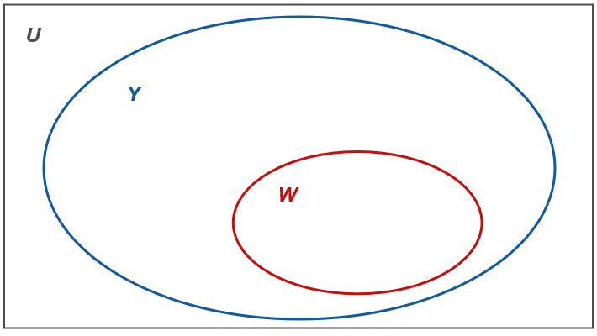
Example 4: Drawing a Venn Diagram with Subsets—Slide 4
Figure 10
Although your diagram may look a little different than the one shown in Figure 10, it should resemble the structure of this one: the oval representing W should be completely contained within the oval representing Y.

Slide 26
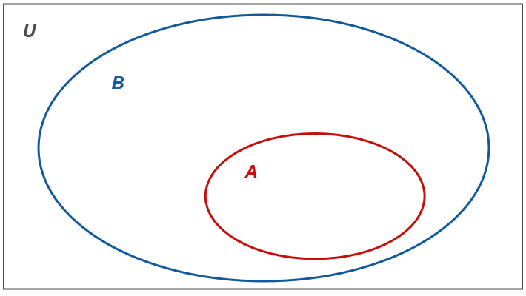
Skill Check 2
Draw a Venn diagram of the following.
Answer:

Slide 27
Helpful Hint 3

Slide 28
Definition: Proper Subset
When
and A contains at least one element that
is not contained in B, B is a proper subset of A and is denoted by

Slide 29
Example 5: Identifying Proper Subsets—Slide 1
Let M = {a, b, c, d, e, f}. Determine if the following sets are proper subsets of M.
N = {a, b, f},
P = {c},
R = {a, b, c, d, e, f},
S = {a, b, h}.

Slide 30
Example 5: Identifying Proper Subsets—Slide 2
Solution
Both sets N and P are proper subsets of M because each are subsets of M but are not equal to M. The set R is not a proper subset of M because it contains every element of M; that is, R = M. Set S is also not proper subset of M because S is not a subset at all. It contains the element h, which is not in M. That is,

Slide 31
Example 6: Identifying Proper Subsets—Slide 1
Let X = {Brazil, Vietnam, Columbia}, which are the top three coffee-producing countries in the world (as measured in metric tons). List all the proper subsets of X.
Solution
All proper subsets of X must exclude at least one member of X. Since X has three members, each proper subset can have at most two elements. In fact, the proper subsets may contain two elements, one element, or no elements. A table listing out the possible proper subsets will help us keep track.

Slide 32
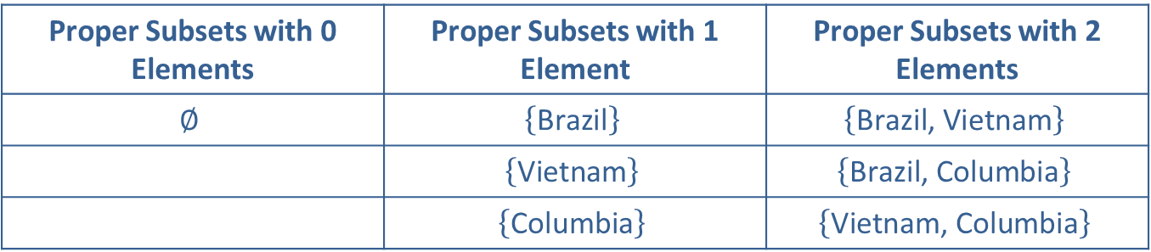
Example 6: Identifying Proper Subsets—Slide 2
Table 2: Proper Subsets of X
Proper Subsets with 0 Elements | Proper Subsets with 1 Element | Proper Subsets with 2 Elements
$$∅$$ | $$\left\{\text{Brazil}\right\}$$ | $$\left\{\text{Brazil}\text{, }\text{Vietnam}\right\}$$
 | $$\left\{\text{Vietnam}\right\}$$ | $$\left\{\text{Brazil}\text{, }\text{Columbia}\right\}$$
 | $$\left\{\text{Columbia}\right\}$$ | $$\left\{\text{Vietnam}\text{, }\text{Columbia}\right\}$$
In total there are 7 proper subsets of X.

Slide 33
Skill Check 3
List all of the proper subsets of the set {a, b, c, d}.
Answer:

Slide 34
Definition: Number of Subsets and Proper Subsets of a Set
If the cardinal number of a set is n, then the set has
subsets and
proper subsets.

Slide 35
Example 7: Determining the Number of Subsets—Slide 1
Dr. Williams is eating at a local buffet one afternoon and notices a sign that says
"So many possibilities—you could spend a
lifetime eating at our buffet and never
have the same meal twice!"
He wonders how many different meals he could make from the 16 items on the buffet. He can have all, none, or some of the items. Determine the number of different meals he could make at the buffet.

Slide 36
Example 7: Determining the Number of Subsets—Slide 2
Solution
When Dr. Williams makes a meal, there is no requirement on the number of food items he needs to have in a meal. For example, he could have a meal with just one item or a meal with all 16 items, or anything in between. Thus, each meal he chooses is a subset of the items from the buffet. The number of different meals that Dr. Williams could put together is the number of subsets of the 16 items on the buffet. We can use the formula for the number of subsets to determine how many different meals he could make. Using the formula for the number of subsets, we have the following.

Slide 37
Example 7: Determining the Number of Subsets—Slide 3
This means that if Dr. Williams ate at the buffet once a day every day, he could eat for almost 180 years without duplicating a meal. Certainly, it would seem the sign is not misleading.

