Slide 1
Section 2.3
Operations with Sets

Slide 2
Definition: Intersection
The intersection of two sets A and B is the set of all elements common to both A and B. We denote the intersection of A and B as

Slide 3
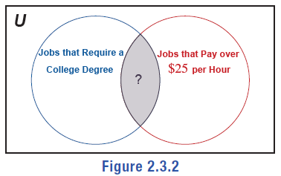
Example 1: Determining the Intersection of Sets—Slide 1
a. ​Find the intersection of the sets
​
b. ​Interpret the intersection of the sets in the Venn diagram in Figure 2.
Figure 2

Slide 4
Example 1: Determining the Intersection of Sets—Slide 2
Solution
a. ​Since the intersection of two sets consists of all of the elements that appear in both sets at the same time, we can see that the intersection of A and B consists of only the number 2.
​

Slide 5
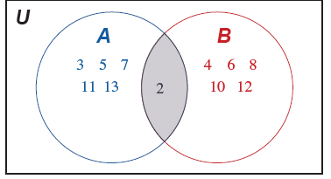
Example 1: Determining the Intersection of Sets—Slide 3
​We can also use a Venn diagram to find the intersection.
​
Figure 3
You may have noticed that A is a list of the first six prime numbers and B is the list of the first six positive even integers.
As a reminder, 2 is the only prime number that is even!

Slide 6
Example 1: Determining the Intersection of Sets—Slide 4
b. ​The intersection of two sets is the set of elements that are common to both sets. In the given Venn diagram, we see a set representing jobs that require a college degree and a second set representing jobs that pay over $25 an hour. The intersection of these, denoted by the overlapping portion of the circles in the diagram, represents jobs that require a college degree and pay over $25 an hour.

Slide 7
Helpful Hint
In a Venn diagram, any elements in the intersection of sets are only listed once. Likewise, we only list elements once when using the roster notation for an intersection.

Slide 8
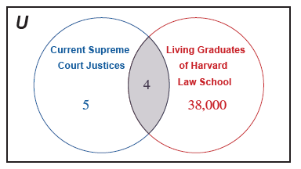
Example 2: Using a Venn Diagram to Find the Intersection of Sets—Slide 1
Harvard Law School has produced more Supreme Court Justices than any other law school. Use the Venn diagram below to interpret how many of the sitting Justices as of August 2021 graduated from Harvard Law School.
Figure 4

Slide 9
Example 2: Using a Venn Diagram to Find the Intersection of Sets—Slide 2
Solution
Using the Venn diagram, we see that there are more than 38,000 living alumni of Harvard Law School and that of the 9 Supreme Court Justices, 5 of them graduated from a law school other than Harvard. The overlapping portion in the middle of the diagram gives us our answer and tells us that 4 of the current Supreme Court Justices graduated from Harvard Law School. (If you're curious, the 4 justices are Breyer, Gorsuch, Kagan, and Roberts.)

Slide 10
Skill Check 1

Slide 11
Definition: Disjoint
Two sets A and B are disjoint if there are no elements in set A that are also contained in set B. Their intersection is the empty set, denoted by

Slide 12
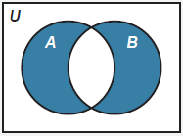
Helpful Hint—Slide 1
Disjoint sets can also be represented by a Venn diagram where the overlap between the sets is empty, as shown below.
Figure 6

Slide 13
Example 3: Identifying Disjoint Sets—Slide 1
Let
Determine if sets A and B are disjoint and draw a Venn diagram to illustrate the relationship between sets A and B.
Solution
Since it would be impossible for a student to be in both set A (by having a GPA that is less than 2.5) and set B (by having a GPA greater than 3.0), sets A and B are disjoint.

Slide 14
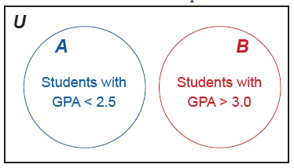
Example 3: Identifying Disjoint Sets—Slide 2
In this Venn diagram, the universal set represents all students regardless of their grade point average. Because sets A and B are disjoint, there are no common GPAs between the two sets, which is illustrated by two circles not overlapping. Any student with a GPA between 2.5 and 3.0 is not represented in either set A or set B.
Figure 7

Slide 15
Definition: Union
The union of two sets A and B is the set of all elements
in A or in B. We denote the union of A and B as

Slide 16
Example 4: Determining the Union of Sets—Slide 1
Sarah has lived in Ohio, Pennsylvania, and Michigan. Her friend Trevor has lived in Colorado, Ohio, and Georgia. Her friend Ron has lived in Washington and Idaho. Let the residential locations of each friend be represented by the following sets:
Find the following unions.

Slide 17
Example 4: Determining the Union of Sets—Slide 2
Solution
a. ​To find the union of sets S and T, we need to find the elements that appear in either set S or set T. The elements of set S are O H, PA, and MI, and the elements of set T are C O, O H, and GA. We simply combine the items together to create a new set to represent the union.
​

Slide 18
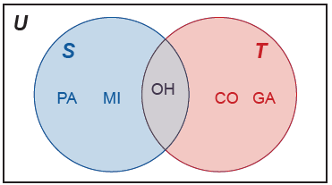
Example 4: Determining the Union of Sets—Slide 3
​Note that any repeated elements only get listed once. Figure 8 shows the Venn diagram that gives us a visual illustration of the union.
​
Figure 8
Note that
In other words, the state that Sarah and Trevor have both lived in is Ohio.

Slide 19
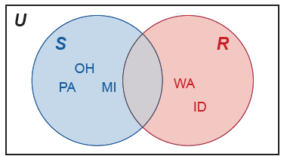
Example 4: Determining the Union of Sets—Slide 4
​Finding the union of sets S and R is done in a similar manner.
Figure 9
Using the Venn diagram, it is easy to see that the intersection of these two sets is empty because Sarah and Ron have not lived in any of the same states. Therefore,
and sets S and R are disjoint.

Slide 20
Skill Check 2
Let U be students enrolled at M L K High School,
Answer:

Slide 21
Definition: Inclusion-Exclusion Principle
The inclusion-exclusion principle states that the cardinality of the union of two sets A and B is calculated by adding the number of elements in set A to the number of elements in set B and subtracting the number of elements that appear in both sets.

Slide 22
Example 5: Applying the Inclusion-Exclusion Principle—Slide 1
Consider the scenario where a state senate is voting on a bill. The senate has 35 members, of which 15 are Democrats and 20 are Republicans. Five of the 35 members represent urban areas of the state, two of which are Democrats. The bill is expected to receive "Yes" votes from the Democrat members and from members who represent urban areas. Determine how many Yes votes the bill is expected to receive.

Slide 23
Example 5: Applying the Inclusion-Exclusion Principle—Slide 2
Solution
Let set A consist of Democrats and set B consist of members representing urban areas. The number of expected Yes votes is the number of elements in their union.
The Inclusion-Exclusion Principle tells us that
In other words, the total number of Yes votes will be the total number of Democrat members plus the total number of members representing urban areas minus the number of members who appear in both of those groups.
We are told that two members are Democrats who represent urban areas; that is,
We also know
Using the formula, we have the following.
Thus, the bill is expected to receive 18 Yes votes.

Slide 24
Helpful Hint—Slide 2
Recall that the complement of set A consists of all the elements in the given universal set that are not contained in A. The complement of A is denoted

Slide 25
Example 6: Combining Intersection and Union—Slide 1
Let
Find the following.

Slide 26
Example 6: Combining Intersection and Union—Slide 2
Solution
a. ​In order to find the solution when combining the operations of intersections and unions of sets, it might be best to describe the set first. The set
is the set of all elements that are in M or are in the intersection of N and K.

Slide 27
Example 6: Combining Intersection and Union—Slide 3
Just as in order of operations with numbers, we need to perform the operation in parentheses first. That is, find
first.
Now, we can replace
with the simplified set we just
found and solve as follows.

Slide 28
Example 6: Combining Intersection and Union—Slide 4
b. ​Similarly, we can find
by performing the
union inside the parentheses first and then the intersection with M.

Slide 29
Skill Check 3
Let
Answer:

Slide 30
Example 7: Combining Operations—Slide 1
Let
Find the following.

Slide 31
Example 7: Combining Operations—Slide 2
Solution
a. ​Notice that the complement sign is on the outside of the parentheses. That means that we need to perform the operation inside the parentheses first; that is, find the union of A and B.
Now, we take the complement of

Slide 32
Example 7: Combining Operations—Slide 3
b. To find the intersection of these sets, we need to first
find the complement of B.
​ Next, we take the intersection of ${\text{B}}^{′}$ and A.

Slide 33
Definition: De Morgan's Laws
Let A and B be sets. Then,

Slide 34
Fun Fact
De Morgan's Laws are named after British mathematician Augustus De Morgan (1806–1871). Born in India, his family moved to England when he was seven months old. He referred to himself as "neither English, nor Scottish, nor Irish, but a Briton unattached." Along with mathematics, he loved playing the flute and even studied law for a short time. At age 22, he became a professor of mathematics at the newly established London University.

Slide 35
Example 8: Using De Morgan's Laws—Slide 1
Let
If set A represents even numbers that are less than or equal to 10 and set B represents prime numbers that are less than or equal to 10, then we can write the sets as follows.
Verify that

Slide 36
Example 8: Using De Morgan's Laws—Slide 2
Solution
Since
we know that
Similarly,
That means that
Notice that
Hence, we have verified De Morgan's law for A and B.

Slide 37
Skill Check 4
Given sets
Answer:
This gives that

