Slide 1
Section 2.4
Applications and Survey Analysis

Slide 2
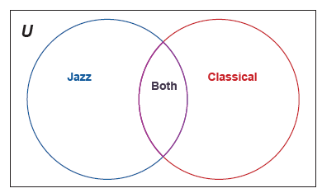
Example 1: Drawing a Venn Diagram for Survey Analysis—Slide 1
A survey that asked 500 donors of an artistic nonprofit organization about their musical choices showed that 350 of them listen to jazz, 300 listen to classical, and 200 listen to both. Draw a Venn diagram to illustrate this survey and determine how many donors surveyed don't listen to either jazz or classical music.
Solution
The Venn diagram will have two circles to represent each of the sets "Jazz" and "Classical." We know that the circles will overlap, since we also are told that some respondents listen to both. Figure 2 shows the skeleton Venn diagram without the number of responses filled in.
Figure 2

Slide 3
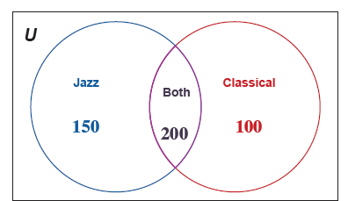
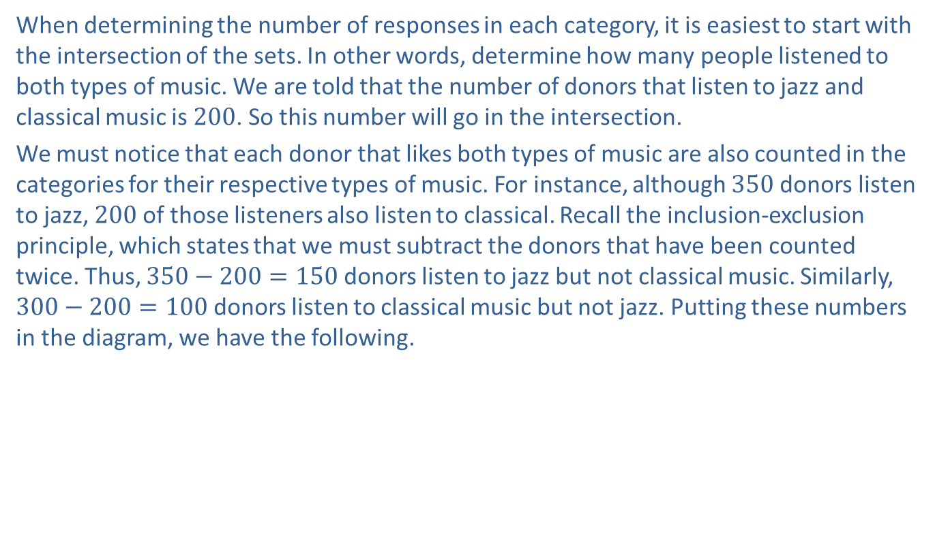
Example 1: Drawing a Venn Diagram for Survey Analysis—Slide 2
When determining the number of responses in each category, it is easiest to start with the intersection of the sets. In other words, determine how many people listened to both types of music. We are told that the number of donors that listen to jazz and classical music is 200. So this number will go in the intersection.
We must notice that each donor that likes both types of music are also counted in the categories for their respective types of music. For instance, although 350 donors listen to jazz, 200 of those listeners also listen to classical. Recall the inclusion-exclusion principle, which states that we must subtract the donors that have been counted twice. Thus, $350−200=150$ donors listen to jazz but not classical music. Similarly, $300−200=100$ donors listen to classical music but not jazz. Putting these numbers in the diagram, we have the following.
Figure 3

Slide 4
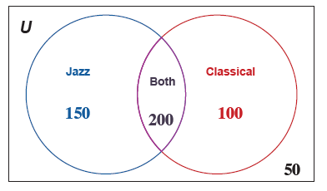

Example 1: Drawing a Venn Diagram for Survey Analysis—Slide 3
The last step is to determine how many donors surveyed do not listen to either type of music. To calculate this, we need to subtract the numbers in each region from the total number of people surveyed.
$500−150−200−100=50$.
Thus, there are 50 donors who do not listen to either jazz or classical music. This number is placed on the outside of the circles. Figure 4 shows the completed Venn diagram.
Figure 4: Completed Venn Diagram

Slide 5
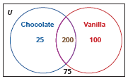
Skill Check 1
A survey of 400 customers at an ice cream shop showed that 225 customers like chocolate ice cream, 300 like vanilla, and 200 like both. Draw a Venn diagram to illustrate the survey results. How many customers responded that they didn't like either chocolate or vanilla ice cream?
Answer:
75 like neither ice cream.

Slide 6
Helpful Hint
The word "and" implies the intersection of two sets while the word "or" implies the union of two sets.

Slide 7
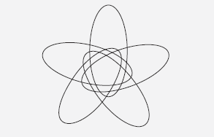
Fun Fact
A Venn diagram that uses only circles to represent sets is limited to three or fewer sets. However, Venn himself showed that Venn diagrams exist for any number of sets. Figure 6 is a Venn diagram of five sets using congruent ellipses.
Figure 6

Slide 8
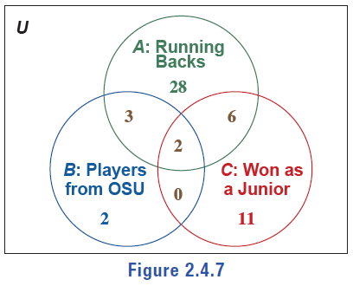
Example 2: Interpreting a Venn Diagram of Three Sets—Slide 1
The Heisman Trophy, created in 1935, is awarded every year to an outstanding college football player. The Venn diagram in Figure 7 tells us about some of the past winners and contains the number of elements that belong to the three sets A, B, and C. A is the set of winners whose position was that of running back, B is the set of winners from The Ohio State University (OSU), and C is the set of winners who were classified as juniors when they won.
Figure 7
Use the information in the diagram to determine the following and describe what each represents.

Slide 9
Example 2: Interpreting a Venn Diagram of Three Sets—Slide 2
Solution
a.​ To find
we need to consider the intersection of all three sets
A, B, and C. Working with three sets and their intersections, we need to be careful and make sure we are considering the proper intersection. This is represented by the triangular middle section of the Venn diagram. We are looking for the number of elements that are common to all three sets. We observe in the Venn diagram that there are two elements represented in the intersection of sets A, B, and C. Thus,
b.​ This overlapping region represents the number of times the Heisman Trophy winner was in his junior year, a running back from The Ohio State University.

Slide 10
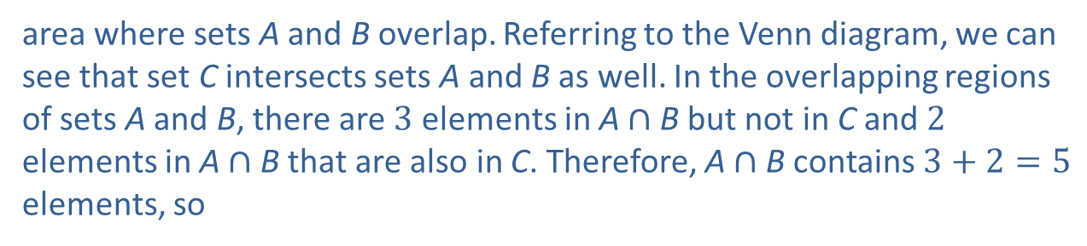
Example 2: Interpreting a Venn Diagram of Three Sets—Slide 3
b.​ To find
we need to determine the number of elements in the
area where sets A and B overlap. Referring to the Venn diagram, we can see that set C intersects sets A and B as well. In the overlapping regions of sets A and B, there are 3 elements in A $∩$B but not in C and 2 elements in A$∩$B that are also in C. Therefore, A$∩$B contains $3+2=5$ elements, so
This intersection of A and B represents occurrences where the Heisman Trophy winner was a running back and was from The Ohio State University.

Slide 11
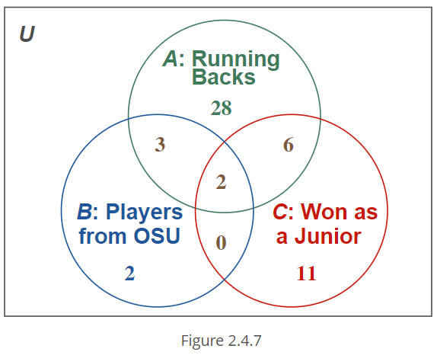
Skill Check 2
Use the Venn diagram from Figure 7 to find the following.
Figure 7
Answer :

Slide 12
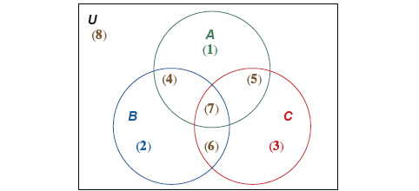
Example 3: Constructing a Venn Diagram of Three Sets—Slide 1
Consider the universal set
Given subsets A = {a, e, i, o, u},
B = {a, b, c, d, e, f, g, h, I, j, k, l}, and C = {a, I, u, m, n, i}, draw a Venn diagram to represent the relationships between the sets.
Solution
Let's begin by noting what our sets are and how they relate to one another. Notice that the universal set consists of the letters in the English alphabet, set A consists of all of the vowels, set B contains the first 12 letters of the alphabet, and the elements of set C spell the word alumni. As we place the elements in the diagram, remember that each of the elements in the universal set may only be placed in one of the eight regions in the Venn Diagram, as shown in Figure 9.
Figure 9: Regions of a Three-Set Venn Diagram

Slide 13
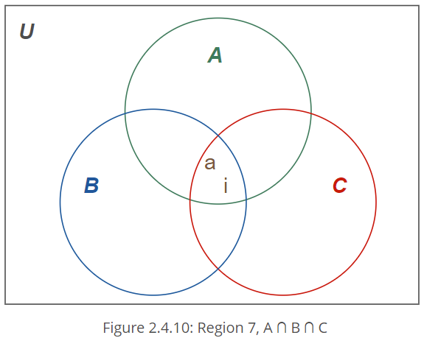
Example 3: Constructing a Venn Diagram of Three Sets—Slide 2
We'll begin with the intersection of all three sets, region (7). Comparing the elements of sets A, B, and C, the elements common to all three sets are the vowels a and i. In other words,
Figure 10
Next, we’ll determine where the three remaining elements of set A belong—the vowels e, o, and u.

Slide 14
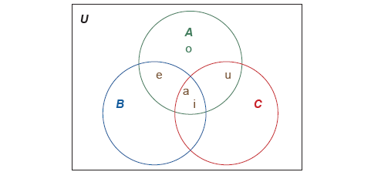
Example 3: Constructing a Venn Diagram of Three Sets—Slide 3
When compared to sets B and C, the only vowel not in either B or C is o. So the only element in area (1) is o. That leaves us with placing e and u in their correct regions. Notice that
We've already placed the
elements a and i in region (7), which means e is the only element in region (4), the intersection of A and B but not C. Finally,
Again, we've placed a and i in region (7), so u belongs in region (5), the intersection of A and C but not B.
Figure 11: Placement of the Elements in Set A

Slide 15
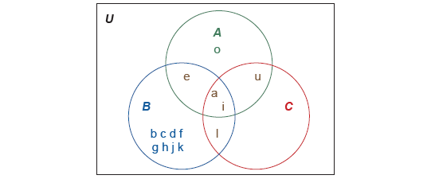
Example 3: Constructing a Venn Diagram of Three Sets—Slide 4
Now that we’ve positioned all of the elements in set A, we turn our attention to set B, which consists of {a, b, c, d, e, f, g, h, i, j, k, l}. Let’s look at region (6), which is the intersection of sets B and C only (not including set A). The intersection of sets B and C is {a, l, i}. However, since the vowels in set B have already been accounted for, we are only left with the element l for region (6). We then place the remaining elements of set B in region (2), which are the elements b, c, d, f, g, h, j, and k.
Figure 12: Placement of the Elements in Set A and Set B

Slide 16
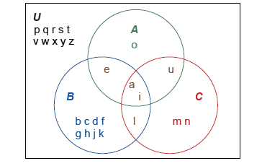
Example 3: Constructing a Venn Diagram of Three Sets—Slide 5
Now we turn our attention to set C. We can see that region (3) will contain the elements of C that we have not already placed—the elements m and n. Any remaining letters of the alphabet are placed in region (8) of the universal set. Thus, we have the following Venn diagram.
Figure 13: Venn Diagram Solution

Slide 17
Example 4: Constructing a Venn Diagram for Survey Analysis—Slide 1
A group of students majoring in international relations are polled on whether they have taken courses in any of three languages: French, German, and Russian. Every student took at least one of the languages. No student who took French also took Russian, but 39 who took French also took German. Eighty-four students who took German also took Russian. Altogether, 55 reported taking French, 141 reported taking German, and 92 reported taking Russian. Draw a Venn diagram to illustrate this survey and determine how many students were polled.

Slide 18
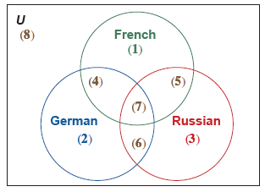
Example 4: Constructing a Venn Diagram for Survey Analysis—Slide 2
Solution
Since we are not given the individual elements, we will place the count of the number of elements in a region instead of listing the elements as we did before. Recall that when there are three sets of consideration, there are eight possible regions to place elements in. Each of the student responses may only be placed in one of the eight regions. The eight regions for our diagram represent students taking: (1) French only, (2) German only, (3) Russian only, (4) French and German but not Russian, (5) French and Russian but not German, (6) German and Russian but not French, (7) French and German and Russian, and (8) None. Figure 14 shows our skeleton diagram.
Figure 14

Slide 19
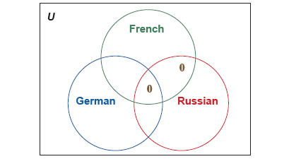
Example 4: Constructing a Venn Diagram for Survey Analysis—Slide 3
We will start with the intersection of all three sets. We are told that no student who took French also took Russian, which means that region (5) will have 0 elements. Notice that this also means that no student could have taken all three languages, so region (7) will also have 0 elements. This means that regions (7) and (5) will both have 0 in them.
Figure 15: Regions (7) and (5) Filled In

Slide 20
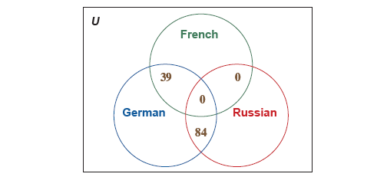
Example 4: Constructing a Venn Diagram for Survey Analysis—Slide 4
That leaves two more intersection regions—regions (4) and (6). We were given the information about both of these intersections. We know that 39 students took French and German, so region (4) will have 39 elements. And 84 students took both German and Russian, so region (6) will have 84.
Figure 16: Regions (7), (6), (5), and (4) Filled In

Slide 21
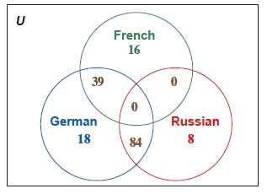
Example 4: Constructing a Venn Diagram for Survey Analysis—Slide 5
Finally, we need to determine the number of students who took a single language in order to fill in regions (1), (2), and (3). Since we are given that 55 students took French, of which 39 also took German, we can remove the students that have been counted twice to determine that 55 −39 = 16 students took only French. There were 141 students that took German, and of those students, 84 also took Russian and 39 also took French. Therefore, 141 −84 −39 = 18 students took only German. Lastly, 92 students reported taking Russian. Of those students, 84 also took German and 0 students also took French. Thus, 92 −84 = 8 students took only Russian. Placing these in the diagram, we have the following.
Figure 17

Slide 22
Example 4: Constructing a Venn Diagram for Survey Analysis—Slide 6
We were told that all students majoring in international relations took at least one of these three languages, which means there are no students in region (8). We can now add the regions together to determine how many students were polled.
16 + 39 + 18 + 84 + 8 = 165.
Thus, there were 165 students majoring in international relations in the survey.

Slide 23
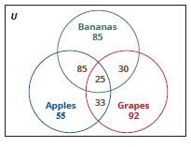
Skill Check 3
A survey of shoppers at a grocery store found that 225 shoppers like bananas, 198 like apples, and 180 like grapes. All of the shoppers like at least one of the three fruits. Twenty-five shoppers like all three fruits. There are 110 shoppers that like bananas and apples, 58 that like apples and grapes, and 55 that like bananas and grapes. Draw a Venn diagram to illustrate this poll and determine how many shoppers were in the survey.
Answer: 405 shoppers in the survey.

Slide 24
Example 5: Constructing a Venn Diagram of Three Sets—Slide 1
A city employee surveyed 1000 residents to gauge interest in a possible new bus line. After being shown information about the proposed route, survey respondents were asked to answer Yes or No to the following questions.
1. ​Do you think the new bus line should be added?
2. ​Would you be willing to pay additional taxes to implement the new route?
3. ​Would you be likely to ride on the new route?
The survey responses are summarized in the table below. How many respondents responded No to all three questions?

Slide 25
Example 5: Constructing a Venn Diagram of Three Sets—Slide 2
Table 1: City Employee Survey Results
Number of Responses | Yes Votes
556 | Question 1
262 | Question 2
331 | Question 3
257 | Question 1 and 2
325 | Question 1 and 3
152 | Question 2 and 3
150 | Question 1, 2, and 3

Slide 26
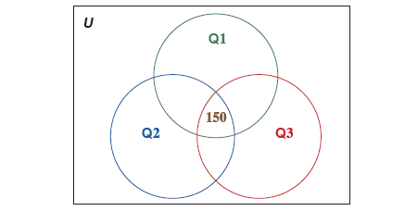
Example 5: Constructing a Venn Diagram of Three Sets—Slide 3
Solution
Once again, we need a Venn diagram with three sets. The circles will represent the Yes votes for each of the three questions. We start by looking at the intersection of all three sets—the respondents who voted Yes on all three questions. There are 150 respondents in this intersection.
Figure 18: Answered Yes on All 3 Questions

Slide 27
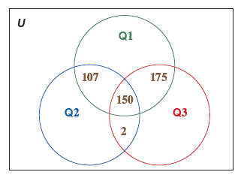
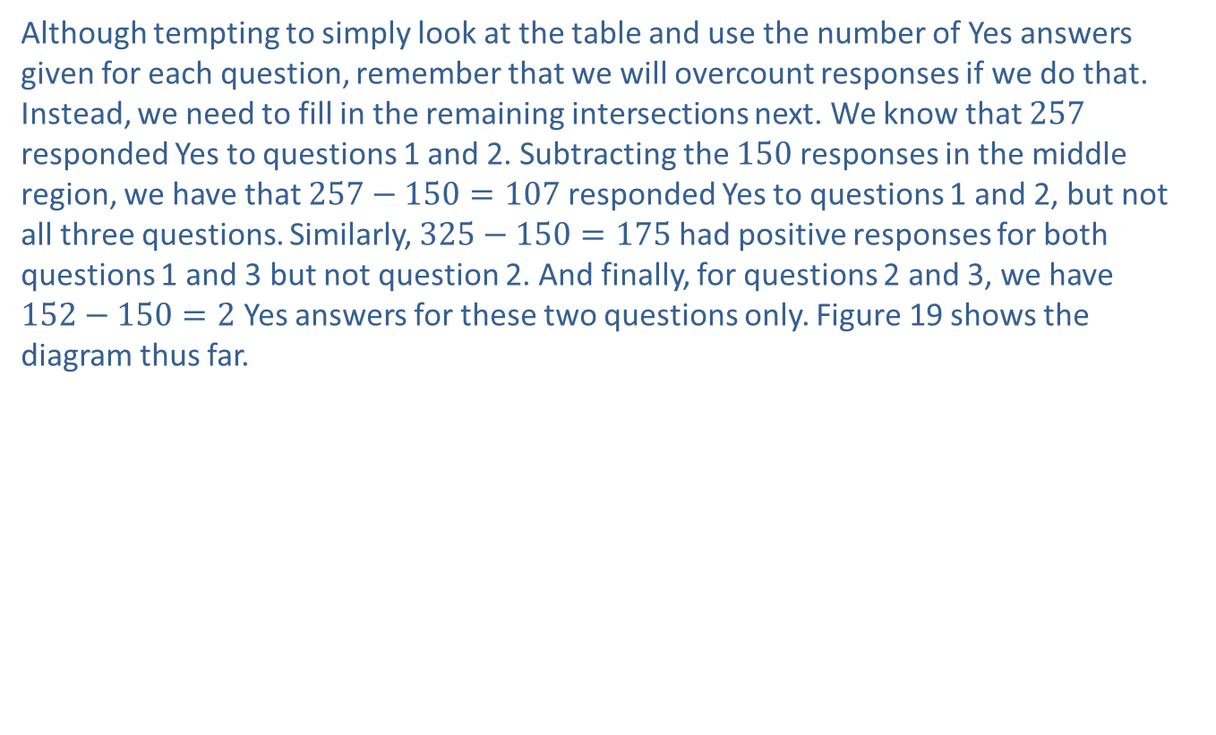
Example 5: Constructing a Venn Diagram of Three Sets—Slide 4
Although tempting to simply look at the table and use the number of Yes answers given for each question, remember that we will overcount responses if we do that. Instead, we need to fill in the remaining intersections next. We know that 257 responded Yes to questions 1 and 2. Subtracting the 150 responses in the middle region, we have that $257−150=107$ responded Yes to questions 1 and 2, but not all three questions. Similarly, $325−150=175$ had positive responses for both questions 1 and 3 but not question 2. And finally, for questions 2 and 3, we have $152−150=2$ Yes answers for these two questions only. Figure 19 shows the diagram thus far.
Figure 19

Slide 28
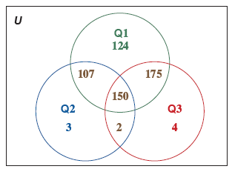
Example 5: Constructing a Venn Diagram of Three Sets—Slide 5
Next, we use subtraction for the remaining regions in the sets that are residents who answered Yes to only one question
Question 1: 556 −107 −150 −175 = 124,
Question 2: 262 −107 −150 −2 = 3,
Question 3: 331 −175 −150 −2 = 4.
Figure 20

Slide 29
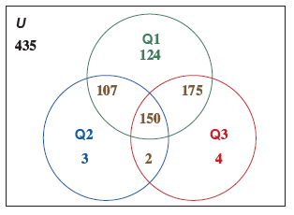
Example 5: Constructing a Venn Diagram of Three Sets—Slide 6
Finally, subtract all the numbers in the regions (1) through (7) from 1000 to determine how many residents answered No to all three questions.
1000 −124 −107 −175 −150 −3 −2 −4 = 435.
Figure 21 shows the completed Venn Diagram.
Figure 21
There were 435 residents who responded No to all three questions

