Slide 1
Chapter 2
Review

Slide 2
Definition: Set
A set is a collection of objects made up of specified elements, or members.

Slide 3
Definition: Roster Method
Roster notation specifies the members of a set by listing all of the elements in the set, separated by commas and surrounded by curly braces.

Slide 4
Definition: Equal Sets
Two sets are said to be equal if they contain exactly the same elements. If sets A and B are equal, we write A = B.

Slide 5
Definition: Cardinal Number
The number of elements contained in a finite set is called the cardinal number of the set, or the cardinality. The cardinal number of set A is denoted by

Slide 6
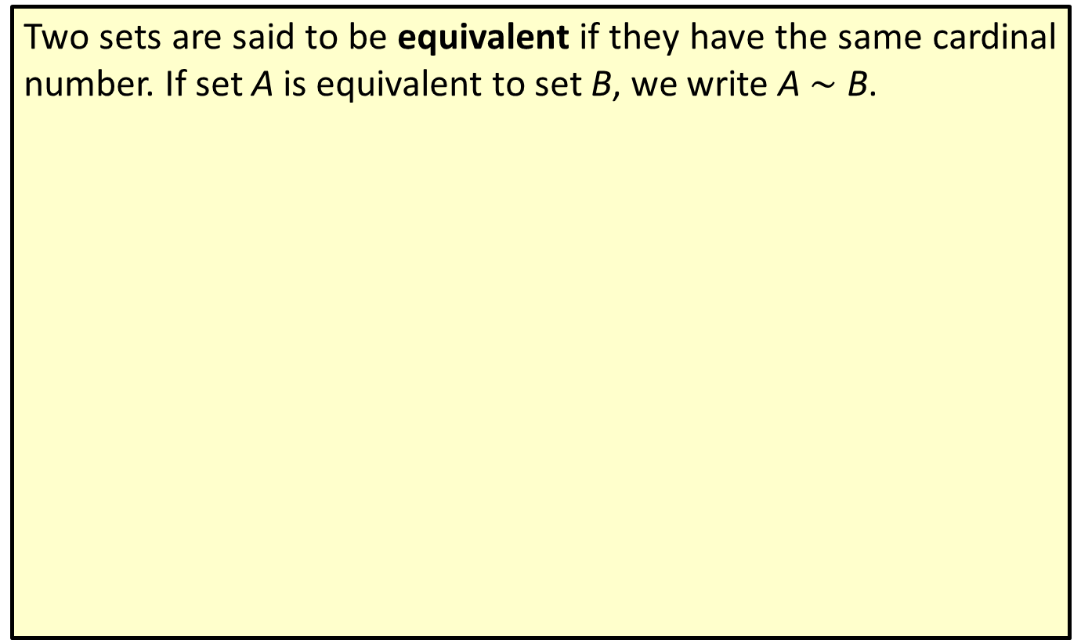
Definition: Equivalent Sets
Two sets are said to be equivalent if they have the same cardinal number. If set A is equivalent to set B, we write A $∼$ B.

Slide 7
Definition: Set-Builder Notation
Set-builder notation specifies the members of a set using a variable, a vertical separator, and a rule defining the elements, all surrounded by curly braces. It can be used when the members of the set all share certain properties. For instance, the set of all integers is represented by
$ℤ$
and is read, " $ℤ$ is the set of all n such that n is an integer."

Slide 8
Definition: Empty Set
The empty set is the set that contains no elements. If set A is empty, we write
The cardinality of the empty set is 0.

Slide 9
Definition: Universal Set
The set of all elements being considered for any particular situation is called the universal set and is denoted by U.

Slide 10
Definition: Complement
The complement of set A consists of all the elements in the given universal set that are not contained in A. The complement of A is denoted

Slide 11
Definition: Venn Diagram
A Venn diagram is a visualization of the relationships between a collection of sets. In a Venn diagram, the sets are represented by circles (or ovals) contained within a rectangular region that represents the universal set.

Slide 12
Definition: Subset
Let A and B be sets. The set B is a subset of A if every element of B is also an element of A. This is denoted by

Slide 13
Definition: Proper Subset
When
and A contains at least one element that
is not contained in B, B is a proper subset of A and is denoted by

Slide 14
Definition: Number of Subsets and Proper Subsets of a Set
If the cardinal number of a set is n, then the set has
subsets and
proper subsets.

Slide 15
Definition: Intersection
The intersection of two sets A and B is the set of all elements common to both A and B. We denote the intersection of A and B as

Slide 16
Definition: Disjoint
Two sets A and B are disjoint if there are no elements in set A that are also contained in set B. Their intersection is the empty set, denoted by

Slide 17
Definition: Union
The union of two sets A and B is the set of all elements
in A or in B. We denote the union of A and B as

Slide 18
Definition: Inclusion-Exclusion Principle
The inclusion-exclusion principle states that the cardinality of the union of two sets A and B is calculated by adding the number of elements in set A to the number of elements in set B and subtracting the number of elements that appear in both sets.

Slide 19
Definition: De Morgan's Laws
Let A and B be sets. Then,

Slide 20
Eight Regions of a Venn Diagram with Three Sets—Slide 1
A Venn diagram having three sets will always be divided into eight distinct regions: 7 regions representing the three sets and their possible intersections and 1 region outside of the sets representing all universal elements not an any of the sets. These regions are shown in Figure 8.

Slide 21
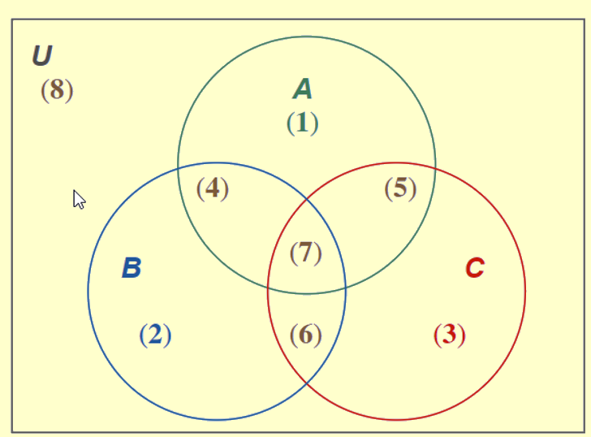
Eight Regions of a Venn Diagram with Three Sets—Slide 2
Figure 8: Eight Regions of a Venn Diagram with Three Sets

Slide 22
Eight Regions of a Venn Diagram with Three Sets—Slide 3
Each of the elements in the universal set may only be placed in one of these eight regions, which are described as follows.
(1) contains elements in set A only.
(2) contains elements in set B only.
(3) contains elements in set C only.
(4) contains elements in sets A and B but not C.
(5) contains elements in sets A and C but not B.
(6) contains elements in sets B and C but not A.
(7) contains elements in sets A and B and C.
(8) contains elements in the universal set but not sets A or B or C.

