Slide 1
Section 3.1
Logic Statements and Their Negations

Slide 2
Definition: Statement
A mathematical statement is a complete sentence that asserts a claim which is either true or false, but not both at the same time.

Slide 3
Helpful Hint 1
Mathematical logic statements are most commonly represented by lower case letters.

Slide 4
Definition: Paradox
A paradox is a sentence that contradicts itself and therefore has no single truth value. A paradox cannot be a mathematical statement.

Slide 5
Example 1: Identifying Mathematical Statements—Slide 1
Determine if the following sentences are statements.
  a: It is raining outside.
  b: Beaches are the most beautiful place to vacation.
  c: Today is Monday.
  d: Today is Monday and tomorrow is Friday.
  e: I lie all the time.

Slide 6
Example 1: Identifying Mathematical Statements—Slide 2
Solution
a is a statement because it can be assigned a truth value depending on the weather outside.
b is an opinion and therefore not a statement.
c is a statement since it can be either true or false, depending on the current day the statement is read.
d is a statement even though it is always false.
e is a paradox and not a statement since it contradicts itself and therefore has no truth value.

Slide 7
Skill Check 1
Determine if the following sentences are mathematical statements.
m: Aretha Franklin was the first woman inducted into the Rock and Roll Hall of Fame.
n: A physician has the most stressful job in the world.
o: Any number multiplied by zero equals one.
Answer: m and o are statements; n is not a statement.

Slide 8
Definition: Negation
The negation of a statement is the logical opposite of that statement, or its denial. Negations always have the opposite truth value of the original statement. Negations are denoted by the symbol

Slide 9

Helpful Hint 2
The negation of p may be written using any of the following symbols.
Alternate phrasings of
"not p "
"it is not the case that p "

Slide 10
Fun Fact
In English when you negate a negative, you are back to the original positive statement. However, in some languages like Hebrew, Russian, or French, two "nots" is an emphasis to mean " really not."

Slide 11
Example 2: Negating Mathematical Statements—Slide 1
Negate the following statements.
  a: Melony is wearing a red raincoat.
  b: The door is not closed.
  c: None of the tourists brought raincoats.
  d: I run less than Cara.

Slide 12
Example 2: Negating Mathematical Statements—Slide 2
Solution
a: Melony is not wearing a red raincoat.
b: The door is not not closed.
Instead of having two consecutive "nots" in a sentence, we more commonly say, "The door is closed." Notice that statement b is actually the negation of the statement "The door is closed." Thus, when we negate statement b, we are back to the original statement "The door is closed."

Slide 13
Example 2: Negating Mathematical Statements—Slide 3
c: Some of the tourists brought raincoats.
We could also say, "At least one of the tourists brought a raincoat."
d: I do not run less than Cara.
Notice that we could also write "I run the same as or more than Cara." We need both parts since the opposite of "less than" is "more than or equal to."

Slide 14
Skill Check 2
Negate the following statement.
Some of the students completed their assignments.
Answer: None of the students completed their assignments.

Slide 15
Definition: Compound Statements
A compound statement is composed of two or more statements joined together by connective words such as and, or, or implies.

Slide 16
Definition: Conjunction
If a and b are statements, then " a and b " is a compound statement called a conjunction. The symbol ∧ is used to represent a conjunction.

Slide 17
Example 3: Writing Conjunctions
Symbolically—Slide 1
Consider the following statements.
  a: Snow is falling.
  b: The sun is shining.
Write the following compound statements using logic symbols.
  c: Snow is falling and the sun is shining.
  d: The sun is shining and snow is not falling.

Slide 18
Example 3: Writing Conjunctions
Symbolically—Slide 2
Solution
  c = Snow is falling and the sun is shining.
  = (Snow is falling) and (the sun is shining).
  = a ∧ b.
  d = The sun is shining and snow is not falling.
  = (The sun is shining) and (snow is not falling).

Slide 19
Definition: Disjunction
If a and b are statements, then " a or b " is a compound statement called a disjunction. The symbol ∨ is used to represent a disjunction.

Slide 20
Example 4: Writing Disjunctions
Symbolically—Slide 1
Consider the following statements.
  p: He will go to the movies tonight.
  q: He will stay home to give the dog a bath tonight.
Write the following compound statements using logic symbols.
  r: He will go to the movies tonight or he will stay home to give the dog a bath tonight.
  s: He will not go to the movies tonight or he will not stay home to give the dog a bath tonight.

Slide 21
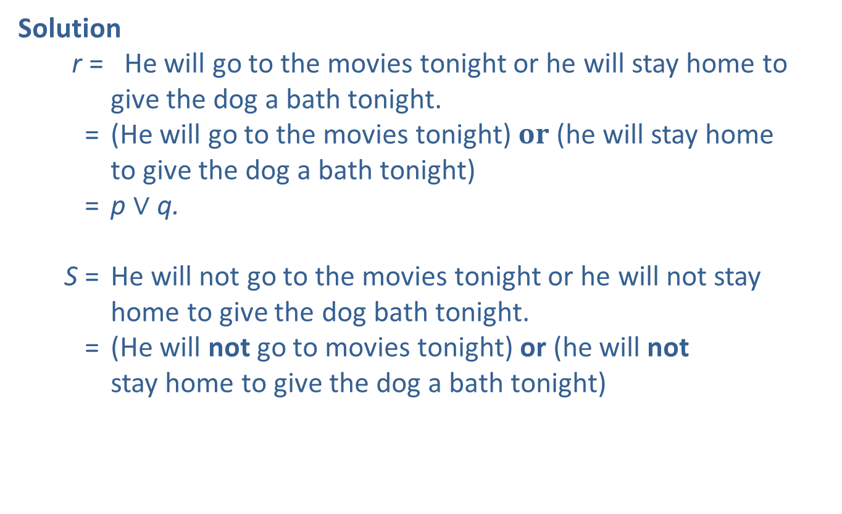
Example 4: Writing Disjunctions
Symbolically—Slide 2
Solution
r = He will go to the movies tonight or he will stay home to
  give the dog a bath tonight.
  = (He will go to the movies tonight) 𝐨𝐫 (he will stay home
  to give the dog a bath tonight)
  = p ∨ q.
  S = He will not go to the movies tonight or he will not stay
  home to give the dog bath tonight.
  = (He will not go to movies tonight) or (he will not
  stay home to give the dog a bath tonight)

Slide 22
Helpful Hint 3
Mathematical logic always uses the inclusive or, meaning one or the other, or both. The inclusive or is represented by the symbol ∨.

Slide 23
Definition: Conditional
If a and b are statements, then "if a, then b " is a compound statement called a conditional. The symbol ⇒ is used to represent a conditional statement.

Slide 24
Helpful Hint 4
Here are a few of the many ways to convey p ⇒ q.
" p implies q ",
" if p, then q ",
" p is sufficient for q ",
" q is necessary for p ",
" p will lead to q ",
" q if p ",
" q whenever p ",
" p only if q "

Slide 25
Example 5: Writing Conditional Statements Symbolically—Slide 1
Consider the following statements.
  s: The water temperature on Saturday is below 76.2°F.
  t: You are allowed to wear a wetsuit in the triathlon.
Write the following compound statements using logic symbols.
  q: If the water temperature on Saturday is below 76.2°F,
  then you are allowed to wear a wetsuit in the triathlon.
  r: You are not allowed to wear a wetsuit in the triathlon if
  the water temperature on Saturday is not below 76.2°F.
Solution
q = If the water temperature on Saturday is below 76.2°F, then you are
allowed to wear a wetsuit in the triathlon.
= If (the water temperature on Saturday is below 76.2°F, then (you are
allowed to wear a wetsuit in the triathlon).
= s ⇒ t

Slide 26
Example 5: Writing Conditional Statements Symbolically—Slide 2
Be careful on the last one. Notice which simple statement follows the "if" part of the condition. This is the part that needs to be written first symbolically.
r = You are not allowed to wear a wetsuit in the triathlon if the water
Temperature on Saturday is not below 76.2°F.
= (You are not allowed to wear a wetsuit in the triathlon) if (the
water temperature on Saturday is not below 76.2°F).
= If (the water temperature on Saturday is not below 76.2°F), then
(you are not allowed to wear a wetsuit in the triathlon).

Slide 27
Skill Check 3
Consider the following statements.
a: I am hungry.
b: I am tired.
c: I am in college.
Write the following three compound statements symbolically.
1. ​I am hungry and tired.
2. ​I am hungry or I am in college.
3. ​I am tired and not in college.
Answer:

Slide 28
Definition: Biconditional
If a and b are statements, then " a if and only if b " is a compound statement called a biconditional. The symbol ⇔ is used to represent a biconditional statement.

Slide 29
Example 6: Writing Biconditional Statements Symbolically—Slide 1
Consider the following statements.
  c: Octopuses have three hearts.
  d: The platypus does not have a stomach.
Write the following compound statements using logic symbols.
  e: The platypus does not have a stomach if and only if octopuses have three hearts.
  f: Octopuses do not have three hearts if and only if the platypus has a stomach.

Slide 30
Example 6: Writing Biconditional Statements Symbolically—Slide 2
Solution
  e = The platypus does not have a stomach if and
  only if octopuses have three hearts.
  = (The platypus does not have a stomach) if and
  only if (octopuses have three hearts).
  = c ⇔ d.
  f = Octopuses do not have three hearts if and only if the
  platypus has a stomach.
  = (Octopuses do not have three hearts) if and only if (the
  platypus has a stomach).

