Slide 1
Section 3.2
Truth Tables

Slide 2
Introduction to Truth Tables—Slide 1
As we stated in Section 3.1, mathematical logic deals in part with deciding the truth value of different types of statements. For instance, consider the statement a and its negation
If we let a be the statement “Today is Monday,” then it is either true or false, depending on when you are reading this. If a is true, then its negation,
will be false.
However, if a is false, then its negation will be true.

Slide 3

Introduction to Truth Tables—Slide 2
To help us keep track of the different possible truth values for a statement, we can construct a truth table. A truth table is a chart with rows and columns that systematically lists out each possible combination of truth values. Once fully complete, the truth table reveals the conditions under which a statement is true and when it is false. One of the simplest truth tables is that of the negation we just discussed. It is shown in Table 1.
Table 1: Negation Truth Table
𝑎 | $∼$𝑎
T | F
F | T

Slide 4
Helpful Hint 1
As compound statements get more complicated, you will begin to see the natural progression of difficulty in the columns leading up to the last column, which always contains the entire compound statement.

Slide 5
Definition: Conjunction Truth Value
If a and b are statements, then the conjunction " a and b " is true only when both a and b are true; otherwise, the conjunction is false.

Slide 6
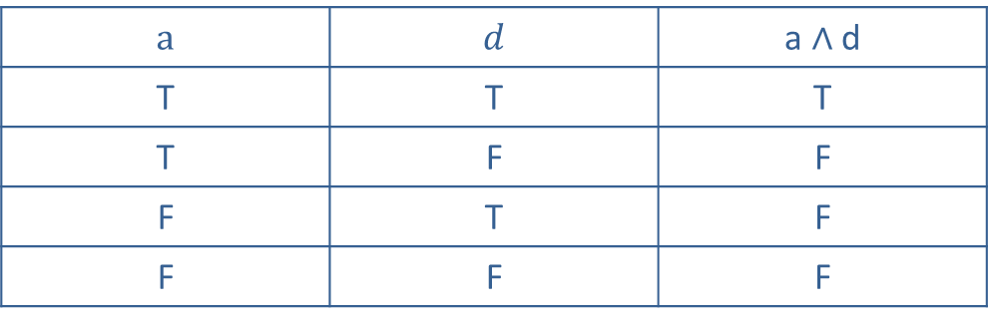
Introduction to Truth Tables—Slide 3
In order for a conjunction to be true, each of the individual parts of the compound statement must be true; otherwise, it is false. So we can look across each row of the truth table and decide which truth value should be placed in the final column.
Table 4: Conjunction Truth Table
$$a$$ | 𝑑 | a ∧ d
T | T | T
T | F | F
F | T | F
F | F | F

Slide 7
Helpful Hint 2
The order of statements in a conjunction does not matter; that is,

Slide 8
Definition: Disjunction Truth Value
If a and b are statements, then the disjunction
" a or b " is always true unless a and b are both false.

Slide 9
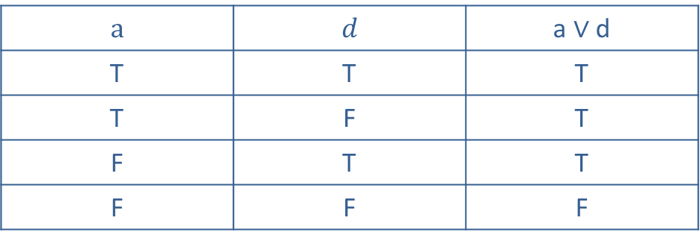
Introduction to Truth Tables—Slide 4
Let’s take a look at the truth values for the other three types of compound statements: disjunctions, conditionals, and biconditionals. If a compound statement is a disjunction (that is, it contains the word or), recall that we will assume that the disjunction is inclusive. That is to say that the statement is true if either of its components are true. So in contrast to a conjunction, where there is only one true value, a disjunction will always be true unless each of the simple statements are false. Table 5 shows the truth table for the disjunction
Table 5: Disjunction Truth Table
$$a$$ | 𝑑 | a $∨$ d
T | T | T
T | F | T
F | T | T
F | F | F

Slide 10
Helpful Hint 3
The order of statements in a disjunction does not matter; that is,

Slide 11
Definition: Conditional Truth Value
If a and b are statements, then the conditional "if a, then b " is always true unless a is true and b is false.

Slide 12
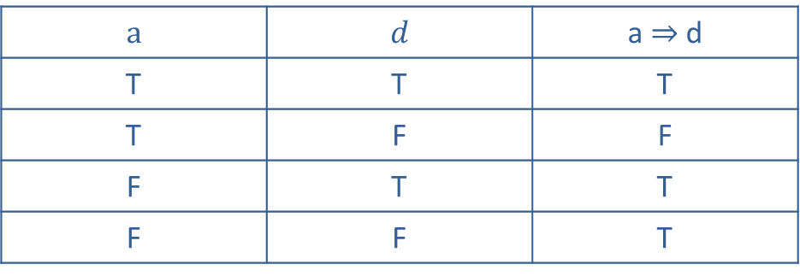
Introduction to Truth Tables—Slide 5
Next is the conditional statement, where one statement implies another. A conditional is true in all cases except when p is true and q is false. The statement structure of “If a, then b” can be best described by thinking of a promise. If you do a, then I promise to do b. The only time the promise is false, or broken, is when you do a and I don’t do b. Think of everything before the implies arrow as the if part of the statement, and everything after the arrow is the then statement. Table 6 shows the truth table for the conditional statement
Table 6: Conditional Truth Table
$$a$$ | 𝑑 | a $⇒$ d
T | T | T
T | F | F
F | T | T
F | F | T

Slide 13
Helpful Hint 4
The order of statements in a conditional matters; that is,

Slide 14
Definition: Biconditional Truth Value
If a and b are statements, then the biconditional " a if and only if b " is true only if a and b have the same truth value; that is, either both are true or both are false.

Slide 15
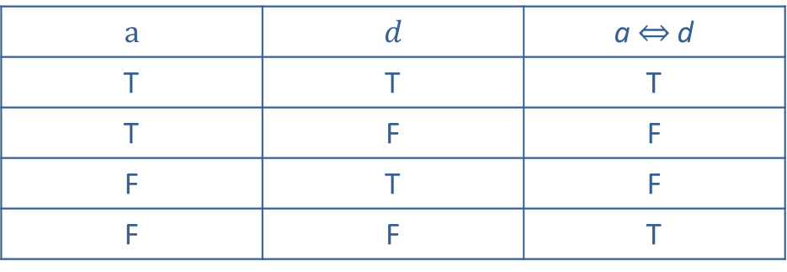
Introduction to Truth Tables—Slide 6
Finally, a biconditional statement (if and only if) is true only when each component of the statement has the same truth value; that is, either both are true or both are false. Table 7 shows the truth table for the biconditional statement
Table 7: Biconditional Truth Table
$$a$$ | 𝑑 | a ⇔ d
T | T | T
T | F | F
F | T | F
F | F | T

Slide 16
Helpful Hint 5
The order of statements in a biconditional does not matter; that is,

Slide 17
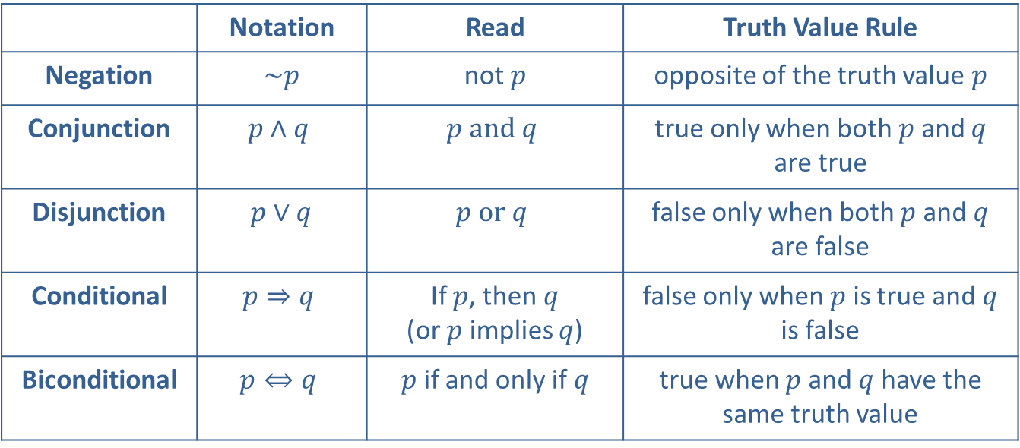
Introduction to Truth Tables—Slide 7
Table 8: Summary of Logic Statements
 | Notation | Read | Truth Value Rule
Negation | ∼$\text{p}$ | not $\text{p}$ | opposite of the truth value $\text{p}$
Conjunction | $$p∧q$$ | $$p and q$$ | true only when both $\text{p}$ and $q$ are true
Disjunction | $p∨q$ | $$p or q$$ | false only when both $\text{p}$ and $q$ are false
Conditional | $$p⇒q$$ | If $p$, then $q$ (or $p$ implies $q$) | false only when $\text{p}$ is true and $q$ is false
Biconditional | $$p⇔q$$ | $p$ if and only if $q$ | true when $\text{p}$ and $q$ have the same truth value

Slide 18
Example 1: Constructing a Truth Table—Slide 1
Construct a truth table for the conjunction
determine when the statement is true and when it is false.
Solution
Notice that we have parentheses in this compound statement. Just like in algebra, parentheses are used to reduce ambiguity with logical symbols. If there are parentheses, we work from the
inside out. So in our table we will first find
will negate it. We need a column for a, a column for b, a column
and finally a column for the negation
So our truth table template looks
like Table 9. Notice that the last column is the compound statement we were given.

Slide 19
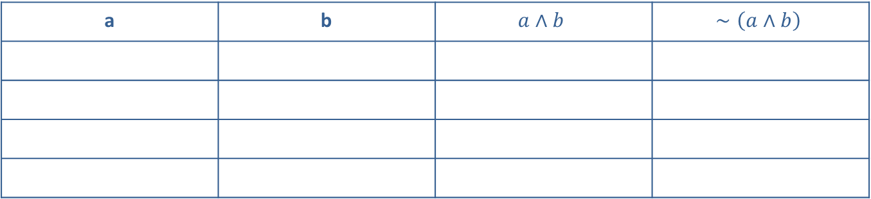
Example 1: Constructing a Truth Table—Slide 2
a | b | $$a∧b$$ | $$∼\left(a∧b\right)$$
The negation has the opposite truth value of the original statement. So we can fill in the fourth column by changing the truth vales of the third column.

Slide 20
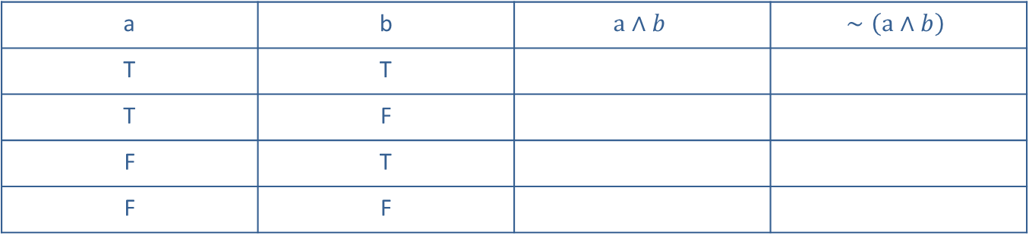
Example 1: Constructing a Truth Table—Slide 3
a | b | $$a∧b$$ | $$∼\left(a∧b\right)$$
T | T
T | F
F | T
F | F
To fill in the third column, remember that the conjunction is true only when both parts are true. Referring to the first and second columns, we can fill in the third column.

Slide 21
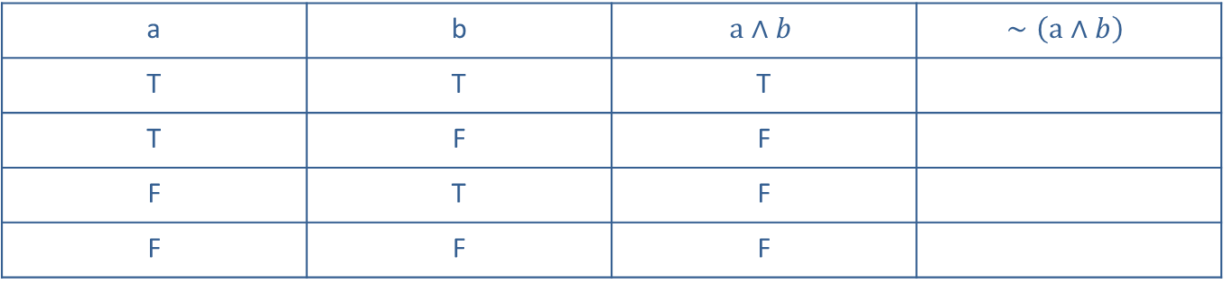
Example 1: Constructing a Truth Table—Slide 4
a | b | $$a∧b$$ | $$∼\left(a∧b\right)$$
T | T | T
T | F | F
F | T | F
F | F | F
The negation has the opposite truth value of the original statement. So we can fill in the fourth column by changing the truth vales of the third column.

Slide 22
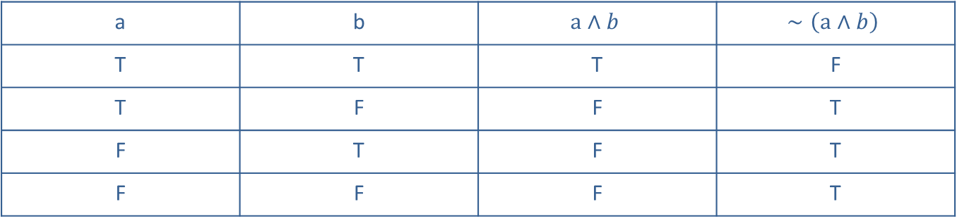
Example 1: Constructing a Truth Table—Slide 5
a | b | $$a∧b$$ | $$∼\left(a∧b\right)$$
T | T | T | F
T | F | F | T
F | T | F | T
F | F | F | T
This truth table tells us that the negation of a conjunction statement is only false on one occasion: when both parts are true. Otherwise, the statement is true.

Slide 23
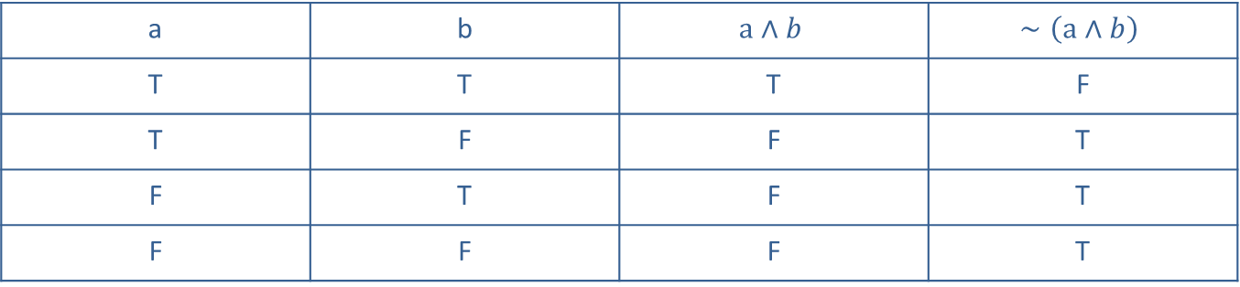
Skill Check 1
Consider the following statements.
f: Arizona is the first state listed alphabetically.
g: Albany is the capital of New York.
Determine the truth value of each statement and then use Table 12 to determine if the statement
a | b | $$a∧b$$ | $$∼\left(a∧b\right)$$
T | T | T | F
T | F | F | T
F | T | F | T
F | F | F | T
Answer: f is false and g is true, so

Slide 24
Example 2: Constructing a Truth Table Containing Three Simple Statements—Slide 1
Construct a truth table for the conjunction
determine when the statement is true and when it is false.
Solution
To form the truth table for this compound statement, we need several columns. We need a column for each original statement c, d, and e, and we'll also need columns for the negation of e
along with
and the final statement
means that the table will have six columns and
can fill in the first three columns with all possible truth combinations for the simple statements as shown in Table 13.

Slide 25
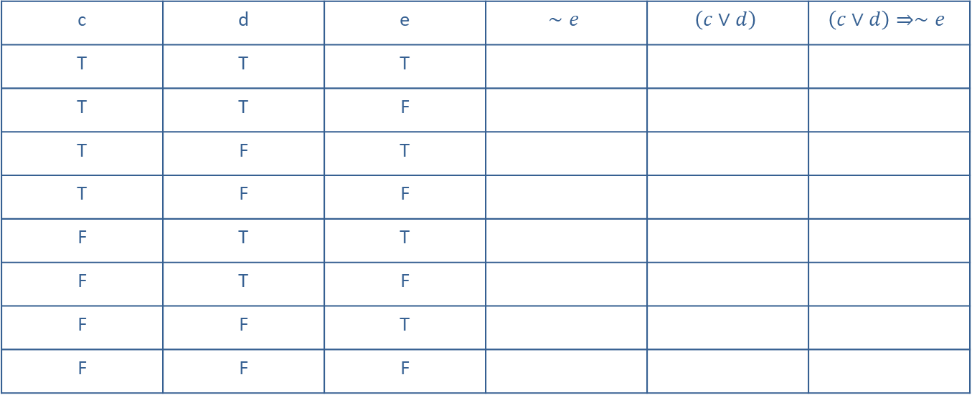
Example 2: Constructing a Truth Table Containing Three Simple Statements—Slide 2
c | d | e | $$∼e$$ | $$\left(c∨d\right)$$ | $$\left(c∨d\right)⇒∼e$$
T | T | T
T | T | F
T | F | T
T | F | F
F | T | T
F | T | F
F | F | T
F | F | F

Slide 26
Example 2: Constructing a Truth Table Containing Three Simple Statements—Slide 3
Next, the fourth column contains the negation of e, which is simply the opposite truth value of the third column. We also know how to fill in the disjunction in the fifth column by referring to the columns for c and d. Recall that a disjunction is false only when both parts are false. Table 14 shows these columns filled in.

Slide 27
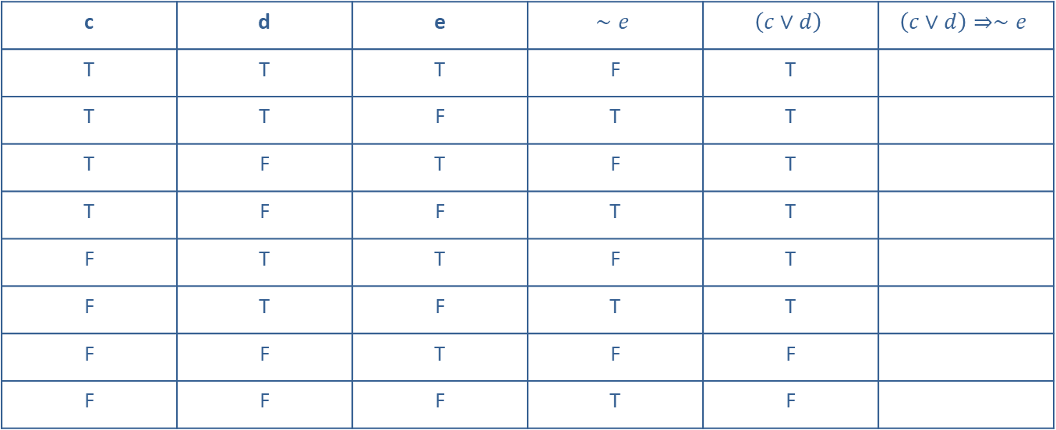
Example 2: Constructing a Truth Table Containing Three Simple Statements—Slide 4
c | d | e | $$∼e$$ | $$\left(c∨d\right)$$ | $$\left(c∨d\right)⇒∼e$$
T | T | T | F | T
T | T | F | T | T
T | F | T | F | T
T | F | F | T | T
F | T | T | F | T
F | T | F | T | T
F | F | T | F | F
F | F | F | T | F

Slide 28
Example 2: Constructing a Truth Table Containing Three Simple Statements—Slide 5
Lastly, the final column contains the conditional statement "if
" As we fill in the final column, we will be
focused on the columns that contain the "if a, then b " parts—the fourth and fifth columns. Remember that the only time a conditional statement is false is when the if part is true while the then part is false.

Slide 29
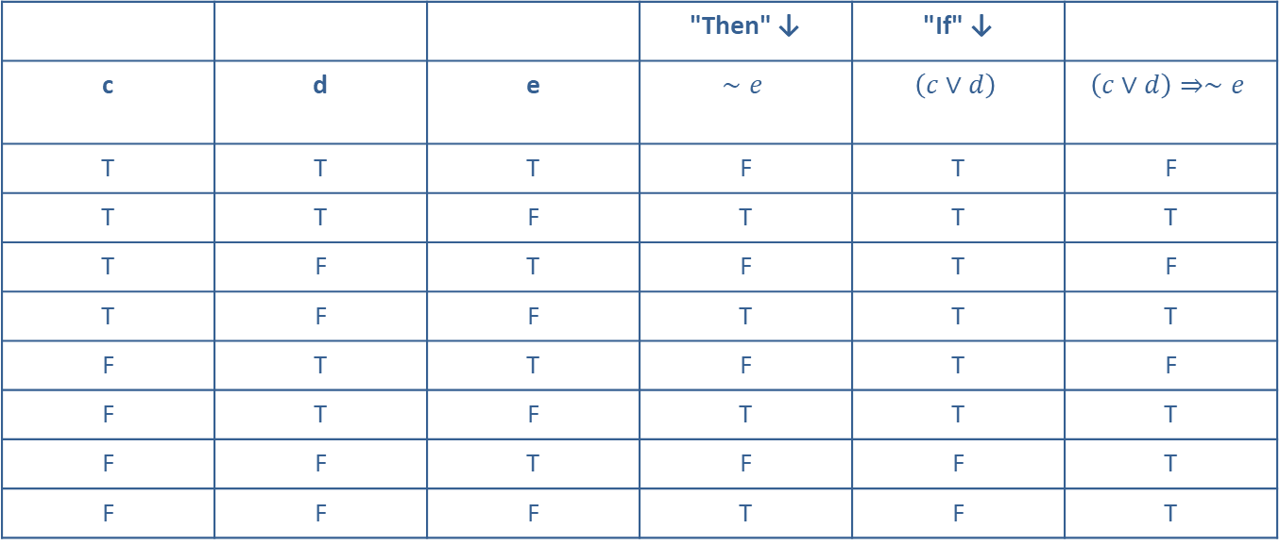
Example 2: Constructing a Truth Table Containing Three Simple Statements—Slide 6
 |  |  | "Then" ↓ | "If" ↓
c | d | e | $$∼e$$ | $$\left(c∨d\right)$$ | $$\left(c∨d\right)⇒∼e$$
T | T | T | F | T | F
T | T | F | T | T | T
T | F | T | F | T | F
T | F | F | T | T | T
F | T | T | F | T | F
F | T | F | T | T | T
F | F | T | F | F | T
F | F | F | T | F | T
Thus, we know that the statement
circumstances, while the remaining five circumstances have a truth value of true.

Slide 30
Helpful Hint 6
When constructing truth tables, the order of the columns is not crucial. Some tables show all of the simple statements of the compound statement first, while others follow a progression of the compound statement reading left to right.

Slide 31
Example 3: Constructing a Truth Table from Words—Slide 1
Construct the truth table for the following compound statement and determine when the statement is true and when it is false.
If you're not making mistakes, then you're not doing anything.
—John Wooden

Slide 32
Example 3: Constructing a Truth Table from Words—Slide 2
Solution
First, we need to identify and label the two simple statements of the compound sentence. The easiest way to do this is to write them down without using the negations. We'll add the negations later. So our two statements, a and b, are the following.
  a: You are making mistakes.
  b: You are doing something.
Notice that the word "anything" is used in the second part of the original statement. But in English, since we don't commonly say "you are doing anything," we will use the word "something" in our second simple statement.

Slide 33
Example 3: Constructing a Truth Table from Words—Slide 3
Then, we can negate each of these two simple statements.
a: You are not making mistakes.
b: You are not doing anything.
Symbolically, our conditional statement is
we have "not doing anything" as the negation of "doing something," which matches the original quote.
If you are not making mistakes, then you are not doing something.
The truth table we need will contain columns for

Slide 34
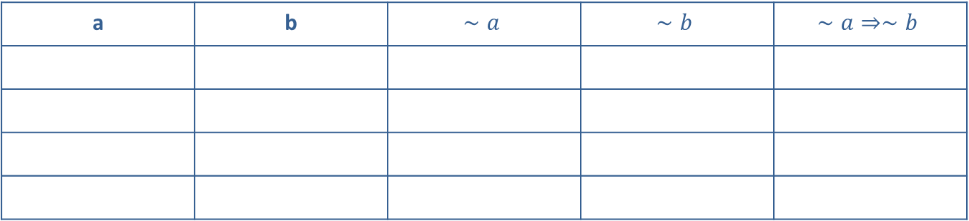
Example 3: Constructing a Truth Table from Words—Slide 4
a | b | $$∼a$$ | $$∼b$$ | $$∼a⇒∼b$$
Fill in the table from left to right as we have done so far. Remember that a conditional statement is false only when the if part is true and the then part is false. The completed truth table will look like Table 17.

Slide 35
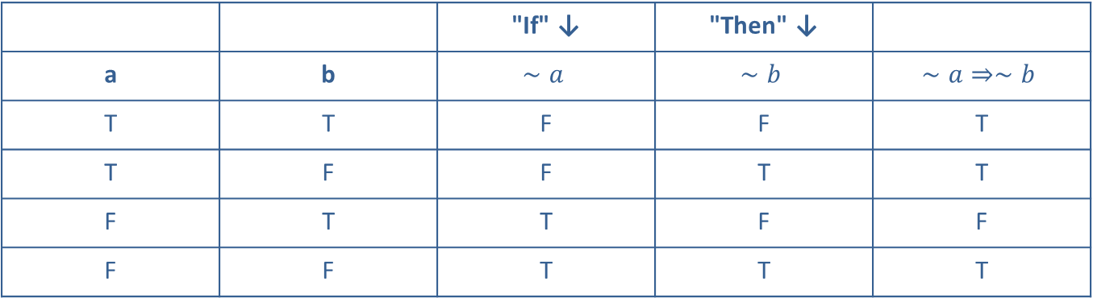
Example 3: Constructing a Truth Table from Words—Slide 5
 |  | "If" ↓ | "Then" ↓
a | b | $$∼a$$ | $$∼b$$ | $$∼a⇒∼b$$
T | T | F | F | T
T | F | F | T | T
F | T | T | F | F
F | F | T | T | T
From the truth table, we can see that the compound statement is true in all but one of the cases: the statement is false when you are not making mistakes and you are doing something.

Slide 36
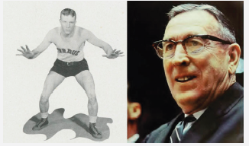
Fun Fact
John Wooden was the first person to be inducted in the Basketball Hall of Fame both as a player (1960) and a coach (1973). Since then, only three other basketball players have achieved the same honors.
Figure 1

Slide 37
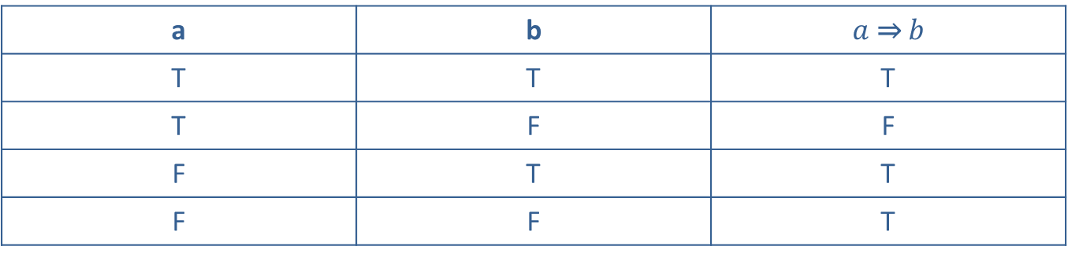
Skill Check 2—Slide 1
Construct a truth table for the conditional statement in Example 3. This time let statements a and b be the following.
  a: You are not making mistakes.
  b: You are not doing anything.
Does your truth table have the same truth values as the table in Example 3? Should it?
Truth Table
a | b | $a$ ⇒ $b$
T | T | T
T | F | F
F | T | T
F | F | T

Slide 38
Skill Check 2—Slide 2
Answer: No, the truth tables do not look exactly the same. The truth tables have the same meaning, but do not look identical since a and b are defined differently.

Slide 39
Definition: Tautology
A tautology is a statement that is true in all possible circumstances.

Slide 40
Example 4: Constructing a Truth Table for a Tautology—Slide 1
Construct the truth table for the following compound statement.
Next year, Imre can take physics or he cannot take physics.
Solution
Notice that this time, there is really only one simple statement. The second part is simply the negation of the first part. Thus, we have c and
c as the following.
  c: Imre can take physics next year.
c: Imre cannot take physics next year.

Slide 41

Example 4: Constructing a Truth Table for a Tautology—Slide 2
Our entire compound statement can then be expressed symbolically by
The truth table will only need 3
Remember, a disjunction will only be false when both parts are false. Table 18 shows the completed truth table.
$$c$$ | $$∼c$$ | $$c∨∼c$$
T | F | T
F | T | T
Hence, "Next year, Imre can take physics or he cannot take physics" is a tautology, since all truth values for the disjunction in the last column are true

Slide 42
Example 5: Constructing a Truth Table for a Conditional Statement—Slide 1
Consider the following quote from the movie The Hunger Games: Catching Fire ¹.
Peeta Mellark to Katniss Everdeen:
"…if you can stop looking at me like I'm wounded, then I can quit acting like it. Then maybe we have a shot at being friends."
a. Construct a truth table for Peeta's conditional quote.
b. ​Determine if Peeta's statement is a tautology.
1. Simon Beaufoy and Michael Arndt. The Hunger Games: Catching Fire. Directed by Francis Lawrence. (Santa Monica, CA: Lionsgate, 2014), DVD.

Slide 43
Example 5: Constructing a Truth Table for a Conditional Statement—Slide 2
Solution
a. As we've stated before, English is a rich and complicated language. We need to be cautious about simply seeing the words if…, then and assuming it's a straightforward conditional statement without looking at the intent behind the statement. In the original quotation, the words if…, then do actually appear; however, the word then occurs again without a matching if to go with it. The then part of Peeta's conditional statement can be perceived as twofold. If Katniss changes her gaze, then two things will happen: Peeta's behavior will change and they have a shot at friendship.
​"…if you can stop looking at me like I'm wounded, then I can quit acting like it, and (then) maybe we have a shot at being friends."

Slide 44
Example 5: Constructing a Truth Table for a Conditional Statement—Slide 3
  As a formal "if a, then b " compound statement, Peeta's quote involves 3 simple statements: p, q, and r.
    ​p: You stop looking at me like I'm wounded.
    q: I can quit acting like I'm wounded.
    r: We have a shot at being friends.
  The logical mathematical statement that follows from the quote is
  ​As we build the truth table for the logic statement, we need to include a column for each individual part that is contained in the final conditional statement. Also, remember to include enough rows for three simple statements; that is,
The first part of the table should look like Table 19.

Slide 45
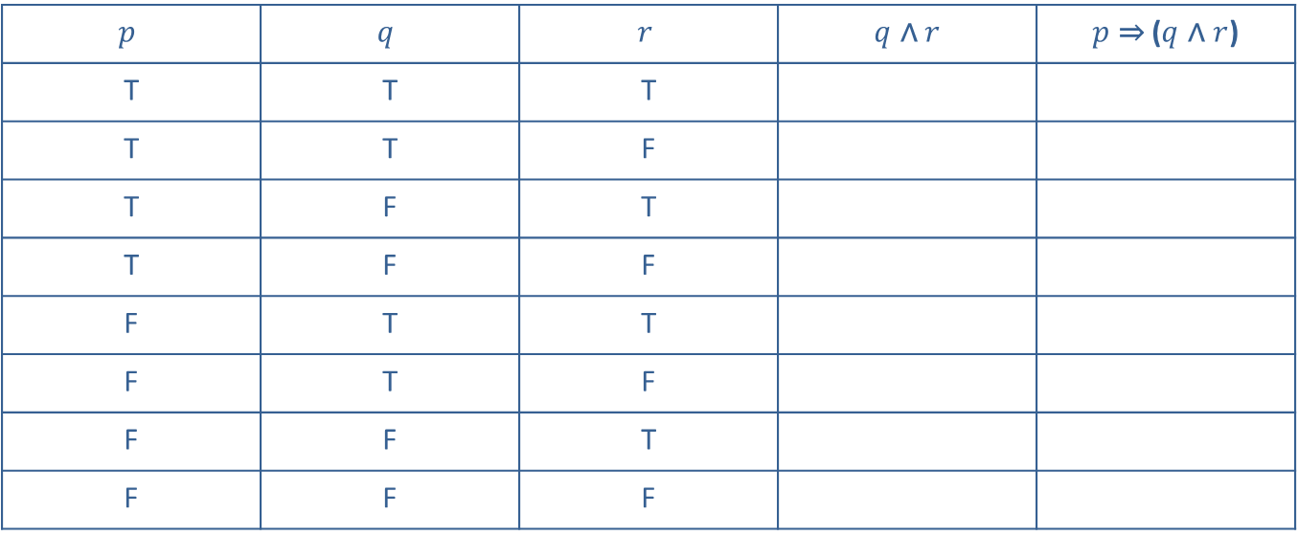
Example 5: Constructing a Truth Table for a Conditional Statement—Slide 4
$$p$$ | $$q$$ | $$r$$ | $q$ ∧ $r$ | $p$ ⇒ ($q$ ∧ $r$)
T | T | T
T | T | F
T | F | T
T | F | F
F | T | T
F | T | F
F | F | T
F | F | F
Next, complete the column for the conjunction (that is, the and statement). Remember that a conjunction is true only if both of the individual statements are true.

Slide 46
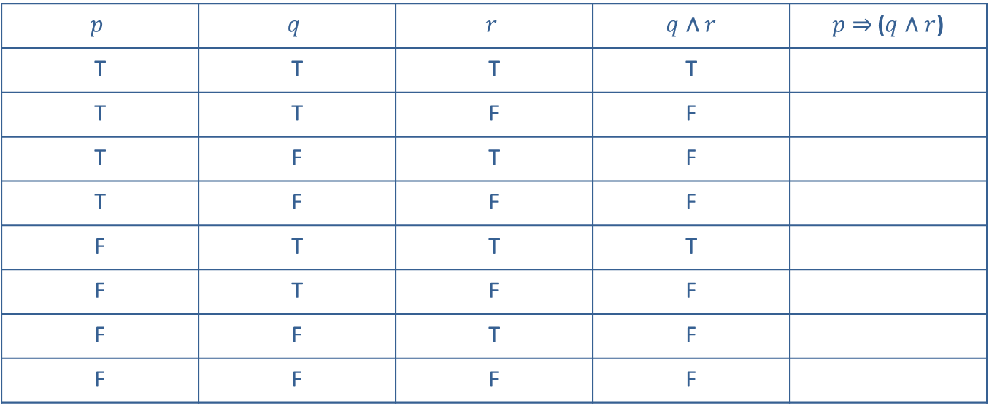
Example 5: Constructing a Truth Table for a Conditional Statement—Slide 5
$$p$$ | $$q$$ | $$r$$ | $q$ ∧ $r$ | $p$ ⇒ ($q$ ∧ $r$)
T | T | T | T
T | T | F | F
T | F | T | F
T | F | F | F
F | T | T | T
F | T | F | F
F | F | T | F
F | F | F | F
Finally, fill in the conditional column using the columns that contain the if and then parts.

Slide 47
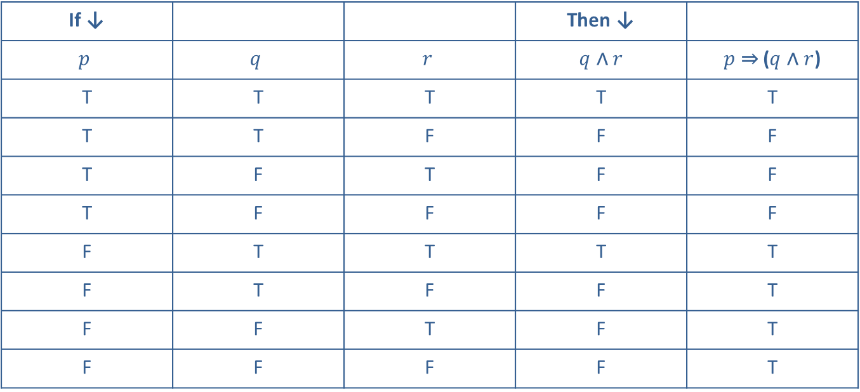
Example 5: Constructing a Truth Table for a Conditional Statement—Slide 6
If ↓ |  |  | Then ↓
$$p$$ | $$q$$ | $$r$$ | $q$ ∧ $r$ | $p$ ⇒ ($q$ ∧ $r$)
T | T | T | T | T
T | T | F | F | F
T | F | T | F | F
T | F | F | F | F
F | T | T | T | T
F | T | F | F | T
F | F | T | F | T
F | F | F | F | T

Slide 48
Example 5: Constructing a Truth Table for a Conditional Statement—Slide 7
b. The truth table shows us that the statement would be true in all but 3 cases. Because the statement is not always true, it is not a tautology. The 3 cases in which Peeta's statement turns out to be false are as follows.
  a. TTF = Katniss stops looking at him like he’s wounded; he stops acting like it, but they don’t have a shot at being friends.
  b. TFT = Katniss stops looking at him like he’s wounded; he does not stop acting like it, and they do have a shot at being friends.
  c. TFF = Katniss stops looking at him like he’s wounded; but he does not stop acting like it, and they don’t have a shot at being friends.

Slide 49
Helpful Hint 7
Because the English language is prone to ambiguities, sometimes you will need to use your judgment to insert any necessary connectives. In mathematics, it is wise to always be as precise as possible.

