Slide 1
Section 3.4
Valid Arguments and Fallacies

Slide 2
Definition: Logical Arguments
Argument
A logical argument consists of a series of logical statements.
Premise
A premise is a statement at the beginning of an argument used to support a particular conclusion.
Conclusion
A conclusion is the ending statement of an argument.

Slide 3
Example 1: Identifying Premises and Conclusions—Slide 1
Identify the premises and conclusion in each of the following arguments.
a. If we update the technology, then we will have a better product and fewer complaints. Our technology was updated last month, so we will receive fewer complaints this month.
b. ​The president of the United States must be younger than 40. Bruce Springsteen is president of the United States. Therefore, Bruce Springsteen must be younger than 40.

Slide 4
Example 1: Identifying Premises and Conclusions—Slide 2
Solution
a. The premises in support of the conclusion come first in the argument. The conclusion is the last statement. Thus, we have the following.
    ​Premise 1: If we update the technology, then we will have a better product and fewer complaints.
    ​Premise 2: Our technology was updated last month.
    Conclusion: We will receive fewer complaints this month.
b. ​This argument has two premises and a conclusion.
    ​Premise 1: The president of the United States must be younger than 40.
    ​Premise 2: Bruce Springsteen is president of the United States.
    ​Conclusion: Bruce Springsteen must be younger than 40.

Slide 5
Helpful Hint 1
If-then statements can be used in the premise of an argument. Be careful to correctly identify the conclusion in such cases.

Slide 6
Skill Check 1
Identify the premises and conclusion in the following argument.
If the weather is warm, we will go the beach. We're at the beach, so it must be warm outside.
Answer:
Premise 1: If the weather is warm, we will go the beach.
Premise 2: We're at the beach.
Conclusion: It is warm outside.

Slide 7
Definition: Valid and Invalid Arguments
Valid Argument
A valid argument is a deductive argument where the conclusion is always guaranteed from the premises.
Invalid Argument
An invalid argument is a deductive argument where the conclusion is not always guaranteed from the premises.

Slide 8
Think Back—Slide 1
Deductive reasoning uses statements that are commonly accepted as facts to make a case for a certain conclusion.

Slide 9
Think Back—Slide 2
A tautology is a statement that is true in all possible circumstances.

Slide 10
Using a Truth Table to Determine the Validity of an Argument
1. Express the argument in symbolic form as an if-then statement. The if portion will consist of the premises joined together with conjunctions. The then portion is the conclusion. For example, if there are n premises, the statement will be of the form
​
2. Construct a truth table for the if-then statement.
3. ​If the implication is a tautology, then the argument is valid, otherwise the argument is invalid.

Slide 11
Example 2: Determining the Validity of an Argument—Slide 1
Decide if the following argument is valid by using a truth table.
  If someone lives in the city of Phoenix, Arizona, then they live in the Mountain Standard Time Zone. Sebastian does not live in the Mountain Standard Time Zone. Therefore, Sebastian does not live in the city of Phoenix, Arizona.
Solution
We begin by identifying the premises and conclusion.
  Premise 1: If someone lives in the city of Phoenix, Arizona, then they live in the Mountain Standard Time Zone.
  Premise 2: Sebastian does not live in the Mountain Standard Time Zone.

Slide 12
Example 2: Determining the Validity of an Argument—Slide 2
  Conclusion: Sebastian does not live in the city of Phoenix, Arizona.
Next, we will represent the simple statements with letters so that we can write the argument symbolically.
  p: Someone lives in Phoenix, Arizona.
  q: They live in the Mountain Standard Time Zone.
Therefore,
  Premise 1 is
Premise 2 is
Conclusion is

Slide 13
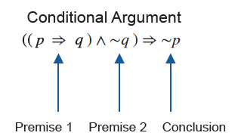
Example 2: Determining the Validity of an Argument—Slide 3
To write the argument symbolically, we write a conditional statement where we join the premises together as a conjunction that implies the conclusion. Thus, the argument is written in the following way.

Slide 14
Example 2: Determining the Validity of an Argument—Slide 4
We can now construct the truth table for the argument.
𝑝 | 𝑞 | 𝑝 ⇒ 𝑞 | ~ ̴ 𝑞 | (𝑝 ⇒ 𝑞) ∧ ~ 𝑞 | ̴~ 𝑝 | ((𝑝 ⇒ 𝑞) ∧ ̴ 𝑞) ⇒ ̴ 𝑝
T | T | T | F | F | F | T
T | F | F | T | F | F | T
F | T | T | F | F | T | T
F | F | T | T | T | T | T
Notice that the final column is true in every case, meaning it is a tautology. Therefore, the argument is valid, which means that the conclusion follows from the premises.

Slide 15
Helpful Hint 2
The following notation is also used to represent logical arguments.
The premises are listed above the line and the conclusion is listed below the line. The ∴ means therefore.

Slide 16
Example 3: Determining the Validity of an Argument—Slide 1
Decide if the following argument is valid by using a truth table.
  If you work hard, you will succeed. You succeeded, so you must have worked hard.
Solution
Begin by identifying the premises and conclusion.
  Premise 1: If you work hard, you will succeed.
  Premise 2: You succeeded.
  Conclusion: You worked hard.
Next, we will represent the simple statements with letters so that we can write the argument symbolically.
  a: You work hard.
  b: You succeeded.

Slide 17
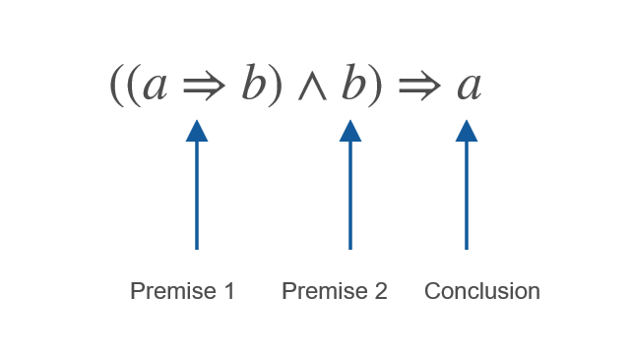
Example 3: Determining the Validity of an Argument—Slide 2
Therefore,
  Premise 1 is
  Premise 2 is b.
  Conclusion is a.
Thus, the argument is written symbolically as follows.
Next, construct the truth table for the argument.

Slide 18
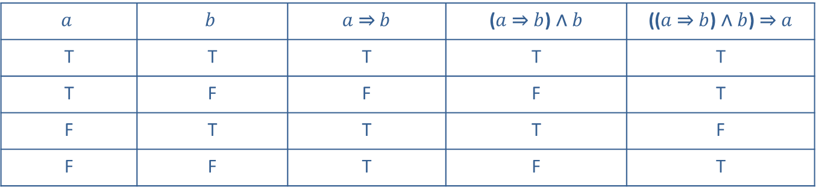
Example 3: Determining the Validity of an Argument—Slide 3
$$a$$ | $$b$$ | $a$ ⇒ $b$ | ($a$ ⇒ $b$) ∧ $b$ | (($a$ ⇒ $b$) ∧ $b$) ⇒ $a$
T | T | T | T | T
T | F | F | F | T
F | T | T | T | F
F | F | T | F | T
Notice that the final column is not true in every case. Row three has a false truth value. Therefore, the argument is invalid, which means that the conclusion does not follow from the premises. In other words, your success was not necessarily because you worked hard.

Slide 19
Skill Check 2
Determine whether the following argument is valid.
If my phone crashes, then I will lose all my photos. My phone did not crash. Therefore, I did not lose my photos.
Answer: Invalid

Slide 20
Definition: Sound Argument
A sound argument is a valid argument using true premises.

Slide 21
Example 4: Determining If an Argument Is Sound—Slide 1
Use a truth table to determine if the following is a sound argument.
  If the President of the United States is unable to carry out his or her constitutional role, then the Vice President becomes the President of the United States. In November 1963, President John F. Kennedy was fatally shot. Therefore, without an election, Vice President Lyndon Johnson became President of the United States.

Slide 22
Example 4: Determining If an Argument Is Sound—Slide 2
Solution
Begin by identifying the premises and conclusion.
  Premise 1: If the President of the United States is unable to carry out his or her constitutional role, then the Vice President becomes the President of the United States.
  Premise 2: President John F. Kennedy was fatally shot.
  Conclusion: Vice President Lyndon Johnson became President of the United States.
Next, represent the simple statements with letters.
  p: The President of the United States is unable to carry out his or her constitutional role.
  q: The Vice President becomes the President of the United States.

Slide 23
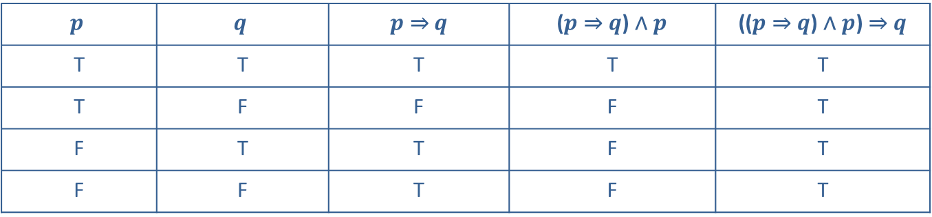
Example 4: Determining If an Argument Is Sound—Slide 3
Therefore,
  Premise 1 is
  Premise 2 is p.
  Conclusion is q.
Thus, the argument is represented by truth table is as follows.
$$p$$ | $$q$$ | $p$ ⇒ $q$ | ($p$ ⇒ $q$) ∧ $p$ | (($p$ ⇒ $q$) ∧ $p$) ⇒ $q$
T | T | T | T | T
T | F | F | F | T
F | T | T | F | T
F | F | T | F | T

Slide 24
Example 4: Determining If an Argument Is Sound—Slide 4
You can see that the implication is a tautology, and thus valid.
For the argument to be sound, we must start with a true statement. Therefore, we'll only consider the first two rows of the table. We can confirm (via history books or the internet) that in 1963, President John F. Kennedy was fatally shot. In other words, statement p is true (the President was unable to carry out his constitutional role). In the same manner, we know that statement q is true in this argument because the Vice President at the time, Lyndon Johnson, became President of the United States. Since we are starting with true statements, and this is a valid argument, we know that this argument is also sound.

Slide 25
Skill Check 3
Determine whether the following is a sound argument.
Marcy is very allergic to strawberries. Last week, she inadvertently drank some punch with strawberry puree in it. As a result, she had an allergic reaction and had to be taken to urgent care.
Answer: The argument is sound.

Slide 26
Definition: Fallacy
A fallacy is an error in reasoning that leads to an invalid argument.

Slide 27
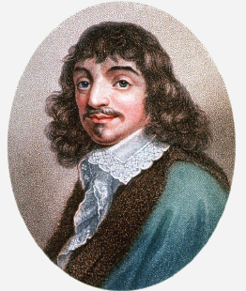
Math Milestone
René Descartes was a famed philosopher who thought that science and mathematics could be used to explain everything in nature and wrote many works explaining his reasoning. At the age of 41, he published La Geométrie, which gave birth to Cartesian geometry that is widely studied today. Sadly, he died of pneumonia at the age of 54.
Figure 1

Slide 28
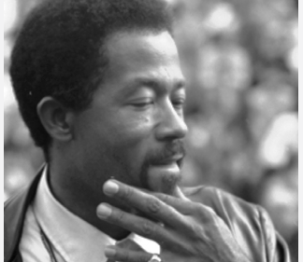
Fun Fact
Eldridge Cleaver ran as a candidate in the 1968 presidential election under the Peace and Freedom Party. He received 36,571 votes, even though some states held that he did not meet the constitutional requirement for age and therefore could be excluded from the ballot. The Constitution requires that the US President be at least 35 but does not specify when he must have reached that age. Cleaver would not have been 35 until more than a year after the inauguration day in 1969.
Figure 2

Slide 29
Example 5: Identifying Fallacies—Slide 1
Identify the type of fallacy used in each of the following statements.
a: If public spending is not reduced, our economy will collapse.
b: Heather just had a new fuel pump put in her car. Forty-eight hours later, her car won't start. Heather's father thinks the mechanic must not have installed the fuel pump correctly.
Solution
a: This is a false dilemma. The argument makes it seem like there are only two options: either public spending decreases or the economy collapses. However, it is also possible that the economy can be strong while public spending remains the same.

Slide 30
Example 5: Identifying Fallacies—Slide 2
b: This is post hoc, ergo propter hoc. There are many other things that could cause Heather's car to not start, including a lack of fuel! It is not unreasonable to consider that there might be a connection, but it is still a fallacy to assert that the one thing happening after the other is the only possible explanation.

Slide 31
Skill Check 4
Identify the type of fallacy used in the following statement.
Liam drives an expensive car. He must have money to spare!
Answer: Non sequitur

Slide 32
Summary of Fallacies—Slide 1
Table 5: Summary of Fallacies
Type of Fallacy | Description
Post Hoc, Ergo Propter Hoc (After This, Therefore Because of This) | Because one thing happened first, it caused the other to happen.
Dicto Simpliciter (Hasty Generalization) | Making broad, sweeping generalizations based on a few specific occurrences.
Ad Hominem (Personal Attack) | Attacking someone's person, character, or motives instead of addressing the premise of the argument.
Petitio Principii (Circular Reasoning) | The premise and conclusion state the same thing.
Non Sequitur (It Does Not Follow) | The conclusion does not logically follow from the premise; it follows a diversion.

Slide 33
Summary of Fallacies—Slide 2
Table 5: Summary of Fallacies (cont.)
Type of Fallacy | Description
Straw Man (Exaggerated or Distorted View of the Opponent) | The distortion of someone's ideas or beliefs so that they can easily be knocked down.
False Dilemma (Illusion of Limited Choice) | Argument that rests on the assumption that there are only two choices as a solution.
Argumentum ad Populum (Appeal to the People) | Stating that the majority, or even just a large number, of people are doing something as the basis for supporting a conclusion.

