Slide 1
Chapter 3
Review

Slide 2
Definition: Statement
A mathematical statement is a complete sentence that asserts a claim which is either true or false, but not both at the same time.

Slide 3
Definition: Paradox
A paradox is a sentence that contradicts itself and therefore has no single truth value. A paradox cannot be a mathematical statement.

Slide 4
Definition: Negation
The negation of a statement is the logical opposite of that statement, or its denial. Negations always have the opposite truth value of the original statement. Negations are denoted by the symbol

Slide 5
Definition: Compound Statements
A compound statement is composed of two or more statements joined together by connective words such as and, or, or implies.

Slide 6
Definition: Conjunction
If a and b are statements, then " a and b " is a compound statement called a conjunction. The symbol
is used to
represent a conjunction.

Slide 7
Definition: Disjunction
If a and b are statements, then " a or b " is a compound statement called a disjunction. The symbol
is used to
represent a disjunction.

Slide 8
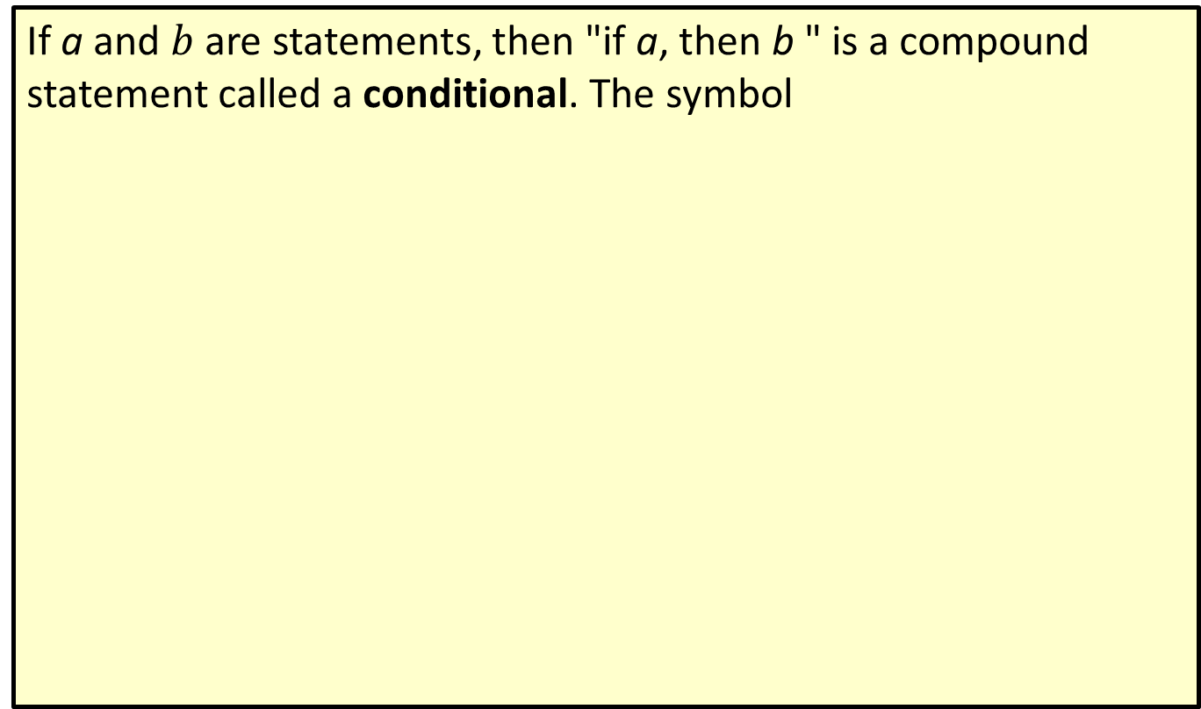
Definition: Conditional
If a and $b$ are statements, then "if a, then b " is a compound statement called a conditional. The symbol
is used to
represent a conditional statement.

Slide 9
Definition: Biconditional
If a and b are statements, then " a if and only if b " is a compound statement called a biconditional.
used to represent a biconditional statement.

Slide 10
Definition: Conjunction Truth Value
If a and b are statements, then the conjunction " a and b " is true only when both a and b are true; otherwise, the conjunction is false.

Slide 11
Definition: Disjunction Truth Value
If a and b are statements, then the disjunction " a or b " is always true unless a and b are both false.

Slide 12
Definition: Conditional Truth Value
If a and b are statements, then the conditional "if a, then b " is always true unless a is true and b is false.

Slide 13
Definition: Biconditional Truth Value
If a and b are statements, then the biconditional " a if and only if b " is true only if a and b have the same truth value; that is, either both are true or both are false.

Slide 14
Definition: Tautology
A tautology is a statement that is true in all possible circumstances.

Slide 15
Definition: Logically Equivalent Statements
Logically equivalent statements are statements that have exactly the same truth values in all corresponding circumstances. Equivalence is denoted with the symbol

Slide 16
De Morgan's Laws
1.

Slide 17
Negation of Conditional Statements

Slide 18
Definition: Argument
A logical argument consists of a series of logical statements.

Slide 19
Definition: Premise
A premise is a statement at the beginning of an argument used to support a particular conclusion.

Slide 20
Definition: Conclusion
A conclusion is the ending statement of an argument.

Slide 21
Definition: Valid Argument
A valid argument is a deductive argument where the conclusion is always guaranteed from the premises.

Slide 22
Definition: Invalid Argument
An invalid argument is a deductive argument where the conclusion is not always guaranteed from the premises.

Slide 23
Definition: Sound Argument
A sound argument is a valid argument using true premises.

Slide 24
Definition: Fallacy
A fallacy is an error in reasoning that leads to an invalid argument.

Slide 25
Using a Truth Table to Determine the Validity of an Argument
1. Express the argument in symbolic form as an if-then statement. The if portion will consist of the premises joined together with conjunctions. The then portion is the conclusion. For example, if there are n premises, the statement will be of the form
​
2. Construct a truth table for the if-then statement.
3. ​If the implication is a tautology, then the argument is valid, otherwise the argument is invalid.

