Slide 1
Section 4.1
Proportions, Percentages, and Ratios

Slide 2
Fun Fact
Have you been "ratioed" on Twitter? If the number of comments your tweet receives is smaller than the number of likes or retweets, indicating that the tweet is more disliked than liked, you've been ratioed!

Slide 3
Definition: Proportion
A proportion is a fraction of a whole.

Slide 4
Think Back 1
Recall that fractions are of the form

Slide 5
Think Back 2
The greatest common divisor (GCD)—also called the greatest common factor (GCF)—is the largest integer that divides two numbers without a remainder.

Slide 6
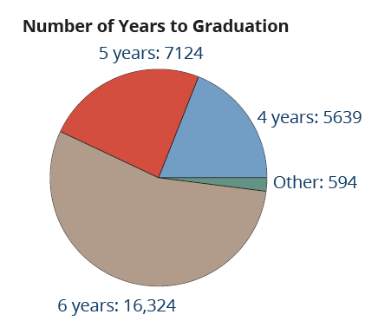
Example 1: Finding Proportions—Slide 1
The pie chart shows the number of years it takes for students to graduate with a bachelor's degree for a certain state college system. Use the pie chart to determine the proportions of students earning a bachelors who graduate within
a. 4 years,
b. 5 years, and
c. 6 years.
Write each proportion as a fraction
of the total number of students.
Figure 1

Slide 7
Example 1: Finding Proportions—Slide 2
Solution
Since a proportion is a fraction of the whole, first we need to know the total number of students by adding all of the categories in the pie chart.
Total Number of Students: 5639 + 7124 + 16,324 + 594 = 29,681
Each proportion is found by creating a fraction with the respective numbers for each category. We are only asked to find the proportions of 4-, 5-, and 6-year graduates. So we will not need to determine the proportion of "other" students.

Slide 8
Example 1: Finding Proportions—Slide 3
​
a. Proportion of Students Who Graduate in 4 Years
b. Proportion of Students Who Graduate in 5 Years
c. ​Proportion of Students Who Graduate in 6 Years
Note that we will not reduce the fractional answers here since we were asked to give each proportion as a fraction of the total number of students.

Slide 9
Definition: Percentage
A percentage is an amount per 100, expressed using a percent sign, %.

Slide 10
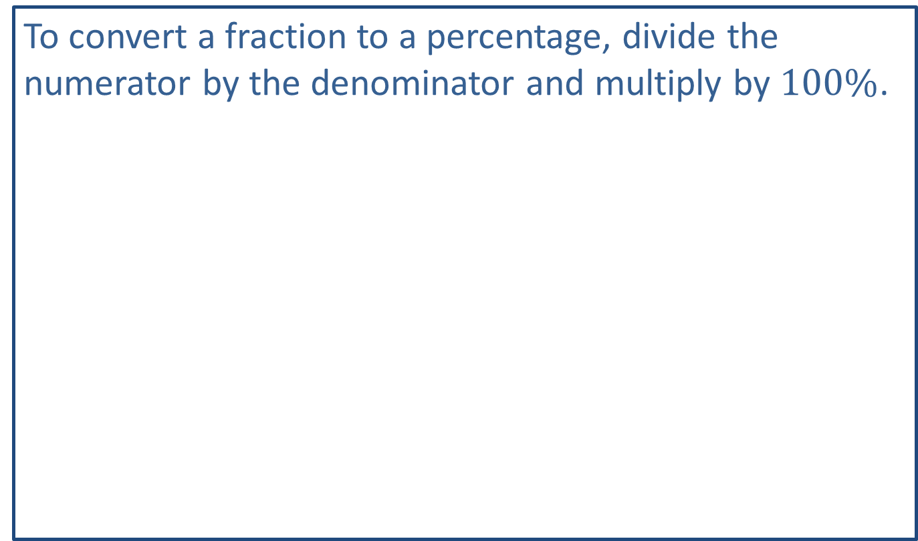
Think Back 3
To convert a fraction to a percentage, divide the numerator by the denominator and multiply by $100\%$.
fraction to decimal to percent

Slide 11
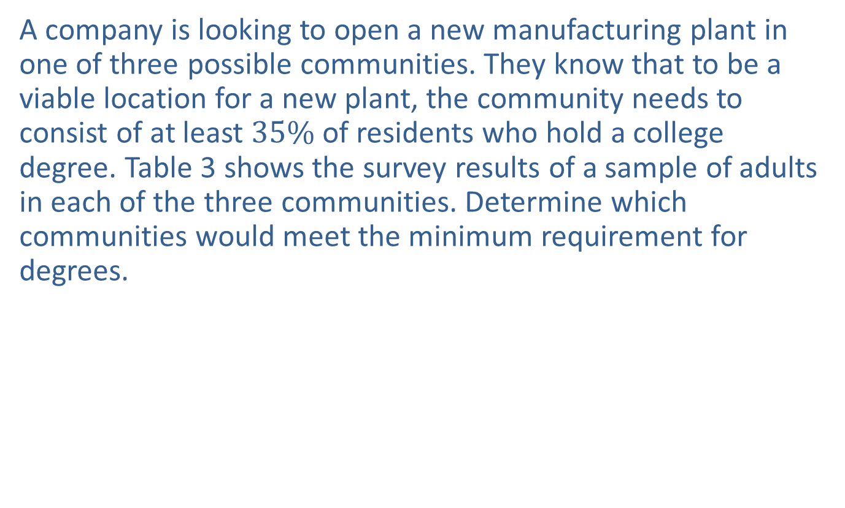
Example 2: Finding Proportions—Slide 1
A company is looking to open a new manufacturing plant in one of three possible communities. They know that to be a viable location for a new plant, the community needs to consist of at least $35\%$ of residents who hold a college degree. Table 3 shows the survey results of a sample of adults in each of the three communities. Determine which communities would meet the minimum requirement for degrees.
Table 3: Random Sample of Adults
 | Community A | Community B | Community C
Have a Degree | 3720 | 3996 | 4400
Do Not Have a Degree | 6290 | 8806 | 7170
Total | 10,020 | 12,802 | 11,570

Slide 12

Example 2: Finding Proportions—Slide 2
Solution
For each community, calculate the proportion of adults who have a degree and then write it as a percentage to determine if it meets the $35\%$ cutoff.
So both communities A and C meet the required minimum percentage.

Slide 13
Skill Check 1
In baseball and softball, a player's batting average is the proportion of the number of hits to the number of "at bats." What is Jessica's batting average if she had 5 hits in a game with 12 at bats? Express the answer as both a fraction and a percentage rounded to the nearest hundredth.
Answer:

Slide 14
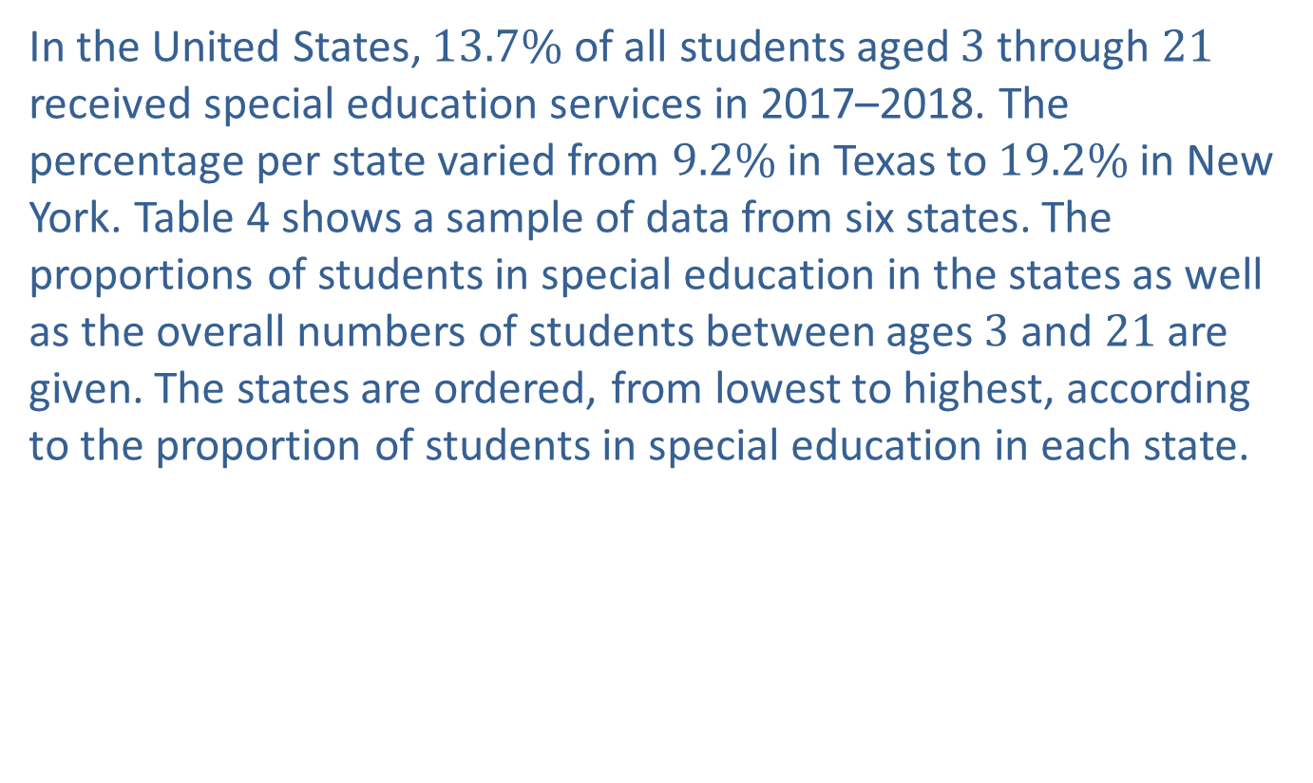
Example 3: Using Percentages—Slide 1
In the United States, $13.7\%$ of all students aged 3 through 21 received special education services in 2017–2018. The percentage per state varied from $9.2\%$ in Texas to $19.2\%$ in New York. Table 4 shows a sample of data from six states. The proportions of students in special education in the states as well as the overall numbers of students between ages 3 and 21 are given. The states are ordered, from lowest to highest, according to the proportion of students in special education in each state.

Slide 15
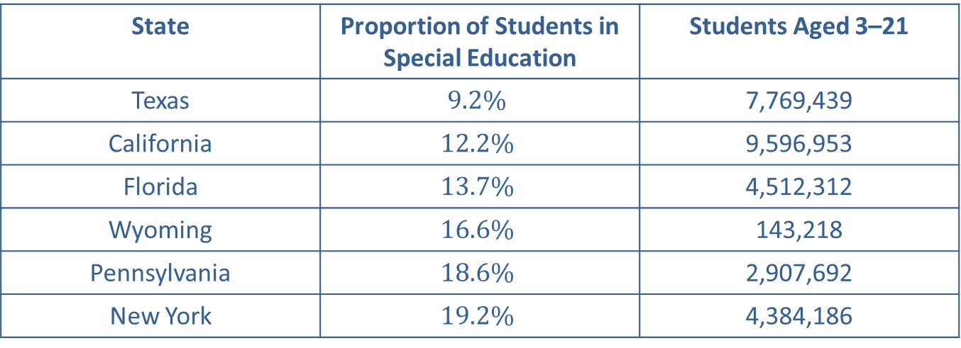
Example 3: Using Percentages—Slide 2
Table 4: Sample of States by Proportion of Students Receiving Special Education Services
State | Proportion of Students in Special Education | Students Aged 3–21
Texas | $$9.2\%$$ | 7,769,439
California | $$12.2\%$$ | 9,596,953
Florida | $$13.7\%$$ | 4,512,312
Wyoming | $$16.6\%$$ | 143,218
Pennsylvania | $$18.6\%$$ | 2,907,692
New York | $$19.2\%$$ | 4,384,186
Source: "Digest of Education Statistics: 2018," National Center for Education Statistics, last modified December 2019, https://nces.ed.gov/programs/digest/d18/index.asp.

Slide 16
Example 3: Using Percentages—Slide 3
a. Determine the number of students in special education in each of the states listed, and then use these numbers to order the states from highest to lowest. (Round your answer to the nearest whole number of students.)
b. Suppose that a new federal initiative to provide money to education departments across the states is in the planning stages. A committee is considering how to disperse federal funds to states based on their populations of students in special education. Discuss whether the committee should base its decision on the proportions of students or the number of students in special education from each state.

Slide 17
Example 3: Using Percentages—Slide 4
​ Solution
a. To determine the number of students in special education in each state, multiply the percentage by the respective number of students aged 3–21 as shown in Table 5, ordering the states by number of students in special education, from lowest to highest.

Slide 18
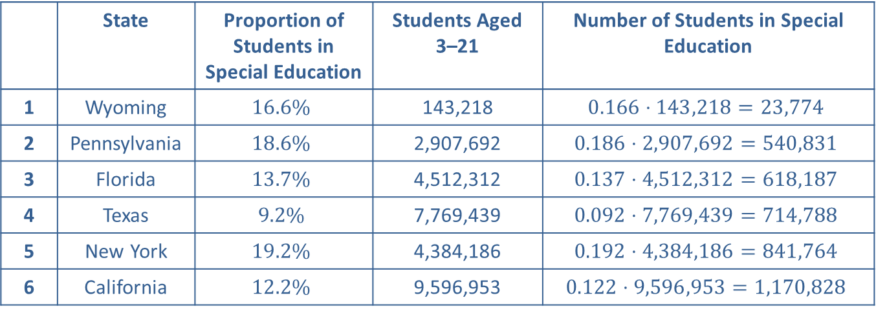
Example 3: Using Percentages—Slide 5
Table 5: Ranking of States by Number of Students in Special Education
 | State | Proportion of Students in Special Education | Students Aged 3–21 | Number of Students in Special Education
1 | Wyoming | $$16.6\%$$ | 143,218 | $$0.166⋅143,218=23,774$$
2 | Pennsylvania | $$18.6\%$$ | 2,907,692 | $$0.186⋅2,907,692=540,831$$
3 | Florida | $$13.7\%$$ | 4,512,312 | $$0.137⋅4,512,312=618,187$$
4 | Texas | $$9.2\%$$ | 7,769,439 | $$0.092⋅7,769,439=714,788$$
5 | New York | $$19.2\%$$ | 4,384,186 | $$0.192⋅4,384,186=841,764$$
6 | California | $$12.2\%$$ | 9,596,953 | $$0.122⋅9,596,953=1,170,828$$
b. ​Although the proportions give a sense of relative scale for each state, the initiative funding should be scaled according to the number of students in special education. Notice that although Wyoming is in the middle of the rankings proportionally, the actual number of students in special education is much, much smaller simply because Wyoming's population is smaller. On the other hand, Texas ranks lowest proportionally, but is in the top half for number of students in special education.

Slide 19
Example 4: Finding Quantities from Proportions as Fractions
Suppose that the proportion of people who are left-handed is approximately
If there are 45 people in Room A and 74 people in
Room B, estimate how many left-handed people are in each room.
Solution
To find the number of left-handed people in each room, multiply the
proportion
by the total number of people in each room.
Estimated Number of Left-Handed People in Room A:
Therefore, we would expect there to be about 4 left-handed people in a room of 45.
Estimated Number of Left-Handed People in Room B:
Therefore, we would expect there to be about 7 left-handed people in a room of 74.

Slide 20
Think Back
A vinculum is a horizontal line placed above a number or group of numbers in a decimal and is used to indicate unending repetition.

Slide 21
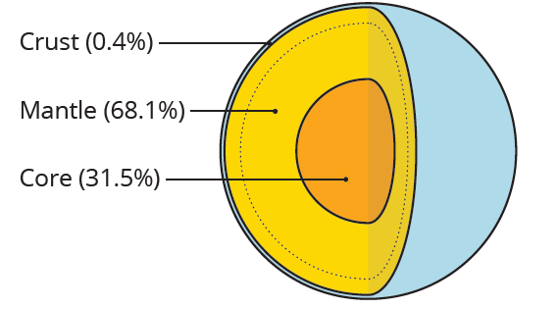

Example 5: Using Proportions and Percentages—Slide 1
Earth consists of three parts: crust, mantle and core. Earth’s core makes up $31.5\%$ of Earth's mass. The mantle makes up $68.1\%$ of its mass. Although 20 to 30 miles thick, the crust only makes up a small proportion of its mass—the remaining $0.4\%$. If the total mass of Earth is
what is the mass of Earth’s crust?
Figure 2

Slide 22

Example 5: Using Proportions and Percentages—Slide 2
Solution
We are given the fact that Earth has a total mass of
and its crust is $0.4\%$ of the overall mass.
We simply need to multiply the two quantities together to find the amount of mass that is crust. Because we are given the proportion of crust as a percentage, we need to first write it as a decimal before multiplying the two together.

Slide 23
Example 5: Using Proportions and Percentages—Slide 3
So the mass of Earth's crust is

Slide 24
Think Back 4—Slide 1
For very large or very small numbers, an alternative method to express decimals, called scientific notation, is often used. Scientific notation requires that we rewrite a number to be between 1 and 10 and then multiply the number by a power of 10 equal to the number of decimal places represented. So, 3,658,000,000,000,000 can be rewritten in scientific notation as
Small numbers less than 1
will have negative powers of 10. For example, 0.0000223 is written

Slide 25
Think Back 4—Slide 2
Numbers in scientific notation can be multiplied by multiplying the respective parts of the notation together and using the product rule for exponents.
For example, the two numbers above are multiplied together as follows.

Slide 26
Definition: Ratio
A ratio is a comparison of measured quantities whose units are of the same type. It is most often written with a colon between quantities; for example,

Slide 27
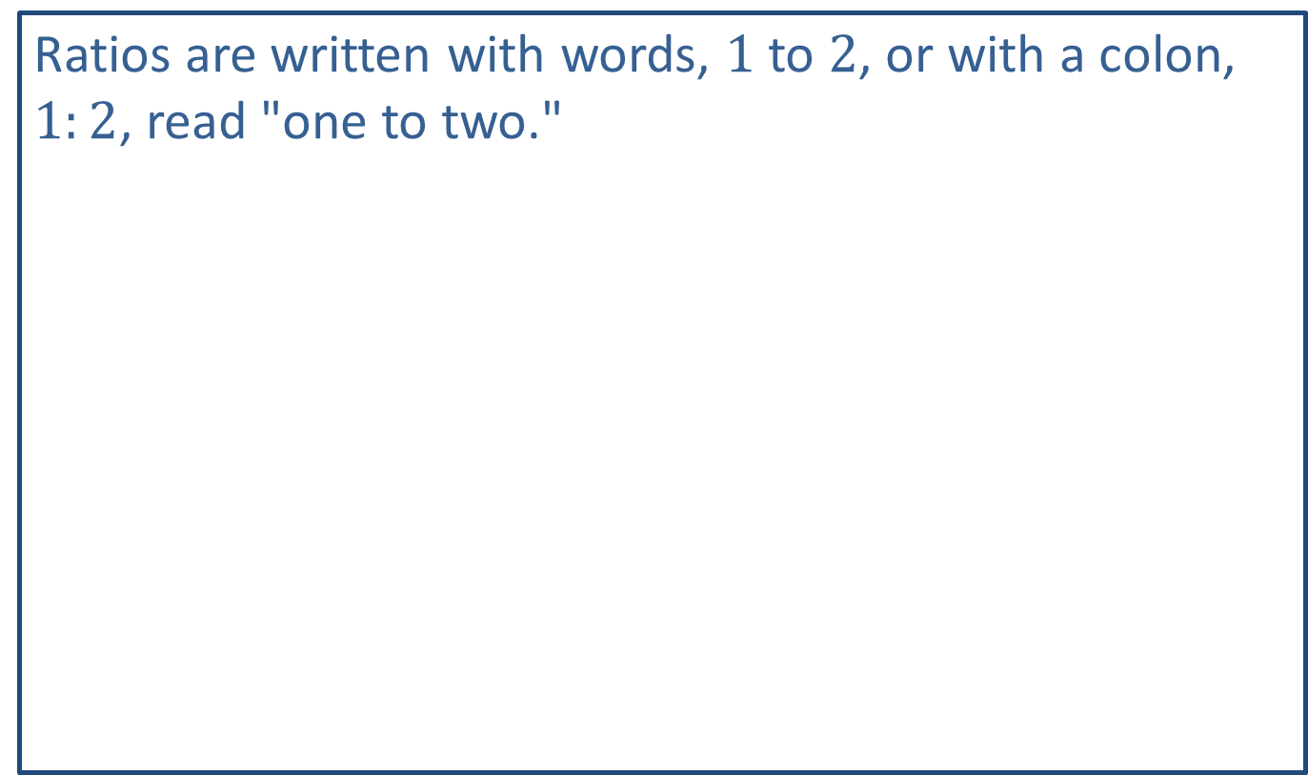
Helpful Hint
Ratios are written with words, 1 to 2, or with a colon, $1:2$, read "one to two."

Slide 28
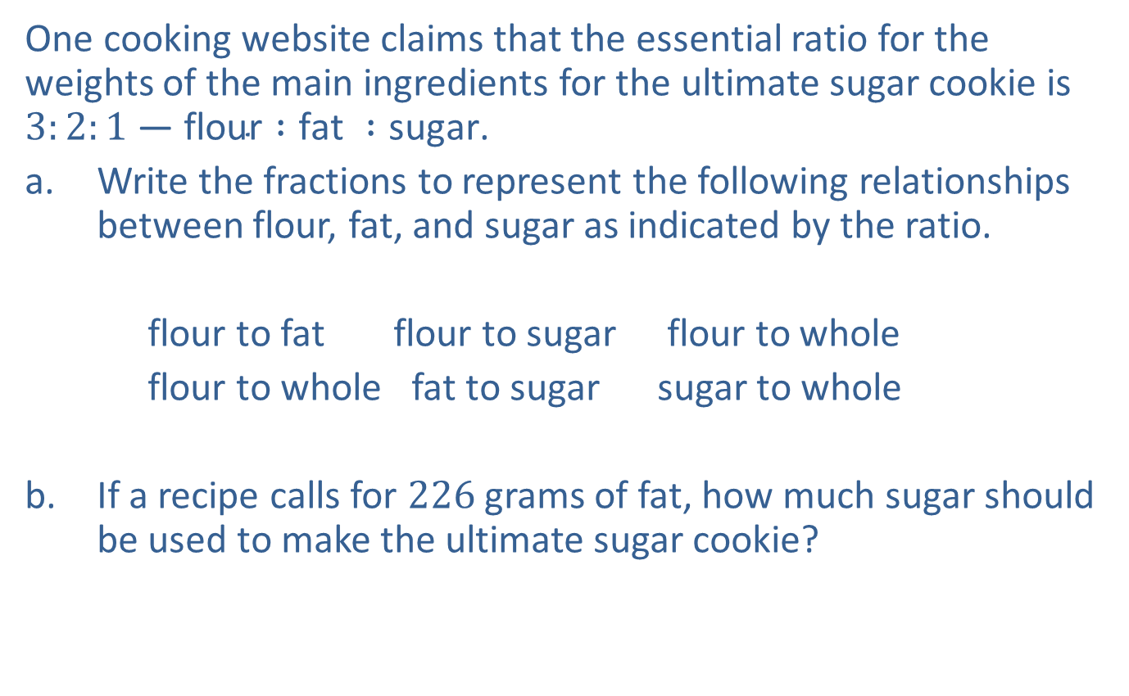
Example 6: Interpreting Ratios—Slide 1
One cooking website claims that the essential ratio for the weights of the main ingredients for the ultimate sugar cookie is $3:2:1$ — $\text{flour} :\text{fat} :\text{sugar}$.
a. ​Write the fractions to represent the following relationships between flour, fat, and sugar as indicated by the ratio.
flour to fat flour to sugar flour to whole
flour to whole fat to sugar sugar to whole
b. ​If a recipe calls for 226 grams of fat, how much sugar should be used to make the ultimate sugar cookie?
​

Slide 29

Example 6: Interpreting Ratios—Slide 2
Solution
a. First note that there are 6 parts in the whole. The fractions associated with the recipe ratio $3:2:1$ are as follows.
b. The fractions from part a. tell us that the fat to sugar ratio is 2 to 1, so there will be twice as much fat as sugar. If there are 226 grams of fat, we need 113 grams of sugar.

Slide 30
Example 7: Writing Ratios—Slide 1
On a university campus, the fall enrollment data shows that the new freshman class consists of 214 out-of-state residents and 321 in-state residents. Write the ratio of in-state residents to out-of-state residents and determine the number of students in the freshman class.

Slide 31
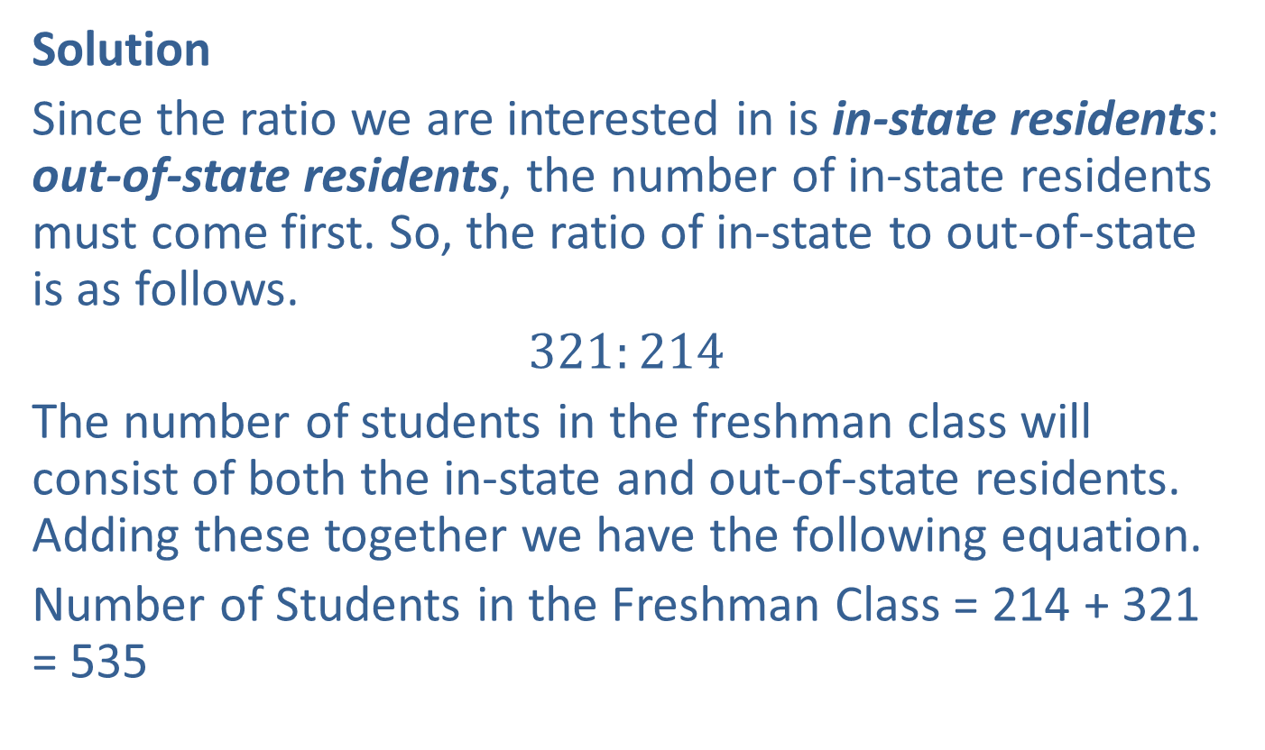
Example 7: Writing Ratios—Slide 2
Solution
Since the ratio we are interested in is in-state residents: out-of-state residents, the number of in-state residents must come first. So, the ratio of in-state to out-of-state is as follows.
$$321:214$$
The number of students in the freshman class will consist of both the in-state and out-of-state residents. Adding these together we have the following equation.
Number of Students in the Freshman Class = 214 + 321 = 535

Slide 32
Definition: Equivalent Ratios
Equivalent ratios are ratios that express the same relationship.

Slide 33
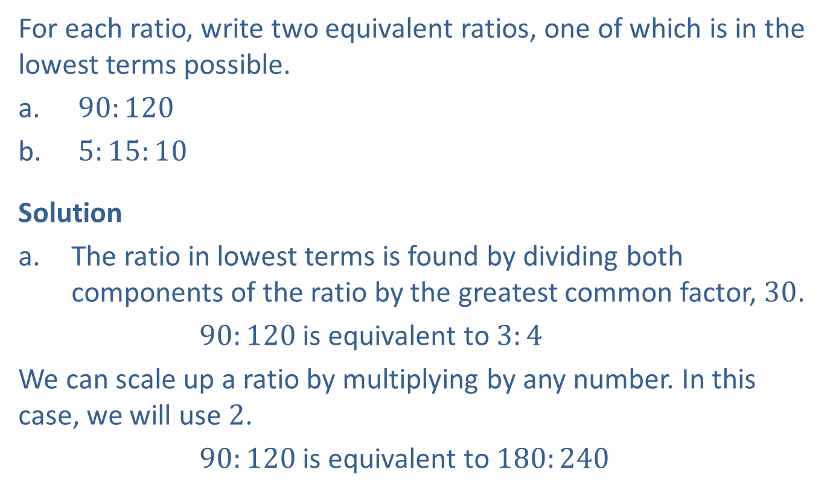
Example 8: Writing Equivalent Ratios—Slide 1
For each ratio, write two equivalent ratios, one of which is in the lowest terms possible.
a. $90:120$
b. $5:15:10$
Solution
a. The ratio in lowest terms is found by dividing both components of the ratio by the greatest common factor, 30.
$90:120$ is equivalent to $3:4$
​We can scale up a ratio by multiplying by any number. In this case, we will use 2.
​ $90:120$ is equivalent to $180:240$

Slide 34
Example 8: Writing Equivalent Ratios—Slide 2
b. ​The ratio in lowest terms is found by dividing all three components of the ratio by the greatest common factor, 5.
​
​We can scale up a ratio by multiplying by any number. In this case, we will use 3.

Slide 35

Skill Check 2
State law requires that a day care have a maximum class size of 30 children for every 2 providers. Write the ratio of children to providers in lowest terms.
Answer : $15:1$children to providers
​

Slide 36
Example 9: Finding Equivalent Ratios with Proportional Equations—Slide 1
The local elementary school is taking its first graders on a field trip to an aquarium. Aquarium guidelines state that a ratio of 3 adult chaperones for every 10 students must be maintained.
a. If 90 students plan to go to the aquarium, how many adult chaperones are needed?
b. If 143 people go on the field trip, how many of the attendees are adults?

Slide 37
Example 9: Finding Equivalent Ratios with Proportional Equations—Slide 2
Solution
Since the ratio of adults to children is
we know that each group of 13 attendees should consist of, on average, 3 adults and 10 children. This means that the fraction of adults to attendees is
and the fraction of children to attendees is
a. We've been asked to find the number of adults needed if 90 students attend. This ratio can be

Slide 38
Example 9: Finding Equivalent Ratios with Proportional Equations—Slide 3
We can use these ratios to set up the proportional equation
and then solve for x.
This gives the equivalent ratio of
which means that 27 adults would need to chaperone the field trip if 90 students attend.

Slide 39
Example 9: Finding Equivalent Ratios with Proportional Equations—Slide 4
b. Here we are asked to find the number of adults in a group of 143 attendees. We need to use the fractions that we derived from the ratio. This fraction can be described by
and is equivalent
We can use these fractions to set up the proportional
and then solve for x.

Slide 40
Example 9: Finding Equivalent Ratios with Proportional Equations—Slide 5
​This gives the equivalent fraction of
33 of the attendees are adults if the group consists of 143 people.

Slide 41
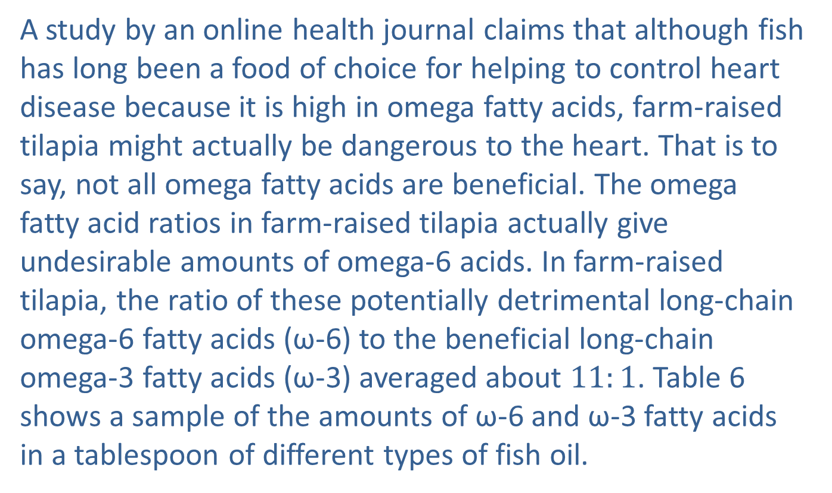
Example 10: Writing and Interpreting Ratios—Slide 1
A study by an online health journal claims that although fish has long been a food of choice for helping to control heart disease because it is high in omega fatty acids, farm-raised tilapia might actually be dangerous to the heart. That is to say, not all omega fatty acids are beneficial. The omega fatty acid ratios in farm-raised tilapia actually give undesirable amounts of omega-6 acids. In farm-raised tilapia, the ratio of these potentially detrimental long-chain omega‑6 fatty acids (ω-6) to the beneficial long-chain omega-3 fatty acids (ω-3) averaged about $11:1$. Table 6 shows a sample of the amounts of ω-6 and ω-3 fatty acids in a tablespoon of different types of fish oil.

Slide 42
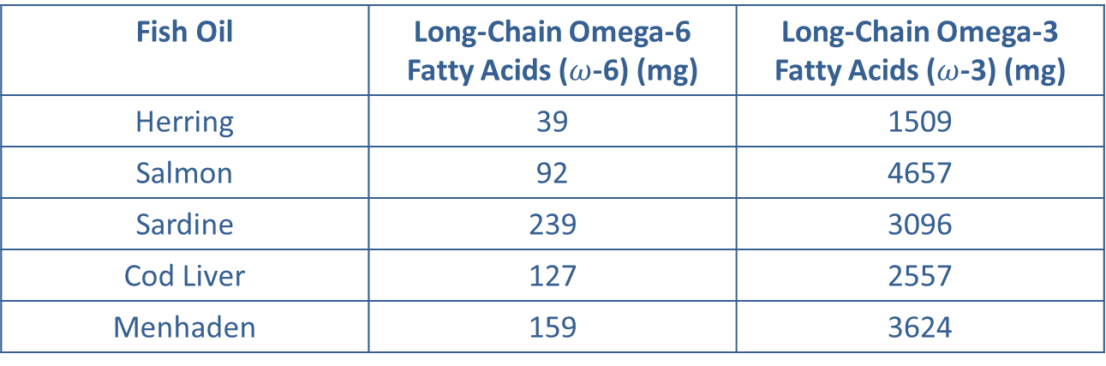
Example 10: Writing and Interpreting Ratios—Slide 2
Table 6: Omega Fatty Acids in a Tablespoon of Various Fish Oils
Fish Oil | Long-Chain Omega-6 Fatty Acids ($ω$-6) (mg) | Long-Chain Omega-3 Fatty Acids ($ω$-3) (mg)
Herring | 39 | 1509
Salmon | 92 | 4657
Sardine | 239 | 3096
Cod Liver | 127 | 2557
Menhaden | 159 | 3624
Source: FoodData Central, U.S. Department of Agriculture, accessed February 16, 2021, https://fdc.nal.usda.gov/index.html.
a. Write a ratio for each fish oil so that it can be compared to the given ratio for farm‑raised tilapia.
b. Write an equivalent ratio for the fatty acids in each fish oil so that you can more easily compare it to the tilapia. Round to the nearest ten-thousandth, if necessary. Explain how the ratios of fatty acids in the fish oil compare to that of the tilapia.

Slide 43
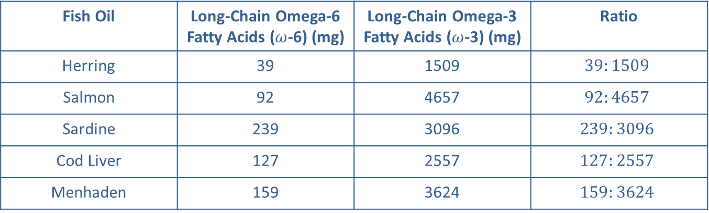

Example 10: Writing and Interpreting Ratios—Slide 3
Solution
a. In the information given, we were told that the ratio $11:1$ for farm-raised tilapia was the ratio of ω-6 to ω-3. So, for comparison we need to list the ω-6 fatty acids first in each of the new ratios. For each ratio, write the numbers in the order they appear in the table, since the ω-6 values are listed first.
​
Table 7: Ratio of ω-6 to ω-3 in Various Fish Oils
Fish Oil | Long-Chain Omega-6 Fatty Acids ($ω$-6) (mg) | Long-Chain Omega-3 Fatty Acids ($ω$-3) (mg) | Ratio
Herring | 39 | 1509 | $$39:1509$$
Salmon | 92 | 4657 | $$92:4657$$
Sardine | 239 | 3096 | $$239:3096$$
Cod Liver | 127 | 2557 | $$127:2557$$
Menhaden | 159 | 3624 | $$159:3624$$

Slide 44
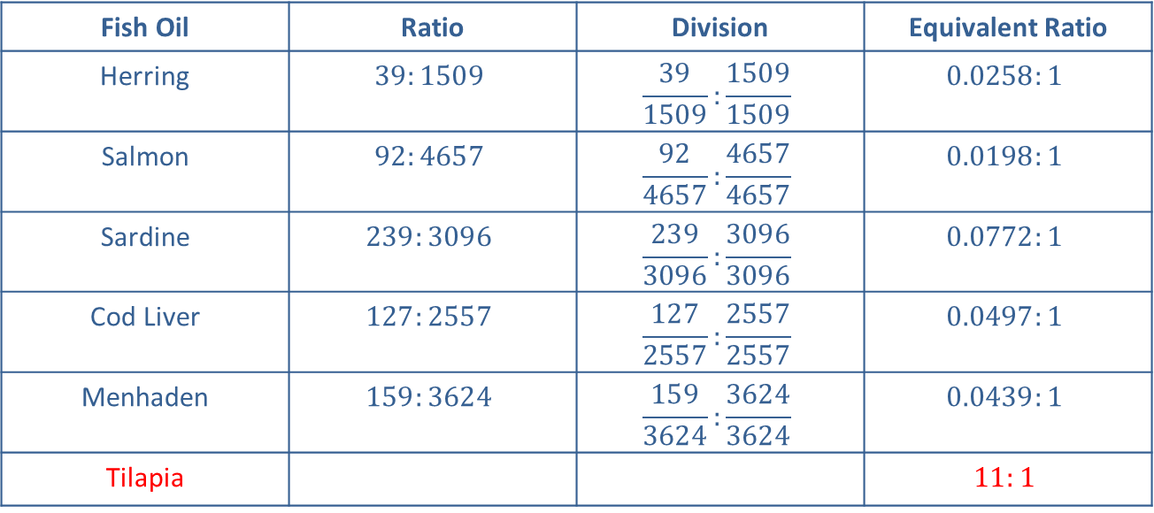
Example 10: Writing and Interpreting Ratios—Slide 4
b. ​In order to compare the ratios of fatty acids, we can create equivalent ratios so that they all have a common form. Since the farm-raised tilapia has a 1 on the right side of the ratio, we'll divide each ratio by the right-hand number so that it also will have a 1.
Table 8: Ratio of ω-6 to ω-3 in Various Fish Oils
Fish Oil | Ratio | Division | Equivalent Ratio
Herring | $$39:1509$$ | $$\frac{39}{1509}:\frac{1509}{1509}$$ | $$0.0258:1$$
Salmon | $$92:4657$$ | $$\frac{92}{4657}:\frac{4657}{4657}$$ | $$0.0198:1$$
Sardine | $$239:3096$$ | $$\frac{239}{3096}:\frac{3096}{3096}$$ | $$0.0772:1$$
Cod Liver | $$127:2557$$ | $$\frac{127}{2557}:\frac{2557}{2557}$$ | $$0.0497:1$$
Menhaden | $$159:3624$$ | $$\frac{159}{3624}:\frac{3624}{3624}$$ | $$0.0439:1$$
Tilapia |  |  | $$11:1$$

Slide 45
Example 10: Writing and Interpreting Ratios—Slide 5
Now that all the ratios are in a common form, we can see that the other fish have much lower ratios of omega-6 fatty acid (ω-6) to omega-3 fatty acid (ω -6) than tilapia. The closest ratio is that of sardines, and it has more than a hundredfold difference!

Slide 46
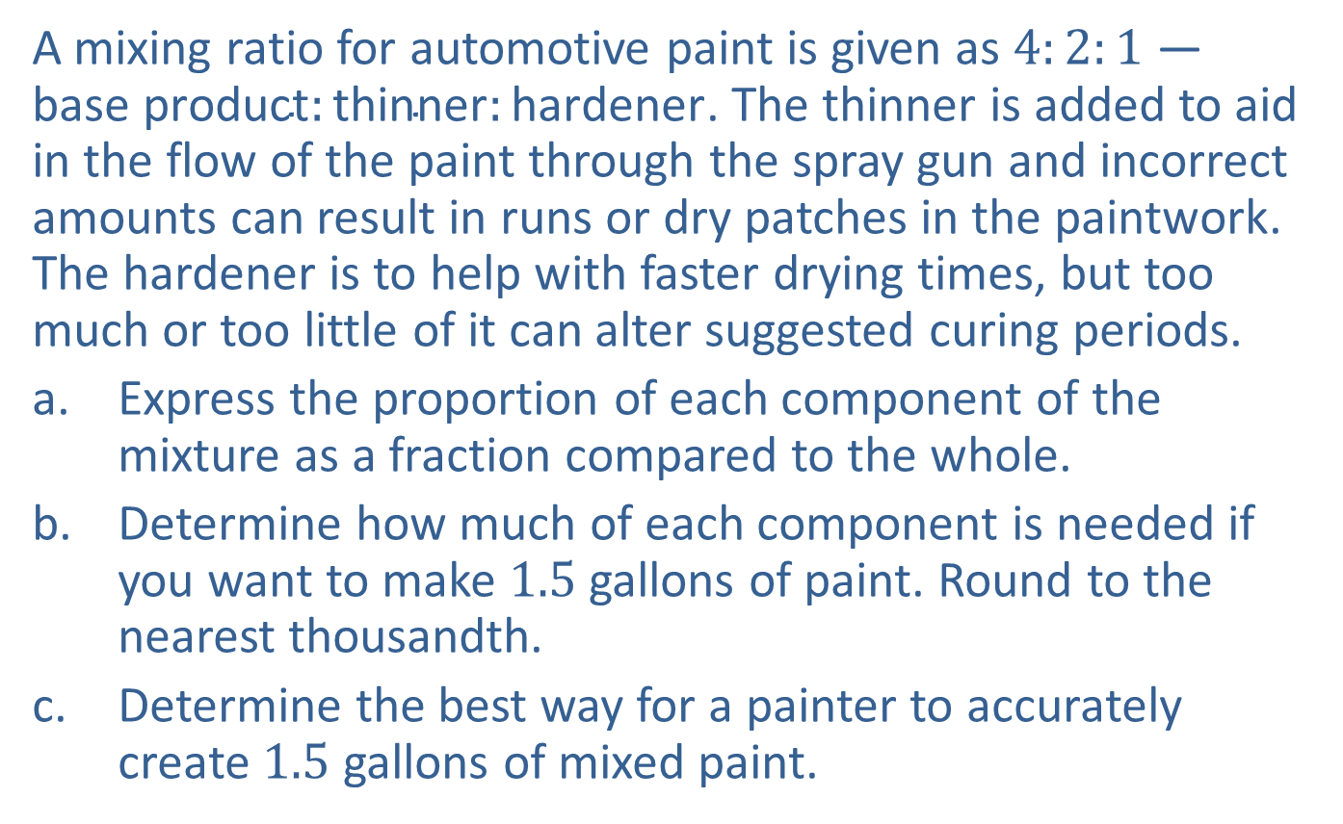
Example 11: Using Proportions to Express a Ratio—Slide 1
A mixing ratio for automotive paint is given as $4:2:1$ — $\text{base} \text{product}:\text{thinner}:\text{hardener}$. The thinner is added to aid in the flow of the paint through the spray gun and incorrect amounts can result in runs or dry patches in the paintwork. The hardener is to help with faster drying times, but too much or too little of it can alter suggested curing periods.
a. Express the proportion of each component of the mixture as a fraction compared to the whole.
b. Determine how much of each component is needed if you want to make 1.5 gallons of paint. Round to the nearest thousandth.
c. Determine the best way for a painter to accurately create 1.5 gallons of mixed paint.

Slide 47
Example 11: Using Proportions to Express a Ratio—Slide 2
Solution
a. The proportion of each component will be a fraction of the total amount of product. First, notice that there are seven equal parts in this ratio:
4 base product + 2 thinner + 1 hardener = 7 total.
Therefore, the proportions are as follows.

Slide 48
Example 11: Using Proportions to Express a Ratio—Slide 3
b. Altogether, we want to have 1.5 gallons of paint, so we need to know how much of each component we should mix in. In order to determine the amount of each component needed for 1.5 gallons of paint, we multiply each proportion by the total amount of paint needed.

Slide 49
Example 11: Using Proportions to Express a Ratio—Slide 4
c. ​Let's take a moment to notice that the decimal amounts found in part b. of each component required for 1.5 gallons of paint will need to be measured with great precision to ensure that there are no problems painting the car. In reality, that would be very difficult to achieve. To avoid this situation, a painter could choose to mix the paint using the ratios rather than the estimated decimals so that measuring is easier. ​
If we start with 1 gallon of base product, we know that the amount of thinner will need to be half of that, or 0.5 gallons, and the amount of hardener will be half of the thinner amount, or 0.25 gallons. Take a moment and verify that these amounts are still in the correct ratio given originally. Using this method, the painter will end up with 1.75 gallons of paint that is accurately mixed, from which it's easy to measure out the 1.5 gallons needed.

Slide 50

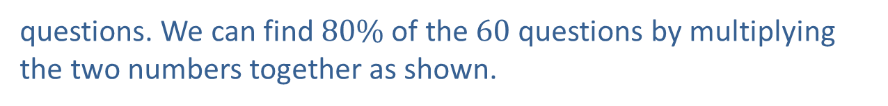
Example 12: Finding Proportions and Ratios—Slide 1
Suppose you earned a B on your last History 102 test by getting $80\%$ of the questions correct.
a. ​If there were 60 equally weighted questions on the test, how many did you answer correctly?
b. ​What was your ratio of correct to incorrect answers on the test?
Solution
a. We know that you correctly answered
questions. We can find $80\%$ of the 60 questions by multiplying the two numbers together as shown.
Therefore, you correctly answered 48 questions on the test.

Slide 51
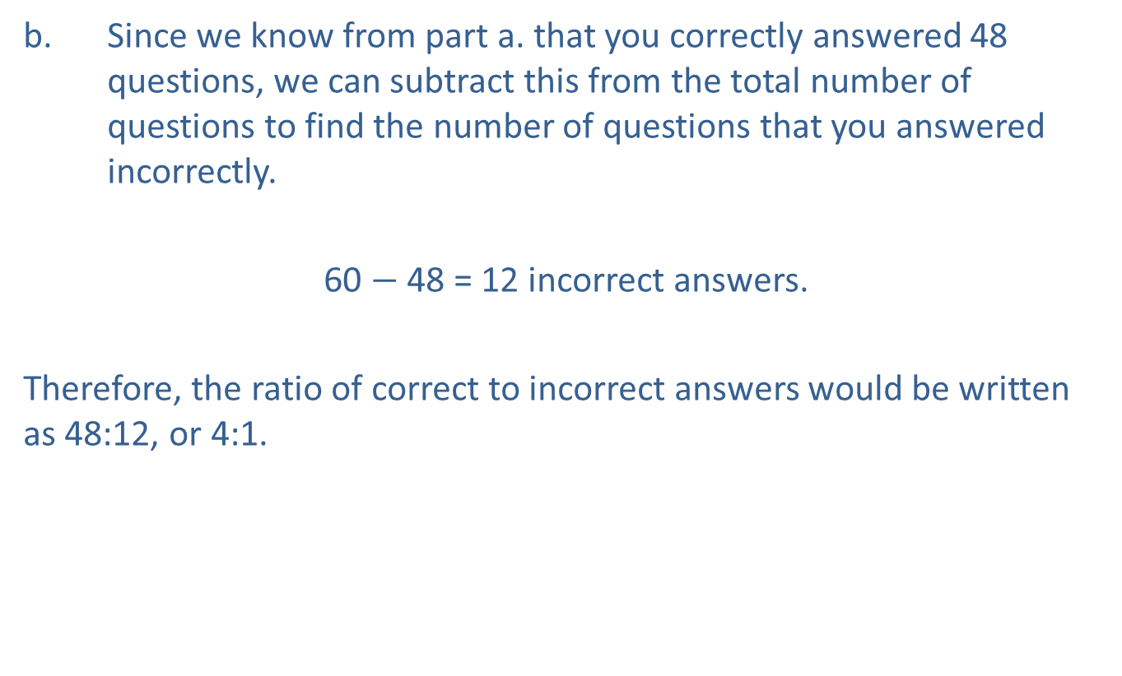
Example 12: Finding Proportions and Ratios—Slide 2
b. Since we know from part a. that you correctly answered 48 questions, we can subtract this from the total number of questions to find the number of questions that you answered incorrectly.
60 $−$ 48 = 12 incorrect answers.
​
Therefore, the ratio of correct to incorrect answers would be written as 48:12, or 4:1.

