Slide 1
Section 4.2
Using Percentages

Slide 2
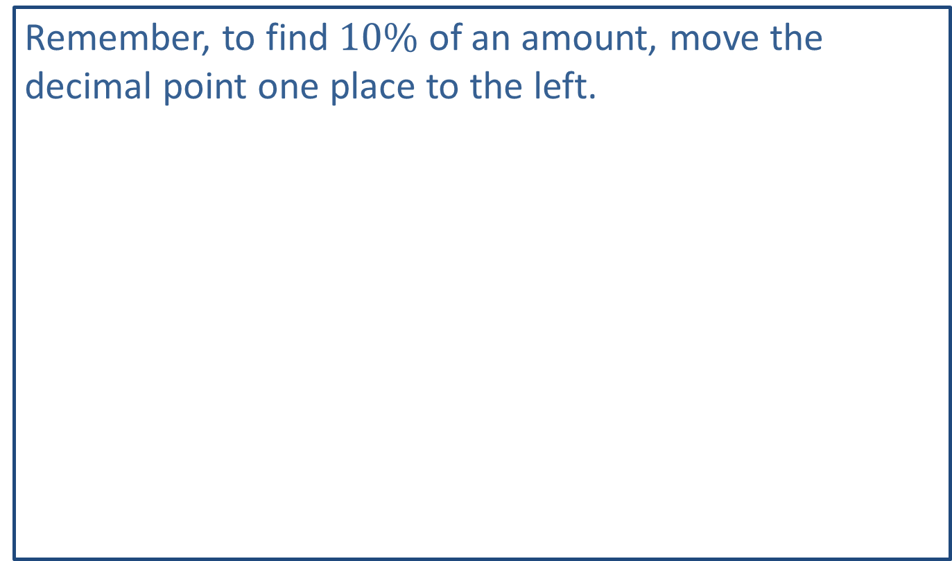
Think Back 1
Remember, to find $10\%$ of an amount, move the decimal point one place to the left.

Slide 3
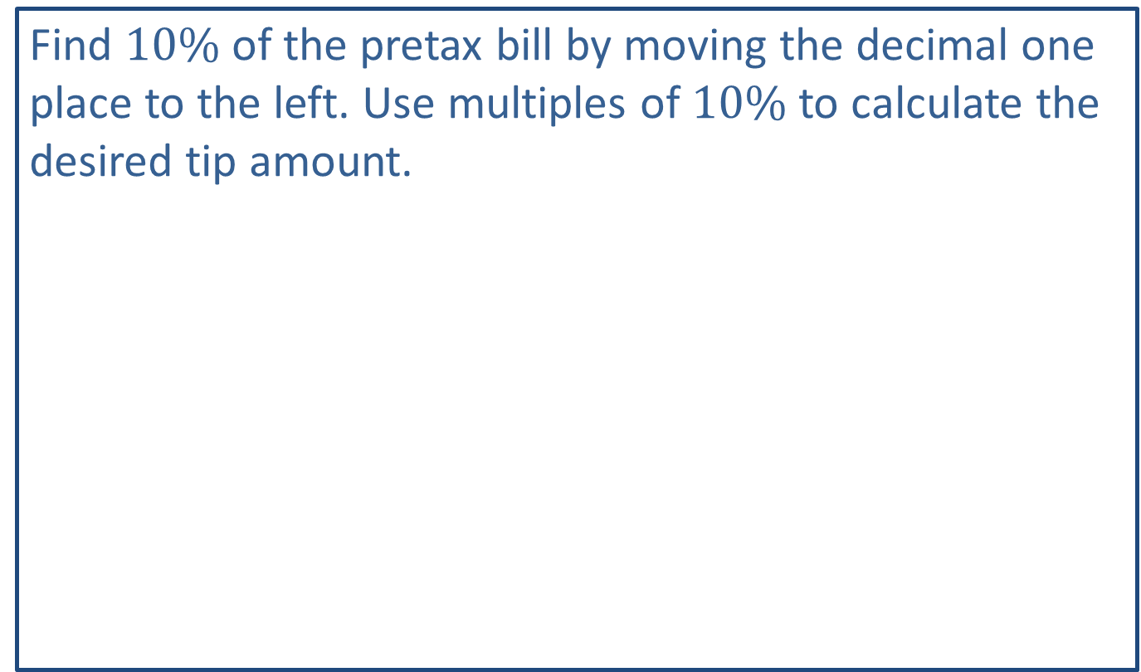
Helpful Hint 1
Find $10\%$ of the pretax bill by moving the decimal one place to the left. Use multiples of $10\%$ to calculate the desired tip amount.

Slide 4
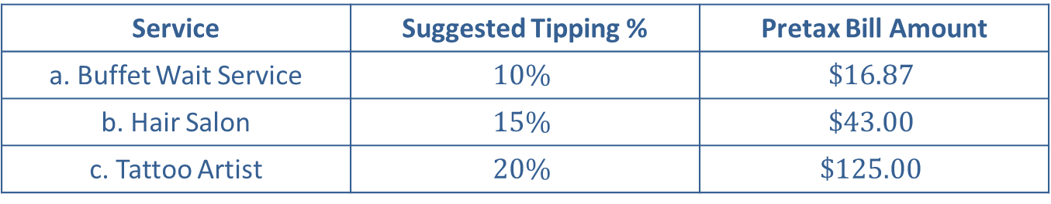
Example 1: Finding Tip Amounts—Slide 1
The following are suggested tipping percentages from the "Worldwide Tipping Guide." Find each suggested tip amount based on the pretax bill total without using a calculator.
Table 1: Suggested Tipping Percentages
Service | Suggested Tipping % | Pretax Bill Amount
a. Buffet Wait Service | $$10\%$$ | $$\$16.87$$
b. Hair Salon | $$15\%$$ | $$\$43.00$$
c. Tattoo Artist | $$20\%$$ | $$\$125.00$$

Slide 5
Example 1: Finding Tip Amounts—Slide 2
Solution
a. Buffet Wait Service
​to find a 10% tip on the service, simply move the decimal one place to the left.
10% of $16.87 = $1.687 ≈ $1.69.
b. Hair Salon
​To find a 15% tip on the service, begin by finding 10% in the same way as in part a.
10% of $43.00 = $4.300 = $4.30
​

Slide 6
Example 1: Finding Tip Amounts—Slide 3
​Then add on half of the 10%.
15% of $43.00 = $4.30 + $2.15 = $6.45.
c. Tattoo Artist
​To find 20% tip on the service, begin by finding 10%, and then double it.
10% of $125.00 = $12.50.
20% of $125.00 = $12.50 ⋅ 2 = $25.00 ​

Slide 7
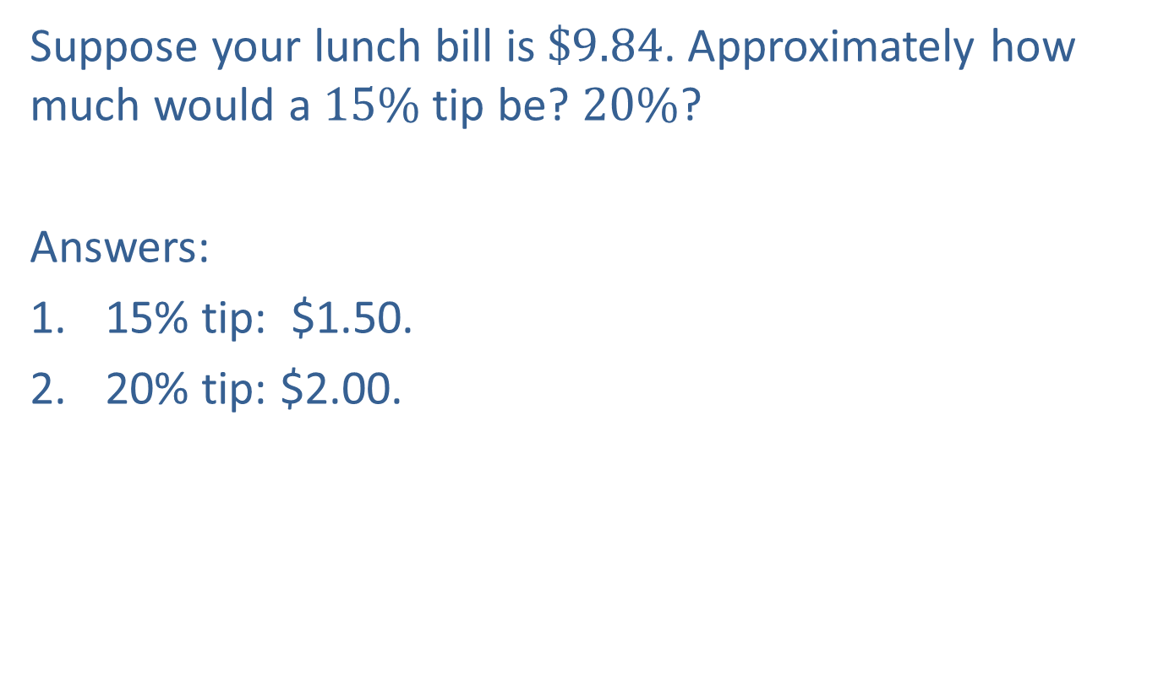
Skill Check 1
Suppose your lunch bill is $\$9.84$. Approximately how much would a $15\%$ tip be? $20\%$?
Answers:
1. ​15% tip: $1.50.
2. 20% tip: $2.00.

Slide 8
Definition: List Price, Discount, and Sale Price
List Price
The price of an item as it is listed for public sale is the list price.
Discount
A discount is a reduction made from the list price. This is often given as a percentage of the list price.
Sale Price
The sale price, also called the net price, is the actual cost of an item after any discounts are subtracted.
Sale Price = List Price − Discount

Slide 9
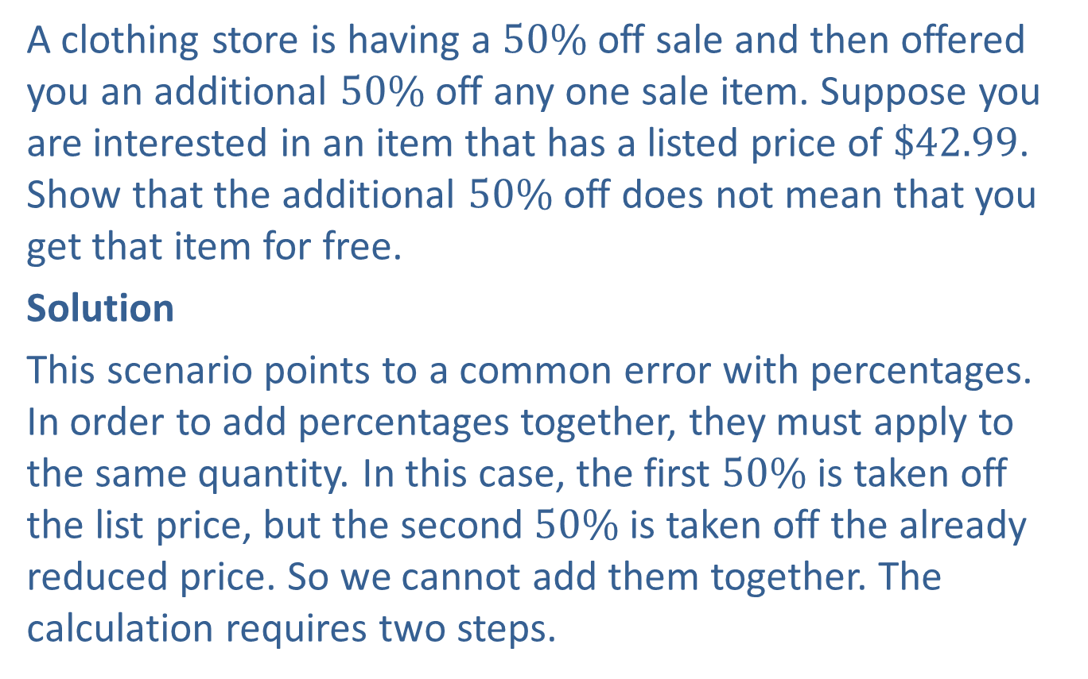
Example 2: Calculating Sale Price—Slide 1
A clothing store is having a $50\%$ off sale and then offered you an additional $50\%$ off any one sale item. Suppose you are interested in an item that has a listed price of $\$42.99$. Show that the additional $50\%$ off does not mean that you get that item for free.
Solution
This scenario points to a common error with percentages. In order to add percentages together, they must apply to the same quantity. In this case, the first $50\%$ is taken off the list price, but the second $50\%$ is taken off the already reduced price. So we cannot add them together. The calculation requires two steps.

Slide 10
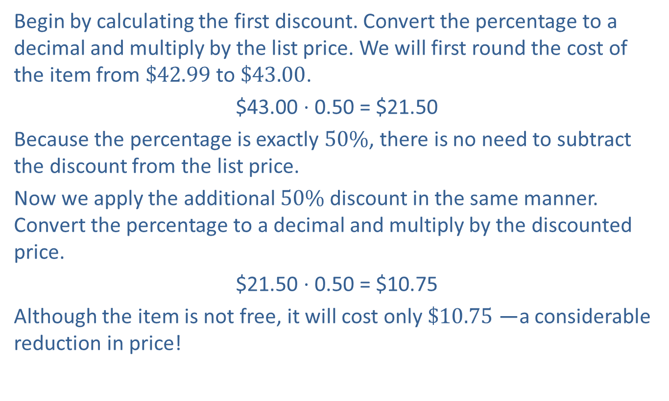
Example 2: Calculating Sale Price—Slide 2
Begin by calculating the first discount. Convert the percentage to a decimal and multiply by the list price. We will first round the cost of the item from $\$42.99$ to $\$43.00$.
$43.00 ⋅ 0.50 = $21.50
Because the percentage is exactly $50\%$, there is no need to subtract the discount from the list price.
Now we apply the additional $50\%$ discount in the same manner. Convert the percentage to a decimal and multiply by the discounted price.
$21.50 ⋅ 0.50 = $10.75
Although the item is not free, it will cost only $\$10.75$ —a considerable reduction in price!

Slide 11
Skill Check 2
Find the sale price of a new sweater that is 40% off the list price of $88.00.
Answer: $52.80

Slide 12
Definition: Sales Tax
A charge collected by the government for the sale of goods is called a sales tax.
Sales Tax = (Selling Price) ⋅ (Sales Tax Percentage as a Decimal)

Slide 13
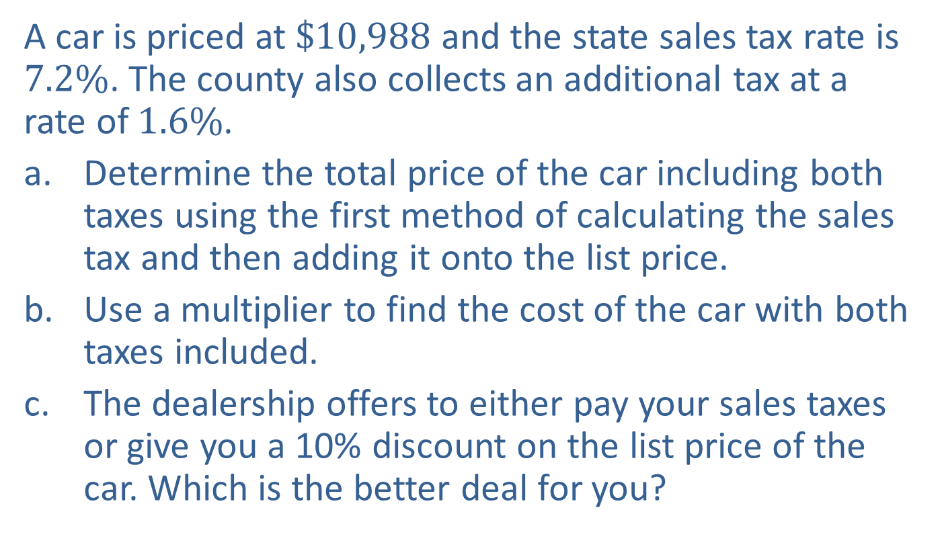
Example 3: Calculating Cost with Sales Tax—Slide 1
A car is priced at $\$10,988$ and the state sales tax rate is $7.2\%$. The county also collects an additional tax at a rate of $1.6\%$.
a. Determine the total price of the car including both taxes using the first method of calculating the sales tax and then adding it onto the list price.
b. Use a multiplier to find the cost of the car with both taxes included.
c. The dealership offers to either pay your sales taxes or give you a 10% discount on the list price of the car. Which is the better deal for you?

Slide 14
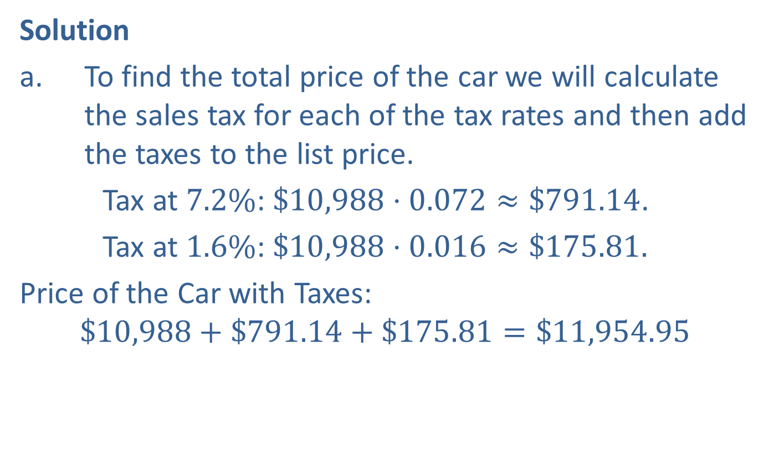
Example 3: Calculating Cost with Sales Tax—Slide 2
Solution
a. To find the total price of the car we will calculate the sales tax for each of the tax rates and then add the taxes to the list price.
​Tax at $7.2\%$: $\$10,988⋅0.072≈\$791.14$.
​ Tax at $1.6\%$: $\$10,988⋅0.016≈\$175.81.$
​Price of the Car with Taxes:
$$\$10,988+\$791.14+\$175.81=\$11,954.95$$

Slide 15


Example 3: Calculating Cost with Sales Tax—Slide 3
b. Because both tax percentages are being applied to the same quantity (i.e., the list price of the car), we can find the multiplier by adding both of the sales tax percentages to $100\%$ and then converting to a decimal.
Our multiplier is 1.088.
​Multiplying by the list price determines the total cost including both sales taxes.
Price of the Car with Taxes:
$$\$10,988⋅\$1.088≈\$11,954.94$$

Slide 16

Example 3: Calculating Cost with Sales Tax—Slide 4
​First, if the dealership pays the taxes owed on the car, you end up buying the car for the list price only, which is $\$10,988$.
​ The second option is a $10\%$ discount. We will calculate the
discounted price by using a multiplier, which is
Discounted Price: $10,988 ⋅ 0.90 = $9,889.20
We now need to calculate the cost with taxes on this discounted price using the multiplier we calculated in part b.
Discounted price with Taxes: $9,889.20 ⋅ 1.088 ≈ $10,759.45
Therefore, the $10\%$ discount is the better deal for the car.

Slide 17
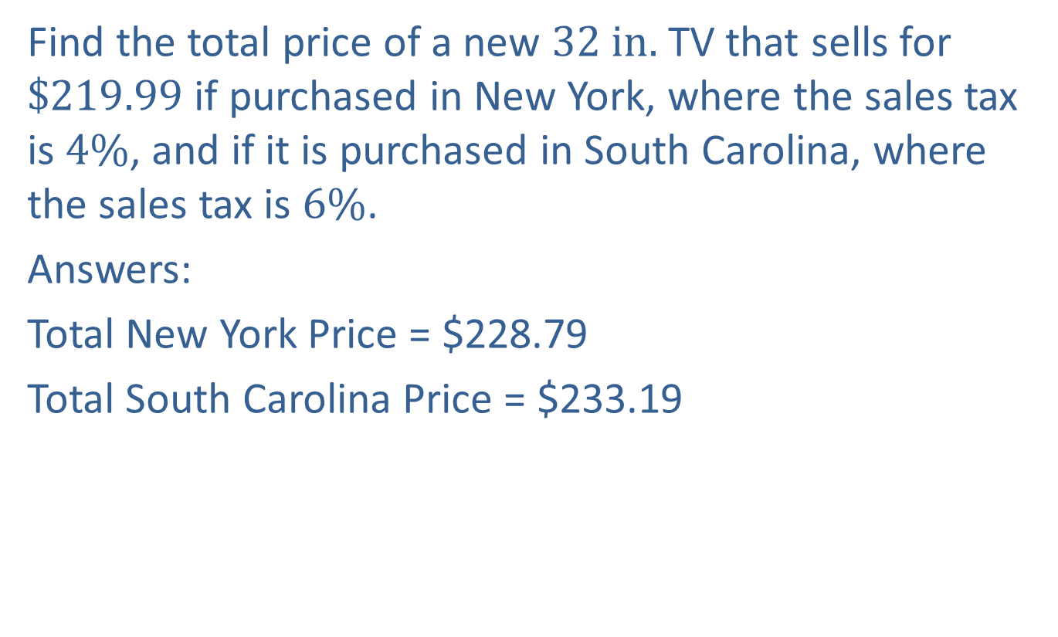
Skill Check 3
Find the total price of a new $32 in.$TV that sells for $\$219.99$ if purchased in New York, where the sales tax is $4\%$, and if it is purchased in South Carolina, where the sales tax is $6\%$.
Answers:
Total New York Price = $228.79
Total South Carolina Price = $233.19

Slide 18
Definition: Absolute Change and Percentage Change
Absolute Change
The absolute change between two amounts is the absolute value of the difference between the two numbers.
Percentage Change
The percentage change between two amounts is the absolute change expressed as a percentage of the original value.

Slide 19
Think Back 2
The absolute value of any number is the distance that number lies from zero without regard to sign. For example, the absolute value of 8 is 8, and the absolute value of −8 is also 8. To indicate absolute value symbolically, we use a vertical bar on both sides of the number; that is,

Slide 20
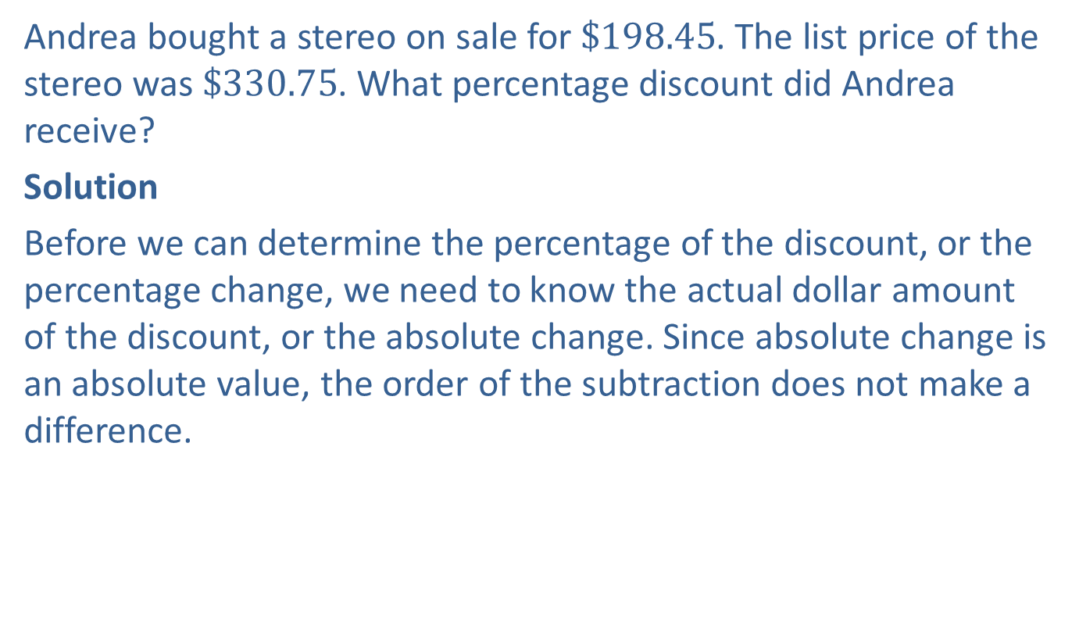
Example 4: Determining a Discount—Slide 1
Andrea bought a stereo on sale for $\$198.45$. The list price of the stereo was $\$330.75$. What percentage discount did Andrea receive?
Solution
Before we can determine the percentage of the discount, or the percentage change, we need to know the actual dollar amount of the discount, or the absolute change. Since absolute change is an absolute value, the order of the subtraction does not make a difference.

Slide 21
Example 4: Determining a Discount—Slide 2
To determine what percentage change this is, divide the absolute change (or discount amount) by the list price, or original amount, as follows.
So the list price of the stereo was discounted by $40\%$.

Slide 22

Skill Check 4
Max bought a computer on sale for $\$432$. The list price of the computer was $\$1200$. What percentage discount did Max receive?
Answer: 64%

Slide 23
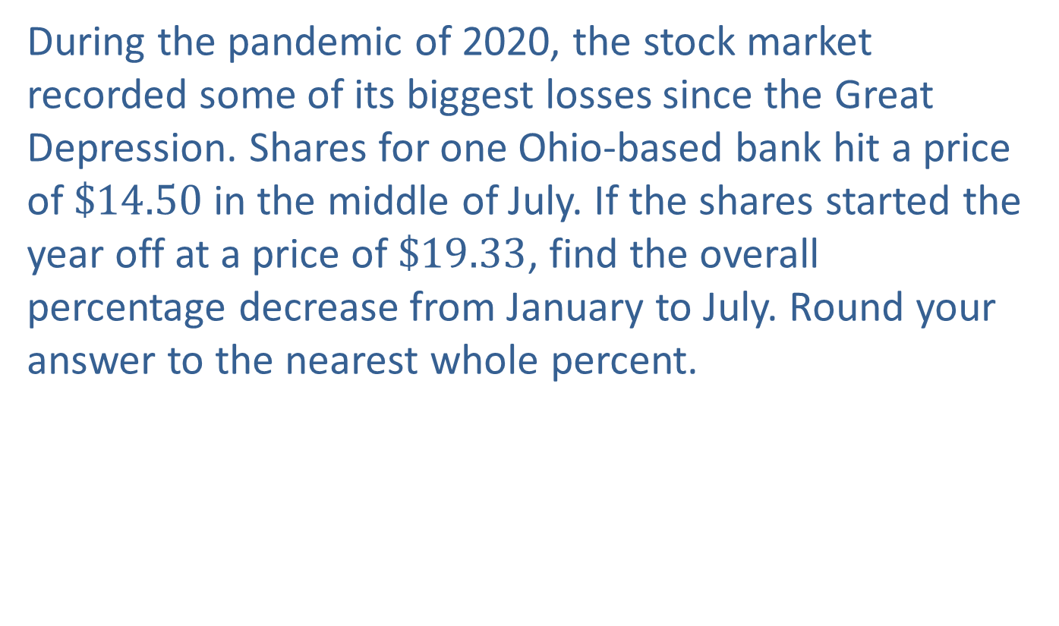
Example 5: Computing Percentage Decrease—Slide 1
During the pandemic of 2020, the stock market recorded some of its biggest losses since the Great Depression. Shares for one Ohio-based bank hit a price of $\$14.50$ in the middle of July. If the shares started the year off at a price of $\$19.33$, find the overall percentage decrease from January to July. Round your answer to the nearest whole percent.

Slide 24
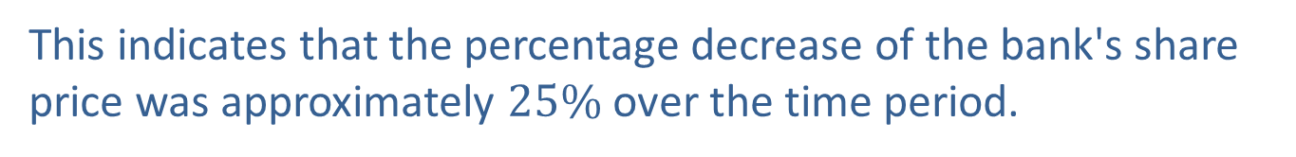
Example 5: Computing Percentage Decrease—Slide 2
Solution
Just as in the previous example, to find the percentage decrease, or percentage change, we must calculate the absolute change and then divide that by the original amount. We can write this as one step instead of two as follows.
This indicates that the percentage decrease of the bank's share price was approximately $25\%$ over the time period.

Slide 25
Example 6: Finding Percentage Change—Slide 1
A student group is trying to increase its monthly attendance.
a. ​If after a big recruiting push, the meeting attendance increased from 25 to 38 people, what was the percentage change in attendance?
b. During the third meeting, only 31 people attended. What was the percentage change from the second meeting to the third? Round your answer to the nearest whole percent.
c. ​For advertising purposes, the organization decides to promote the overall increase in attendance for the two-month span since it has increased from the original number of attendees. Calculate the percentage change from Meeting 1 to Meeting 3.

Slide 26
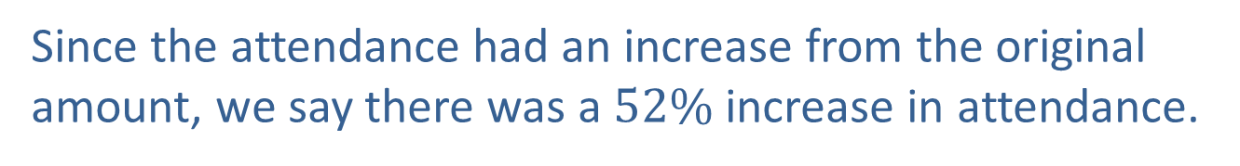
Example 6: Finding Percentage Change—Slide 2
Solution
a. To find the percentage change, we need to know the absolute change in attendance between the first meeting and the second meeting. Use subtraction to find this value.
more people came to the
second meeting
Next, substitute the appropriate values into the equation to find the percentage change.
Since the attendance had an increase from the original amount, we say there was a $52\%$ increase in attendance.

Slide 27
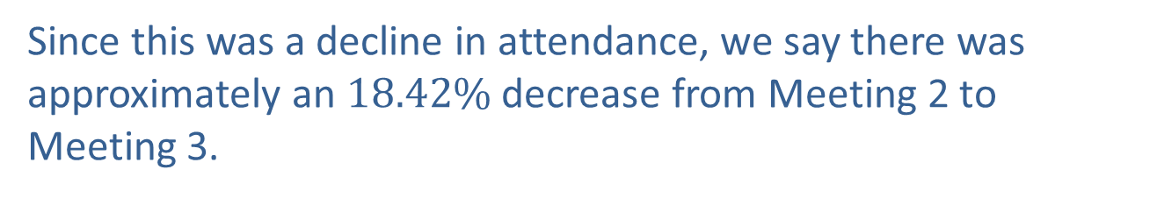
Example 6: Finding Percentage Change—Slide 3
b. Now, if at the next meeting only 31 people attend, what is the percentage change from Meeting 2 to Meeting 3?
​This time, the absolute change in attendance is as follows.
​Substituting this into our formula, we calculate the percentage change as follows.
Since this was a decline in attendance, we say there was approximately an $18.42\%$ decrease from Meeting 2 to Meeting 3.

Slide 28
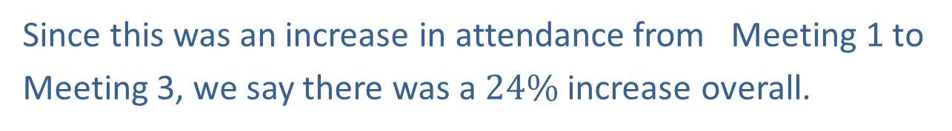
Example 6: Finding Percentage Change—Slide 4
c. Recall that, in Meeting 1, there were 25 people in attendance and in Meeting 3, there were 31 people. We need to subtract these numbers to find the absolute change in attendance.
So our percentage change is as follows.
Since this was an increase in attendance from Meeting 1 to
Meeting 3, we say there was a $24\%$ increase overall.

Slide 29
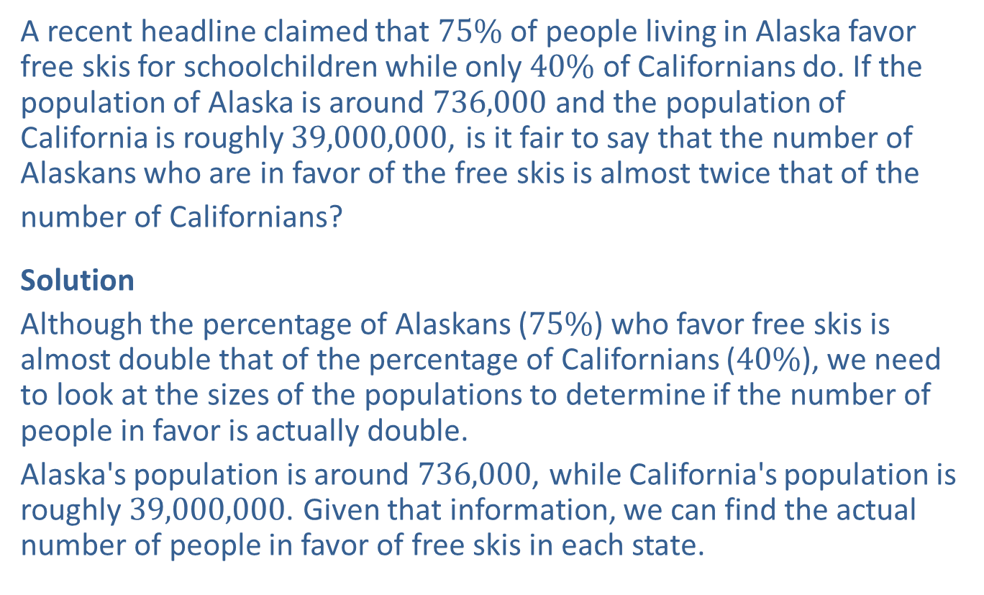
Example 7: Avoiding Percentage Misuse—Different-Sized Populations—Slide 1
A recent headline claimed that $75\%$ of people living in Alaska favor free skis for schoolchildren while only $40\%$ of Californians do. If the population of Alaska is around 736,000 and the population of California is roughly 39,000,000, is it fair to say that the number of Alaskans who are in favor of the free skis is almost twice that of the
number of Californians?
Solution
Although the percentage of Alaskans ($75\%$) who favor free skis is almost double that of the percentage of Californians ($40\%$), we need to look at the sizes of the populations to determine if the number of people in favor is actually double.
Alaska's population is around 736,000, while California's population is roughly 39,000,000. Given that information, we can find the actual number of people in favor of free skis in each state.

Slide 30
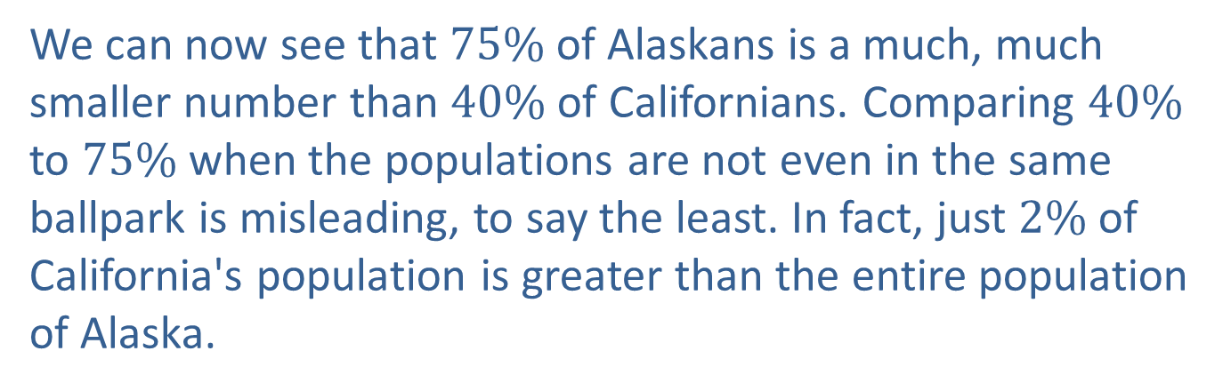
Example 7: Avoiding Percentage Misuse—Different-Sized Populations—Slide 2
We can now see that $75\%$ of Alaskans is a much, much smaller number than $40\%$ of Californians. Comparing $40\%$ to $75\%$ when the populations are not even in the same ballpark is misleading, to say the least. In fact, just $2\%$ of California's population is greater than the entire population of Alaska.

Slide 31
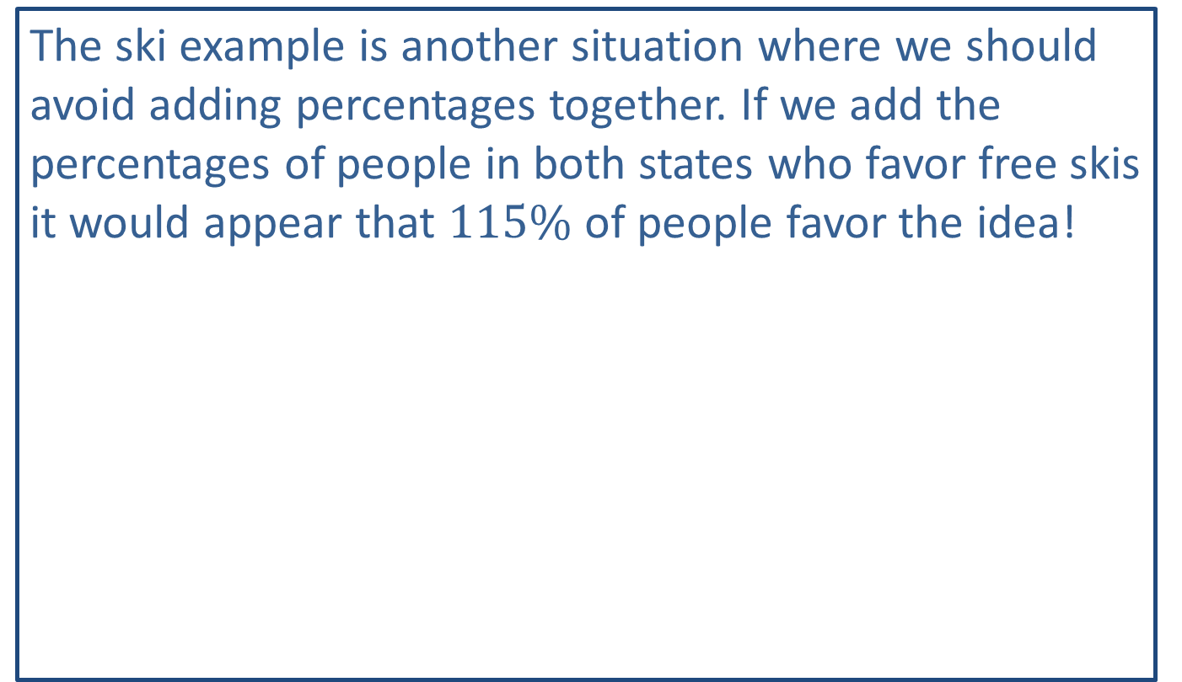
Helpful Hint 2
The ski example is another situation where we should avoid adding percentages together. If we add the percentages of people in both states who favor free skis it would appear that $115\%$ of people favor the idea!

Slide 32
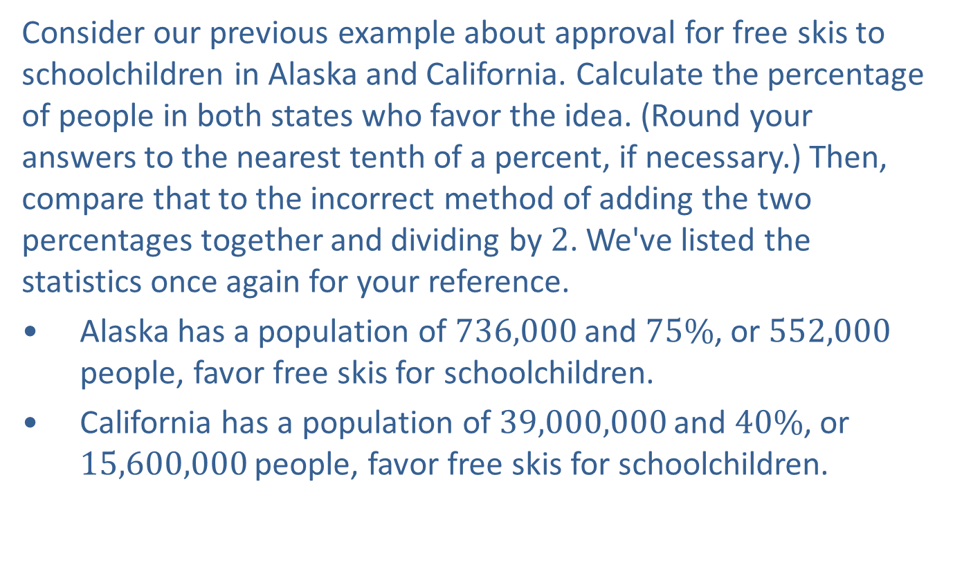
Example 8: Avoiding Percentage Misuse—Averaging Percentages—Slide 1
Consider our previous example about approval for free skis to schoolchildren in Alaska and California. Calculate the percentage of people in both states who favor the idea. (Round your answers to the nearest tenth of a percent, if necessary.) Then, compare that to the incorrect method of adding the two percentages together and dividing by 2. We've listed the statistics once again for your reference.
Alaska has a population of 736,000 and $75\%$, or 552,000 people, favor free skis for schoolchildren.
​California has a population of 39,000,000 and $40\%$, or 15,600,000 people, favor free skis for schoolchildren.

Slide 33
Example 8: Avoiding Percentage Misuse—Averaging Percentages—Slide 2
Solution
To calculate the percentage of people who are in favor of the idea from both states, add the number of votes in favor in the numerator and add the total populations in the denominator.
Correct Method to Determine Percentage of Votes in Favor:
The combined percentage of people in both states in favor of free skis is calculated as shown.

Slide 34
Example 8: Avoiding Percentage Misuse—Averaging Percentages—Slide 3
The following is an incorrect method to find the average of the percentages.
Because the sizes of the populations are not the same, we cannot simply average the two percentages as shown.

Slide 35
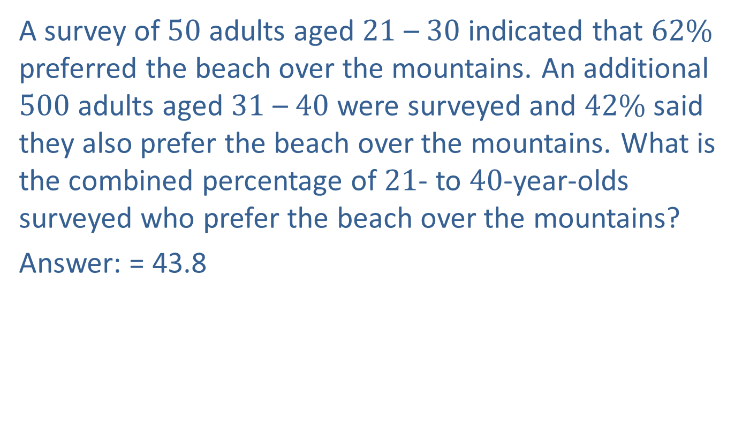
Skill Check 5
A survey of 50 adults aged 21 – 30 indicated that $62\%$ preferred the beach over the mountains. An additional 500 adults aged 31 – 40 were surveyed and $42\%$ said they also prefer the beach over the mountains. What is the combined percentage of 21- to 40-year-olds surveyed who prefer the beach over the mountains?
Answer: = 43.8

Slide 36
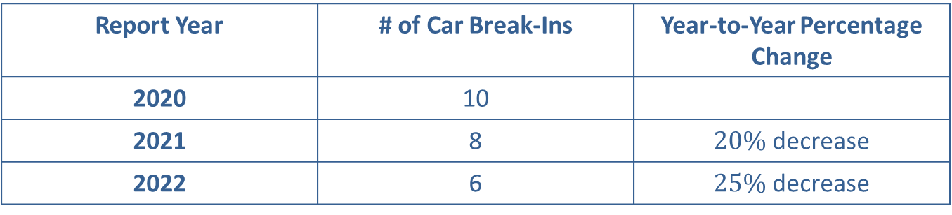

Example 9: Avoiding Percentage Misuse—Shifting Reference Points—Slide 1
Campus police are proud to report that car break-ins on campus decreased by $25\%$ this year compared to only a $20\%$ decline the previous year. They promoted the fact that their law enforcement efforts reduced the number of break-ins more this year than in the previous year. Use Table 2 to determine if their claim is justified.
Table 2: Campus Car Break-In Report
Report Year | # of Car Break-Ins | Year-to-Year Percentage Change
2020 | 10
2021 | 8 | $20\%$ decrease
2022 | 6 | $25\%$ decrease

Slide 37
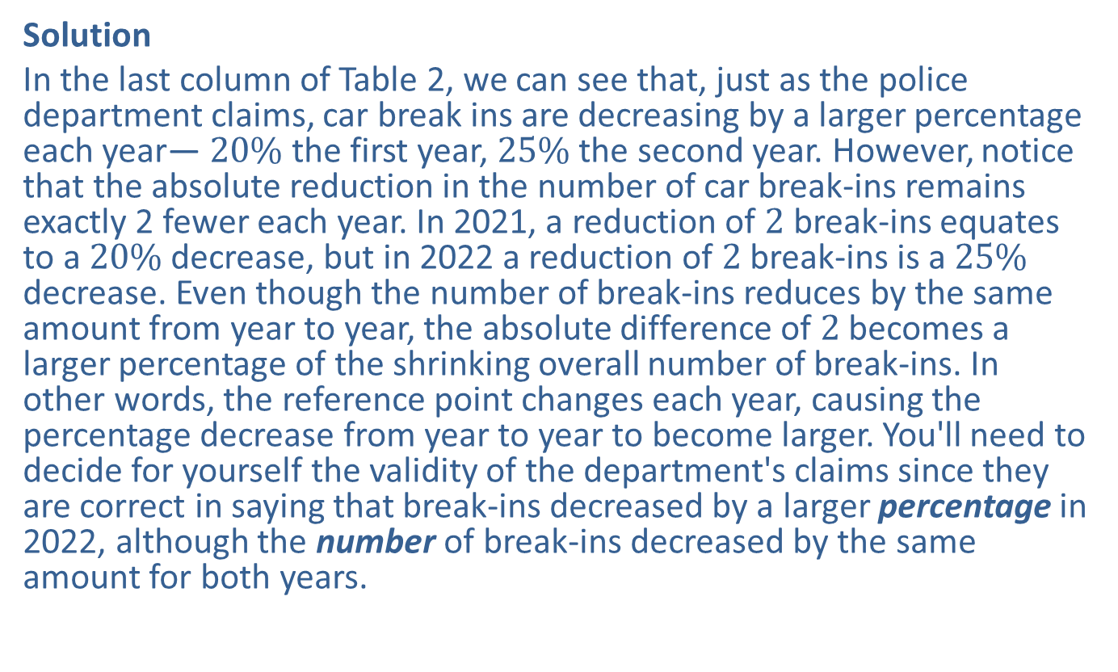
Example 9: Avoiding Percentage Misuse—Shifting Reference Points—Slide 2
Solution
In the last column of Table 2, we can see that, just as the police department claims, car break ins are decreasing by a larger percentage each year— $20\%$ the first year, $25\%$ the second year. However, notice that the absolute reduction in the number of car break‑ins remains exactly 2 fewer each year. In 2021, a reduction of 2 break-ins equates to a $20\%$ decrease, but in 2022 a reduction of 2 break-ins is a $25\%$ decrease. Even though the number of break-ins reduces by the same amount from year to year, the absolute difference of 2 becomes a larger percentage of the shrinking overall number of break-ins. In other words, the reference point changes each year, causing the percentage decrease from year to year to become larger. You'll need to decide for yourself the validity of the department's claims since they are correct in saying that break-ins decreased by a larger percentage in 2022, although the number of break-ins decreased by the same amount for both years.

