Slide 1
Section 4.3
Rates, Unit Rates, and Rates of Change

Slide 2
Helpful Hint 1
Notice that 8 cents per dollar is
which is 8%.

Slide 3
Definition: Rate
A rate is a fraction used to compare two quantities that are not necessarily in the same units.

Slide 4
Example 1: Writing Rates—Slide 1
The click-through rate (CTR) in internet marketing is the rate at which ads are being viewed by potential customers. The rate is calculated by dividing the total number of clicks on the ad by the total number of people who view the ad (impressions). Table 1 gives the number of impressions and clicks for three different versions of an ad for a start-up company. Write the click-through rate for each version and then change it to a percentage by dividing.
Table 1: Impressions vs. Clicks
 | Impressions (Views) | Clicks
Ad A | 34,271 | 592
Ad B | 36,859 | 471
Ad C | 31,022 | 519

Slide 5

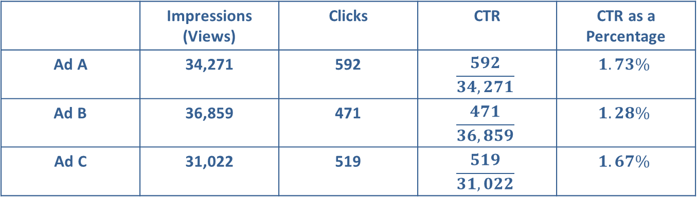
Example 1: Writing Rates—Slide 2
Solution
We are told that the click-through rate is the number of clicks divided by the number of views:
Once found, divide the numerator by the denominator and
multiply by $100\%$ to get the rate as a percentage.
Table 2: Click-Through Rates
 | Impressions (Views) | Clicks | CTR | CTR as a Percentage
Ad A | 34,271 | 592 | $$\frac{592}{34,271}$$ | $$1.73\%$$
Ad B | 36,859 | 471 | $$\frac{471}{36,859}$$ | $$1.28\%$$
Ad C | 31,022 | 519 | $$\frac{519}{31,022}$$ | $$1.67\%$$
While defining what makes a good click-through rate is still a highly debated topic, it is generally considered that a $2\%$ rate is successful.

Slide 6

Example 2: Identifying Rates—Slide 1
BuyinBulk offers 30 pounds of candy for $\$64.49$ on its website. Which of the following fractions represents the rate given by their website?

Slide 7
Example 2: Identifying Rates—Slide 2
Solution
There are actually two correct ways to write the rate from the website: answers b. and d.
Choice b. provides pounds per dollars.
Choice d. provides price per 30 pounds.
Both a. and c. are incorrect because neither fraction compares the amount of candy to the price of the candy.

Slide 8
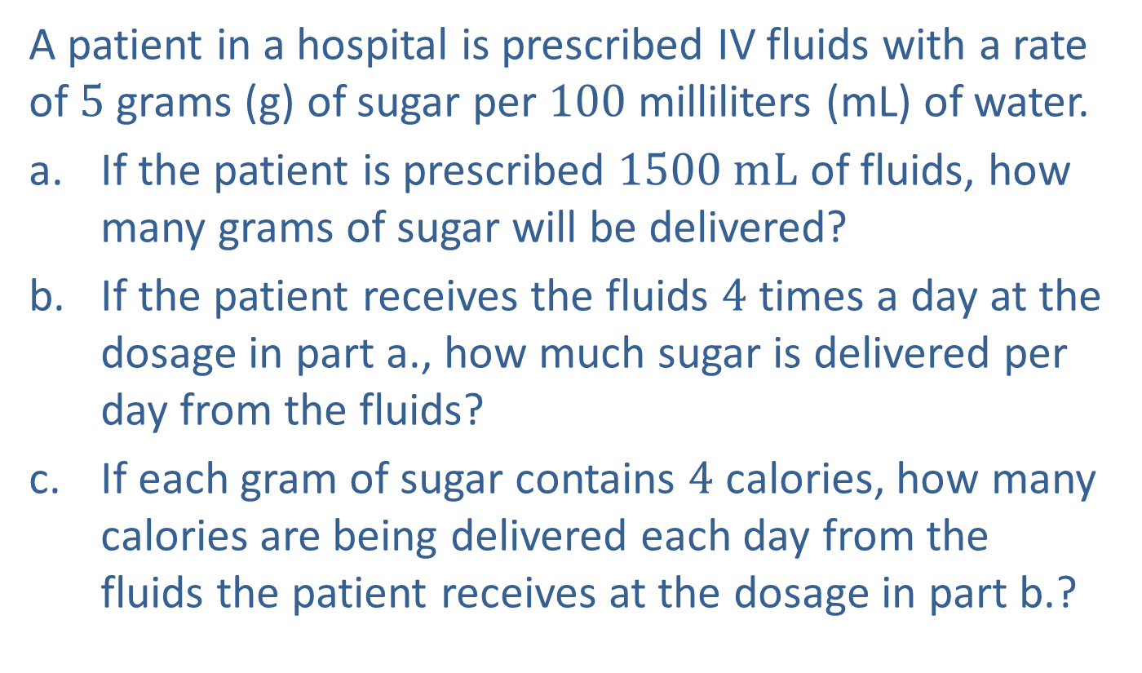
Example 3: Using Rates—Slide 1
A patient in a hospital is prescribed IV fluids with a rate of 5 grams (g) of sugar per 100 milliliters (mL) of water.
a. ​If the patient is prescribed $1500 mL$ of fluids, how many grams of sugar will be delivered?
b. ​If the patient receives the fluids 4 times a day at the dosage in part a., how much sugar is delivered per day from the fluids?
c. ​If each gram of sugar contains 4 calories, how many calories are being delivered each day from the fluids the patient receives at the dosage in part b.?

Slide 9
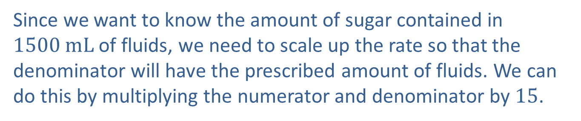
Example 3: Using Rates—Slide 2
Solution
a. Begin by writing down the rate of sugar delivered in the I V fluids.
Since we want to know the amount of sugar contained in $1500 mL$ of fluids, we need to scale up the rate so that the denominator will have the prescribed amount of fluids. We can do this by multiplying the numerator and denominator by 15.
Therefore, 75 grams of sugar is delivered.

Slide 10
Example 3: Using Rates—Slide 3
b. If the patient receives the solution 4 times a day, multiply the sugar content in one dose of fluids by 4 to find how much sugar is delivered per day.
Thus, 300 grams of sugar are delivered per day.
c. The calories delivered in 4 dosages can be calculated as follows.
Therefore, 1200 calories are being delivered.

Slide 11
Example 4: Using Rates—Slide 1
Gold is relatively heavy when compared to other metals. It has a density of
whereas lead has a density of
and aluminum's density is
If a gold bar has a volume of
what is its mass?

Slide 12
Example 4: Using Rates—Slide 2
Solution
Density is a rate of mass to volume,
and we are given the
density of gold.
Now, we need to multiply the numerator and denominator by the required volume.
This tells us the mass of the gold bar is 987.20 grams.

Slide 13
Helpful Hint 2
Density is a rate of mass to volume and is represented
by the Greek letter ρ, pronounced “rho.”

Slide 14
Helpful Hint 5
When written out, the word "per" indicates that the denominator amount of a rate is about to follow.

Slide 15
Example 5: Working with Miles per
Gallon—Slide 1
As a college graduation present, Katie's parents helped her buy her first new vehicle. She chose one that claims a fuel efficiency of 29 miles per gallon (mpg) on the highway.
a. Check how close the fuel consumption on Katie's new car is to the manufacturer's claim if she drove 309 miles on 11 gallons of gas. Round your answer to the nearest hundredth.
b. What might explain any discrepancies between the manufacturer's rate and Katie's car performance? Should she return the car to the dealer?

Slide 16
Example 5: Working with Miles per
Gallon—Slide 2
Solution
​Begin by setting up the rate of miles per gallons,
Katie drove 309 miles on 11 gallons of gas.
Notice that the number of miles will be in the numerator and the number of gallons will be in the denominator of the rate.

Slide 17
Example 5: Working with Miles per
Gallon—Slide 3
To compare Katie's fuel consumption rate to that of the manufacturer’s claim, we need to divide the numerator and denominator by 11, so that the new denominator is 1 gallon.
Therefore, Katie registered approximately 1 mile per gallon less than was claimed.

Slide 18
Example 5: Working with Miles per
Gallon—Slide 4
One possible explanation is that Katie did not drive all 309 miles on the highway. We are not told the specifics of her journey.
It also might be a case of accuracy on Katie's end. Suppose she actually used 10.6 gallons to drive for 309.2 miles. Then the mpg is
This does not seem to warrant Katie returning the new car.

Slide 19

Skill Check 1
If rice costs $\$7.99$ for a 5-pound bag, determine the cost per pound of the rice. Round your answer to the nearest cent.
Answer: $1.60 per pound

Slide 20
Definition: Unit Rate
A unit rate is a rate comparing two measured quantities, one of which is a single unit written in the denominator of the fraction.

Slide 21
Helpful Hint 3
To convert rate to a unit rate, divide the numerator of the fraction by the denominator and keep the units.

Slide 22
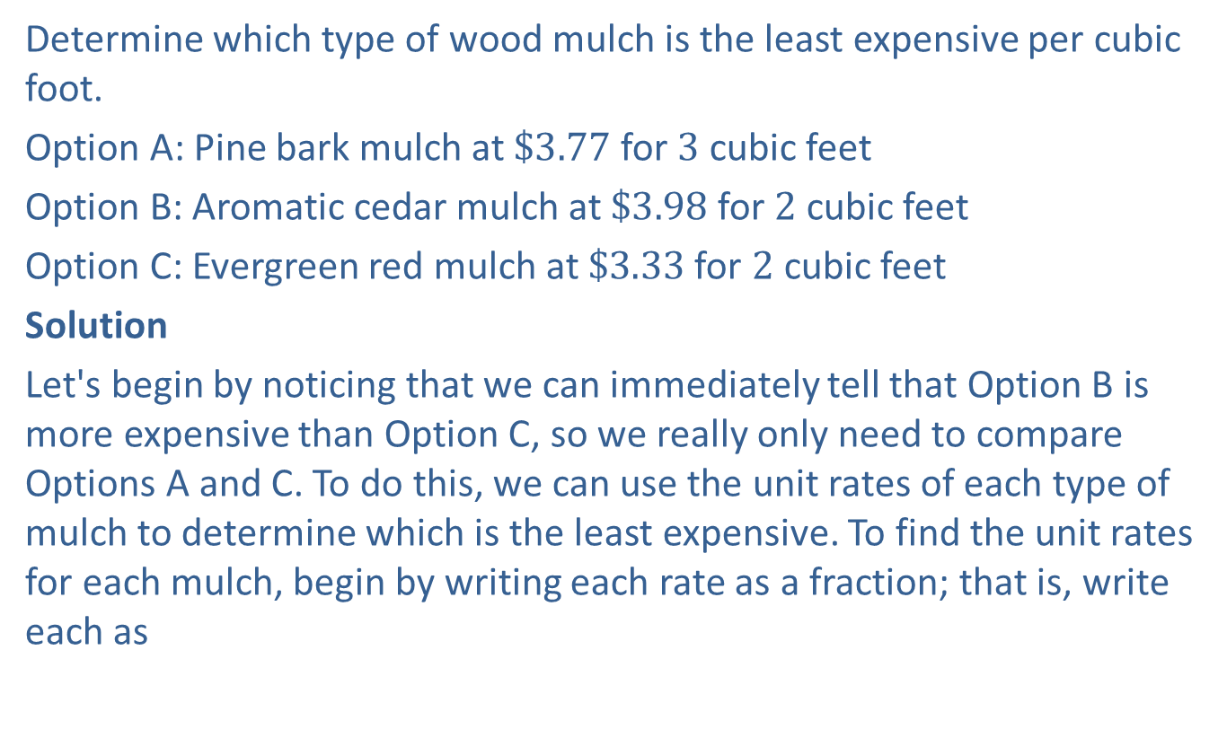
Example 6: Finding Unit Rates—Slide 1
Determine which type of wood mulch is the least expensive per cubic foot.
Option A: Pine bark mulch at $\$3.77$ for 3 cubic feet
Option B: Aromatic cedar mulch at $\$3.98$ for 2 cubic feet
Option C: Evergreen red mulch at $\$3.33$ for 2 cubic feet
Solution
Let's begin by noticing that we can immediately tell that Option B is more expensive than Option C, so we really only need to compare Options A and C. To do this, we can use the unit rates of each type of mulch to determine which is the least expensive. To find the unit rates for each mulch, begin by writing each rate as a fraction; that is, write each as
Then convert each to a unit rate using division.

Slide 23

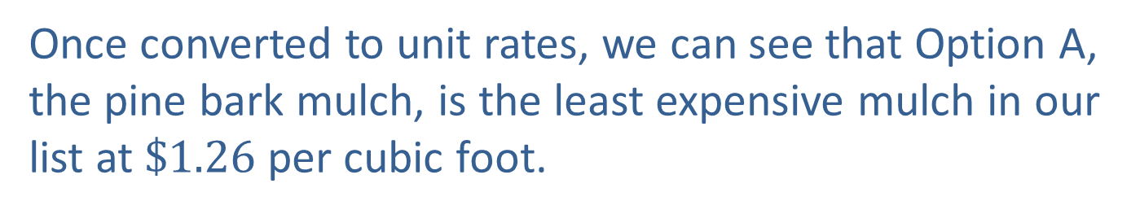

Example 6: Finding Unit Rates—Slide 2
or $\$1.26$ per cubic foot
or $\$1.67$ per cubic foot
Once converted to unit rates, we can see that Option A, the pine bark mulch, is the least expensive mulch in our list at $\$1.26$ per cubic foot.

Slide 24
Skill Check 2
Helium gas (H e) was placed in a container fitted with a porous membrane. The helium effused, or passed, through the membrane at the rate of
Find the unit rate of effusion per hour for the helium.

Slide 25
Example 7: Using Unit Rates—Slide 1
Emma is traveling to Italy for spring break and is checking the exchange rate between dollars and euros (€). Table 3 shows a certain section of the exchange rates that Emma found listed on the internet
Table 3: Euro Exchange Rates
Currency Name | Units per EUR | EUR per Unit
US Dollar (USD) | 1.139700 | 0.877448
Argentine Peso | 81.189972 | 0.012317
Brazilian Real | 6.119143 | 0.163422
British Pound | 0.907733 | 1.101645
Canadian Dollar | 1.551809 | 0.644409

Slide 26
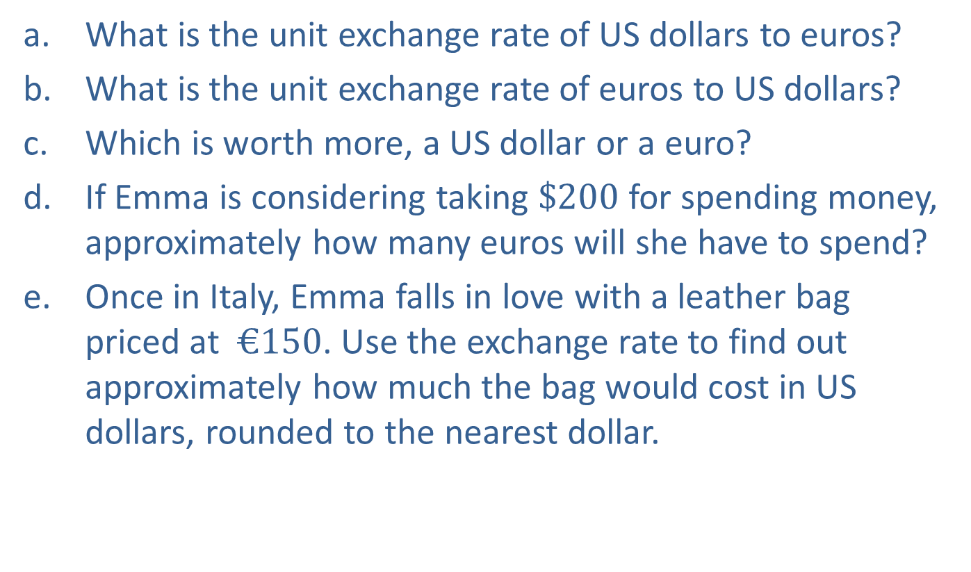
Example 7: Using Unit Rates—Slide 2
a. What is the unit exchange rate of US dollars to euros?
b. What is the unit exchange rate of euros to US dollars?
c. Which is worth more, a US dollar or a euro?
d. If Emma is considering taking $\$200$ for spending money, approximately how many euros will she have to spend?
e. Once in Italy, Emma falls in love with a leather bag priced at $€150$. Use the exchange rate to find out approximately how much the bag would cost in US dollars, rounded to the nearest dollar.

Slide 27
Example 7: Using Unit Rates—Slide 3
Solution
a. The format of this table is very similar to many others you will find
online. Reading it correctly is half the battle. The column labeled
“Units per EUR” shows the amount of corresponding currency that is
equivalent to one euro. For example, approximately 81 Argentine
pesos equals 1 euro. If we want a rate of US dollars to euros, the unit
rate for euros should be in the denominator. Reading across the first
row, we see that there are 1.1397 US dollars to each euro.
b. This time we need the rate for euros to US dollars, so the dollar amount
will be in the denominator. The column labeled “EUR per Unit” provides
the number of euros equivalent to one unit of the currency listed.

Slide 28
Example 7: Using Unit Rates—Slide 4
c. Notice that both of the rates we found in parts a. and b. express the relationship between US dollars and euros. We just need to think carefully about what they are saying. The US dollars to euro rate in part a. says that each euro is worth 1.14 US dollars. Therefore, because it costs more than one dollar to buy one euro, we say the euro is worth more than the dollar. Similarly, the euros to dollars rate in part b. says that each US dollar is worth 0.88 euros; that is, less than 1 euro.
d. To change US dollars to euros, we can multiply by the rate we just found in part b. so that dollars will cancel, and we'll be left with euros.

Slide 29
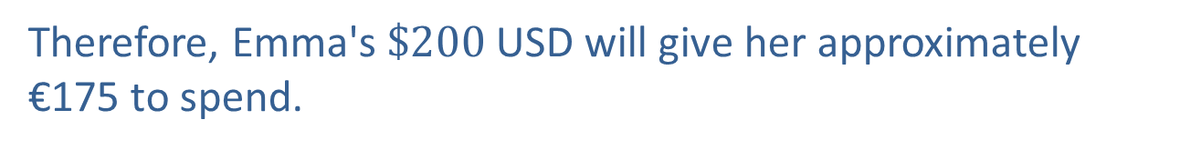
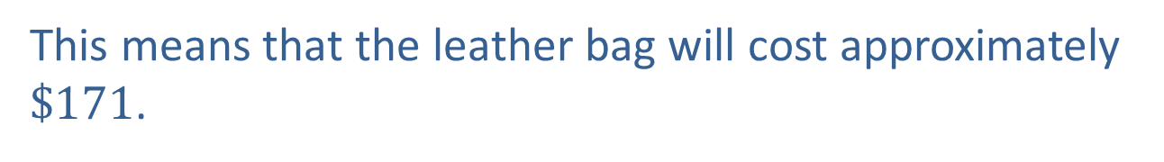
Example 7: Using Unit Rates—Slide 5
Therefore, Emma's $\$200$ USD will give her approximately €175 to spend.
e. To change euros to US dollars, we will use the rate we found in part a. so that euros will cancel and leave dollars in the numerator.
This means that the leather bag will cost approximately $\$171$.

Slide 30
Fun Fact
Exchange rates are fluid; that is, they are subject to change at any time. Because financial markets around the world are functioning 24-7, rates are constantly being updated.

Slide 31

Example 8: Using Rates for Comparison—Slide 1
You and your friends are deciding what you should do together Friday night. Here are the options that you've come up with:
1. ​Laser tag: $\$13.00$ per person for 2 games
2. Laser tag: $\$18.00$ per person for 3 games
3. County Fair: $\$20.00$ wristbands allowing all-you-can-ride access for the night.
To make the decision easier, present your friends with rates for the evening's options based on the amount of time each option would take.
a. Write down a rate for each option if it takes 30 minutes to play a game of laser tag and you would stay at the fair from 8 p.m. until 10 p.m.
b. Discuss whether it would be useful to convert the rates from part a. into unit rates

Slide 32
Example 8: Using Rates for Comparison—Slide 2
Solution
a. Since we are asked to write rates based on cost and time, we will write each option as a fraction with cost in the numerator of the fraction and time in the denominator.
We are given the costs for 2 options of laser tag. Since it takes 30 minutes to play one game of laser tag, the denominator is calculated by multiplying the number of games played by 30 minutes.

Slide 33
Example 8: Using Rates for Comparison—Slide 3
​For the fair option, the rate is based on staying at the fair from 8 p.m. until 10 p.m., which is 2 hours of unlimited rides.

Slide 34
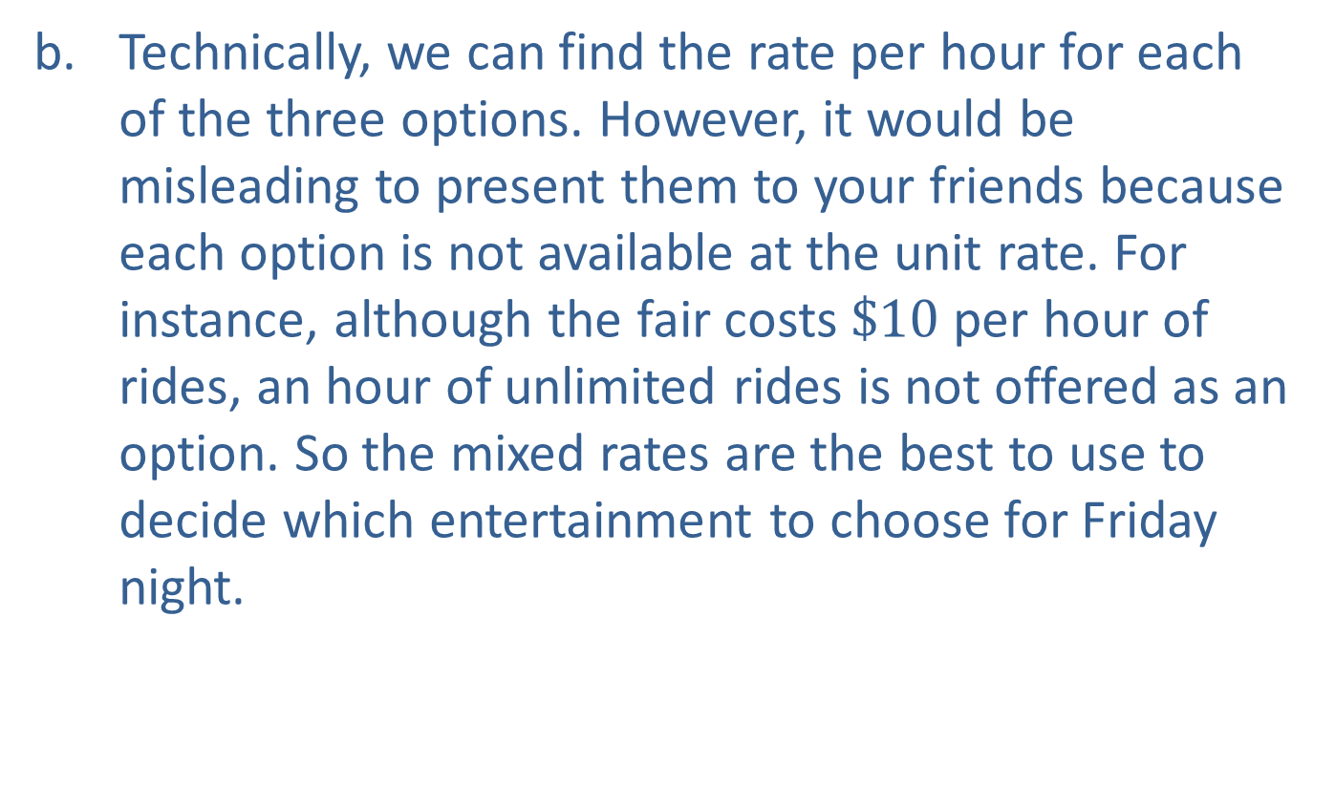
Example 8: Using Rates for Comparison—Slide 4
b. Technically, we can find the rate per hour for each of the three options. However, it would be misleading to present them to your friends because each option is not available at the unit rate. For instance, although the fair costs $\$10$ per hour of rides, an hour of unlimited rides is not offered as an option. So the mixed rates are the best to use to decide which entertainment to choose for Friday night.

Slide 35
Definition: Rate of Change
The rate of change of one quantity with respect to another is how much the first quantity changes for each unit change of the second quantity.

Slide 36
Helpful Hint 4

Slide 37
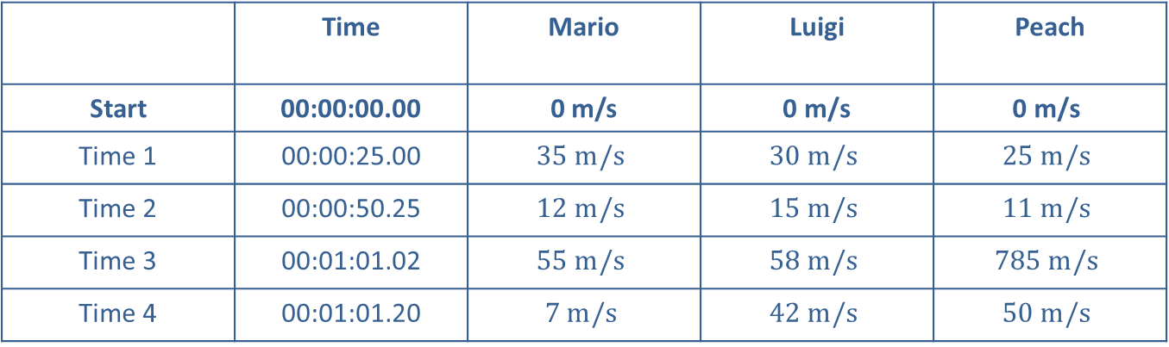
Example 9: Calculating Rate of Change—Slide 1
Table 4 shows the speed of racers at various times during a game of Mario Kart.
Table 4: Speed of Racers at Various Times
Velocity at Time Mark
 | Time | Mario | Luigi | Peach
Start | 00:00:00.00 | 0 m/s | $$\text{0 }\text{m}\text{/}\text{s}$$ | $$\text{0 }\text{m}\text{/}\text{s}$$
Time 1 | 00:00:25.00 | $$35 m/s$$ | $$30 m/s$$ | $$25 m/s$$
Time 2 | 00:00:50.25 | $$12 m/s$$ | $$15 m/s$$ | $$11 m/s$$
Time 3 | 00:01:01.02 | $$55 m/s$$ | $$58 m/s$$ | $$785 m/s$$
Time 4 | 00:01:01.20 | $$7 m/s$$ | $$42 m/s$$ | $$50 m/s$$

Slide 38
Example 9: Calculating Rate of Change—Slide 2
a. ​What is Mario's acceleration between the start and Time 1
b. Does Luigi or Peach decelerate more between Times 1 and 2?
c. ​One of the characters gets shrunk, and consequently is not able to travel as fast, right before Time 4. Which one do you think it is?
d. The human body reacts adversely to high levels of acceleration, with loss of consciousness for accelerations over
Is it feasible for human
drivers to safely experience Peach's acceleration between Times 2 and 3 when she had a speed boost?

Slide 39
Example 9: Calculating Rate of Change—Slide 3
Solution
a. Acceleration is the rate of change between velocity and time. To calculate acceleration, the change in velocity will be in the numerator and the change in time will be in the denominator.
​ Mario's acceleration between the start and Time 1
is calculated as follows.
Notice that acceleration is measured in meters per second per second, which we refer to as “meters per second squared.”

Slide 40
Example 9: Calculating Rate of Change—Slide 4
b. In order to find out who decelerates more, we need to calculate the change in velocity between Times 1 and 2 for both Luigi and Peach.
So Luigi decelerates at a faster rate than Peach between Times 1 and 2. Notice that even though Peach is going slower at Time 2, Luigi had the bigger change in velocity.

Slide 41

Example 9: Calculating Rate of Change—Slide 5
c. ​If we consider the velocity of each racer at Time 4, we can see that Mario is going the slowest at $7 m/s$, so he is most likely to have been shrunk. We do not have to consider acceleration here.
d. ​Peach's acceleration between Times 2 and 3 is calculated as follows.
Therefore, human drivers could not safely experience this acceleration.

Slide 42
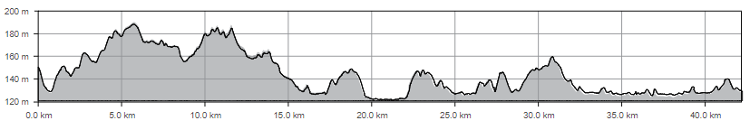
Example 10: Calculating Rate of Change—Slide 1
The Rock 'n' Roll Marathon in Nashville, Tennessee, is known to be a hilly racecourse. Figure 2 shows the average change in elevation along the 42.195-kilometer route. Use the chart to answer the following questions.
Figure 2: 2019 Rock ‘n’ Roll Nashville Marathon Elevation Chart

Slide 43
Example 10: Calculating Rate of Change—Slide 2
a. ​At what point in the race are runners at the highest elevation on the course?
b. ​What is rate of change of elevation over the first 5 kilometers?
c. Explain if there is a level section of the course where runners are neither going up a hill or down one.
d. How would you determine where the steepest incline and steepest decline are likely to be along the course based on the chart?

Slide 44
Example 10: Calculating Rate of Change—Slide 3
Solution
a. The runners will be at the course's highest elevation when the line graph is at the highest point on the chart. This appears to be around the 6-kilometer marker.
b. To find the rate of change we find the difference in elevation from the starting point to the 5-kilometer marker in the numerator and the distance covered in the denominator.

Slide 45
Example 10: Calculating Rate of Change—Slide 4
c. When the course is level, the elevation is constant as the distance changes. We can see that from about the 20-kilometer marker to approximately the 22.5-kilometer marker the elevation remains at 123 meters and therefore the course is flat.
d. Steep inclines and declines occur when the change in elevation happens quickly, not necessarily at the highest or lowest elevations along the route. Therefore, steep inclines or declines will occur at the places along the chart where the rate of change is the greatest; that is, the elevation has a large jump over a short distance.

Slide 46
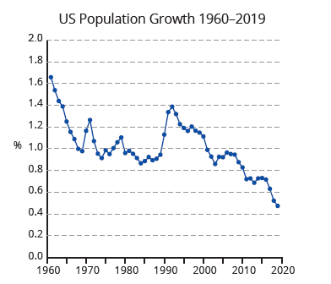
Example 11: Drawing Conclusions from Rate of Change—Slide 1
The following chart shows the United States population growth rates from 1960 to 2019.³
Source: “Population growth (annual % ) – United States”, The World Bank, accessed February 17,
2021, https://data.worldbank.org/indicator/SP.POP.GROW?locations=US
Figure 3

Slide 47
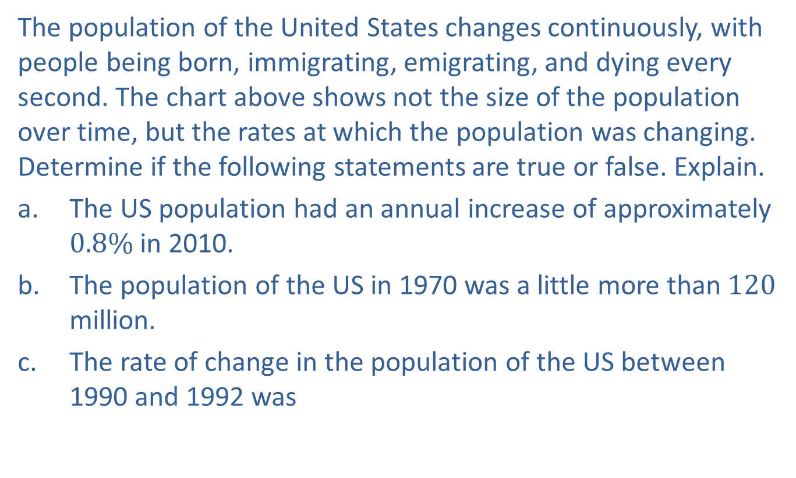
Example 11: Drawing Conclusions from Rate of Change—Slide 2
The population of the United States changes continuously, with people being born, immigrating, emigrating, and dying every second. The chart above shows not the size of the population over time, but the rates at which the population was changing. Determine if the following statements are true or false. Explain.
a. The US population had an annual increase of approximately $0.8\%$ in 2010.
b. ​The population of the US in 1970 was a little more than 120 million.
c. The rate of change in the population of the US between 1990 and 1992 was
d. The US population has been declining since the 1990s.

Slide 48
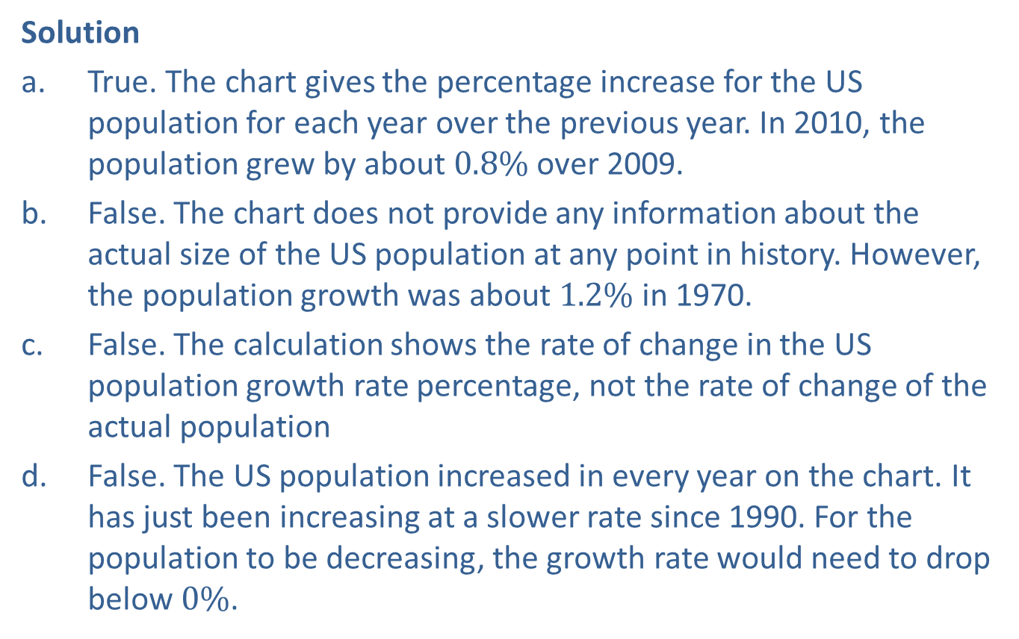
Example 11: Drawing Conclusions from Rate of Change—Slide 3
Solution
a. True. The chart gives the percentage increase for the US population for each year over the previous year. In 2010, the population grew by about $0.8\%$ over 2009.
b. ​False. The chart does not provide any information about the actual size of the US population at any point in history. However, the population growth was about $1.2\%$ in 1970.
c. False. The calculation shows the rate of change in the US population growth rate percentage, not the rate of change of the actual population
d. ​False. The US population increased in every year on the chart. It has just been increasing at a slower rate since 1990. For the population to be decreasing, the growth rate would need to drop below $0\%$.

