Slide 1
Section 4.4
Using Rates for Dimensional Analysis

Slide 2
Definition: Conversion Factor and Dimensional Analysis
Conversion Factor
A conversion factor is a fraction that is equal to 1 but contains different units of measurement in the numerator and denominator.
Dimensional Analysis
Dimensional analysis is a method of using conversion factors to change from one unit of measurement to another.

Slide 3
Helpful Hint
Recall that mpg means “miles per gallon.”

Slide 4
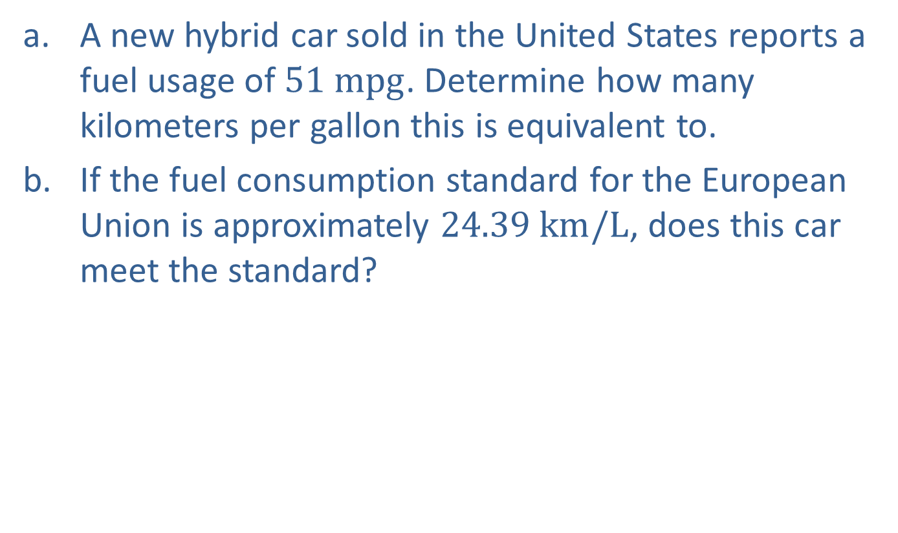
Example 1: Using Dimensional Analysis with One Conversion Factor—Slide 1
a. ​A new hybrid car sold in the United States reports a fuel usage of $51 mpg$. Determine how many kilometers per gallon this is equivalent to.
b. If the fuel consumption standard for the European Union is approximately $24.39 km/L$, does this car meet the standard?

Slide 5
Example 1: Using Dimensional Analysis with One Conversion Factor—Slide 2
Solution
​Let’s begin by writing the rate we were given as a fraction.
​Next, we need a conversion factor that relates miles and kilometers. Table 1 shows that 1 mile is approximately 1.61 kilometers, so the following fractions are both conversion factors.
Conversion Factors Using Miles and Kilometers:

Slide 6
Example 1: Using Dimensional Analysis with One Conversion Factor—Slide 3
​The conversion factor is shown in both formats to emphasize the point that both are appropriate factors, but we want to choose the most useful one in this situation. We wish to know kilometers per gallon, or
Notice that we need to end up
having kilometers in the numerator, so we will use the second form of the conversion factor in our multiplication.
Since the units are now kilometers per gallon, we are finished. This means that 51 miles per gallon are approximately 82.11 kilometers per gallon.

Slide 7

Example 1: Using Dimensional Analysis with One Conversion Factor—Slide 4
b. To determine if the car meets the European Union standards, we need to change the rate we found in part a. from gallons to liters. Table 4.4.1 shows that 1 gallon is approximately 3.785 liters. Since we want to ultimately end up with liters in the denominator, the conversion factor should be written in the form
Using multiplication,
we have the following conversion.
Since the European Union standard is $24.39 km/L$, the new hybrid does not quite meet the standard.

Slide 8
Skill Check 1
Convert 180 centimeters to inches.
Answer: 70.87

Slide 9
Helpful Hint 2
When setting up a conversion factor, diagonal units should cancel so that you are left with the desired units in your answer.

Slide 10
Example 2: Using Dimensional Analysis with One Conversion Factor—Slide 1
A pesticide label recommends using its product at a rate of 10 milliliters concentrate per 5 liters of water to cover an area of 40 square meters. A 5-gallon sprayer is being used for the mixture. How many milliliters of concentrate should be added if the sprayer’s container is filled with water to the 5-gallon mark? Recall that 1 gallon is approximately 3.785 liters.
Solution
Begin by writing both the recommended rate of concentrate to water (which is given), as well as the conversion factor for gallons to liters.

Slide 11
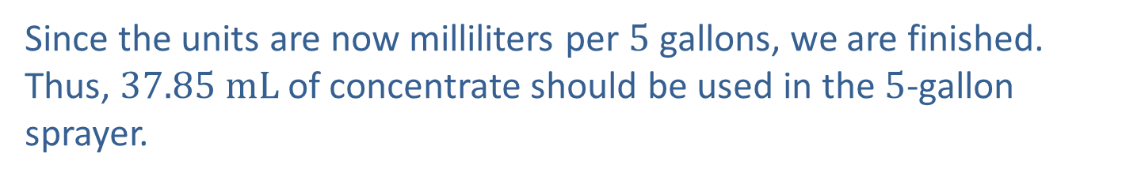
Example 2: Using Dimensional Analysis with One Conversion Factor—Slide 2
We wish to find the rate of milliliters to gallons, or
So we will use the second form of the conversion factor, which has gallons in the denominator, in our multiplication.
Since the units are now milliliters per 5 gallons, we are finished. Thus, $37.85 mL$ of concentrate should be used in the 5-gallon sprayer.

Slide 12

Example 3: Using Dimensional Analysis with More Than One Conversion Factor—Slide 1
The density of mercury is given as a rate of $13.6 g/mL$. What is the density of mercury in pounds per liter if 1 pound is equal to 0.454 kilograms?
Solution
Begin by writing the rates that were given, the density of mercury as well as the conversion factor for pounds to kilograms.
Note that we will need to change grams to pounds and milliliters to liters. The given density is in grams, which will need to change to kilograms before we can use the one conversion factor.

Slide 13
Example 3: Using Dimensional Analysis with More Than One Conversion Factor—Slide 2
Notice that the first form of the conversion factor has pounds in the numerator, so we will use that one. The final form should have liters in the denominator, so we will need to use a second conversion factor to transpose milliliters into liters. There are 1000 milliliters in 1 liter, so the conversion factors are
Again, we will use the first form since we need to end up
with liters in the denominator.
Multiplying each conversion factor by the original rate, remembering that the order of multiplication is flexible, we have the following.

Slide 14
Example 3: Using Dimensional Analysis with More Than One Conversion Factor—Slide 3
So the density of mercury is
We can reduce
this to lowest terms by dividing both the numerator and denominator by the greatest common factor 2.

Slide 15
Skill Check 2
Determine how many minutes are in three weeks.
Answer: 30,240

Slide 16
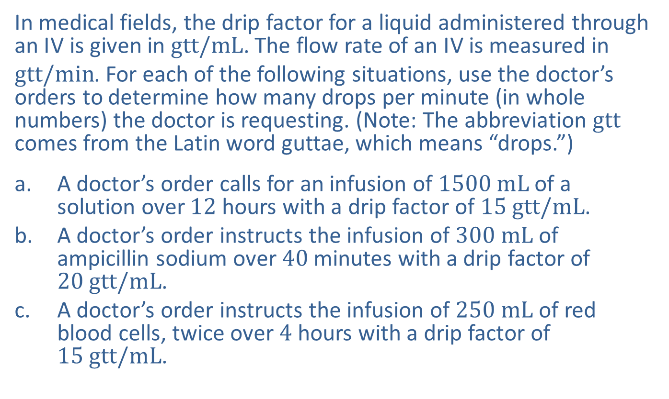
Example 4: Using Dimensional Analysis with More Than One Conversion Factor—Slide 1
In medical fields, the drip factor for a liquid administered through an I V is given in $gtt/mL$. The flow rate of an I V is measured in
$gtt/min$. For each of the following situations, use the doctor’s orders to determine how many drops per minute (in whole numbers) the doctor is requesting. (Note: The abbreviation $gtt$ comes from the Latin word guttae, which means “drops.”)
a. A doctor’s order calls for an infusion of $1500 mL$ of a solution over 12 hours with a drip factor of $15$ $gtt/mL$.
b. ​A doctor’s order instructs the infusion of $300 mL$ of ampicillin sodium over 40 minutes with a drip factor of $20$ $gtt/mL$.
c. A doctor’s order instructs the infusion of $250 mL$ of red blood cells, twice over 4 hours with a drip factor of $15$ $gtt/mL$.

Slide 17
Example 4: Using Dimensional Analysis with More Than One Conversion Factor—Slide 2
Solution
In each case, the doctor’s order is given in milliliters over a period of time. Since we are asked to find drops per minute, we need to use conversion factors to make sure the time unit is in minutes (if it’s not already in minutes) and the amount of liquid is in number of drops instead of milliliters. We begin by writing the doctor’s order as a rate and determining what conversion factors we need to multiply by.

Slide 18
Example 4: Using Dimensional Analysis with More Than One Conversion Factor—Slide 3
a. The rate in this doctor’s order is given as
Notice that we will need to change hours to minutes and milliliters to drops. The conversion factor comparing hours to
minutes is either
Because we need to cancel the hours out of the denominator of the rate, we need to use the second conversion factor, which has hours in the numerator. We will also use the drip factor, which was given as
Multiplying the original rate by both conversion factors, we have

Slide 19
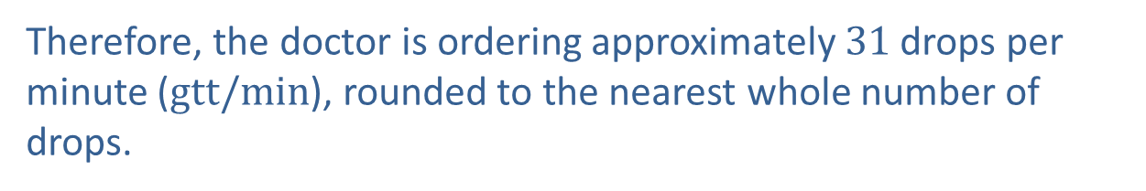
Example 4: Using Dimensional Analysis with More Than One Conversion Factor—Slide 4
After multiplying, we have a rate showing the number of drops over
720 minutes. Since we want the unit rate per minute, we need to
divide both the numerator and denominator by 720.
Therefore, the doctor is ordering approximately 31 drops per minute ($gtt/min$), rounded to the nearest whole number of drops.

Slide 20
Example 4: Using Dimensional Analysis with More Than One Conversion Factor—Slide 5
b. ​​We will follow the same procedure as we did in part a. The doctor’s order gives an overall rate of
Notice that the order is already in minutes,
so there is no need for a time conversion factor. However, we still need a drip factor in order to
change milliliters to drops. It is given as
Multiplying, we get the following rate in drops over minutes.

Slide 21
Example 4: Using Dimensional Analysis with More Than One Conversion Factor—Slide 6
Finally, we change to a unit rate per minute by dividing the numerator and denominator by 40.
Therefore, the doctor is ordering 150 drops per min ($gtt/min$).

Slide 22
Example 4: Using Dimensional Analysis with More Than One Conversion Factor—Slide 7
c. In the last scenario, the doctor’s instructions ask for 250 mL to be given twice over 4 hours. Thus, the overall rate is
Again, we will need to change
hours to minutes using
and change milliliters to
drops using the drip factor given as
We will also condense steps and divide at the end so that we have a unit rate per minute.

Slide 23
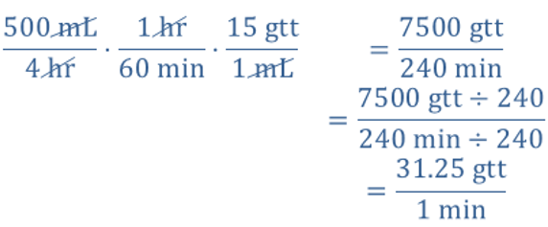
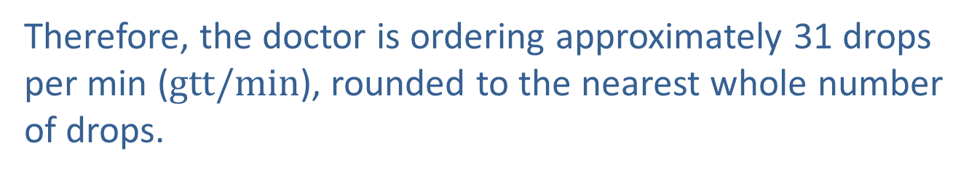
Example 4: Using Dimensional Analysis with More Than One Conversion Factor—Slide 8
Therefore, the doctor is ordering approximately 31 drops per min ($gtt/min$), rounded to the nearest whole number of drops.

Slide 24
Example 5: Investigating a Conversion Error—Slide 1
In 1983, Air Canada’s Boeing 767 jet famously ran out of fuel midflight in what became known as the “Gimli Glider” incident. Instead of calculating the number of liters needed to hit a required 22,300 kilograms of fuel, the crew calculated how many liters were needed to hit 22,300 pounds—just about half of the fuel required. In the end, the skilled pilots were able to land the plane by gliding the last 100 kilometers, bringing all on board to safety
Follow the given steps to correctly calculate how much fuel should have been loaded onto the plane. The fuel requirement for the plane to make the trip was 22,300 kilograms. A float stick check indicated that the tanks contained 7682 liters of fuel already.
a. Calculate the additional amount of fuel in kilograms that needed to be added to the fuel tanks in order to meet the requirement if the mass of 1 liter of fuel in this situation was 0.803 kilograms.
b. Convert the fuel amount found in part a. from kilograms to liters.

Slide 25
Example 5: Investigating a Conversion Error—Slide 2
Solution
a. ​The plane needs 22,300 kilograms of fuel to make the trip. We are told there are 7682 liters of fuel already on board. So we will need to subtract the amount of fuel that is already in the plane’s tanks from the amount required. Before we can subtract, we need to convert the fuel amount in the tanks from liters to kilograms. The volume of jet fuel varies with temperature. In this case, the mass of 1 liter of fuel was 0.803 kilograms. Therefore, we will use the conversion factor

Slide 26
Example 5: Investigating a Conversion Error—Slide 3
Mass of Fuel Already in the Plane’s Tanks:​
Now we can subtract since both measurements are in kilograms.
Mass of Additional Fuel Required: 22,300 kg$−$ 6169 kg = 16,131 kg
Therefore, $16,131 kg$ of fuel needed to be added to the fuel tanks.

Slide 27
Example 5: Investigating a Conversion Error—Slide 4
b. Now we need to convert the required fuel amount, which is in kilograms, into a volume using liters. The conversion factor is the same, but with the numerator and denominator flipped.
In comparison, using an incorrect conversion factor, the crew calculated that only 4,917 liters of fuel needed to be added to the plane’s tanks, which is why they ran out of gas!

