Slide 1
Chapter 4
Review

Slide 2
Definition: Proportion
A proportion is a fraction of a whole.

Slide 3
Definition: Percentage
A percentage is an amount per 100, expressed using a percent sign, %.

Slide 4
Definition: Ratio
A ratio is a comparison of measured quantities whose units are of the same type. It is most often written with a colon between quantities; for example, a: b.

Slide 5
Definition: Equivalent Ratios
Equivalent ratios are ratios that express the same relationship.

Slide 6
Definition: List Price
The price of an item as it is listed for public sale is the list price.

Slide 7
Definition: Discount
A discount is a reduction made from the list price. This is often given as a percentage of the list price.

Slide 8
Definition: Sale Price
The sale price, also called the net price, is the actual cost of an item after any discounts are subtracted.
Sale Price = List Price − Discount

Slide 9
Definition: Sales Tax
A charge collected by the government for the sale of goods is called a sales tax.
Sales Tax = (Selling Price) ⋅ (Sales Tax Percentage as a Decimal)

Slide 10
Definition: Absolute Change
The absolute change between two amounts is the absolute value of the difference between the two numbers.

Slide 11
Definition: Percentage Change
The percentage change between two amounts is the absolute change expressed as a percentage of the original value.

Slide 12
Definition: Rate
A rate is a fraction used to compare two quantities that are not necessarily in the same units.

Slide 13
Definition: Unit Rate
A unit rate is a rate comparing two measured quantities, one of which is a single unit written in the denominator of the fraction.

Slide 14
Definition: Rate of Change
The rate of change of one quantity with respect to another is how much the first quantity changes for each unit change of the second quantity.

Slide 15
Definition: Conversion Factor
A conversion factor is a fraction that is equal to 1 but contains different units of measurement in the numerator and denominator.

Slide 16
Definition: Dimensional Analysis
Dimensional analysis is a method of using conversion factors to change from one unit of measurement to another.

Slide 17
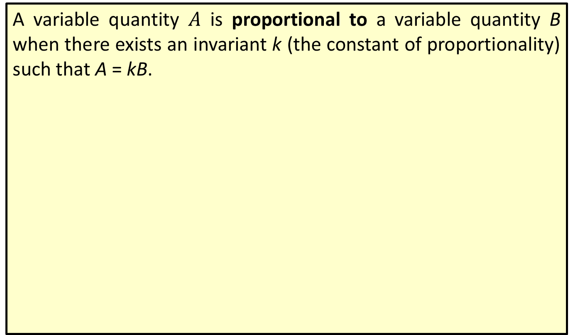
Definition: Proportional to
A variable quantity $A$ is proportional to a variable quantity B when there exists an invariant k (the constant of proportionality) such that A = kB.

Slide 18
Definition: Hooke's Law
The proportional relationship between the force applied to a spring and the length of the spring is given by
F = kx,
where F is the force applied to a spring, x is the displacement of the spring (either stretched or compressed), and k is the spring constant.

