Slide 1
Section 5.1
Linear Equations and Functions

Slide 2
Think Back—Slide 1
A variable is a symbol (often a letter) used to represent an unknown quantity.

Slide 3
Definition: Dependent and Independent Variables
Dependent Variable
The value of the dependent variable changes with respect to the value of the independent variable.
Independent Variable
The value of an independent variable does not rely on the values of the other variables in an expression or function, and its value determines the values of the other variables.

Slide 4
Helpful Hint—Slide 1
Simplify means to make easier to understand or reduce the number of parts.
Solve means to find a solution to a problem or question.

Slide 5
Definition: Possible Solutions to Linear Equations
One solution —there exists only one number that makes the equation true.
Infinitely many solutions —any number makes the equation true.
No solution —no number exists that makes the equation true.

Slide 6
Think Back—Slide 2
A coefficient is the number (or constant) in front of a variable. Variables without a number written before them are understood to have a coefficient of one.

Slide 7
Definition: Steps for Solving Linear Equations in One Variable
Step 1: Clear the equation of fractions and decimals by multiplying both sides of the equation by the least common denominator (LCD).
Step 2: Simplify the expressions on both sides by clearing the equation of parentheses. Repeat Step 1 if fractions or decimals remain; otherwise move to Step 3.
Step 3: the expressions on both sides by combining like terms.
Step 4: Isolate the variable on one side of the equation.
Step 5: Make the variable coefficient equal to 1.

Slide 8
Think Back—Slide 3
The least common denominator (LCD) is the least common multiple (LCM) of all of the denominators, or the smallest number that is divisible by all denominators.

Slide 9
Example 1: Solving a Linear Equation—Slide 1
Determine the maximum number of guests that can attend the after-party Everett is planning by solving the following equation.
$4000 = $12.45x + $1300
Solution
Notice that the equation is already simplified and there are no fractions, decimals, or parentheses that need to be cleared. So according to the steps for solving linear equations in one variable, we can start with step 4: isolate the variable on one side of the equation.

Slide 10
Example 1: Solving a Linear Equation—Slide 2
This tells us that Everett can have a maximum of 216 people attend the party and still not exceed his budget.

Slide 11
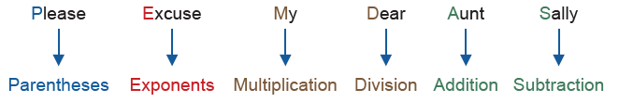
Think Back—Slide 4
PEMDAS is a helpful way to remember the correct sequence of calculations when simplifying.
Perform the multiplication and division as it appears from left to right in the expression. Similarly, do the same with addition and subtraction.

Slide 12
Example 2: Solving Linear Equations—Slide 1
For each equation, use the steps for solving linear equations to solve the given linear equation for y. State if there is one solution, no solution, or infinitely many solutions.
​

Slide 13
Example 2: Solving Linear Equations—Slide 2
Solution
a.​ The variable is y this time rather than x as we have seen before, but the variable y only ever appears with an exponent of 1. So we know that
​
is a linear equation. Notice that the numbers 4.1
and 2.6 contain tenths. We can multiply both sides of the equation by 10 to eliminate the decimals. Afterward, we need to clear the equation of parentheses. That is, we need to distribute the number on the outside of the parentheses, multiplying it by everything on the inside.

Slide 14
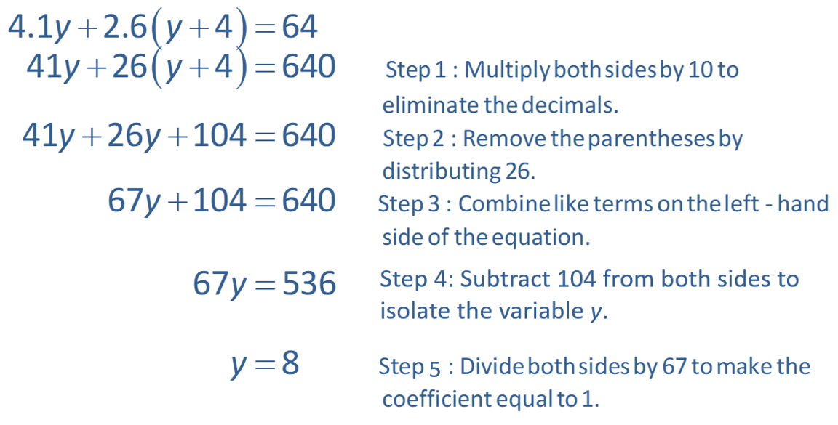
Example 2: Solving Linear Equations—Slide 3

Slide 15
Example 2: Solving Linear Equations—Slide 4
​From this we know that only a single solution is possible. We'll take a moment to check that the solution does indeed solve the equation. To do this, we substitute the answer for the variable back into the original equation.

Slide 16
Example 2: Solving Linear Equations—Slide 5
Since the result is a true statement when we substitute the solution back into the original equation, we know that this equation has only one solution, y = 8.
​Note that it is never a bad idea to check your answers when solving an equation. We will leave that for you to practice on your own after each example for the remainder of the section.
b. The equation
is a linear equation
in w, so we can follow the steps for solving a linear equation.

Slide 17
Example 2: Solving Linear Equations—Slide 6
​The first step in our guidelines is to clear the equation of fractions or decimals. To do this, multiply both sides of the equation by the LCD, which is 8 in this case.

Slide 18
Example 2: Solving Linear Equations—Slide 7
​When we reach a place where both sides of the equation are the same, we can stop. This signifies that the equation is always true. That is, any number we substitute in for x will make the equation true.
​Therefore, this equation has infinitely many solutions; that is, the solution set is all real numbers.
c.​ Again, notice that
is a linear equation in t, so we can follow the steps for solving a linear equation.
​Step 1 says to eliminate any fractions or decimals. The decimal numbers all contain hundredths, so multiplying both sides of the equation by 100 will remove the decimals.

Slide 19
Example 2: Solving Linear Equations—Slide 8
Notice that once we eliminated the variable t, we are left with a false statement. This indicates that our original equation does not have any solutions.
​Therefore, we say that there is no solution to this equation.

Slide 20
Skill Check 1
Solve the following linear equation.

Slide 21
Helpful Hint—Slide 2
A rate is a fraction used to compare two quantities that are not necessarily in the same units.

Slide 22
Example 3: Solving a Proportional Equation—Slide 1
In chemistry, the law of definite proportions states that every chemical compound contains fixed and constant proportions (by mass) of its component elements. Specifically, any sample of pure water contains 11.19% hydrogen and 88.81% oxygen by mass. Consider a sample of pure water that contains 2.5 grams of hydrogen. Find x, the amount of oxygen in the sample, given the following proportional equation.

Slide 23
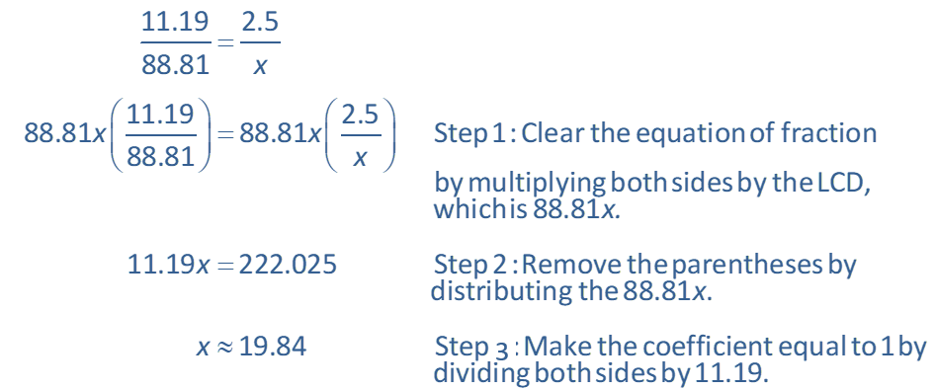
Example 3: Solving a Proportional Equation—Slide 2
Solution
We'll continue to use the same steps as before to solve the equation. Notice that the left-hand side of the equation is simply a number, so we can go ahead and multiply both sides of the equation by the LCD.
So there are approximately 19.84 grams of oxygen in the sample of water.

Slide 24

Skill Check 2
In October 2020, the following proportional equation represented the monetary value between Euros and American dollars. Solve the equation to determine the value of $200 €$ in American dollars at that time.
Answer: $236

Slide 25
Example 4: Solving for a Variable—Slide 1
The formula for the perimeter of a rectangle is P = 2l + 2w, where P is the perimeter, l is the length, and w is the width. Solve the formula for w.
Solution
Notice that there are three variables in this linear equation: P, l, and w. Since we want to solve for w, we will treat the other two variables as if they were numbers.

Slide 26
Skill Check 3
The volume of a cube V is given by the formula
V = lwh, where l is the length, w is the width, and h is the height. Solve the equation for the width.

Slide 27
Definition: Function
A function is a set of ordered pairs in the form (x, y) where each x-coordinate is associated with exactly one y-coordinate.

Slide 28
Example 5: Evaluating Functions—Slide 1
Evaluate the following functions for the given values.
Solution
To find the solution, we need to evaluate each function at the given value; that is, substitute the appropriate number in for x in each function.
By Hand
a. The notation
indicates that x $=5$, so we substitute 5 in for the
variable x in the function

Slide 29

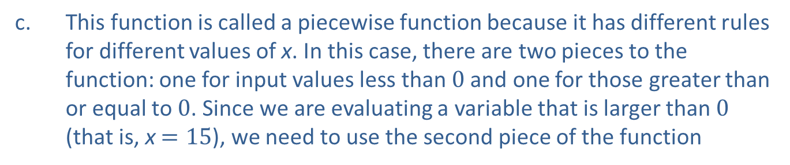
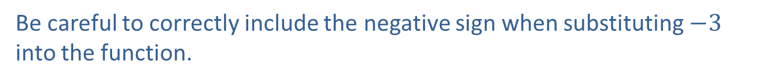
Example 5: Evaluating Functions—Slide 2
b.​ This time, the independent variable is t, but we still follow the same procedure. We substitute t $=−3$ into the function
​
Be careful to correctly include the negative sign when substituting $−3$ into the function.
c. This function is called a piecewise function because it has different rules for different values of x. In this case, there are two pieces to the function: one for input values less than 0 and one for those greater than or equal to 0. Since we are evaluating a variable that is larger than 0 (that is, x $=15$), we need to use the second piece of the function
We can ignore the other piece of the function. Thus, we have the following.

Slide 30
Example 5: Evaluating Functions—Slide 3
d. ​Even though the function may be less familiar to you, the same process applies. Since we are looking for
​
we substitute the value 2 in for x in the function.
TI-83/84 Plus
To evaluate functions in a calculator, we first store the functions by pressing y= and typing in the right-hand side of the function using X,T,θ,n for the variable, x. Let's type the function in part a. for Y1, and the function in part b. for Y2.
The function in part c. is called a piecewise function because it has different rules for different values of x. In this case, there are two pieces to the function: one for input values less than 0 and one for those greater than or equal to 0. Since we are evaluating a variable that is larger than 0 (that is, x = 15), we need to use the second piece of the function
We can ignore the other piece of the function and type X$−$1 for Y3.

Slide 31
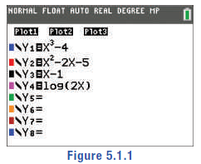
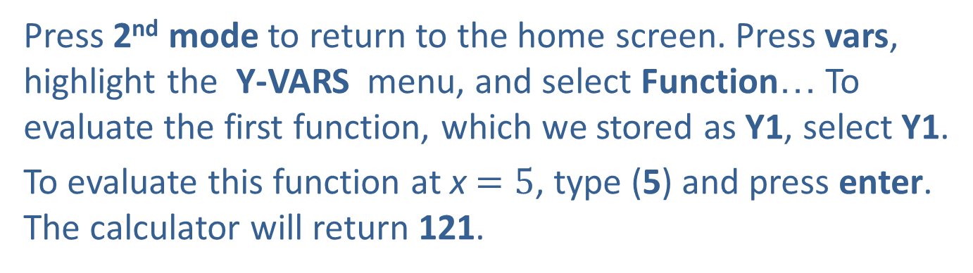
Example 5: Evaluating Functions—Slide 4
Finally, type the function in part d. for Y4.
Figure 1
Press 2nd mode to return to the home screen. Press vars, highlight the Y-VARS menu, and select Function… To evaluate the first function, which we stored as Y1, select Y1.
To evaluate this function at x $=5$, type (5) and press enter. The calculator will return 121.

Slide 32
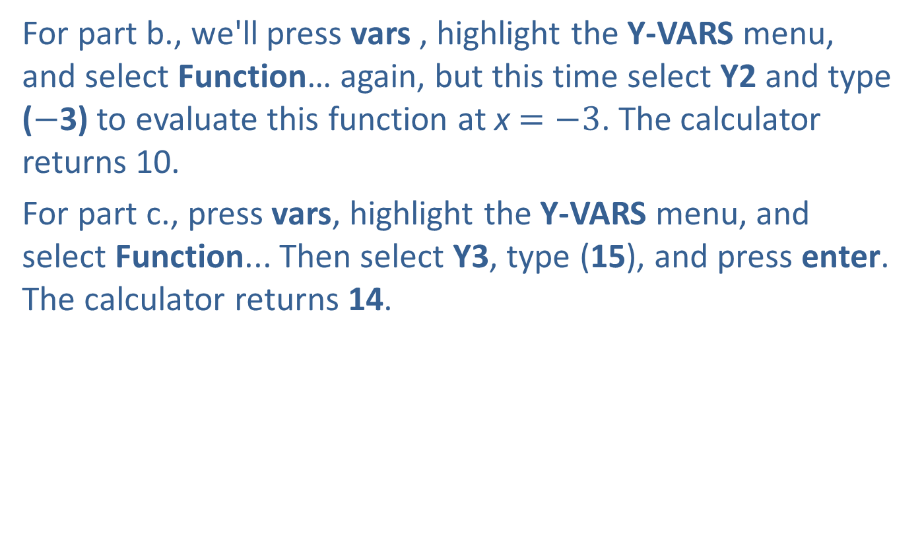
Example 5: Evaluating Functions—Slide 5
For part b., we'll press vars , highlight the Y-VARS menu, and select Function… again, but this time select Y2 and type ($−$3) to evaluate this function at x $=−3$. The calculator returns 10.
For part c., press vars, highlight the Y-VARS menu, and select Function... Then select Y3, type (15), and press enter. The calculator returns 14.

Slide 33
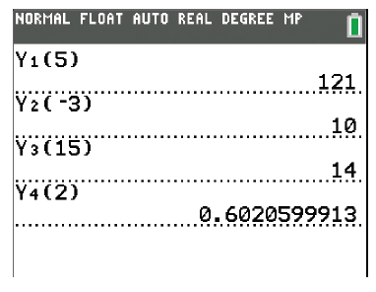
Example 5: Evaluating Functions—Slide 6
Finally, we’ll press vars, highlight the Y-VARS menu, select Function…, and select Y4. We want to evaluate this function at x = 2, so type (2) and press enter . The calculator returns 0.6020599913.
Figure 2

Slide 34
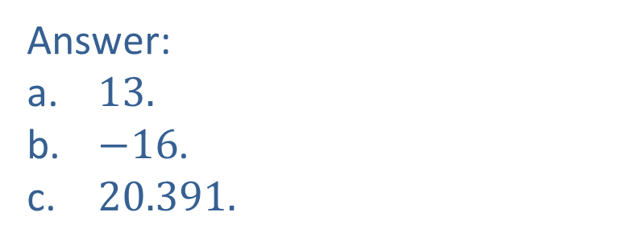
Skill Check 4
Evaluate the following functions for the given values, round to the nearest thousandth if necessary.
Answer:
a.​ 13.
b. ​$−16$.
c.​ 20.391.

Slide 35
Definition: Domain and Range
Domain
The domain of a function is the set of all input values (independent variable) that result in a real number value for the output values (dependent variable).
Range
The range of a function is the set of all possible output values (dependent variable) that correspond to the domain values.

Slide 36
Helpful Hint—Slide 3
Each element of the domain is assigned to exactly one element in the range but not vice versa. For instance, in the function

Slide 37
Example 6: Determining Domain and Range—Slide 1
Answer the following questions about the domain and the range.
a.​ Use your knowledge of real numbers to determine how their properties limit the domain and range of the function
b.​ The graph in Figure 3 is a plot of a radial wave function describing the energy states of a hydrogen atom.¹ Determine if the following statements about the graph are true or false. If false, explain why.
i.​ The domain of a looks to be between 0 and 0.11, inclusive.
ii.​ The range of c is a subset of the range of b.
iii.​ All three wave functions have the same domain.
​ 1 Benjamin Obi Tayo, “Hydrogen Atom,” Medium, February 11, 2019, https://medium.com/modernphysics/hydrogen-atom-4ca1599e94a8

Slide 38
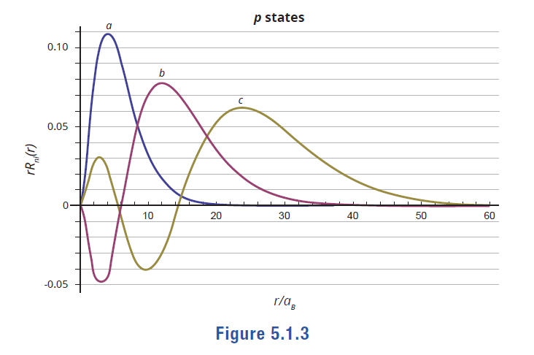
Example 6: Determining Domain and Range—Slide 2
Figure 3

Slide 39

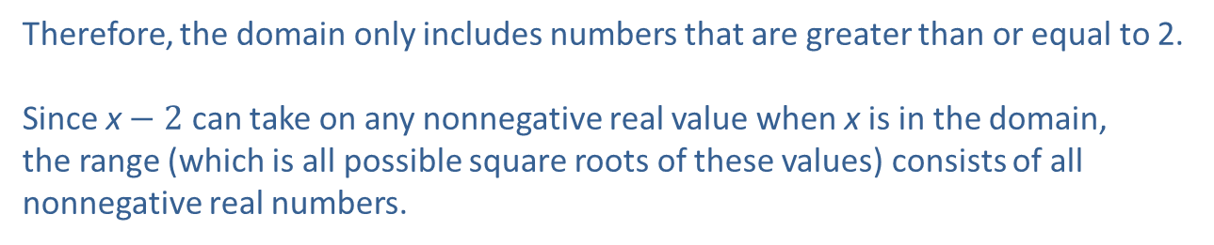
Example 6: Determining Domain and Range—Slide 3
c.​ The function P represents the number of penguin eggs laid each season in the Antarctic Peninsula based on the number of adult penguins and climate conditions. What can you say about the domain and range of the function?
Solution
a.​ We know that we can only take the square root of positive real numbers. Therefore, the expression under the radical sign must be a nonnegative number; that is, x $−$ 2 ≥ 0. We can solve this inequality to identify the restrictions on x.
Therefore, the domain only includes numbers that are greater than or equal to 2.
​
Since x$− 2$ can take on any nonnegative real value when x is in the domain,
the range (which is all possible square roots of these values) consists of all
nonnegative real numbers.

Slide 40
Example 6: Determining Domain and Range—Slide 4
b. i. The domain of a looks to be between 0 and 0.11, inclusive.
The values of the domain lie along the x-axis and the values of the
range lie along the y-axis. Therefore, this first statement is false.
The domain is not between the two numbers given; however, the
range, or the output numbers, appears to fall between 0 and 0.11
inclusive.
ii. The range of c is a subset of the range of b.
We can see that the values for the range (y-axis) of c fall within the
range values of b. Therefore, this statement is true.
iii. All three wave functions have the same domain.
All three wave functions are defined for all values of the independent
variable between 0 and 60. Therefore, this statement is true.

Slide 41
Example 6: Determining Domain and Range—Slide 5
c. Because the function is based on counting the number of live animals, both the domain and range have to be at least 0, and integers; that is, they cannot be negative numbers, fractions, or decimals. This will be true for all living things.

