Slide 1
Section 5.2
Linear Modeling

Slide 2
Think Back 1
An ordered pair (x, y) or coordinate pair represents a point on the rectangular Cartesian system, where x indicates the distance along the x-axis from the origin and y indicates the distance along the y-axis.

Slide 3
Helpful Hint 1
The graphs of linear equations are lines in the Cartesian coordinate system. Graphing the equations gives us an additional perspective that can add insight and be useful in decision making.

Slide 4
Definition: f of x Slope Formula
The slope of a line passing through the points (x₁, y₁) and (x₂, y₂) is given by the following.

Slide 5
Helpful Hint 2
It does not matter which of the points we choose to label (x₁, y₁) for the slope formula. What is important is that the subtraction of coordinates occurs in the same order in both the numerator and denominator. That means that

Slide 6
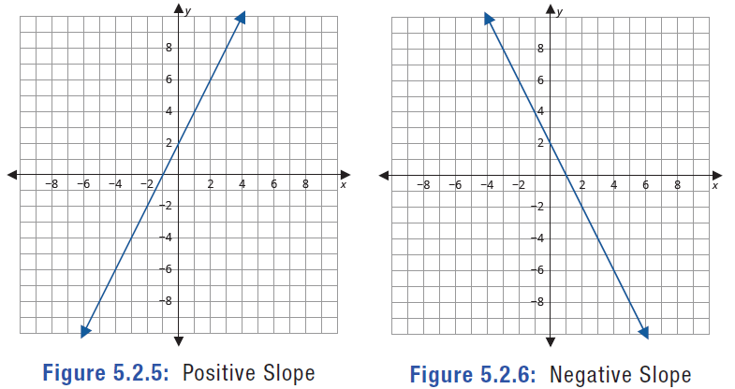
Helpful Hint 3—Slide 1
Figure 5: Positive Slope
Figure 6: Negative Slope

Slide 7
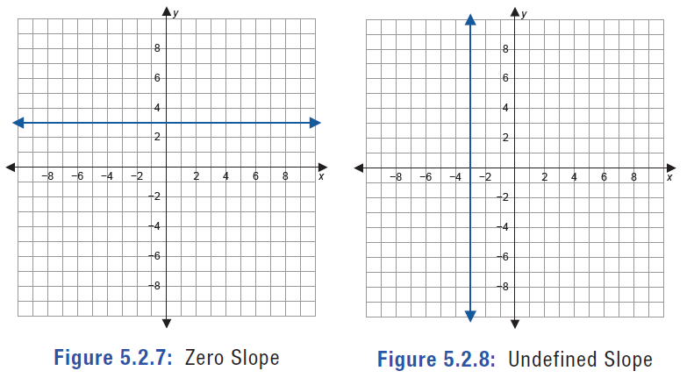
Helpful Hint 3—Slide 2
Figure 7: Zero Slope
Figure 8: Undefined Slope

Slide 8
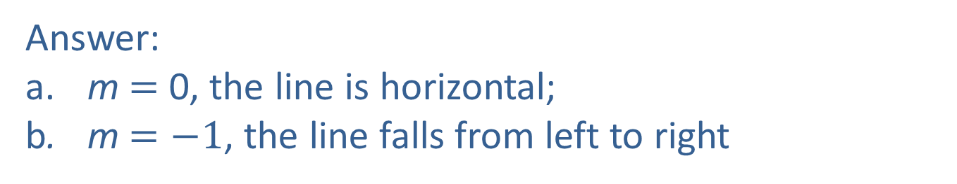
Skill Check 1
Find the slope of the line passing through each pair of points.
​
Answer:
a.​ m $=$ 0, the line is horizontal;
b. m $=−1$, the line falls from left to right

Slide 9
Definition: f of x Formulas for the Equation of a Line
The point-slope form of the equation for a line, where m is the slope of the line and (x₁, y₁) is a point on the line, is
The slope-intercept form of the equation for a line, where m is the slope and b is the y-intercept, is
y = mx + b.

Slide 10
Example 1: Modeling with a Linear Equation—Slide 1
As we've seen throughout the section, Tiffany has data about the square footage and price of each house sold in the neighborhood. Using this information, which is shown in Figure 9, answer the following questions to help Tiffany make an informed decision about the house.

Slide 11
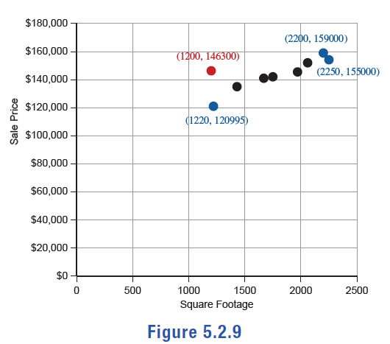
Example 1: Modeling with a Linear Equation—Slide 2
Figure 9

Slide 12
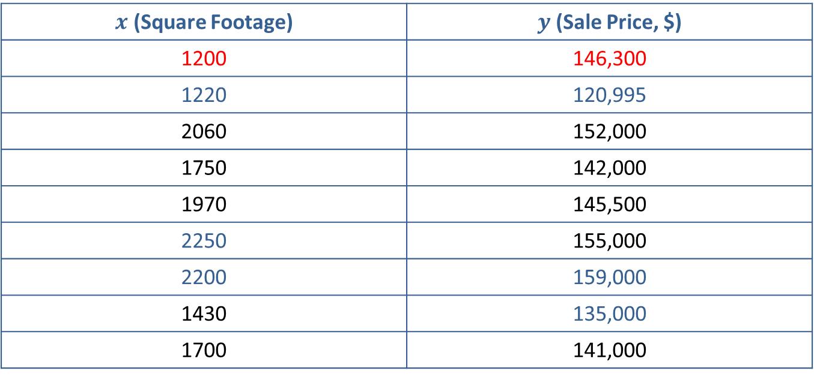
Example 1: Modeling with a Linear Equation—Slide 3
Table 3: Ordered Pairs
$x$ (Square Footage) | $y$ (Sale Price, $)
1200 | 146,300
1220 | 120,995
2060 | 152,000
1750 | 142,000
1970 | 145,500
2250 | 155,000
2200 | 159,000
1430 | 135,000
1700 | 141,000

Slide 13
Example 1: Modeling with a Linear Equation—Slide 4
a.​ First consider the houses based on price. Find the slope-intercept form of the equation for the line that passes through the points representing the lowest-priced house, (1220, 120995), and the highest-priced house, (2200, 159000). Round the slope to the nearest hundredth.

Slide 14
Example 1: Modeling with a Linear Equation—Slide 5
b.​ Next consider the houses based on square footage. Find the slope-intercept form of the equation for the line passing through the points representing the house with the smallest square footage, (1220, 120995), and the house with the largest square footage, (2250, 155000). Round the slope to the nearest hundredth.
c. ​Use the equations found in parts a. and b. to find two estimates of the price Tiffany should pay for the 1200 square foot house she is interested in.

Slide 15
Example1: Modeling with a Linear Equation—Slide 6
Solution
a.​ We will let the lowest-priced house be Point 1 and the highest-priced house be Point 2. Therefore, (x₁, y₁) = (1220, 120995) and (x₂, y₂) = (2200, 159000).
​By Hand
We can write the equation of the line using point-slope form since we are given two points. Begin by finding the slope of the line. Substitute the coordinate values into the slope formula and simplify, as shown.

Slide 16

Example 1: Modeling with a Linear Equation—Slide 7
So the slope of the line is approximately 38.78.
Next, substitute one of the points and the slope into the point-slope formula and simplify. Since it doesn't make a difference which point we choose, we will use the point representing the lowest-priced house, $\left(1220\text{, }120995\right)$.

Slide 17
Helpful Hint 4
When using the by hand method, a more precise equation can be found by keeping the slope in fraction form until the final step of finding the equation.

Slide 18
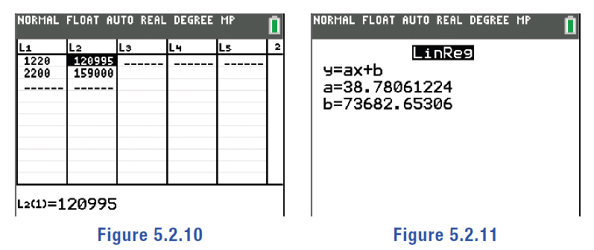
Example 1: Modeling with a Linear Equation—Slide 8
TI-83/84 Plus
To find the slope-intercept form of the equation using a TI-83/84 Plus calculator, begin by entering the points in the list function of the calculator. Press stat, select Edit…, and enter the x-values for L1 and the y-values for L2. Press stat again, highlight CALC, and select Lin Reg (ax + b). Move your cursor down to highlight Calculate and press enter.
Figure 10
Figure 11

Slide 19
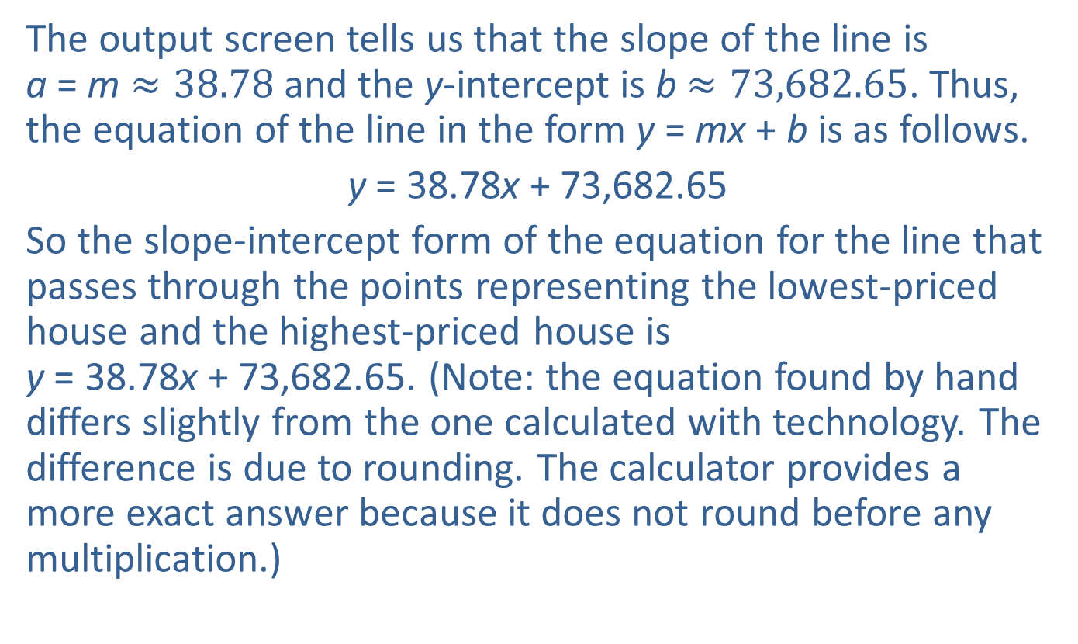
Example 1: Modeling with a Linear Equation—Slide 9
The output screen tells us that the slope of the line is a = m $≈38.78$ and the y-intercept is b $≈73,682.65$. Thus, the equation of the line in the form y = mx + b is as follows.
y = 38.78x + 73,682.65
​So the slope-intercept form of the equation for the line that passes through the points representing the lowest-priced house and the highest-priced house is y = 38.78x + 73,682.65. (Note: the equation found by hand differs slightly from the one calculated with technology. The difference is due to rounding. The calculator provides a more exact answer because it does not round before any multiplication.)

Slide 20
Example 1: Modeling with a Linear Equation—Slide 10
b.​ We will let the house with the smallest square footage be Point 1 and the house with the largest square footage be Point 2. Therefore, (x₁, y₁) = (1220, 120995) and (x₂, y₂) = (2250, 155000).
​By Hand
Once again, we begin by finding the slope of the line. Substitute the coordinate values into the slope formula.

Slide 21

Example 1: Modeling with a Linear Equation—Slide 11
So the slope of the line is approximately 33.01.
We will use the point representing the largest house, $\left(2250\text{, }155000\right)$, and the slope in the point-slope formula to determine the equation.

Slide 22
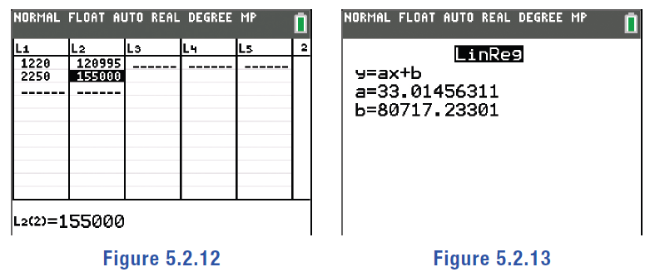
Example 1: Modeling with a Linear Equation—Slide 12
TI-83/84 Plus
Begin by entering the points in the list function of the calculator. Press stat, select Edit…, and enter the x-values for L1 and the y-values for L2. Press stat again, highlight CALC, and select Lin Reg (ax + b). Move your cursor down to highlight Calculate and press enter .
Figure 12
Figure 13

Slide 23
Helpful Hint 5
Although we estimated the line that looked to be closest to most of the houses in the graph by selecting two points, there is a mathematical process to find the line of best fit, which we will cover more thoroughly in Section 12.3.

Slide 24
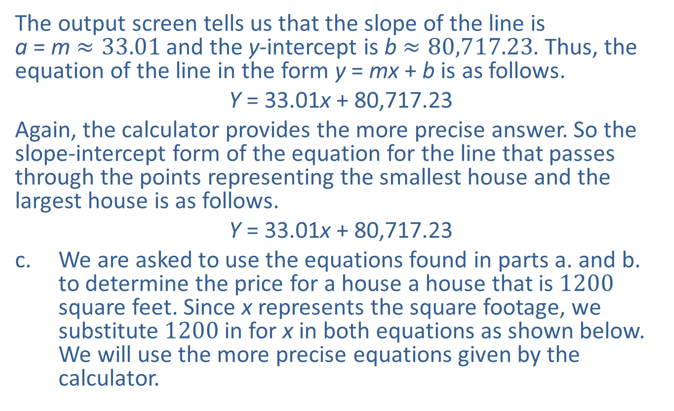
Example 1: Modeling with a Linear Equation—Slide 13
The output screen tells us that the slope of the line is a = m $≈33.01$ and the y-intercept is b $≈80,717.23$. Thus, the equation of the line in the form y = mx + b is as follows.
Y = 33.01x + 80,717.23
​Again, the calculator provides the more precise answer. So the slope-intercept form of the equation for the line that passes through the points representing the smallest house and the largest house is as follows.
Y = 33.01x + 80,717.23
c.​ We are asked to use the equations found in parts a. and b. to determine the price for a house a house that is 1200 square feet. Since x represents the square footage, we substitute 1200 in for x in both equations as shown below. We will use the more precise equations given by the calculator.

Slide 25

Example 1: Modeling with a Linear Equation—Slide 14
​$\text{Equation} \text{based} \text{on} \text{smallest} \text{square} \text{footage}\text{ (}\text{b}\text{) }$
​Equation based on lowest price (a)
Notice that by using both equations we have created a price range for a 1200 square foot house that would be in line with the other houses in the neighborhood. Based on the data known, we can say that a house with 1200 square feet should cost between $120,219 and $120,329. Since the house Tiffany is interested in is actually listed at $146,300, based on our model it seems that it is overpriced for the neighborhood.

Slide 26

Skill Check 2
Find the slope-intercept form of the equation for line passing through the points $\left(31\text{, }85\right)$ and $\left(27\text{, }98\right)$.
Answer:
y = $−$3.25x + 185.75

Slide 27
Think Back 2
Recall that the coordinates of the y-intercept are (0, b)

Slide 28

Skill Check 3
Identify the slope and y-intercept, along with another point on the line 14x – 2y = 20, given that y = 7x – 10 and
are equivalent equations.
Answer: m $=7$,

Slide 29
Example 2: Graphing a Linear Equation from Slope-Intercept Form and Point-Slope Form—Slide 1
Ethan is giving a PowerPoint presentation in his international business class about a start-up business idea. For visual effect, he intends to have a slide showing the equations of the lines used in his analysis to find the break-even point where the venture will actually be making money. The equations of the lines to be shown on the slide are given here. Graph each of the lines in parts a. and b. on the same graph.
c. ​Using the graph of the lines from parts a. and b., estimate the break-even point for Ethan's venture.

Slide 30

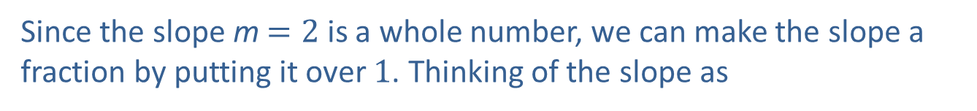
Example 2: Graphing a Linear Equation from Slope-Intercept Form and Point-Slope Form—Slide 2
Solution
a.​ First, we graph the equation y = 2x + 3 on the coordinate plane.
​By Hand
The first equation, y = 2x + 3, is given in slope-intercept form, y = mx + b. We can see the slope is m $=2$ and the y-intercept is b $=3$ or $\left(0\text{, }3\right)$. When creating a graph using a point and the slope, always plot the point on the graph first and then, starting from that point,
count the slope as
to identify a second point on the line.
Since the slope m $=2$ is a whole number, we can make the slope a
fraction by putting it over 1. Thinking of the slope as
is more convenient for graphing purposes since the rise and run are both clearly stated.
We can now draw the line passing through the two points.

Slide 31
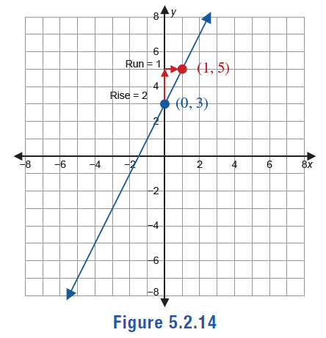
Example 2: Graphing a Linear Equation from Slope-Intercept Form and Point-Slope Form—Slide 3
Figure 14

Slide 32
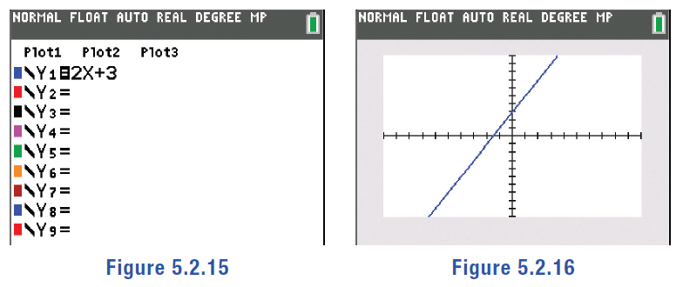
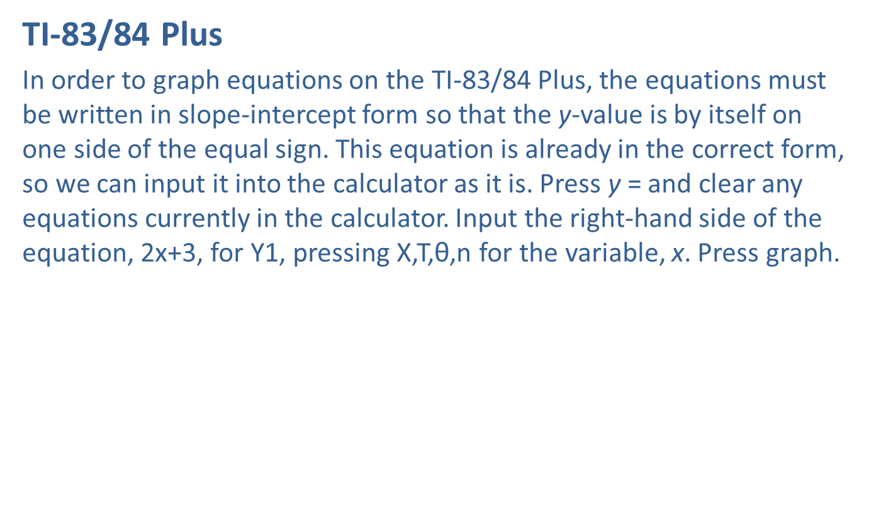
Example 2: Graphing a Linear Equation from Slope-Intercept Form and Point-Slope Form—Slide 4
TI-83/84 Plus
In order to graph equations on the TI-83/84 Plus, the equations must be written in slope-intercept form so that the y-value is by itself on one side of the equal sign. This equation is already in the correct form, so we can input it into the calculator as it is. Press y = and clear any equations currently in the calculator. Input the right-hand side of the equation, 2x+3, for Y1, pressing X,T,θ,n for the variable, x. Press graph.
Figure 15
Figure 16

Slide 33
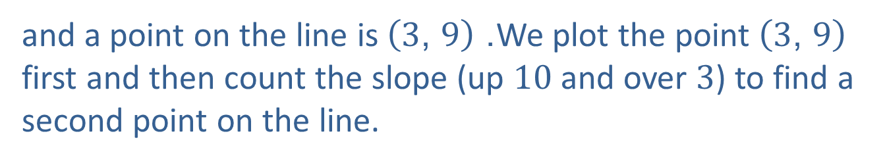
Example 2: Graphing a Linear Equation from Slope-Intercept Form and Point-Slope Form—Slide 5
b.​ Next, we graph the equation
​
on the same coordinate plane.
By Hand
The second equation
is given in point-slope form:
Thus, the slope m is
and a point on the line is $\left(3\text{, }9\right)$. We plot the point $\left(3\text{, }9\right)$ first and then count the slope (up 10 and over 3) to find a second point on the line.

Slide 34
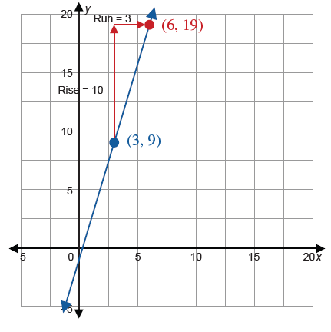
Example 2: Graphing a Linear Equation from Slope-Intercept Form and Point-Slope Form—Slide 6
Figure 17

Slide 35
Example 2: Graphing a Linear Equation from Slope-Intercept Form and Point-Slope Form—Slide 7
TI-83/84 Plus
Before we can enter this equation into the calculator, the equation must be written in slope-intercept form with the y-value by itself on one side of the equal sign. To do this, we simplify and rearrange the equation by clearing it of the parentheses and isolating the variable y.
Now that we have the equation in slope-intercept form, press y= and input the right-hand side of the equation for Y2. Press graph.

Slide 36
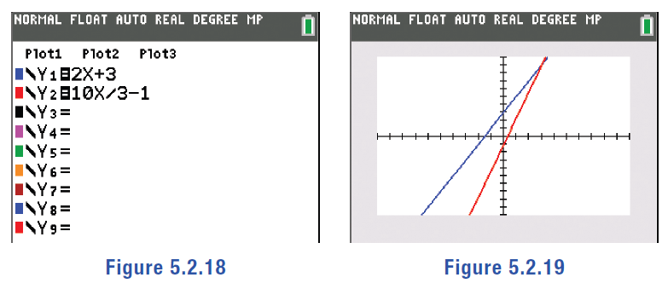
Example 2: Graphing a Linear Equation from Slope-Intercept Form and Point-Slope Form—Slide 8
Figure 18
Figure 19
​So Ethan's PowerPoint slide would have the following graph showing both lines.​

Slide 37
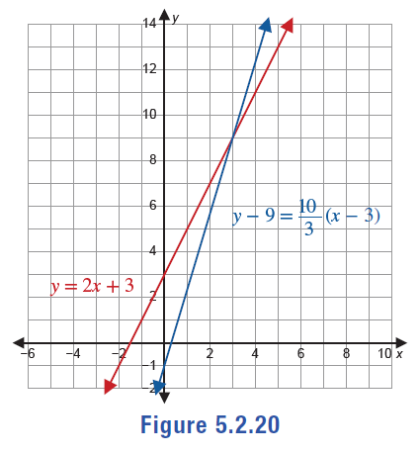
Example 2: Graphing a Linear Equation from Slope-Intercept Form and Point-Slope Form—Slide 9
Figure 20

Slide 38

Example 2: Graphing a Linear Equation from Slope-Intercept Form and Point-Slope Form—Slide 10
c.​ The break-even point for Ethan’s venture occurs where the lines intersect. We can estimate that this happens around the point $\left(3\text{, }9\right)$. We will cover break-even points and how to find them precisely in a later section.

Slide 39
Helpful Hint 6
In order to graph a linear equation, regardless of the form it's presented in, we can simply rearrange the equation so that it is in slope-intercept form.

Slide 40
Tech Tip
Pressing window or zoom will allow you to adjust the display window on the calculator.

Slide 41
Helpful Hint 7
Be careful when determining the signs of the coordinates (x₁, y₁). Remember that in point-slope form, the x-values and y-values are being subtracted.

Slide 42
Definition: Parallel and Perpendicular Lines—Slide 1
Consider two lines y = m₁x + b₁ and y = m₂x + b₂.
If the two lines have the same slope (that is, m₁ = m₂), then they are parallel lines, which means they never intersect.
If the two lines have slopes that are negative
reciprocals of each other
then they are perpendicular lines, which means they intersect at right angles.

Slide 43
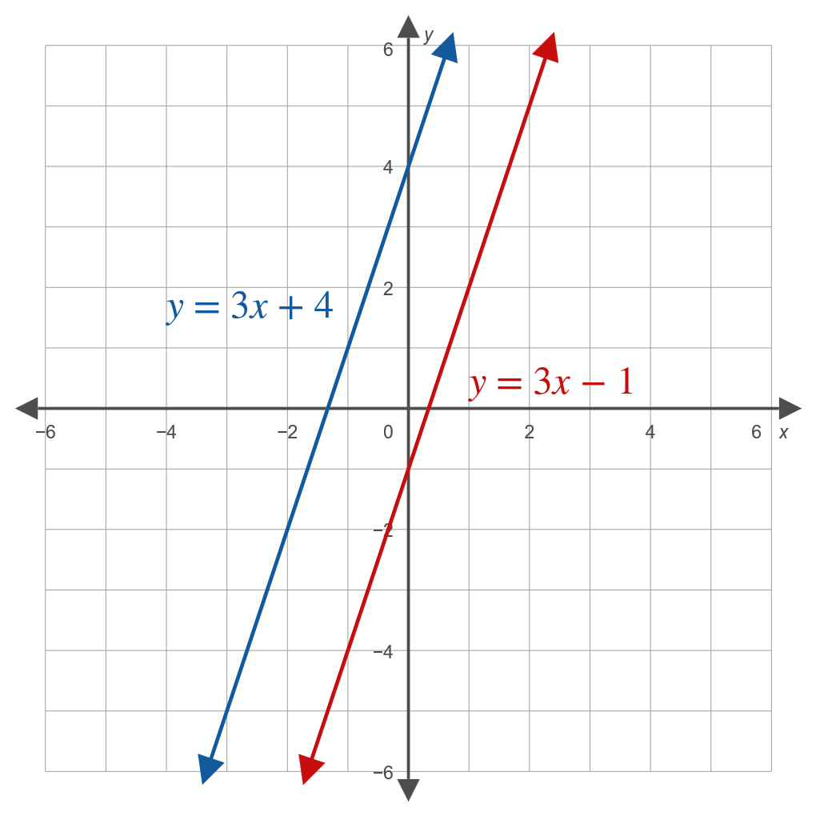
Definition: Parallel and Perpendicular Lines—Slide 2
Figure 21: Parallel Lines

Slide 44
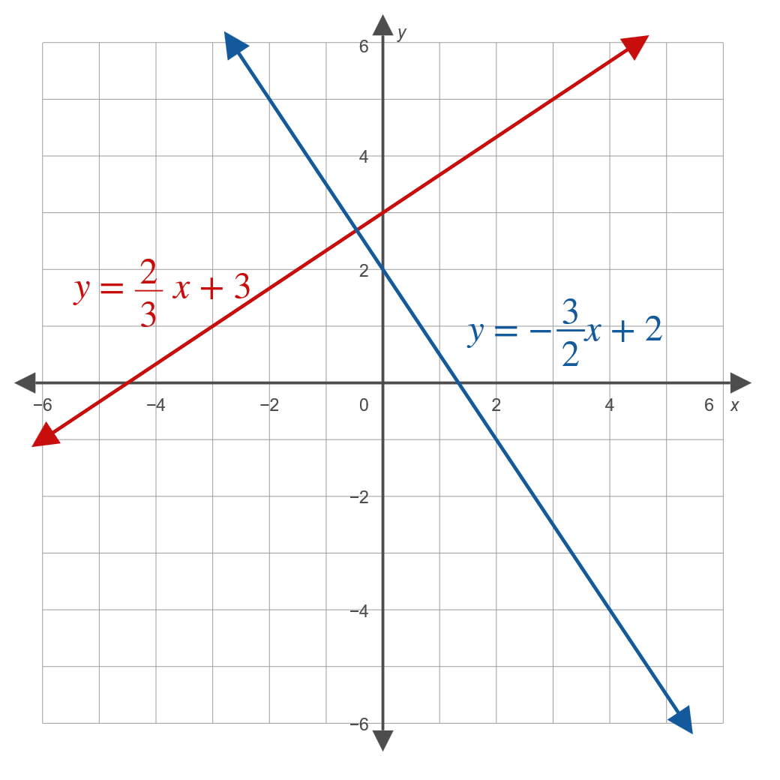
Definition: Parallel and Perpendicular Lines—Slide 3
Figure 22: Perpendicular Lines

Slide 45
Example 3: Finding the Equations of Parallel and Perpendicular Lines—Slide 1
AutoCAD, a computer-aided design and drafting software, has been widely used for almost 40 years. As part of an introductory AutoCAD class, students need to be able to draw lines that are both parallel and perpendicular to other lines. To understand the calculations that the software automates, they are given criteria and asked to find the equation of each line based on the information given. Use the criteria to write the equation of the desired line in slope-intercept form.

Slide 46
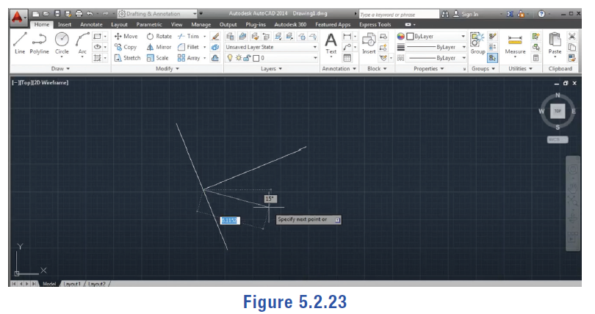
Example 3: Finding the Equations of Parallel and Perpendicular Lines—Slide 2
Figure 23

Slide 47

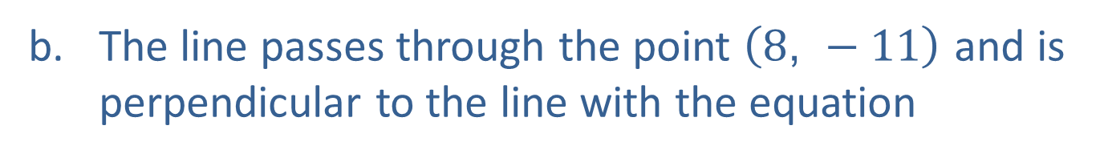
Example 3: Finding the Equations of Parallel and Perpendicular Lines—Slide 3
a. ​The line passes through the point $\left(−2\text{, }3\right)$ and is parallel to the line with the equation
​
b. ​The line passes through the point $\left(8\text{, }−11\right)$ and is perpendicular to the line with the equation

Slide 48

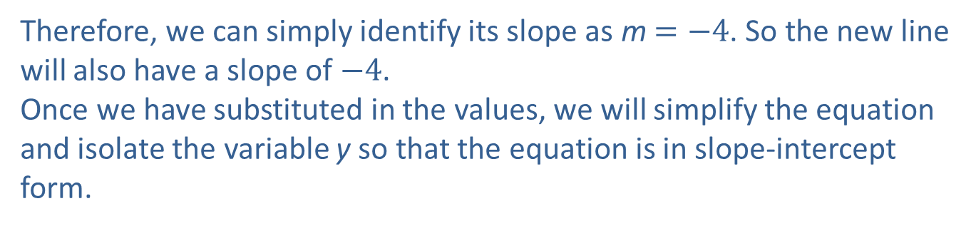
Example 3: Finding the Equations of Parallel and Perpendicular Lines—Slide 4
Solution
a.​ In order to find the equation of the line using the point-slope formula, we need the value of the slope along with the coordinates of a point on the line. We are given a point that lies on the line, $\left(−2\text{, }3\right)$. To determine the slope, we can use fact that parallel lines have equal slopes. The line we are
given is written in point-slope form:
​
Therefore, we can simply identify its slope as m $=−4$. So the new line will also have a slope of $−4$.
​Once we have substituted in the values, we will simplify the equation and isolate the variable y so that the equation is in slope-intercept form.

Slide 49

Example 3: Finding the Equations of Parallel and Perpendicular Lines—Slide 5
So the equation of the line, in slope-intercept form, that passes through the point $\left(−2\text{, }3\right)$ and is parallel to the line

Slide 50

Example 3: Finding the Equations of Parallel and Perpendicular Lines—Slide 6
b.​ Once again, we need a point and the slope in order to write the equation. We are given a point $\left(8\text{, }−11\right)$ and the fact that the line is perpendicular to a particular line. The line we are given is written in slope-intercept form:
​
​
We can identify its slope as
The slope of the line we are interested in will be
the negative reciprocal of this slope. Therefore, the slope of the new line is
Once we have substituted in the values, we will simplify the equation and isolate the variable y so that the equation is in slope-intercept form.

Slide 51
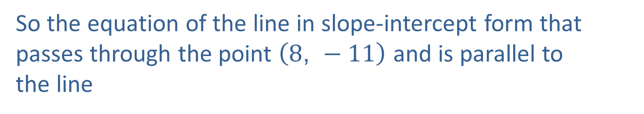
Example 3: Finding the Equations of Parallel and Perpendicular Lines—Slide 7
So the equation of the line in slope-intercept form that passes through the point $\left(8\text{, }−11\right)$ and is parallel to
the line

Slide 52
Skill Check 4
What is the slope of the line which is perpendicular to the line
Answer:

Slide 53
Definition: Horizontal and Vertical Lines—Slide 1
The graph of a horizontal line y = b will pass through the point (0, b).

Slide 54
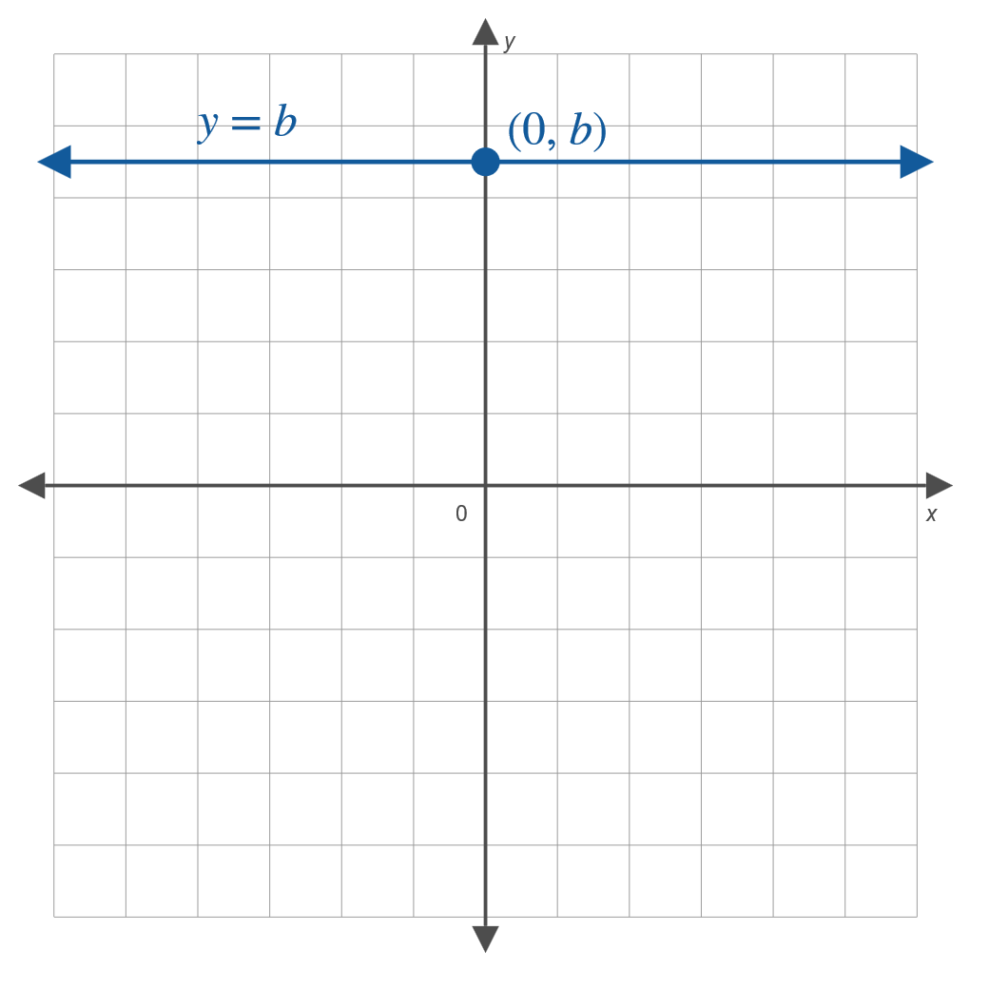
Definition: Horizontal and Vertical Lines—Slide 2
Figure 26: Horizontal Line

Slide 55
Definition: Horizontal and Vertical Lines—Slide 3
The graph of a horizontal line x = a will pass through the point (a, 0).

Slide 56
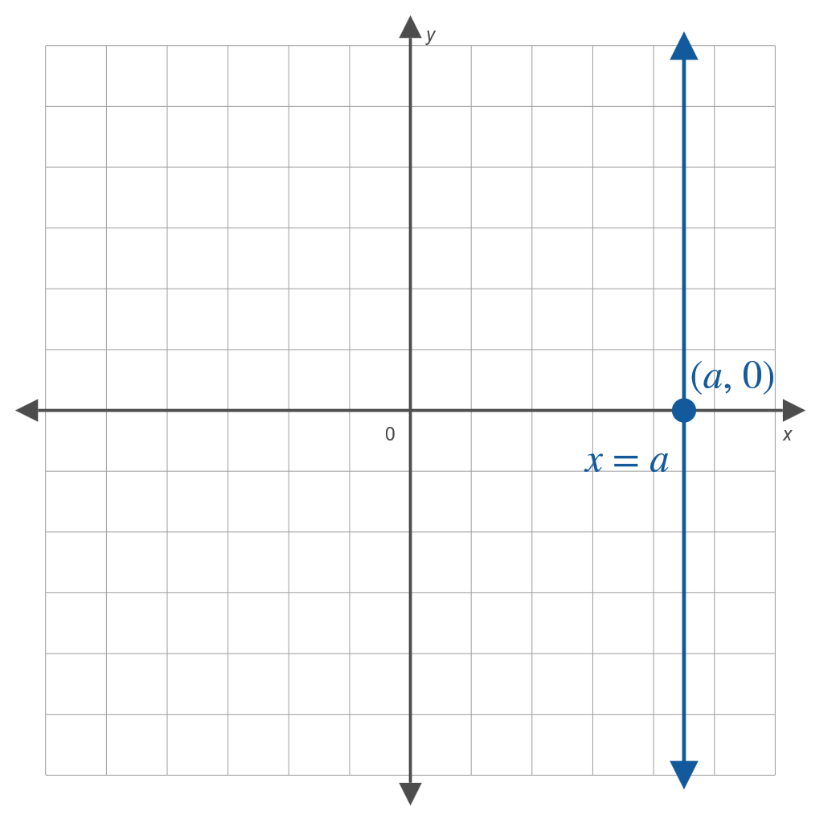
Definition: Horizontal and Vertical Lines—Slide 4
Figure 27: Vertical Line

